Slide 1

Overview of Speciated Mercury at Anthropogenic Emission Sources
3rd International Conference on Earth Science & Climate Change, San Francisco, July 28-30, 2014
Shuxiao Wang
Tsinghua University

Slide 2
Contents
Introduction of Hg emission and speciation
Hg speciation and transformation in flue gas
  Coal combustion
  Cement production
  Non-ferrous metal smelting
  Iron and steel production
Speciated Hg emissions for China
Conclusions

Slide 3
Introduction of mercury emission and speciation

Slide 4
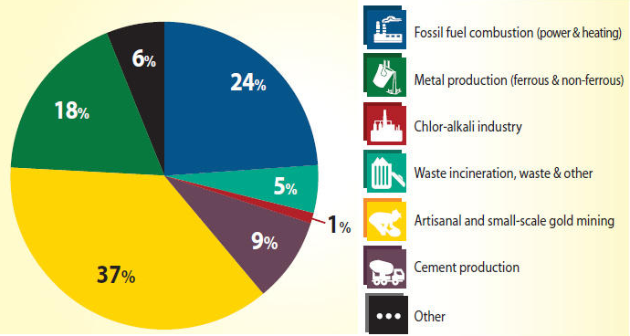
Global anthropogenic Hg emissions to air
UNEP. Global Mercury Assessment, 2013
Notes:
The overall magnitude of the anthropogenic emissions is estimated at about 2000 Mg/year

Slide 5
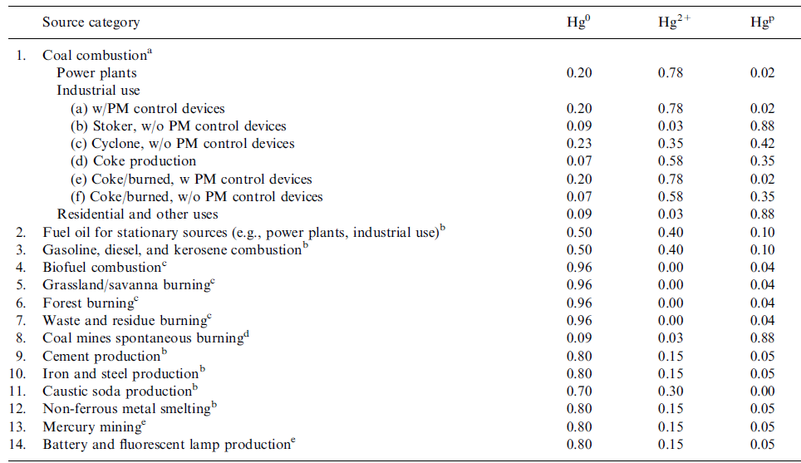
Speciation profile of Hg emissions
The data used is
for outdated industrial process/air pollution control techniques
not from field tests
Streets et al., 2005
Notes:
The chemical speciation of mercury emissions is also not well known. Until now, speciated mercury sampling has been conducted only for a few source categories, hence,there is typically a paucity of speciated data for most source categories.
Emission speciation is an important source of uncertainty when assessing the atmospheric fate of mercury because Hg(0), Hg(II) and Hg(p) have very
different physico-chemical characteristics and, consequently, have very different
atmospheric lifetimes.

Slide 6
Hg speciation and transformation in coal combustion

Slide 7
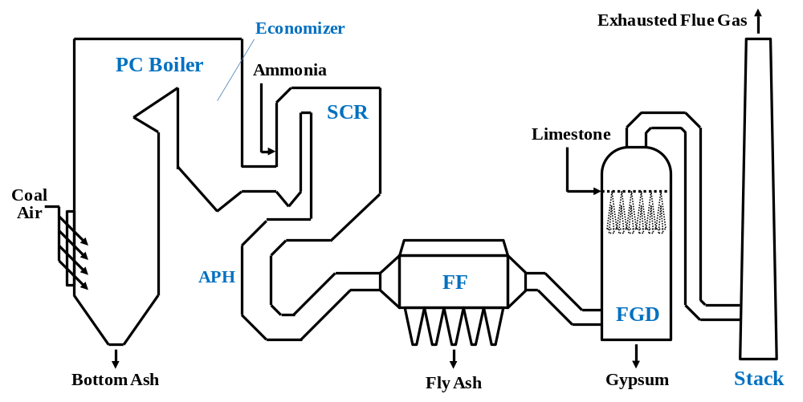
Configuration of coal-fired power plants
ESP/FF

Slide 8
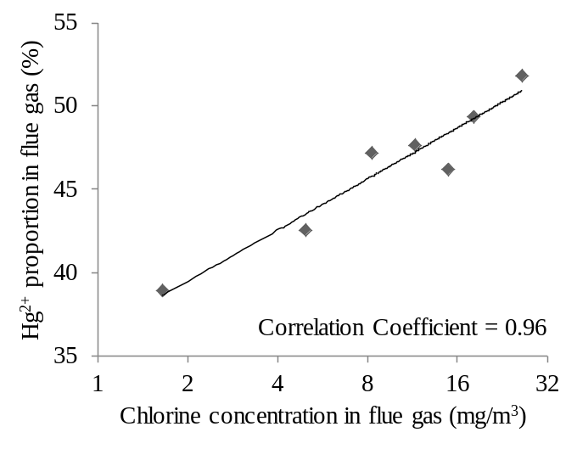
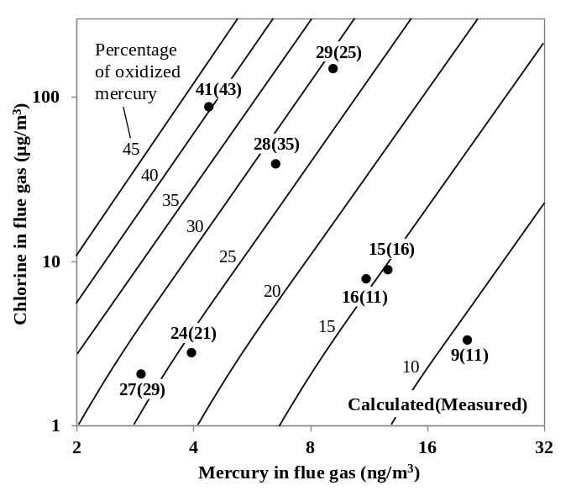
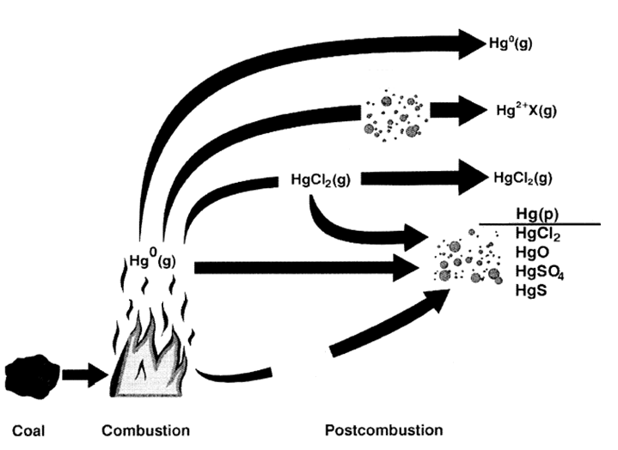
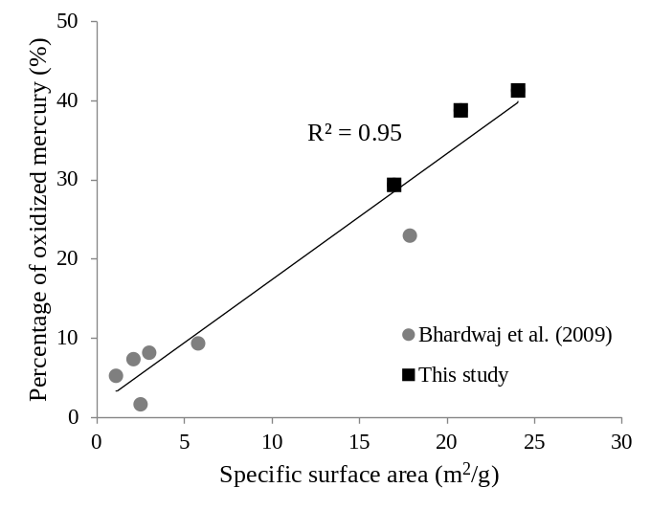
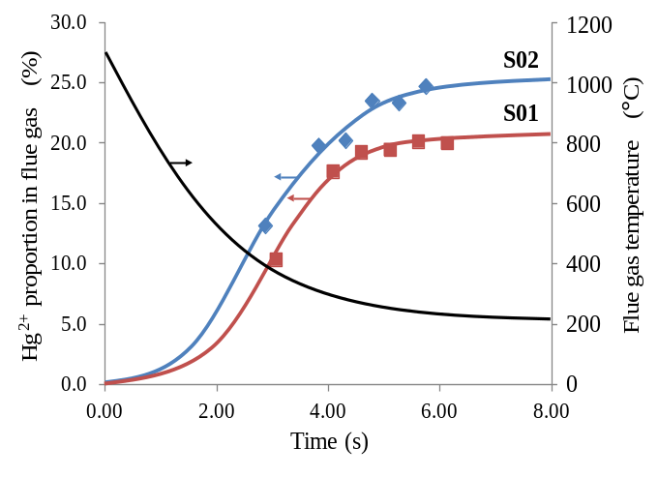
Hg speciation in coal combustion flue gas
Chlorine concentration
Hg concentration
Surface area
temperature
Galbreath K C & Zygarlicke C J, 2000, 65–66: 289–310
Zhang et al., in preparation

Slide 9
Hg oxidation across SCR
SCR catalysts significantly oxidize Hg⁰
2HCl + Hg⁰ + 1/2 O₂ ↔ HgCl₂ + H₂O
2NH₃ + 3 HgCl₂ ↔ N₂ + 3 Hg⁰ + 6 HCl
2NO + 2 NH₃ + 1/2 O₂ ↔ 2 N₂ + 3 H₂O
Senior, 2005
Notes:
Cl in coal promotes Hg⁰ oxidation
Ammonia might decrease Hg⁰ oxidation

Slide 10
Hg transformation across ESP/FF
Over 99% of Hg_{p} can be removed by ESP/FF
Complicated Hg⁰ Hg²⁺ transformation in ESP
About 60% of Hg²⁺ can be removed by FF
FF has no influence on Hg⁰
ESP/FF

Slide 11
Hg transformation across WFGD
About 80% of Hg²⁺ can be removed by WFGD
ESP/FF

Slide 12
Summary of Hg speciation after APCDs
 | Hg⁰ | Hg²⁺ | Hg_{p} | No. of tests
None | 56 (8-94) | 34 (5-82) | 10 (1-28) | 13
ESP | 58 (16-95) | 41 (5-84) | 1.3 (0.1-10) | 31
ESP+WFGD | 84 (74-96) | 16 (4-25) | 0.6 (0.1-1.9) | 7
FF | 31 (10-58) | 58 (34-76) | 11 (1-25) | 3
WS | 65 (39-87) | 33 (10-60) | 2.0 (0.2-4.5) | 6
SCR+ESP+WFGD | 73.8 (16-96) | 26 (4-84) | 0.2 (0.1-0.4) | 6
FF+WFGD | 78 | 21 | 0.9 | 1
(CFB+)ESP | 72 | 27.4 | 0.6 | 1
Chen et al., 2007; Zhou et al., 2008; Wang et al., 2008; Yang et al., 2007; Duan et al., 2005; Kellie et al., 2004; Shah et al., 2010; Guo et al., 2004; Tang, 2004; Goodarzi, 2004; Lee et al., 2006; Kim et al., 2009; Wang et al., 2010; Zhang et al., 2012

Slide 13
Hg speciation and transformation in non-ferrous metal smelters

Slide 14
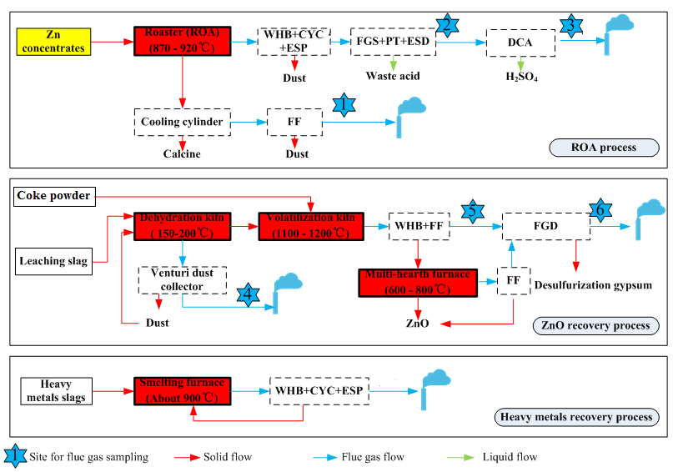
Configuration of non-ferrous metal smelter

Slide 15
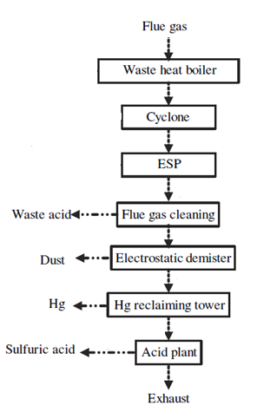
Hg transformation across ROA process
Oxidize Hg⁰ to Hg²⁺ by O and Cl
Remove over 98% of Hg_{p}
Remove a large amount of Hg²⁺
Oxidize Hg⁰ to Hg⁺ by HgCl₂ to form insoluble Hg₂Cl₂
Remove most of Hg⁰ and Hg²⁺
Oxidize Hg⁰ to Hg²⁺ via catalyst
Remove a large amount of Hg²⁺
Wang et al., 2010

Slide 16
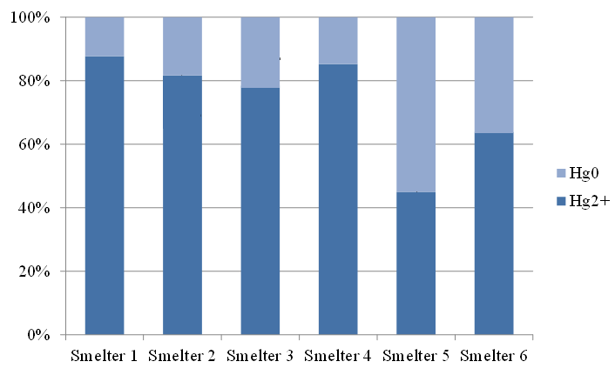
Hg speciation before and after acid plants
Conversion and absorption process has significant impact
DCDA is more effective than SCSA
Hg²⁺ dominates in flue gas after acid plants
DCDA
DCDA
DCDA
DCDA
SCSA
DCDA
DCDA – double conversion double absorption
SCSA – single conversion single absorption
Zhang et al., 2012
Notes:
P31页的柱状图中，蓝色深浅的百分比柱子是最终的形态分布，虚线的位置是进入制酸系统之前的形态分布，箭头表示制酸系统对各个厂的气态汞的形态分布带来的影响。

Slide 17
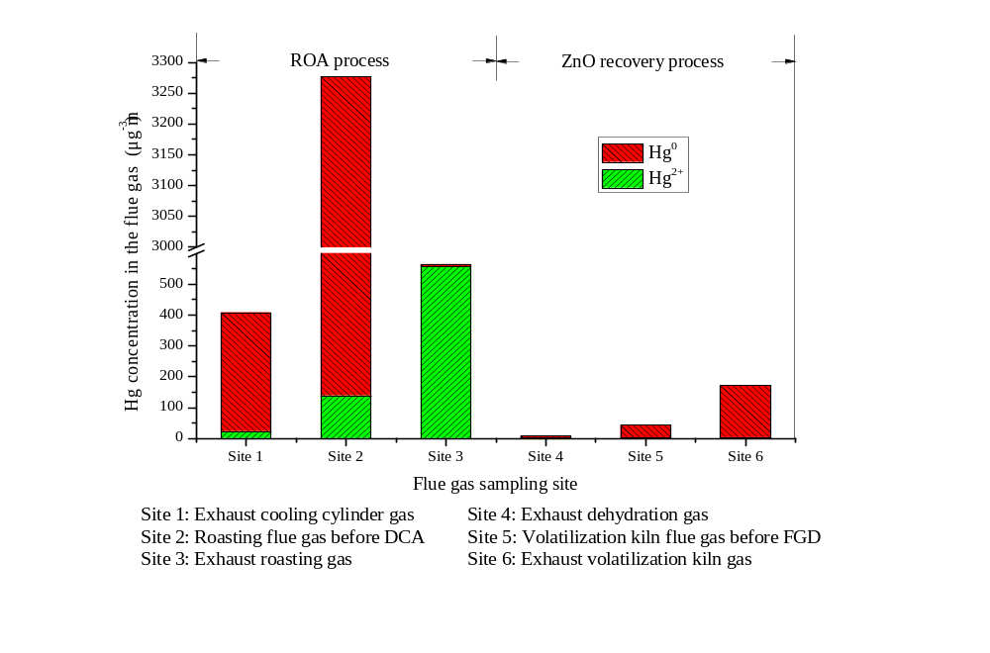
Hg speciation in flue gas of various kilns
Hg⁰ is the main chemical form in exhaust gases from cooling cylinder and volatilization kiln, accounting for up to 97.8% of total Hg
Wu et al., submitted

Slide 18
Summary of Hg speciation after APCDs
 | Hg⁰ | Hg²⁺ | Hg_{p}
DC+FGS+ESD+DCDA | 46 | 49 | 5
DC+FGS+ESD+MRT+DCDA | 6 | 90 | 4
DC+FGS+ESD+SCSA | 57 | 38 | 5
DC+FGS | 41 | 54 | 5
DC | 33 | 62 | 5
FGS | 65 | 33 | 2
None | 56 | 34 | 10
Wang et al., 2010; Li et al., 2010; Zhang et al., 2012; Wu et al., 2012

Slide 19
Hg speciation and transformation in cement plants

Slide 20
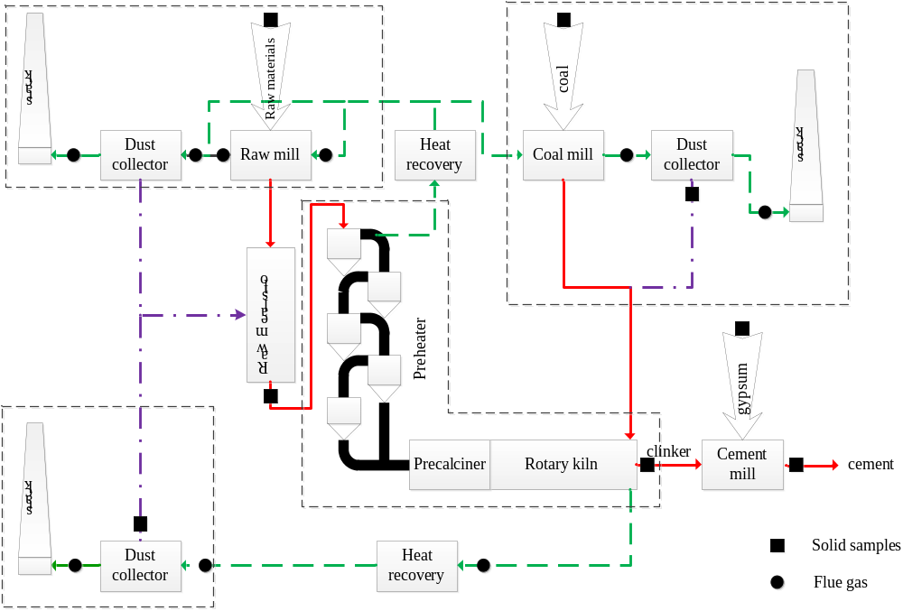
Hg flow during cement production
Precalciner process is the predominant cement production process worldwide
The recycling of collected dust from FFs/ESPs and the preheat of raw materials/coal cause mercury cycling in cement production
Wang et al., 2014
Notes:
Mercury emitted from cement production originates from coal and other fuels used and raw
material such as limestone and other additives. Mercury concentrations are highly variable in
fuels and raw materials and significant emission reductions can be achieved by switching to
lower mercury fuels and raw materials.
18. Adsorption of mercury to cement kiln dust in cement production is highly dependent on the
operating conditions in the plant, where lower temperatures promote adsorption. Removal of
mercury from the process can be achieved by removal of dust from the particle control device,
if the temperature of the exhaust gases is low. Since cement kiln dust removed from stack
gases in cement production to a large extent is recirculated in the process,

Slide 21
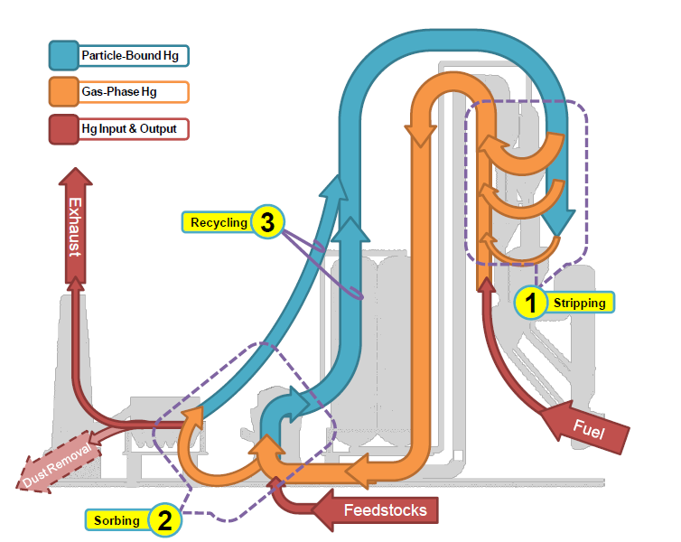
Hg transformation within cement plants
Kiln Feed
Temperature from 350 to 850℃,Hg vaporization/ decomposition
330 ºC
Stack
Temperature from 200 to 50 ℃,Hg adsorption on raw materials and dust
1000 ºC
Fuels From Kiln & Precalciner
90 ºC
Raw Mill
Coal Mill
BH Catch
Long residence time (>25s)and high PM concentration (>10g/m3), Hg oxidation and adsorption when flue gas cooling
Sikkema et al., 2011
Notes:
Volatilised mercury condenses at relatively low temperature (120-150°C) on raw
material particles in the kiln system (UNEP Toolkit, 2010). With a low enough temperature of
the flue gas, mercury adsorbed on particles will be collected together with the particles in a
particle collection device. It is common that the dust collected in the particle control device
(often called cement kiln dust, CKD) is recycled back into the production process (Senior,
2010).

Slide 22
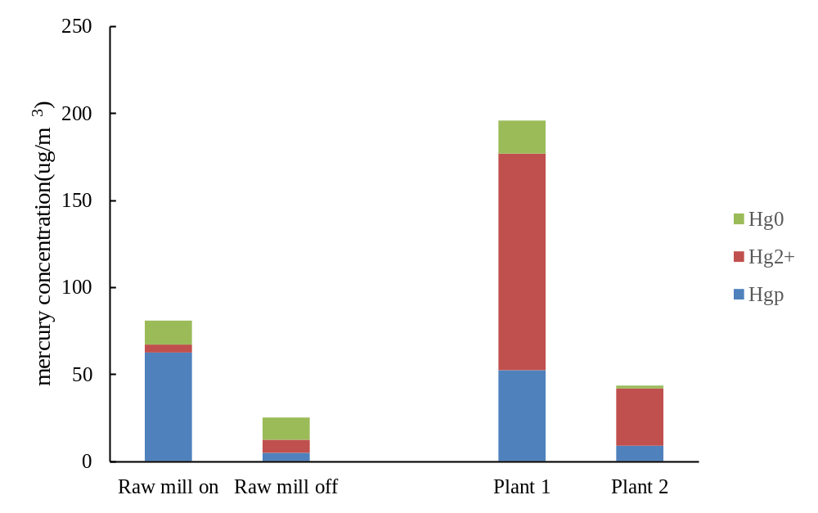
Hg species at the outlet of kiln system
The mercury species measured at the outlet of the kiln system is predominantly oxidized mercury and particle-bound mercury
The kinetically-limited mercury oxidation in the flue gas is promoted compared with power plants
Mlakar et al., 2010
Wang et al., 2014

Slide 23
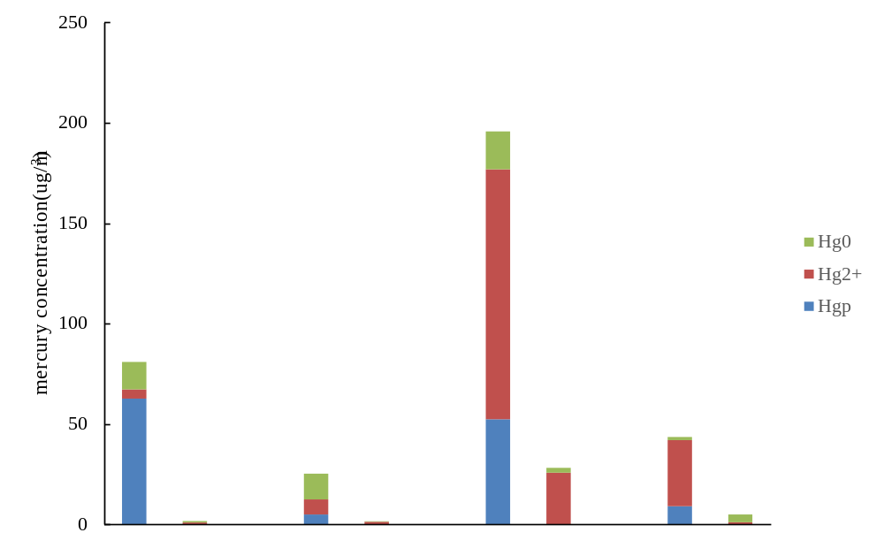
Hg transformation in raw mill and FF
The removal efficiencies of raw mill+FF are more than 90%
Before raw mill
Before raw mill
Before raw mill
Before raw mill
Stack
Stack
Stack
Stack
Raw mil on
Raw mil off
Plant 1
Plant 2
Mlakar et al., 2010
Wang et al., 2014

Slide 24
Summary of Hg speciation profiles
The mercury emission profile used in previous inventories: 80% Hg⁰, 15% Hg²⁺ and 5% Hg^{p}
Recent tests indicate that the mercury emitted from cement plant is mainly in oxidized form, accounting for 61.3-90.8%
Proportions of emitted mercury species (%) |  | Hg⁰ | Hg²⁺ | Hg^{p}
Streets et al., 2005 | Cement production | 80 | 15 | 5
Mlakar et al., 2010 | Raw mill off | 16 | 75.7 | 8.3
 | Raw mill on | 43.1 | 45.5 | 11.4
Wang et al., 2014 | Plant 1 | 9.2 | 90.8 | 0
 | Plant 2 | 38.7 | 61.3 | 0
 | Plant 3 | 23.4 | 75.1 | 1.6

Slide 25
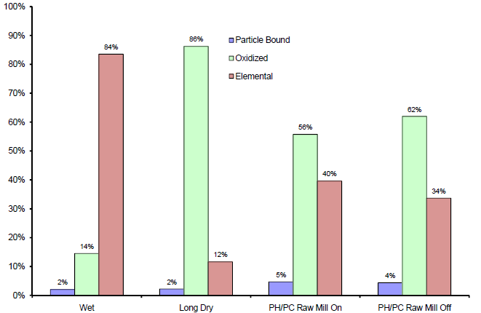
Summary of Hg speciation profiles
Schreiber & Kellett, 2009

Slide 26
Hg speciation and transformation in iron and steel production

Slide 27
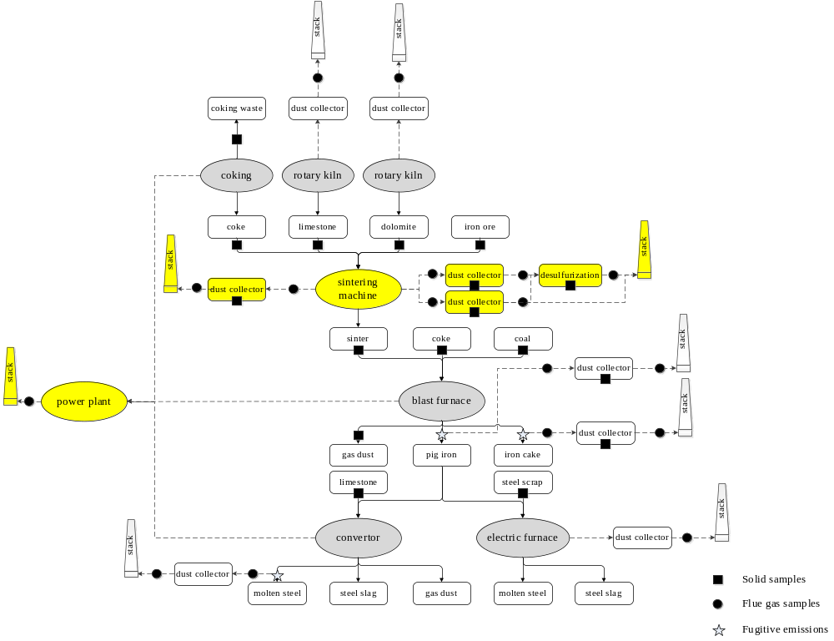
Iron and steel production process
Fukuda et al., 2011
Wang et al., in preparation
Notes:
The Hg emissions from the sintering machine accounted for over 90% of total mercury emissions from iron and steel production
ESPs are installed to clean the flue gas, and flue gas desulfurization devices are installed for sintering machine flue gas

Slide 28
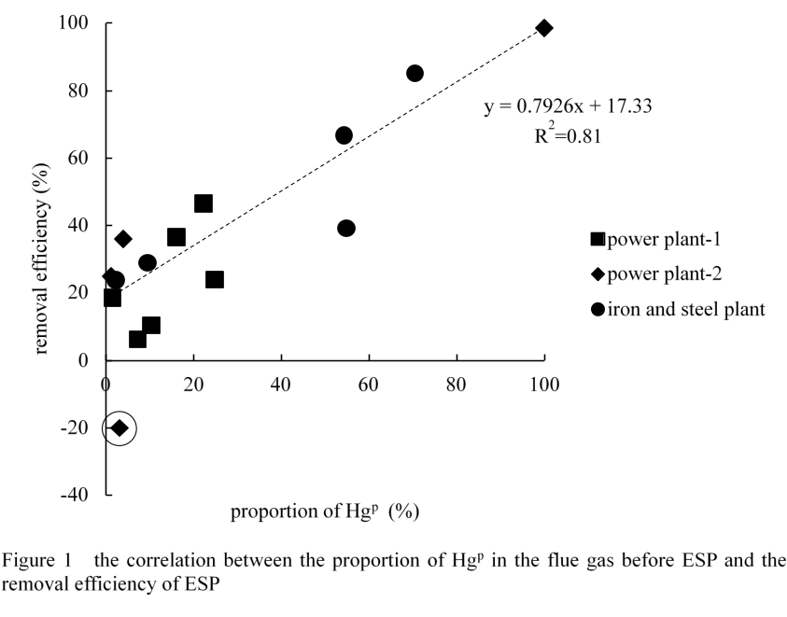
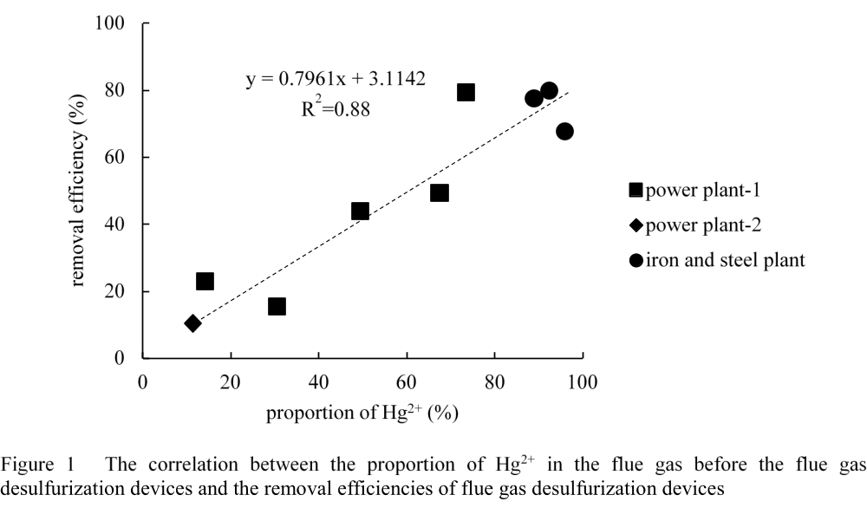
Hg transformation in iron & steel plants
Mercury is vaporized into the flue gas as Hg⁰ (>1000°C)
The predominant species before ESPs is Hg²⁺, possibly caused by the Fe₂O₃-containing particles in the flue gas
The Hg removal of ESPs and FGD are correlated with the proportion of Hg^{p} and Hg²⁺ in the flue gas before the facility
ESP
Desulfurization devices
Wang et al., in preparation

Slide 29
Summary of Hg speciation profiles
The mercury species emitted into atmosphere depend on mercury speciation of each stack, and mercury emissions from each stack
Proportions of emitted mercury species (%) |  | Hg⁰ | Hg²⁺ | Hg^{p}
Streets et al., 2005 | Iron and steel production | 80 | 15 | 5
Wang et al., 2014 Plant 1 | rotary kiln for limestone | 20.8 | 79.2 | 0.0
 | rotary kiln for dolomite | 8.1 | 91.9 | 0.0
 | Sintering machine | 32.1 | 67.9 | 0.0
 | electric furnace | 92.1 | 7.9 | 0.0
 | Power plant | 15.0 | 85.0 | 0.0
Wang et al., 2014 Plant 2 | Sintering machine-high-sulfur | 0.0 | 100.0 | 0.0
 | Sintering machine-low-sulfur | 0.8 | 99.2 | 0.0
 | Sintering machine tail | 14.3 | 85.7 | 0.0
 | Blast furnace-pig iron | 38.0 | 62.0 | 0.0
 | Blast furnace-iron scrap | 50.0 | 48.6 | 0.0
 | Convertor-crude steel | 53.3 | 46.7 | 0.0
 | Power plant | 77.7 | 22.3 | 0.0

Slide 30
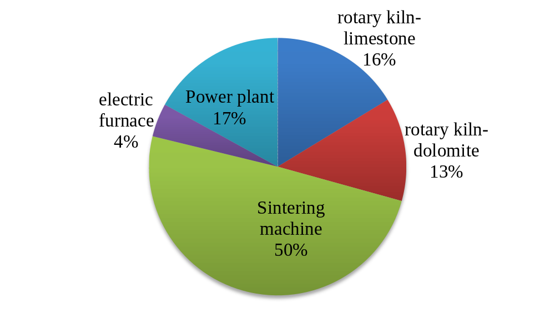
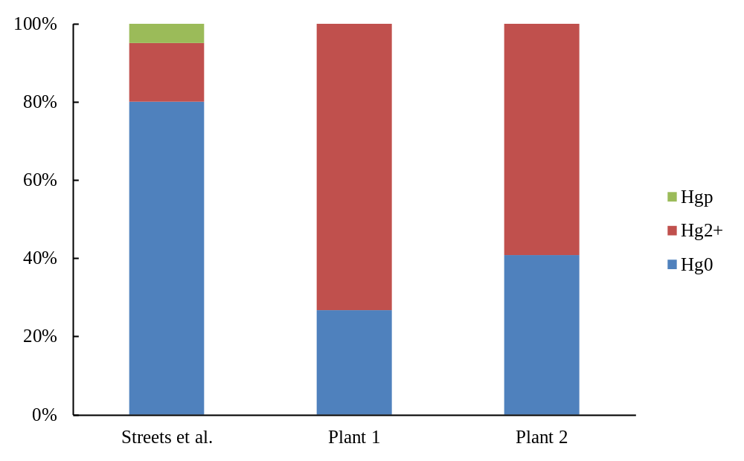
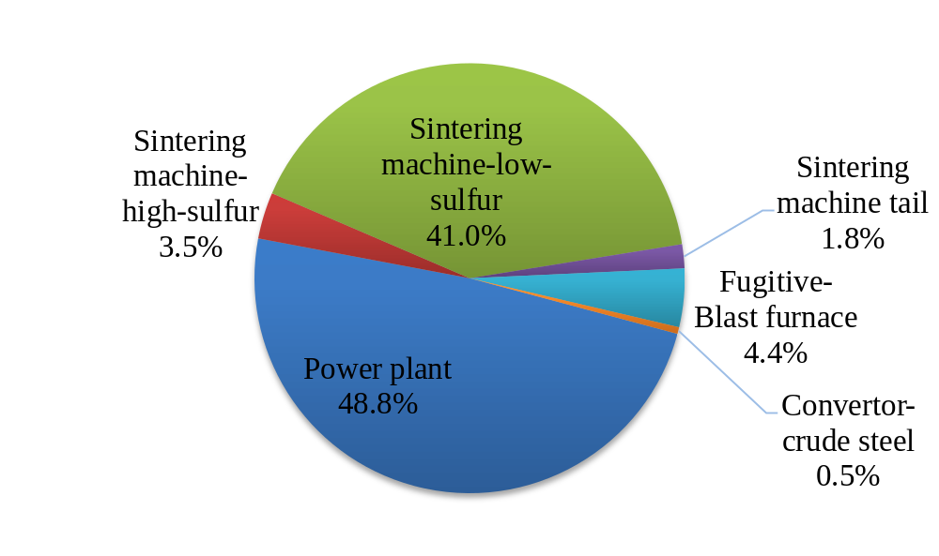
Summary of Hg speciation profiles
Sintering and power plants are predominant emission sources
Hg²⁺ accounts for 59-73% of total Hg in flue gas emitted to air
Speciation profile used in previous study is: 80% Hg⁰, 15% Hg²⁺ and 5% Hg^{p}

Slide 31
Speciated Hg emissions for China

Slide 32
Updated speciation profile of Hg emissions
Sub-category | Updated |  |  | Streets et al. (2005)
 | Hg⁰ | Hg²⁺ | Hg_{p} | Hg⁰ | Hg²⁺ | Hg_{p}
Coal-fired power plants | 0.79 | 0.21 | 0.00 | 0.20 | 0.78 | 0.02
Industrial coal combustion | 0.66 | 0.32 | 0.02 | 0.20 | 0.78 | 0.02
Residential coal combustion | 0.59 | 0.33 | 0.07 | 0.09 | 0.03 | 0.88
Other coal combustion | 0.66 | 0.32 | 0.02 | 0.09 | 0.03 | 0.88
Stationary oil combustion | 0.50 | 0.40 | 0.10 | 0.50 | 0.40 | 0.10
Mobile oil combustion | 0.50 | 0.40 | 0.10 | 0.50 | 0.40 | 0.10
Biomass fuel combustion | 0.74 | 0.05 | 0.21 | 0.96 | 0.00 | 0.04
Waste incineration | 0.96 | 0.00 | 0.04 | 0.96 | 0.00 | 0.04
Cremation | 0.96 | 0.00 | 0.04 | 0.96 | 0.00 | 0.04
Zinc smelting | 0.30 | 0.65 | 0.05 | 0.80 | 0.15 | 0.05
Lead smelting | 0.57 | 0.38 | 0.05 | 0.80 | 0.15 | 0.05
Copper smelting | 0.47 | 0.48 | 0.05 | 0.80 | 0.15 | 0.05
Gold production | 0.80 | 0.15 | 0.05 | 0.80 | 0.15 | 0.05
Mercury production | 0.80 | 0.15 | 0.05 | 0.80 | 0.15 | 0.05
Cement production | 0.34 | 0.65 | 0.01 | 0.80 | 0.15 | 0.05
Iron and steel production | 0.34 | 0.66 | 0.00 | 0.80 | 0.15 | 0.05
Aluminum production | 0.80 | 0.15 | 0.05 | 0.80 | 0.15 | 0.05
Notes:
针对每个行业，结合不同控制措施的形态分布和不同污控设施组合的安装比例就得到该行业的总体形态分布。

Slide 33
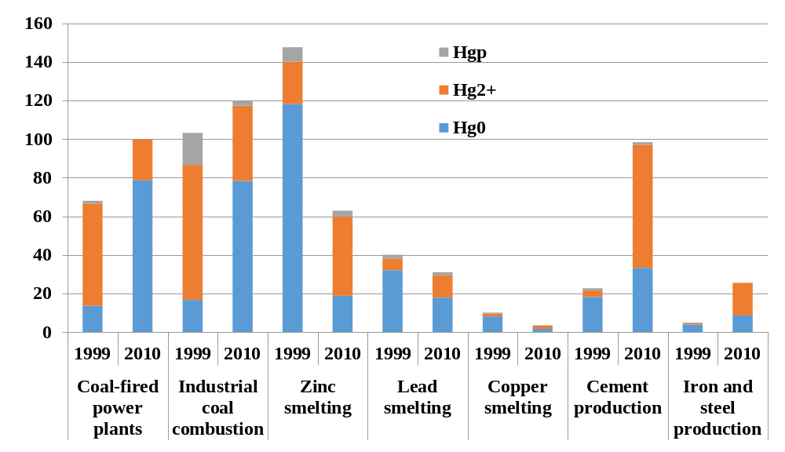
Speciated Hg emissions for China
 | HgT | Hg0 | Hg2+ | Hgp
1999 emission (Streets et al., 2005) | 535.8 | 299.2 | 171.9 | 64.7
2010 emissions (Wang et al., 2013) | 531.1 | 302.5 | 214.4 | 14.1
Notes:
Incorporating the most recent new test results
Considering the improved knowledge of chemical mechanism
Improvement of Novel/updated processes
Application of advanced air pollution control technologies
Relatively lower Hg content in fuels/raw materials

Slide 34
Conclusions

Slide 35
Conclusions
Homogeneous process at high temperature (400-750°C) and heterogeneous process at low temperature (200-400°C) have equivalent influence on Hg speciation
Composition of fuels or raw materials affects composition of flue gas (e.g. halogen) and properties of fly ash (e.g. SSA), resulting in different Hg speciation
Conventional air pollution control devices have co-benefit removal efficiencies on different Hg species and contribute to Hg transformation
Recent field tests have provided new knowledge and more reliable Hg speciation profile for emission inventories
The speciated Hg emissions have changed significantly and will have substantial impacts on atmospheric Hg transports
Notes:
Flue gas composition, e.g. HCl, HBr, Hg, SO2, NO, NH3, O2, SO3, PM concentration
Fly ash properties, e.g. specific surface area (SSA), LOI, Fe, catalytic composition
Catalysts in devices, e.g. SCR catalyst, conversion catalyst in acid plant
Operational conditions, e.g. flue gas temperature, NH3 injection rate of SCR, slurry spray rate of WFGD
Conventional air pollution control device (APCD), e.g. ESP, FF, WFGD, SCR, acid plant
Dedicated mercury control technologies, e.g. Hg reclaiming tower in smelters

Slide 36

Thanks for your attention!
Contact information:
Tel: 86-10-62771466
Email: shxwang@tsinghua.edu.cn

