Slide 1

HIF3A variant interacts with obesity on ALT mediated by DNA methylation
Shuo Wang
PhD student
Institute of Child and Adolescent Health
of Peking University, China
Advisor: Jun Ma, Haijun Wang

Slide 2
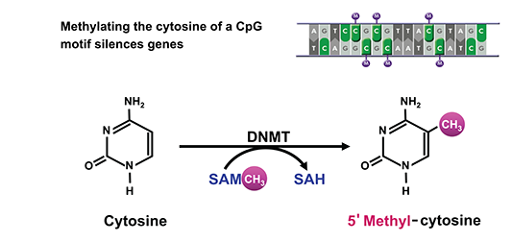
Introduction
Epigenetic
Heritable events not caused by changes in DNA sequence, and can influence gene expression
Missing heritability
DNA methylation could contribute to the development
of obesity and other diseases like NAFLD
DNA methylation
A common epigenetic mechanism that occurs by the addition of a methyl (CH₃) group to DNA, thereby often modifying the function of the genes.
CpG sites
Notes:
First, I’ll introduce the DNA methylation very briefly.

Slide 3
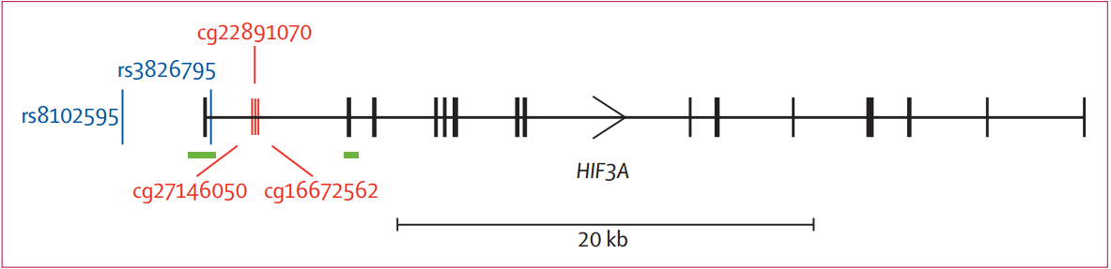
EWAS
epigenetic genomic association study
In 2014, Dick et al. identified a specific association between BMI and DNA methylation
HIF3A: Hypoxia Inducible Factor 3 Alpha Subunit, encoding the α-3 subunit of the hypoxia inducible transcription factors (HIFs), which regulate adaptive responses to low oxygen tension (hypoxia)
Dick KJ, Nelson CP, Tsaprouni L, et al. DNA methylation and body-mass index: a genome-wide analysis. Lancet,2014, 383(9933): 1990–1998.
Notes:
Just like the GWAS studies, scientists investigated the DNA methylation in a genomic scale, which is called EWAS.
Identified … at 3 CpG sites of the HIF3A gene, and also reported nearby SNPs to be associated with methylation. In this picture, the three methylation sites were shown in red, and the SNPs were shown in blue. The three methylation sites all locate at the first intron of the gene.
The name of this gene is …

Slide 4
EWAS
epigenetic genomic association study
In 2014, Dick et al. identified a specific association between BMI and DNA methylation
In 2015, Demerath et al. validated the results through another EWAS study and found that HIF3A methylation was associated with long term BMI change
HIF3A
Demerath EW, Guan W, Grove ML, et al. Epigenome-wide Association Study (EWAS) of BMI, BMI Change, and Waist Circumference in African American Adults Identifies Multiple Replicated Loci. Hum Mol Genet, 2015,24(15):4464-4479.
Notes:
thus，HIF3A became a very promising gene related to obesity

Slide 5
Aim
Focus: HIF3A gene, SNP + methylation
1) To validate the association between HIF3A methylation among Chinese children;
2) To find other obesity-related phenotypes related to HIF3A methylation;
3) To explore the relation among obesity, HIF3A variant, methylation and other obesity-related phenotypes
ALT(alanine aminotransferase)
Notes:
Therefore，in this study we focused on the HIF3A gene, and investigated on both the SNP level and DNA methylation level.dy
The aims of the study are:…

Slide 6
Methods
Study design
A case-control study.
Subjects and indicators
Anthropometric Measurement
Height, weight, waist circumstance
Serological Markers
TC, TG, HDL-C, LDL-C, GLU, insulin, ALT
2030 Chinese 7-18y children
(705 obese;1325 non-obese controls)
SNP
(rs3826795)
110 severely obese children and
110 age- and gender- matched normal-weight controls
DNA Methylation
(HIF3A)
Notes:
SNP (rs3826795), anthropometric measurement, serological markers including (TC, TG, HDL-C, LDL-C, GLU, insulin, ALT): among 2030 Chinese 7-18y children (705 obese cases and 1325 non-obese controls)
DNA methylation (HIF3A) was measured among 110 severely obese children and 110 age- and gender- matched normal-weight controls.

Slide 7
SNP genotyping (rs3826795)
Genotyping system: Sequenom’s MassARRAY system.
The genotyping call rate: 97.9%.
DNA methylation detection (HIF3A)
Genomic DNA of peripheral blood leukocytes
Sequenom’s MassARRAY system (MALDI-TOF-MS).
Quality Control
Duplication
100% methylated positive controls
0% methylated negative controls
Notes:
Methylation detection was conducted in duplicate for all the samples. Data with more than 30% disparity between duplicate samples were excluded. A fully-methylated positive control and a 0-methylated negative control were included for each run.

Slide 8
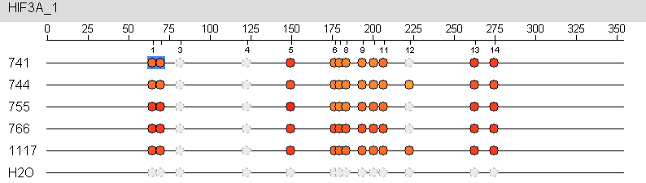
Cpg sites obtained
Figure. Simplified output of MassARRAY DNA methylation detection system
Table. Position of the tested CpG sites (GRCh37/hg19)
CpG1.2 | 46801557*,46801562
CpG5 | 46801642*
CpG6.7.8 | 46801669,46801672*,46801676
CpG11 | 46801699
CpG13.14 | 46801755,46801760
Finally, 9 CpG sites in 5 CpG units were obtained, with call rates greater than 80%.
*The 3 sites reported by previous EWAS studies [2,3].
Notes:
截取的output
某些位点距离太近，只能以unit形式得到均值
某些位点被exclude，包括CpG9 10因为。。，以及CpG12因为low call rate
Finally，得到。。
标出的是三个以前研究报道过的位点
whereas the remaining 6 CpG sites were not included in the Illumina 450K Bead Chip used by the two EWAS studies, nor had been reported to be associated with obesity-related phenotypes in other studies.

Slide 9
Results
1. Validation of HIF3A methylation difference between obese children and controls
Table 1. General characteristics of the obese children and controls
 | Obese Children(n=107) | Controls(n=105) | P Value
Age (years) | 11.1(2.6) | 11.0(2.6) | 0.919
Male | 55(51.4) | 52(49.5) | 0.785
BMI (kg/m²) | 28.4(3.8) | 17.1(2.1) | <0.001
P=0.027
P=0.044
Figure 1. HIF3A methylation values in obese children and controls
Notes:
性别年龄间无差别
We observed significantly higher methylation levels in obese children than in controls at both CpG5 and CpG11 (P <0.05)
其中Cpg5直接验证了既往研究，而CpG11是新位点
另外两个site，slightly higher，but not significant

Slide 10
2. Association between HIF3A methylation and obesity-related phenotypes
TC
TG
HIF3A methylation
Partial correlation analyses
LDL-C
HDL-C
GLU
Before adjusting for BMI：
HOMO-IR
ALT
After adjusting for BMI：
(r=0.226, P =0.007 at CpG11)
HIF3A methylation may have a BMI-independent association with ALT.

Slide 11
Does the association still exist on the snp level?
The HIF3A rs3826795 were detected in 2030 subjects
No significant association of rs3826795 was found with obesity (P=0.843), BMI (P=0.268) or ALT (P=0.340).
Stratified analyses was conducted in subgroups based on the obesity status
Why?
705 obese children
2030 subjects
1325 non-obese children
Notes:
因此我们进一步分析snp，但是并没有如预期中发现snp-alt的关联
In order to explain this
Which were 705 obese children and 1325 non-obese children

Slide 12
3. Interaction of obesity and HIF3A variant on plasma ALT
The G-allele number was positively associated with elevated ALT (β’=0.075, P=0.037).
Each G-allele increased the LgALT level by 0.030.
Obese
Non-obese
No significant association between ALT and the SNP (P=0.741)
SNP × besity_status
P_{inter}=0.042
Notes:
multivariate linear regression model
tested and there was a significant interaction between the G-allele number in the HIF3A rs3826795 polymorphism and obesity on ALT

Slide 13
4. Mediation analyses of HIF3A variant, methylation and plasma ALT in obese children
Y = cX + age + age² + gender + e₁
M = ax + age + age² + gender + e₂
Y = c’X + bM + age+ age² + gender + e₃.
HIF3A methylation (M)
Testing b:
significant mediation effect
Testing c’:
a complete mediation effect
a=0.252
(P=0.009)
b=0.242
(P=0.014)
ab/c*100%=81.3%
HIF3A SNP (X)
c’=0.140 (P=0.144)
ALT (Y)
c=0.075, (P=0.037)
Notes:
Since we found the association between HIF3A snp and alt in obese children, the next thing we wanted to know is the relation among the three factors: HIF3A variant, methylation and ALT. So we conducted mediation analyses among obese children
Here we used the mediation analyses model develeped by …, and we used Y X M to represent the dependent variable, the independent variable and the mediation factor, we used a b c to represent the coefficents in each equation, and age, age square and gender were adjusted for in each equation.
By testing b, we can know that the mediation effect was significant. The analyses also provided method to test whether the mediator acts as a complete or incomplete mediator, by testing c’.
This doesn’t mean the effect of snp on alt should be 100% mediated by methylation, instead, it means the pure effect of snp on alt without the existence of methylation was insignificant.In fact, when we calculated the ab/c, we got 81.3%, which means that around 80% of the effect was mediated by methylation.

Slide 14
Discussion
Known to be influenced by environmental factors, DNA methylation can also be modulated by genetic variants.
Effect size of metQTL (rs3826795-CpG site 46801642):
Grundberg, et al. [10] conducted analysis of metQTL in a genome study and revealed that 28% genome CpGs were associated with nearby SNPs (within 100 kb).
metQTL: methylation quantitative-trait locus
In the EWAS study [13] : each G allele increased the methylation level by 0.039-0.051 in different cohorts.
In our study: each G allele increased the methylation level by 0.029 in obese children, and 0.022 in non-obese children.
Ethnic difference? Age difference?
Notes:
The first thing I want to discuss is the association between snp and methylation. DNA methylation got famous because as an epigenetic factor, it could be influenced by environmental factors. Meanwhile, the DNA methylation is also associated with snp, and studies show that about 28% of DNA methylation sites were associated with SNPs.

Slide 15
MECHANISM that the hif3a gene leads to alt elevation in obese children
Pro-inflammatory Cytokine Production
Cellular
Hypoxia
Increased Adipose Mass and Adipocyte Diameter
A biomarker to reflect the
defect of liver function
a. chronic low-grade inflammation
from visceral adipose tissue;
b. excess free fatty acids
Obesity
Status
ALT
Elevation
Milić S, Lulić D, Štimac D. Non-alcoholic fatty liver disease and obesity: biochemical, metabolic and clinical presentations. World J Gastroenterol,2014,20(28):9330-9337.
Johnson AR, Milner JJ, Makowski L. The inflammation highway: metabolism accelerates inflammatory traffic in obesity. Immunol Rev, 2012,249(1):218-238.
Notes:
Basically, we should say the mechanism that… is still unknown. So let’s start with ALT.
ALT is clinically used to reflect the defect of liver function.
A review [] focusing on biochemical and metabolic relation of obesity and liver diseases claimed that two most critical factors contributing to liver injury progression is 1)chronic low-grade inflammation from visceral adipose tissue; and 2) excess free fatty acids.
In another review focusing on obesity and inflammation, the author explained that in the status of obesity, a variety of cell populations began to exhibit an increased adipose mass and adipocyte diameter, which could lead to cellular hypoxia and further result in pro-inflammatory cytokine production.

Slide 16
MECHANISM that the hif3a gene leads to alt elevation in obese children
A possible speculation:
Obesity started a cellular hypoxia status through expanded adipocyte size
Inflammatory cytokines are activated by hypoxia
Resulting in the defect of liver function and elevated ALT.
This process could be modulated by the HIF3A polymorphism.
HIF3A
SNP
Obesity
Status
HIF3A
Methylation
Inflammatory
Cytokines
ALT
Elevation
Notes:
So a possible speculation should be…
This chain is still incomplete, so further studies on the mechanism are still needed.

Slide 17
limitations
Case-control design and causality
Methylation and tissue problem
By comparing the results from different tissue, the EWAS study supported the use of whole-blood DNA methylation profiling for identification of relevant epigenetic changes.
Further studies were needed for understanding the mechanism of the relation among obesity, ALT and the HIF3A gene.
Dick KJ, Nelson CP, Tsaprouni L, Sandling JK, Aïssi D, Wahl S, et al. DNA methylation and body-mass index: a genome-wide analysis. Lancet,2014, 383(9933): 1990–1998.
Notes:
Several limitations of the current study should be noticed.
First of all, though we have tested the relation among obesity, ALT, HIF3A SNP and methylation by conducting the interaction analysis and the mediation analysis, the case-control design of the current study means that we cannot assess the causality. And we didn’t conduct further molecular studies to understand the mechanism.
Secondly, known to be a tissue specific biomarker, the HIF3A methylation levels were examined in the current study using peripheral blood samples instead of adipose issues or hepatic issues, thus we couldn’t know whether the effect was similar in other tissues.
However, several other studies also used peripheral blood to test DNA methylation [12,26], and by comparing the results from different tissue, the EWAS study supported the use of whole-blood DNA methylation profiling for identification of relevant epigenetic changes. Thirdly, we didn’t test gene expression or cytokines data.

Slide 18
conclusion
In conclusion, we found that obesity interacts with the HIF3A rs3826795 polymorphism on plasma ALT, and the effect of rs3826795 on ALT in obese children could be mediated by HIF3A DNA methylation.
The results provided new evidence to the function of the HIF3A gene and the mechanism linking obesity and ALT.
The study would be helpful for future risk assessment and personalized medicine of liver diseases such as NAFLD.

Slide 19
Thank you for your attention!
HIF3A variant interacts with obesity on ALT mediated by DNA methylation
Shuo Wang
PhD student, Institute of Child and Adolescent Health of Peking University, China
Advisor: Jun Ma, Haijun Wang

