Slide 1
About OMICS Group
OMICS Group is an amalgamation of Open Access Publications and worldwide international science conferences and events. Established in the year 2007 with the sole aim of making the information on Sciences and technology ‘Open Access’, OMICS Group publishes 500 online open access scholarly journals in all aspects of Science, Engineering, Management and Technology journals. OMICS Group has been instrumental in taking the knowledge on Science & technology to the doorsteps of ordinary men and women. Research Scholars, Students, Libraries, Educational Institutions, Research centers and the industry are main stakeholders that benefitted greatly from this knowledge dissemination. OMICS Group also organizes 500 International conferences annually across the globe, where knowledge transfer takes place through debates, round table discussions, poster presentations, workshops, symposia and exhibitions.

Slide 2
OMICS International Conferences
OMICS International is a pioneer and leading science event organizer, which publishes around 500 open access journals and conducts over 500 Medical, Clinical, Engineering, Life Sciences, Pharma scientific conferences all over the globe annually with the support of more than 1000 scientific associations and 30,000 editorial board members and 3.5 million followers to its credit.
OMICS Group has organized 500 conferences, workshops and national symposiums across the major cities including San Francisco, Las Vegas, San Antonio, Omaha, Orlando, Raleigh, Santa Clara, Chicago, Philadelphia, Baltimore, United Kingdom, Valencia, Dubai, Beijing, Hyderabad, Bengaluru and Mumbai.

Slide 3
Review of Topical Skin Lightening Agents
Dr. Shuba Dharmana M.B.B.S, D.F.F.P, D.P.D
Dermatologist, Hair Transplant Surgeon
Founder LeJeune Group of Medspas

Slide 4
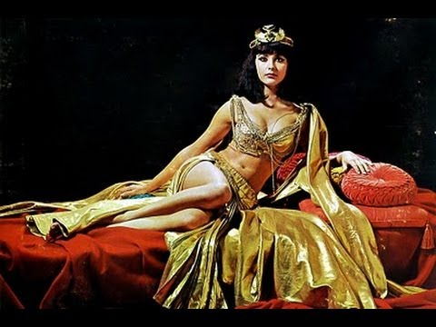
Ancient practices
Queen Cleopatra -milk
Chinese -ground pearl
Ancient Romans - lead
Japanese -Bird dropping
Indians- Turmeric paste

Slide 5
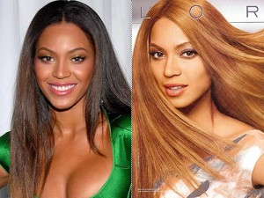
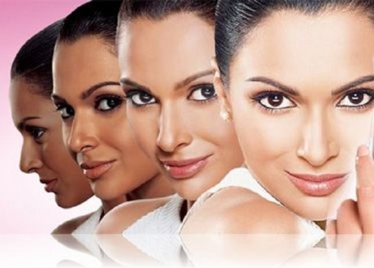
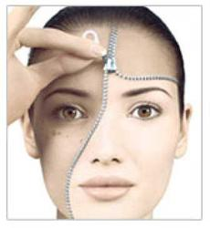
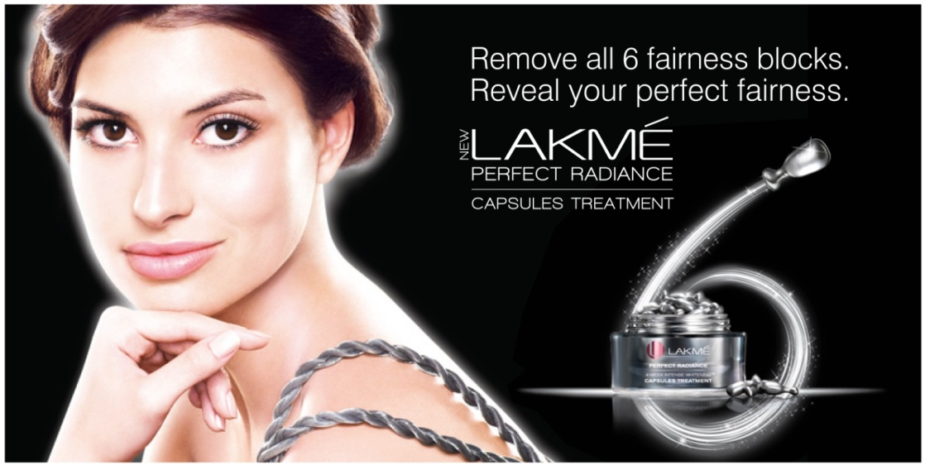
Fairness Industry

Slide 6
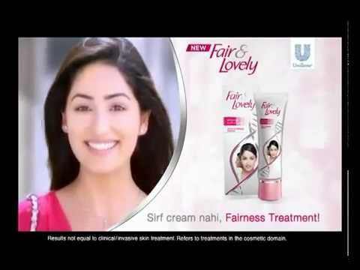
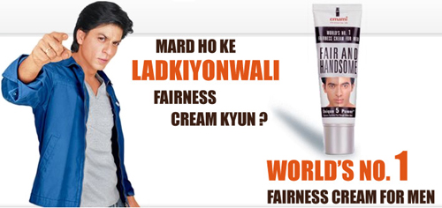
Fair and Lovely?

Slide 7
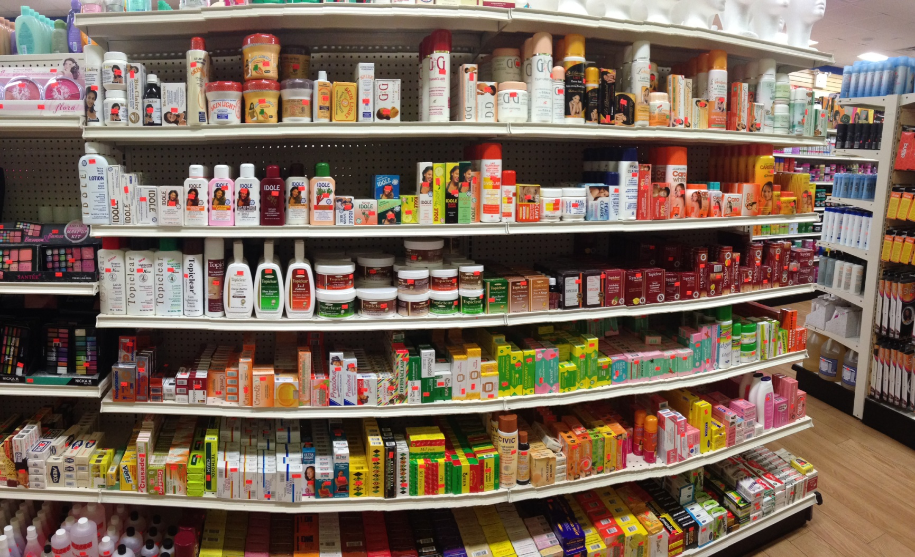
Fairness creams

Slide 8

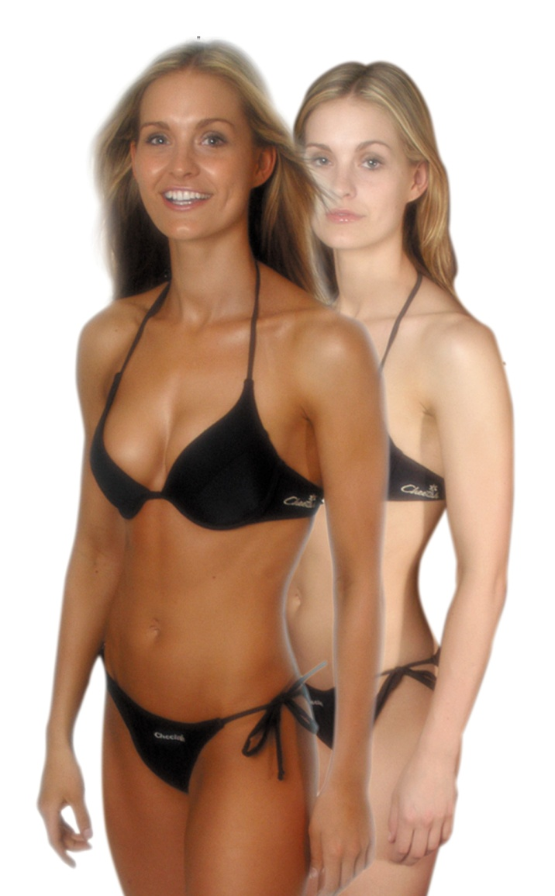
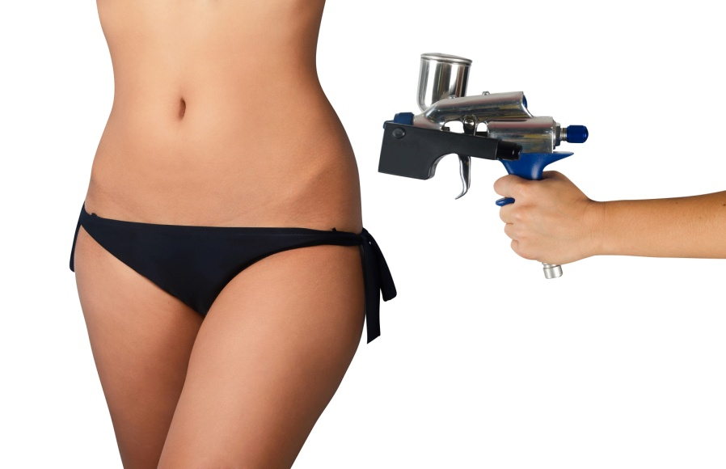
What about Tanning?

Slide 9
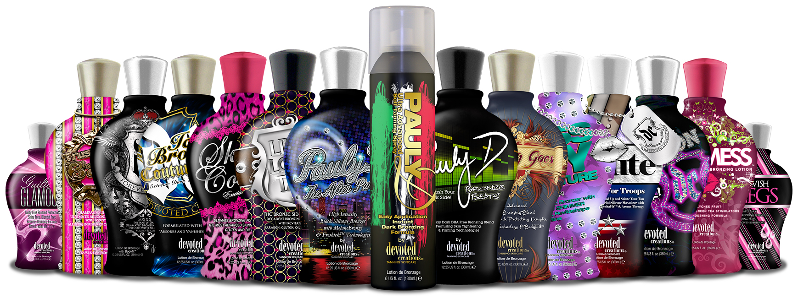
Tanning Industry

Slide 10
Pigmentary disorders
Hyperpigmentation
  Localised:
    PIH- Acne, Contact dermatitis, Lupus etc
    Melasma
    Acanthosis nigricans, Seborrhoeic keratosis
    Café au lait Macules
  Diffuse:
    Disease: Haemochromatosis, Hyperthyroidism, addison’s disease
    Drugs: Tetracyclines, amiodarone, griseofulvin, trimethoprim, quinine, gold, mercury, bismuth
    Plants/foods: lemons, limes, fig leaves or stems, celery, dill, parsnips, and carrot juice. Phyto photodermatitis
    Neoplasm: Melanoma

Slide 11
Consultation
Onset of hyperpigmentation: congenital- café au lait childhood- freckles pregnancy-melasma
Duration
Systemic symptoms: adrenal disease, hyperthyroidism, diabetes
Drug history- medication, supplements
Exposure to plants
Exposure to sunlight

Slide 12
Treatment principles
Identify and treat systemic disease
Stop the offending drug/plant
Treat the underlying inflammatory condition- acne, lupus
Sun awareness- avoid sun, sunscreen
Topical skin lightening agents
Dermabrasion
Peels
Lasers

Slide 13
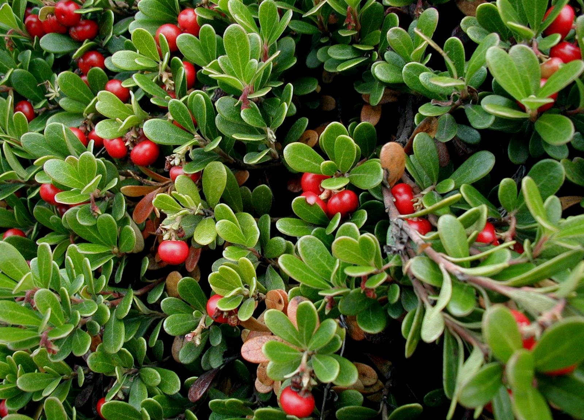
Topical skin Lightening agents
Botanicals:
  Arbutin 1%
  Mulberry extract
  Licorice extract
  Aloesin
  Gentisic acid
  Flavonoids
  Hesperidin
  Ascorbic acid
  Niacinamide
  Poly phenols
  Soy proteins
  Yeast derivatives

Slide 14
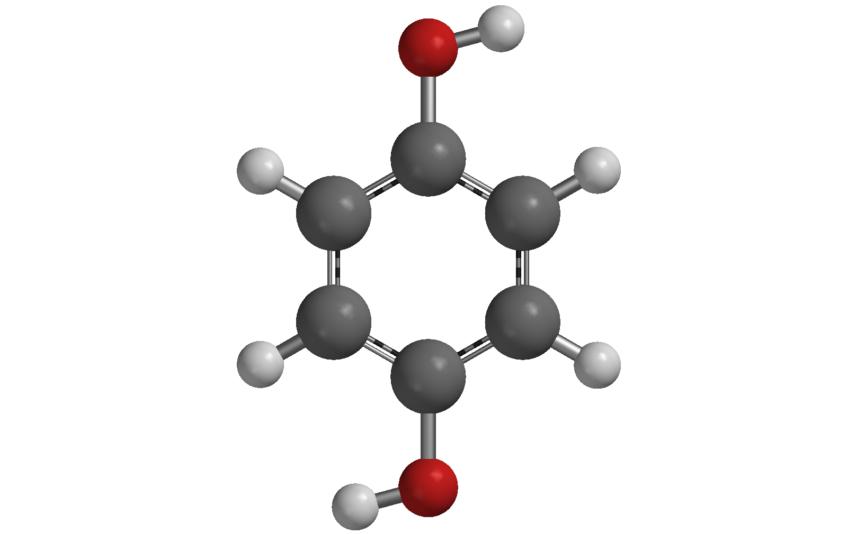
Topical Skin Lightening Agents
  Hydroquinone
  Topical retinoids: tretinoin
  Other agents:
    Azelaic acid
    Kojic Acid
    Mequinol
    Isopropylcatechol
    N-acetyl-4-cysteaminylphenol
    N-acetyl glucosamine
    Piceatannol
  Unregulated
    Turmeric
    Lemon juice
    Camphor
  Topical Corticosteroids
  Mercury
  Ellagic Acid
  Lignin Peroxidase

Slide 15
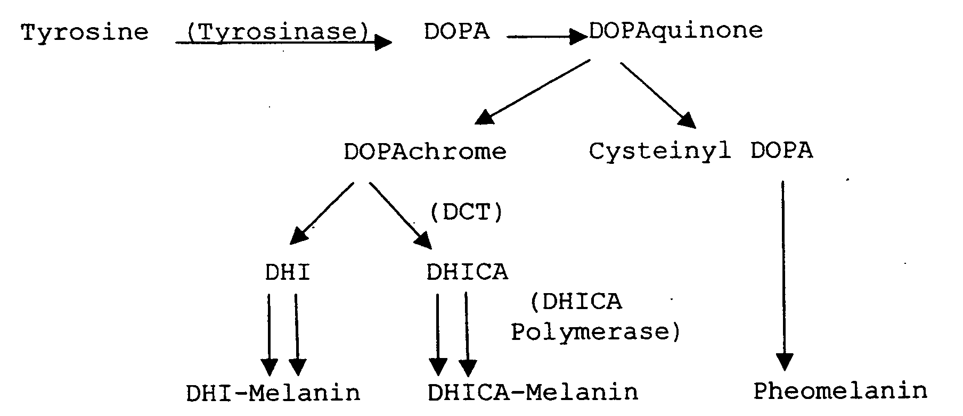
Melanin synthesis
Increased melanocyte numbers, increased melanogenesis, spillage of melanin into the dermis and exogenous pigment deposits.

Slide 16
Hydroquinone
Gold standard for treating Hyperpigmentation
Used in treatment of PIH, Melasma
Used in concentration of 2-4%. OTC- 2%
Inhibits tyrosinase. Reduces conversion of Dopa to melanin
Used in combination with retinoids, alpha hydroxy acids and antioxidants
Used in triple combinations creams with tretinoin and fluocinolone
Decrease in lesion size, pigmentation, disease severity
Effects seen as early as 4 weeks. Optimal effect after 6-10 weeks

Slide 17
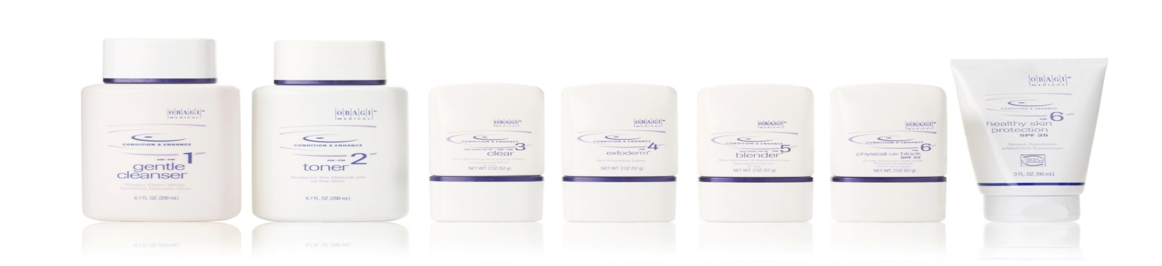
Safety of Hydroquinone
Oral Hydroquinone – a carcinogen- based on rodent studies
Side effects- ochronosis, Proloned usage of 4-5% HQ with retinoic acid has caused irritant reactions
FDA has proposed to withdraw the 1982 rule that hydroquinone is GRASE and further additional studies should be conducted regarding safety in humans OTC hydroquinone agents in 2006
FDA yet to make a final ruling

Slide 18
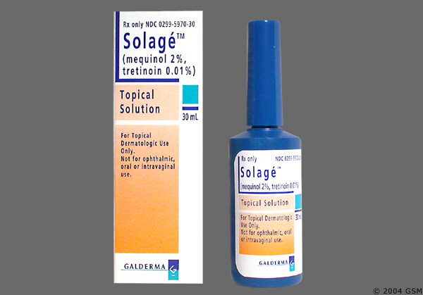
Mequinol
4-Hydroxyanisole , derivative of
Hydroquinone
Less irritative
Inhibits Tyrosinase
Used in 2-4% concentration
Used in combination with tretinoin
Safe & effective treatment in dark
skin types
Favourable benefit-risk ratio compared to
hydroquinone

Slide 19
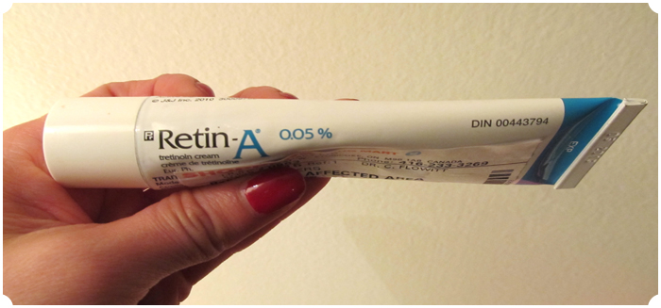
Retinoids
Tretinoin, Adapalene, isotretinoin, tazarotene
Improvement in photoageing, PIH, melasma
Tretinoin used in concentration of 0.01-0.1%
Side effects: Erythema, peeling, PIH
Irritant dermatitis is a risk in dark skinned individuals and when used in higher concentration
Reduce dose and titrate to higher doses gradually
Using cream based formulation reduces irritation
Using along with a moisturiser
Maximum effects seen at 8-12 months

Slide 20
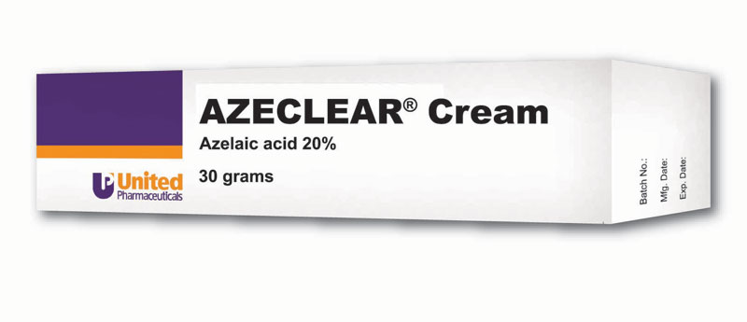
Azelaic Acid
Dicarboxylic acid isolated from Pityrosporum ovale
15-20% concentrations as efficient as HQ
Less of an irritant
Significantly greater decreases in pigmentary intensity
Combination with 15-20% glycolic- as efficacious as 4% HQ in treating PIH, melasma
Side effects are mild and temporary- pruritus, erythema, scaling and irritation

Slide 21
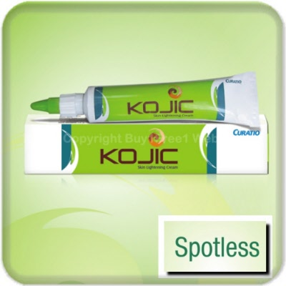
Kojic Acid
Tyrosinase inhibitor
Chelation agent produced by Aspergillus oryzae
Used alone or in combination with glycolic acid or Hydroquinone
Used in concentration of 1% in cosmetic creams
1-4% concentration in skin lightening preperations
Adverts effects: contact dermatitis
High sensitising potential
Banned in Japan- mutagenicity concerns

Slide 22
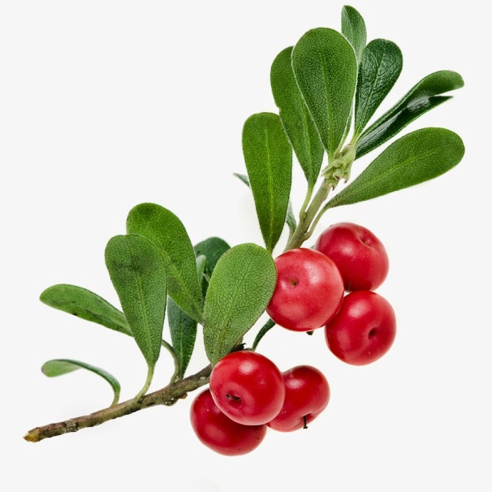
Arbutin
Glycosylated hydroquinones derived from leaves of bearberry, pear and cranberry
Inhibits Tyrosinase activity
Inhibits melanosome maturation
Efficacy is concentration dependant
Paradoxical hyperpigmentation seen with higher doses
Alpha-Arbutin & Deoxy-Arbutin are synthetic. Show greater tyrosinase inhibition
Effective in lightening solar lentigenes

Slide 23
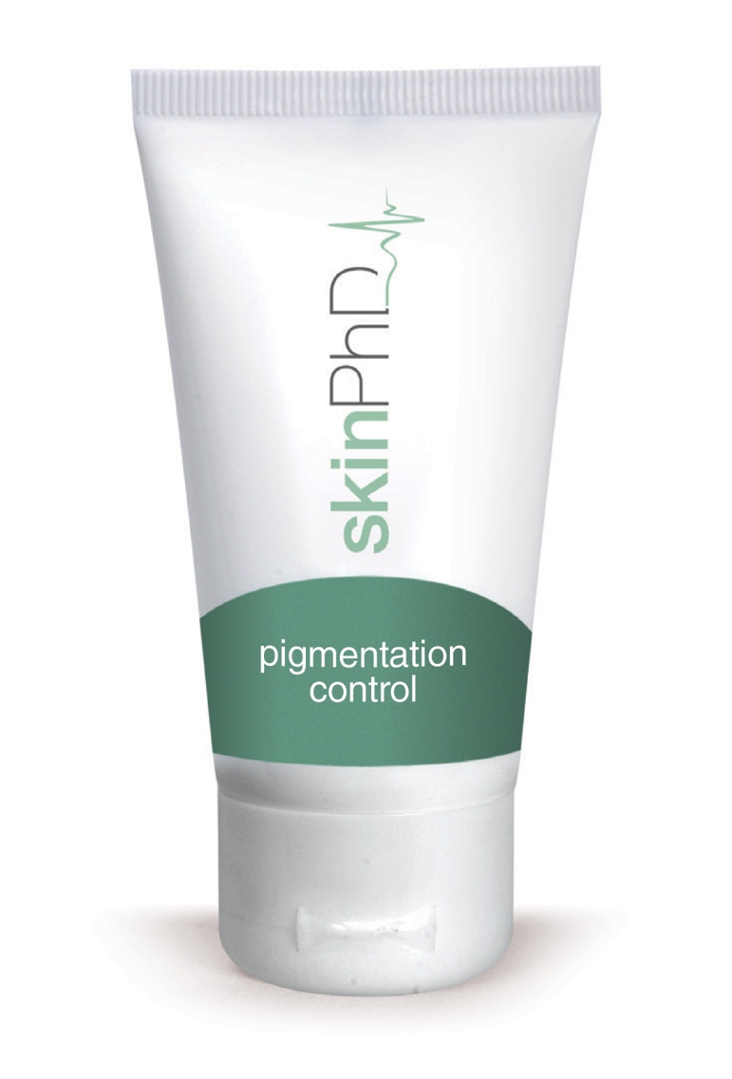
Niacinamide
Derivative of Niacin, Vit B3
Treatment of acne
Decereases melenosome transfer
Decreases melanogenesis
Concentrations of 2-5%
melasma, UV induced hyperpigmentation
alone or with N-acetyl glucosamine
Safety & efficacy studies needed in PIH

Slide 24
N-Acetyl Glucosamine
Amino sugar which is a pre cursor to Hyaluronic acid
Inhibits tyrosinase glycosylation
Used in 2% concentration alone or in combination with niacinamide
Well tolerated with mild- moderate irritation
Safe and efficacious in treatment of hyperpigmentation secondary to sun exposure

Slide 25
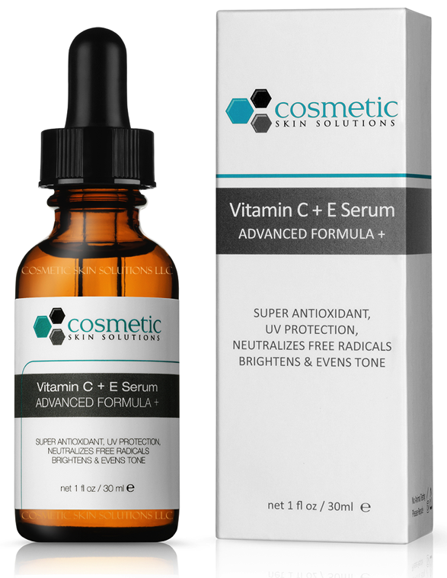
Ascorbic Acid
Naturally occuring antioxidant
Suppresses melanin synthesis
Used in 5-10% conc in
combination with other agents like HQ
Efficacious in photoageing and melasma
By itself not efficacious

Slide 26
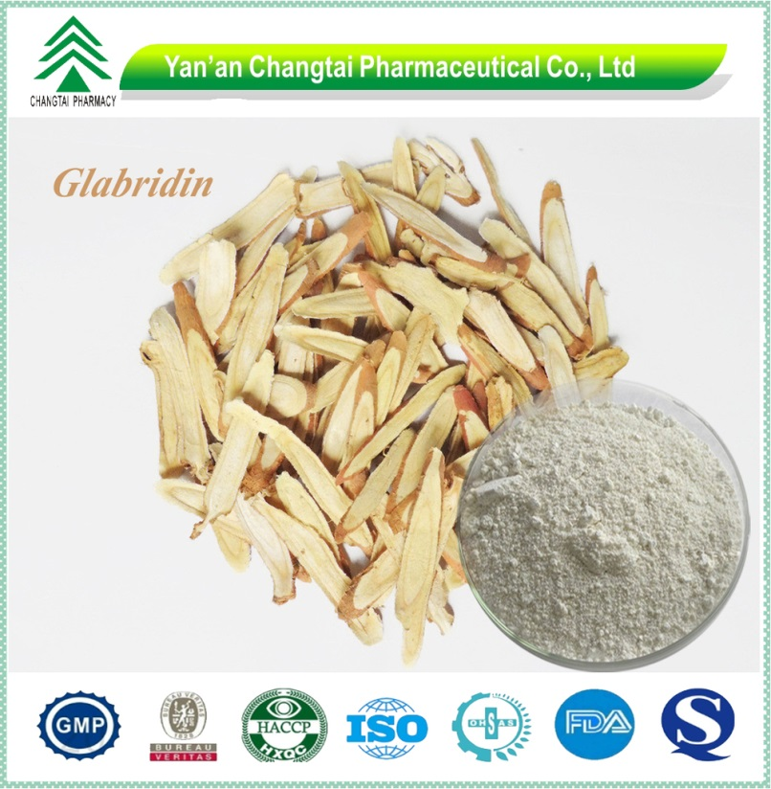
Liquorice Extract
Plant extract
Glabridin, licochalcone A, Liquiritin
Galbridin, licochalcone A
-Inhibit tyrosinase activity
Liquiritin causes depigmentation
by causing melanin dispersion
Dosage of 1mg/day- melasma
Used in cosmetic products.
Eg, Image MD

Slide 27
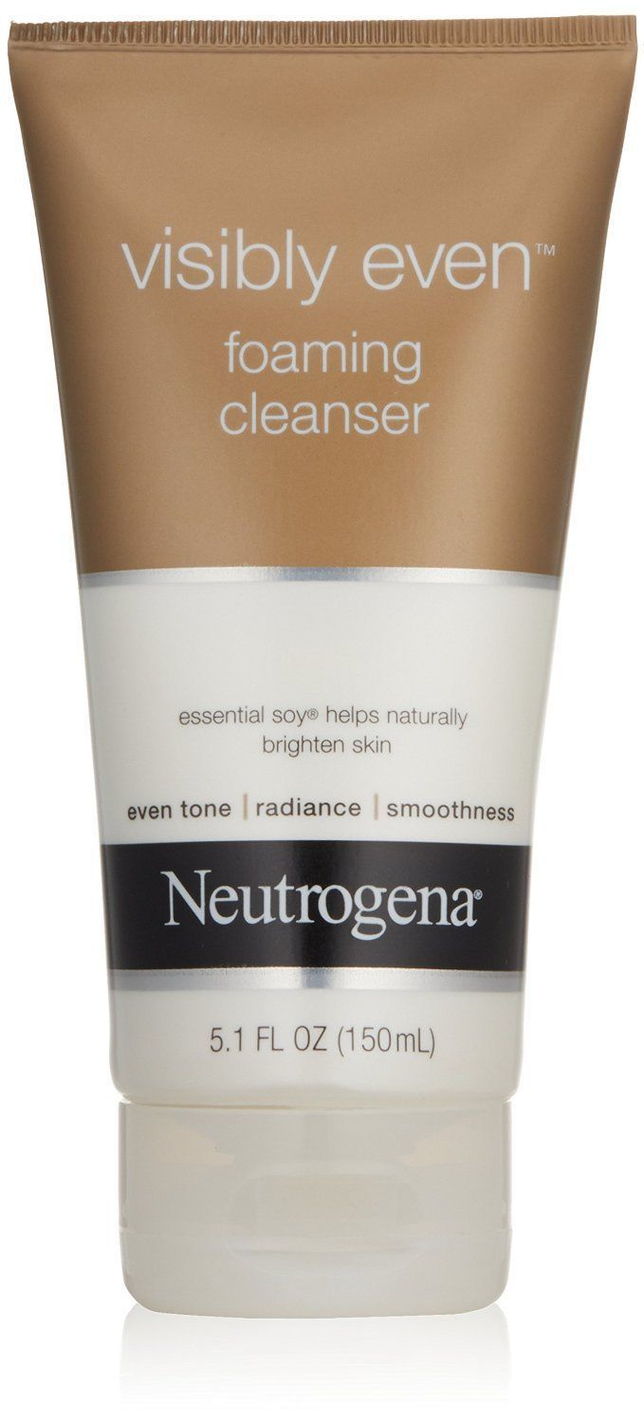
Soy
Protein proteinase inhibitors-
soybean trypsin inhibitor, STI &
Bowman±Birk protease inhibitor (BBI)
Complex mechanism of inhibition of
protease-activated receptor 2 (PAR-2)
activation leads to depigmentation
Trace amounts of free fatty acids & their
acyl CoA esters- inhibit trypsin thus adding
to the inhibition of the PAR-2 pathway.
Used in cosmetic skin moisturisers
for skin lightening

Slide 28
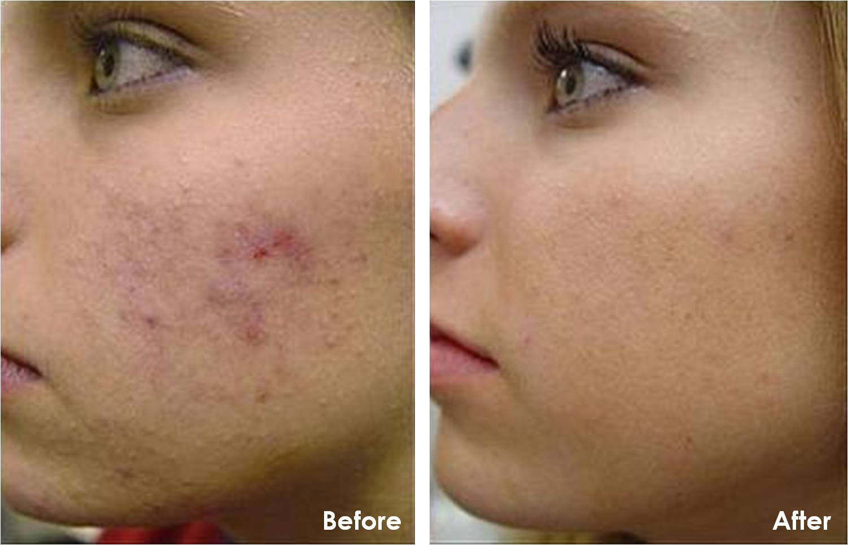
Chemical peels
Alone or in combination with skin lightening agents
Reduce dyschromias and PIH
Superficial -Glycolic -20-70% conc, salicylic, lactic
Modified Jessner’s, Yellow Peel
Moderate Depth- TCA 15-35%
Deep peels- Phenol
Reduce irritation. Use sun care
Pre-treatment- tretinoin, HQ, alpha hydroxy acid

Slide 29
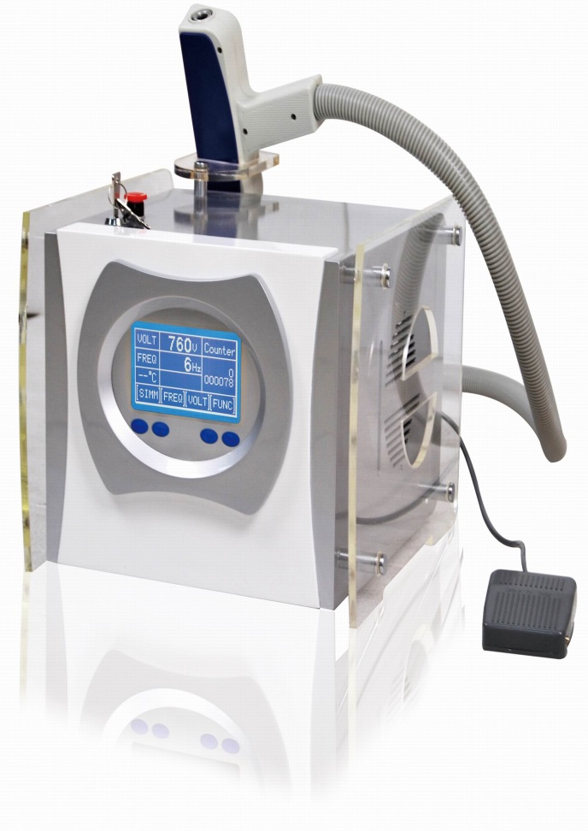
Laser Therapy
1064nm QS (Nd:YAG) laser
greater margin of safety
satisfactory results
Safer in dark skinned people
Fractional ablative & non ablative
post procedure cosmeceutical use
IPL in pigmented lesions
Laser induced PIH
pre treatment with skin lightening
agents to reduce the risk of PIH

Slide 30
Emerging Therapies
2% Undecylenoyl phenylalanine – solar lentigenes
5% Methimazole
Dioic acid
Aloesin
4-(1-phenylethyl)1,3-benzenediol
Paper mulberry
Ellagic acid
Quinolines
Piperlonguminine
Luteolin
Calycosin2

Slide 31
Thank You….

Slide 32
Let us meet again..
We welcome you all to our future conferences of OMICS International
5th International Conference and Expo
on
Cosmetology, Trichology & Aesthetic Practices
On
April 25-27, 2016 at Dubai, UAE
http://cosmetology-trichology.conferenceseries.com/

