Slide 1
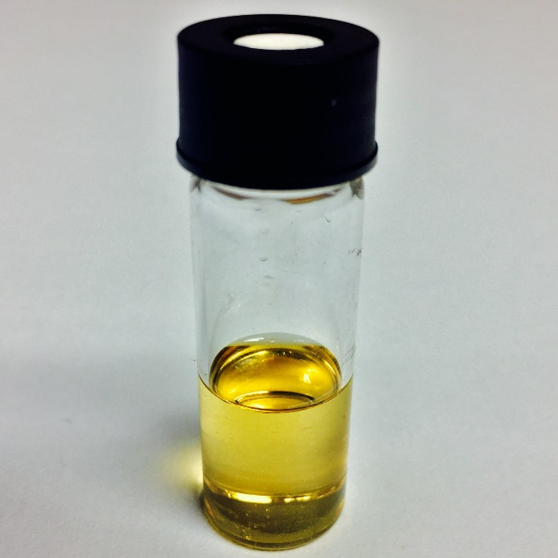


Development of Supercritical Transesterification for Sustainable Conversion of Oils to Biodiesel
Shriyash Deshpande
Aydin Sunol, Ph.D., P.E.
George Philippidis, Ph.D.

Slide 2

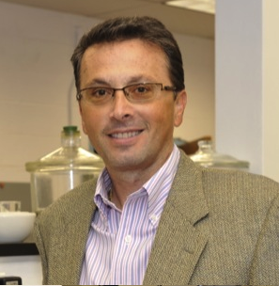
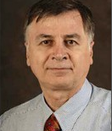
Our Research Team
Kyle Cogswell,
Aaron Driscoll,
Ahmet Manisali,
Ph.D. Candidates, University of South Florida
Shriyash Deshpande,
M.S., Chemical Engineering
George Philippidis, Ph.D.,
Principle Investigator
Biofuels
Aydin Sunol, Ph.D.,
Principle Investigator
Supercritical Technology

Slide 3
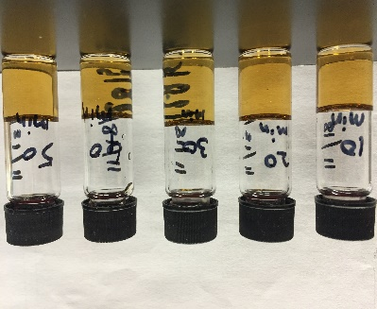
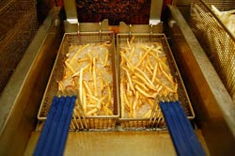

How it started
Biodiesel
Used oil & waste grease from restaurants
USF Engineering produces biodiesel
Community Integration
Input: Used oil & waste grease
Biodiesel powers BullRunners
Output: Fuel to the buses

Slide 4
Overview
Produce about 20,000 gallons per year B100 fuel to power Bull Runner buses on campus
Raw materials can be obtained from local resources
Successful preliminary tests for supercritical transesterification using soybean oil on a pilot scale basis
Scale up of technology for implementing on the university scale

Slide 5
What is Supercritical Transesterification?
Catalyst free transesterification using high temperature and high pressure
Process utilizes the high temperatures and pressures to weaken the alcohol O-H bonds
This decreases the alcohol polarity, solvating the triglycerides
Has several advantages over the conventional acid/base catalyzed transesterification process

Slide 6
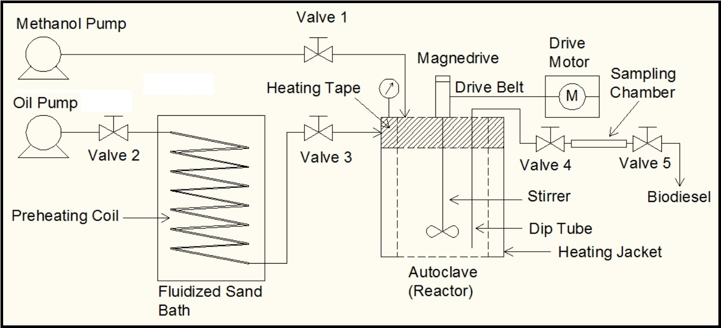
Experimental Setup

Slide 7
Experimental Work
Experiments to study yields at different temperature-molar ratio combinations
A 2² factorial design with center point replicates was implemented for the experiments
Products were sampled at 10 minute time intervals, up to 50 minutes reaction time
GC-MS based analytical technique to determine the methyl esters and their content in the sample

Slide 8
Experimental Results
Methyl ester yields up to 90% were achieved within 10 minutes reaction time at 325 °C and 43:1 methanol/oil molar ratio
Yields up to 97% were achieved for 50 minute reaction time at similar conditions
Yield saturation occurs as reaction progresses beyond 40 minutes

Slide 9
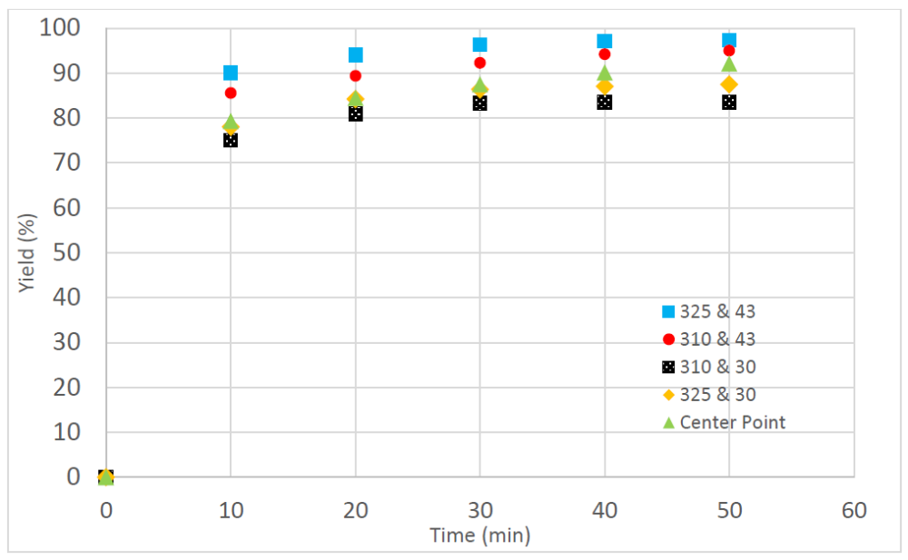
Yield vs Time Plots for Experiments

Slide 10
Surface Plots

Slide 11
Surface Plots

Slide 12
Conclusions
Successful experiments in a batch type reactor setting establish the potential of this technology
Supercritical transesterification with methanol can achieve yields of 90% within 10 minutes reaction time
Factorial design allowed us to determine the significant factors affecting the yield
Molar ratio was found to affect the yield more significantly than reaction temperature

Slide 13
Next Steps
Experiments with used cooking oil and mixed/recycled/waste alcohol
Scale up of technology and setup of a continuous supercritical transesterification process
Implement a self sustaining biodiesel production facility on the campus

