Slide 1
Genetic Engineering of D. radiodurans for uranium bioremediation from high radiation environment
Shree Kumar Apte
Molecular Biology Division
Bhabha Atomic Research Centre, Mumbai-400085, India
8th European Biotechnology Congress, Frankfurt, Germany
August 18, 2015

Slide 2
Uranium resources
Primary
High grade ore: 2% U (20,000 ppm)
Low grade ore: 0.1% U (1000 ppm)
[India : 0.03-0.06% U (300-600 ppm)]
Secondary
Rock phosphate: 100-200 ppm
Monazite: 50-200 ppm
Carbonaceous matter: 300 ppm
Uranium in spent fuel
Acidic waste
< 1mM uranyl nitrate, pH 3-7
Alkaline waste
< 1mM uranyl carbonate, pH 7-10
Uranium in sea water
3ppb / 13 nM, pH 7.5-7.8
Di-/Tetravalent uranyl carbonate complex,
[UO₂(CO₃ )₃] ²⁻/ [UO₂(CO₃)₃] ⁴⁻
Total U in sea water: 4.5 billion tonnes
(1000 X of terrestial ores)
Dilute solutions with 1- 4 mM uranium at pH 5-10 need to be addressed

Slide 3
Mechanism of metal precipitation by PhoN
HUO₂PO_{4 ↓}(insoluble and membrane bound)
Localised high concentration of Pi
UO₂²⁺ (soluble)
Outer membrane
Pi
Periplasm
PhoN
β-Phosphoglycerate
Inner membrane
Cytoplasm

Slide 4
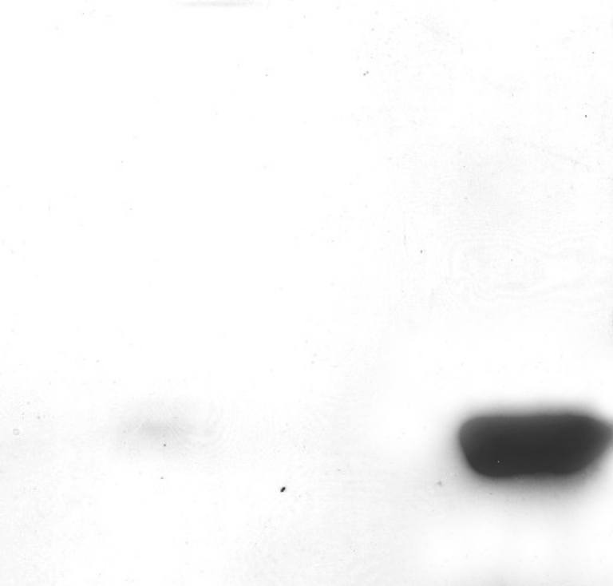
Engineering E. coli for PhoN Overexpression
Samonella phoN gene with its native promoter works well in E. coli
(Seetharam, Soundarajan, Udas, Rao and Apte, Proc. Biochem. 44: 246-250, 2009)
Over expression of PhoN
S.typhi E. coli Controls E.coli 5µg 50µg 5µg PhoN
5µg
Multicopy plasmid (pUC19) based PhoN overexpression

Slide 5
URANIUM BIO-PRECIPITATION with BACTERIA
>95% URANIUM (1mM) IS PRECIPITATED
FROM AQUEOUS SOLUTIONS BY GM
E.
coli
100
80
60
% Uranium precipitated
unbuffered
40
citrate buffer
20
acetate buffer
0
0
1
2
3
4
Time (hrs)
VIABLE CELLS ARE NOT NEEDED

Slide 6
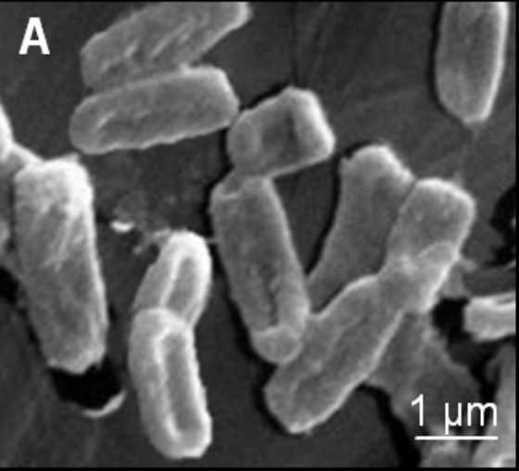
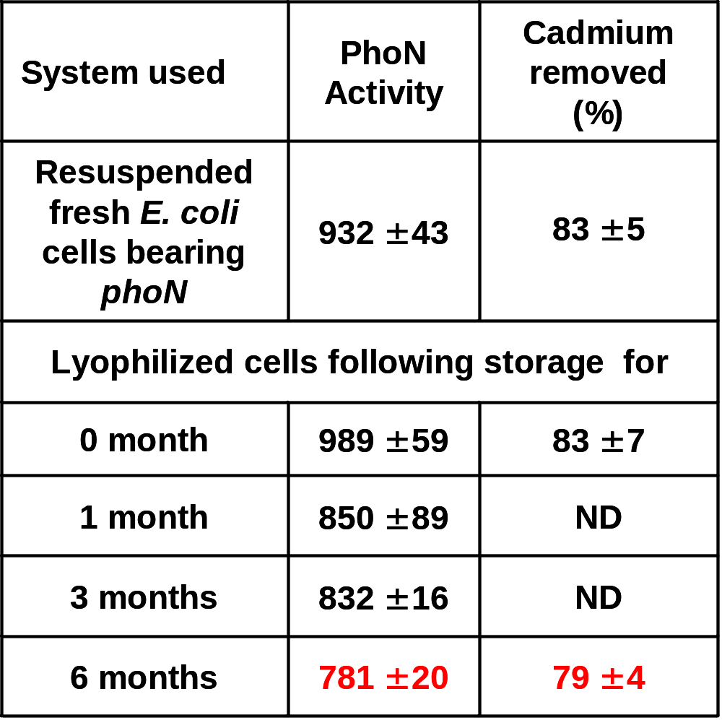
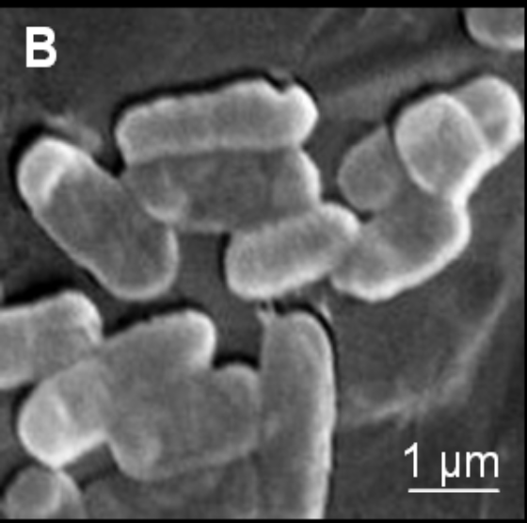
Post-lyophilisation Performance of E. coli bearing phoN
Cells retained their integrity and activities, but lost viability
Metal
(Seetharam, Soundarajan, Udas, Rao and Apte, Proc. Biochem. 44: 246-250, 2009)

Slide 7
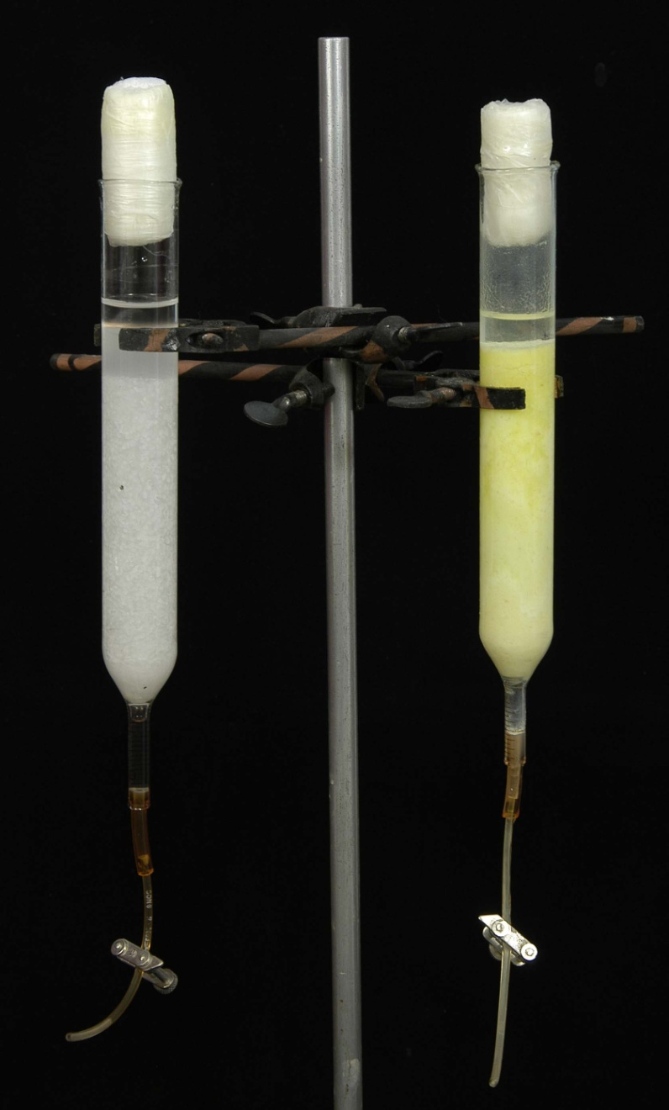
Column based uranium precipitation by E. coli-phoN clones
E. coli-pRAD1
E. coli-pPN1
INPUT SOLUTION
5 mM Uranyl Nitrate with10 mM β-glycerophosphate in 1.5 litres of 2 mM Acetate Buffer
COLUMN
200 mg of lyophilized cells immobilized in 15% polyacrylamide gel.
GEL VOLUME : 100 ml
Run time : 56 h
Total Loading on the column
7.6 g of U/g dry wt. of cells

Slide 8
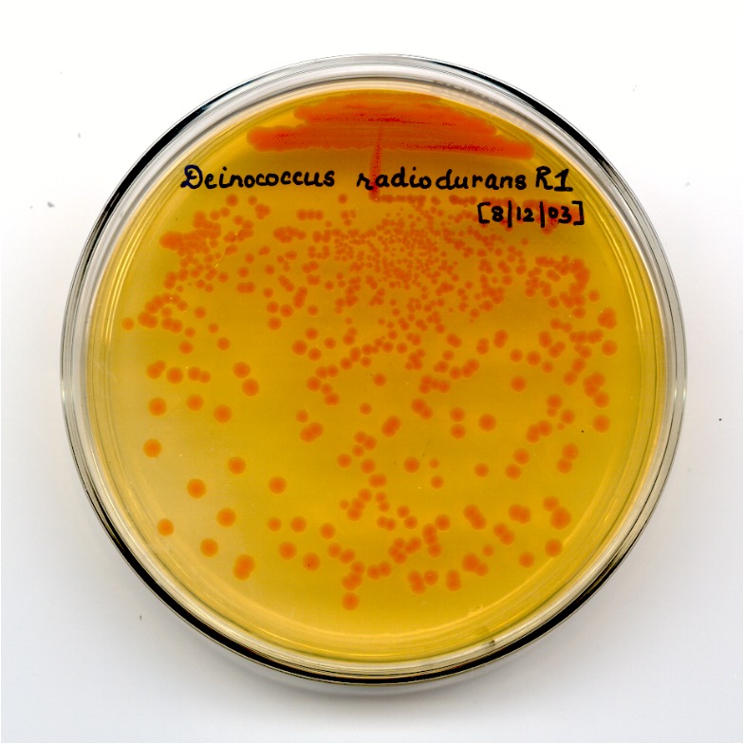
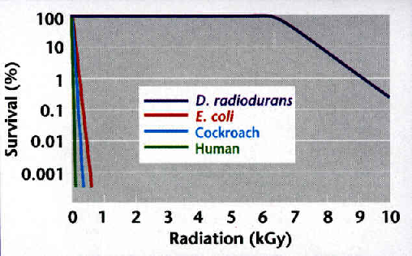
The Extreme Radioresistance of Deinococcus radiodurans
Provides opportunities for novel basic research and applications

Slide 9
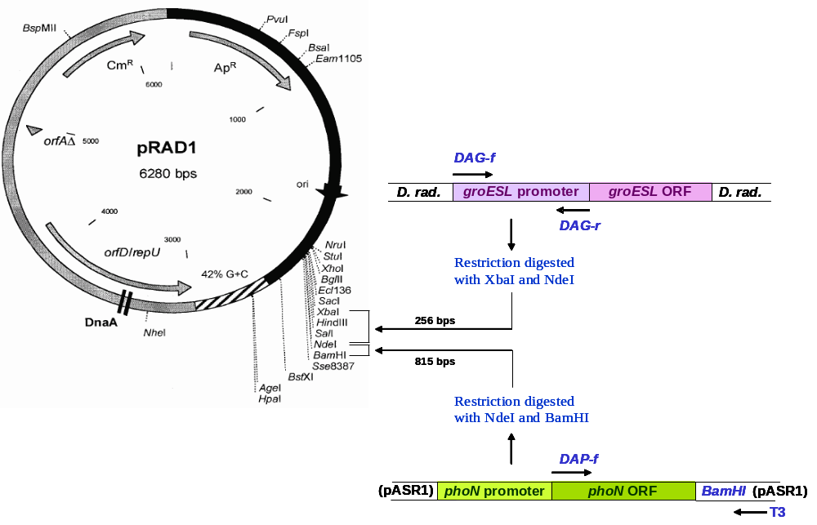
Engineering phoN in Deinococcus radiodurans
Restriction digested with XbaI and NdeI
Restriction digested with NdeI and BamHI
(Appukuttan , Rao & Apte, Appl. Env. Microbiol. 72: 7873-7878, 2006)

Slide 10
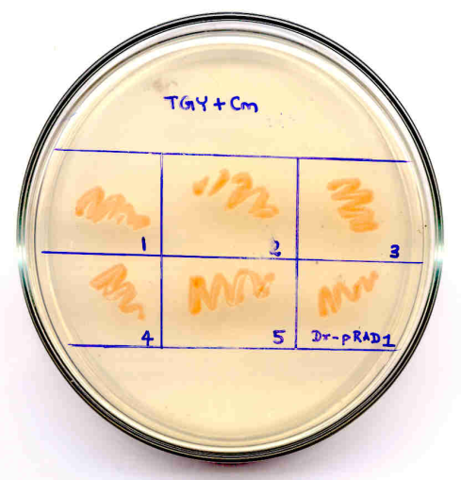
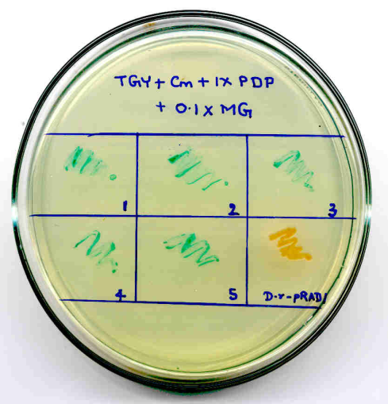
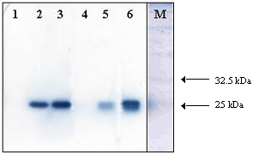
Genetic engineering of phoN gene into D. radiodurans
Deinococcus radiodurans
Wild type Engineered
1 - E. coli - pRAD1
2 - E. coli - groESL+phoN (GN)
3 - E. coli - full phoN (CL#50)
4 - D. rad - pRAD1
5 - D. rad - full phoN (CL#29)
6 - D. rad - groESL+phoN (DN)
(Appukuttan , Rao & Apte, Appl. Env. Microbiol. 72: 7873-7878, 2006)

Slide 11
Uranium precipitation by E. coli and Deinococcus clones under 6kGy dose of irradiation
100
E. coli (c)
D. radiodurans (c)
D. radiodurans (i)
80
60
% Uranium precipitated
40
20
E. coli (i)
0
0
2
4
6
8
10
Time (h)
(Appukuttan, Rao & Apte, Appl. Env. Microbiol. 72: 7873-7878, 2006)

Slide 12
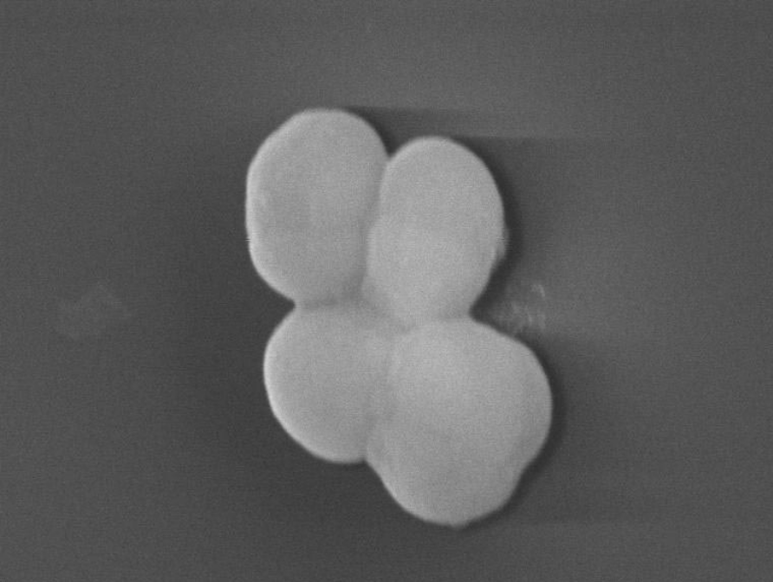
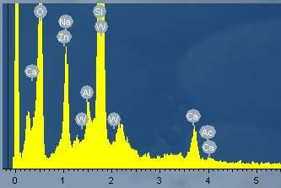
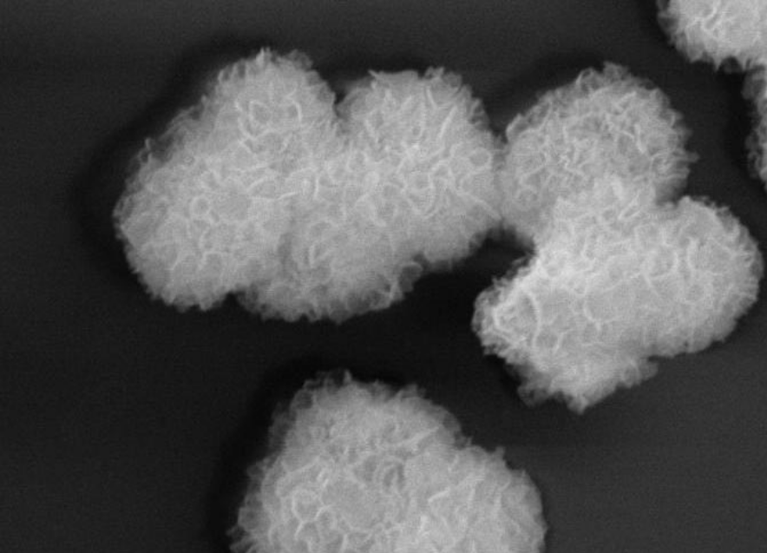
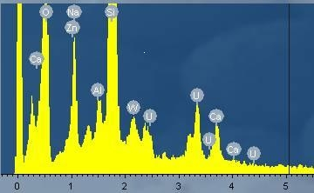
Cell-surface bound uranyl phosphate precipitate (SEM)

Slide 13
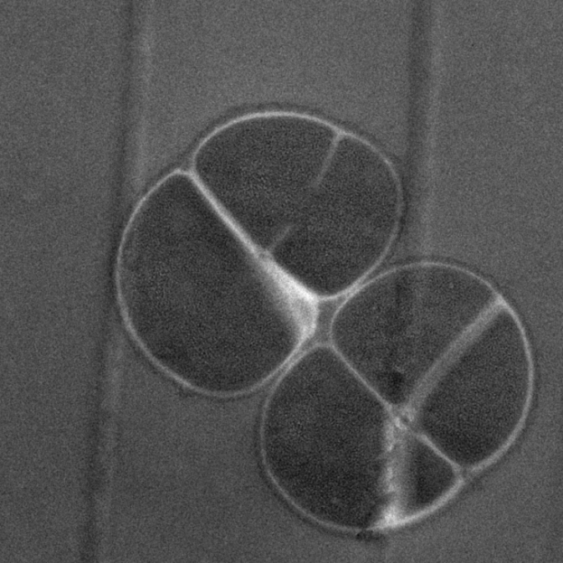
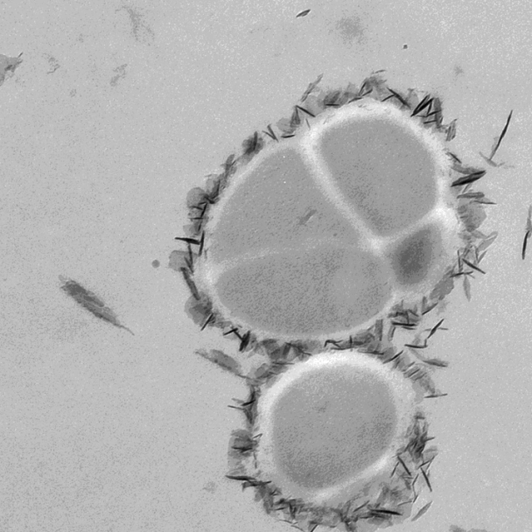
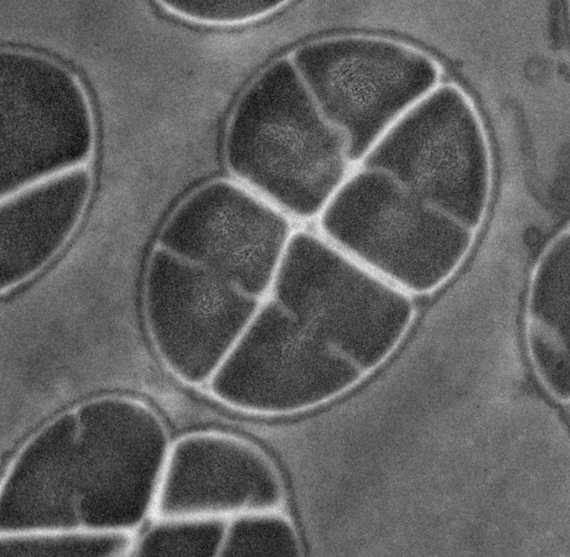
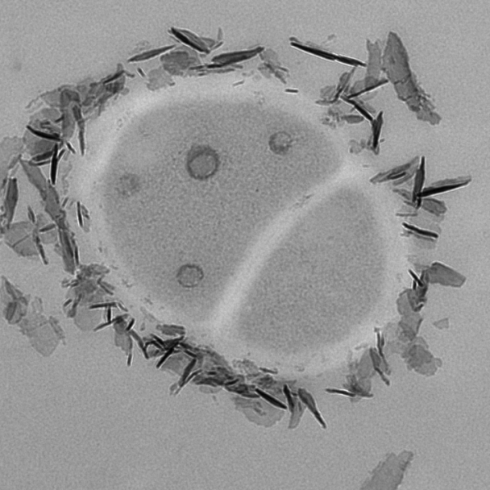
Seeing is believing …………….
Cell-surface bound uranyl phosphate precipitate (TEM)

Slide 14
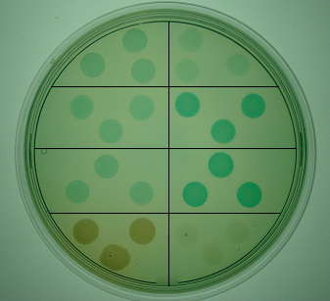
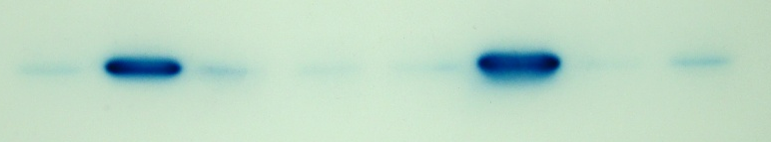
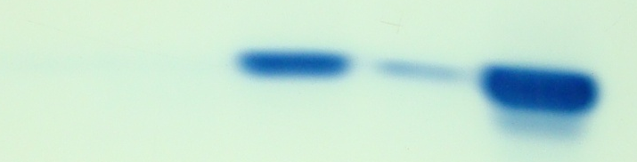
A Radiation responsive Deinococcal Promoter (P_{ssb})
rpsF 18
rpsF 6 ssb
-102bp
phoN
pSN2
-132bp
pSN3
-351bp
pSN4
RDRM2 RDRM 1
pRN1
C
S
γ-ray
7 kGy
H₂O₂
50 mM
Mito-C
20 µg ml⁻¹
UV
5 kJ m⁻²
pSN2
C S C S C S C S
pSN3
pSN4
pSN2
pSN3
pSN4
C T C T C T
pRN1
⁶⁰Co, γ-ray (7 kGy)
⁶⁰Co, γ-ray (7 kGy)
(Ujaoney, Potnis, Dani, Mukhopadhyay & Apte, J.Bacteriol., 2011)

Slide 15
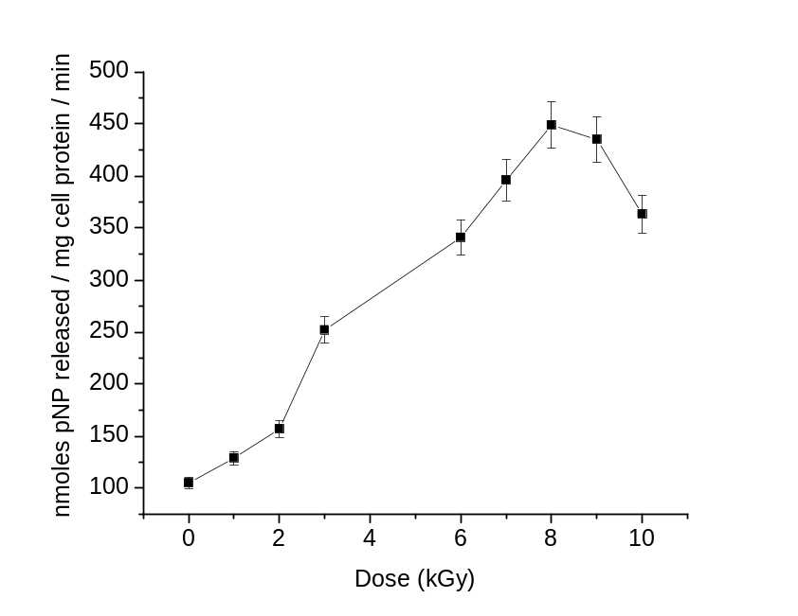
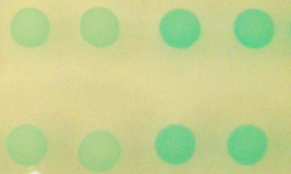
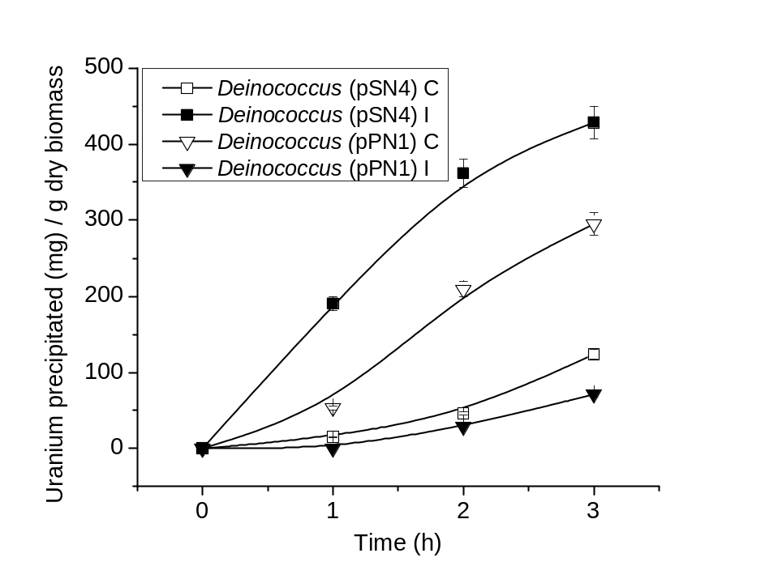
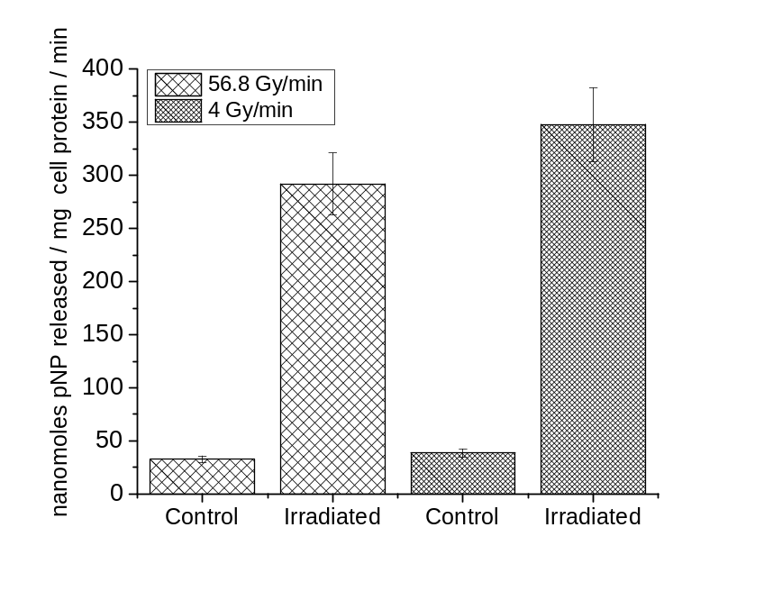
Use of radiation-induced P_{ssb} promoter for U bioprecipitation
(a)
(b)
Control Irradiated
4 Gy/min
56.8 Gy/min
(c)
(d)

Slide 16
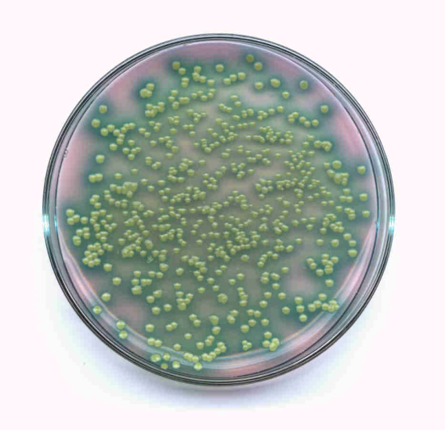
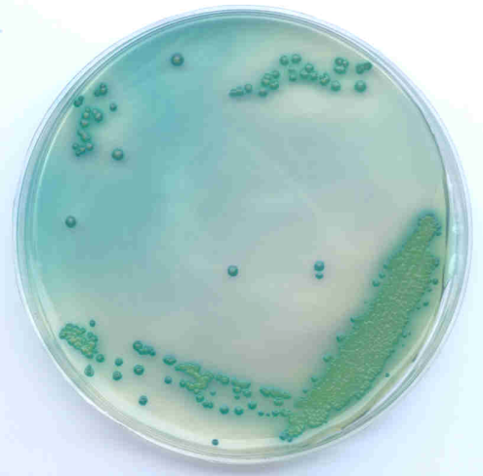
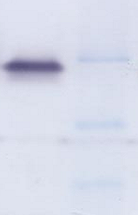
An Alkaline Phosphatase Over-producer Bacterial Isolate
Genetic Basis of this Enzyme Activity was investigated and cloned
9
10
8
175kDa
6
nmoles p-NP/min
4
5
2
0
0
1
2
3
4
5
6
7
8
9
10
11
12
pH
pH optima for acid and alkaline phosphatase
of Novosphingobium sp. BSAR-1
Zymogram for alkaline
phosphatase analysis
(Nilgiriwala, Alahari, Rao and Apte, Appl. Env. Microbiol. 74: 5516-5523, 2008)

Slide 17
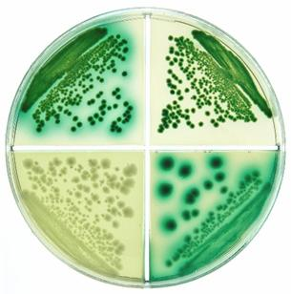
Phenotype of various native and recombinant PhoK expressing strains
BSAR-1
KN20
EK4 + IPTG
EK4 - IPTG
(Nilgiriwala, Alahari, Rao and Apte, Appl. Env. Microbiol. 74: 5516-5523, 2008)

Slide 18
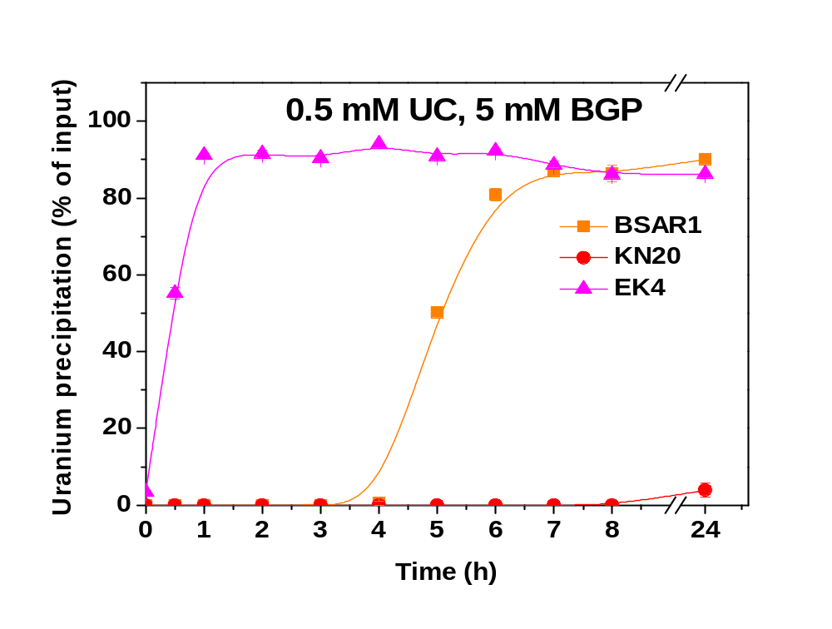
Uranium bioprecipitation at pH 9.0 using PhoK
(Nilgiriwala, Alahari, Rao and Apte, Appl. Env. Microbiol. 74: 5516-5523, 2008)

Slide 19
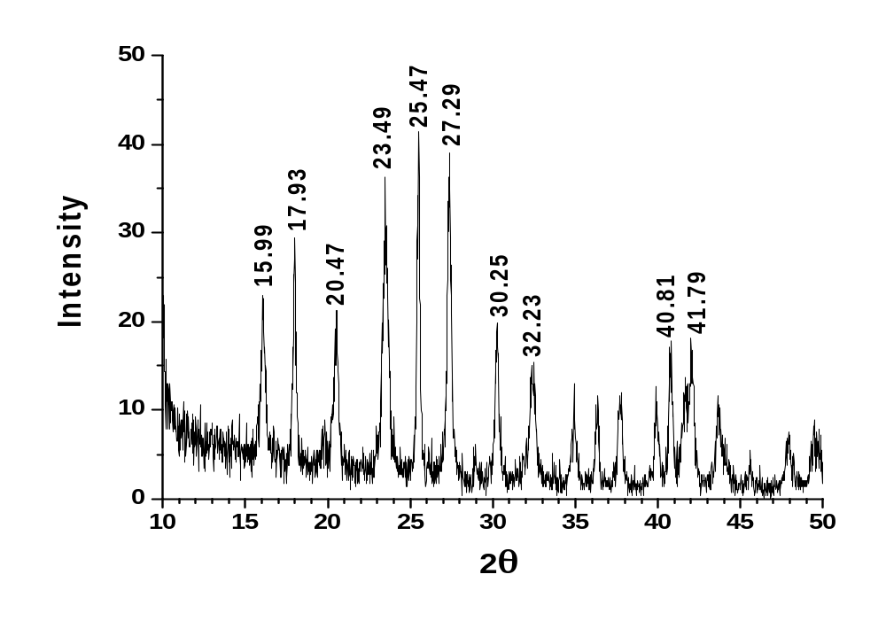
Precipitate identified as H₂(UO₂)₂(PO₄)₂.8H₂O, metaautunite or chernikovite by Powder-XRD analysis
(Nilgiriwala, Alahari, Rao and Apte, Appl. Env. Microbiol. 74: 5516-5523, 2008)

Slide 20
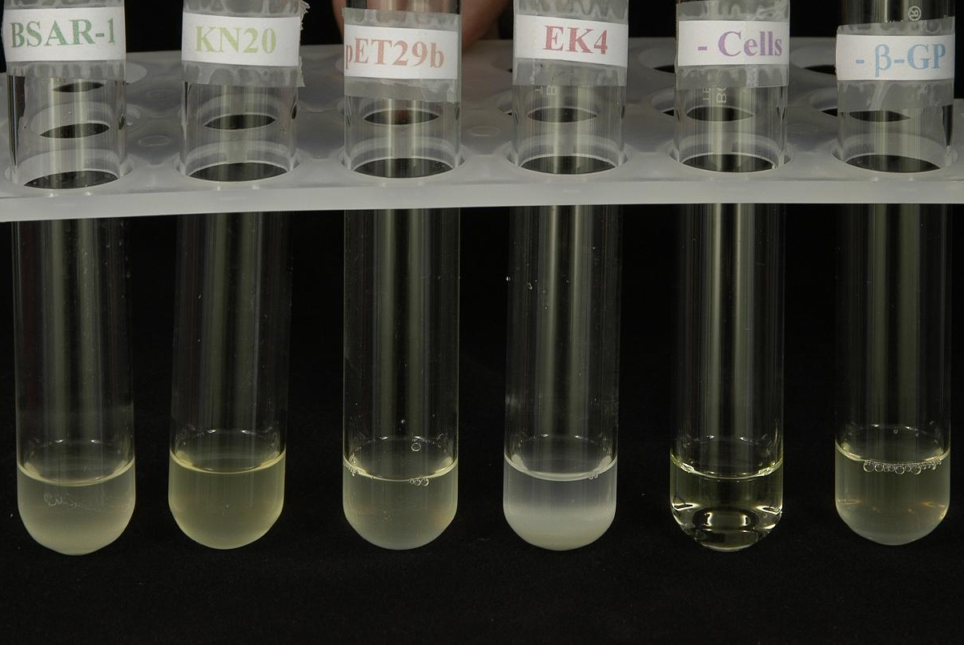
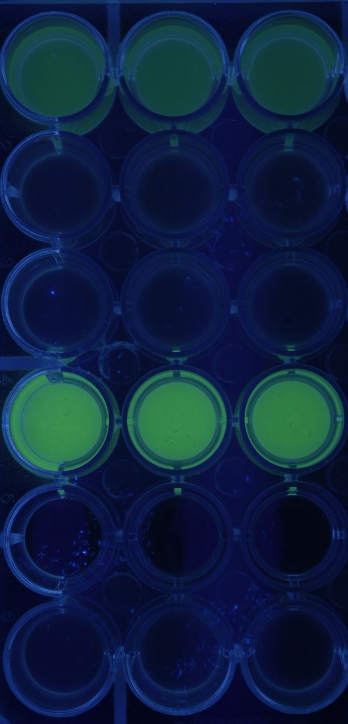
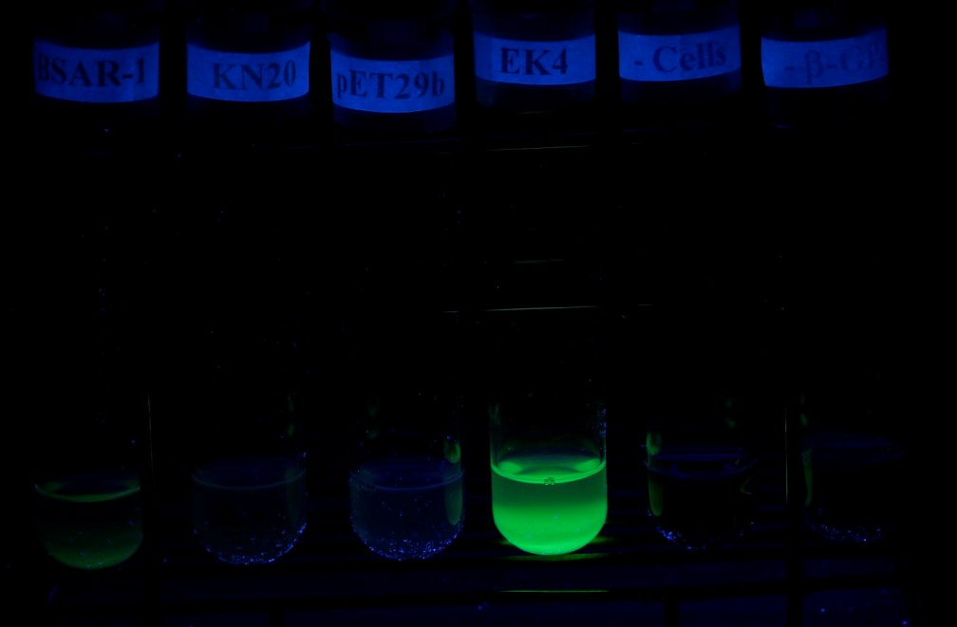
Uranium precipitation at pH 9.0 using PhoK alkaline phosphatase
BSAR-1
White light
KN20
pET29b
EK4
- cells
- βGP
UV light

Slide 21
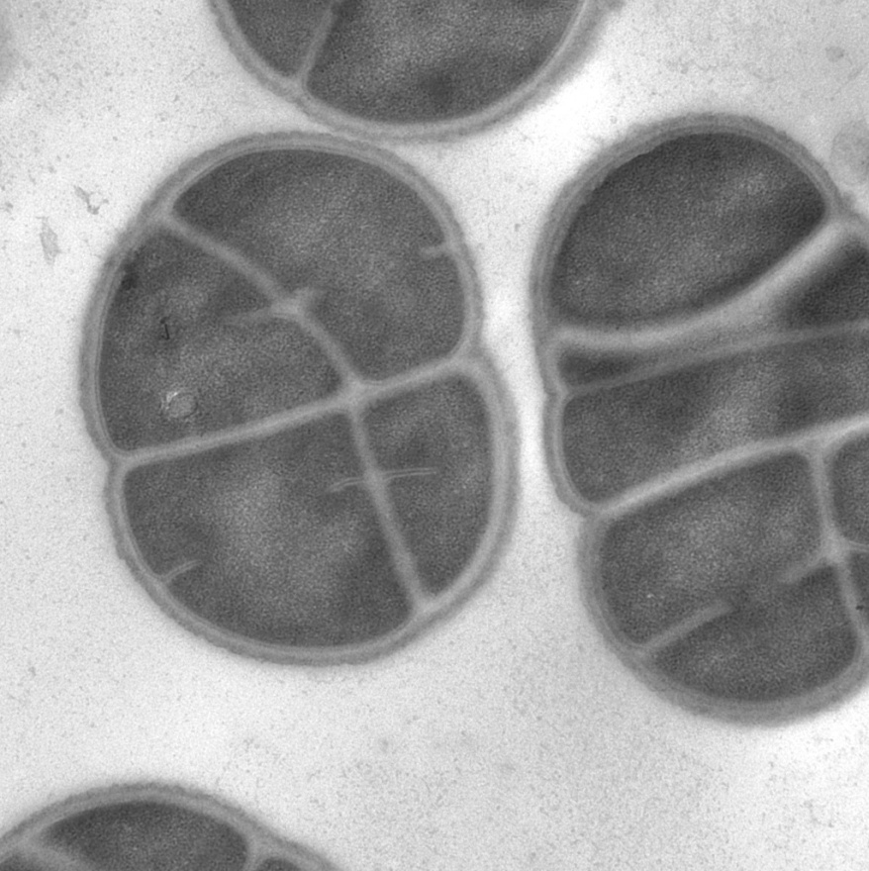
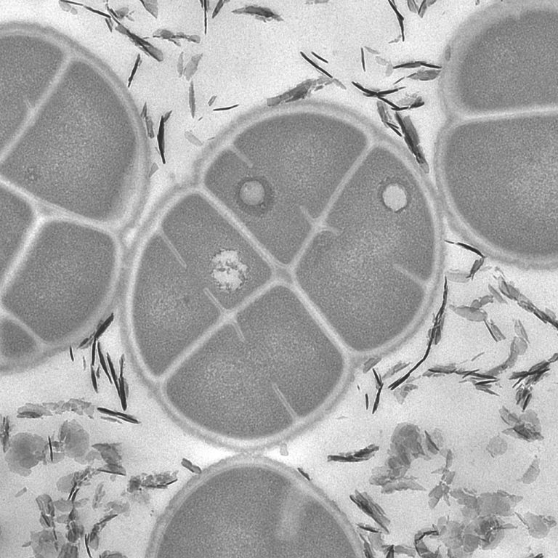
Seeing is believing …….
TEM images of Deino-PhoK cells
500 nm
500 nm
Deino-PhoK without uranium treatment
Deino-PhoK with uranium treatment
Needle shaped crystals of uranyl phosphate seen in uranium treated samples

Slide 22
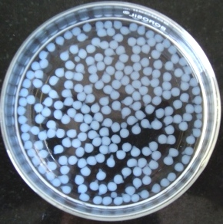
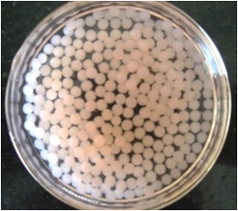
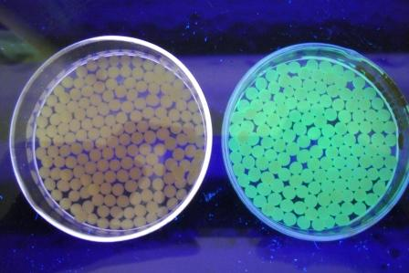
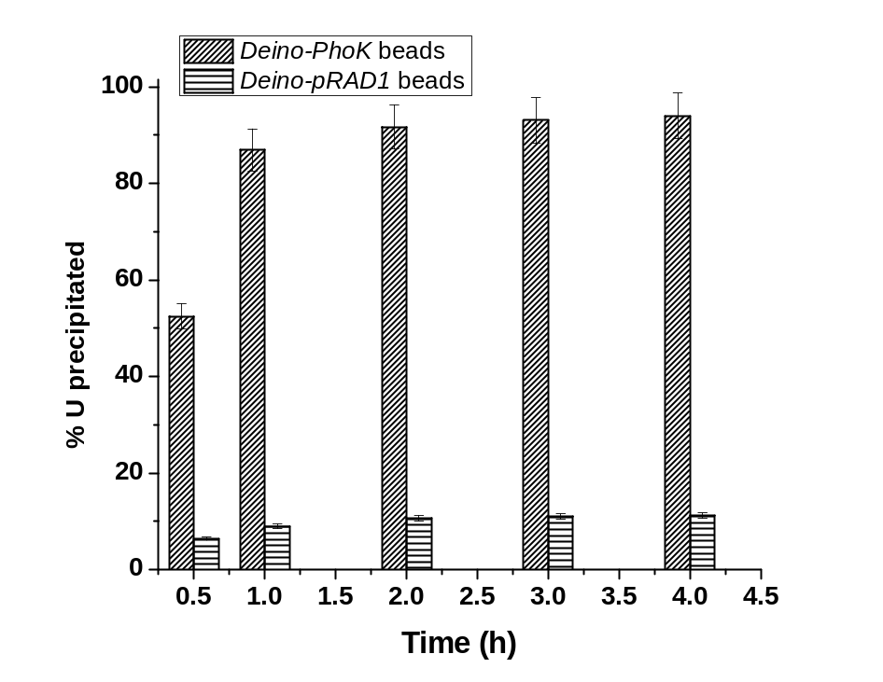
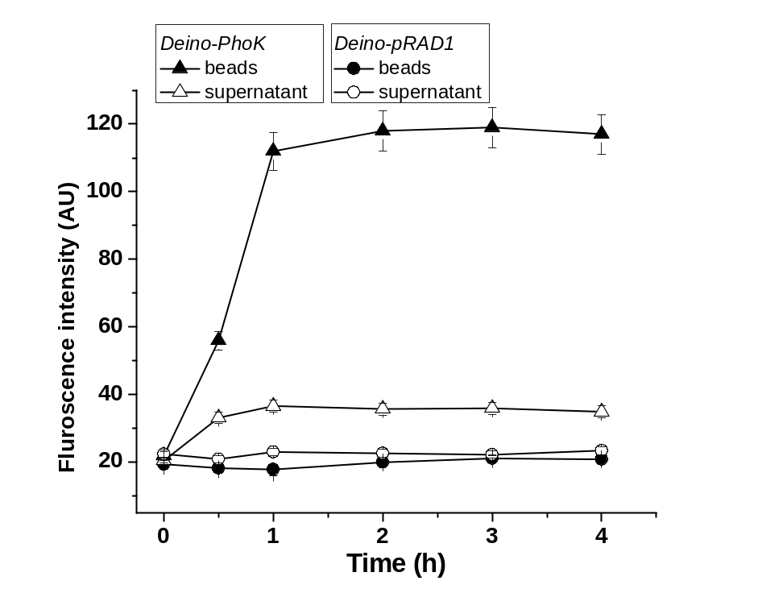
Easy recovery of precipitated uranyl phosphate through beads
A
B
C
Empty beads Deino-PhoK (-U) Deino-PhoK (+U)
D
E

Slide 23
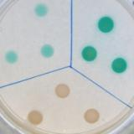
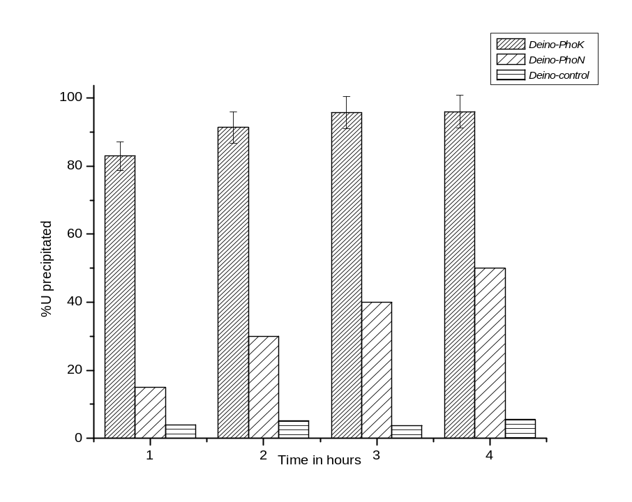
Comparison of Deino-PhoN and Deino-PhoK strains
Recombinant Deinococcus strains on PDP-MG plate
Phosphatase activity of recombinant strains
Clones | Specific Activity (nmoles of p-NP liberated/min/mg of total cellular protein)
Deino- pRAD1 | 18 + 5
Deino-PhoK | 7000 + 1000
Deino-PhoN | 200 + 10
1 Deino-pRAD1
2 Deino-PhoK
3 Deino-PhoN

Slide 24
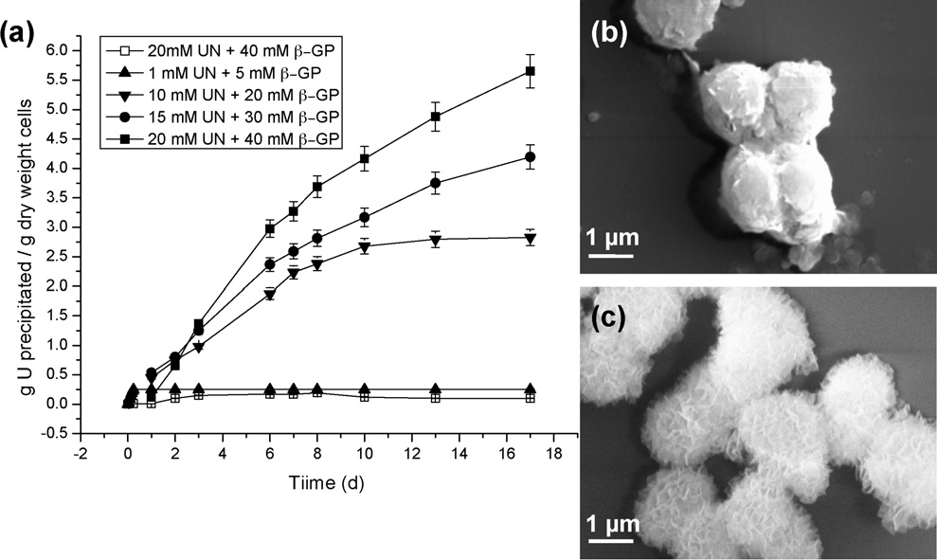
Maximum loading possible with Deino-PhoN

Slide 25
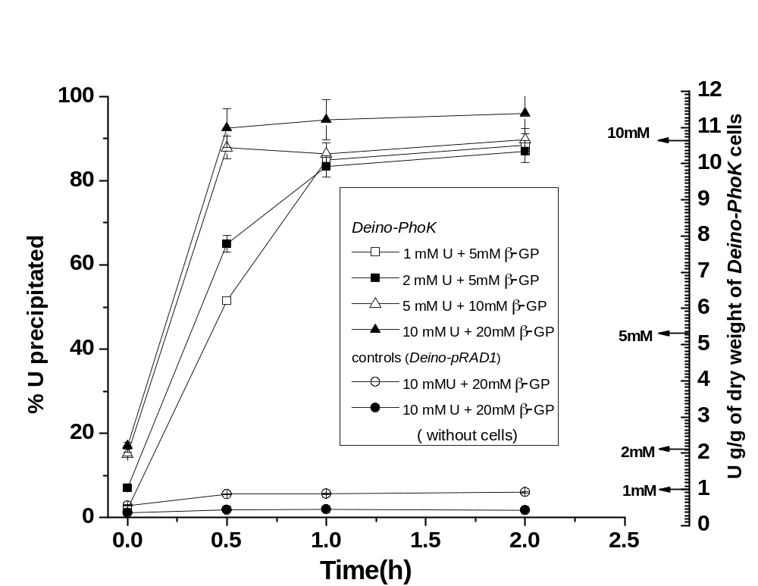
Maximum loading possible with Deino-PhoK

Slide 26
SUMMARY
Metal precipitation using phosphatases is an old story.
Novelty of the present work :
  Use of heavy metal tolerant enzymes
  Cloning/characterization of a very active alkaline phosphatase (PhoK)
  Extension of metal bioremediation to alkaline solutions
  Recombinant radioresistant microbes to biorecover uranium from
  acidic/alkaline solutions in high radiation environments.
  Lyophilization to extend shelf-life while retaining precipitation ability
  Volume reduction, high U loading, easy recovery

Slide 27
Related Publications
Appukuttan, D, Rao, A. S. and Apte, S. K. (2006) Appl. Env. Microbiol. 72 : 7873-7878.
Nilgiriwala, K., Alahari, A., Rao, A. S. and Apte, S. K. (2008) Appl. Env. Microbiol. 1784 : 1256-1264.
Seetharam, C., Soundarajan, S., Udas, A. C., Rao, A. S. and Apte, S. K. (2009) Proc. Biochem. 44 : 246- 250.
Nilgiriwala, K., Bihani, S C., Das, A., Prashar, V., Kumar, M., Ferrer, J-L, Apte, S. K. and Hosur, M. V. (2009) Acta Cryst. F65 : 917-919.
Ujaoney, A. K., Potnis, A., Mukhopadhyay, R. and Apte, S. K. (2010) J. Bacteriol. 192 : 5637-5644.
Bihani, S., Das, A., Nilgiriwala, K., Prashar, V., Pirocchi, M., Apte, S. K., Ferrer, J. and Hosur, M. V. (2011) PLoS ONE 6 : e22767.
Appukuttan, D., Seetharam, C., Padma, N., Rao, A. S. and Apte, S. K. (2011) J. Biotechnol. 154 : 285- 290.
Seetharam-Misra C., Appukuttan D., Kantamreddi V. S. S., Rao A. S. and Apte S. K. (2012) Bioengineered Bugs 3 : 44-48.
Kulkarni, S., Ballal, A. and Apte, S. K. (2013) J. Hazard. Metals 262 : 853-861.
Misra, C.S., Mukhopadhyaya, R. and Apte, S. K. (2014) J. Biotechnol. 189 : 88–93.

Slide 28
ACKNOWLEDGEMENTS
Deinococcus radiodurans strain R1 M. Daly & K. Minton Useful Vectors Mary Lidstrom
PhoN for U/Cd bioprecipitation Deepti Appukuttan, Chitra Seetharam & A.S. Rao
PhoK for U bioprecipitatio Kayzad Nilgiriwala, Anuradha Alahari & A. S. Rao,
Sayali Kulkarni,
SEM-EDX Shovit Bhattacharya & N. Padma (TPPED, BARC)
TEM Anand Ballal, Alka Gupta
ICP-MS Sanjukta A. Kumar (ACD, BARC)
AAS A.C. Udas & Suvarna Soundarajan (ACD, BARC)
XRD Analysis N. Raghumani & Rakesh Shukla (CD, BARC)
Funding : Department of Atomic Energy and Department of Science & technology, India

Slide 29
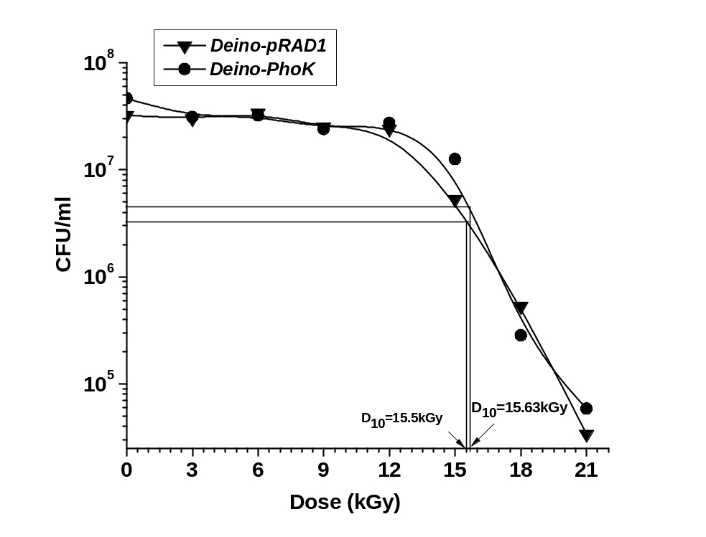
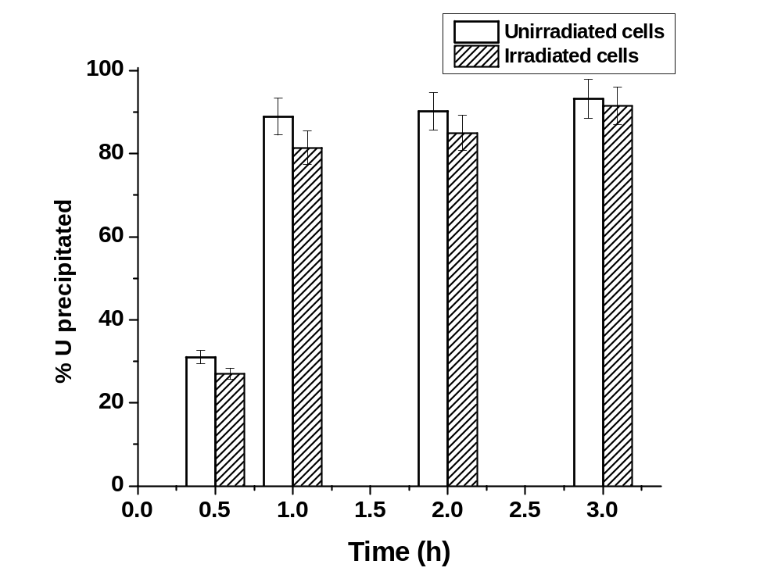
Recombinant strain functions well in high radiation environment
A
B
Addition of PhoK does not compromise or alter radioresistance
Irradiation (6 kGy, ⁶⁰Co -rays) does not influence bioprecipitation

