Slide 1
About Omics Group
OMICS Group International through its Open Access Initiative is committed to make genuine and reliable contributions to the scientific community. OMICS Group hosts over 400 leading-edge peer reviewed Open Access Journals and organize over 300 International Conferences annually all over the world. OMICS Publishing Group journals have over 3 million readers and the fame and success of the same can be attributed to the strong editorial board which contains over 30000 eminent personalities that ensure a rapid, quality and quick review process.

Slide 2
About Omics Group conferences
OMICS Group signed an agreement with more than 1000 International Societies to make healthcare information Open Access. OMICS Group Conferences make the perfect platform for global networking as it brings together renowned speakers and scientists across the globe to a most exciting and memorable scientific event filled with much enlightening interactive sessions, world class exhibitions and poster presentations
Omics group has organised 500 conferences, workshops and national symposium across the major cities including SanFrancisco,Omaha,Orlado,Rayleigh,SantaClara,Chicago,Philadelphia,Unitedkingdom,Baltimore,SanAntanio,Dubai,Hyderabad,Bangaluru and Mumbai.

Slide 3
LASERS
AND
OPTICS
IN
CLINICAL UROLOGY

Slide 4
PROF. SHIVADEO S. BAPAT
MS, FRCS, FRCSE
MAHARASHTRA MEDICAL FOUNDATION’S
RATNA MEMORIAL HOSPITAL
PUNE – 411036 – INDIA

Slide 5
UROLOGY IS A BRANCH OF SURGERY
WITH THE ADVENT OF NEWER INSTRUMENTS AND BETTER UNDERSTANDING OF THE HUMAN BODY FUNCTIONS, UROLOGY HAS MADE TREMENDOUS PROGRESS AS AN INDEPENDENT SPECIALTY
MAJORITY OF UROLOGICAL SURGERIES ARE BEING UNDERTAKEN ENDOSCOPICALLY & ARE CLASSIFIED AS “MINIMALLY INVASIVE SURGERIES”

Slide 6
THIS PRESENTATION IS A TRIBUTE TO YOU ALL
“THE FACULTY OF ALL PHYSICISTS, BASIC RESEARCHERS & ENGINEERS”
WHO ARE CONSTANTLY DEVELOPING NEWER MATERIALS & EQUIPMENTS.
WITH THESE EQUIPMENTS, WE, THE MEDICAL PERSONNEL ARE OFFERING TREATMENT MODALITIES THAT ARE
SAFER AND LESS PAINFUL TO THE HUMANITY
&
ULTIMATELY, WE TAKE THE CREDIT

Slide 7
I WILL BE MAINLY DISCUSSING THE USE OF LASERS & OPTICS:
WHAT WE HAVE
&
WHAT WE WOULD
PREFER TO HAVE
IN THE DAY TO DAY UROLOGICAL PRACTICE

Slide 8
LASERS
FOUR TYPES OF LASERS ARE BEING USED IN UROLOGY
ND: YAG LASER
KTP (LBO) - GREEN LIGHT LASER
THULIUM LASERS (YAG & FIBER)
HOLMIUM: YAG LASER

Slide 9
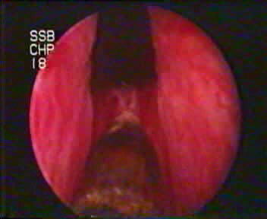
ND: YAG LASER
NO IMMEDIATE SURGICAL EFFECT
DEPTH OF TISSUE DAMAGE UP TO 10 MM
EXCELLENT COAGULATION
NO CUTTING
NO EFFECT ON STONES
NOT POPULAR IN UROLOGY AT ALL

Slide 10
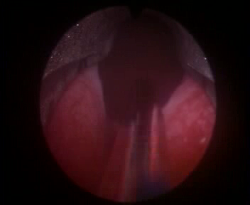
KTP (LBO) - GREEN LIGHT LASER
VAPORIZATION OF RED TISSUE ONLY
ONLY APPLICATION IS FOR BPH
NO TISSUE FOR HISTOLOGICAL EXAMINATION
NO EFFECT ON STONE
SINGLE ORGAN CONFINED USAGE
HIGH RECURRENT EXPENSES FOR SINGLE USE SIDE FIRING FIBER

Slide 11
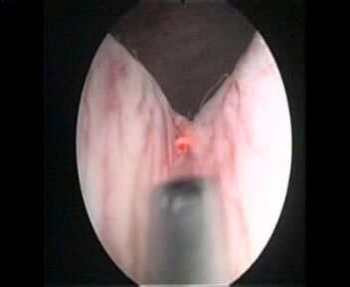
THULIUM YAG LASER
EXCELLENT CUTTING & COAGULATION
NO VIBRATIONS @ THE TIP – BETTER CONTROL
GOOD FOR ALL SOFT TISSUE CUTTING
SOME DEGREE OF CHARRING OF THE TISSUE
WIDELY USED IN UROLOGY
VERY LIMITED EFFECT ON SOFT STONES

Slide 12
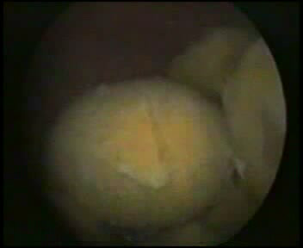
HOLMIUM LASER
BEST FOR STONE FRAGMENTATION - OF ALL TYPES
GOOD CUTTING & COAGULATION UNDER IRRIGATION
PULSED LASER -VIBRATIONS @ THE TIP – NEEDS GOOD STABILIZATION @ THE TIP
MULTI DISCIPLINARY USAGE
AS OF TODAY – MOST POPULAR LASER IN UROLOGY

Slide 13
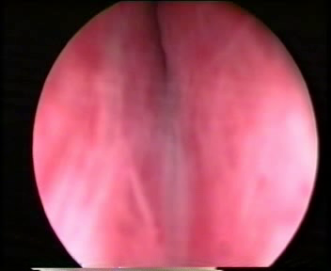
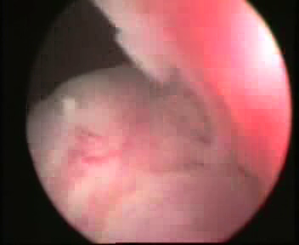
HOLMIUM CLIPS

Slide 14
HOLMIUM LASER
IN A DEVELOPING COUNTRY IT IS VERY IMPORTANT TO HAVE ONE LASER WHICH WILL BE USEFUL FOR SOFT TISSUE CUTTING + COAGULATION & BE USEFUL FOR CRUSHING ALL TYPES OF STONES
HOLMIUM LASER SERVES BOTH THE REQUIREMENTS
HENCE IT IS VERY POPULAR

Slide 15
HOLMIUM LASER
HOLMIUM LASER IS A PULSED LASER
HENCE THERE ARE CONSIDERABLE VIBRATONS AT THE TIP OF THE FIBER
TISSUES SPLIT WITH THE CONTACT OF HOLMIUM LASER ENERGY (MECHANICAL EFFECT OF STEAM BUBBLE)
LASER DELIVERY FIBER NEEDS TO BE STABILIZED ALMOST TILL THE TIP OF THE LASER

Slide 16
LASER: OUR WISH LIST
A SINGLE LASER MACHINE WITH
ADJUSTABLE WAVELENGTH
APPLICATION SPECIFIC SETTINGS
LASER WAVELENGTH CAN BE DECIDED BY THE SURGEON:
Eg: VAPORIZATION / CUT / COAGULATE / FRAGMENT STONES / BONE ABLATION, TISSUE TYPE & DEPTH OF PENETRATION

Slide 17
LASER: OUR WISH LIST
SURGEON WILL INITIALLY SET THE PARAMETERS AS PER HIS NEEDS ON THE DISPLAY
THE IDEAL WAVELENGTH WILL THEN BE FLASHED ON THE SCREEN
SURGEON WILL SELECT THE REQUIRED WAVELENGTH & STARTS SURGERY
IT SHOULD BE POSSIBLE TO DELIVER THE LASER ENERGY THROUGH A FLEXIBLE GLASS FIBER

Slide 18
OPTICS
PROF. HAROLD HOPKINS (UK) REVOLUTIONIZED ALL THE UROLOGICAL ENDOSCOPES BY INTRODUCING ROD LENSES (1966)
QUALITY OF VISION WAS SUPERB
THIS FACILITATED ENDOPHOTOGRAPHY & FILMING DUE TO THE INCORPORATION OF BRIGHT & COLD FIBER LIGHT

Slide 19
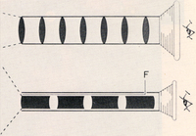
DESIGN OF ROD LENS
CONVENTIONAL
ROD

Slide 20
OPTICS
NEXT STEP WAS TO PRODUCE TELESCOPES OF DIFFERENT SIZES AND LENGTHS
BUT THERE WAS LIMITATION FOR PRODUCTION OF THINNER & LONGER TELESCOPES LIKE LONG & SLENDER URETEROSCOPES
LONG & THIN SCOPES PRODUCED HALF MOONING EFFECT ON BENDING

Slide 21
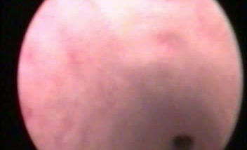
OPTICS

Slide 22
GLASS BUNDLE IMAGING
A QUARTZ GLASS FIBER AFTER PROPER CLADDING IS CAPABLE OF TRANSMITTING LIGHT FROM ITS ONE END TO THE OTHER END
DURING THE LIGHT TRANSMISSION THERE IS NO ATTENUATION OF LIGHT
IN ADDITION MINIMAL HEAT IS TRANSMITTED – THUS AT THE OTHER OR “OBJECTIVE” END WE GET MINIMAL HEAT: HENCE IT IS CALLED AS “COLD LIGHT”

Slide 23
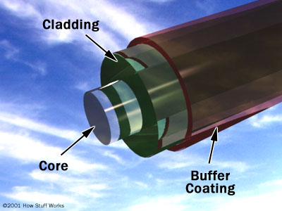
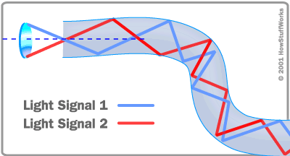
FIBER LIGHT & OPTICS PRINCIPLE

Slide 24
OPTICS
NEXT LOGICAL STEP WAS TO ARRANGE THE GLASS FIBERS IN A COHERENT FASHION & USE THEM AS VISION BUNDLE
ANOTHER PARALLEL INCOHERENT GLASS BUNDLE IS USED AS THE LIGHT CARRIER
BY INCORPORATING THE ABOVE COMBINATION, SLENDER SEMI RIGID & FLEXIBLE TELESCOPES WERE SUCCESFULLY PRODUCED

Slide 25

FIBER LIGHT INCOHERENT BUNDLE

Slide 26

“COHERENT” IMAGE GUIDES

Slide 27
OPTICS
LONG AND SLENDER SEMI-RIGID TELESCOPES (URETEROSCOPES) ARE QUITE DURABLE AND ARE IN EXTENSIVE USE.
THESE FORM A PART OF BASIC ARMAMENTARIUM THAT ANY UROLOGIST SHOULD HAVE IN HIS INVENTORY OF EQUIPMENT

Slide 28
OPTICS
‘CHIP ON THE TIP’ WAS THE NEXT ADVANCEMENT
VISUAL QUALITY IS OF HIGHEST ORDER IN COMPARISON WITH THE SEMI-RIGID & FLEXIBLE FIBER TELESCOPES
WITH EACH REFINEMENT AND MINIATURIZATION, ENDOSCOPIC EQUIPMENTS ARE GETTING MORE DELICATE & EXPENSIVE

Slide 29
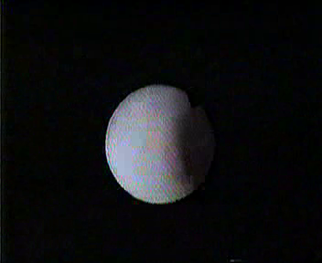
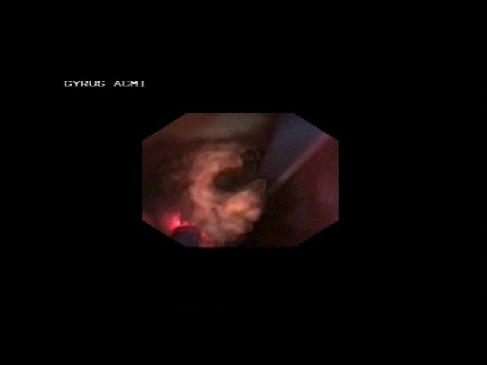
OPTICS

Slide 30
OPTICS
OPTICS HAVE REACHED A VERY HIGH DEGREE OF PERFECTION
RIGID AND SEMI-RIGID SCOPES ARE STURDY AND LONG LASTING
MAIN PROBLEM IS WITH THE FLEXIBLE SCOPES.

Slide 31
OPTICS
WHEN THESE INSTRUMENTS ARE DAMAGED, THEY CAN’T BE REPAIRED
EXISTING COMPANIES NORMALLY FOLLOW THE POLICY OF ‘REPAIR EXCHANGE’
DAMAGED EQUIPMENT IS REPLACED BY A NEW ONE

Slide 32
OPTICS
BREAKAGE OF THE WIRES WHICH PRODUCE DEFLECTION IN THE TERMINAL SEGMENT - DUE TO EXCESSIVE USAGE AND PRESSURE APPLIED
DAMAGE OF THE VISION AND LIGHT CARRYING BUNDLES - DUE TO ACCIDENTAL FIRING OF LASER ENERGY WITHIN THE SHEATH OR CLOSE TO THE TIP LENS

Slide 33
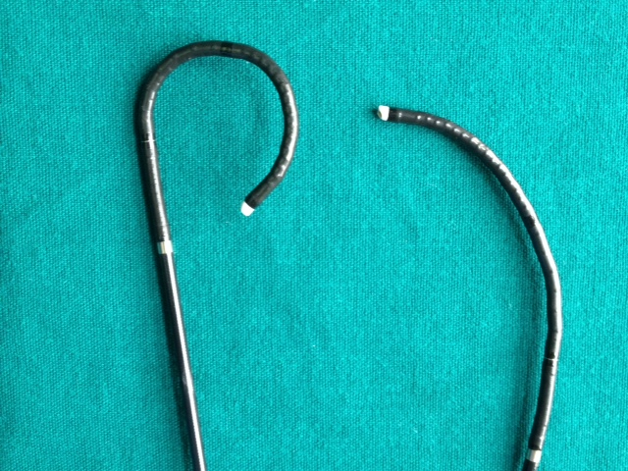
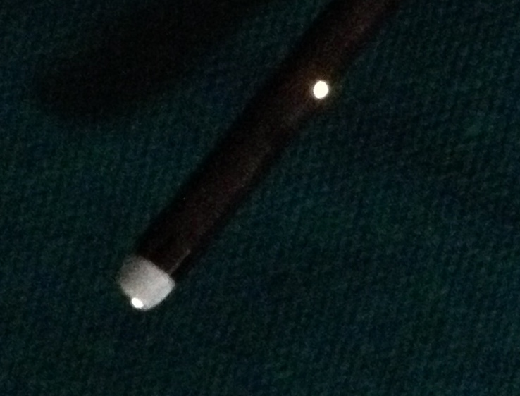
OPTICS

Slide 34
OPTICS: OUR WISH LIST
IS IT POSSIBLE TO INCORPORATE THIN BUT VERY STRONG WIRES FOR DEFLECTION PURPOSES ?
IS IT POSSIBLE TO INCORPORATE LASER RESISTANT MATERIAL IN MANUFACTURE OF THE WORKING CHANNEL IN THE SHEATH, THROUGH WHICH LASER FIBER IS INSERTED ?

Slide 35
FUTURE PROSPECTS
ALL THE LATEST INVENTIONS & MATERIALS ARE USED TO MANUFACTURE NEWER, BETTER & SAFER EQUIPMENTS
ULTIMATELY THE END USERS,THE ‘MEDICAL PROFESSIONALS’ ARE TO BE CONVINCED TO USE THESE EQUIPMENTS

Slide 36
THUS THE END RESULT OF ALL THE COMBINED EFFORTS, BY YOU AND US,
WILL BE
SAFER AND LESS PAINFUL SURGERIES
&
A MORE HAPPIER PATIENT COMMUNITY

Slide 37
THANK YOU

Slide 38
Let Us Meet Again
We welcome all to our future group conferences of Omics group international
Please visit:
www.omicsgroup.com
www.Conferenceseries.com
http://optics.conferenceseries.com/

