Slide 1




Satellite 2015
Comparison Analysis of Global Horizontal Irradiance between Korea Institute of Energy Research and NASA
Shin-Young Kim
Korea Institute of Energy Research (KIER)
Korea University
2015. 8. 17.
Notes:
I am Shin-Young Kim, came from Daejeon, Korea.

Slide 2


1
1
Introduction
• Research Objectives
• Definition of Global Horizontal Irradiance (GHI)
• Solar Monitoring History in KIER
Notes:
First of all, I am going to research objectives, definition of global horizontal irradiance,
And solar monitoring history in our institute.

Slide 3


1
Comparison Analysis of GHI between KIER and NASA
Introduction
• Research Objective: Reliability verification for the ground- measured data in
KIER compared with the satellite derived data in NASA
• More specifically,
- Proposing a predictable formula for the global solar radiation data measured in KIER
related to the satellite derived data in NASA
- Forecasting global solar radiation for the areas not measured in Korea compared with
the ground-measured data in KIER
- Providing a basic data in compiling reliable database for the global solar radiation values
in solar technology development
Notes:
This study was conducted to verify the reliability for the ground-measured data in KIER as compared with the satellite-derived data from NASA.
• More specifically, this study was done to propose a predictable model for the global solar radiation data measured in KIER related to the satellite-derived data from NASA, to forecast global solar radiation for the areas not measured yet in Korea compared with the ground-measured data in KIER, and eventually to provide basic data in compiling reliable database for the global solar radiation values of solar technology development in our country.

Slide 4
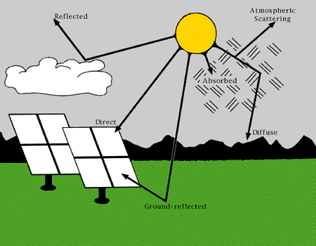
1
Comparison Analysis of GHI between KIER and NASA
Introduction
• Global Horizontal Irradiance (kWh/m²/day)
- Amount of electromagnetic energy (solar radiation) incident on the surface of the earth.
Also referred to as total or global solar radiation
- The sum of Direct Normal Irradiance (DNI), Diffuse Horizontal Irradiance (DHI), and
ground-reflected radiation
GHI=DHI+DNI*cos(Z)
Z: solar zenith angle
Notes:
Global Horizontal Irradiance defines as amount of electromagnetic energy incident on the surface of the earth, and also referred to as total or global solar radiation and the sum of direct Normal Irradiance (DNI), Diffuse Horizontal Irradiance (DHI), and ground-reflected radiation.
However, since ground reflected radiation is usually insignificant compared with direct normal irradiance or diffuse horizontal irradiance, global radiation is said to be the sum of direct and diffuse radiation in all practical purposes.

Slide 5
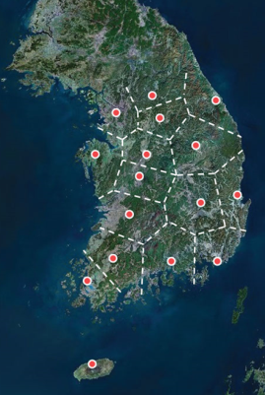
1
Comparison Analysis of GHI between KIER and NASA
Introduction
• Solar Monitoring History in KIER
1980
1990
2000
2010
2020
GHI
GHI, DNI
15
16
5
PSP
PSP, NIP
CM 11, CMP 11, CMP 22, CMP 21
CH-1, CHP 1
Analogue
Digital
▲ Solar Monitoring History in KIER and
South Korea Solar Radiation Monitoring Stations
Notes:
As shown in this figure, at first, our institute measured GHI using PSP at 15 monitoring stations in South Korea from 1982 to 1990, and then measured DNI as well as GHI using PSP and NIP, CM 11, CMP 11, and so on, at 16 monitoring stations from 1990 to 2010, and nowadays, we are measuring both GHI and DNI at 3 zones.
(아래 것은 무엇이니?? 발표 안했으면 해~)
PSP, NIP - EPPLEY
CH-1, CHP 1, CM 11, CMP 11, CMP 22, CMP 21 – KIPP & ZONEN
Eppley Precision Spectral Pyranometer (PSP)
This radiometer measures sun and sky irradiance in the range of wavelengths 0.285 to 2.8 microns, including most of the solar spectrum. The PSP is intended to weight the energy flux in all wavelengths equally. It is a “hemispheric receiver” intended to approximate the cosine response for oblique rays.

Slide 6

1
2
Research Method
• Research Area, Daejeon
• Data Information and Measuring GHI Values in KIER and in NASA
• KIER
- Solar Radiation Data Measurement and Collection Method
- Solar Radiation Measurement
• NASA
- Overview of NASA Data Used to Derive Parameters in SSE Release 6.0
• Statistical Analysis
Notes:
Following are research method.

Slide 7
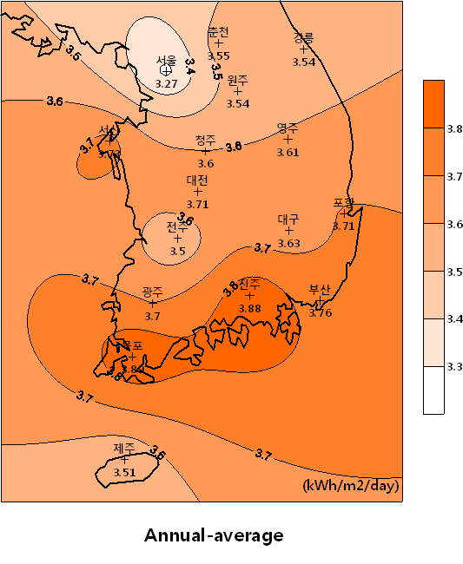
2
Comparison Analysis of GHI between KIER and NASA
Research Method
• Research Area, Daejeon - Lat.(N) 36º 22’, Long.(E) 127º 22’L/////((/Lat.(N) 3 22’
▲ Daily Average GHI Resource Map of South Korea
Notes:
Research area used in this study was Daejeon,(레이저 포인트로 오른쪽 그림의 대전을 가리키며)
The reasons are, since KIER located in Daejeon, measuring GHI value could be carefully supervised, and GHI value of Daejeon showed relatively high compared with other areas in South Korea as shown in this map.

Slide 8
2
Comparison Analysis of GHI between KIER and NASA
Research Method
• Data Information and Measuring GHI Values in KIER and in NASA
Classification | Content
Period | 1992. 1. 1 ~ 2005. 6. 30
Data Type | Daily Average of GHI
Measuring Method | KIER | Ground | Model PSP of the EPPLEY Laboratory, Inc. (EPLAB)
 | NASA | Satellite | Surface Radiation Budget (SRB) portion of NASA’s Global Energy and Water Cycle Experiment (GEWEX) - The current SRB archive is Release 3.0
Notes:
Data used were those obtained from January first nineteen ninety two(1992. 1. 1), to June thirtieth twenty five(2005. 6. 30), and data type was daily average value of GHI. With regard to the measuring method, our institute measured GHI value directly on the ground, on the other hand, in case of NASA, data were derived from satellite.

Slide 9
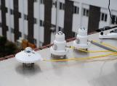
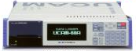


2
Comparison Analysis of GHI between KIER and NASA
Research Method
• KIER - Solar Radiation Data Measurement and Collection Method
Data Measurement
Data Logger
Sub Server
Wireless Mesh Network/ Internet
Main Server
ㆍ Server
- KIER Data
ㆍ Sub Server
- Korea Institute of Ocean Science and Technology (KIOST),
National Meteorological Satellite Center (NMSC) Data
ㆍ Hard Disk
- Korea Meteorological Administration (KMA) Data
Data Measurement
Data Logger
▲ Data Measurement and Collection Procedure
Notes:
• In our institute, Data were measured from each measurement equipment with network, and then collected to data logger, and then transmitted to Sub Server through Ethernet(?) or CDMA and then transmitted to Main Server through Wire Mesh Network.(간단히 언급)
• Satellite data are transmitted from Korea Institute of Ocean Science and Technology (KIOST) and National Meteorological Satellite Center (NMSC) to a separate server which is different from a server that receive measured data from New and Renewable Energy Resource Center
• Korea Meteorological Administration (KMA) data are received using hard disk

Slide 10
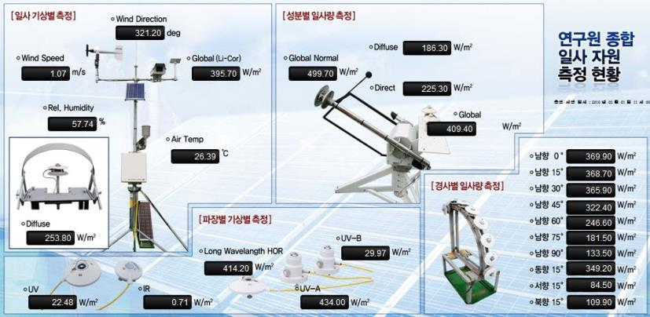
2
Comparison Analysis of GHI between KIER and NASA
Research Method
• KIER - Solar Radiation Measurement
- Solar Radiation Measurement Depending on Meteorological
- Solar Radiation Measurement Depending on Ingredient
- Solar Radiation Measurement Depending on Slope
- Measurement Depending on Wavelength and Meteorological
▲ Measurement Status of Total Solar Radiation Resource of Laboratory
Notes:
Solar radiation measurement in our institute is composed of four parts, such as meteorological, ingredient, slope, and wavelength.(위 그림을 가리키며)

Slide 11
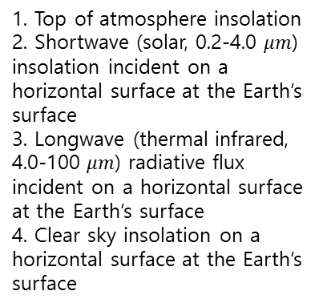
2
Comparison Analysis of GHI between KIER and NASA
Research Method
• NASA - Overview of NASA Data Used to Derive Parameters in SSE Release 6.0
Programs Contributing to SSE Release 6.0
SSE Archive
NASA/ISCCP & CERES/MODIS
NASA GEWEX/SRB Release 3.0
Daily averaged parameters
(July 1, 1983 –
June 30, 2005)
ㆍTOA Radiance, Clouds, and Surface Parameters
ㆍGlobal estimates of the solar and thermal infrared wavelength radiation at earth’s surface and top of atmosphere
1. Top of atmosphere insolation
2. Shortwave (solar, 0.2-4.0 $μm$) insolation incident on a horizontal surface at the Earth’s surface
3. Longwave (thermal infrared, 4.0-100 $μm$) radiative flux incident on a horizontal surface at the Earth’s surface
4. Clear sky insolation on a horizontal surface at the Earth’s surface
▲ SSE Release 6.0 Data Flow/Sources
Notes:
Overview of NASA data used is as shown in this figure. (나사 것이라 자세히 설명 안 부쳐도 될 것)

Slide 12
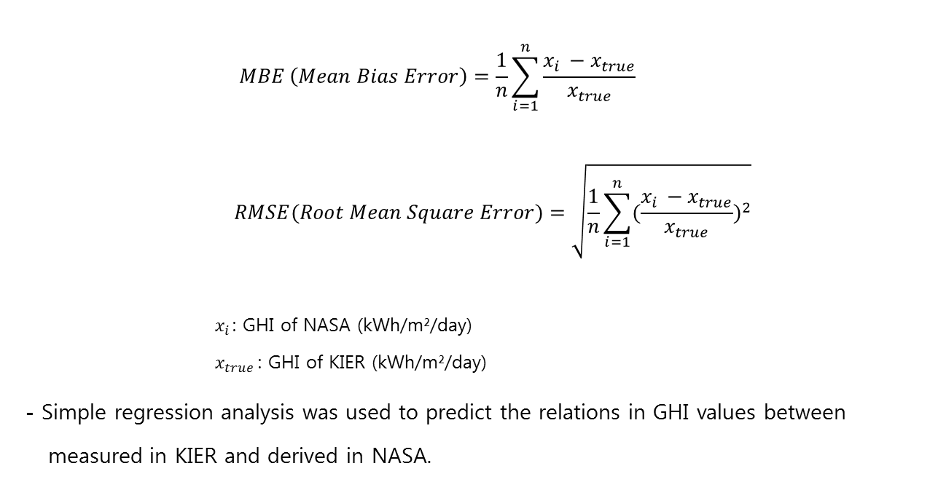
2
Comparison Analysis of GHI between KIER and NASA
Research Method
• Statistical Analysis : MBE, RMSE, and Regression Analysis
- Daily Avg., Monthly Avg., and Annual Avg. GHI data measured in KIER and derived in
NASA were treated statistically using Bias (%) and RMSE (%) to determine the errors .
$$MBE \left(Mean Bias Error\right)=\frac{1}{n}\sum_{i=1}^{n}{\frac{x_{i }−x_{true}}{x_{true}}}$$
$$RMSE(Root Mean Square Error)=\sqrt{\frac{1}{n}\sum_{i=1}^{n}{{(\frac{x_{i }−x_{true}}{x_{true}})}^{2}}}$$
${ x}_{i }$: GHI of NASA (kWh/m²/day)
${ x}_{true}$: GHI of KIER (kWh/m²/day)
- Simple regression analysis was used to predict the relations in GHI values between
measured in KIER and derived in NASA.
Notes:
To achieve the objectives of this study, Daily Avg., Monthly Avg. and Annual Avg. GHI values were treated statistically using mean bias error, root mean square error, and simple regression analysis. MBE and RMSE were used to determine the errors among the data, and simple regression analysis was used to predict the reliable relationship in the data between KIER and NASA.

Slide 13
3
3
Results
• Comparison in GHI values between measured in KIER and derived in
NASA using Bias and RMSE for the time period of January 1, 1992-
June 30, 2005
• Comparison and Relationship in Daily Avg. GHI Values between
KIER and NASA
• Comparison and Relationship in Monthly Avg. GHI Values between
KIER and NASA
• Comparison and Relationship in Annual Avg. GHI Values between
KIER and NASA
Notes:
Following are the results of this research.

Slide 14
3
Comparison Analysis of GHI between KIER and NASA
Results
ㆍComparison in GHI values between measured in KIER and derived in NASA
using Bias and RMSE for the time period of January 1, 1992-June 30, 2005
Parameter | Average GHI (kWh/m²/day) |  | Bias (%) | RMSE (%)
 | KIER | NASA
Daily Average GHI | 3.53 | 4.01 | 17.55 | 42.53
Monthly Average GHI |  |  | 17.79 | 33.51
Annual Average GHI |  |  | 13.90 | 14.64
cf. ) SSE versus BSRN (Baseline Surface Radiation Network) Daily Average GHI for the
Time Period of January 1, 1992 - June 30, 2005
Parameter | Region | Bias (%) | RMSE (%)
Daily Average GHI | Global | -1.58 | 20.57
Notes:
As shown in above table, average GHI value measured in KIER and derived from NASA for thirteen and half years(13년 반) was three point five three(3.53) and four point zero one(4.01)kilowatt-hour per square meter per day, respectively. Average daily GHI value in KIER seemed to be a little lower than the value from NASA.
Results of statistical analyses using Mean Bias Error(MBE) and Root Mean Square Error(RMSE) showed that the relatively large errors existed among the values between KIER and NASA, and the errors in daily average GHI value between KIER and NASA appeared to be great compared with monthly, and annual average value. (Results of Bias in daily, monthly, and annual average GHI values between KIER and NASA was seventeen point five five percent (17.55%), seventeen point seven nine percent(17.79%), and thirteen point nine zero percent(13.90%), respectively. Results of RMSE in daily, monthly, and annual average GHI values between KIER and NASA was forty two point five three percent(42.53%), thirty three point five one percent (33.51%), and fourteen point six four percent (14.64%), respectively). On the other hand, with regard to daily average GHI value, Bias and RMSE value between NASA and BSRN showed relatively low compared with the value between KIER and NASA. These results seem to be that relatively large error existed in daily average GHI value between KIER and NASA compared to the error between NASA and BSRN.
(It is said that the quality ground-measured data are usually considered more accurate than satellite-derived values. However, practically, measurement uncertainty from calibration drift, operational uncertainty, or data gaps are often unknown or unreported in many ground site data sets.) Moreover, nations including Korea, Japan, and especially China in northeast asia are facing with the severe air pollution problems such as aerosols and consequent abnormal changes in weather, yellow dust, and so on.
So, it could be suggested that such factors may be the reasons of relatively high errors between ground-measured data and satellite-derived data.

Slide 15
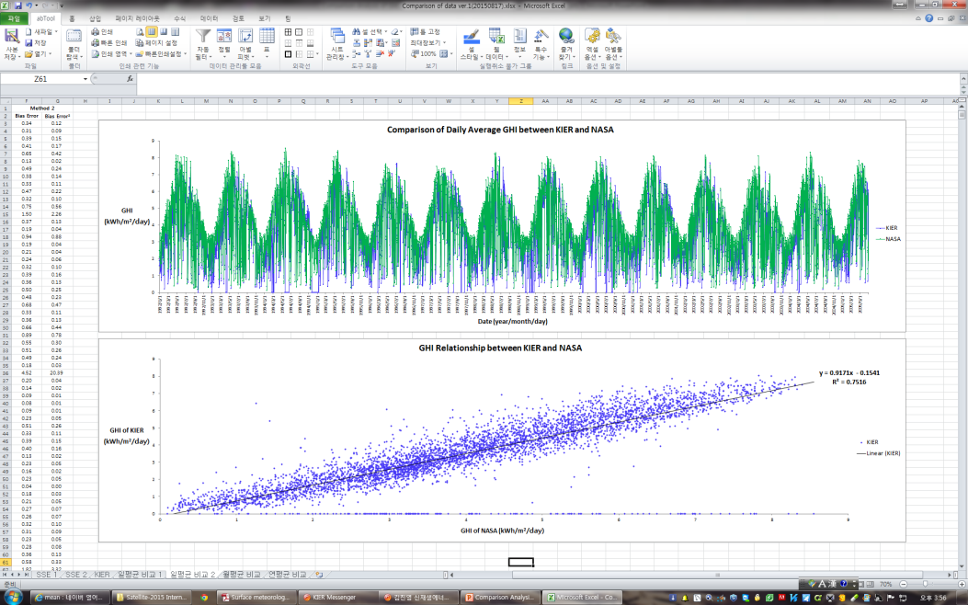
3
Comparison Analysis of GHI between KIER and NASA
Results
• Comparison and Relationship in Daily Avg. GHI Values between KIER and NASA
( F=14897.279, p<0.001 )
Notes:
Daily average GHI values in KIER and from NASA for thirteen and half years are shown in above figure. Color blue and color green represents values in KIER and NASA, respectively. As shown in this figure, green is obvious compared to blue, and this means that the daily average GHI values from NASA were higher than those in KIER. Below figure shows the result of simple regression analysis, which is used to determine and to predict the relationship between daily average GHI values in KIER and NASA.
When GHI value for NASA and KIER was independent variable and dependent variable, respectively, regression line could be made for predicting relations between GHI values in KIER and NASA. Regression line formed as a result of regression analysis was, y equals zero point nine two x minus zero point one five. And, r squared, namely, coefficient of determination was zero point seven five. R-squared is a statistical measure of how close the data are to the fitted regression line, and is always between 0 and 1.
In general, the higher the R-squared, the better the model fits the data, and if r squared is from zero point six five to zero point seven or more, the model is said to be adequate. However, R-squared always does not indicate whether a regression model is adequate or not.
And, in this case, we need another indication standard. The goodness of fit of a statistical model describes how well it fits a set of observations, and measures of it summarize the discrepancy between observed values and the values expected under the model in question. For this reason, F value(MSR/MSE), that is, mean square regression divided by mean square error should be calculated to evaluate the goodness of fit in this model.
The results observed showed that approximately seventy five percent of variation in GHI values for KIER could be explained by the regression line. And, the model was on the goodness of fit, because the F value was statistically significant at the significance level of less than zero point zero zero one.
So, the results indicated that significant relationship existed in the daily GHI values between KIER and NASA, and daily average GHI value for KIER could be predicted using this regression model.

Slide 16
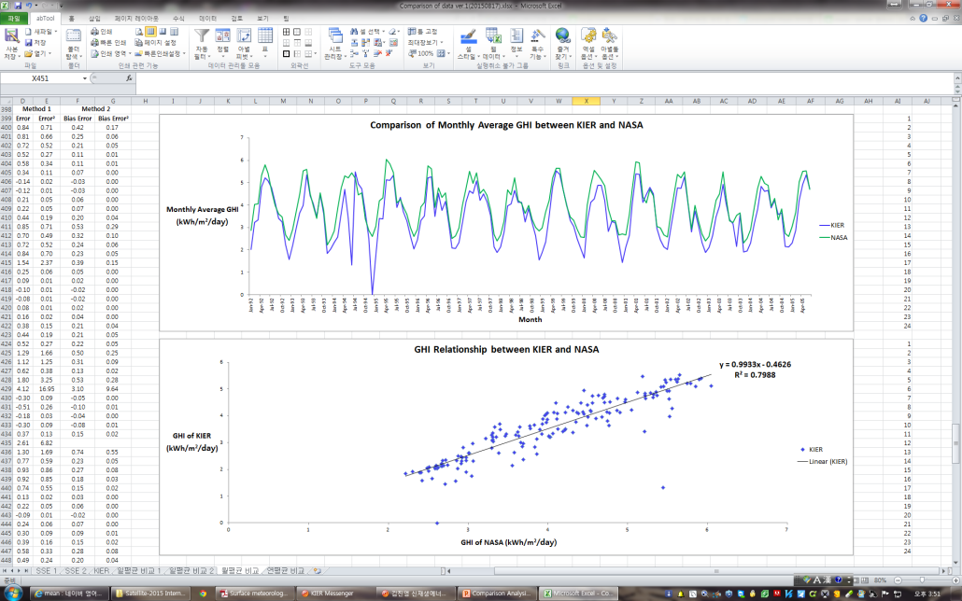
3
Comparison Analysis of GHI between KIER and NASA
Results
• Comparison and Relationship in Monthly Avg. GHI Values between KIER and NASA
( F=635.390, p<0.001 )
Notes:
Monthly average GHI values in KIER and NASA are shown in above figure, and shows a similar tendency appeared in daily average values. (시간이 없으면 괄호안은 생략 And, the regression line formed was, y equals zero point nine nine three three x minus zero point four six two six. And, r squared was zero point seven nine eight eight.) This results indicated that approximately eighty percent of variation in GHI values for KIER could be explained by the regression line, and since the F value was statistically significant at the significance level of less than zero point zero one, the model was also on the goodness of fit. So, the results, like daily average result, indicated that significant relationship existed between KIER and NASA, and monthly average GHI value for KIER could be predicted using above regression model.

Slide 17
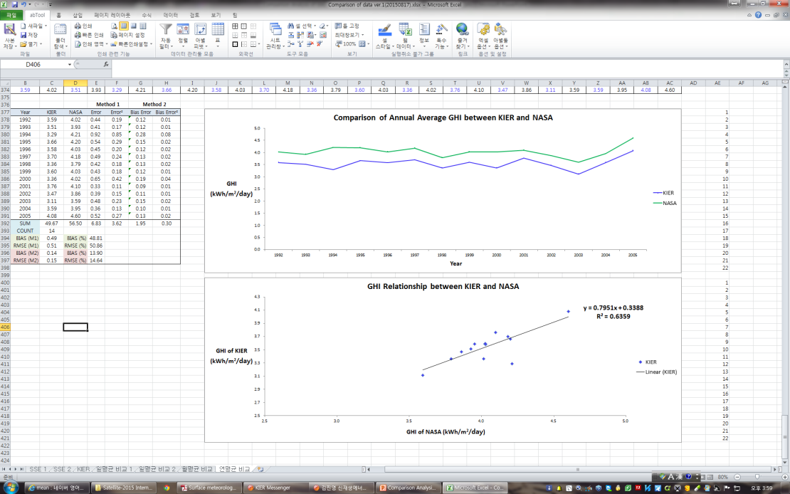
3
Comparison Analysis of GHI between KIER and NASA
Results
• Comparison and Relationship in Annual Avg. GHI Values between KIER and NASA
( F=20.956, p<0.001 )
Notes:
Annual average GHI values in KIER and NASA and the results of regression analysis are shown in these figures, and above figure shows a similar tendency in daily and monthly average values. (And, the regression line formed was, y equals zero point seven nine five one x plus zero point three three eight eight.) And, r squared was zero point six four. So, approximately sixty four percent of variations in GHI values for KIER could be explained by the regression line. Since the F value was statistically significant at the significance level of less than zero point zero zero one, regression model also appeared to be on the goodness of fit. So, this result, like daily and monthly average results, indicated that significant relationship existed between KIER and NASA, and annual average GHI value for KIER could be predicted using above regression model.

Slide 18
4
4
Conclusion
Notes:
Following are conclusions.

Slide 19
4
Comparison Analysis of GHI between KIER and NASA
Conclusion
• Daily average GHI values measured in KIER and those derived from NASA for thirteen and half years was 3.53 kWh/m²/day and 4.01 kWh/m²/day , respectively.
And, daily average GHI value for KIER seemed to be a little lower than the value from NASA.NThisth
• Results of statistical analyses using Mean Bias Error(MBE) and Root Mean Square Error(RMSE) showed that the relatively large errors existed among the values between KIER and NASA, and the errors in daily average GHI value between KIER and NASA appeared to be great compared with monthly, and annual average value .
•sResults of statistical analyses using simple regression analysis showed that approximately 75% of variation of GHI values in KIER could be explained by the regression line, and the line was fitted well.(p<0.001). Approximately 80% of variation in monthly average values and 64% of variation in annual average values in KIER could be explained by the regression line. The regression line was also fitted well.(p<0.001). These results indicated that significant relationship existed in the GHI values between KIER and NASA, and GHI value variations in KIER could be explained by the regression models. Thus, it could be suggested that the ground- measured data in KIER have reliable verification compared with the satellite-derived data from NASA.
Notes:
This study was undertaken to verify the reliability for the ground-measured data in KIER as compared with the satellite-derived data from NASA.
• Daily average GHI values measured in KIER and values derived from NASA for thirteen and half years was three point five three (3.53 kWh/m²/day) and four point zero one kilowatt hour per squared meter per day (4.01 kWh/m²/day), respectively. And, daily average GHI value in KIER seemed to be a little lower than the value from NASA. It is assumed that the ground measured values were influenced by several factors including air pollution such as aerosols, subsequent meteorological changes, and so on.
• Results of statistical analyses using Mean Bias Error(MBE) and Root Mean Square Error(RMSE) showed that the relatively large errors existed among the values between KIER and NASA, and the errors in daily average GHI value between KIER and NASA appeared to be great compared with monthly, and annual average value.
• Results of statistical analyses using simple regression analysis showed that approximately 75% of variation of GHI values in KIER could be explained by the regression line, and the line was fitted well statistically at the significance level of less than zero point zero zero one.(p<0.001). Approximately 80% of variation in monthly average values and 64% of variation in annual average values in KIER could be explained by the regression line, and the line was also fitted well at the statistical significance level of less than zero point zero zero one.(p<0.001). These results indicated that significant relationship existed in the GHI values between KIER and NASA, and GHI value variations in KIER could be explained by the regression models. Thus, it could be suggested that the ground- measured data in KIER have reliable verification compared with the satellite-derived data from NASA.
And, it is assumed that the ground-measured data in KIER could provide the basic data in forecasting global solar radiation for the areas not measured yet, and in compiling reliable database for the GHI values in solar technology development in our country.

Slide 20

THANKS FOR YOUR LISTENING
Comparison Analysis of GHI between KIER and NASA

