Slide 1
Formulation of Nutraceuticals and Dietary Supplements:
Formulation and Regulatory Challenges
Shilpa Raut, Ph.D.
Research Scientist – Formulation
Nutrilite Health Institute (Amway)
Pharmaceutics and Novel Drug Delivery Systems Conference 2016

Slide 2
NUTRACEUTICAL nu·tra·ceu·ti·cal also nu·tri·ceu·ti·cal
Nutraceuticals are gaining attention due to the increasing consumer market share for wellness products
noun \ˌnü-trə-ˈsü-ti-kəl\ : a specially treated food, vitamin, mineral, herb, dietary supplement etc., that you eat or drink in order to improve your health
Full Definition of NUTRACEUTICAL
A foodstuff (as a fortified food or dietary supplement) that provides health benefits in addition to its basic nutritional value
http://www.merriam-webster.com/

Slide 3
Introduction
Solid dosage formulation and process design for drug products and nutrition products is similar.
Purpose and regulatory requirements may differ
Desire for a safe and effective dosage form is the same
Desire for most cost effective formulation and process is the same

Slide 4
Formulation Challenges of Nutrition Tablet Design
Botanicals are complex with multiple chemical components
Can contain up to 50 active ingredients; 70- 90% of the formula can be actives
Botanicals and extracts can vary based on region the crop was grown, season grown in and other factors
Generally large dose per daily serving

Slide 5
Formulation Challenges of Nutrition Tablet Design
Significant variation in active ingredient particle size, compression and flow characteristics within one dosage form
Large variation in heat, light and moisture sensitivity of ingredients within one formula
Requires addition of overages

Slide 6
Formulation Challenges of Nutrition Tablet Design
Hardness, Friability
Uniformity
Test method
Disintegration, Dissolution
Stability

Slide 7
As we move toward stricter regulations and higher quality standards….
Formulation Challenges of Nutrition Tablet Design
Optimized Choice
TECHNOLOGICAL FACTORS
Particle size/Micronization
Surface area
Porosity
Crystal structure
Powder flowability
Compressibility
Plastic/brittle fracture
Moisture content
ANALYTICAL FACTORS
Chemical Analysis
Impurities/Contamination
Structural Analysis
SEM Images
X-ray Diffraction
Thermo analysis (DSC/ TGA)
NMR
FTIR
STABILITY FACTORS
Solid State Stability
Degradation Forces
pH stability
Moisture Activity
Microbial bio burden
Notes:
Multi-active formulas- so ingredients have different particle size, hydrophilicity, flow properties etc leading to tablet capping, lamination, sticking etc

Slide 8
Formulation Challenges of Nutrition Tablet Design
Finished good specifications for:
Identity
Purity
Strength
Composition
Shelf Life
cGMP for manufacturing, storage and handling, packaging and labeling

Slide 9
Claims Substantiation
Different countries have different requirements
Established generic claims for vitamins and minerals
Due to regulations or USPs, may compel companies to conduct clinical research
Challenges:
Choice of study population
Nature of nutraceuticals
Notes:
Health effects are often small and easily affected by heterogeneity of subjects and environmental factors. Effects may be jeopardized by confounding factors such as eating, smoking, exercise habits etc
Vitamin and minerals have various sites of action and becomes difficult to evaluate effectiveness

Slide 10
Regulatory Considerations
The Regulatory Landscape has a strong influence …

Slide 11
Global Formulation and Process Design
Just a Few References That Must be Considered
  WHO
  British Pharmacopoeia
  US Pharmacopoeia
  European Pharmacopoeia
  China Pharmacopoeia
  China GB National standards
  Japan Pharmacopoeia
Codex Alimentarius
ICH
Korea HFF Codex
Japan Positive list for use in foods (not a drug ingredient)

Slide 12




Registration Certifications May Be required
Certification requirements often apply to excipients as well as active ingredients
GMO Free
Halal
Kosher
WADA Compliance
  (World Anti Doping Agency) country and product specific

Slide 13
More Challenges for Global Formulation
Registration category/classification
  According to claims and ingredients the formula may fit into different categories by country
Registration complexity varies by category and country, dossier requirements vary greatly
Testing requirements for finished products, as well as ingredients and excipients, are not uniform

Slide 14
Nutrition – Food Products (Powders, Drinks and Bars)
Notification or No Registration Market
Registration Market (low/med complexity )
Registration Market (med/high complexity )

Slide 15
Nutrition - Categories Excluding Food Products
(Health Supplements, TCM’s, Health Foods and items considered “Drugs/Medicines”)
Notification or No Registration Market
Registration Market (low/med complexity )
Registration Market (med/high complexity )

Slide 16
Nutrition Classifications (not comprehensive)
Dietary Supplement
Food
NHP- Compendial
NHP- Non Compendial
Health Functional Food
Tablet Food
Health Food
General food
Drug
Traditional Chinese Medicine
OTC
Food Supplement
Traditional Medicine
Complimentary Medicine
Functional Food
Novel Food
Phytotherapeutic
Food complement
Natural product
Natural Products, Drug
Herbals
Nutrient Supplement
Food for Specified Health Uses

Slide 17

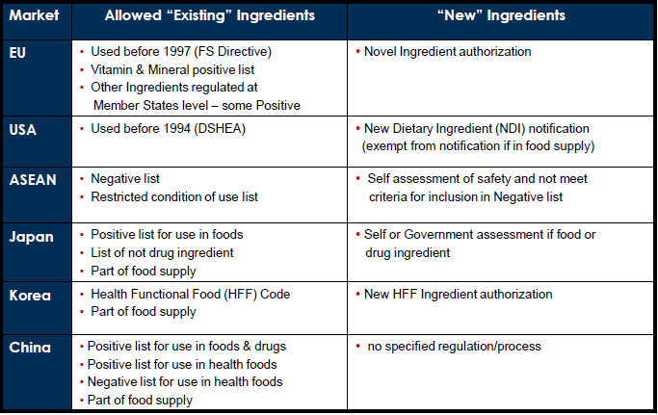
Allowance of Ingredients
Reference:
Notes:
“New Ingredients; China – must comply to regulations and process for new ingredients.

Slide 18
Several Countries have their own testing requirements or “positive list” that impact choices
Do not always reciprocate the USP standards for excipients
  China- CHP, MOH, GB Guobiao, or “National Standard”
  Korea, HFF (Health Function Food Code) and MFDS (Ministry of Food and Drug Safety) re-org March 2013
  Japan, JFHA- Japan Health Food Association (positive list for food additives)
Notes:
With regard to food additives, only those substances that are included on a
“positive list” covering 350 synthetic food additives plus 490 natural origin
additives can be used in supplements marketed in Japan. Any item not on this
list is not permitted as an ingredient in supplement products. Many additives
commonly used in the United States and elsewhere are not on this list. In
addition, additives which have been approved for use in Japan in
pharmaceuticals are not permissible for use in supplements unless they are on
the positive list.
Differences in international regulations on excipient qualification
- Regulations on in-country source may be less or more stringent than either the USP or manufacturers internal standards.
Allowed excipients and usage levels restricted in several markets.
add to the already challenging task of safe, quality, product formulation for a global market
Under the new category of “food for specified health uses,” applicants
are required to submit safety and efficacy data that some observers believe could
result in regulatory scrutiny almost as comprehensive as required for
pharmaceuticals.

Slide 19
Example: Malaysia
Four nutrition categories- Functional Foods, Traditional Medicine, OTC, Health Supplement.
Many Products fall into the Food Drug Interface (FDI)
Depending on characteristics and ingredients, they may be regulated by the National Pharmaceutical Control Bureau (NPCB) or the Food Safety and Quality Division (FSQD) of the Ministry of Health

Slide 20
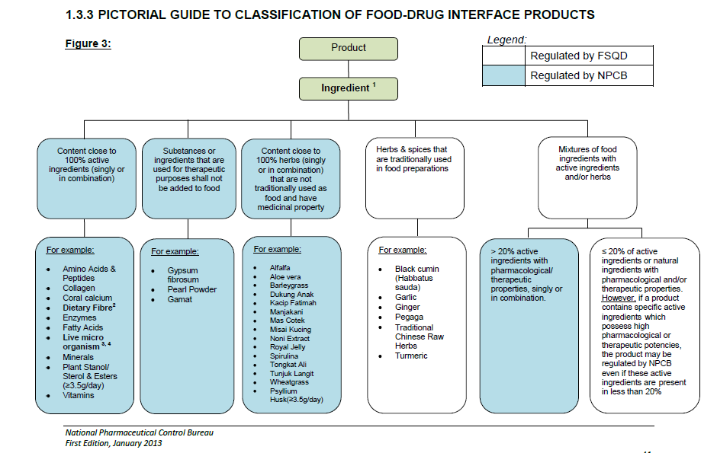
National Pharmaceutical Control Bureau
First Edition, January 2013 , MOH Malaysia

Slide 21
Towards Global Harmonization
International Alliance of Dietary/
Food Supplements Associations
Global Information, Science and Regulation
  IADSA is the leading international expert association regarding the globalization of food supplement markets and increasing regulatory challenges.
  Includes food supplement associations from 6 continents
  IADSA aims to build an international platform for debate and a sound legislative and political environment for the development of the food supplement sector worldwide.

Slide 22
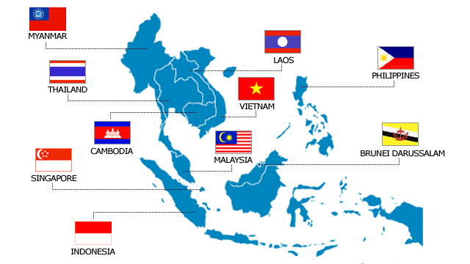
ASEAN (Association of Southeast Asian Nations)
10 Member States
Approx 520 million population

Slide 23
Regulatory trends: Global Formulation
(Nutrition)
Regulatory scrutiny is increasing, but with regional differences
Increased focus on substantiation of health claims through clinical studies
Food safety issues will result in more restrictions
Some regions heading towards globally harmonized rules (EU, ASEAN)
*However, regulatory harmonization delayed in some regions due to local interests

Slide 24
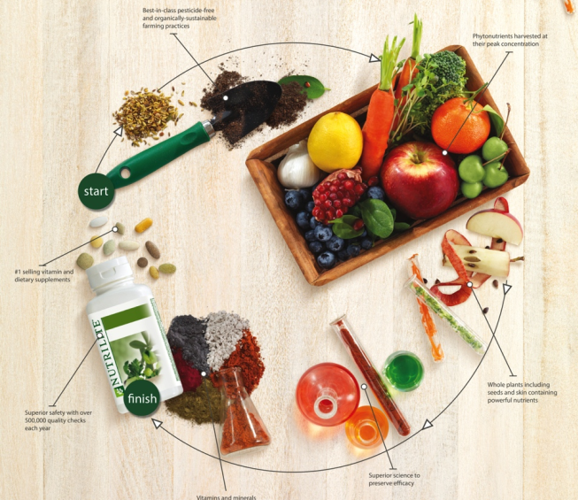
At Amway Nutrilite
We Nurture Our Ingredients Every Step of the Way
Notes:
This gives us at Nutrilite a great opportunity to provide preventive solutions for an optimal health and specifically by being able to control the whole supply chain of our products from seed to supplements
We ensure the quality of our products by monitoring the process from the very moment a seed is planted, to when the plant is harvested, to when it’s used in our products.

Slide 25
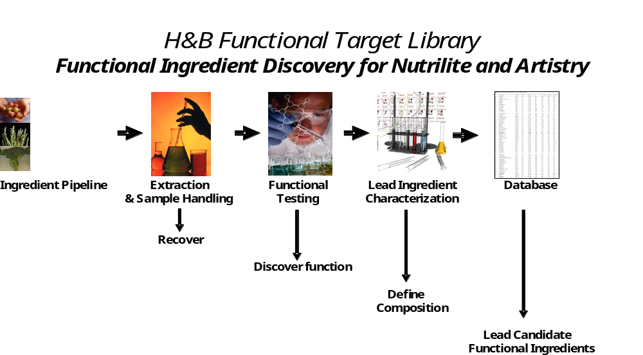
A Library of more than 2,500 Botanicals
Bioassays for 6 mains functions: Antioxidant, DNA Health, Energy Health, Anti-Inflammation, Glycation and Pigmentation
Notes:
But how do we decide on which botanical to put together and how to we select the right combination of botanical to create our concentrate?
Like anything else at Nutrilite, there is a science behind it, and probably one of the best and exciting research that would make Big Pharma envious.
At Amway headquarters, back in Michigan, we have what we call the functional target library or FTL. This library is literally a library of more than 2,500 botanicals that we have tested against 6 different biossays. Bioassays are test in a tube that can predict if the botanical will have an activity on a specific biological function.
The 6 main functions we are interested in are antioxidant, DNA Health, Energy Health, Anti-Inflammation and two functions specific to Beauty: Glycation and Pigmentation.
We first get our plants from the farms, then select which part of the plants we want to use (aerial, leaves, fruits, stems, roots), then grind them and make a power out of it to go through water or ethanol extraction. Once we have an extract we can test the extract on the bioassay and identify if there is an activity or what scientist call a “hit”.
Once we have identified which extract is a hit then we can characterize the composition of this extract through heavy analytical equipment called HPLC/MS which will pretty much break down the structure of any molecules in the extract so scientist can build it back and identify which compounds have an biological activity.
They are then entered in our FTL database for Product Developer to use into future products.

Slide 26
FTL to Product Development
Technologies to support Discovery and Development
Agricultural Research
Chemistry & Bioassay (Analytical Sciences Lab)
Clinical Testing
Process Technology
Quality
Rapid Prototyping
Notes:
Talk about AS capabilities
Process technology: State of the art lab with equipment for tableting and softgel
Expertise in formulation, processes and regulatory

Slide 27
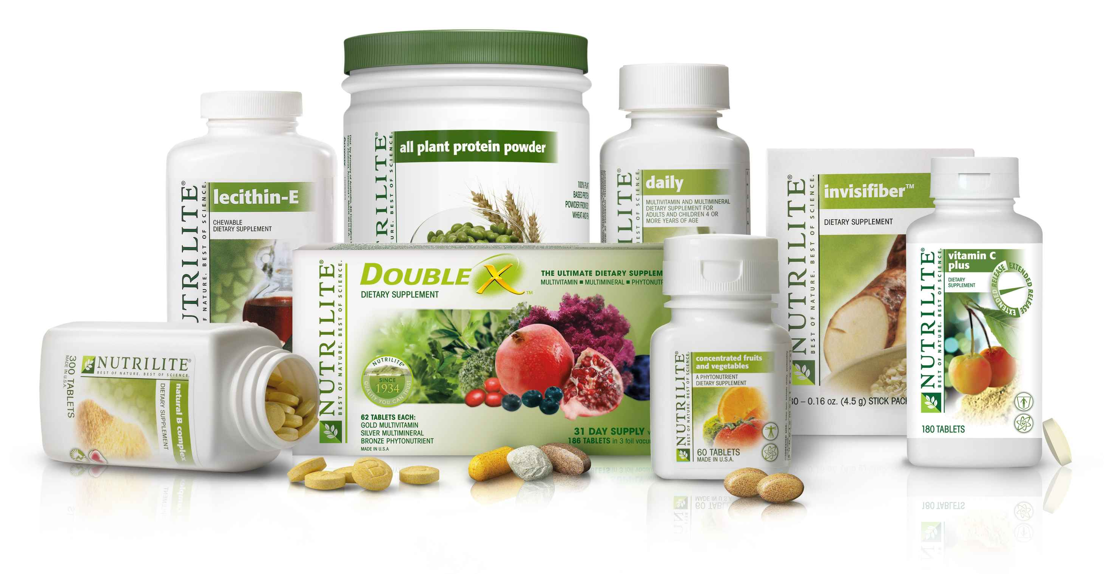
Nutrilite is the world's number one selling vitamins and dietary supplements brand
Notes:
In addition to essential and targeted supplements, many of our products provide plant concentrates which help fill the dietary gap of phytonutrients.
So why is Nutrilite the world’s number one selling vitamins and dietary supplements brand?
I think the key reason is because of our philosophy of best of nature and best of science as well as our unique story of seed to supplement that we just described.

Slide 28
Summary
  Formulation of Nutraceuticals is similar and yet different than pharmaceutical formulation
  Regulations vary by different countries – there is a need for harmonization
  Formulation, testing and labeling of nutraceuticals is getting stricter as we enhance safety and quality
  Nutrilite at Amway will continue to make advancements in formulation for optimal health and wellness

Slide 29
Thank you
Acknowledgements:
Thank you to Mary Murray, Senior Principle Scientist at Nutrilite
Thank you to Supplement Product Development group

Slide 30
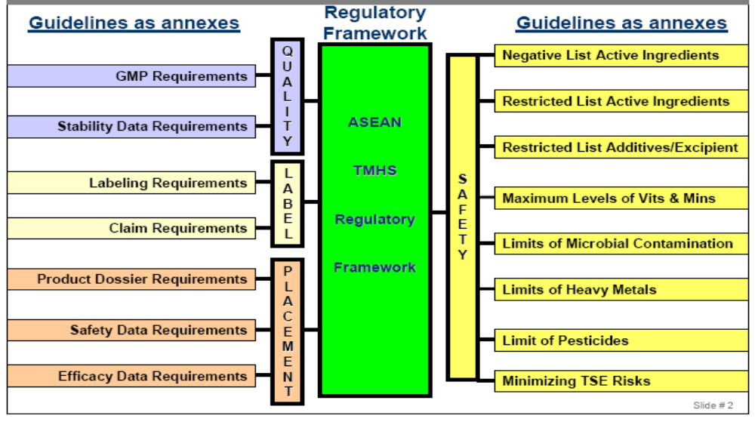
ASEAN HARMONIZATION OF
TMHS (Traditional Medicine Health Supplement) REGULATIONS

Slide 31
ASEAN Proposal: Global List of Restricted
Additives & Excipients
Currently many countries and regions maintain “positive lists”
ASEAN Guiding principles for entry of additives and excipients into ASEAN List of Restricted Additives and Excipients
  Development stage
  Not listed in CODEX or any international reference

