Slide 1
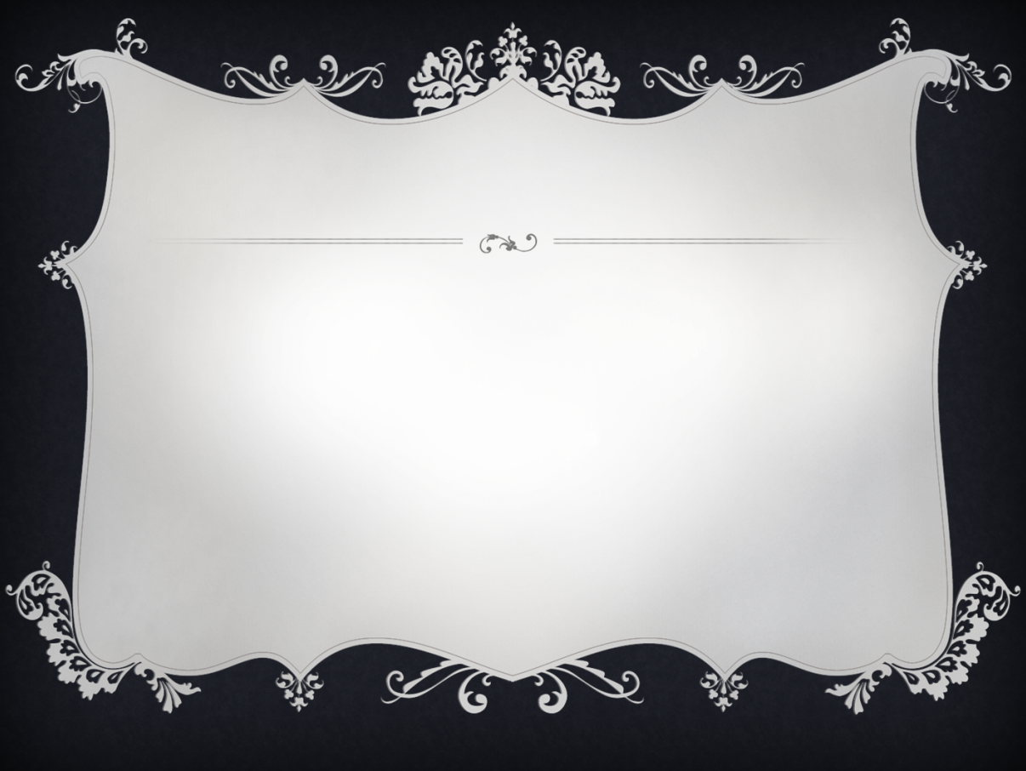
A Role of Maspin in Prostate Epithelial Homeostasis and Tumor Progression
Shijie Sheng, Ph.D.
Professor of Pathology and Oncology
Wayne State University School of Medicine
Tumor Biology & Microenvironment Program
Karmanos Cancer Institute
Detroit, MI

Slide 2

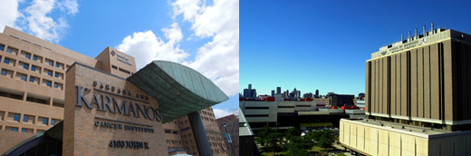
Acknowledgements
Collaborators:
Drs. Wael Sakr (MD)
Michael Cher (MD)
R. Daniel Bonfil (PhD)
Fulvio Lonardo (MD)
Gerold Bepler (MD)
Michele Cote (PhD)
Gregory Dyson (PhD)
Lawrence G. Lum (MD)
Kang Chen (PhD)
Elisabeth Heath (MD, PhD)
Dr. Yue Yang (Peking University Health Sciences Center)
Dr. Laura Rozek (University of Michigan)
The Sheng Lab:
Sijana Dzinic (PhD)
Margarida Bernardo (PhD)
Xiaohua (Joshua) Li (PhD)
Alexander Kaplun (PhD)
Ivory Dean (PhD Student)
Extramural Funding
NIH/NCI 1R01CA127735
NIH/NCI 2R01CA84176
NIH/NCI 2R01CA084176-S3
NIH/NCI 1R21CA154319*
The Fund for Cancer Research
*Multi-PI plan with Dr. Lonardo

Slide 3
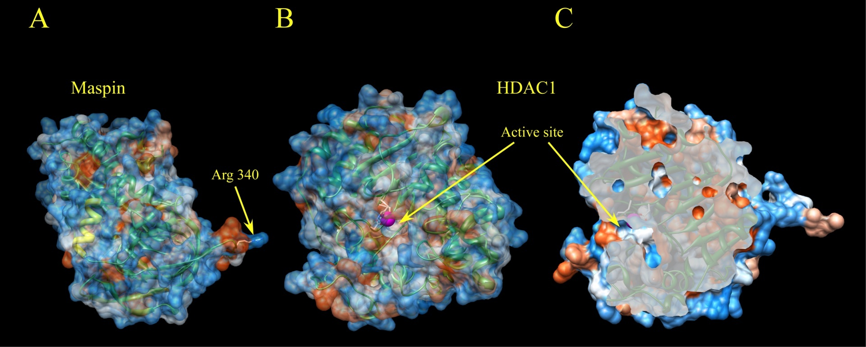
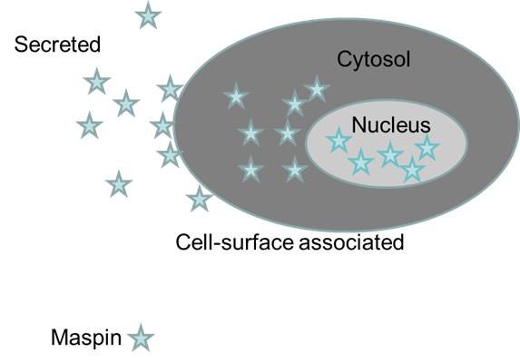
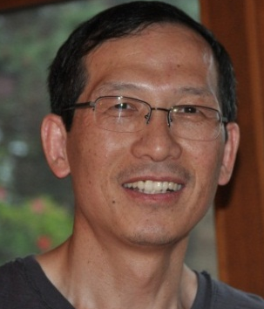
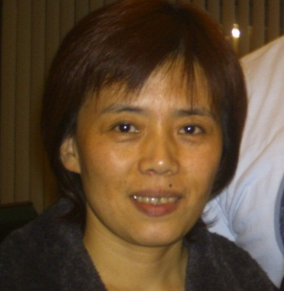
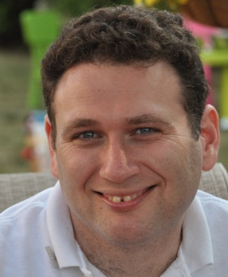
Epithelial-specific Maspin
Experimental model:
Prostate cancer bone metastasis
Immune response to tumor xenograft
Function:
Limiting microenvironment-induced
tumor cell phenotypical plasticity
Increase host immune response
Underlying Molecular Mechanism:
Endogenous HDAC inhibition
Potential Clinical Utility:
Molecular Marker
Maspin-based therapeutic strategy
Both endogenous and recombinant Maspin interact and inhibit HDAC1 activity
Endogenous maspin increases Histone acetylation and HDAC1 target gene expression
Endogenous maspin restores epigenetic profile of differentiation in vitro and in vivo

Slide 4
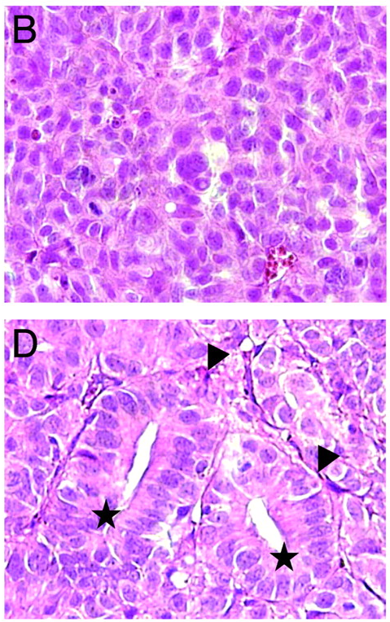
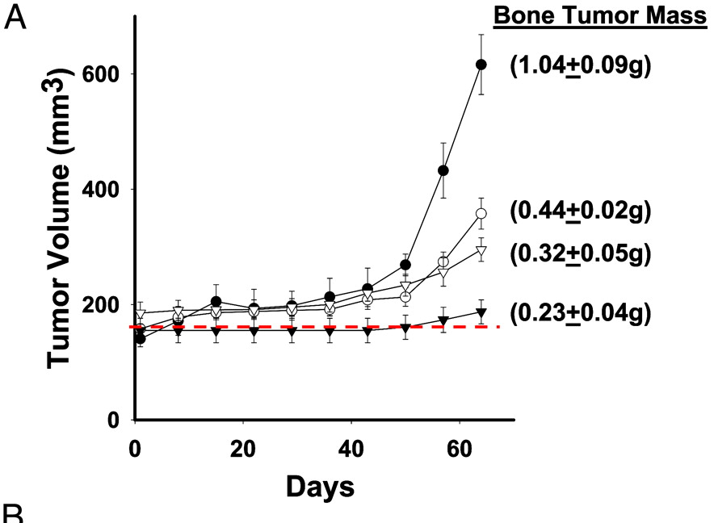
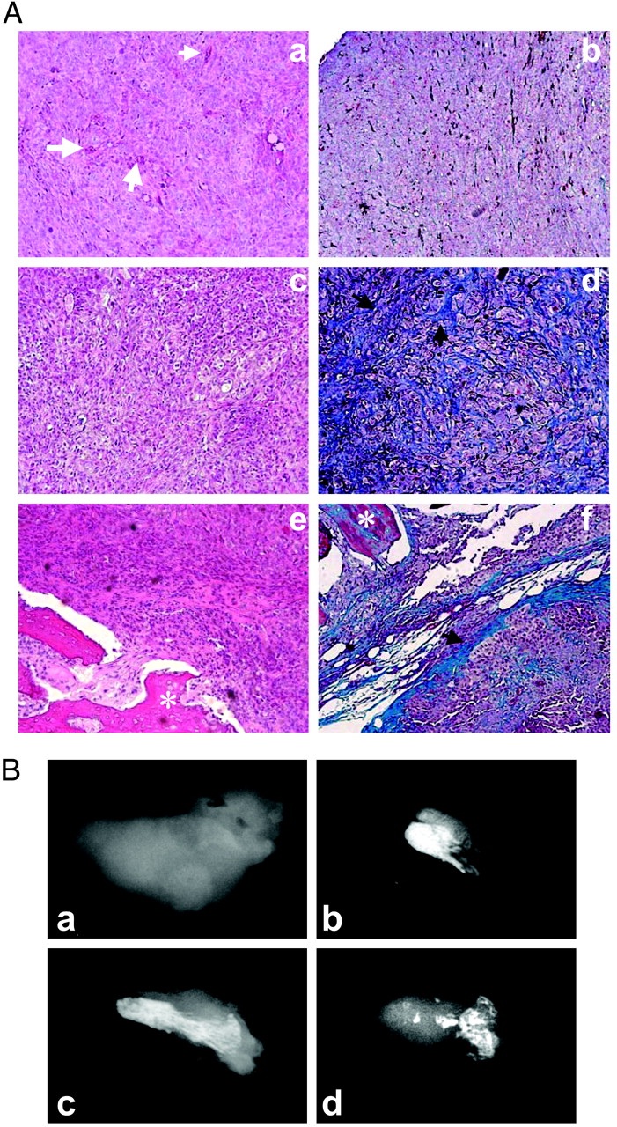
Maspin expression inhibits osteolysis, tumor growth, and angiogenesis in a model of prostate cancer bone metastasis
Neo
Neo
M3
M10
M7
M7
Neo
M7
Notes:
Maspin expression inhibits prostate carcinoma bone tumor growth in the SCID-Hu model (top, and bottom) and inhibits bone degradation (bottom)

Slide 5
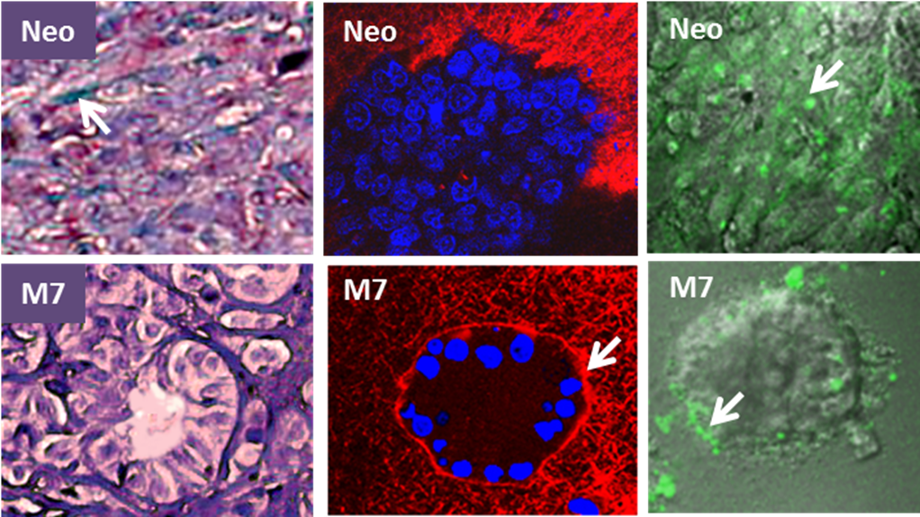
Maspin Reprograms Prostate Cancer Cells toward Differentiation in vivo and in 3D Culture

Slide 6
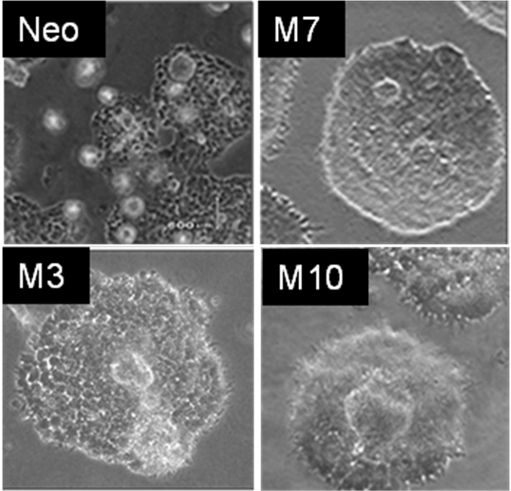
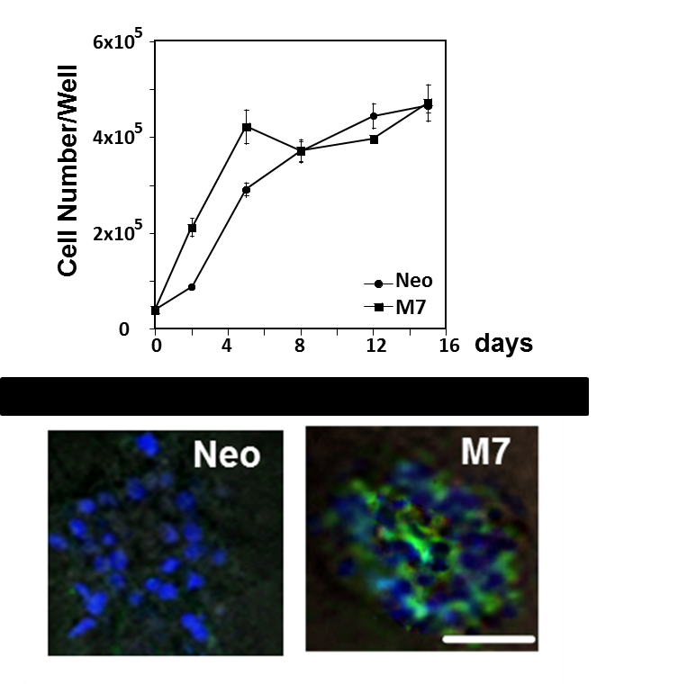
Maspin Reprograms Prostate Cancer Cells toward Differentiation in vivo and in 3D Culture
Notes:
Figure 5.. Phase-contrast (tope two rows) and fluorescence (bottom two rows) representative fields (200x) of stable DU145 cell transfectants seeded on collagen I, in the presence or absence of DQ-collagen I (5 mg/mL), at day 7.

Slide 7
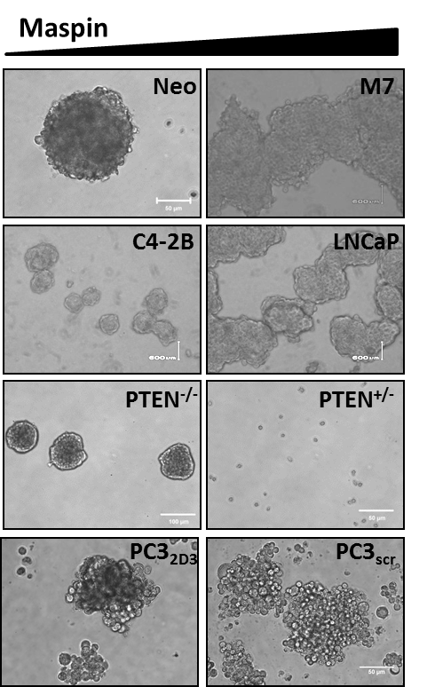
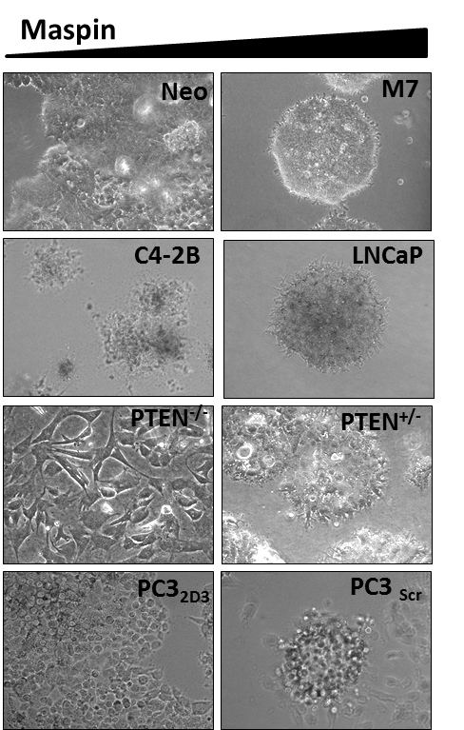
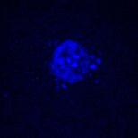
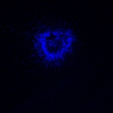
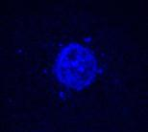
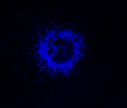
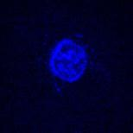
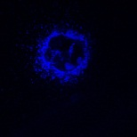
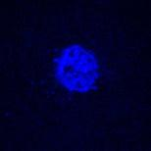
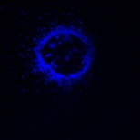
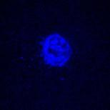
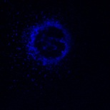
Maspin Correlates with Restriction of “Stemness”
Neo
M7
12 μm
12 μm
17 μm
17 μm
22 μm
22 μm
32 μm
32 μm
42 μm
42 μm
Suspension 3D in Collagen I

Slide 8
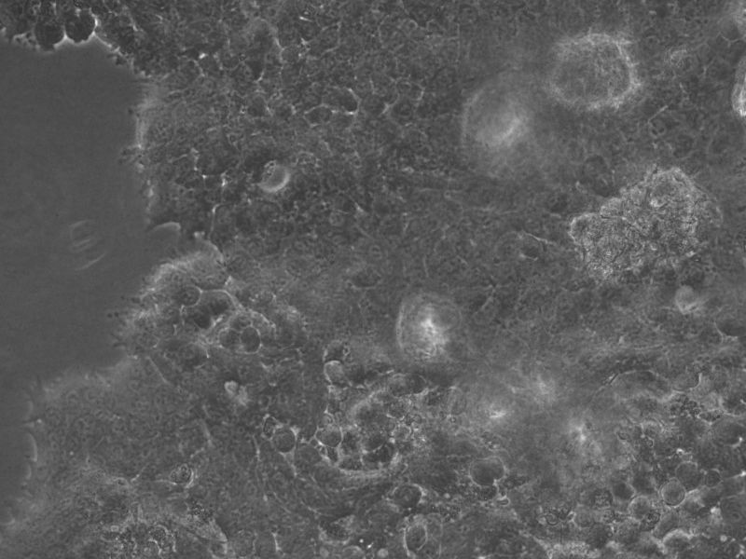
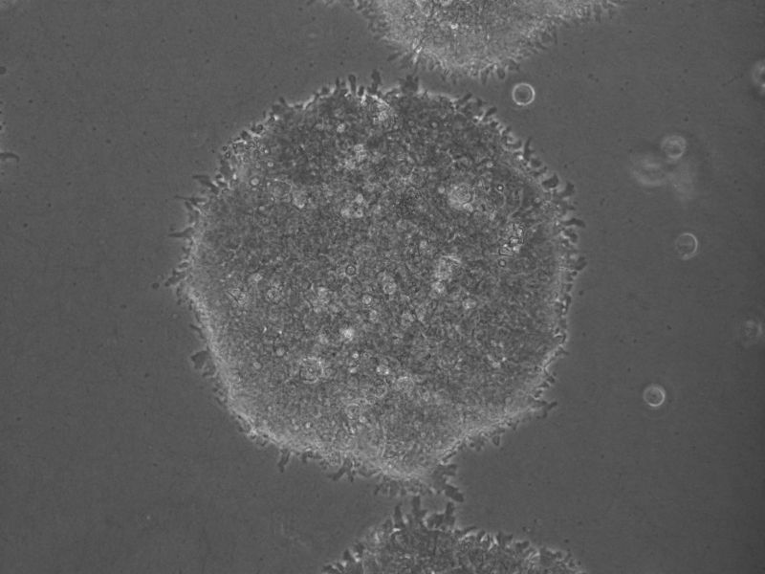
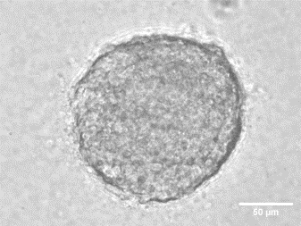
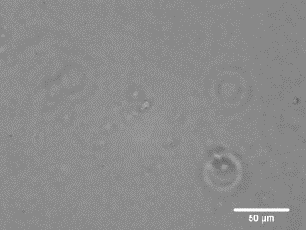
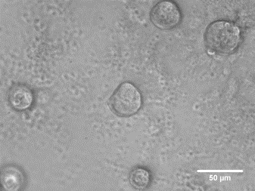
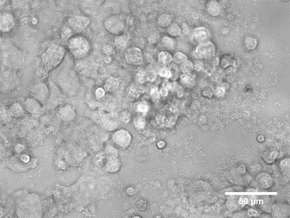
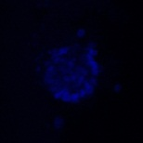
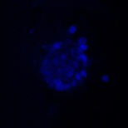
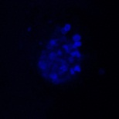
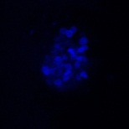
Tumorspheres derived from maspin transfected DU145 cells lost the ability to form
epithelial-structures in 3D Col I
Original Cells in 2D
Grown in Suspension
Embedded in 3D Col I
Embedded in 3D Col I
Embedded in 3D Matrigel
Neo
M7
Neo
M7
Neo
M7
M7
12 μm
22 μm
12 μm
22 μm
24 μm
30 μm
M7
Neo
Neo
Neo
32 μm
42 μm
32 μm
42 μm
36 μm
42 μm
Notes:
Q. Due to heterogeneity we are selecting different populations with different plasticity.
To ensure that the cell sub-population isolated in suspension exhibits a unique set of properties that differ significantly from the original cells grown in 2D, Neo and M7 cells grown in suspension after the first passage were isolated, dispersed with Accumax and embedded in 3D collagen I and Matrigel. The cells cultured in 2D were embedded in parallel. As shown in Fig. 3, the Neo cells grew into solid spheres as ascertained by fluorescence confocal microscopy with the nuclei stained with Hoescht dye whereas the M7 cells were unable to proliferate under these conditions. In Matrigel, however, the Neo cells formed solid tumorspheres (Fig. 4S) and the M7 cells showed a slower rate of proliferation and spread. These results are in stark contrast with those obtained with the original cell populations of Neo and M7 cells. In fact, the Neo cells spread in collagen I in sheet-like structures whereas the M7 cells formed hollow lumen spheroids, as previously reported (Bernardo et al) (Fig. 3). Moreover, the phenotype was specific for collagen I and was not observed when the cells were embedded in Matrigel. However, the Neo stem cell population grown in suspension formed solid tumorspheres in both matrices. Thus, by culturing the cells in 3D matrices, it has been confirmed that the prostate carcinoma cell population isolated from the tumorspheres grown in suspension constitutes a subset that exhibits a distinct phenotype relative to the original cells grown in 2D.
I indeed selected very different populations manisfesting a widely diverse plasticity.

Slide 9
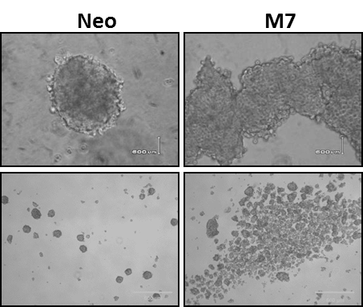
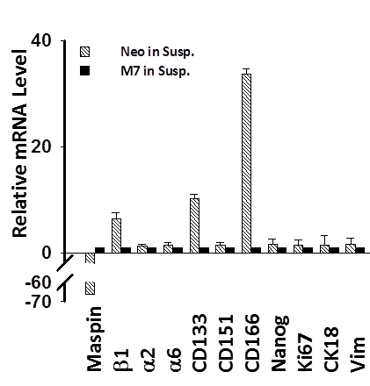
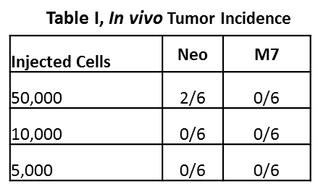
Maspin Reduced Stem Cell Marker Expression and Tumor Initiation

Slide 10
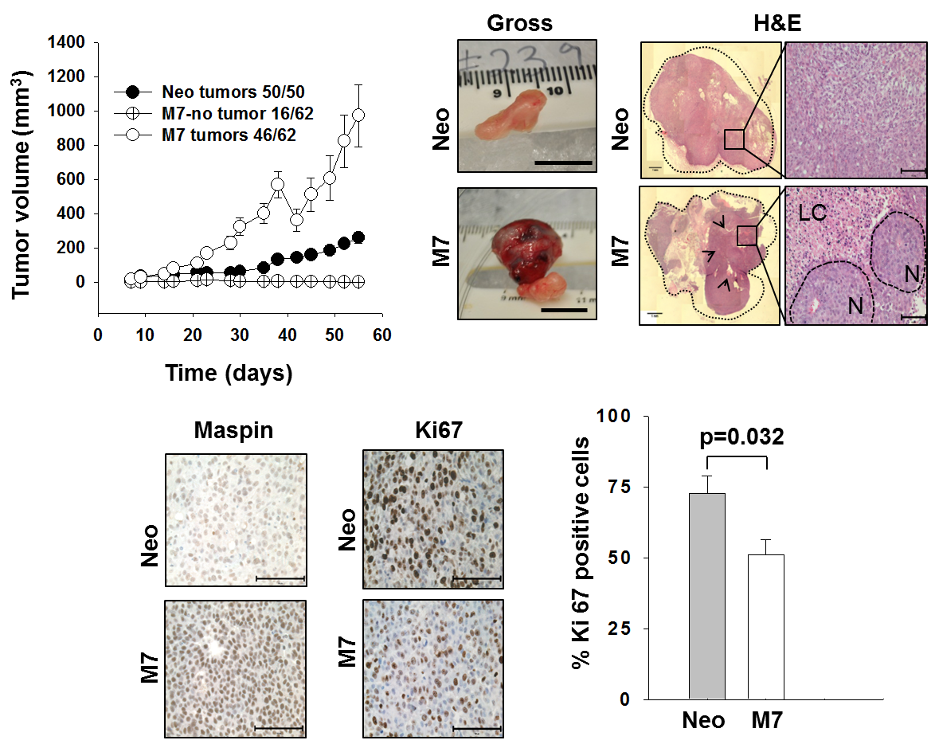
Maspin-expressing xenograft tumors with anti-tumor immune response

Slide 11
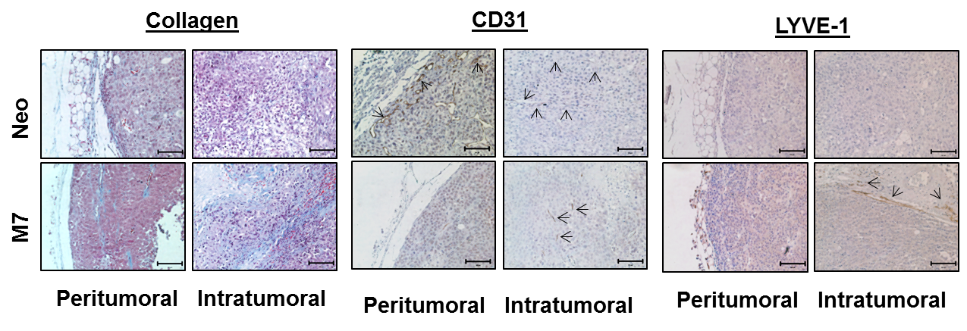
Stromal Response Regulated by Maspin

Slide 12
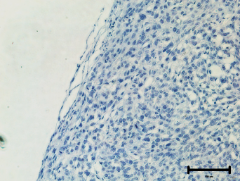
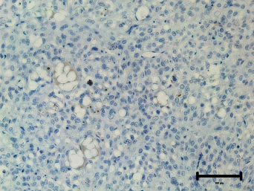
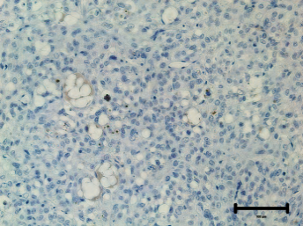
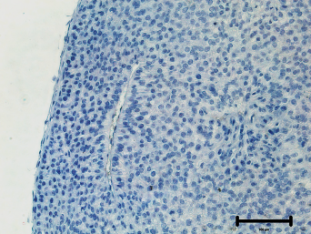
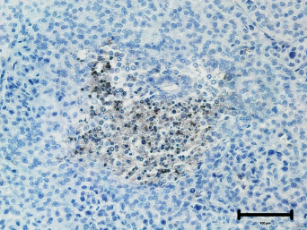
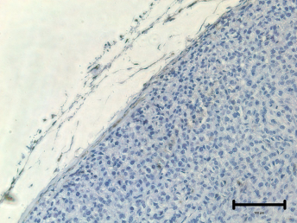
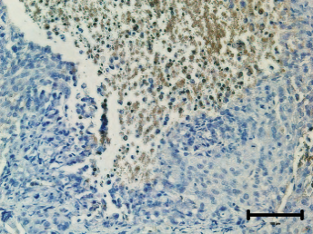
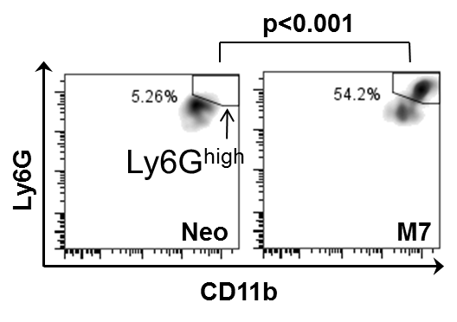
Maspin expression in tumor cells increased neutrophil activation
Peritumoral Intratumoral
Peritumoral Intratumoral
Ly6G
M7 Neo
Elastase
M7 Neo

Slide 13
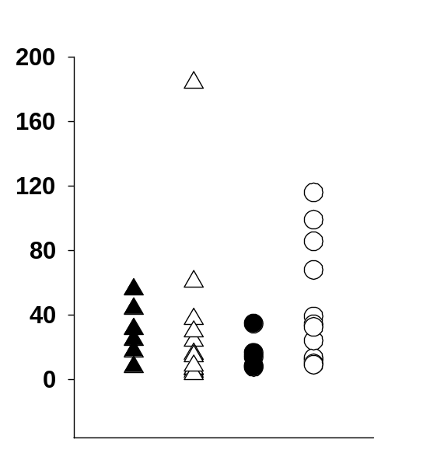
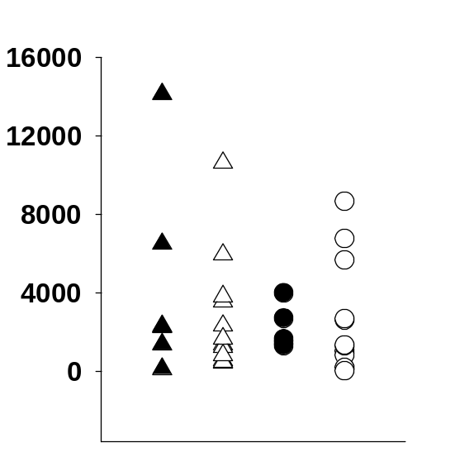
Quantification of tumor-reactive and maspin-specific IgG.
Tumor-reactive IgG (ng/mL)
Maspin-specific IgG (ng/mL)
Neo M7 Neo M7
Neo M7 Neo M7
2 weeks
termination
2 weeks
termination

Slide 14
Maspin, an endogenous HDAC1 Inhibitor
Both endogenous and recombinant Maspin interact and inhibit HDAC1 activity
Endogenous maspin increases Histone acetylation and HDAC1 target gene expression
Endogenous maspin restores epigenetic profile of differentiation in vitro and in vivo

Slide 15


Maspin expression is a fateful step in epithelial cell biology

Slide 16





A Control Button for Maspin Translocation-
Dzinic S, et al, Plos One, 2013
D³⁴⁶
Maspin
Lamin B
Maspin^{D346E}
Lamin B

Slide 18




Strategizing Targeted Therapies for Metastasis
Mas

Slide 19


Towards Maspin-based Biologically Competent Drug Design
X
HDAC1
THANK YOU!
X’
D³⁴⁶

