Slide 1
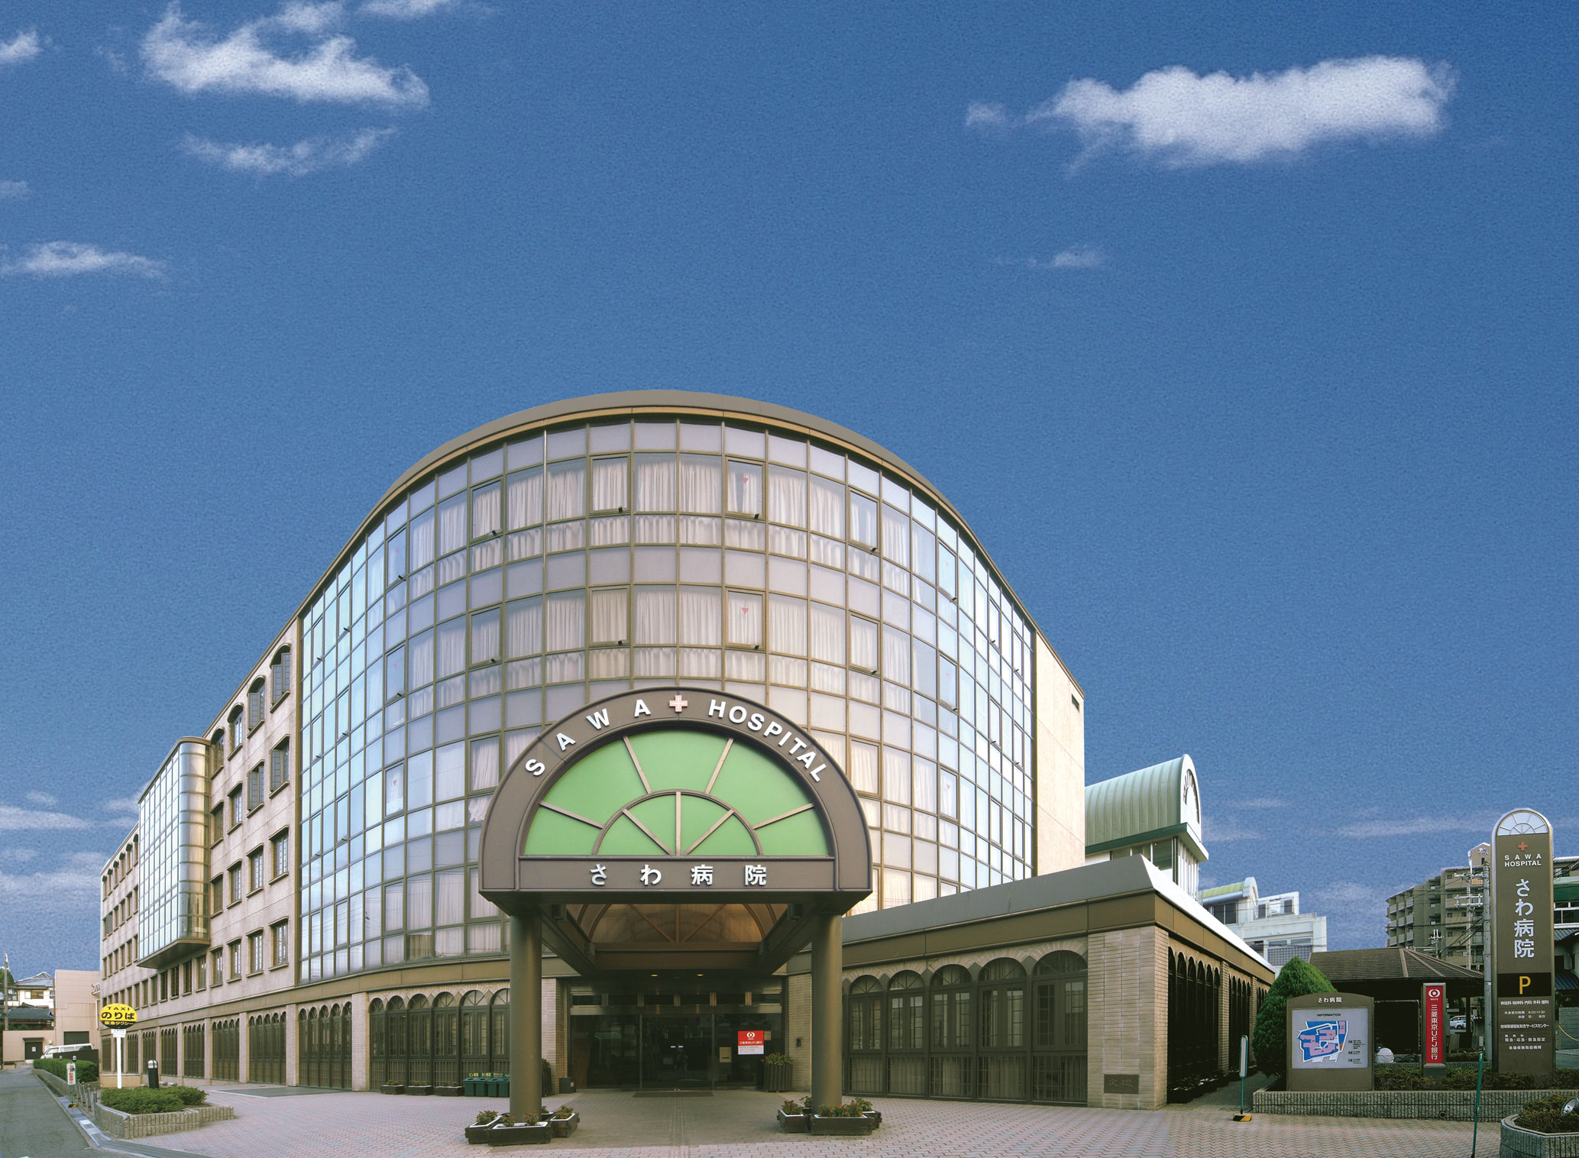
Cerebral Blood Flow by Means of Xenon-enhanced Computed Tomography: From Trans-axial to Surface Quantitative Images
Shigeru Sase¹, Homaro Yamamoto²,
and Yutaka Sawa²
¹Anzai Medical Co., Ltd., Tokyo, Japan
²Sawa Hospital, Osaka, Japan

Slide 2
[Purpose]
To create brain surface images by stacking thin tomographic images obtained by xenon-enhanced computed tomography (Xe-CT).
To demonstrate usefulness of layer-by-layer spherical analysis of blood flow and lambda for patients with dementia.

Slide 3
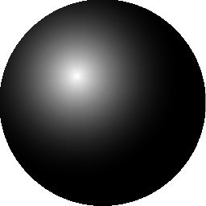
What is Xenon？
① Xe is an inert gas and not metabolized
in human body.
② Goes through blood-brain
barrier.
54
③ Soluble in blood and brain tissue.
Ｘｅ
④ Radiopaque substance due to
large atomic weight.
131.3
Ideal substance as blood-flow tracer using CT.

Slide 4
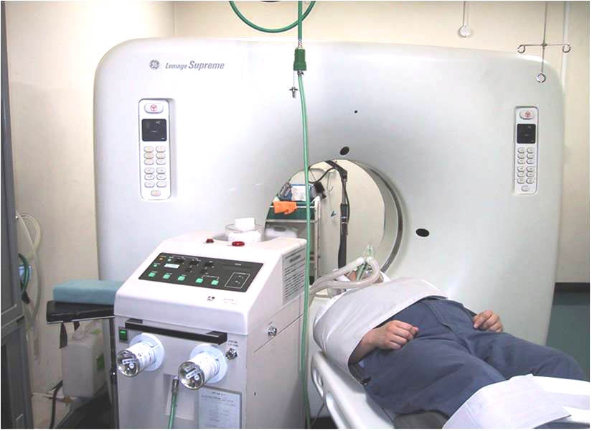
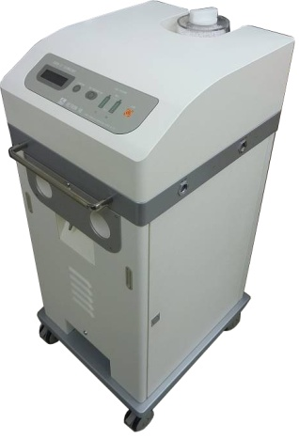

Blood flow measurement using Xe gas
Requirements
Xe gas Inhalator
Workstation for Image Processing
CT System

Slide 5
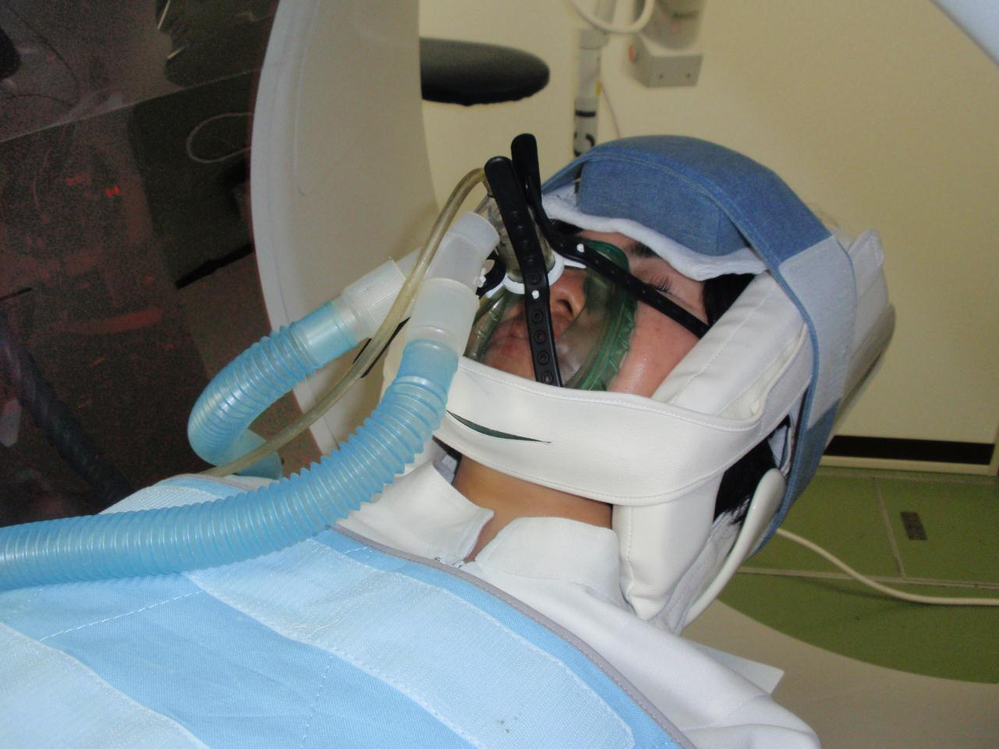
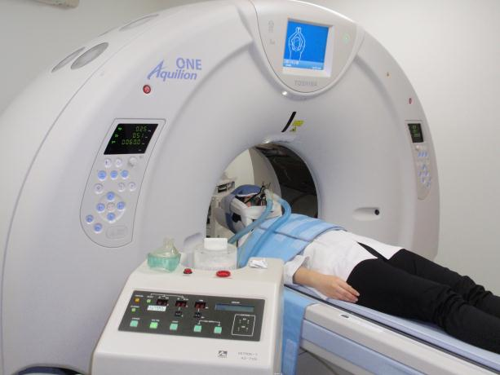
Blood flow measurement using Xe gas
Measurement of respiratory
Xe concentration, which is
used as a surrogate of
arterial Xe.
Inhale 30% Xe for 4 min.
Then, inhale air for 4 min.
Meanwhile, CT scanning
at 1-min intervals.

Slide 6
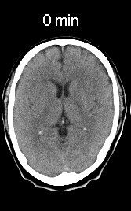
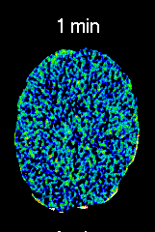
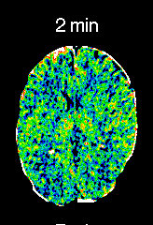
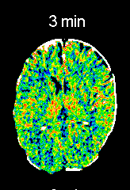
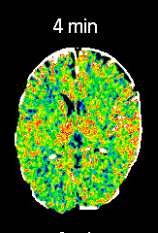
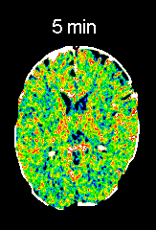
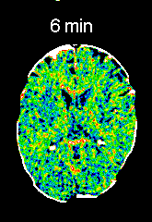
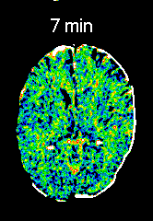
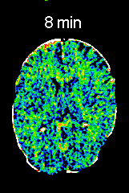
Blood flow measurement using Xe gas
Arterial
Xe Conc.
Aa
Saturation speed (Ka) and saturation concentration(Aa)
of Xe in arterial blood.
Ka
Ka
０
１
２
３
４
５
６
７
８
[min]
Time course of Xe concentration [C(t)]in brain tissue
(Fick’s Law)
Blood flow ( f ) and lambda (λ) can be calculated
pixel by pixel using Ka, Aa and C(t).

Slide 7
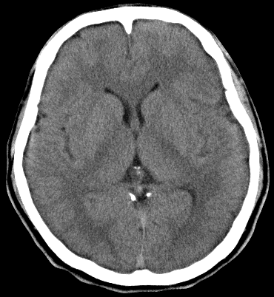
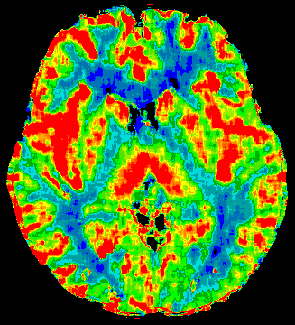
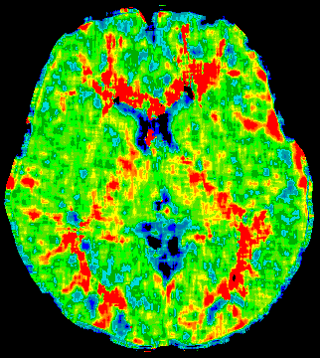
Blood Flow and Lambda Images obtained by Xe-CT
24-y.o. Healthy Man
Blood Flow Image
Lambda Image
[mL/100 g tissue/min]
Xe Solubility Coefficient
Xe Solubility in Tissue
=
Xe Solubility in Blood

Slide 8
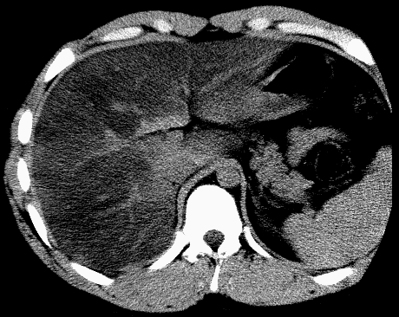
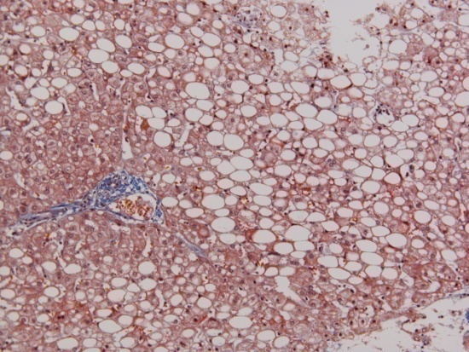
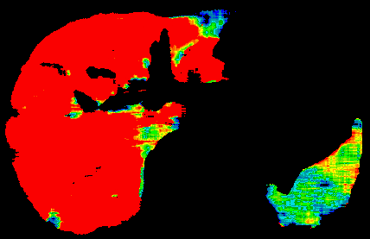
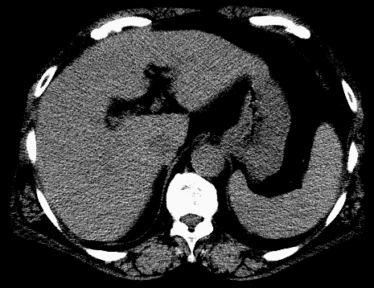
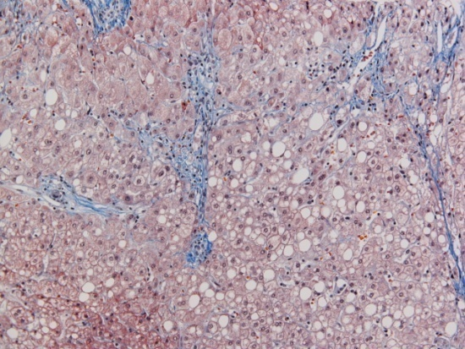
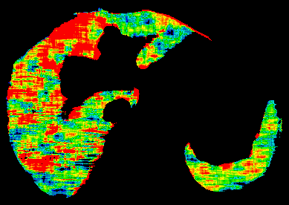
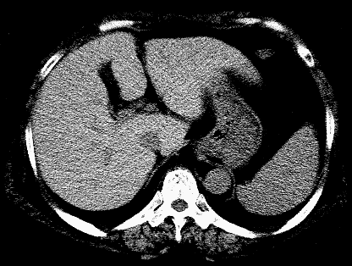
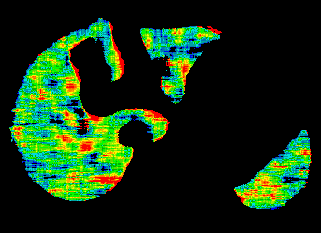
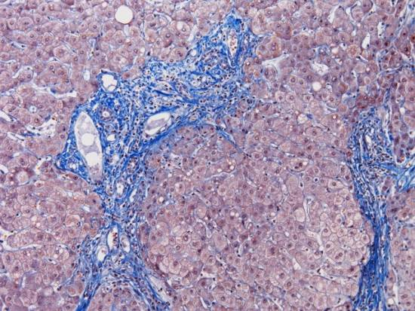

Fatty Liver
Lambda Image
Lambda
Fat-rich
Tissue
High
Fat 90%
15-y.o. Man
1.5 ー
White
Matter
0.8 ー
Gray
Matter
Fat 30%
63-y.o. Woman
Low
Water-rich
Tissue
62-y.o. Woman
Fat 5%

Slide 9
[Methods]
CT: Aquilion ONE (Toshiba, Japan): Area-detector CT capable of volume scan of the brain.
Xe gas inhalator: AZ-725 (Anzai Medical, Japan).
Subjects: Patients with dementia, Age-matched healthy controls.
Creation of brain surface images, and layer-by-layer analyses (layer thickness: 5mm)

Slide 10
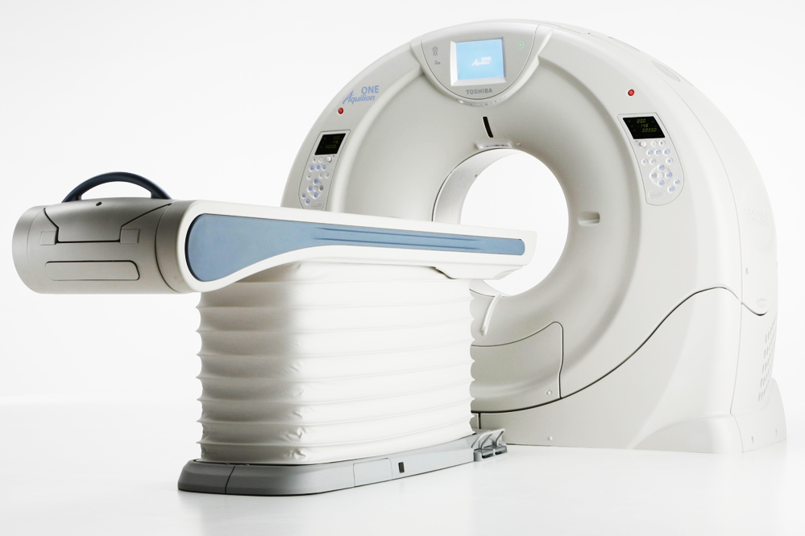

Installed CT Scanner
Toshiba Medical Systems corporation
The coverage of Detector: 160mm （320-row＊896ch）
Slice Thickness: 0.5mm （The thinnest in the industry）

Slide 11
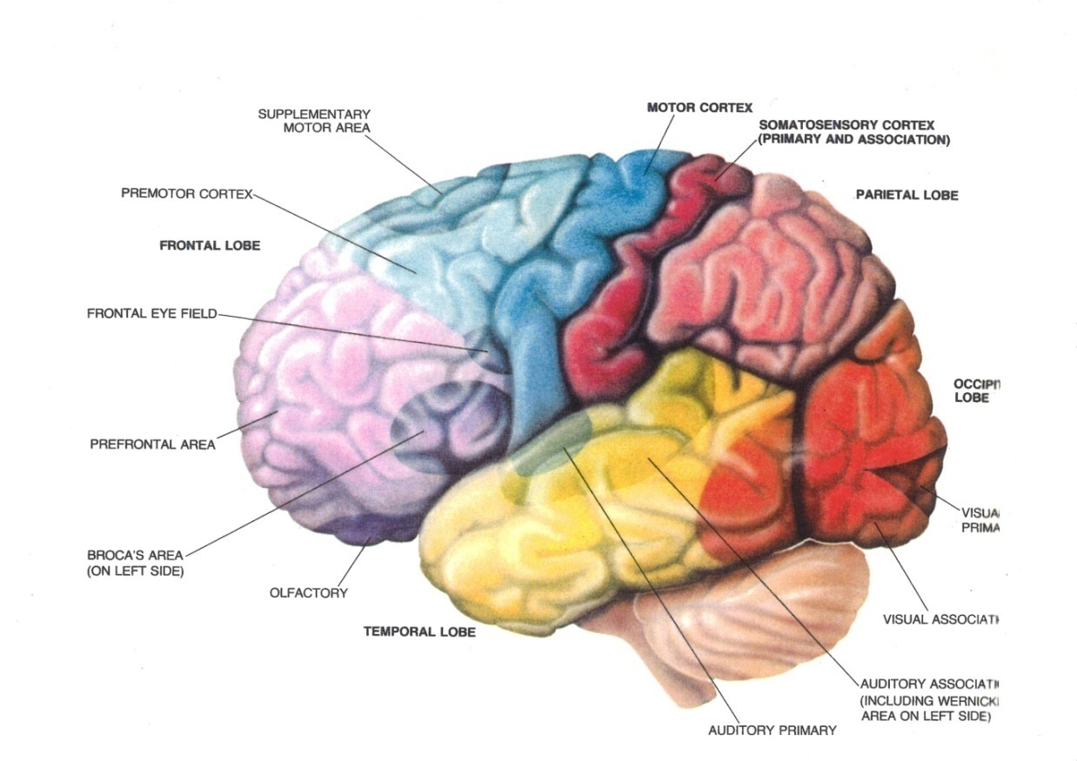
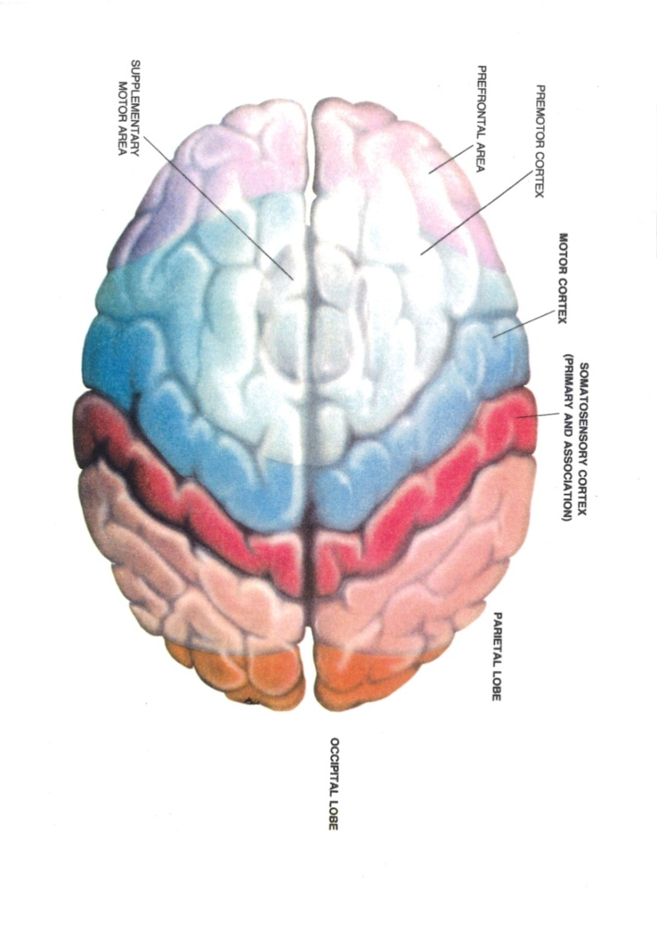
Functional maps of
human cerebral cortex
Parietal Lobe
Frontal Lobe
Occipital
Lobe
Temporal Lobe
Cortices of frontal, parietal, occipital and
temporal lobes

Slide 12
[Results]

Slide 13
Surface images of blood flow and lambda for healthy volunteer

Slide 14
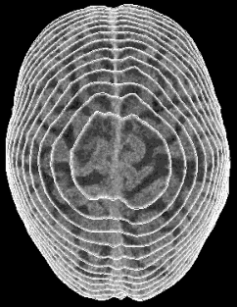
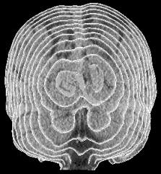
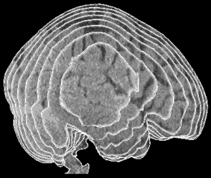
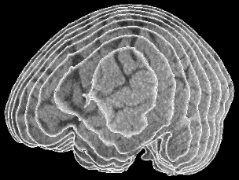
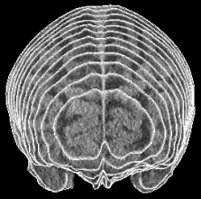
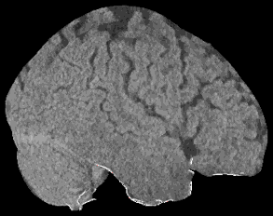
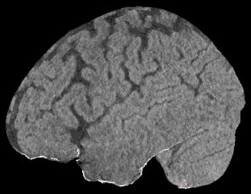
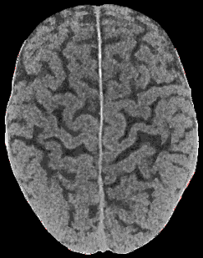
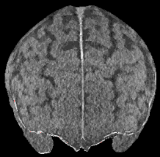
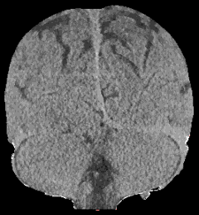
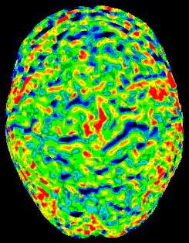
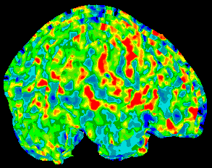
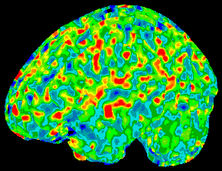
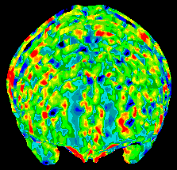
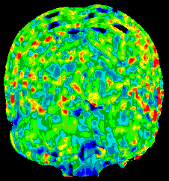
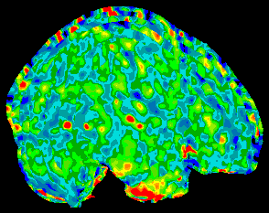
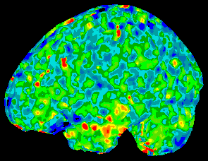
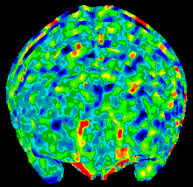
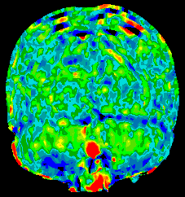
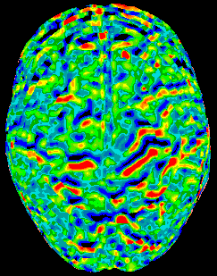
Brain Surface
Healthy Volunteer (77-y.o. Woman)
RT LAT
LT LAT
SUP
ANT
POST
1st Layer
(0-5mm)
CT
2nd Layer
(5-10mm)
CT
Blood
Flow
mL/100g/min
36.1
33.8
38.1
34.5
31.8
Lambda
0.52
0.51
0.53
0.48
0.50

Slide 15
Comparison of Xe-CT and SPECT

Slide 16




















Brain Surface
Patient (78-y.o. Woman)
RT LAT
LT LAT
SUP
ANT
POST
CT
1st Layer
(0-5mm)
Blood
Flow
mL/100g/min
34.6
36.2
32.1
27.3
35.7
CT
2nd Layer
(5-10mm)
Blood
Flow
mL/100g/min
33.0
32.8
32.7
29.7
34.8

Slide 17






Brain Surface
Patient (78-y.o. Woman)
RT LAT
LT LAT
SUP
ANT
POST
CT
1st Layer
(0-5mm)
Blood
Flow
mL/100g/min
34.6
36.2
32.1
27.3
35.7
CT
2nd Layer
(5-10mm)
Blood
Flow
mL/100g/min
33.0
32.8
32.7
29.7
34.8
IMP
SPECT
(3D-SSP)
Blood
Flow

Slide 18





Brain Surface
Patient (78-y.o. Woman)
RT LAT
LT LAT
SUP
ANT
POST
CT
1st Layer
(0-5mm)
Blood
Flow
mL/100g/min
34.6
36.2
32.1
27.3
35.7
CT
2nd Layer
(5-10mm)
Blood
Flow
mL/100g/min
33.0
32.8
32.7
29.7
34.8
IMP
SPECT
(3D-SSP)
Flow
Reduction
Regions

Slide 19
Comparison of AD patient and healthy volunteer

Slide 20




















Brain Surface
AD Patient (83-y.o. Woman)
RT LAT
LT LAT
SUP
ANT
POST
CT
1st Layer
(0-5mm)
Blood
Flow
mL/100g/min
25.5
25.1
25.2
26.8
21.6
CT
2nd Layer
(5-10mm)
Blood
Flow
mL/100g/min
22.2
25.1
25.9
25.1
21.6

Slide 21





Brain Surface
AD Patient (83-y.o. Woman)
RT LAT
LT LAT
SUP
ANT
POST
CT
1st Layer
(0-5mm)
Blood
Flow
mL/100g/min
25.5
25.1
25.2
26.8
21.6
CT
2nd Layer
(5-10mm)
Blood
Flow
mL/100g/min
22.2
25.1
25.9
25.1
21.6
Healthy
Volunteer
(77-y.o.
Woman)
Blood
Flow
mL/100g/min
36.1
33.8
38.1
34.5
31.8

Slide 22
Effect of drug administration to AD patient

Slide 23




















Brain Surface
(2nd Layer)
AD Patient (77-y.o. Woman)
RT LAT
LT LAT
SUP
ANT
POST
CT
Before
Galantamine
Blood
Flow
mL/100g/min
22.7
24.3
24.0
20.9
22.7
CT
After
Galantamine
(3 months)
Blood
Flow
mL/100g/min
24.9
26.1
26.2
25.7
24.4

Slide 24
Brain Surface
(2nd Layer)
AD Patient (77-y.o. Woman)
RT LAT
LT LAT
SUP
ANT
POST
CT
Before
Galantamine
Blood
Flow
mL/100g/min
22.7
24.3
24.0
20.9
22.7
CT
After
Galantamine
(3 months)
Blood
Flow
mL/100g/min
24.9
26.1
26.2
25.7
24.4

Slide 25


1st to 10th layer images
Superior View
Superior View
1st Layer
5 mm
2nd Layer
10th Layer

Slide 26


Limbic System
Thalamus
Hypothalamus
Cingulate Gyrus
White
Matter
Mamillary Body
Parahippocampal
Gyrus
Hyppocampus
(From Wikipedia)
Amygdala

Slide 27
Schematic
Diagram
Superior View Images
1st Layer
2nd Layer
Side View
Remove white areas
in the figure.

Slide 28
Comparison of healthy volunteer and AD patient

Slide 29



Healthy Volunteer
(77-y.o. Woman)
Blood Flow
Lambda
1st Layer

Slide 30



Healthy Volunteer
(77-y.o. Woman)
1st Layer
Blood Flow
Lambda
2nd Layer

Slide 31



Healthy Volunteer
(77-y.o. Woman)
Blood Flow
Lambda
3rd Layer

Slide 32



Healthy Volunteer
(77-y.o. Woman)
Blood Flow
Lambda
4th Layer

Slide 33



Healthy Volunteer
(77-y.o. Woman)
Blood Flow
Lambda
5th Layer

Slide 34



Healthy Volunteer
(77-y.o. Woman)
Blood Flow
Lambda
6th Layer

Slide 35



Healthy Volunteer
(77-y.o. Woman)
Blood Flow
Lambda
7th Layer

Slide 36



Healthy Volunteer
(77-y.o. Woman)
Blood Flow
Lambda
8th Layer

Slide 37



Healthy Volunteer
(77-y.o. Woman)
Blood Flow
Lambda
9th Layer

Slide 38



Healthy Volunteer
(77-y.o. Woman)
Blood Flow
Lambda
10th Layer

Slide 39



AD Patient
(83-y.o. Woman)
1st Layer
Blood Flow
Lambda

Slide 40



AD Patient
(83-y.o. Woman)
2nd Layer
Blood Flow
Lambda

Slide 41



AD Patient
(83-y.o. Woman)
3rd Layer
Blood Flow
Lambda

Slide 42



AD Patient
(83-y.o. Woman)
4th Layer
Blood Flow
Lambda

Slide 43



AD Patient
(83-y.o. Woman)
5th Layer
Blood Flow
Lambda

Slide 44



AD Patient
(83-y.o. Woman)
6th Layer
Blood Flow
Lambda

Slide 45



AD Patient
(83-y.o. Woman)
7th Layer
Blood Flow
Lambda

Slide 46



AD Patient
(83-y.o. Woman)
8th Layer
Blood Flow
Lambda

Slide 47



AD Patient
(83-y.o. Woman)
9th Layer
Blood Flow
Lambda

Slide 48



AD Patient
(83-y.o. Woman)
10th Layer
Blood Flow
Lambda

Slide 49


















Healthy Volunteer
(77-y.o. Woman)
AD Patient
(83-y.o. Woman)
Blood Flow
Lambda
Blood Flow
Lambda

Slide 50
Healthy Volunteer
(77-y.o. Woman)
AD Patient
(83-y.o. Woman)
Blood Flow
Lambda
Blood Flow
Lambda

Slide 51
Healthy Volunteer
(77-y.o. Woman)
AD Patient
(83-y.o. Woman)
Blood Flow
Lambda
Blood Flow
Lambda

Slide 52
Healthy Volunteer
(77-y.o. Woman)
AD Patient
(83-y.o. Woman)
Blood Flow
Lambda
Blood Flow
Lambda

Slide 53









AD Patient
(77-y.o. Woman)
AD Patient
(83-y.o. Woman)
Blood Flow
Lambda
Blood Flow
Lambda

Slide 54
[Conclusions]
Method of creating quantitative blood flow images for the brain surface was established.
Layer-by-layer spherical analysis would provide useful information which could not be obtained from tomographic images.
High lambda suggests accumulation of substances in which xenon is highly soluble.

Slide 55
[Future]
When the function of head movement correction is much more accomplished, radiation exposure will be reduced by nearly half by decreasing the number of CT scans (from 9 to 5).
Improvement of CT image processing by TOSHIBA could reduce mAs with little deterioration of the quality of CT images and also reduce the radiation exposure.
Quantitative judgment of treatment effectiveness, specifying the form of dementia, and detecting the dementia in its early stage, by means of Xe-CT.

Slide 56
Thank you very much.

