Slide 1
INTEGRATING THE MILESTONES IN GYNECOLOGIC ONCOLOGY GLOBALLY. GYNECOLOGICONCOLOGY-2016
MAY 19-21, 2016 AT SAN ANTONIO, USA.
The Necessity to Stratify Gynecologic Patients In-Vitro Prior to In-Vivo Treatment Modalities.
Sherry Bradford, PhD
AccuTheranostics, 875 Ellicott St – Suite 586, Buffalo, NY, 14203, USA
SUNY @ Buffalo

Slide 2
PERSONSALIZED MEDICINE
The FACTS
WHY STRATIFY PATIENTS? WHY USE CELL DEATH-BASED ASSAYS?
INSIGHT: GENETICS
Cancer as a disease is not a genomic phenomenon. YIKES!!!!!!
It is a phenotypic one.
MUST consider the Tumor Microenvironment; The tumor microenvironment (TME) contributes to tumor heterogeneity. Normal Neighboring Cells
THE INVITRO TEST [taking into consideration TC’s, NNC’s, TME]
RESULTS
In Vitro Testing (11 Breast Infiltrating Ductal Carcinomas) THIS showed the test had validity
In Vivo (5 ovarian carcinomas post in vitro)
In Vivo (Anecdotal)
DISCUSSION/CONCLUSION
Mine and Others will be presented
After all we didn’t reinvent the wheel (Mesopotamia 3500BC), many thought leaders came before us BUT…… the Discussion/Conclusion will establish and support that ChemoFit is a rational and compelling in vitro test that correlates with in vivo outcomes and further substantiates why we must stratify patients prior to administering chemotherapeutic agents(and perhaps even radiation). Moreover the quantifiable substance to be analyzed can be liquid, solid, BM, etc as long as it has cells.

Slide 3

THE FACTS
 Nearly 80,000 women are diagnosed with gynecologic cancers in the United States
 Breast cancer is by far the most common cancer diagnosed in females worldwide, and the second major cause of female mortality and morbidity in the western world.^{[1]} It is because metastatic breast cancers are frequently hard to treat (surgically and therapeutically) – metastasis is the major cause of mortality.
 Ovarian cancer found to be the 2nd most common gynecologic cancer with about
22,000 new cases per year, leading to 16,000 deaths yearly.
 Every woman is at risk for developing a gynecologic cancer. It is estimated that there will be about 98,000 new cases diagnosed and approximately 30,000 deaths in the United States during 2015 as per American Cancer Society. Ovarian cancer has the highest estimated mortality rate at 66%. Ovarian cancer often has no symptoms at the early stages, so the disease is generally advanced when it is diagnosed.
 https://www.emedevents.com/conferenceview/united-states-of-america/texas/san-antonio/medical-conferences-2016/experts-meeting-on-gynecologic-oncology-2016-31585
 OMICS International – Conference Summary

Slide 4

METHODS AND STRATEGIES RELATED TO MANAGEMENT AND QUALITY IMPROVEMENT OF CANCER THERAPY AS WELL AS EXPLORE NEW IDEAS AND CONCEPTS ON A GLOBAL SCALE AND TOPICS INCLUDE OVARIAN CANCER, BREAST CANCER ETC
WHY STRATIFY PATIENTS? WHY USE CELL DEATH-BASED ASSAYS?
Microscopic histological “sameness” does not equate to physiological “sameness” (phenotype), THEREFORE Cancer patients will be highly individual in their response to chemotherapies.
Heterogeneity within the tumor itself AND from person to person
Genes→ Tx→ Trx→Protein – (Genotype-to-Epigenetics (modifications)-to-Phenotype)
Cancer doesn’t grow too much it dies too little. Thus growth-based assays don’t work and why cell- death-based assays do. These type of sensitivity assays have been shown to correlate with favorable response, time to progression and survival.

Slide 5
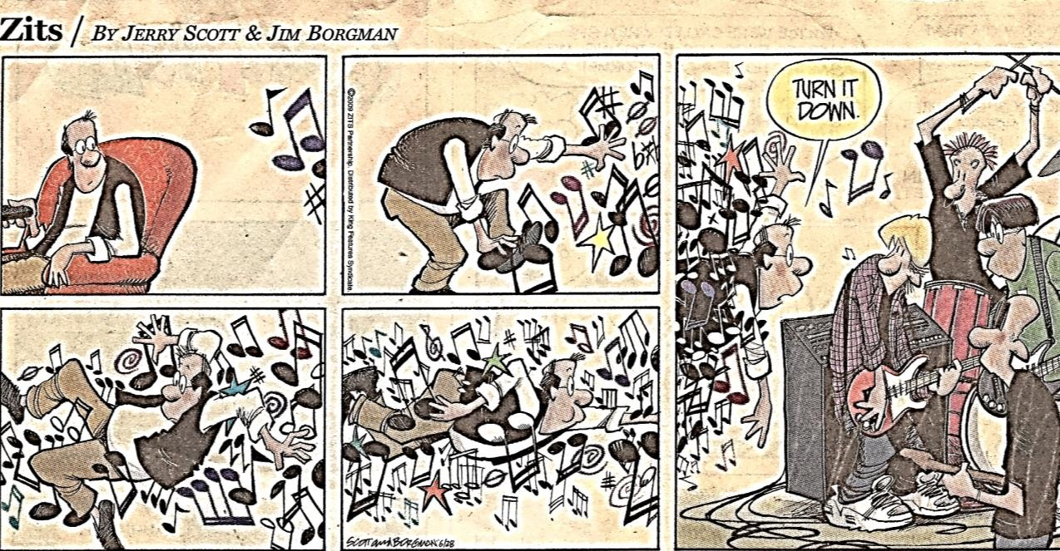
We use clinically applicable/achievable doses – More does not equate to better (etoposide) – Noise
Genomic assays cannot reproduce the complexity, cross-talk, redundancy or promiscuity of human tumor biology (Nagourney). “The objective response rate of just 10 percent, almost all in breast and ovarian cancer patients in one study (Von Hoff J Clin Oncol 2010 Nov 20:28(33): 4877-83), suggests that cancer biology is demonstrably more complex than an enumeration of its constituent DNA base pairs.” ((Genomic Assays))
genomics, transcriptomics, epigenomics, proteomics, and metabolomics

Slide 6
INSIGHT: GENETICS Genomic Assays?
Nagourney: a 32-year-old female with an extremely rare malignancy that arose in her kidney AND 33-year-old gentleman with widely metastatic sarcoma.
both had undergone aggressive multi-modality therapies including chemotherapy, radiation and surgery- suffered significant toxicities-both of their diseases had progressed unabated.
both patients had undergone genetic profiling. RESULTS:. The young woman had “no measurable genetic aberrancies” from a panoply of 370 cancer-causing exomes, while the young man’s tumor revealed no somatic mutations and only two germ-line SNV’s (single nucleotide variants) from a 50 gene NextGen sequence, neither of which had any clinical or therapeutic significance.
By conventional wisdom, cancer is a genetic disease. Yet, neither of these patients carried detectable “driver” mutations. Are we to conclude that the tumors that invaded the cervical vertebra of the young woman, requiring an emergency spinal fusion, or the large mass in the lung of the young man are not “cancers”? It would seem that if we apply contemporary dogma, these patients do not have a cancer at all.
Cancer as a disease is not a genomic phenomenon. It is a phenotypic one.
As such, it is extremely likely that these patients’ tumors are successfully exploiting normal genes
in abnormal ways.
  The small interfering RNAs (iRNA) or methylations or acetylation or non-coding DNA’s that conspired to create these monstrous problems are too deeply encrypted to be easily deciphered by our DNA methodologies. (Genomic Assays)
Chemosensitivity assays can identify drugs active in these patients’ tumor, despite the utter lack of genetic targets. - educated by cellular biology in the absence of genomic insights.

Slide 7
INSIGHT: GENETICS Genomic assays
TARGETED THERAPY
Trastuzumab (Herceptin – Her2/neu gene) is a humanized monoclonal antibody - treatment of patients with
Her2-positive breast cancer. reducing disease recurrences by more than 50% and mortality by 1/3
binds to cancer cells expressing the targeted antigen, AND, causes tumor cell degradation.
HOWEVER, only one third of patients have an initial response – and the majority of initial responders demonstrate disease progression within 1 year of treatment initiation. However, some patients with Her2+ tumors have de novo resistance and do not respond to Trastuzamab.
KNOWN that breast cancer is a heterogeneous disease (Sørlie et al 2001; Clarke et al 2001; van de Vijver 2002; van’t Veer 2002)
DUE to differences in gene expression :. profile - to treat (or not to treat) a certain patient, or in choosing the
most appropriate substances. (Biologics. 2007 Mar; 1(1): 19–31)Test in vitro first – drug is EXPENSIVE
heterodimers of EGFR and Her2 have higher stability and therefore cause prolonged receptor signaling
vs EGFR homodimers, rationale for dual targeting of EGFR and Her2 (Konecny et al 2006; Xia et al 2006). ((EGFR overexpression = Gefitinib and erlotinib are EGFR TK inhibitors (EGFR TKIs)) receptor activation, phosphorylation of tyrosine residues on the cytoplasmic domain activates downstream signaling pathways,
= cell survival PI3K (phosphatidylinositol 3-kinase)/Akt pathway, AND cell proliferation pathways mediated by mitogen-activated protein kinase (MAPK). NOW because of hypoxia, hypoxia inducible factor 1α (HIF) is produce which leads to production of vascular endothelial growth factor (VEGF) expression (Yen L et al 2000; Izumi et al 2002), (Laughner et al 2001) . Also due to mTOR and MAPK signaling, which in turn may be blocked by trastuzumab.

Slide 8
WHY USE CELL DEATH-BASED ASSAYS?
Alternative approaches can be identified to provide patients with newer and better therapies as well as sustain
the pharmaceutical industry.
How are drugs initially tested? Cell lines (immortalized) and animal models – translatability to humans?
Cancer drugs target pathways, cell cycle, proteins, etc and thus they should be used in relationship to their mechanism of action and not by the NOT the cancer per se.
Off-protocol, metformin, DCA, nutraceuticals etc
Erlich, Paul, who coined the term "chemotherapy", emphasized the need for agents that were selectively toxic. [microbes]
Black MM, Spear FD (1954) were the first to report the use of .... vitro drug-response tests in terms of their sensitivity and specificity
Nixon Declares War on Cancer- National Cancer Act of 1971, On December 23, 1971, President Nixon followed through on his promise as he signed the National Cancer Act into law, declaring, "I hope in the years ahead we will look back on this action today as the most significant action taken during my Administration."¹
The National Cancer Act (P.L. 92–218), "The War on Cancer," gave the NCI unique autonomy at NIH with special budgetary authority.

Slide 9
Tumor Microenvironment (ME) OUR Gamish!!!!
 Tumor cells can actively elaborate and remodel their surrounding microenvironment and this altered microenvironment can in turn; influence/remodel the behavior of the tumor and influence the metastatic behavior of cancer cells.
Metastatic Cascade
 Tumor–stromal cross-talk initiates the escape of cancer cells from the primary site, the circulation in vasculature, survival,
growth at the secondary site.
Adhesive Interactions Influencing Metastases
 Integrins are the major extracellular matrix (ECM) receptors, integrin adhesive interactions between tumor cells and the ECM
play an important role in metastasis.
In invasive cancers, transition to tissue invasion includes loss of cadherin-dependent transition, partial degradation and remodeling of the ECM.
Immune Cell Influences
junctions, epithelial–mesenchymal
 Tumors hijack normal tissue development programs such as repair and regeneration, and the NK cells originally recruited to the tumor site are able to stimulate immune responses and aid in tumor destruction but eventually become persuaded by mechanisms of immunosuppression. (Immune ck pts)
Paracrine Signaling Molecule
 Various soluble factors such as growth factors and chemokines act in a paracrine fashion to mediate tumor–stromal cross- talk and, in conjunction with integrins, they coordinate cellular functions and signaling pathways that promote EMT, ME remodeling and metastases.

Slide 10
Premetastatic Niche & Tumor Dormancy
► Factors secreted from primary tumors may assemble premetastatic niches for distant metastasis, and tumor dormancy explains late recurrences and drug resistance in metastatic disease.
Therapeutic Targeting of Tumor Stroma Interactions
► Therapeutic targeting of the various elements of the tumor microenvironment or targeting signaling pathways activated by tumor–stromal interactions is a useful strategy to prevent tumor progression/metastasis.
The tumor and its surrounding microenvironment are closely related and interact constantly.
Tumors can influence the microenvironment by releasing extracellular signals, promoting tumor angiogenesis and inducing peripheral immune tolerance, while the immune cells in the microenvironment can affect the growth and evolution of cancerous cells such
as in immuno-editing. The tumor microenvironment contributes to
tumor heterogeneity.
Nagourney, Robert
Bindra, Ranjit S.; Glazer, Peter M. Blagosklonny, Mikhail V
Weber, Cynthia E.; Kuo, Paul C

Slide 11
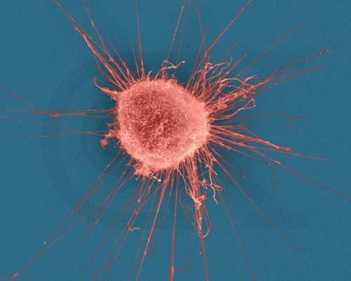
The Emperor of All Maladies: A Biography of Cancer
Siddhartha Mukherjee
Tumor MicroEnvironment
Extracellular Matrix. The ECM is composed of many proteins including laminins, fibronectin (FN), type IV collagen, entactin/nidogen and proteoglycans. Infiltrating cells; vascular cells, fibroblasts; neighboring cells

Slide 12





Methods Materials
Receive fresh tumor biopsy specimen within 24-hrs of surgery.
Disaggregate tumor:
Single Cell Suspension
Kit – Globally Clinical Trials IRBs
Single Cell Heterogenates
SCH
‘Gamish’ – ECM Molecules
Initial Viability Determination
Cell Count & Viability Determination
Equilibrate cells for 24-hrs @ 37⁰C in a humidified 5% CO₂ incubator
Set Up the Test using
Appropriate Controls:
Viable Cells = Cells without Drug
Dead Cells = 56⁰C for 1-hr
Test = Drugs
Continued
72 hrs Incubation

Slide 13



Post incubation, SCHs were washed and tagged with Molecular Probes LIVE/DEAD® Fixable Green Fluorescent Stain (Invitrogen, Molecular Probes) to evaluate SCH viability by Flow Cytometric methodologies. “Gamish” no debris
The reactive stain can permeate the compromised membranes of dead cells and react with free amines on the interior and exterior of the cell, resulting in high/bright staining, whereas only membrane-exterior free
amines of viable cells are available to react with the dye, resulting in dim staining, and intense staining for dead cells .
In vitro SCH chemotherapy response was determined using a Becton Dickinson FACScan Flow Cytometer (BD, 1 Becton Drive Franklin Lakes, NJ USA 07417) - SCH were analyzed for percentage of live versus dead cell populations.

Slide 14
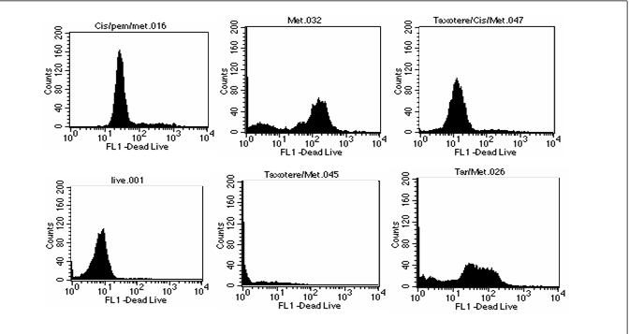
ANALZE ON FLOW CYTOMETER
Both FSC and SSC are unique for every cell-combination of the two used to differentiate various cell types in a heterogeneous sample
The data acquired = ‘events’ and refers to the number of cells (Counts Y-axis)
A histogram is generated based on the data acquired, which in this case represents the percentage of live and
dead cell populations delineated by decades – FL 1 (Amount of Fluorescence – low-to-high – 10⁰ to 10⁴ )
The range 10⁰ to 10¹ is defined as the live population-Resistant cells and the control SCH population (no cytotoxic drugs added) fall in this range - Beyond 10¹ is defined as ‘dead cells’
Between 10⁰ and the first bar is the debris region (cells with low dye uptake)
FSC = cell size SSC = granulation
Flow Cytometry analysis of a non-small cell lung SCH (the histograms in this figure are for illustrative purposes - the lung tumor was not one in this study).
Legends:
live (no exposure to drugs) indicates 98% viability; these cells have only picked up color on the outside of the cell.
95% shattered cells – debris ‘travels’ up the Y axis, the combination of MET and TAX have shattered the cells (made debris of the cells), reflecting no stain/no color.
69% dead cells are in the 2nd decade designated dead, as the cell membrane has been compromised by the drug(s) and the stain has entered intracellularly, thus more color is exhibited. TAR/MET
63% dead cells, cells are in the 2nd decade designated dead.
CIS/PEM/MET (ALIMTA)
9% of the tumor cell populations were killed by MET as a single agent.
9% dead cells (adding CIS to the combination of TAX/MET inhibited cell death).
D
E
F
A
B
C

Slide 15

















































RESULTS
ALL failed conventional therapy
Infiltrating Breast Ductal Carcinoma
Breast IDC
Breast IDC
Breast IDC
1
 | 5% |  | 0%
1
0.8
0.6
0.4
0.2
0
89%
1
83%
1
0.8
0.6
0.4
0.2
0
0.9
0.8
0.6
0.4
0.8
0.7
0.6
0.5
35%
25%
18%16%
0.4
25%
23%
25%
8%
0.3
15%
5%
_{2%} 6% 5%
3%
0.2
3%
2%
2%
0.1
0
DCA DCA DCA DCA
0.2
0
+ Met + +
Riba Tam
+
Raba
DCA DCA + DCA + DCA +
Met Riba + Tam
Raba
Breast IDC
Breast IDC
Breast IDC
Breast IDC
1
0.9
0.8
0.7
0.6
0.5
0.4
0.3
0.2
0.1
0
1
0.9
0.8
0.7
0.6
0.5
0.4
0.3
0.2
0.1
0
95%
85%
1
0.9
0.8
0.7
0.6
0.5
0.4
0.3
0.2
0.1 1%
0
1
0.9
0.8
0.7
0.6
0.5
0.4
0.3
0.2
0.1
0
70%
81% 82%
73%
58% 57%
_{42%}47%
60%
44%
34%
39%
32%
42%41%43%
7% _{2%}
3%
_{25% 24%} 27% 28% 27% 26% _{23%}
20%
1%
DCA
DCA + Met DCA + Tam DCA + Fem DCA + Tax
DCA + Riba +…
DCA + Cis
DCA + Carbo
Unless Noted: DCA inhibited the conventional therapeutic drug; or no synergy was noted with the conventional therapeutic drug; or if synergy was LDS; or inhibition of both agents when combined. This is noted by the Dark Colored Histograms; Red Colored Histograms (X); Synergy (HDS) when conventional chemotherapeutic drug was combined with DCA; Blue Colored Histograms (X); Synergy (IDS) when conventional chemotherapeutic drug was combined with DCA
ABBREVIATIONS: *chlor-Chlorambucil; ix-Ixempra; lap-Lapatinib; lom-Lomustine; TMZ-Temozolomide; eto-Etoposide; met-Metformin; riba-Ribvirin; rapa-Rapammune; tam-Tamoxifen; cis-Cisplatin; tar-Tarceva; MTX-Methotrexate; dox- Doxorubicin; tax-Taxol; fem-Femara; chlor-Chloroquine; FU-Fluorouracil; mito-Mitomycin; vin-vinblastine; carbo-Carboplatin; gem-Gemcitabine; nav-Navelbine; iri-Irinotecan; oxi-Oxilaplatin; HD-High Drug Concentration = 10X Peak Plasma Concentration; LD = Low Drug Concentration = 50% Peak Plasma Concentration

Slide 16
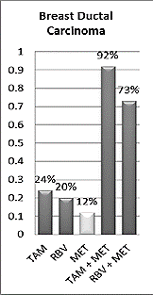
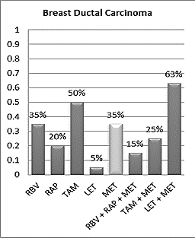
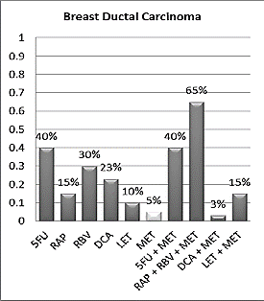
RESULTS
Metformin binds to the cell surface receptor - OCT 1 [Oganic Cation Transporter-1] – once bound, metformin reduces ATP production - inhibiting mTOR activity – resulting in a cytostatic effect. Tumor cells often express high levels of the OCT 1 receptor, indicating a potential role for metformin’s action in promoting entry of therapeutic agents into the tumor microenvironment
Legend: 5FU: 5-fluorouracil; ART: Artesunate; CIS: Cisplatin; DCA: Dichloroacetate; DOC: Docetaxel; DOX: Doxorubicin; ERL: Erlotinib; LET: Letrozole; LOM: Lomustine; MET: Metformin; MTX: Methotrexate; RAP: Rapamycin; RBV: Ribavirin; TAM: Tamoxifen; TMZ: Temozolomide

Slide 17
RESULTS
Ovarian carcinoma - ascites DCA + Tam reduction in CA 125
Ovarian carcinoma - cisplatin tumor shrinkage on CT
Ovarian carcinoma - (+) cis and carbo put on carbo less toxic
Ovarian carcinoma - Lymph node biopsy - gemcitabine too weak for chemo –died
Ovarian carcinoma - Too old for Taxol put on ammonium tetrathiomolybdate
55 yr F with metastatic ovarian carcinoma, treated initially with hysterectomy and bilateral salpingo-oophorectomy with omentectomy, followed by chemotherapy with paclitaxel (Taxol) and carboplatin. 1 yr – recurrence, 2 months post- Medicor/Dr. Khan - Treatment: DCA + TM. This patient was successfully treated with a combination of DCA+TM and experienced stable disease (proven by CA-125 and CT scans) for the entire duration of the treatment which was about 6 months. The main advantage of this treatment was the lack of serious side effects, especially compared to the traditional treatment of chemotherapy. 2015

Slide 18
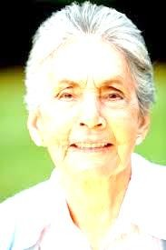

Anecdotal: 89 yr old - F – Breast Cancer
Treated at local cancer institute and was told she had 6 weeks to live
Daughter is a friend and inquired if we could help as she wanted QOL and to see her granddaughter get married which was 6 months away
Suggested: Metformin @ PP; Carboplatin/Taxol @ 1/3 concentration
(avoid tumor lysis syndrome and to give QOL)
Lived 1 yr – 6 mths w/ QOL

Slide 19

Anecdotal: ? yr old - M - Lung Cancer/NSCLC
May 03, 2013
Bonjour Dr. Khan
Now… hold on to your socks.
I had a CAT scan done last week and there are NO traces of tumours on my lungs!!!!
My oncologist is cautiously optimistic. I was supposed to have 6 treatments of chemo and he decided that yesterday, my 4th, would be my last for 3 months followed by another CAT scan in July.
Forever Grateful,
---------------------
From a patient who added metformin to chemo for NSCLC

Slide 20
Discussion/Conclusion
USE OF SCHs
Tumor micromilieu: “passengers”, and “neighbors” have an absolute influence as well.
I.e. the tumor’s “passenger” endothelial cells, and other resident host stromal cells, are critical for cancer progression. Jain et al, show that in tumor transplants - wild-type mouse hosts, = tumor angiogenesis are dependent on transplanted “passenger” endothelial cells rather than recruiting them from the host.
Juxtapositioned (‘neighboring’) cells to the tumor cells also confer signals to the tumor milieu
and vice versa, contributing to evolution, maintenance and progression. What makes some types of
cancer resistant to drugs? Reporting in Nature, researchers write that cancer cells may be dodging treatment with help from seemingly innocent bystanders, neighboring cells [Why do targeted therapies often produce short-lived results? Well, some scientists are looking for answers within the cancer cells. But one team of researchers decided to search for clues beyond the cancer cells, in the tumor's own neighborhood, and they say what they found could have a major impact on cancer research and personalized medicine. Dr. Todd Golub - Nature. -Dana-Farber Cancer Institute]
Researchers, from the Harvard School of Medicine “evolution of tumor cells as a co-evolution between tumor cells and the cells in its microenvironment, so that the developmental trajectory may be established by tissue states defined by a cell-cell interaction network (attractor landscape and tumor evolution) and not defined by gene-gene interactions”. Defining the ‘attractor landscape’ as the ‘neighboring’ cells.

Slide 21
So we’re using SCHs and we get resistance (not sensitivity)……………WHY?…………………………………......
MULTIDRUG RESITANCE BESIDES INHERENT ACQUIRED
WHY INCLUDE THE OTHER CELLS BESIDE THE TCs in the ‘GAMISH’?
Reporting in Nature, Todd Golub Dana-Farber Cancer Institute
cancer cells may be dodging treatment with help from seemingly innocent bystanders.
tumor's microenvironment may affect its behavior.
patient is taking an anti-cancer drug, tailored to the genetic makeup (Personalized Medicine)
of his tumor, and right after the targeted therapy, the patient shows a dramatic recovery, side effects of conventional chemotherapy are minimum.
But then a few months later, the cancer is back again. How ? some scientists WERE looking for answers within the cancer cells. But one team of researchers decided to search for clues beyond the cancer cells, in the tumor's own neighborhood=ME, they found proteins that are mutated in the cancer cell but not in the normal cell. So these show great promise for being much more specific only for the cancer cells, not having side effects. So there's a lot of excitement in our community now around using these new target))ed agents that are specific for particular mutations in particular tumor types.
BUT they did not look at the microenvironment (ME), the neighborhood (NH) CELLS of the tumors, only the tumor cells themselves, but the ME and NH cells were contributing to this resistance.
= different types of fibroblasts, types of blood vessel cells, fat cells, all these types of normal cells in the body that are in and around the tumor, those other cells, could make the melanoma cells resistant to drug therapy.

Slide 22
What did the Dana Farber Researchers Find?
most NH don't make them resistant, but one particular type of fibroblast was able to make melanoma tumor
cells completely resistant to the drug.
there was a single factor, hepatocyte growth factor (HGF), that was needed to make the tumor cells resistant.
In fact, any fibroblast that produces HGF protein was able to make the cancer drug-resistant. HGF plays a role
in a number of developmental processes. It's important in the liver, that's why it's called hepatocyte growth factor. But people hadn't been thinking about it as having anything to do with drug resistance or drug sensitivity for melanoma.
Many times, genes and proteins get named for the first place that they're discovered, but in fact they're later discovered to have important normal roles throughout the body. HGF may be playing this trick on other tumors, as well. there's some early evidence that there might be some particular types of colon cancer, brain tumors ETC
HGF is causing this drug resistance - reverse the drug resistance by blocking the HGF protein with a combination of the B-Raf drug and an inhibitor of the HGF pathway and found that now the tumor cells became sensitive again = the tumor cells died - whereas without this HGF blocker, the cells were completely resistant.

Slide 23
ER+/PR+/Her(-) Breast Cancer - HGF is causing this drug resistance?
 hepatocyte growth factor (HGF)-induces activation of its cell surface receptor = the Met tyrosine kinase (TK)
 the receptor is tightly regulated by paracrine ligand delivery,
 ligand activation at the tumor cell surface, results in ligand/receptor internalization and
degradation.
 HGF/Met signaling now contributes to oncogenesis and tumor progression in several cancers and promotes aggressive cellular invasiveness that is strongly linked to tumor metastasis.
 The prevalence of HGF/Met pathway activation in human malignancies has driven rapid
growth in cancer drug development programs.
 HGF/Met pathway antagonists are now in preclinical and clinical development
Rilotumumab
Targeting the HGF/MET signalling pathway in cancer therapy
Fabiola Cecchi.Daniel C. Rabe and Donald P. Bottaro Expert Opin Ther Targets. 2012 Jun; 16(6): 553–572.

Slide 24
SCHs
Overcoming drug efflux-based multidrug resistance in cancer : one way is to administer the correct agent(s) the FIRST time; NOW cells became resistant not only to the first incorrect drug administered but also to chemically unrelated drugs later administered. Breast and Ovarian cancers
Serious toxicity is a critical problem for effective chemotherapy because most anticancer agents lack selective efficacy in tumors. This leads to tumor resistance to conventional chemotherapy. Chin J Cancer. 2012 Feb; 31(2): 100–109. Chin J Cancer. 2012 Feb; 31(2): 100–109.
Multidrug resistance (MDR), significantly decreases the efficacy of anticancer drugs and causes tumor recurrence, a major challenge in clinical cancer treatment with chemotherapeutic drugs for decades.
*P-glycoprotein (P-gp) and other drug efflux transporters are considered to be critical in pumping anticancer drugs out of cells and causing chemotherapy failure;
P-gp is the most prevalent and single most important cause of multidrug resistance. P-gp gets upregulated after exposure to chemotherapy drugs; the pump is overexpressed breast, ovarian, and other tumors whose healthy tissue counterparts typically express only low levels, (Susan Bates, M.D., (NCI’s Center for Cancer Research)
MRP1 (multidrug resistance protein)

Slide 25
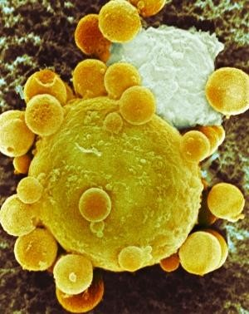
Nature | News
Cancer cells can ‘infect’ normal neighbors ‘GAMISH’
Exosomes TCs, Neighboring Cells, Normal Cells
Tiny RNAs or DNAs/PR shed by tumors can transform healthy cells into cancerous ones. Heidi Ledford
Nature | News 23 October 2014
Act as signals/cell-to-cell commication
A cancer cell (yellow) sheds membrane vesicles.

Slide 26
EXOSOMES/SCHs
Cancer cells -voracious energy consumers, all are dependent on glycolysis.
Nagrath's lab (University of Texas MD Anderson Cancer Center) and others have shown that each type of cancer has a unique metabolic profile.
I.e. aggressive ovarian cancer cells are glutamine-dependent and that depriving the cells of external sources
of glutamine is an effective way to kill late-stage ovarian cancer cells in the lab.
A December 2014 study found that ovarian tumors coax adult stem cells into providing key metabolites they need to grow - exosomes can facilitate crosstalk between cancer cells and other types of cells that are nearby in the microenvironment that surrounds the tumor; exosomes of stromal cells,
stromal exosomes were influencing the energy consumption of cancer cells.“ Known that contrary to popular belief, glucose alone is not enough to stimulate cancer cell growth. However, some tumors love high insulin levels. E.g. breast cancers need insulin. Insulin – grow, multiply, divide.
Thus there exists a reciprocal and dynamic interaction between the tumor cells. its microenvironment, stromal components and neighboring cells to bring about an inherent cellular diversity necessary for tumor evolution, maintenance, survival and progression.
This communication interface facilitates a phenotypic plasticity, conferring a range of phenotypic manifestations within a norm of reactions;
a distinguishable phenotype evolves with substantial intra-tumor heterogeneity, a specific cellular morphology, specific cell surface markers (such as growth factor and hormonal receptors) that induce high metabolic rates, motility, angiogenesis, proliferation rates, immunogenicity (or lack of) and metastatic potential.
Personalized Medicine

Slide 27
WHY DID WE ANALYZE METFORMIN?
Epithelial–Mesenchymal Transition (EMT) – process in which polarized epithelial cells are
converted into motile migratory cells, molecular signature of cancer
= tumor progression. towards dedifferentiated and more malignant states; endows CCs w/ SC properties [EMT sufficient to trigger ontogeny of cancer cells stemness]
EMT gives rise to the dissemination of single carcinoma cells from the sites of the primary tumors; promote cancer cells progression and invasion into the surrounding environment
Normal embryonic model systems and transformed cell lines has identified several signal- transduction pathways for EMT, including the activation of several receptor tyrosine kinases and transforming growth factor-receptors.
► Metformin inhibits EMT pathways, EMT is one of the major hallmarks in cancer. By acting on mesenchymal cancer cells, metformin could prevent generation of cancer stem cell phenotypes. If such a cell reprogramming is demonstrated, then metformin would be an essential weapon in oncological therapy. BLOCKS mTOR/AKT PWs; KILLS Cancer Stem Cells/Adult Cancer Cells, ((later found out we could decrease the dosage of standard chemo by 2/3)) can use it prophylactically non-carcinogenic

Slide 28
WHY DID WE ANALYZE DCA?
TC Mitochondria are hyperpolarized, mito are effectively inactive with ↑glycolysis and ↓ glucose oxidation (GO) conducive with apoptosis resistance = (Warburg Effect/lactic acid fermentation; helps break down the extra-cellular matrix/increases cell mobility (metastases), potentiates tumor growth,, activates angiogenesis
THUS Lactic acidosis mimics tumorigenesis in humans, complete with the inefficient bioenergenic mito
TCs – hypoxia PDK (Pyruvate dehydrogenase kinase) inhibits PDH (phos.) in a variety of cancers thus pyruvate fermented to lactate – glycolytic phenotype no apoptosis
Dichloroacetate (DCA) shifts TC from glycolysis to GO – reversing of mitochondrial hyperpolarization apoptosis. In addition, increases production kreb’s cycle intermediates
*mitochondria-derived ROS,
*activates p53
*or inhibits pro-proliferative and pro-angiogenic transcription factors like nuclear factor of activated T –cells factors (Nuclear factor of activated T-cells (NFAT) shown to be important in immune response. and
*or inhibits hypoxia-inducible factor 1α (HIF 1α).
Reverses the Warburg Effect

Slide 29
WHY THE USE OF THE FLOW CYTOMETER?
All materials that contain cells – thus we are not limited
All types of cell death
Ie. Autophagy is one of the main cytoprotective mechanisms of TCs deploy under cytotoxic stress, survive lethal damage of anti-cancer drugs.
HOWEVER, under specific physiological conditions, autophagy may, directly or indirectly, induce cell death. = lack of cellular content in the autophagosomes, :. autophagosomes are not fully functional, and action of RIPK1 with p62, = Silencing of p62; etc etc
I.e. Treat TCs with sorafenib undergo a caspase-independent cell death, induces formation of Atg5-deficient autophagosomes; promotes the interaction of p62 with RIPK leading to cell death by necroptosis.
Autophagy may be that alternative mode of cell death in apoptosis-resistant cells as there is cross- talk between autophagy and apoptosis PWs at many levels because both pathways share mediators, ranging from the core machinery to upstream regulators. The combined impairment of apoptosis and autophagy promotes necrotic cell death in vitro and in vivo - it is likely that insufficient ATP production to maintain plasma-membrane integrity results in metabolic catastrophe and cell lysis (Our debris?)
Thus, autophagy is emerging as an alternative target to promote apoptosis, autophagy, anoikis, necrosis,
Pedram Kharaziha, et al, Sorafenib-induced defective autophagy promotes cell death by necroptosis. Oncotarget. 2015 Nov 10; 6(35): 37066–37082.

Slide 30
IN CONCLUSION:
Cancer remains one of the most challenging diseases to treat.
This, in part, is due to the heterogeneity of tumors.
Most cancers are monoclonal in origin, however, due to innate genetic instability subsequent cell generations take on new characteristics.
But, tumors cells are not the only contributors of tumor heterogeneity, the entire microenvironmental constituents and its non-tumorous cells have an absolute influence as well.
Thus, there exists a reciprocal and dynamic interaction between tumor cells, microenvironment
constituents and non-tumorous cells that produce a well-defined individualistic tumor phenotype.
The clinical relevance is that the tumor and its microenvironment heterogeneity contributes significantly to the efficacy of drug therapy.
Also, transporter genetic variants cause population-specific differences in drug transport and therefore impart considerable inter-individual variation in pharmacotherapy and thus clinical response to a myriad of agents. a highly individualized therapeutic regimen.

Slide 31
This divergence underscores the necessity of personalized medicine wherein the data garnered from a person’s own cancer is utilized to develop Our lab briefly delineates a reliable in-vitro test that employs a more scientific and logical approach to identify drug(s) and drug combinations that may be efficacious against a specific patient’s tumor in-vivo. The patient’s own tumor mass is fully disaggregated and as such, all cells (microenvironment) that compose the tumor are subjected to cytotoxic/cytolytic agents. The end-point is cell death (not cell-growth), which correlates to clinical outcomes.
Albeit, the entirety our data is not shown our gynecologic studies validate that in-vitro testing does qualify as a tool that can assist and guide oncologists to the most efficacious therapy(s) for their patients.
While the heterogeneity of tumor types and its microenvironment, validates the necessity to individualize chemotherapy, a randomized controlled clinical trial must be designed to further correlate and validate our studies and to fully appreciate the impact of in-vitro chemoresistance and sensitivity testing on cancer recurrence and survival rates.
THE AGE OF PERSONALIZED MEDICINE IS HERE

Slide 32
To Note:
In 2006, Medicare officially recognized cancer chemosensitivity tests as a special test
category in Federal Regulations (42 CFR 414.510(b)(3), 71 FR 69705, 12/01/2006). Medicare has determined that In Vitro Oncologic Chemoresponse Assays (chemosensitivity testing) are "part of the generally accepted medical practice"
and are not experimental. Medicare is billed directly for reimbursement. In the US, many of the private insurance carriers have been reimbursing patients on an individual "medically necessary” basis.

Slide 33
PERSONALIZED THERAPY - A multivariable analysis of 641 single-agent treatment arms demonstrated that personalized therapy compared with nonpersonalized treatment was associated with a higher response rate (31% vs 10.5%), prolonged PFS (5.9 vs 2.7 months), and longer OS (13.7 vs 8.9 months).[68]
Another meta-analysis of clinical trials of US Food and Drug Administration–approved anticancer drugs between 1998 and 2013 (57 randomized and 55 nonrandomized trials; total of 38,104 patients) also supported the benefit of a personalized strategy.[69] Specifically looking only at the experimental arms of 112 registration trials, personalized therapy led to a higher response rate (48% vs 23%), longer PFS (8.3 vs 5.5 months), and longer OS (19.3 vs 13.5 months).
*Nevertheless, the first prospective randomized trial that compared conventional treatment of advanced solid tumors with treatment with targeted agents selected based on the genomic profile of tumors showed disappointing results.[70]
Basket Trials: potential of precision medicine in cancer treatment.. show that a drug focused on a single genetic mutation can be effective across multiple cancer types — although blocking the mutation does not guarantee success.
Umbrella Trials: focuses on a single tumor type or histology and group of two or more enrichment designs, or substudies, that are
connected through a central infrastructure that oversees screening and identification of patients.
Progression Free Survival Overall survival
Is Personalized Medicine Here?
Review Article | April 15, 2016 | Oncology Journal By Benedito A. Carneiro, MD, MSc, Ricardo Costa, MD, MSc, Timothy Taxter, MD,
Sunandana Chandra, MD, Young Kwang Chae, MD, Massimo Cristofanilli, MD, and Francis J. Giles, MB, MD

Slide 34
2ND GENERATION TEST

Slide 35
IMMUNE SYSTEM – PATIENT’S PLASMA (exosomes, abs, prs, etc etc)
the present invention relates to a library of major histocompatibility locus proteins displayed on the surfaces of recombinant yeast cells, to mutant MHC Class II and proteins selected for improved binding to particular target peptides, to mutant MHC proteins selected for binding to a particular antigen, to MHC Class II proteins of improved stability and to the use of the selected high affinity and/or more stable MHC derivatives in diagnostic methods and imaging assays, among other applications including prophylactic and therapeutic treatments I.e. cancers.
SO what is shown here?
tumor cells display the same array of surface molecules as the cells from which they are derived including mutation of MHC proteins themselves. ((Some HLA-mediated diseases are directly involved in the promotion of cancer.))
Thus if it’s yourself treatment MUSt reflect your genetic/phenotypic SELF and not someone else – GENERIC THERAPY vs PERSONALIZED THERAPY

Slide 36



Thank You

