Slide 1
About Omics Group
OMICS Group International through its Open Access Initiative is committed to make genuine and reliable contributions to the scientific community. OMICS Group hosts over 400 leading-edge peer reviewed Open Access Journals and organize over 300 International Conferences annually all over the world. OMICS Publishing Group journals have over 3 million readers and the fame and success of the same can be attributed to the strong editorial board which contains over 30000 eminent personalities that ensure a rapid, quality and quick review process.

Slide 2
About Omics Group conferences
OMICS Group signed an agreement with more than 1000 International Societies to make healthcare information Open Access. OMICS Group Conferences make the perfect platform for global networking as it brings together renowned speakers and scientists across the globe to a most exciting and memorable scientific event filled with much enlightening interactive sessions, world class exhibitions and poster presentations
Omics group has organised 500 conferences, workshops and national symposium across the major cities including SanFrancisco,Omaha,Orlado,Rayleigh,SantaClara,Chicago,Philadelphia,Unitedkingdom,Baltimore,SanAntanio,Dubai,Hyderabad,Bangaluru and Mumbai.

Slide 3


Characterization of New Type-I Quantum Well Cascade Lasers
Sherrie S. Bowman¹, Leon Shterengas², Gela Kipshidze², Richard Tober¹, and Gregory Belenky²
¹Army Research Laboratory, Adelphi, MD
²State University of New York, Stony Brook, NY
2nd International Conference on Lasers, Optics, and Photonics
Philadelphia, PA
September 10, 2014

Slide 4
Outline
Background on Development of Cascade Lasers
New Laser Design & Hakki-Paoli Measurements
Measurements on Reference Laser Design
  Output Power
  Spectra
Measurements on New Laser Design
  Continuous Wave Results
  Preliminary Pulsed Results
Summary/Conclusions
Current/On-going Research
Acknowledgements

Slide 5
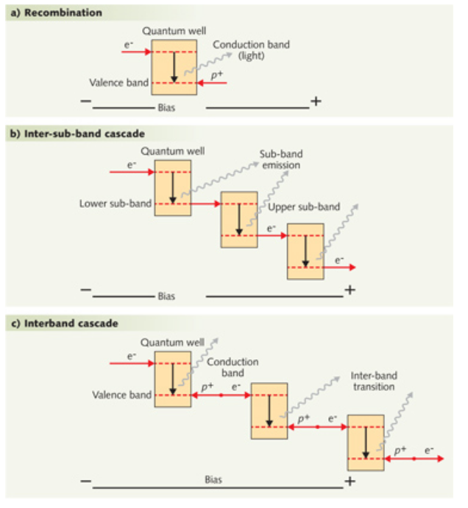
Development of Cascade Lasers
Quantum Cascade Lasers (QCLs):
Cascade of inter-sub-band transitions in the conduction band of a semiconductor.
Interband Cascade Lasers (ICLs):
Cascade of Type-II (staggered gap) interband transitions of a semiconductor.
New Type-I Quantum Well Cascade Lasers:
Cascade of Type-I (straddling gap) interband transitions of a semiconductor.
http://www.laserfocusworld.com/articles/print/volume-48/issue-08/features/new-designs-expand-capabilities-of-quantum-cascade-lasers.html
***Our Goal: To create high power band to band diode laser emitters which operate in the CW regime at room temperature in the spectral region from 1.9 – 3.5 μm.***

Slide 6
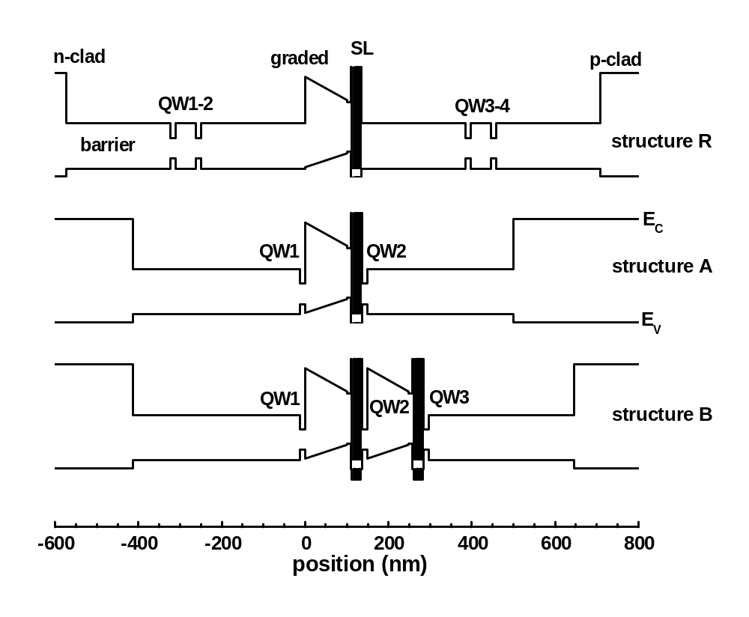
Schematic Band Diagrams of Laser Design
Structure R:
Initial design* that is used as a reference in this work. Active QWs and e⁻ injectors are spaced > 200nm apart.
Structure A:
Similar to Structure R, but the QWs are located adjacent to the injection layers.
Structure B:
The next step in development. Three quantum wells, each located adjacent to injection layers. (Currently under study.)
*L Shterengas, R. Liang, G. Kipshidze, T. Hosoda, S. Suchalkin, G. Belenky. Proc SPIE OPTO, 900213-10 (2014).

Slide 7
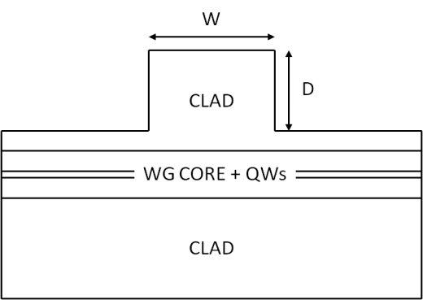
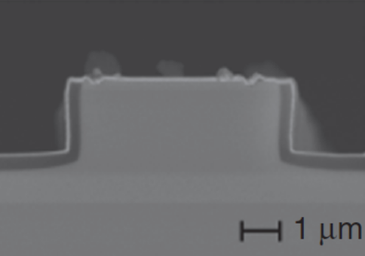
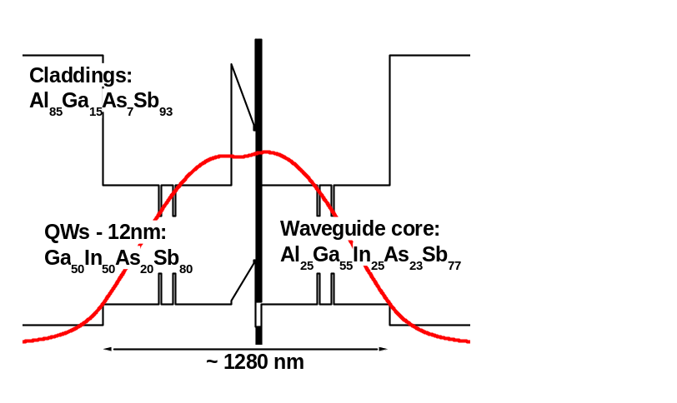
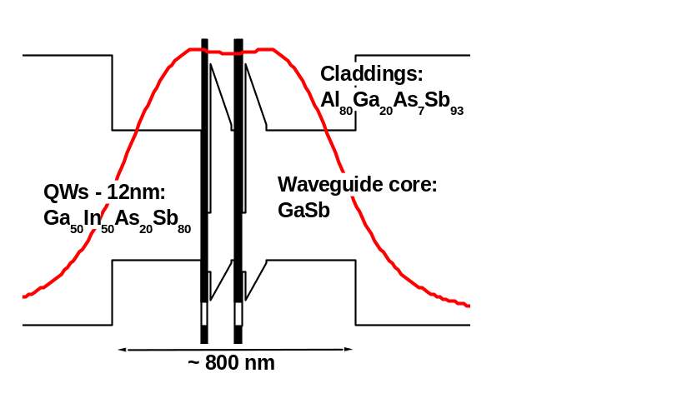
Development of New Cascade Laser
(Above) Cross section of generic ridge waveguide laser and SEM image of the front mirror of dry etched GaSb-based device with laser heterostructure (designed at SUNY).
(Right, Top) Schematic flat band diagram of the casade pumped two-stage type-I QW GaSb-based diode laser (Structure R).
(Right, Bottom) Schematic flat band diagram of the two-stage type-I QW AlGaInAsSb-free cascade laser (Structure A).

Slide 8
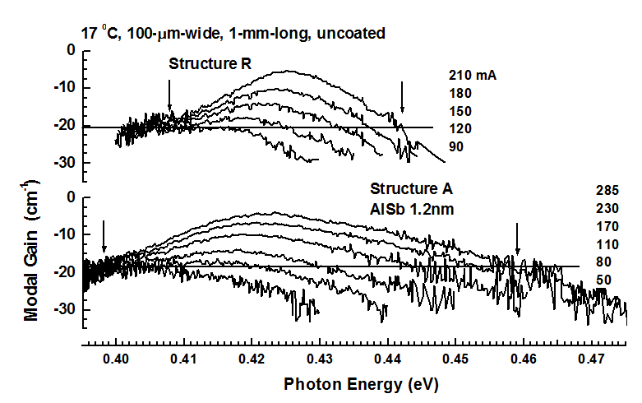
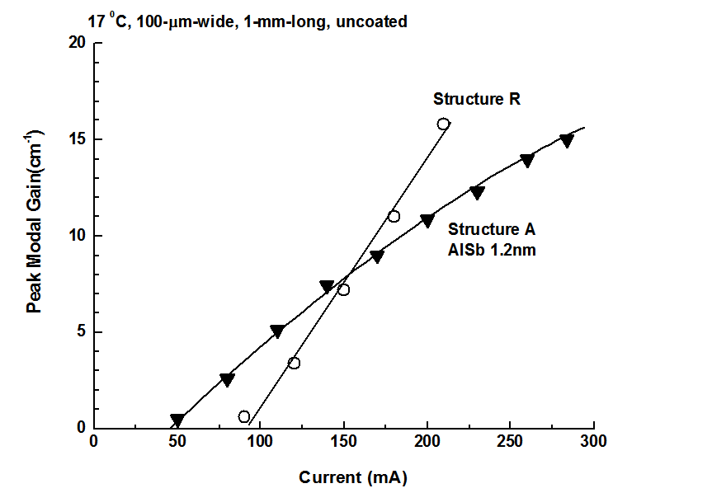
Hakki-Paoli Measurements on Optical Gain
(Left) Modal gain spectra for reference laser (R) and two-stage cascade laser (A). Bandwidth of the gain spectrum was measured at estimated cavity loss level, as indicated by arrows.
Laser R ~38 mEv
Laser A ~ 70 mEv
(Right) Current dependence of peak modal gain in both lasers. The two-fold increase in gain bandwidth was accompanied by suppression of differential gain with respect to concentration (slopes of each curve).
Increasing the thickness of the AlSb layers in the super lattice will decrease the gain bandwidth and increase peak modal gain. This is a design aspect currently being studied.

Slide 9
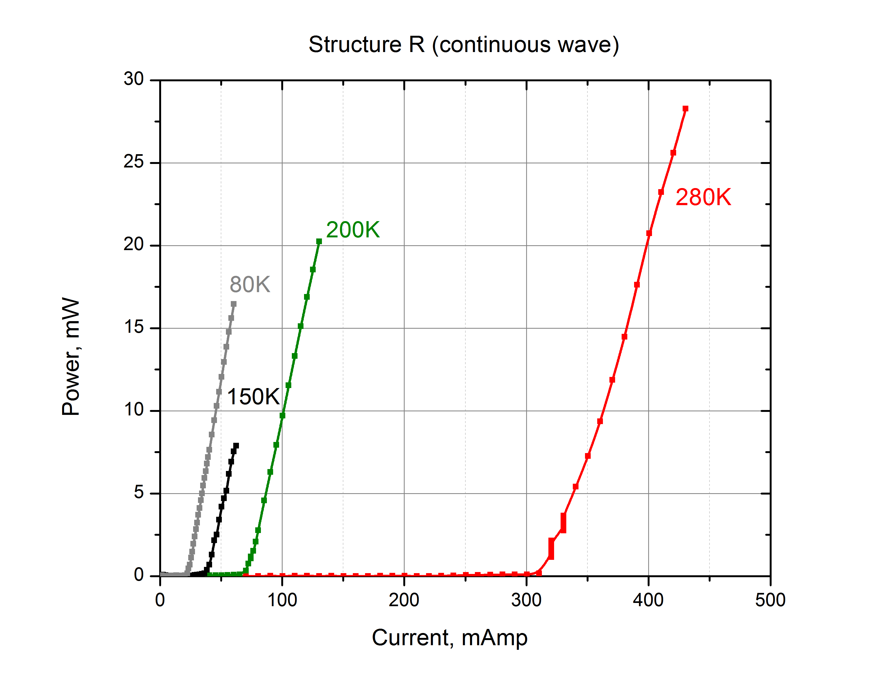
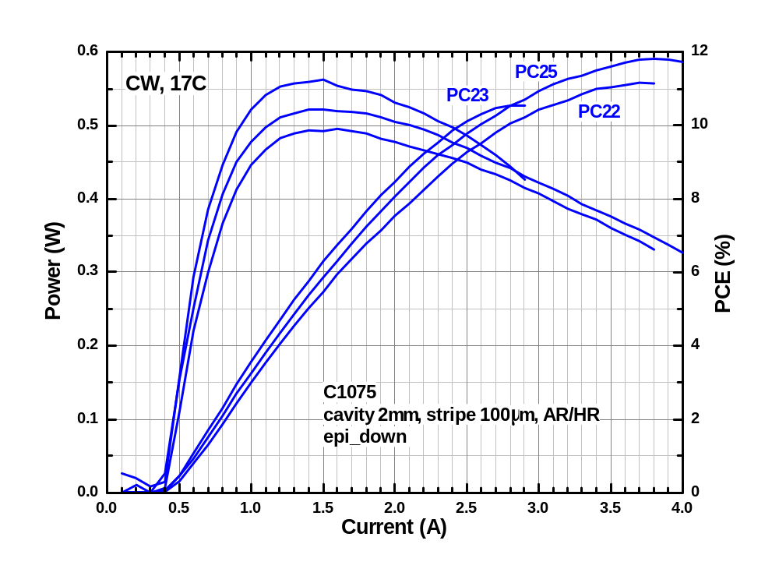
Structure R: Power Measurements
(Left) Representative example of the temperature dependence of the output power in the Structure R laser.
Significantly higher output power is possible, however, unnecessary for the current study.
(Right) Room temperature (17 C, 290 K) output power and power conversion efficiency of the Structure R laser. PC22, PC23, and PC25 each came from the same batch.

Slide 10
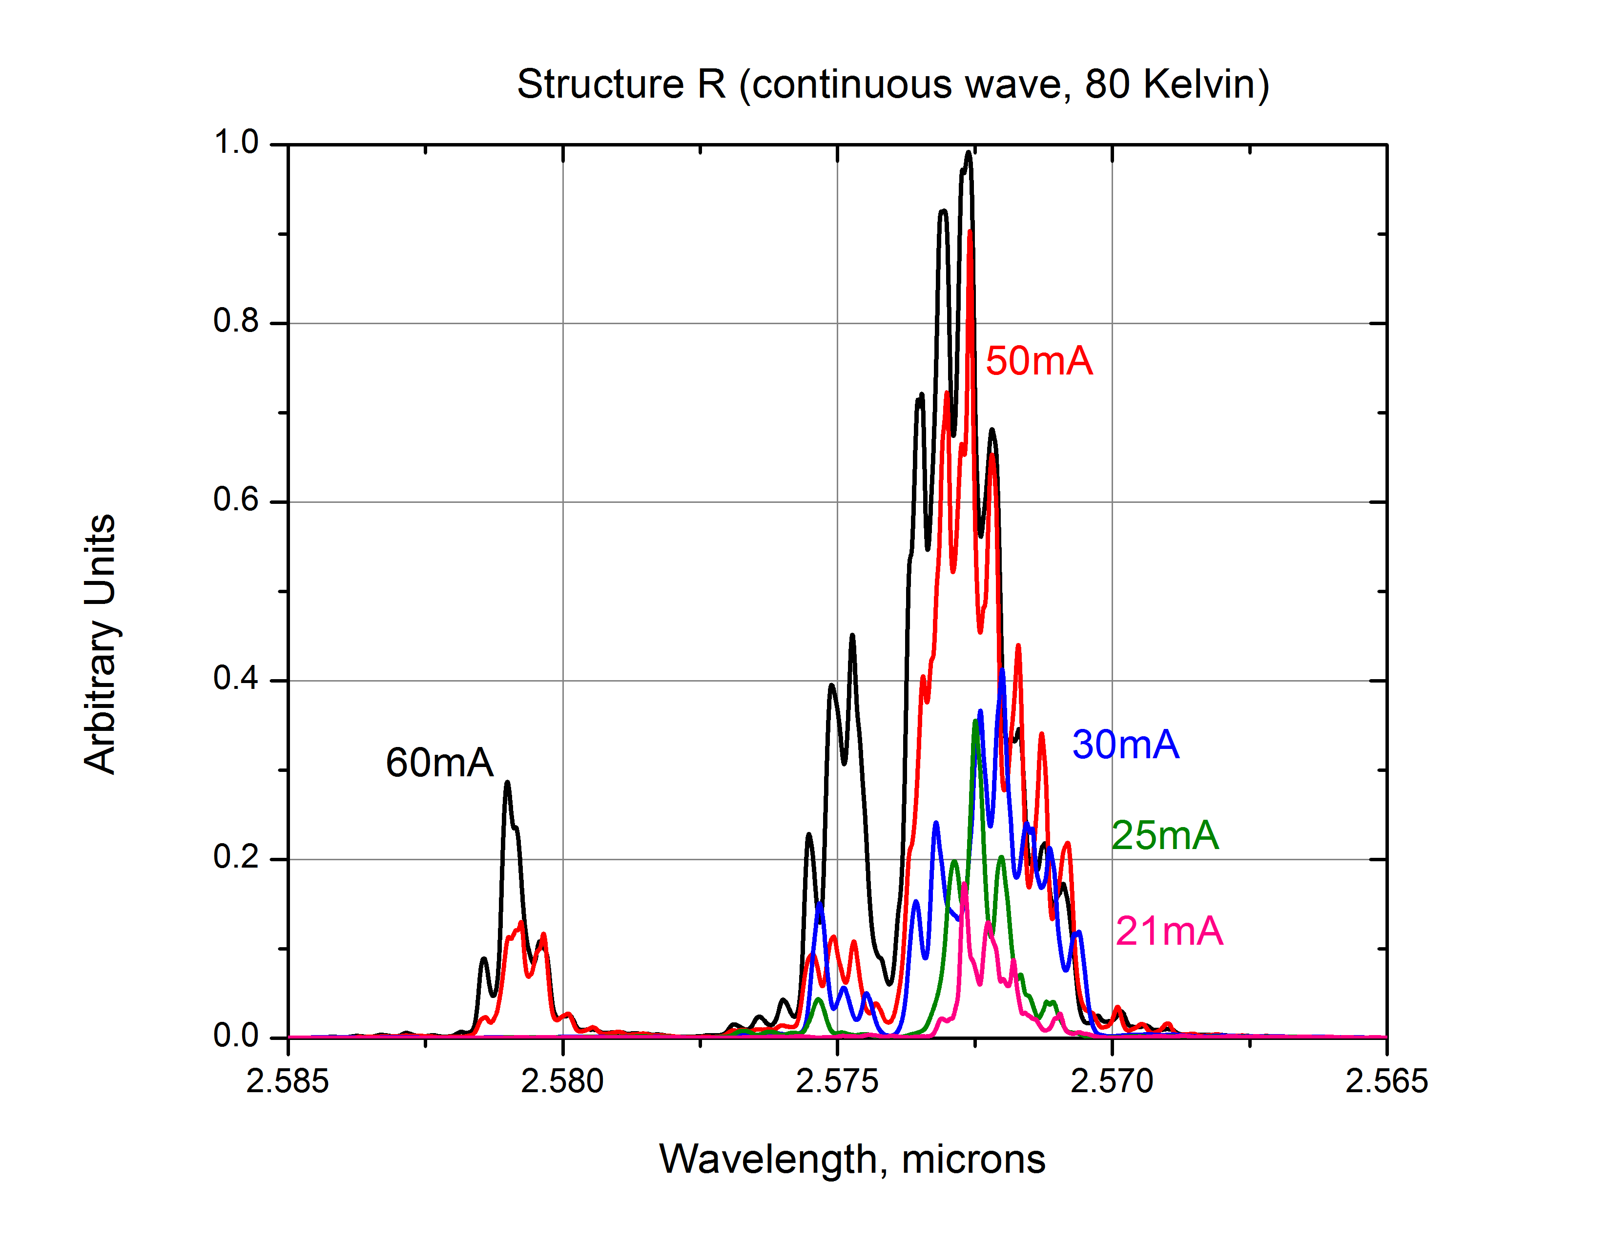
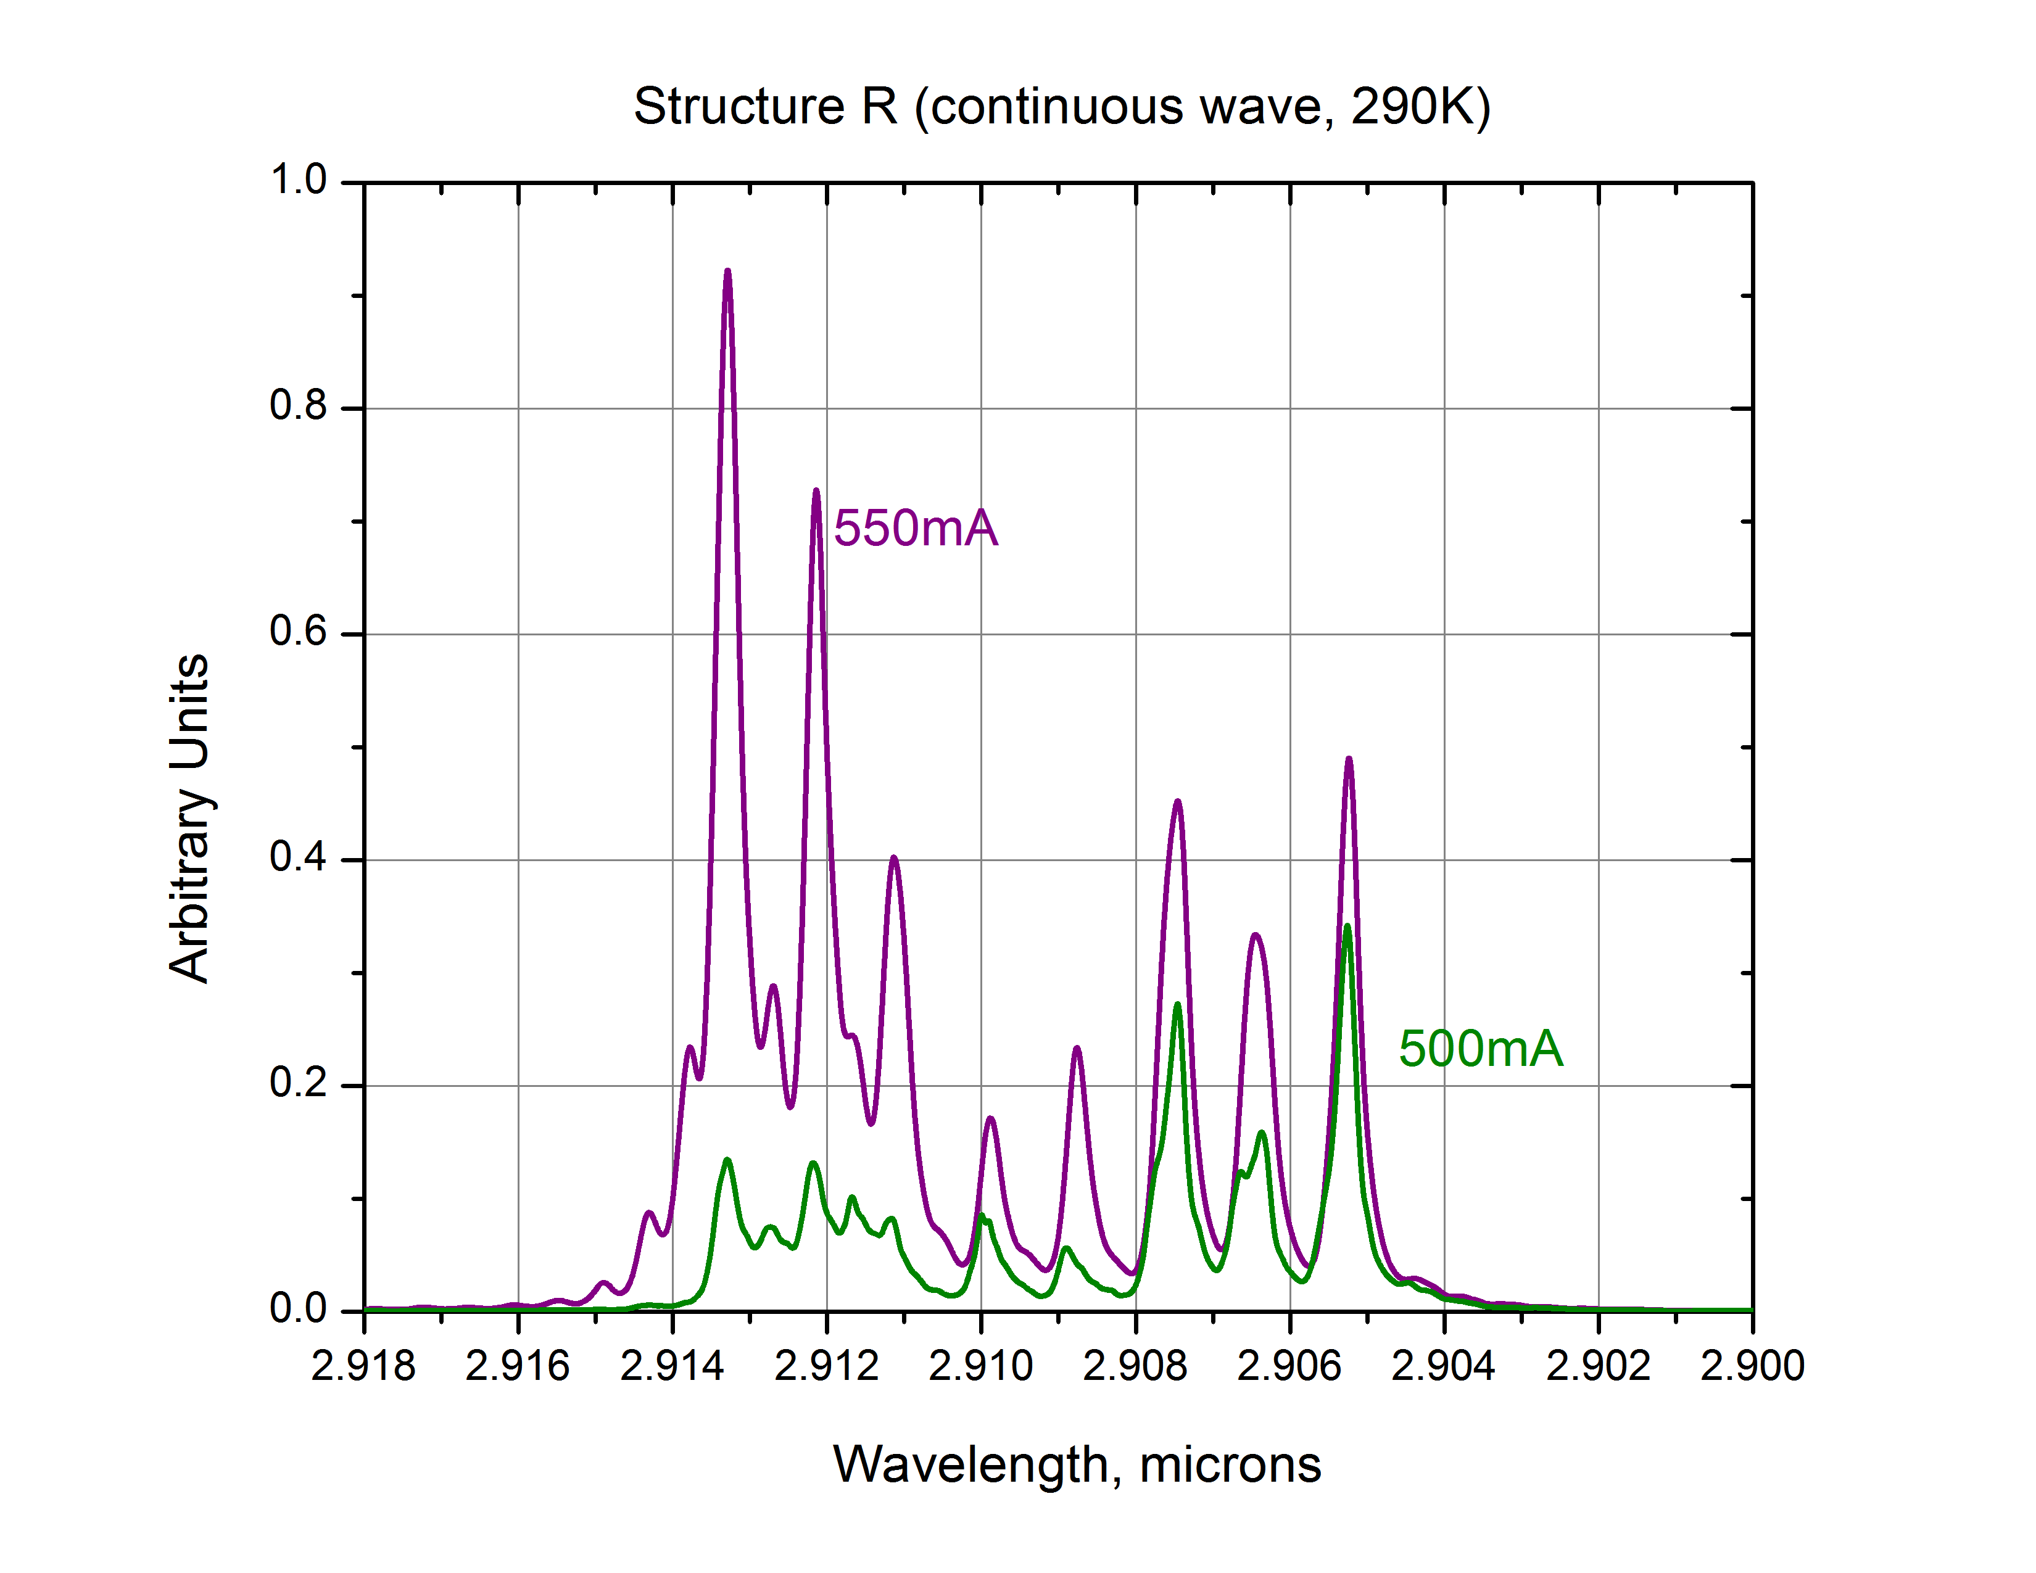
Structure R: Spectral Analysis
(Left) At 80 Kelvin, a complex structure that changed dramatically with current was observed.
(Right) At 290 Kelvin (room temperature), the structure was completely different. Higher resolution spectra are currently being collected/studied.

Slide 11
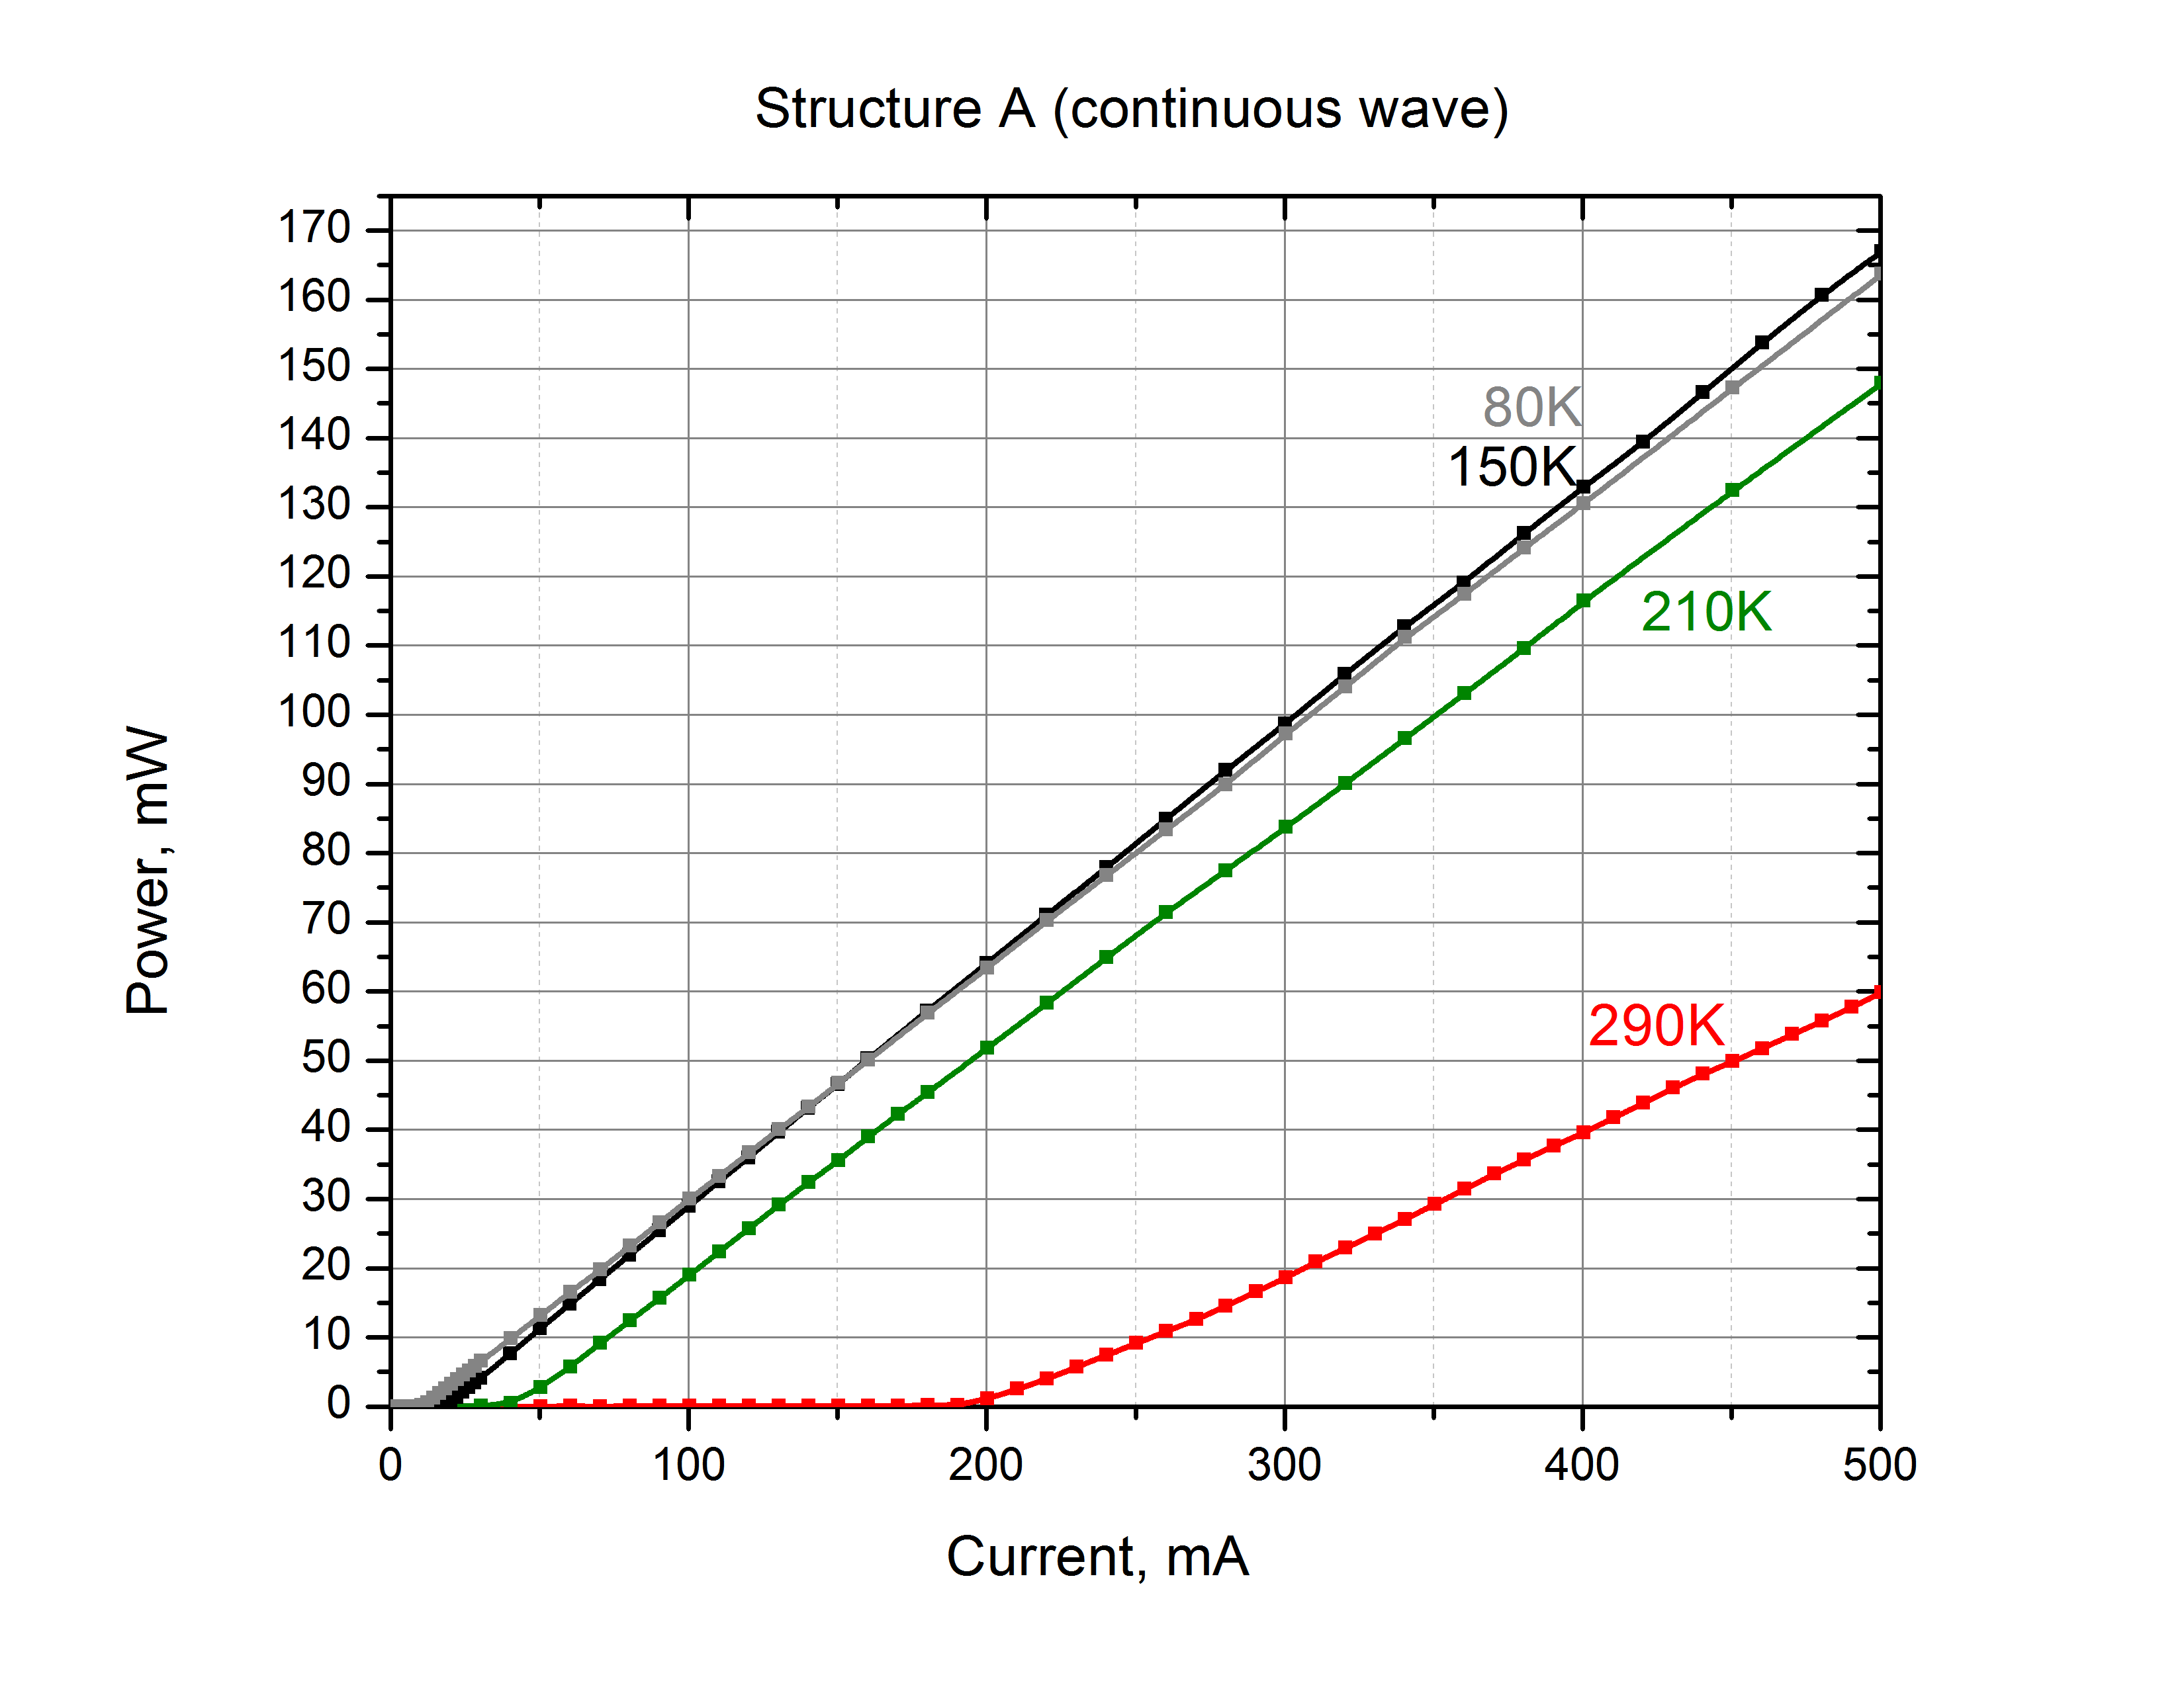
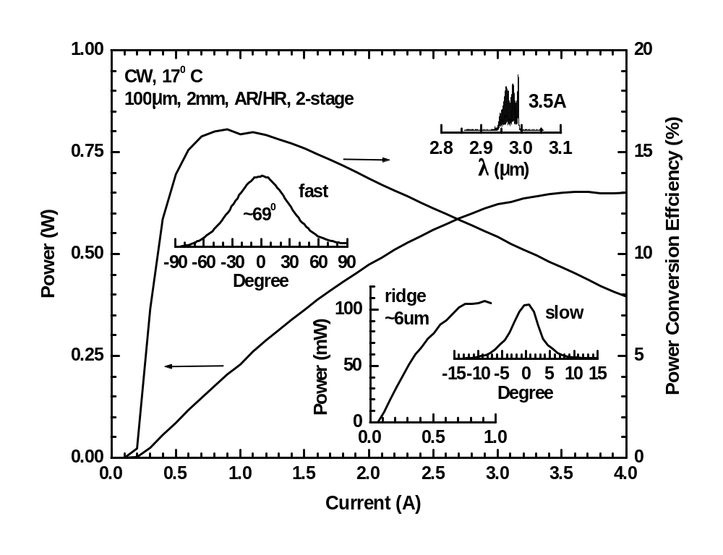
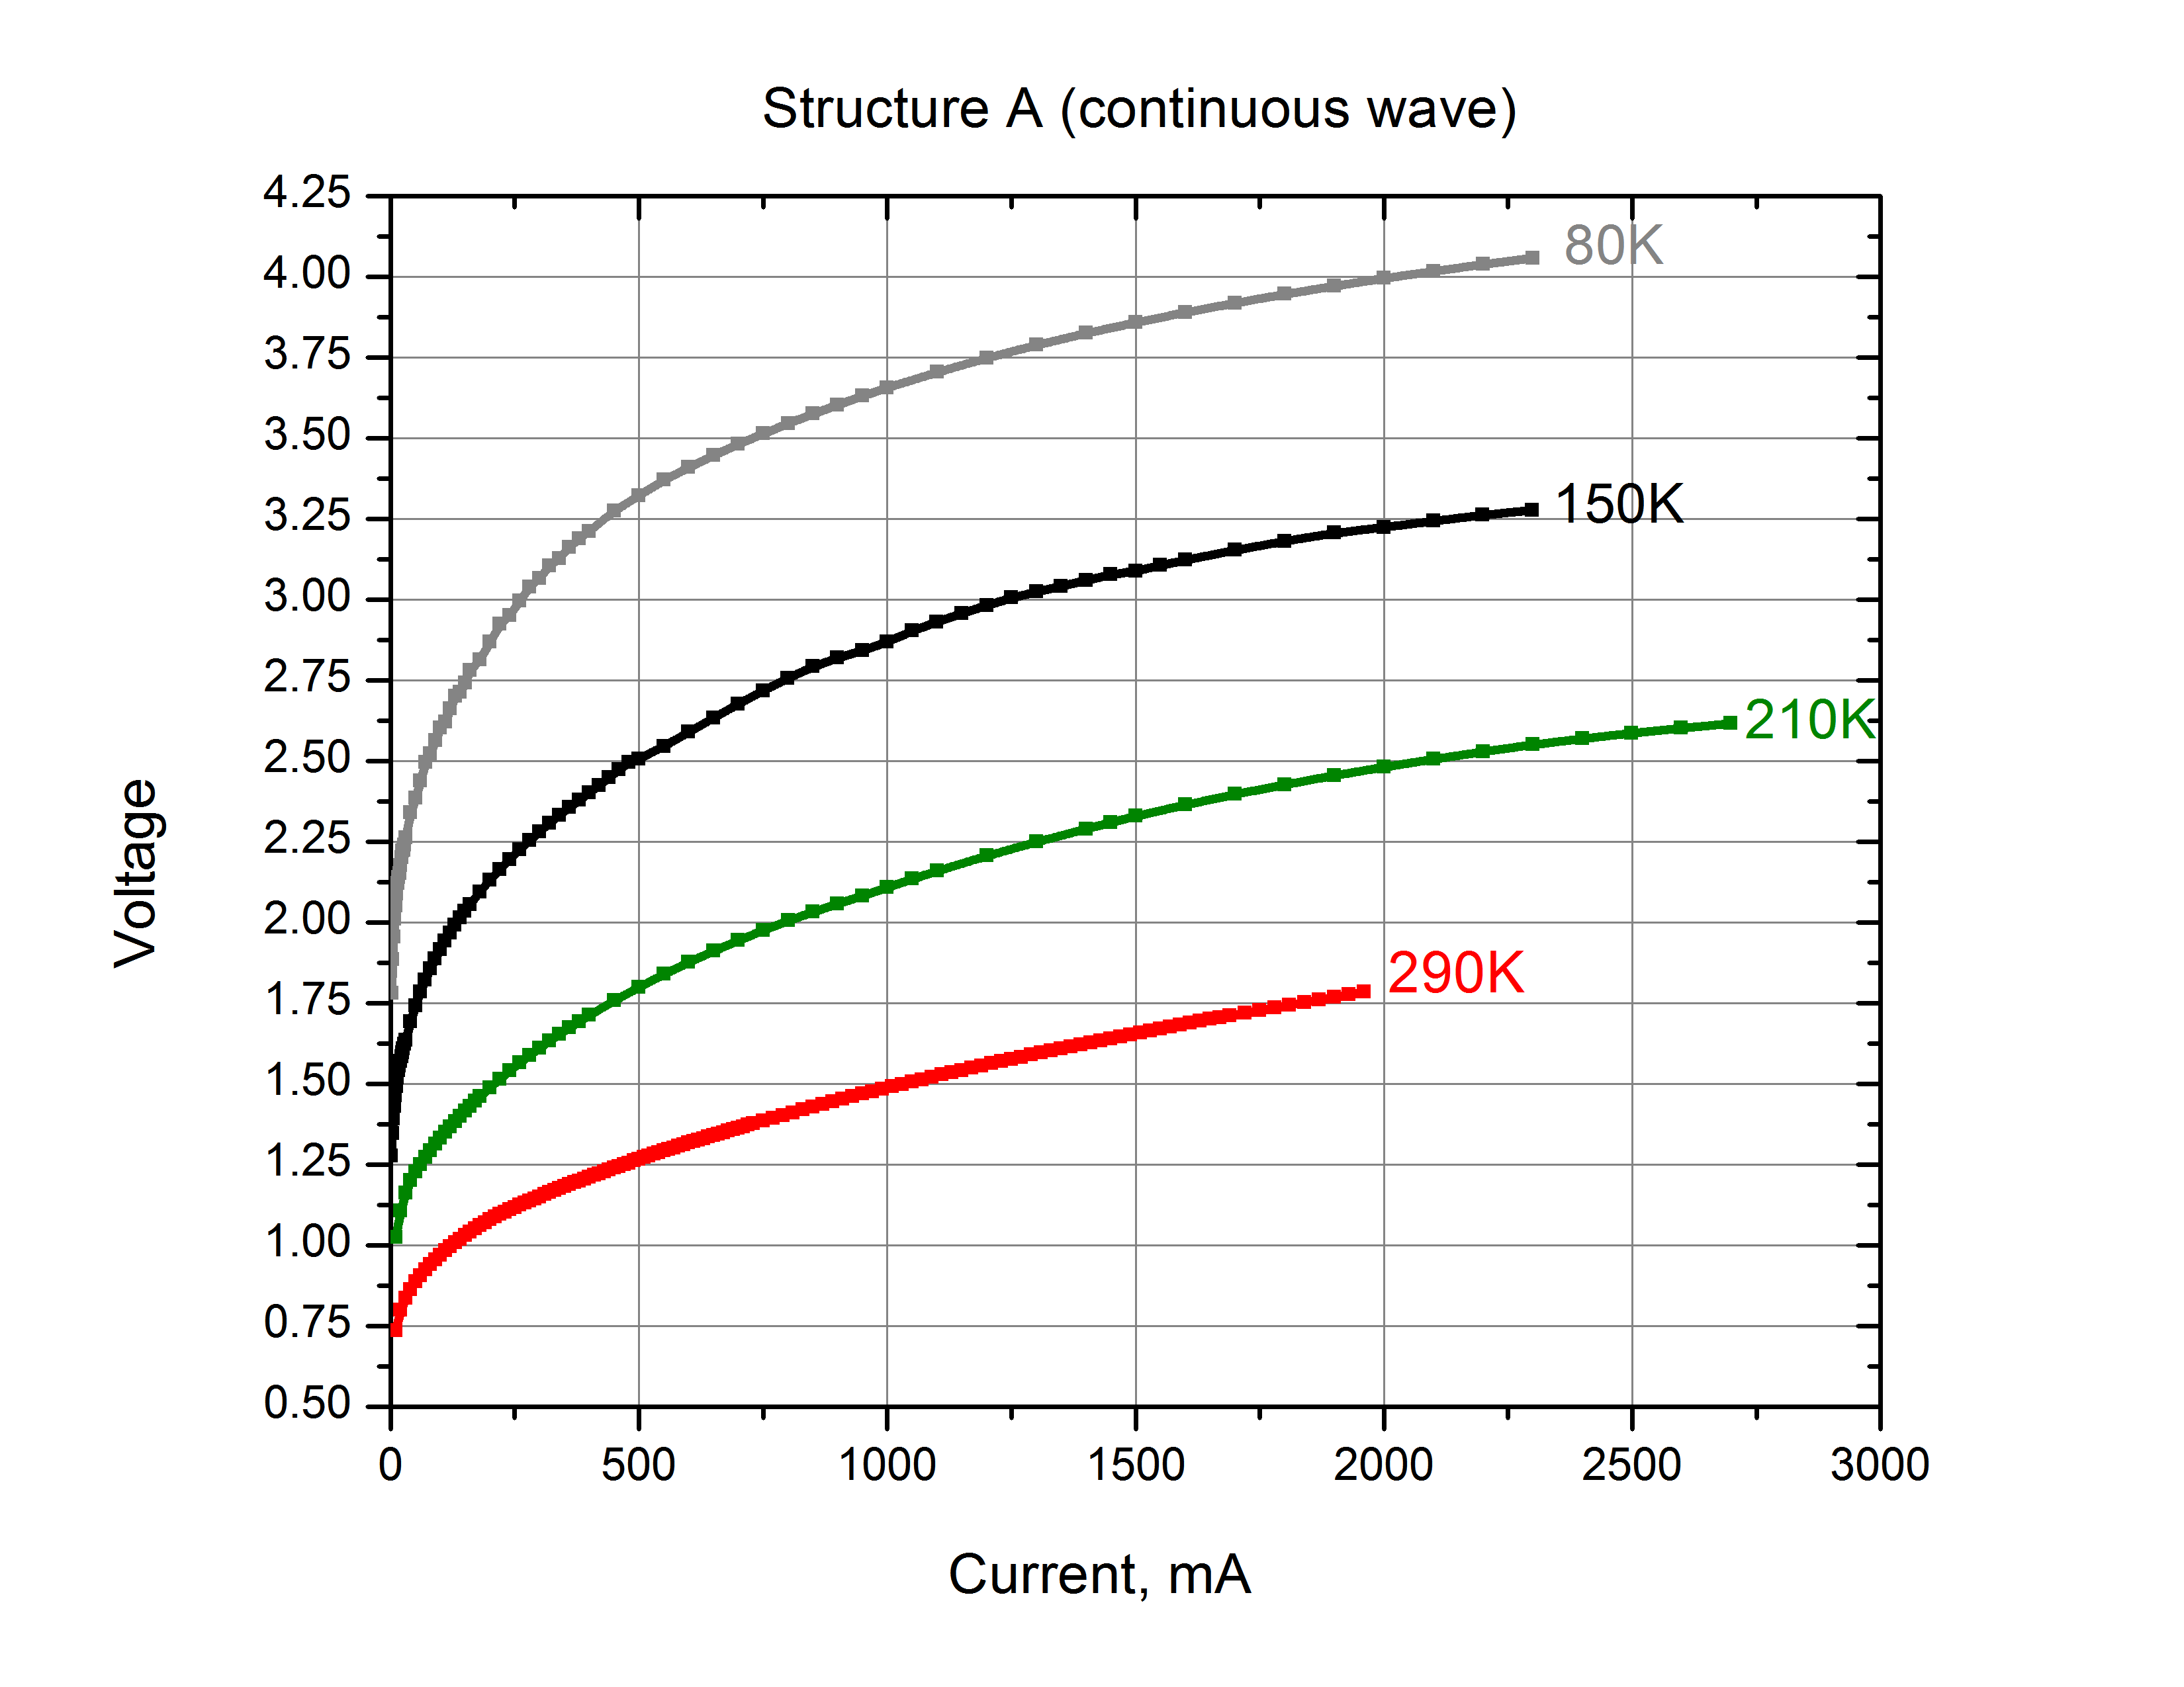
Structure A: Power Measurements
(Below) Room temperature CW output power and power conversion efficiency as a function of current in Structure A. Inserts show laser spectra at maximum power level, fast axis far field pattern, as well as CW power/current characteristics of 2 mm, AR/HR coated narrow ridges with corresponding slow axis far field pattern.

Slide 12
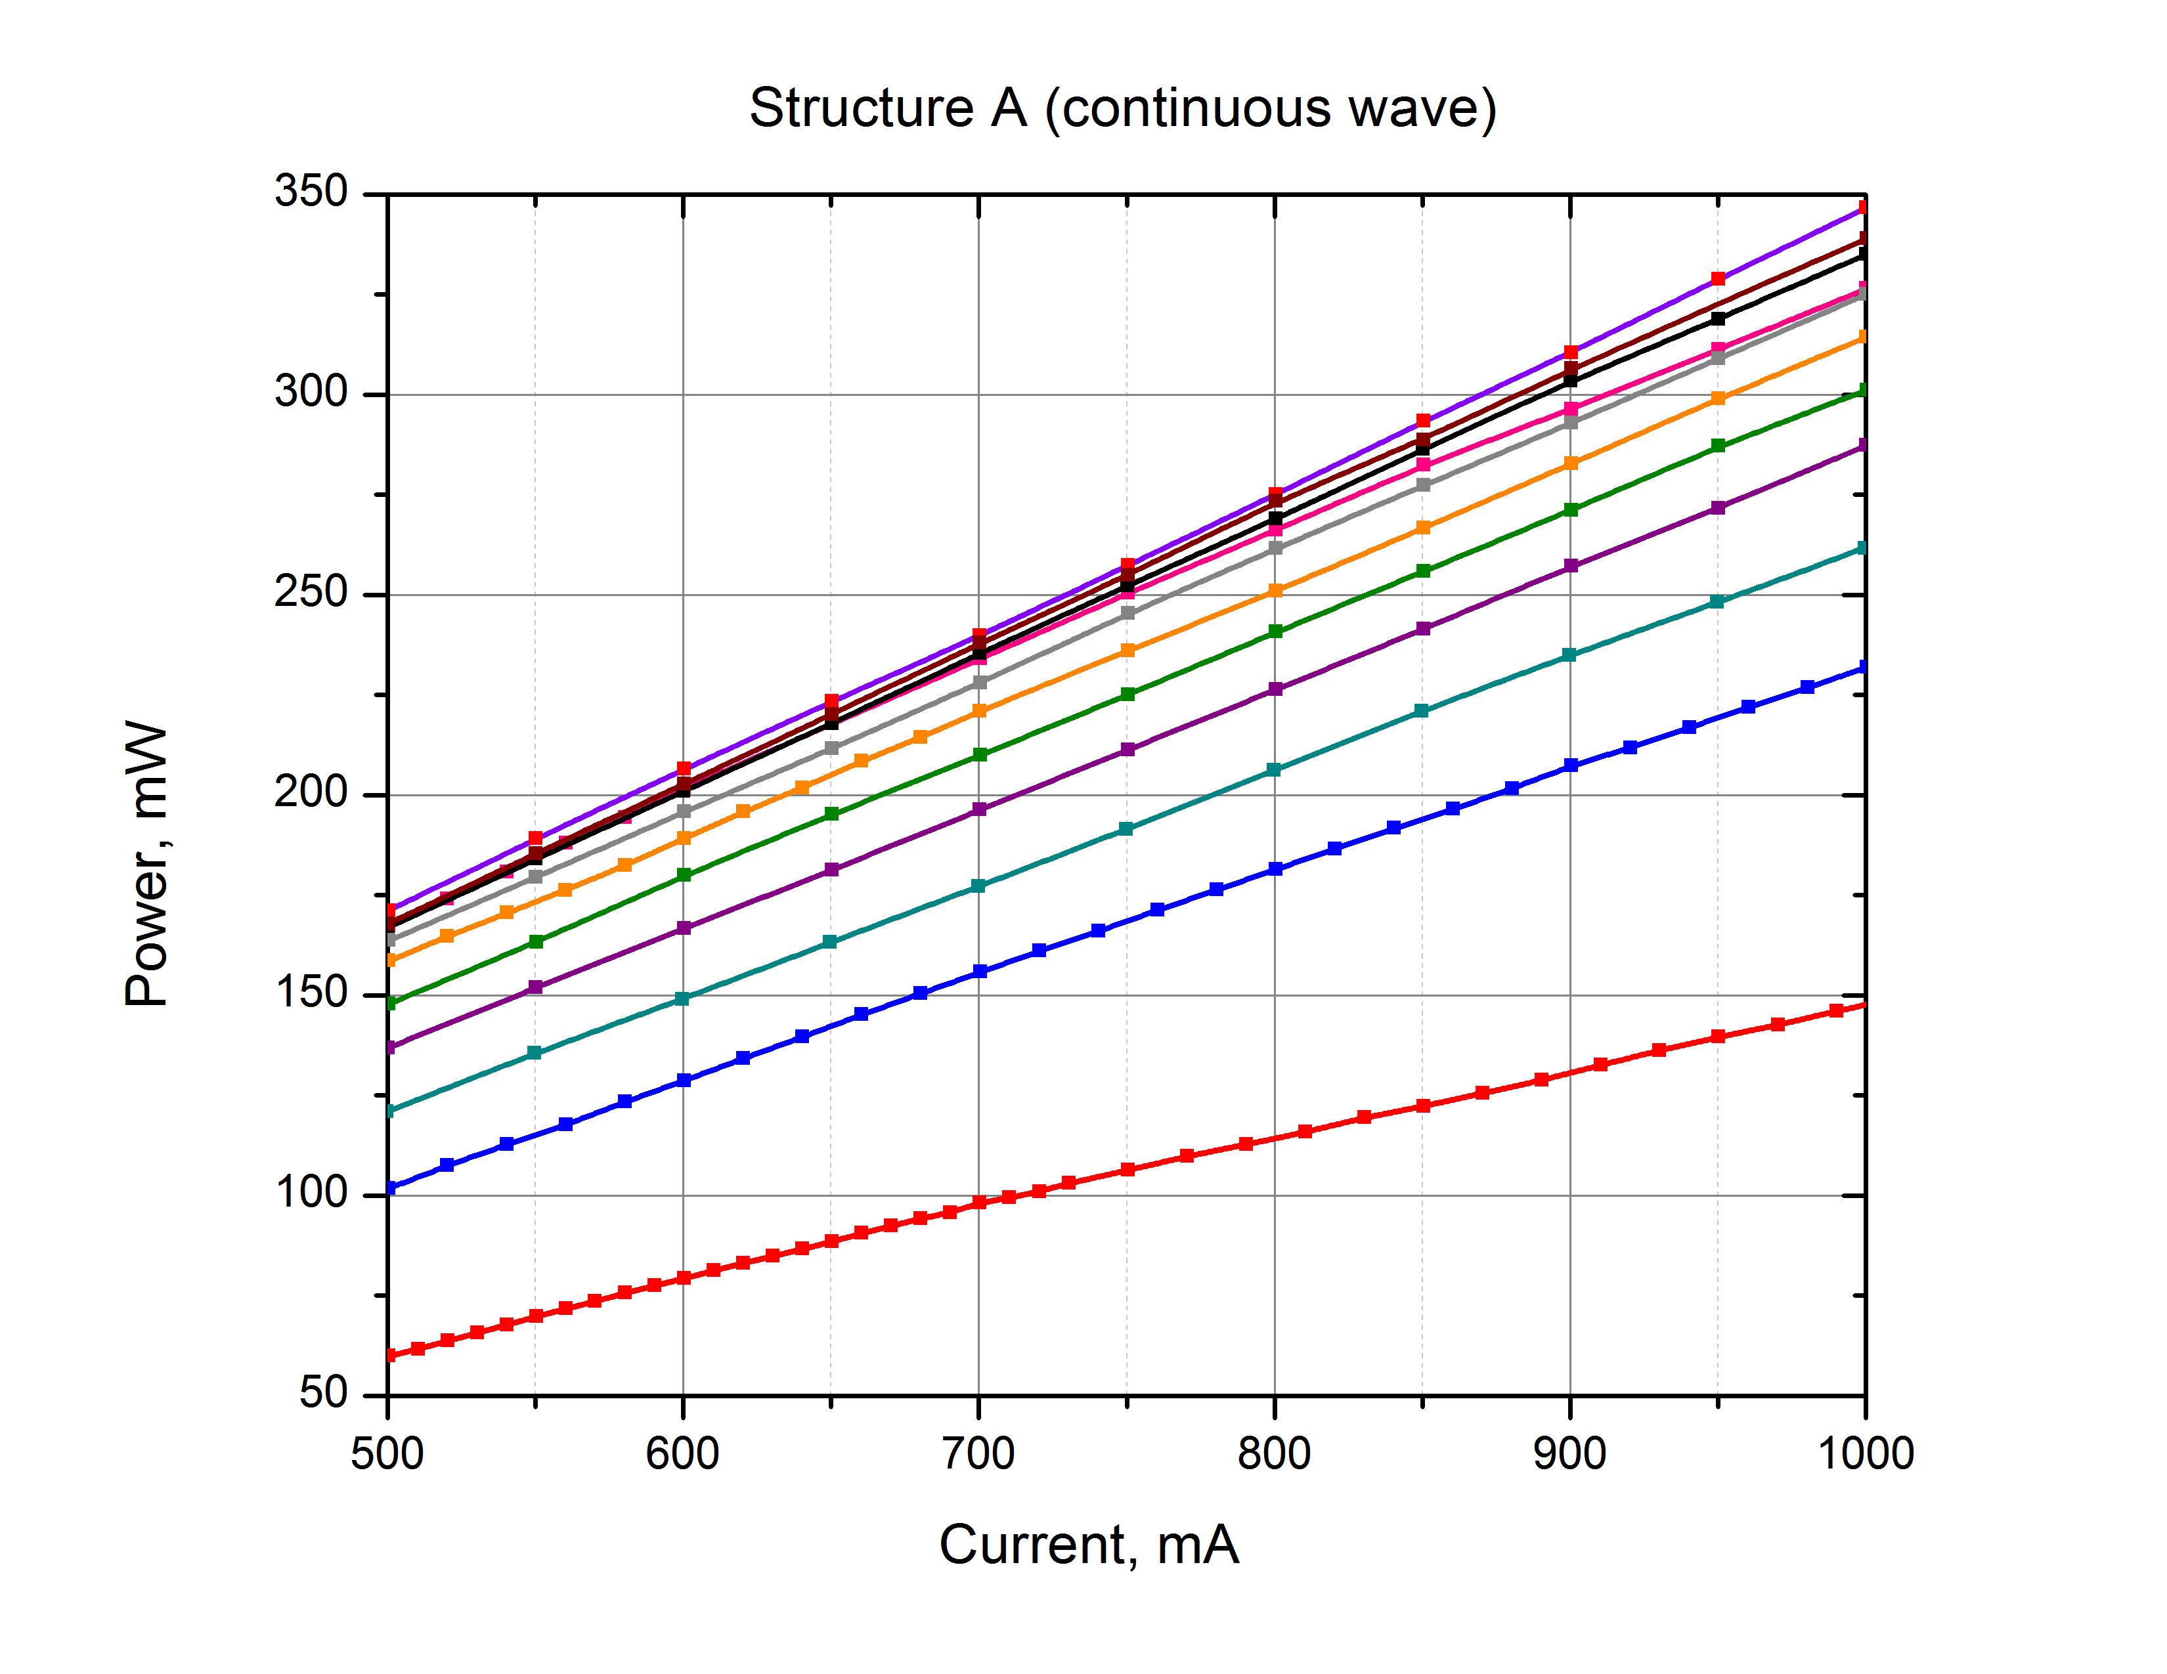
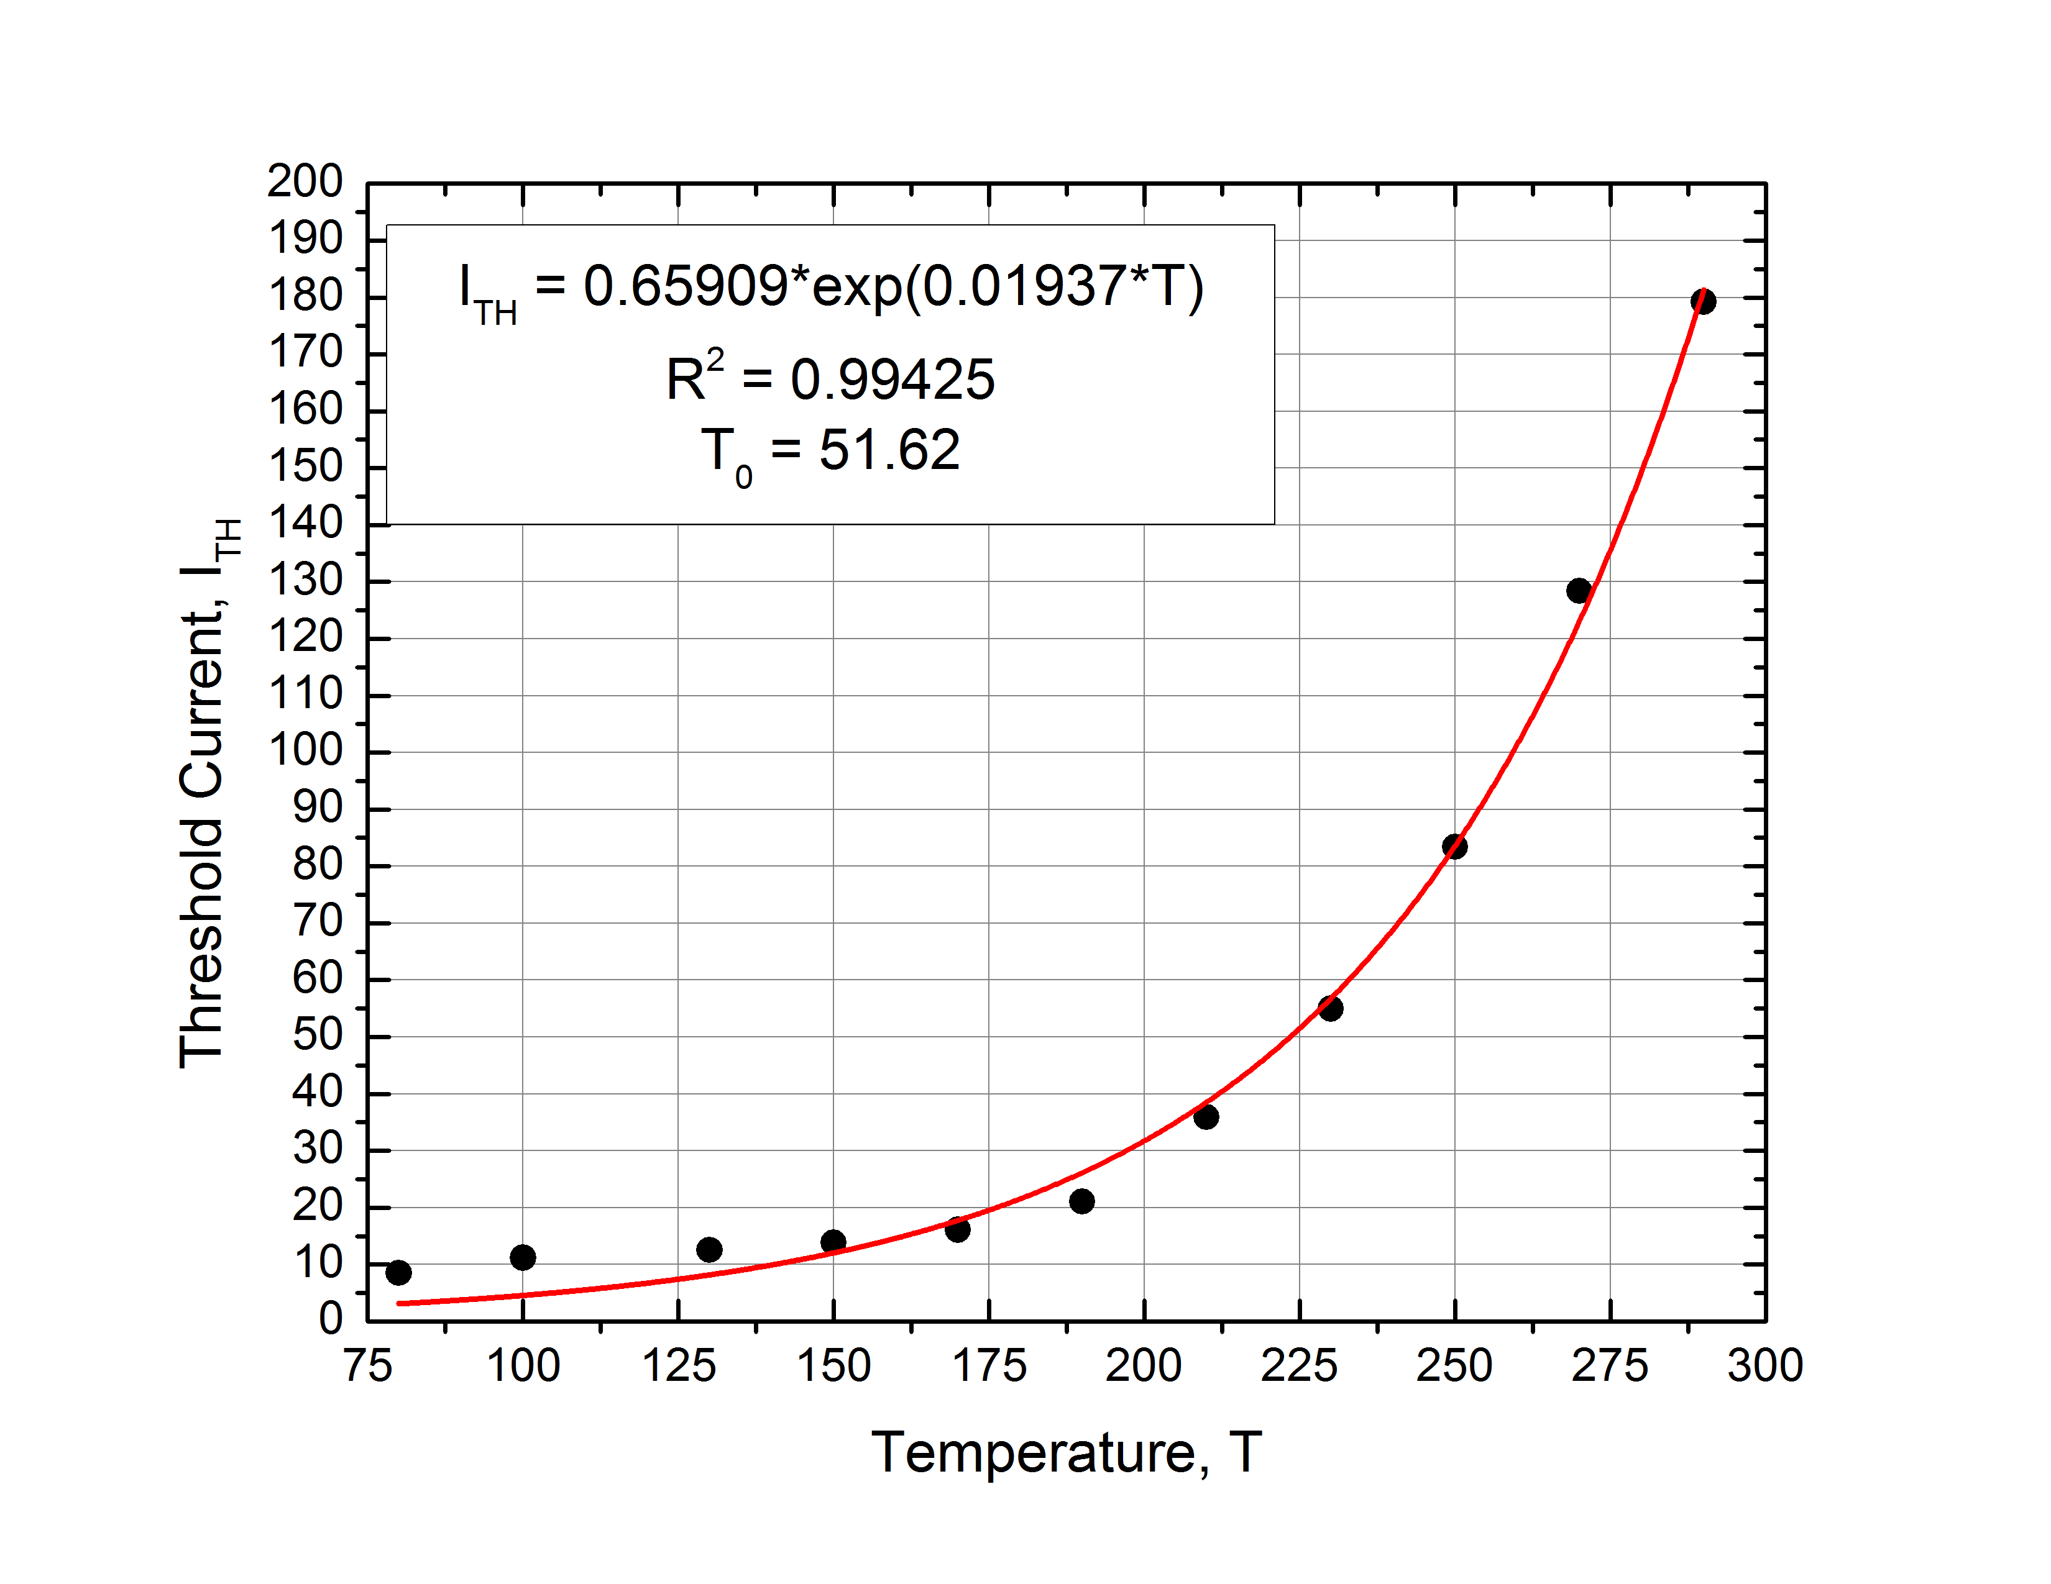
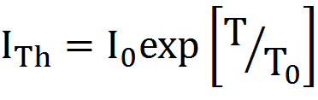
Structure A: T₀ and Current Threshold
Current Threshold: This was calculated as the x-axis intercept from fitting the linear portion of the Power/Current curve (see left) to a straight line.
Temperature Dependence, T_{o}: This was calculated by fitting current threshold as a function of temperature to an exponential function as given below (see right).

Slide 13
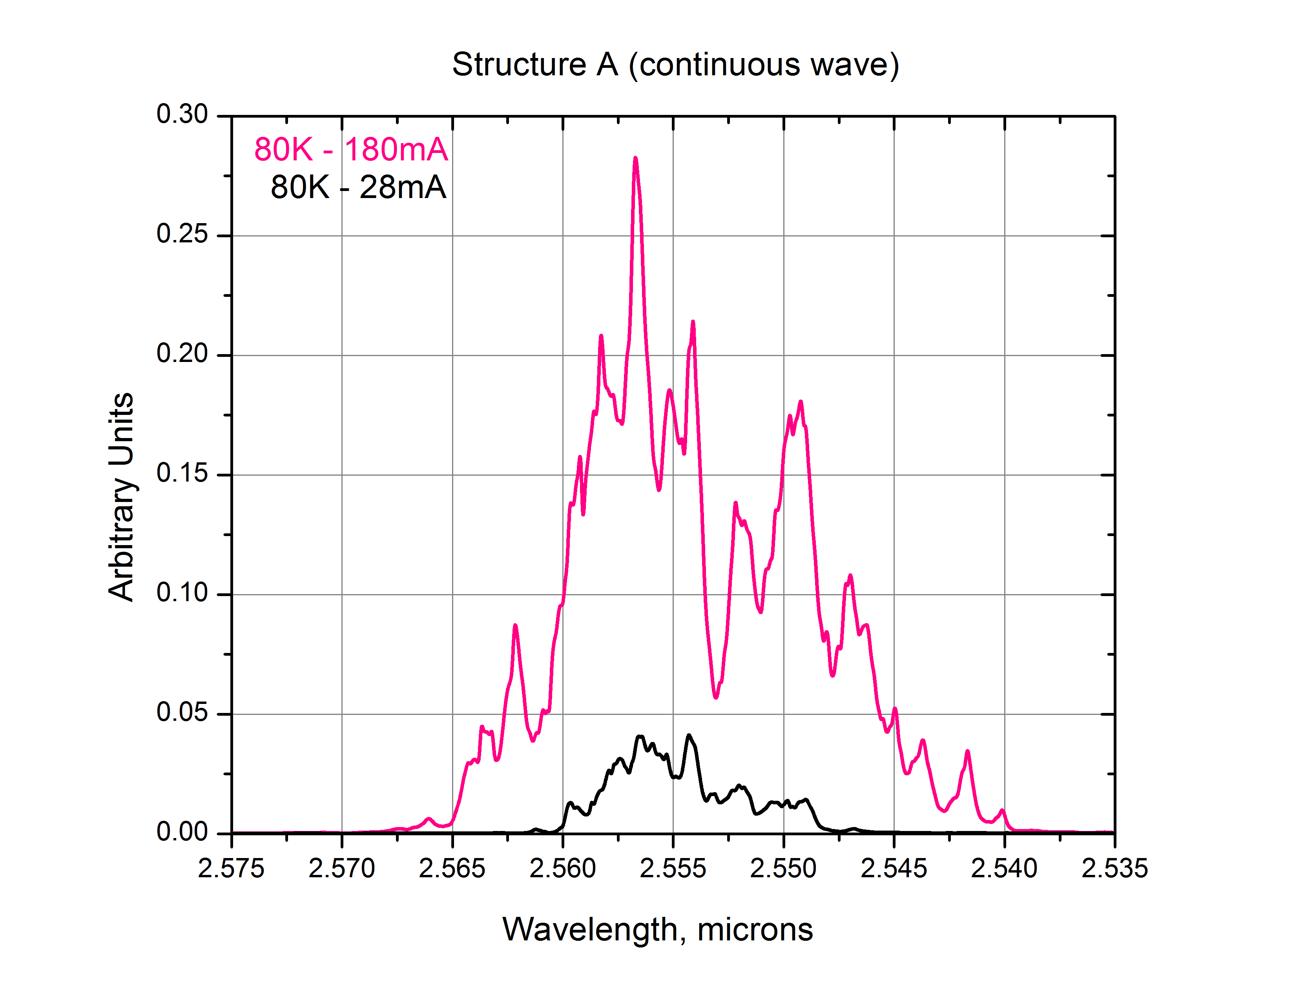
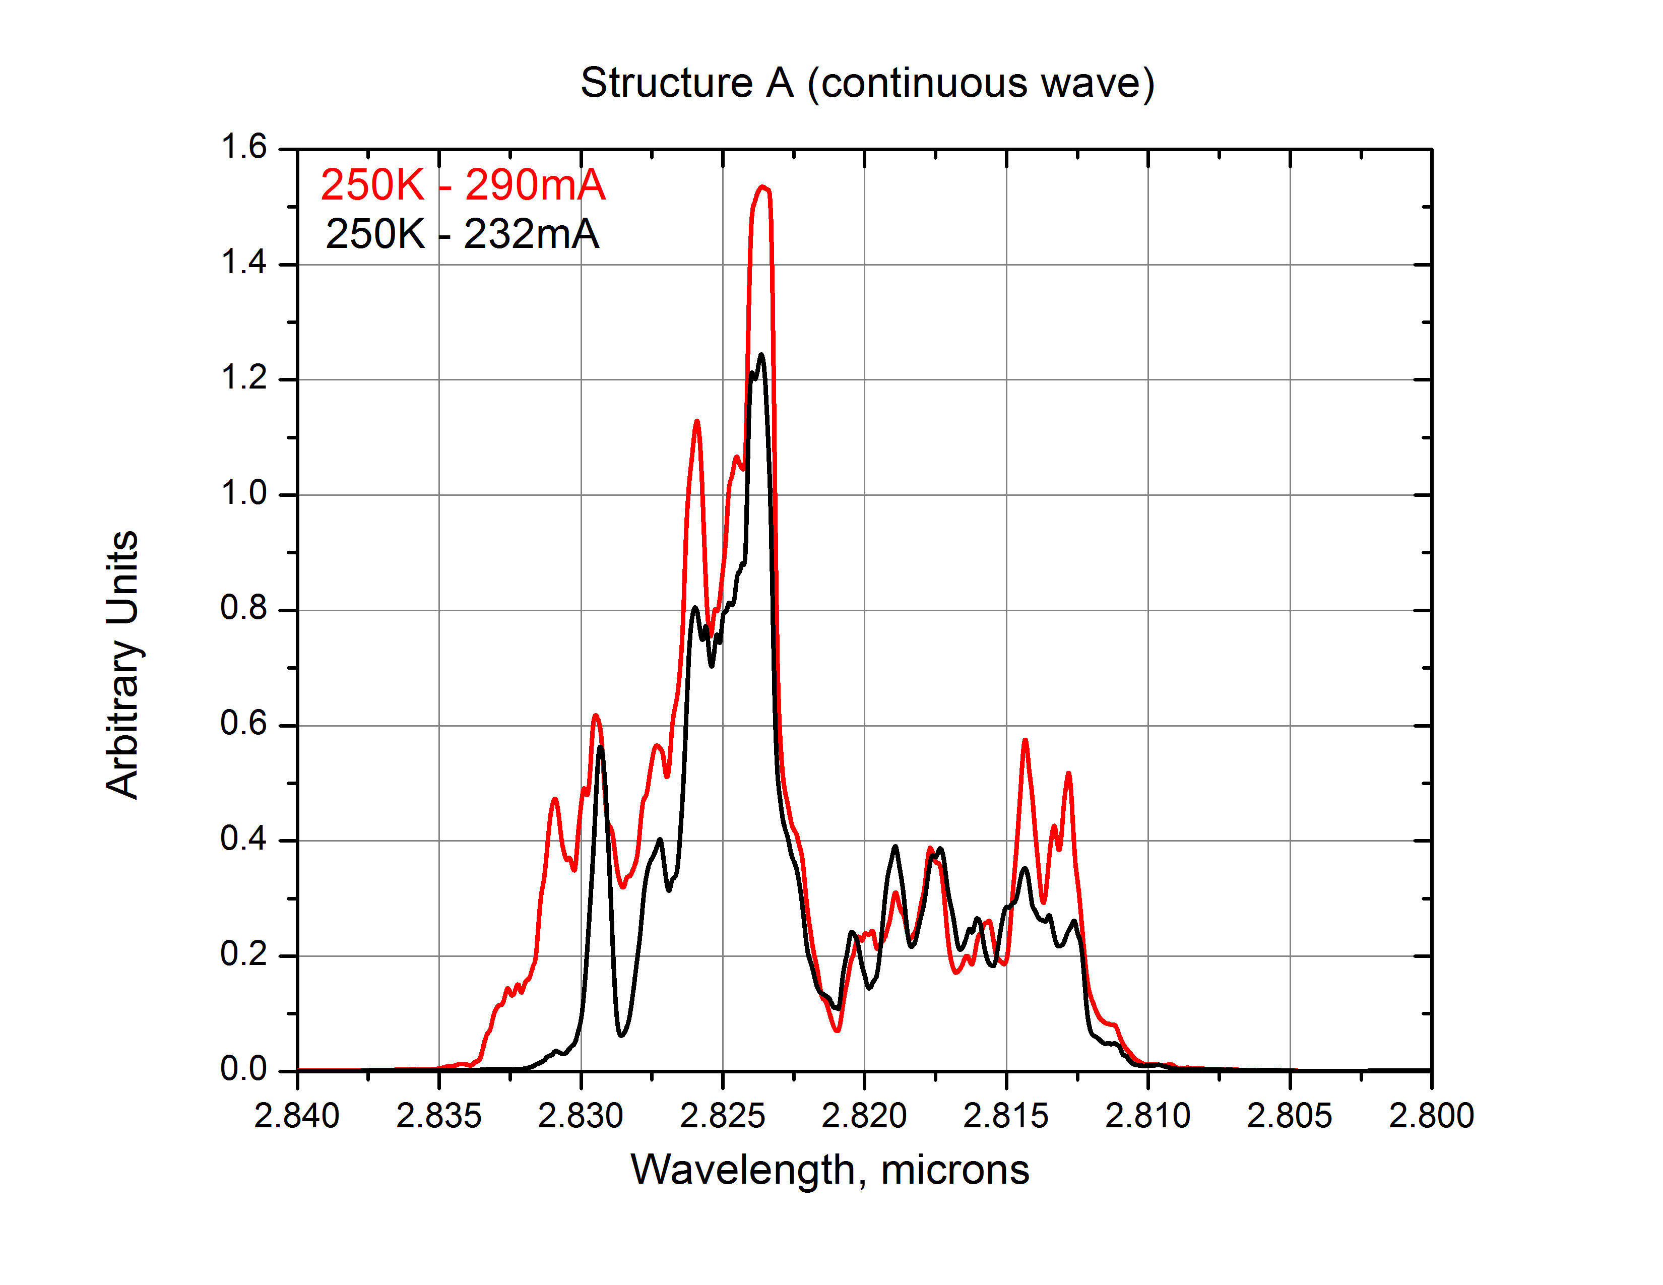
Structure A: Spectral Analysis
(Left) As in the Structure R case, at 80 Kelvin, a complex structure that changed dramatically with current was observed. There is significant overlap of peaks at this resolution level.
(Right) At 290 Kelvin (room temperature), the structure was very different and exhibited less change as a function of current.
Higher resolution spectra are currently being collected/studied.

Slide 14
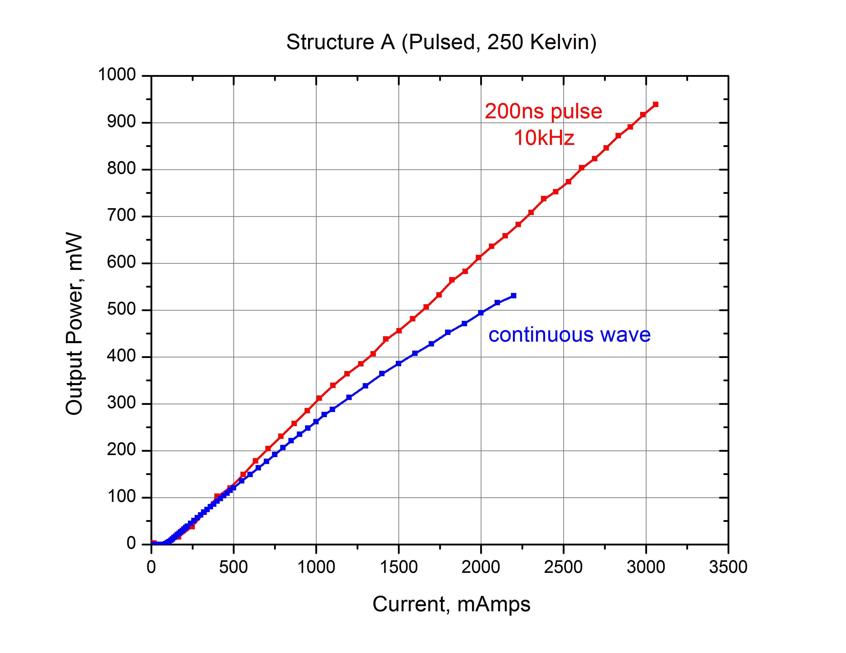
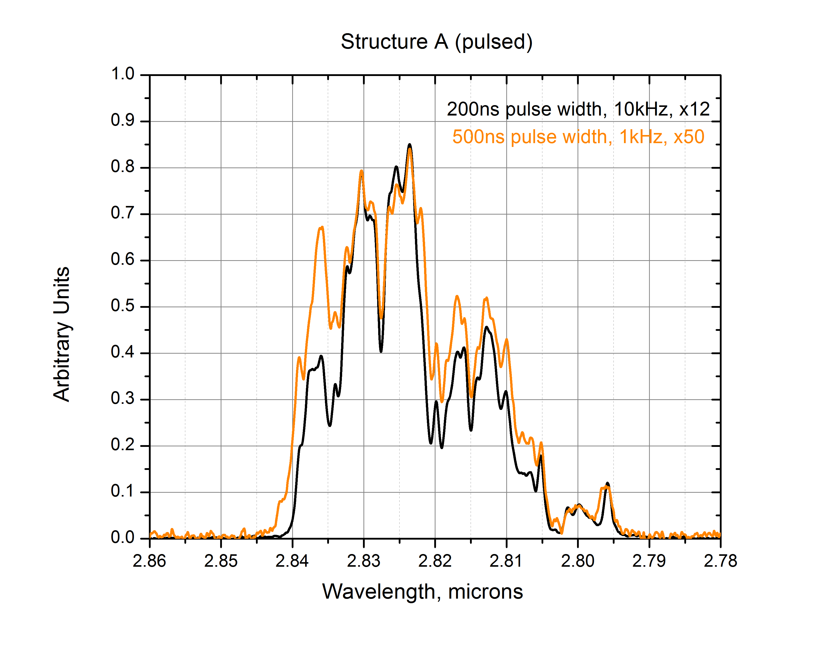
Preliminary Pulsed Laser Results
Output Power Comparison: As current was increased, the output power in pulsed mode surpassed that in continuous wave mode (see example on left).
This is most likely due to temperature rise within the laser and is a focus of study currently being undergone.
Spectral Analysis: Spectral characteristics also change with temperature and so spectra at various pulse widths and repetition rates are currently being collected (see example on right).

Slide 15
Summary and Conclusions
Type-I quantum well laser diodes have been developed and enhanced via cascade pumping.
  GaSb-based, emitting near 3μm
  Modal Gain via Hakki-Paoli
Temperature and current dependence of output power and power conversion efficiency have been measured in two geometries (Structure R and A).
  Moving QWs near one another increases gain bandwidth, output power, and optical confinement
  Power conversion efficiency, threshold currents, and T₀ parameter were calculated.
Spectral characteristics are being studied as a function of applied current and temperature with significant differences being observed in preliminary pulsed mode operation.
  Temperature dependence of features.
  Internal heating effect on output power/spectral characteristics

Slide 16
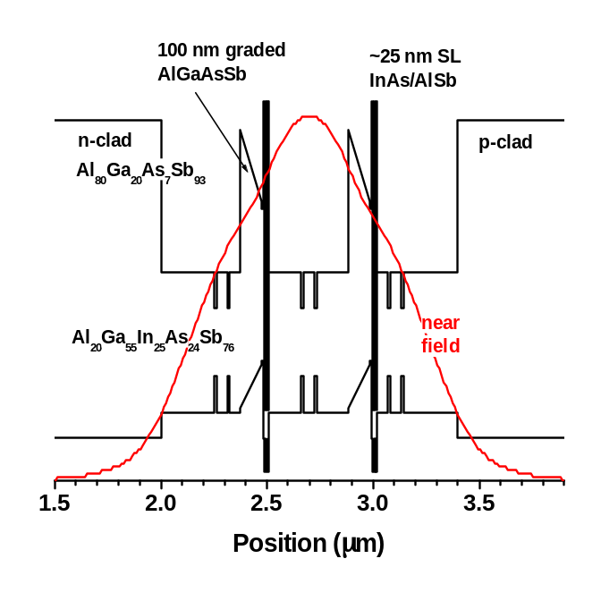
Current and On-going Research
Laser Design
  Triple QW cascade laser (Structure B)
  Modifying Structure A with a thicker super lattice layer (increasing differential gain)
Laser Characterization
  Improving resolution of spectra for better analysis
  Furthering study of laser characteristics in pulsed mode operation.

Slide 17


Acknowledgements
Special thanks to the National Academy of Sciences for their support through the National Research Council for Dr. Bowman’s post-doctoral fellowship.
The authors would also like to acknowledge the support of the US Army Research Office. This work was partially funded by ARO Grant #W911NF1420070.

Slide 18
Let Us Meet Again
We welcome all to our future group conferences of Omics group international
Please visit:
www.omicsgroup.com
www.Conferenceseries.com
http://optics.conferenceseries.com/

