Slide 1
Building Resilience in Construction Site Operations:
Shifting from Protective Safety to Productive Safety
Professor Sherif Mohamed, MSc, PhD, PMP
Griffith University, Queensland, AUSTRALIA
Associate Editor, Journal of Safety Science, Elsevier

Slide 2
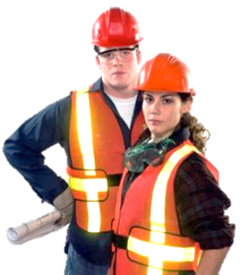
Presentation Outline
Early Thoughts on Safety
Current Thoughts on Safety
New Thoughts on Safety
What Research tells us…

Slide 3
Early Thoughts on Safety
Traditional Safety Programs – 4E’s
Environment
  Hazard identification: to improve physical opportunity to be safe
Engineering
  Risk Reduction: to reduce risk associated with production
Education
  To enhance awareness and performance skills
Enforcement
  To enforce rules again specific unsafe acts.

Slide 4
Early Thoughts on Safety
  Follow standard operating procedures
  +
  Pay attention to what you’re doing
  +
  Don’t make mistakes or break rules
  +
  No equipment failure =
  Things are Safe

Slide 5
Early Thoughts on Safety
Punish violators
  Fire them
  Suspend them
  Retrain them
  Counsel them
If you follow the rules you cannot have an accident
Accidents happen because of Human Error
Workers must be reckless, incompetent, etc..…..
Therefore “Fix the people”
Be more careful, vigilant, etc..

Slide 6
Current Thoughts on Safety
Training
Policies
Slogans
Safe
Environment
Warnings
Regulations
Safety Meetings
Contests & Awards
Committees

Slide 7
“If you do what you’ve always done, you’ll get what you always got!”
Lagging indicator
Time
Compliance does not drive change, it drives incremental adherence.
There comes a point where compliance and injury reduction split. Where better compliance may not further reduce injuries.

Slide 8
War on Errors
Myth: If we only can get rid of Errors, life would be great.
If exposure is reduced, will the injuries be reduced?
Maybe………. Are we sure??
Is it luck?
Maybe……But how can you manage or acquire luck?!!!
Just add more procedure, training, and tighter monitoring of performance!!!

Slide 9
What is Safety, anyway?
Error, violations and all other negatives are NOT the ‘right’ and ‘useful’ ‘targets for intervention.
Safety should not be defined as the absence of something (e.g. violations, incidents)
The assumption is that the systems are already safe, and all is needed is protection from “those unreliable People”
Our systems are complex.

Slide 10
New Thoughts on Safety
These systems are complex and dynamic because of the presence of:
multiple goals (speed, quality, cost, etc.),
multiple interacting parties (various trades and professional disciplines some of which have different mental models, and work packages, heterogeneous client organisation),
complex social structures (hierarchical sub-contracting arrangements, multiple stakeholders), and
the complex technology and operating environments (market pressures, institutional regulations).

Slide 11
New Thoughts on Safety
Very difficult to predict ALL possible interactions between seemingly unrelated systems – complex interactions.
Inadequate risk assessment of operational changes – drift into failure, inability to think of ALL possibilities.
Safety improvements should come from organizations monitoring and understanding the GAP between procedures and practice.

Slide 12
New Thoughts on Safety
New View of Human Error on what goes wrong:
  Human Error is a symptom of trouble deeper inside a system.
  To explain failure, do not try to find where people went wrong.
  Instead, find out how people’s assessments and actions made sense at the time given the circumstances that surrounded them.
  Sources of error are structural, not personal. If you want to understand human error, you have to dig into the system in which people work. You have to stop looking for people’s personal shortcoming.

Slide 13
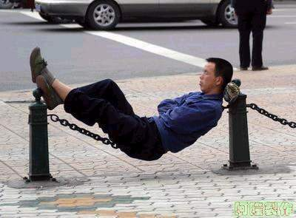
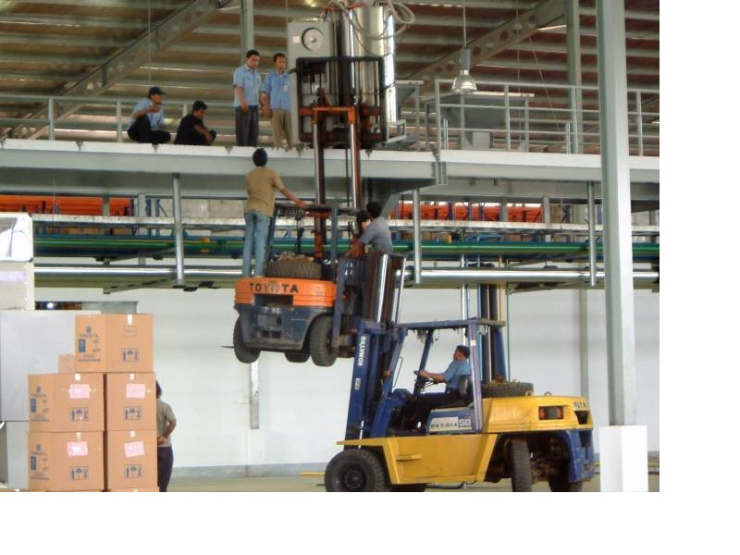
Actions that made sense at the time!!
  WHY it made sense for people to do what they did rather than judging them for what they allegedly did wrong and
  What changes will reduce likelihood of happening again?

Slide 14
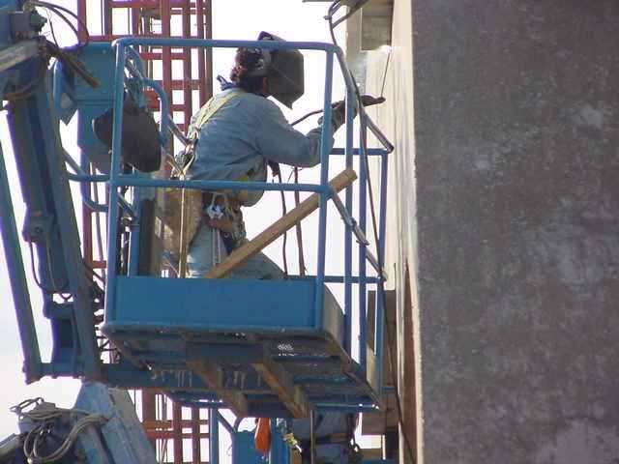
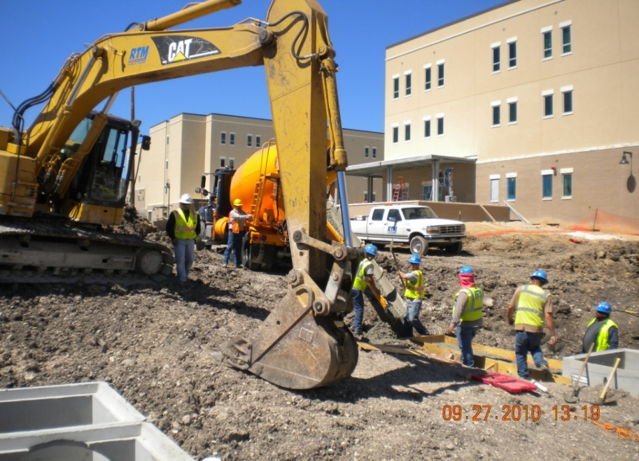
New Thoughts on Safety
Assume we were doing reasonable things given the complexities, dilemmas, tradeoffs, etc..
Simply finding and highlighting mistakes explains nothing.
Saying what did not do or what should have done does not explain why they did what they did.

Slide 15
Yes for Resilience
The Systems are not Perfect. They are usually inherited from one site to another.
They often neglect productivity as an important operational factor, they assume unlimited resources, ignore time pressure realities.
Safety is about the Presence of, and not Absence of, something.
When things go well under difficult circumstances, it is because People have this remarkable adaptive capacity.

Slide 16
Yes for Resilience
Their ability to recognise, and adapt, absorb changes and disruptions – some of which might even lie outside what the system is designed for.
The ability to absorb changes without crumbling.
And that’s what Resilience is all about.

Slide 17
New Thoughts on Safety
Traditional System | Complex System
Machines (control behaviour) | Humans (feedback)
Controlling and predictable | Unpredictable
Rigid | Flexible and creative
Repeat the Past | Offer alternatives
Find comfort in control | Find comfort in evolving

Slide 18
What Research Tells Us…..
Organization Design and Structure
Staffing and Deployment
Pay & Performance
Alignment
Leadership
Communication
Education &
Training
Alolah, T., Stewart, R.A., Panuwatwanich, K. and Mohamed, S. (2014) Developing a comprehensive safety performance evaluation framework Int. J. of Productivity and Performance Management. 63(4), 446-76

Slide 19
What Research Tells Us…..
Top-down driven strategy is the reference point
for the entire safety management system
Identifying
strategy and
targets
Implementing
and monitoring
Learning and
Improving
BSC
Evaluating and
Communicating
Bottom-up approach is the source
for operational feedback and evaluation
Mohamed, S. (2003) Scorecard approach to benchmarking organizational safety culture in construction. J. of Construction Engineering and Management, American Society of Civil Engineers, 129(1), 80-88.

Slide 20
What Research Tells Us…..
Adaptive
Resilience
Foundation
Committed
Leadership
Organisational Support
Shared Desire
For Excellence
Principles
Functions
Safety Management System
Safety Culture
Safety Management
Oversight
Figure adopted from: Jim Collins, Good to Great; HarperCollins Publishers, NY; 2001.

Slide 21

What Research tells us …..
The Invisible asset
But it is There!
You can not see it
You can not touch it
You can not taste it
You can not hear it
You can not smell it

Slide 22
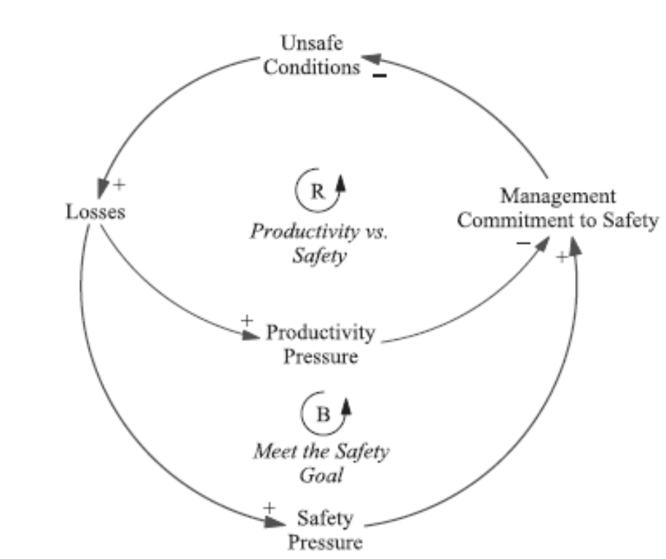
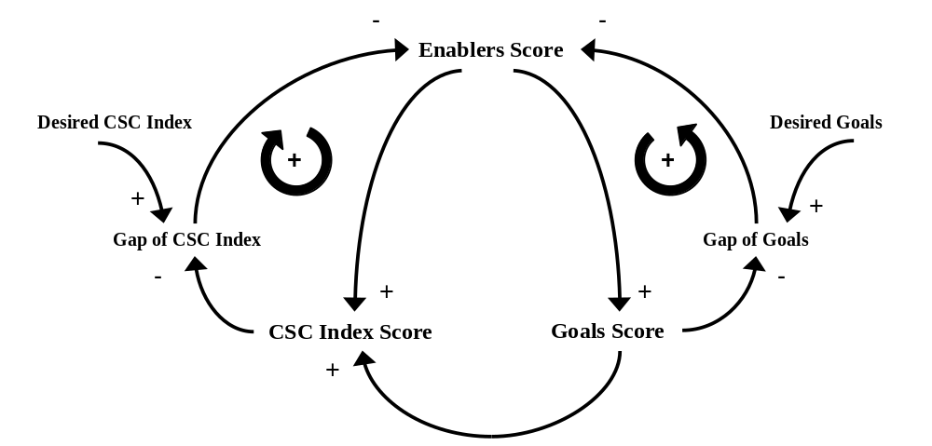
What Research Tells Us…..
Mohamed, S. & Chinda, T. (2011). System dynamics modelling of construction safety culture. Engineering, Construction and Architectural Management, 18(3), 266-281.

Slide 23
What Research Tells Us…..
 | Leading Indicators | Increase over 12 months
Learning | Agreed responsibilities and accountabilities | +12%
 | Perception of a caring organisation | +26%
 | Improvement shared between sites | +14%
 | Effectiveness of visible felt workers leadership | +33%
 | Feedback on +ve and –ve issues | +28%
Productivity (on average) increased by 7.5%

Slide 24
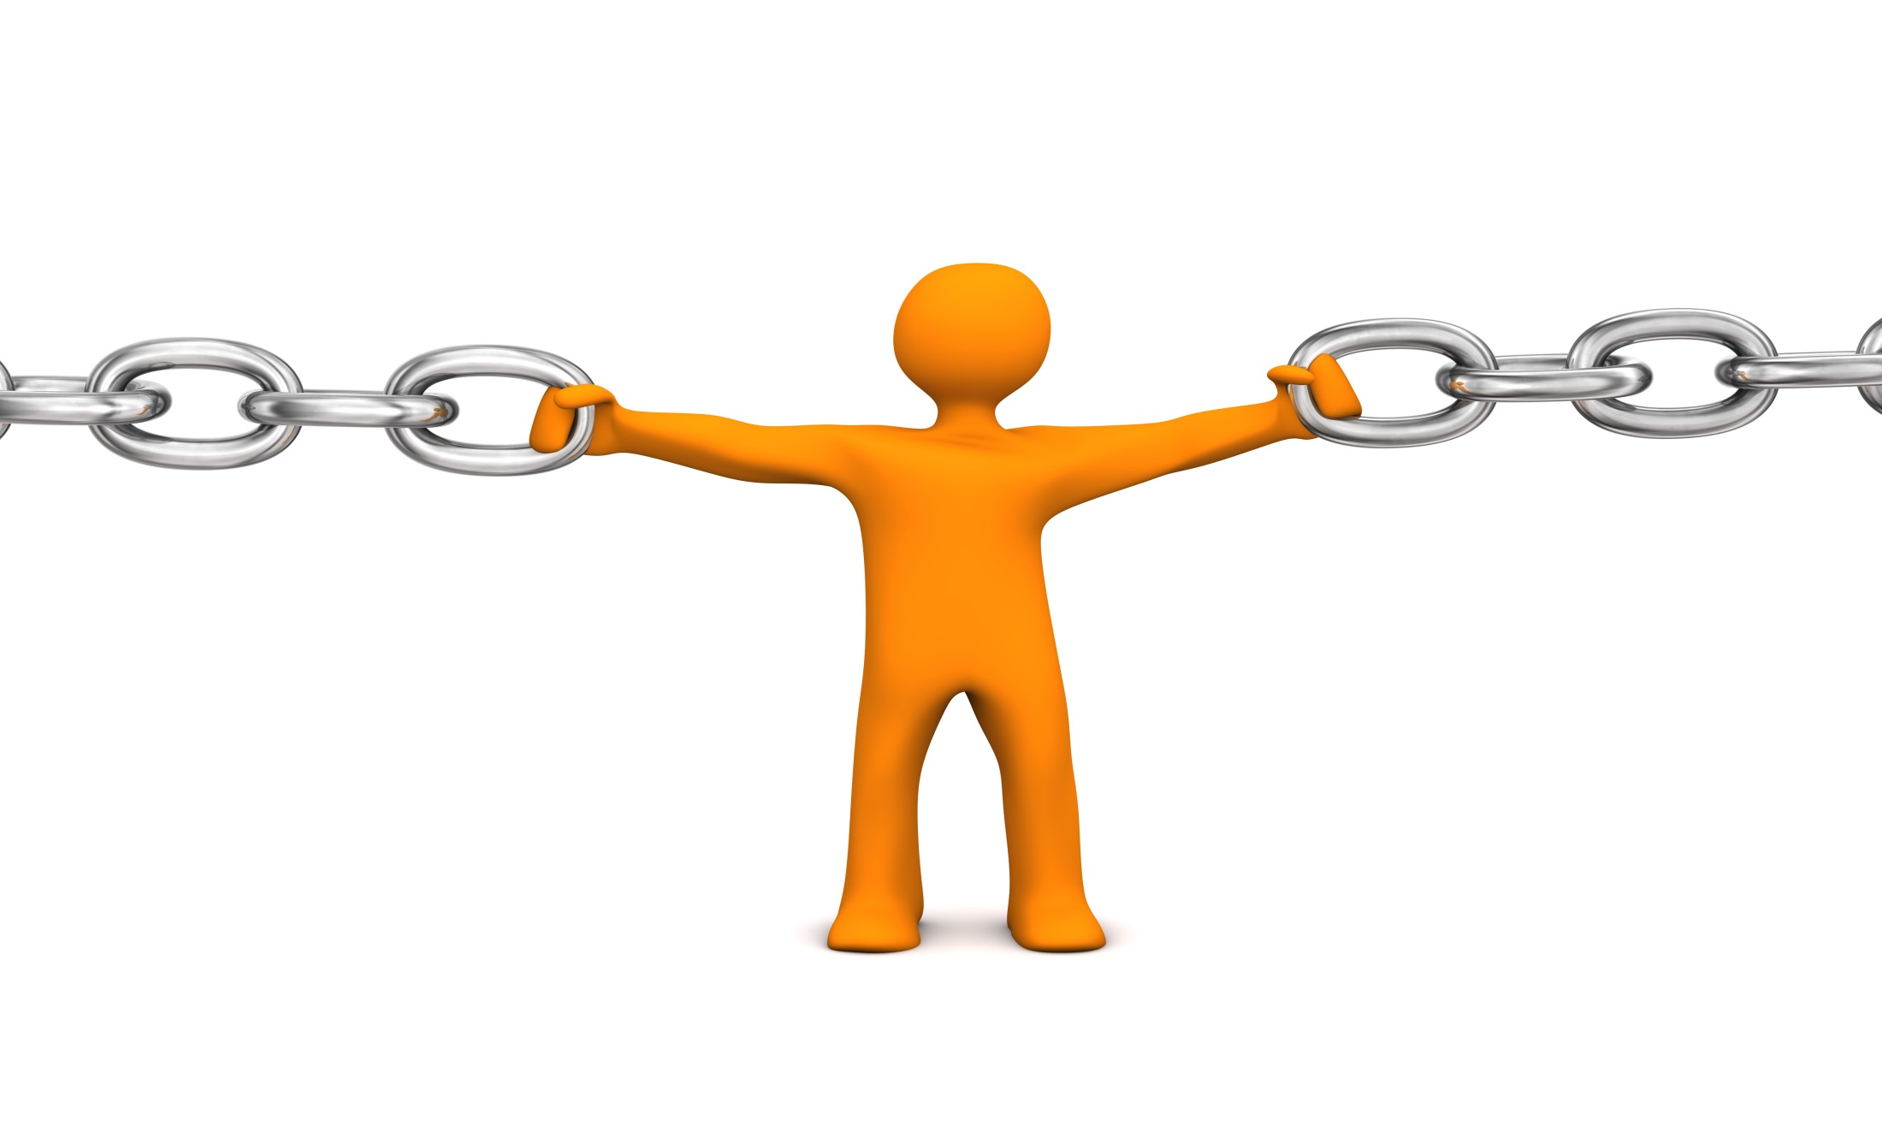
SAFETY
RESILIENCE
Absence of negative events?
Presence of positive capacity?
NO IT’S NOT THE END
IT’S JUST THE
BEGINNING

