Slide 1


Inhaled IFN-α1b for RSV Bronchiolitis
Kunling Shen MD.
President, Chinese Pediatric Society, Chinese Medical Association
Professor , Beijing Children’s Hospital, Capital Medical University

Slide 2
1. Pediatric respiratory viral diseases in China
2. Interferon and antiviral mechanism
3. IFN-α1b aerosol inhalation for RSV inhibition
4. Clinical trial of inhaled IFN-α1b for bronchiolitis- efficacy and safety
Content

Slide 3
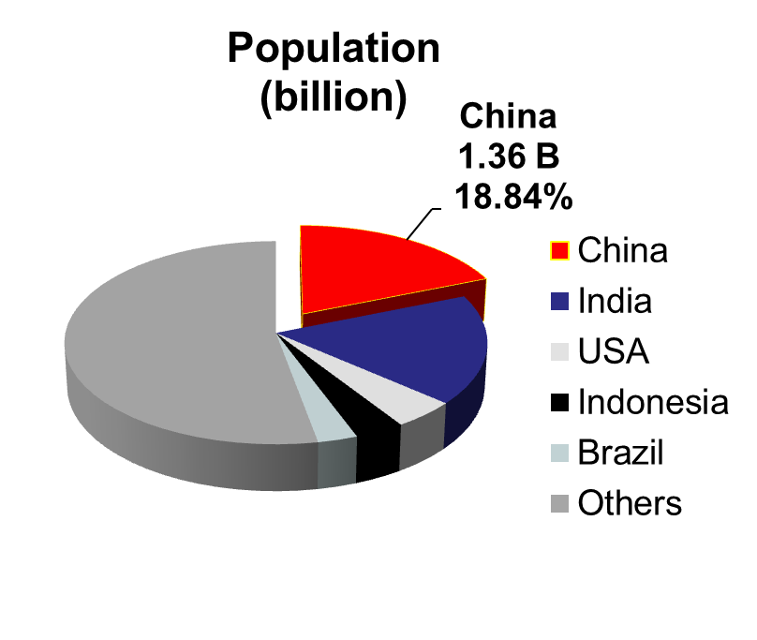
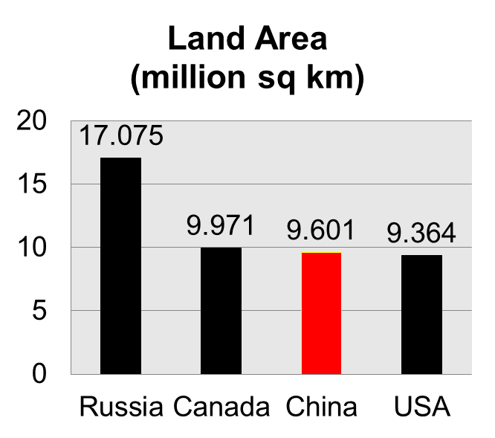
China’s Country Background
China's GDP could top 61.1 trillion yuan (about 10 trillion dollars) by the end of 2014, making China the world's second-largest economy.
Notes:
(From the graphs we can see that China has the third largest land area in the planet which is approximately 9.6 million square kilometers. But we’re holding the largest population which is 1.36 billion people, accounting for 18.84% of world’s population.
And by the end of 2014, China's GDP could top 61.1 trillion yuan (about 10 trillion dollars), making China the world's second-largest economy.

Slide 4
Huge children’s population, steady growth
  Huge base: the sixth national census (2010)
    0-6 years: over 100 million, accounting for 1/5 of the world population of the same age
    0-14 years: 222 million, accounting for 16.6% of China’s total population
    0-18 years: about 300 million, accounting for 22.5%of China’s total population
  Steady growth, especially after the release of two-child policy
    New-born population of about 20 million per year
    New birth rate: 1 baby/4.15 seconds
    The number of births in 2010 was 3 times the number 8 years ago
Notes:
There is huge children’s population in China, 300 millions of 0-18 years which accounting for the 22.5% of China’s total population.

Slide 5
Remarkable Improvement of Health Level of Children
MDG 4 called for a two-thirds reduction in the under-5 mortality rate between 1990 and 2015.
Mortality of infants and children under 5 decreased by 82.3% and 80.8% respectively, from 50.2‰ and 61.0‰ in 1991 to 8.9‰ and 11.7‰ in 2014. China reached MDG4 target ahead of time.

Slide 6
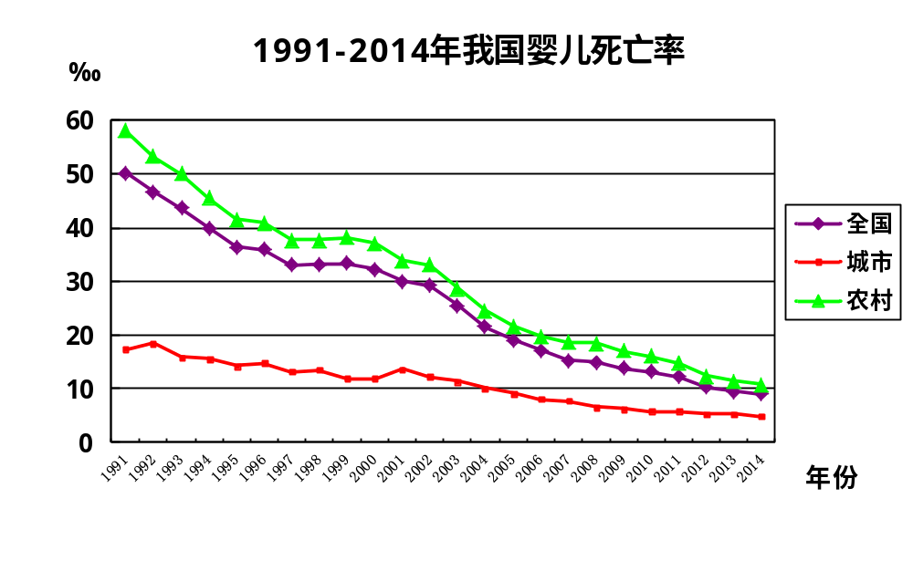
Infant Mortality in China During 1991-2014
Overall
Urban Area
Rural Area
Year

Slide 7
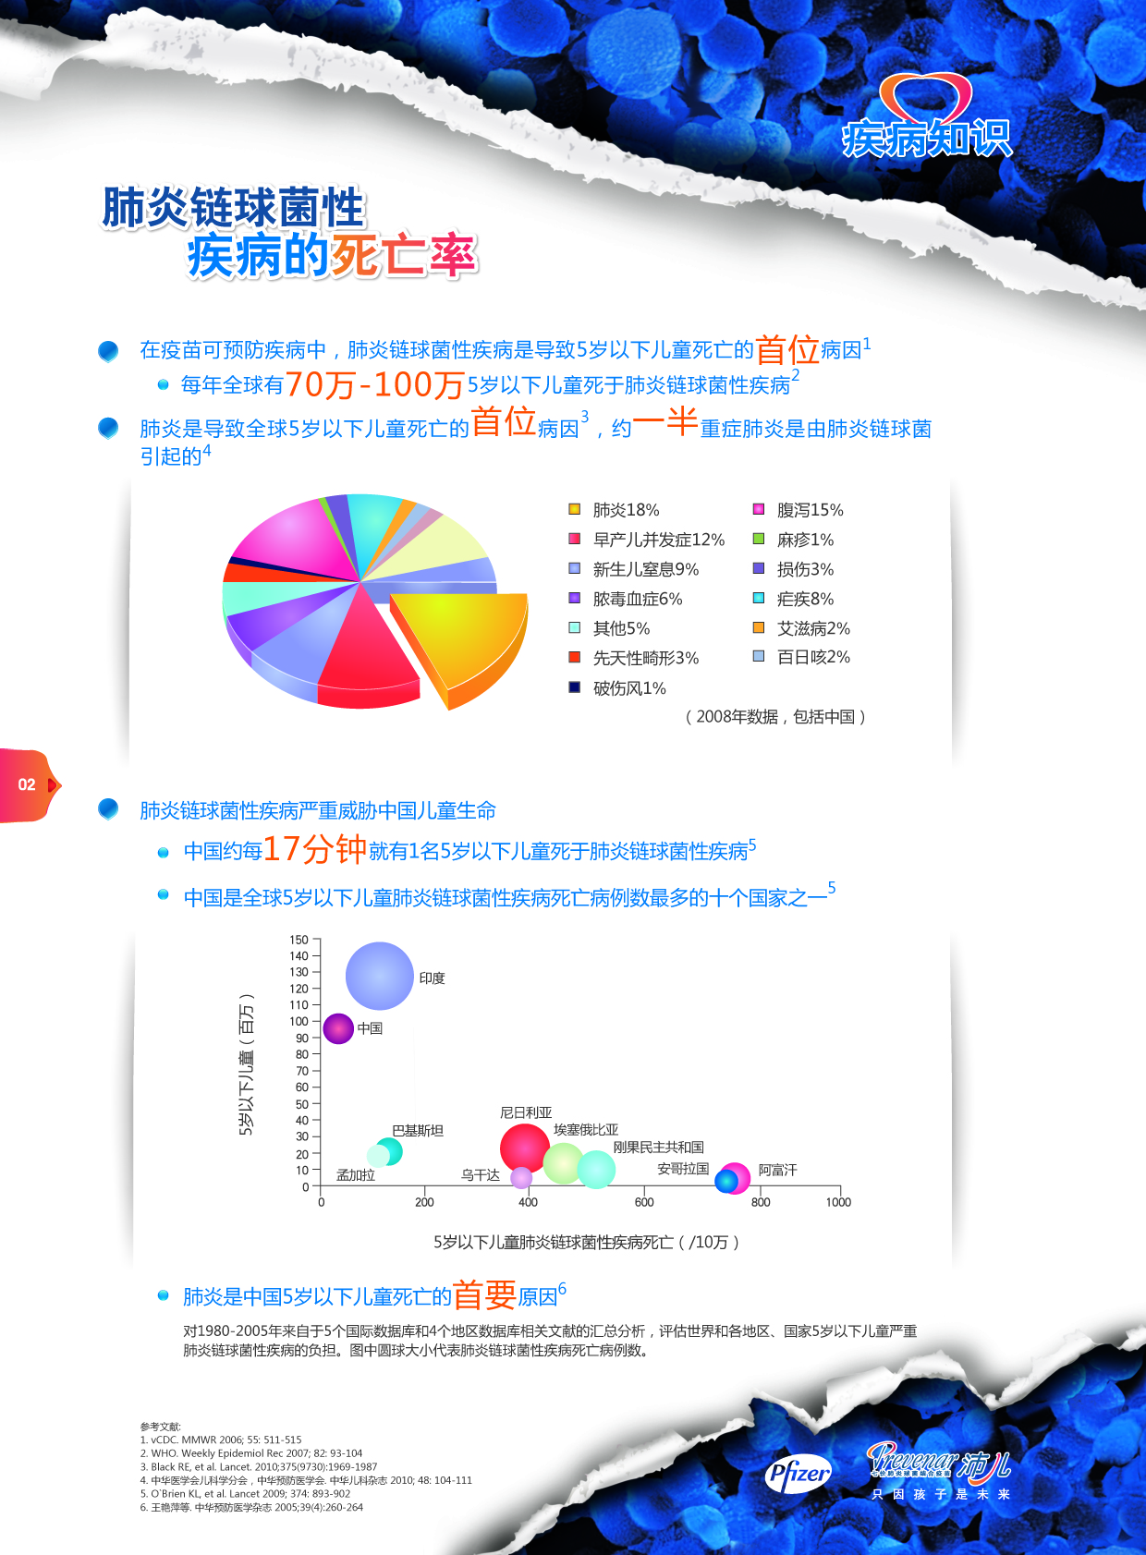
The Leading Causes of Mortality Under Five in the World
Pneumonia, diarrhea and infectious diseases are the main health threats to children < 5 yrs.
Pneumonia is the leading cause of death in children < 5 yrs.
Pneumonia 18%
Diarrhoea 15%
Complications of preterminfants 12%
Measles 1%
Asphyxia neonatorum 9%
Damage 3%
Pyemia 6%
Malaria 8%
18%
Others 5%
AIDS 2%
Congenital malformation 3%
Pertussis 2%
Tetanus 1%
(2008 data, including China)
Notes:
P5: 同时，病毒也是危害儿童健康乃至生命的最主要的威胁。包括肺炎、腹泻等。
At the same time, the virus is also a major threat to children's health and even life, including pneumonia, diarrhea and so on.

Slide 8
Spectrum of Pediatric Disease in China.
Ranking | Category | Prevalence of aged 0-4（‰） | Distribution proportion | Prevalence of aged 5-14（‰） | Distribution proportion | sick numbers of 2007y（10k）
1 | Respiratory Disorders | 160.91 | 79.82% | 74.41 | 73.96% | 2335.1
2 | Digestive Disease | 20.43 | 10.13% | 9.15 | 9.09% | 291.4
3 | Infectious Disease | 5.9 | 2.93% | 4.8 | 4.77% | 120.7
4 | Diseases of the skin and subcutaneous tissue | 5.37 | 2.66% | 2.54 | 2.52% | 78.9
5 | Trauma and Toxicosis | 2.2 | 1.09% | 2.01 | 2.00% | 48.8
6 | Ocular disorders | 1.5 | 0.74% | 2.24 | 2.23% | 48
7 | Unknown | 1.14 | 0.57% | 0.74 | 0.74% | 20.2
8 | Nerve system disease | 0.88 | 0.44% | 0.71 | 0.71% | 17.9
9 | Otitis mastoidea | 0.53 | 0.26% | 0.61 | 0.61% | 13.9
10 | Urogenital disease | 0.62 | 0.31% | 0.51 | 0.51% | 12.8
11 | Desmosis | 0.44 | 0.22% | 0.53 | 0.53% | 11.9
12 | Circulation problem | 0.44 | 0.22% | 0.41 | 0.41% | 9.9
13 | Metabolic and immune diseas | 0.44 | 0.22% | 0.38 | 0.38% | 9.4
14 | Parasitosis | 0.09 | 0.04% | 0.41 | 0.41% | 7.6
15 | hematopoietic disease | 0.09 | 0.04% | 0.33 | 0.33% | 6.2
16 | Others | 0.18 | 0.09% | 0.23 | 0.23% | 5.1
17 | Congenital Anomaly | 0.18 | 0.09% | 0.13 | 0.13% | 3.4
18 | Mental Disorder | 0.09 | 0.04% | 0.15 | 0.15% | 3.1
19 | Benign Tumor | 0 | 0.00% | 0.15 | 0.15% | 2.5
20 | Malignant Tumor | 0.09 | 0.04% | 0 | 0.00% | 0.6
21 | Pregnancy, childbirth and puerperium complication | 0.09 | 0.04% | 0 | 0.00% | 0.6
22 | Perinatal diseases | 0 | 0.00% | 0.03 | 0.03% | 0.5
All |  | 201.6 | 100.00% | 100.61 | 100.00% | 8
According to the national data, respiratory , GI and infectious diseases are the top 3 common types of pediatric disease spectrum in China, accounting for 94% of total children’s cases. Among of them , respiratory disease is the most frequent disease and related to nearly 80% of all cases.
An Analysis Report of the Second National Health Services Survey in 1998 by Ministry of Health.
China Health Statistics Abstract 2008
Notes:
P3 从中国儿童疾病谱来看，呼吸道、消化道疾病和传染病是最常见的三类儿科疾病，约占全部儿童疾病的94%，其中呼吸系统疾病将近80%。
According to diseases spectrum, respiratory disorder, digestive digestive disease and infectious diseases are the top 3 common types of pediatric diseases in China, accounting for 94% total children’s cases. Among of them , respiratory disease is the most frequent disease and related to nearly 80% of all cases.

Slide 9
Respiratory Tract Infection in China
@For each year, there are 240 and 13.5 million person-time children accept treatment in outpatient and inpatient respectively. More than 65% of them due to respiratory tract infection .
@In those with upper respiratory tract infection, 63% outpatient and 38% inpatient cases are caused by viruses and the number reaches 50 million and 1.0 million , respectively .
In children with lower respiratory tract infection ,the figures are 26 million and 2.4 million, respectively.
@Totally ,for each year, there are nearly 80 million children in China needed treatment either in outpatient or inpatient because respiratory viruses infection.
Pediatric infectious disease population
The Population of Children ¹
220 M
Outpatient/hospitalization ¹
240 M/13.5 M
Respiratory tract infectious disease
（68% ² /65%⁸ ）
upper respiratory tract
（50%⁴/31%⁸)
low respiratory tract
（42%⁴/69%⁸)
80 M / 2.7 M
67M/ 6M
Viral(63%⁵/38%⁶)
Viral(40%/40%)⁶
50M/1M
26M/2.4M
Notes:
P4 中国每年因病在门急诊就诊的患儿达到2亿4000万人次，住院1350万人次。其中呼吸道感染性疾病均超过60%.
(黑色的数字代表门急诊患儿数，红色的数字表示住院的患儿数)
在上感人群中，因病毒感染引起门急诊和住院的比例分别为63%和38%，分别为5000万和100万人次
而在下呼吸道感染患儿人群中，这个数字分别为2600万和240万人次。
这样在中国，每年有大约8000万儿童由于病毒引起的呼吸道感染而接受门诊或住院治疗。
For each year,there are 240 and 13.5 Million person-time children accept treatment in outpatient and hospitalizaiton,respectively. More than 65% of them due to respiratory tract infection .
( the number of outpatient is indicated in black and the hospitalization is in red)
In those who have upper respiratory tract infection, 63% outpatient and 38% hospitalization cases are caused by viruses and the number reaches 50 million and 1.0 million , respectively .
In children with lower respiratory tract infection ,the figures are 26 million and 2.4 million ,repectively.
Totally ,for each year, there are nearly 80 million children in China needed treatment either in outpatient or hospitalization because of viruses infection in their respiratory tracts.
Basic estimation assumption：
Outpatient/hospitalization disease spectrum/morbidity data refer to the data of the literature specific areas related to the hospital,without the consideration of patients'age/sick time/geographic viration.
1.1.2013 China Health Statistics Yearbook (demographic indicators / Medical Services)
2. China Practical Medicine .2014,41 (14): 56.
3. Applied Clinical Pediatrics .2010,25 (19): 1453.
4. China Primary Health Care .2014,28 (6): 63.
5. Chinese Journal of Health Laboratory .2008,18 (7): 1263.
6. Applied Clinical Pediatrics .2010,25 (22): 1689.
7. National Center for Disease Control: 2014 National Notifiable infectious diseases cases
8. Yangtze University (Natural Science) .2011,12 (8): 180.
M: million

Slide 10
Virus is the Main Pathogen of ARTI in China
Outpatient (n=1050)
Hospitalization
(n=1016)
The total virus detection rate is 50% and 70% for outpatient and inpatient due to respiratory tract infection, and the top 3 viruses are RSV, HRV and PIV.
It is further indicated that the virus infection is the main cause of respiratory tract infection in China among which RSV is the most common type of virus causing hospitalization.
Sample : NPS Test Method: RT-PCR
Liu CY, Shen KL,et al. Pathogen analysis from ARTI children outpatient and hospitalization in 2010-2012.
Chin J Pediatr. 2013, 51(4):255-259
Notes:
P6: 对病毒种类进一步研究发现，北京地区，呼吸道感染的住院患儿中，病毒总检出率将近70%，检出病毒的前三位依次是RSV、HRV和PIV。
进一步表明病毒感染是导致我国呼吸道感染儿童住院的主要原因，其中RSV是最常见的病毒种类。
An epidemiological study show that , in Beijing area , the total virus detection rate is about 70% and 50% for those children who were in outpatient or hospitalization due to respiratory tract infections, and the top 3 viruses which cause serious illness are RSV, HRV and PIV.
It is further indicated that the virus infection is the main cause of respiratory tract infection in China among which RSV is the most common type of virus causing hospitalization.

Slide 11
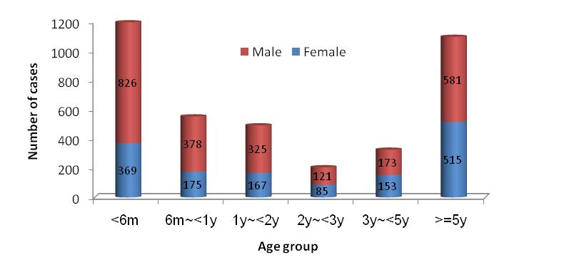
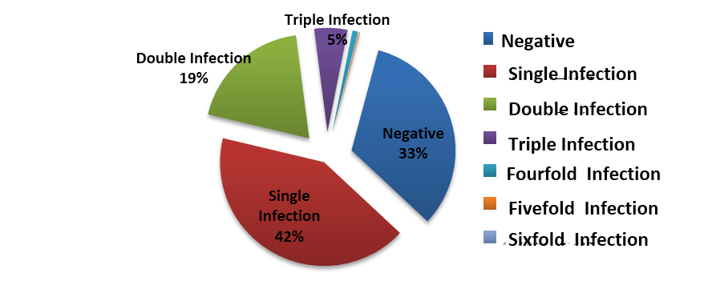
ALRTI Viruses Detection in China（2007~2013）
N= 3870; M：F = 1.64:1, median age = 1 yr
total positive detection ： 67.2%. (2601/3870)
Respiratory Viruses Type Analysis by Age
Virus detection rate was 67.2%, 42% were single virus, 24% of the detected had more than one type of virus. For children under 5, RSV were detected as the No. 1 virus, followed by HRV and PIV.
Notes:
P7: 在另一项更为长期的研究发现，在3870例由于急性下呼吸道感染而就诊的患儿中，2601例检出病毒阳性，总的病毒检出率为67.2 % ，42%为单一病毒感染，超过24%的检出了一种以上的病毒混合感染。
对于5岁以下，各种年龄组患儿，RSV均为检出第一位的病毒种类（蓝色标记）。尤其是6个月以下的小婴儿，RSV的比例占到45%以上。其次HRV和PIV均有较高比例的检出。
In another long-term study we found that in 3870 cases of the children who suffered from acute infection of the lower respiratory tract, the virus detection rate was 67.2%, 42% were single virus infection, over 24% of the detected had more than one type of virus.
For children under 5 years of age, RSV were detected in the first virus type (blue label), followed by PIV and HRV have a higher proportion of detection.

Slide 12


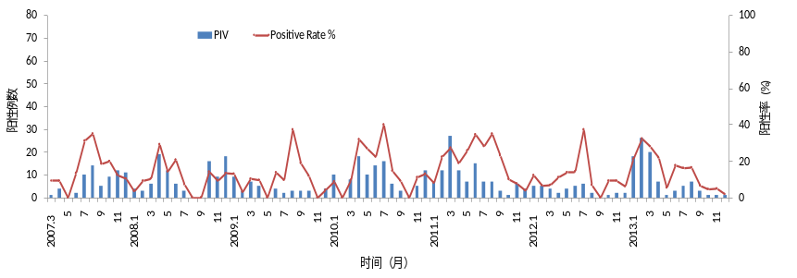
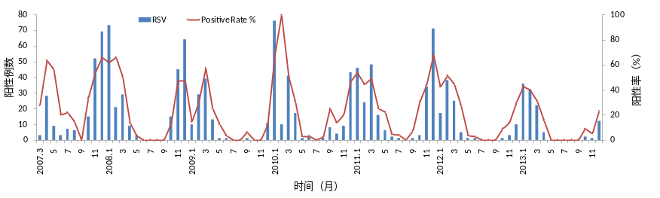

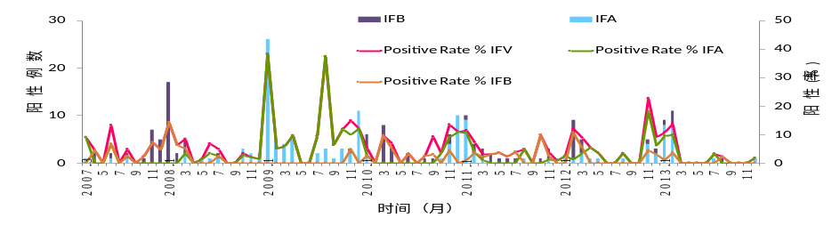

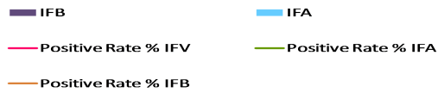
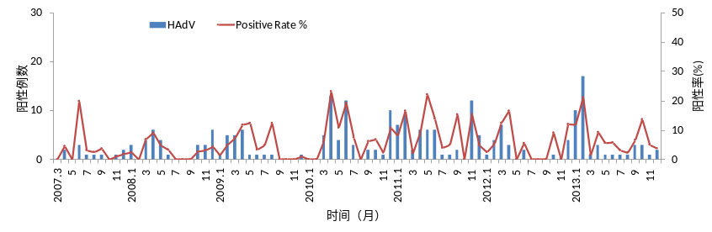
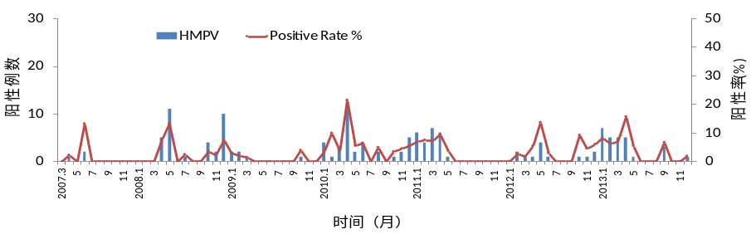
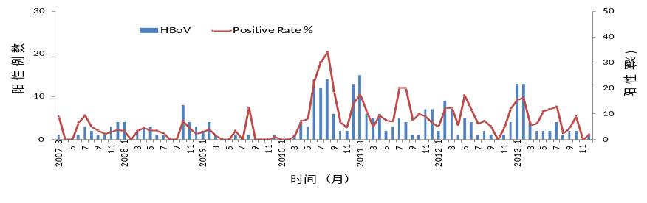
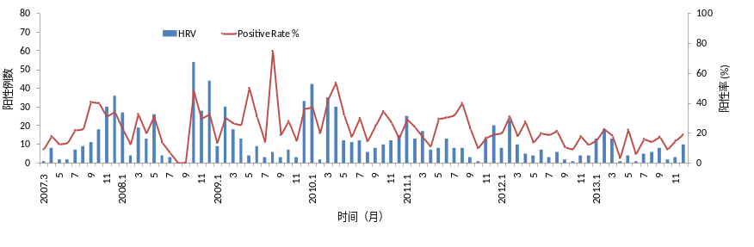
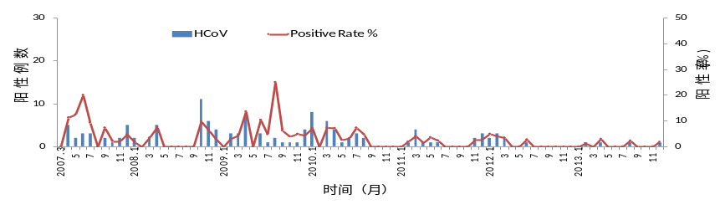
Viral Type by Seasons
RSV
Positive Rate(%)
PIV
Positive Rate(%)
Positive Cases
Positive Cases
Time (month)
Time (month)
Positive Cases
Positive Rate(%)
Positive Rate(%)
Positive Cases
Time (month)
Time (month)
Positive Cases
Positive Rate(%)
HBoV
Positive Rate(%)
Positive Cases
HRV
HCoV
Time (month)
Time (month)
Positive Rate(%)
Positive Rate(%)
Positive Cases
Positive Cases
Time (month)
Time (month)
RSV has obvious seasonal distribution with peak in winter and spring; The other common viruses, HRV and PIV lack of obvious seasonal distribution characteristics.
Notes:
P8: RSV在各种呼吸道病毒中阳性率最高，感染具有明显的季节性分布特点，其流行高峰在冬春季节；IFV的流行高峰在冬季；HMPV整体检出率较低，也主要集中在冬春季节，并且呈现出两年一次流行特征；其他病毒缺乏明显季节分布特点。
The positive rate of RSV in various respiratory virus had the highest infection .RSV has obvious seasonal distribution characteristics and the epidemic peak is in winter and spring; IFV epidemic peaked in winter; the overall detection rate of HMPV is low, it mainly concentrated in the winter season, and presents two years a popular feature; other viruses is lack of obvious seasonal distribution characteristics.

Slide 13

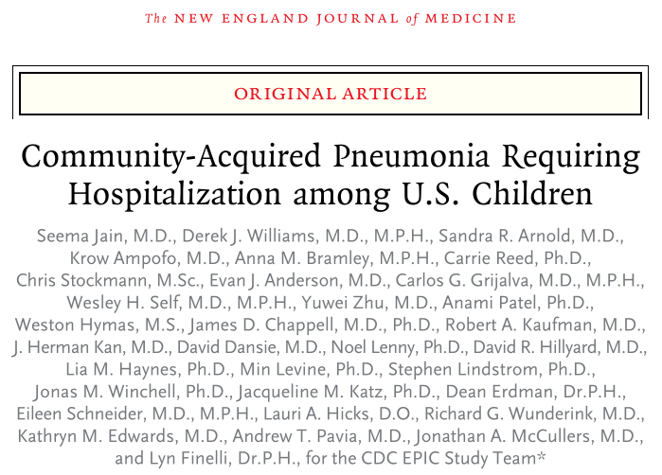
Pathogen Analysis of CAP Requiring Hospitalization in U.S.
Notes:
P9: 2015年2月，《新英格兰医学杂志》发表一篇《对美国儿童社区获得性肺炎需要住院治疗病例的研究》，对美国儿童社区获得性肺炎住院患者，进行了一项非常有意义的流行病学研究。
February 2015, < New England Journal of Medicine >published a paper named < children of America community get pneumonia in hospitalized patients of >, which engaged in a very meaningful epidemiological study of the hospitalized children patients with acquired pneumonia in American community.

Slide 14
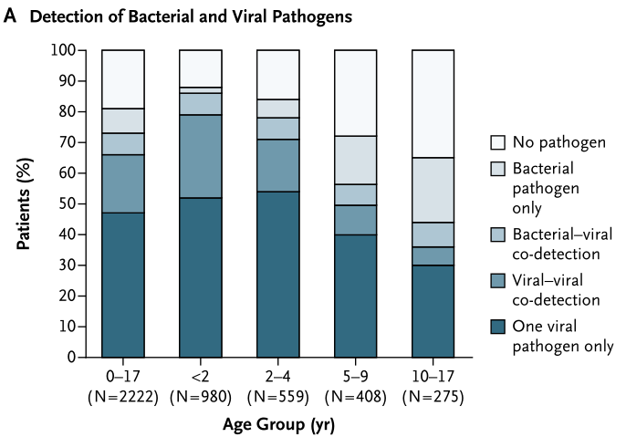
High Virus Detection Rate
N Engl J Med 2015;372:835-45
Distribution of Pathogens by Age
Admission rate (cases/10000）
Y
Y
Y
@ Distribution of pathogens by age showed that in hospitalized CAP, virus detection rate is as high as 66%, especially in young children under 5, virus detection rate is higher. @ Young children hospitalization rate was also significantly higher than 5 years or older children. The results show that virus infection, especially in young children, greatly increased the rate of hospitalization.
Notes:
P10: 研究对比了CAP患儿呼吸道样本、血液样本中的病原感染分布情况，结果发现，儿童CAP住院患者，病毒检出率高达66%，尤其是5岁以下的低龄儿童，病毒检出率更高；
同时，低龄儿童的住院率也显著高于5岁以上的儿童。表明：患者因病毒感染，尤其是低龄儿童，大大增加了CAP儿童的住院率。
The study of CAP in children with respiratory tract samples and blood samples compares the sitiation of pathogenic infection distribution. It was found, CAP in children hospitalized patients, virus detection rate is as high as 66%, especially young children under 5 years of age, virus detection rate is higher.
At the same time, young children hospitalization rate was also significantly higher than 5 years of age or older children. The results show that: patient because of a virus infection, especially young children, greatly increased the rate of hospitalization of cap in children.

Slide 15
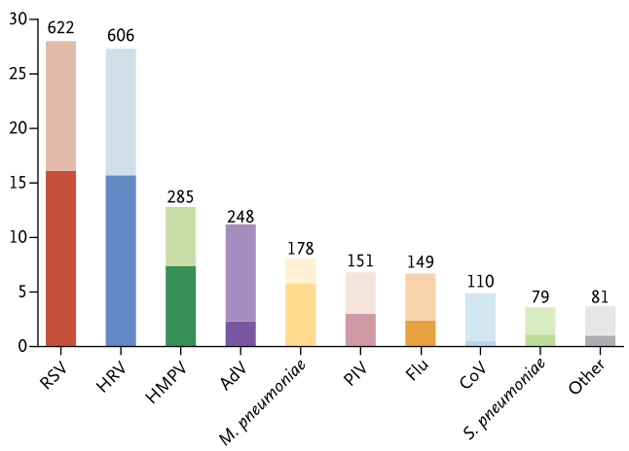
RSV is the most common pathogen of Pediatric CAP
病原体阳性病例（%）
Pathogen positive cases (%)
Light column: co-infection
Dark column: single infection
A detailed analysis showed that the highest detection rate of the pathogen is RSV, followed by HRV, HMPV and Adenovirus (AdV) in pediatric CAP hospitalized.
Detection rate: 66%; RSV, HRV, HMPV, AdV USA
67% RSV, HRV, PIV, AdV China
Jain S,et al. Community-acquired pneumonia requiring hospitalization among U.S. children.
N Engl J Med 2015;372:835-45.
Notes:
P11: 深入分析表明，检出率最高的病原体是RSV，另外鼻病毒（HRV）、偏肺病毒（HMPV）、腺病毒（AdV）等也是非常常见的引起CAP患儿住院的主要原因。
A detailed analysis showed that the highest detection rate of the pathogen is RSV, in addition to the nasal virus (HRV), partial lung virus (HMPV), adenovirus (AdV) and so on are also very common causes of CAP in children hospitalized.

Slide 16
Summary
  Virus is the most common pathogen of pediatric respiratory tract diseases.
  RSV is the most common respiratory virus leading hospitalization for children, especially those under 5 yrs.
  Viral disease seriously harms the health of children.
Notes:
P12:
由此可见，病毒性疾病严重危害中国乃至全球儿童的身体健康
病毒感染是儿童呼吸道疾病的首要病原
RSV是造成儿童，尤其低龄儿童呼吸道感染住院的首要病原
。
It can be seen that, both in China and the whole world, respiratory disease is still the primary disease endangering the health of children.
Virus is the main pathogen of respiratory system diseases.
The RSV which is caused by the children, especially the primary pathogen under the age of 5 young children in hospital.

Slide 17
1. Pediatric respiratory viral diseases in China
2. Interferon and antiviral mechanism
3. IFN-α1b aerosol inhalation for RSV inhibition
4. Clinical trial of inhaled IFN-α1b for bronchiolitis- efficacy and safety
Content

Slide 18
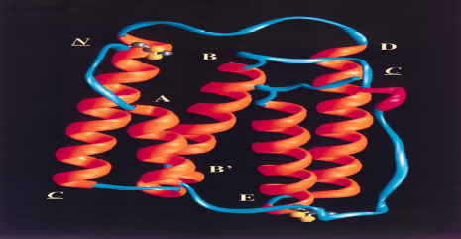
Interferon
@The control of RSV is still lack of effectiveness. Palivizumab is only used in the prevention in high risk patients. Not available in China. Anti RSV vaccine has not made effective progress. Therefore, it needs a safe and effective treatment for RSV and other respiratory viruses.
@Interferon-α is a widely existing cytokine of the mammals, an important component of innative immunity. Having broad spectrum antiviral and immune regulation function.
@Three subtypes of interferon-α approved for lauching:
IFNα1b、IFNα2a and IFNα2b.
@The gene of IFNα2a and IFNα2b is from Caucasian , while gene of IFNα1b is from healthy Chinese umbilical cord blood leukocyte.
Subtype | α1b | α2a | α2b
Gene Source | Leukocyte of Healthy Chinese | Myeloma Cells of Caucasian | Leukocyte of Caucasian
NAb | 2.94 % | 20.9 % | 6.9 %
ADR | 34% | 97% | 80%
Yunde Hou. The 1st national symposia on clinical application of genetic engineering interferon. Shenzhen, 1992
Notes:
P14: 尽管RSV的危害如此严重，但针对RSV的特效防治手段却仍旧缺乏。Palivizumab(Anti-F protein of RSV)帕利珠单抗 只用于早产、先心病患儿的预防性使用，而且中国也没有进口。 抗RSV的疫苗至今也没有取得有成效的进展。
因此需要一种抗RSV，甚至能够对多种病毒感染都有治疗作用的安全有效的治疗方法。
Despite the RSV's harm is so serious, the control method of RSV is still lack of effectiveness. Palivizumab(Anti-F protein of RSV) is only used in the prevention of premature birth, congenital heart disease in children, and China has not imported for now. Anti RSV vaccine has not made effective progress. Therefore, it needs a safe and effective treatment for RSV, and even for many kinds of virus infection.
干扰素α是一种广泛存在于哺乳动物体内细胞因子，是天然免疫的重要成分。具有抗病毒、抗增殖和免疫调节三种主要的生物学功能。尤其是抗病毒作用具有广谱性，即对于多种病毒均有抑制作用。
Interferon-α is a widely existing in cytokine of mammal, and it is an important component of innate immunity. With antiviral, three main biological function of anti proliferation and immune regulation. Especially antiviral effect of IFN-α has broad spectrum, which means it has inhibitory effects on a variety of viruses
有三种亚型的干扰素α被批准上市：IFNα1b、IFNα2a 和 IFNα2b. 其中IFNα2a 和 IFNα2b的基因来源于西方人，IFNα1b的基因来源于健康中国的脐带血白细胞，在使用过程中也显示了一定的特点。
There are three subtypes of interferon-α approved for lauching: IFNα1b、IFNα2a and IFNα2b. The gene of IFNα2a and IFNα2b is from the west, while gene of IFNα1b is from health Chinese Umbilical cord blood leukocyte.

Slide 19
IFN-α for MERS-CoV Infection
Lancet Infect Dis. 2014 Nov;14(11):1090-5.
Ribavirin and interferon alfa-2a for severe Middle East respiratory syndrome coronavirus infection: a retrospective cohort study.
Omrani AS¹, Saad MM¹, Baig K², Bahloul A¹, Abdul-Matin M³, Alaidaroos AY⁴, Almakhlafi GA⁵, Albarrak MM⁵, Memish ZA⁶, Albarrak AM¹.
FINDINGS: (70%) of 20 patients in the treatment group had survived after 14 days, compared with seven (29%) of 24 in the comparator group (p=0·004).
INTERPRETATION: In patients with severe MERS-CoV infection, ribavirin and interferon alfa-2a therapy is associated with significantly improved survival at 14 days
Notes:
P15 作为广谱的抗病毒药物，IFN-α对于近年来新发现的病毒也显示了作用。
研究表明，接受IFN-α联合利巴韦林治疗的20名MERS-CoV感染重症患者中，其14天生存率达到70%，而对照组只有29%，具有统计学差异。而第28天的比较结果无统计学差异。提示IFN-α对于MERS-CoV具有一定的作用。

Slide 20
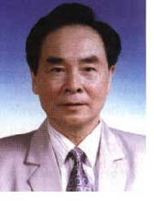
The Origin of IFN-α1b
1982 first cloned from umbilical cord blood leukocytes of healthy Chinese human
1985 first clinical trial of hepatitis B in the world
1987 first clinical trial of cervicitis in the world
in 1999 first Chinese genetic engineered new drug.
interferon α1b is the earliest and the major subtype when Chinese is infected.
It is the most important subtype of interferon transmited from Chinese mother to their infant in a natural status.
Dr.Yunde Hou
Academician of China Academy of Engineering
The inventor of IFNα1b
Notes:
P16: IFNα1b是中国人在受到病毒感染后，出现最早和丰度最高的干扰素亚型，
也是自然状态下，中国人母婴传递最主要的干扰素亚型，是中国第一个基因工程一类新药，1999年上市。这位就是IFNα1b的发明人，侯云德院士。
IFNα1b is the earliest and the highest abundance of interferon subtype when Chinese is infected,It is also the most important subtype of interferon by Chinese mother infant transmission in a natural state.And it is China's first genetically engineered new drugs, listed in 1999.This is the inventor of IFNα1b academician Yunde Hou.

Slide 21
Antiviral Mechanism of IFN-α1b
INTERFEON
Cell Receptor
Antiviral Proteins
Immune response
2’5’-OAS
Phosphodies terase
Protein kinase
CTL
NK
Macrophage
Viral mRNA degradation
Viral protein translation inhibition
Viral protein synthesis initiation inhibition
Promote proliferation
Activate killing
Enhance phagocytosis
Inhibit virus replication
Enhance immune clearance
Virus Clearance
IFN-α1b plays anti-virus effect through inducing antiviral proteins and activation of cellular immunity
Shen KL, Zhang GC , Shang YX et al. Expert consensus on pediatric clinical application of IFN-α1b.
Chinese Journal of Practice Pediatrics. 2015,30(16)1214-9
Notes:
21
P17: IFNα1b的广谱抗病毒作用是通过两种作用机制实现的，IFNα1b与细胞表面的干扰素受体结合后，一方面，诱生多种抗病毒蛋白，在病毒生命周期的多个环节发挥作用，从而抑制病毒在细胞内的复制；另一方面，增强机体的细胞免疫作用，例如CTL、NK、巨噬细胞的作用，加速对病毒的吞噬作用。
The broad spectrum antiviral effect of IFNα1b is achieved through two mechanisms, after the combination of interferon receptor，On the one hand, to induce a variety of antiviral protein and to play a role in the virus life cycle of a number of links, thereby inhibiting the virus in the cell replication;
On the other hand, enhance the cellular immune function of the body, such as NK, CTL, macrophage, accelerate the phagocytosis of the virus

Slide 22
Common Respiratory Viruses Sensitivity to IFN-α1b
Acute respiratory infection ：RV、 RSV 、 IF 、 PIV、ADV
Acute Bronchitis ：RV、 RSV 、 IF 、PIV 、ADV…
Bronchiolitis ：RSV 、 PIV 、ADV …
Bronchopneumonia ： RSV 、 ADV 、 IF 、PIV…
Virus |  | Cell | IC50 | Genome Type | Sensitivity
RSV |  | Hep-2 | 10.4 ng/ml | －RNA | *****
CV |  | Vero | 0.1μg/ml | －RNA | ****
IFV |  | MDCK | 30 ng/ml | －RNA | ****
PIV |  | MDCK | 4.8μg/ml | －RNA | ***
CoV |  | HELA | 3.7μg/ml | ＋RNA | ***
HRV | Prevention Treatment | HELA HELA | 31μg/ml 250μg/ml | ＋RNA | **
ADV |  | HELA | 300μg/ml | ±DNA | *
Cell experiment confirmed: IFN 1b has obvious inhibitory effect for a variety of common respiratory viruses . Among them, the inhibition of RSV is the strongest, there is only 10.4ng/ml IC50 in vitro.
Notes:
P18: 细胞实验也证实，IFNα1b对于多种呼吸道常见病毒均有显著的抑制作用。
其中，对RSV病毒的抑制作用最强，体外IC50只有10.4ng/ml.
Cell experiments also confirmed that IFN 1b for a variety of common respiratory virus has obvious inhibitory effect.
Among them, the inhibitory effect of RSV virus is the strongest, there is 10.4ng/ml only IC50 in vitro

Slide 23
1. Pediatric respiratory viral diseases in China
2. Interferon and antiviral mechanism
3. IFN-α1b aerosol inhalation for RSV inhibition
4. Clinical trial of inhaled IFN-α1b for bronchiolitis- efficacy and safety
Content

Slide 24
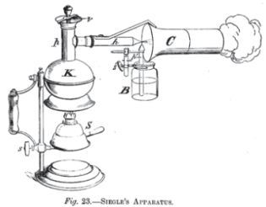
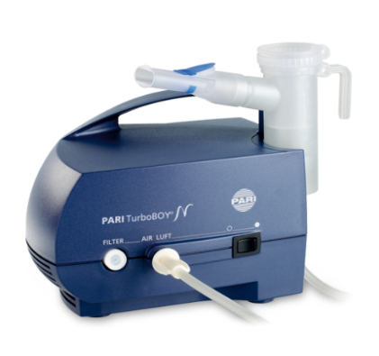
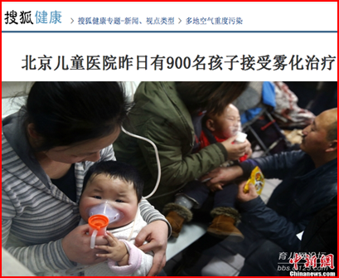
History and Characteristics of Inhalation Therapy
Inhalation method can be traced back to 4000 years ago in India. However , the truly inhalation treatment was origin in German in 19th century by the invention of Siegle steam atomizing inhaler.
After 1950s, inhalation was used for asthma prevention and treatment in U.K. and developed rapidly since then.
Inhaled therapy is widely used by the GINA guidelines
Two Chinese guidelines recommended inhalation therapy as the first choice for asthma treatment since 2003.
Characteristics
1. Reach local disease area directly, working quickly and effectively.
2. Reduce systematic adverse effect significantly.
3. Used in a variety of respiratory tract disease .
4. Increase compliance of patient, especially of children
Notes:
P20 :雾化吸入治疗的发展历史可追溯到4000年前，在20世纪中后期得到快速发展，而吸入疗法也被中、美等国家推荐为治疗哮喘的首选疗法。
雾化吸入的特点：起效快，缩短病程，药物用量少，作用范围广泛等。
The development history of aerosol inhalation treatment can be traced back to 4000 years ago, in the middle of 20th Century getting a rapid development, and inhalation therapy is also recommended for the first choice of asthma treatment in China and the United States and other countries.
The characteristics of aerosol inhalation: rapid onset, shorten the course of disease, the amount of drugs, the role of a wide range.

Slide 25
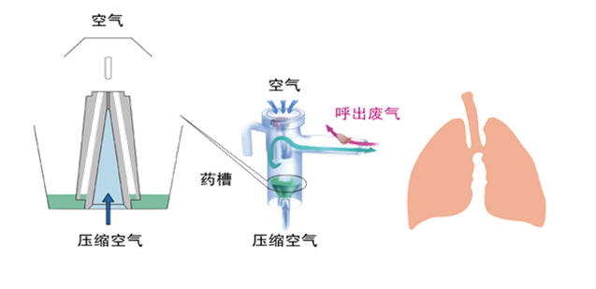
Device for different inhalation administration mode
Clinical Application of Aerosol Inhalation Therapy
Clinical application
pMDI
DPI
Nebulizer
  blast Nebulizer
  ultrasonic Neb.
  mesh Neb.
BPD
Asthma
CF
COPD
Airway humidification
other diseases
Especially suitable for children, the elderly and those with acute disease .
Notes:
P21: 目前市场上吸入装置的种类较多，而其中临床应用最广泛的为雾化器。
Currently, there are different types of inhalation devices on the market,. And the most widely used in clinical applicationl is Nebulizer.
药物经过雾化被人体吸入后，直接作用于气道粘膜，局部作用强：起效快，且全身副作用小，尤其适合儿童使用。
The medicine can directly act on the respiratory tract mucosa and has the advantages of strong targeting, high curative effect, good safety, easy operation and high compliance of children.

Slide 26
IFN-α1b Inhalation for Respiratory Virus Treatment
Advantages
Acting on respiratory tract mucosa directly with stronger targeting, higher curative effect, better safety, and higher compliance of patients.
PK study
Higher concentration and longer retention time in lung tissue.
PD study
Alleviate pathological inflammation and decrease RSV loading in lung.
Multi-center clinical study
RSV bronchiolitis.
Research basis
Recommend
Recommend Inhalation as the conventional drug delivery method of IFN-α1b treatment for respiratory viral infections.
Shen KL, Zhang GC , Shang YX et al. Expert consensus on pediatric clinical application of IFN-α1b.
Chinese Journal of Practice Pediatrics. 2015,30(16)1214-9
Notes:
P22:
目前完成了IFN-α1b雾化吸入抗RSV感染的动物药代动力学、药效学、多中心的临床研究,从多方面证明IFN-α1b雾化吸入抗RSV的有效性和安全性。因此在2015年的发表的一份有关《重组人干扰素α1b儿科应用的专家共识》中，将雾化吸入作为IFN-α1b治疗儿童呼吸系统感染的常规给药方式。
Currently we have carried out studies of inhaled IFN-α1b for treatment of RSV infection including PK、PD and clinical research

Slide 27
PK Study on IFN-α1b Atomization Inhalation
Drugs and Reagents ： radiolabeled IFN-α1b by Na¹²⁵Ⅰ
Experimental animals ：Rabbits
Experimental equipment: SN-6100 Automatic γ radiation counter
Detection method ：
1. Living Imaging of animals in vivo
2. Radiation activity detection of lung tissue with γ counter
Liu JF, Liu JJ, Chu LP, et al. Pharmacokinetics and metabolic pathway of INF-α1b inhalation in rabbit.
Herald of Medicine．2013，32（1）：1-5．
Notes:
P23: 具体实验方案设计及目的
Specific experimental design and purpose

Slide 28
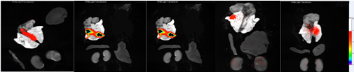
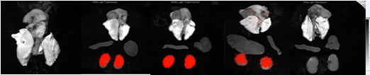
PK and tissue distribution of IFN-α1b Inhalation
0.5h 2h 4h 8h 12h
肺、肝、肾放射γ计数检测(单位：CPM/g)
Atomization Inhalation
Intramuscular Injection
0.5h 2h 4h 8h 12h
atomization inhalation has higher concentration and longer retention is airway and lung -- local therapeutic effect --
Notes:
P24: 雾化吸入0.5h，药物即迅速并大量汇集在肺组织中，其中又以气管分布量最大。
雾化吸入2h，成像显示药物通过气管向肺组织其它部位扩散。放射检测显示药物可以扩散至肺的边缘。
雾化吸入4h，进一步显示药物可以到达肺部的末端组织。成像结果可以看到肾组织中的少量分布。
雾化吸入8h，肺组织中仍有大量的药物分布。而肾脏中可看到只有少量的药物分布。
雾化吸入12h，仍然可以看到肺部明显的药物分布。肾中还维持着较低浓度的，与4h和8h没有特别显著的差异。
Atomizing inhalation of 0.5h, drug that is rapidly and a large number of pooled in the lung tissue, which is the largest distribution of the trachea.
Aerosol inhalation of 2h, imaging shows that the drug through the trachea to other parts of the lung tissue diffusion. Radiation detection shows that drugs can diffuse to the edge of the lung.
Aerosol inhalation of 4h, further showing that the drug can reach the end of the lung tissue. Imaging results can be seen in a small amount of kidney tissue distribution.
Aerosol inhalation of 8h, lung tissue is still a large number of drug distribution, while the kidneys can be seen only a small amount of drug distribution.
Aerosol inhalation of 12h, can still see the drug distribution in the lungs, also maintained a low concentration, and there is no significant difference between 4h and 8h.
肌肉注射0.5h，肺部组织通过成像法检测不到药物存在，γ计数检测显示肺组织中药物浓度非常低。
肌肉注射2h，组织成像仍然检测不到肺组织中药物的存在，而在肾组织中有大量药物聚集，说明在较短的时间内就通过肾脏代谢。
肌肉注射4h，肺组织中有较低分布。药物大量聚集在肾组织，其他组织检测不到信号。
肌肉注射8h，药物仍然在肾组织中有较高含量，肺组织中可检测到药物的信号，说明肌注后药物非常缓慢的进入肺，且浓度较低。
肌肉注射12h，在肝、肾和肺组织中均检测不到药物信号。说明大部分药物已经通过肾脏代谢出体内。
0.5h after Intramuscular injection, lung tissue through the imaging method can not detect the presence of drugs, gamma count test shows that the drug concentration in lung tissue is very low.
2h after Intramuscular injection, tissue imaging is still not detected in the presence of drugs in the lung tissue, while there is a large number of drug accumulation in kidney tissue, which shows that in a relatively short period of time through renal metabolism.
4h after Intramuscular injection, the lung tissue has a lower distribution. Drugs are gathered in a large number of kidney tissue, other organizations can not detect the signal.
8h after Intramuscular injection, the drug is still in the renal tissue have higher content and lung tissue can be detected drug signal that after intramuscular injection of drugs very slowly into the lungs, and low concentration.
12h after Intramuscular injection, in the liver, kidney and lung tissue are not detected in drug signals, indicating that most of the drugs have been through the kidneys to metabolism in vivo.

Slide 29
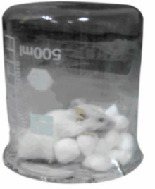

Anti-RSV Study of IFN-α1b Atomization Inhalation
Mice anesthetized with ether
RSV intranasally
Experimental animals：BALB/c mice
Modeling ：Intranasal instillation of RSV
virus solution 100μl
Groups：
IFN-α1b ~ Atomization Inhalation
Ribavirin ~ Intraperitoneal injection
Outcome measures:
1. Lung tissue pathology ； 2. RSV loading ;
Huang KF, Zhang GC, Liu RQ , et al. Anti-RSV Study of IFN-α1b Atomization Inhalation．
Chinese Journal of experimental and clinical infectious diseases . 2013，7（6）：810-815．
Notes:
P25：IFN-α1b雾化吸入抗RSV感染动物实验方案
IFN-α1b aerosol inhalation of anti RSV infection in animal experimental program

Slide 30
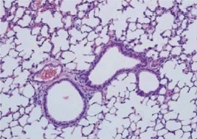
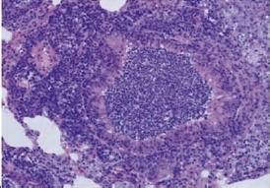
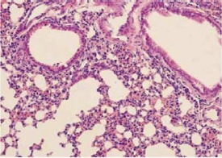
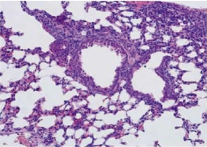
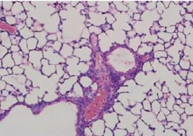
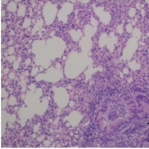
Relieve Pathological Inflammation of Lung Tissue
A lot of secretions and inflammatory cells exudate from endobronchial;
Alveolar wall thickening shows a large number of inflammatory cells infiltration ;
Capillary expansion and hyperemia.
Normal
RSV Infection
IFN-α1b(3.125 μg)
IFN-α1b(12.5 μg)
IFN-α1b(50.0 μg)
Ribavirin
Pathological changes alleviated and inflammation relieved significantly in a dose-dependent manner ;
[1] Li YH, Zhang GC, et al. Atomization inhalation IFN-α1b for RSV treatment experimental study [J]. Northwest National Defense Medical Journal, 2010,31 (3):203-205. [2]Huang KF, Zhang GC, Liu RQ. IFN-α1b and Yanhuning and Xiyanping anti-RSV infection control [J]. The experimental and clinical infectious diseases Journal: electronic version, 2013,7 (6):810-815
Notes:
P26：肺组织病理学结果可见，随着雾化吸入剂量的增加，小鼠肺组织病例炎症损伤逐渐减轻。50微克组趋近正常，优于利巴韦林
The pathological results of lung tissue showed that, with the increase of the dose of aerosol inhalation, the inflammatory damage in the lung tissue of mice was gradually reduced.

Slide 31
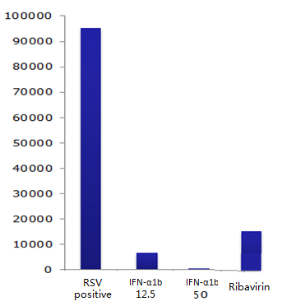
Decrease RSV Load in Lung Tissue
RSV Load
RSV Viral Load
Group | RSV Load
Negative control | —
RSV infection positive | 95178.25±13097.17
IFN-α1b Inhalation（12.5μg） | 6739.85±2590.18
IFN-α1b Inhalation（50μg） | 491.21±55.27
Ribavirin I.P. | 15173.07±2731.50
P | ＜0.05
IFN-α1b inhalation decrease RSV load in local lung tissue ；
Inhibition effect of IFN- α1b is more obviously than ribavirin
[1] Li YH, Zhang GC, et al. Atomization inhalation IFN-α1b for RSV treatment experimental study [J]. Northwest National Defense Medical Journal, 2010,31 (3):203-205. [2]Huang KF, Zhang GC, Liu RQ. IFN-α1b and Yanhuning and Xiyanping anti-RSV infection control [J]. The experimental and clinical infectious diseases Journal: electronic version, 2013,7 (6):810-815
Notes:
P27：IFNα1b 50微克雾化吸入能够降低肺脏组织局部的病毒载量
The virus loading in lung tissue was decreased in IFN-α1b 50μg group.

Slide 32
Summary- IFN-α1b inhalation
Stay in lung with higher concentration and longer retention;
Relieve pathological inflammation caused by RSV in a dose-dependent manner;
Decrease RSV load in lung tissue significantly;
The anti-RSV effect of 50μg (~ human 4μg/kg) inhaled IFN-α1b is better than Ribavirin injection.
Notes:
P28

Slide 33
1. Pediatric respiratory viral diseases in China
2. Interferon and antiviral mechanism
3. IFN-α1b aerosol inhalation for RSV inhibition
4. Clinical trial of inhaled IFN-α1b for bronchiolitis- efficacy and safety
Content

Slide 34
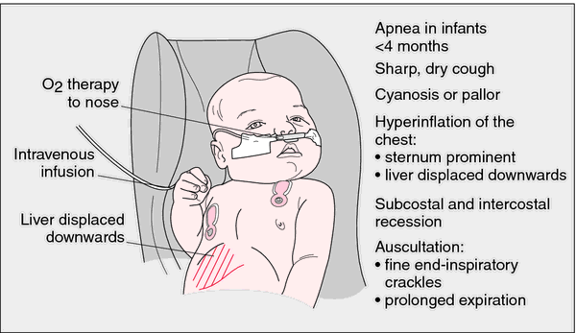
Infectious Bronchiolitis
2 ~6 mo
Pathogens: RSV …….
Winter and spring
Bronchiolitis is a common acute lower respiratory tract infection for infant. The lesions occurred mainly in pulmonary bronchiole. It is a respiratory virus disease. The most common etiology is RSV. The disease occurred in children under 5 years old , 80% within 1 year, mostly children under 6 months.
American Academy of Pediatrics Subcommittee on Diagnosis and Management of Bronchiolitis. Diagnosis and management of bronchiolitis. Pediatrics. 2006;118(4):1774-93.
Notes:
P30: 毛细支气管炎是一种婴幼儿较常见的急性下呼吸道感染,其病变主要发生在肺部的细小支气管，毛细支气管炎最常见的病因是病毒感染。此病多发生在2.5岁以下的小儿，80%在1岁以内，多数是6个月以下的小儿。
Bronchiolitis is a common acute lower respiratory tract infection for infant. The lesions occurred mainly in pulmonary bronchiole and bronchiolitis is the most common cause is infected with the virus. The disease occurred in children under 5 years old in, 80% within 1 year, mostly children under 6 months.

Slide 35
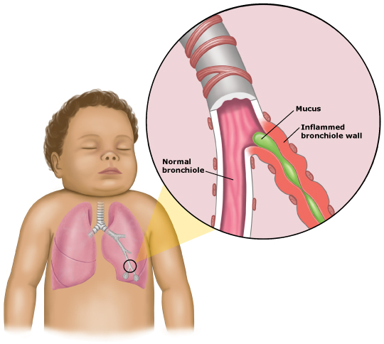
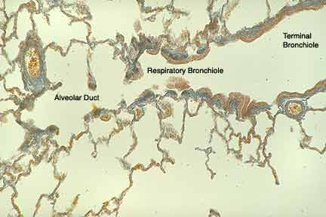
Clinical Manifestation and Pathological Basis
inflammation expand pulmonary interstitial and alveolar forming peribronchiolitis.
Most recovery with exudate absorbed or coughed up
after inflammation .
Scar in trachea wall and bronchus obstruction
(BO) forming
Mucosa welled, inflammatory cells infiltrated, epithelium mucosae damaged and desquamated, mucus secretion increased; Due to the bronchial intraluminal stenosis, the trachea wall have no cartilage support and the capillary bronchial spasms.
Mainly in trachea of 75～300μm in diameter
Asthmatic Dyspnea
American Academy of Pediatrics Subcommittee on Diagnosis and Management of Bronchiolitis. Diagnosis and management of bronchiolitis. Pediatrics. 2006;118(4):1774-93.
Notes:
P31: 毛细支气管炎的临床表现与病理基础。
The clinical manifestation and pathological basis of capillary bronchitis.

Slide 36
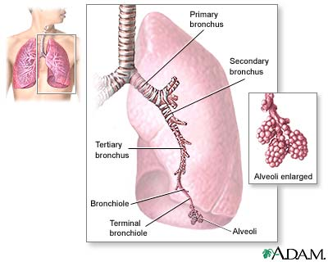
RSV is the main cause of capillary bronchiolitis
Pathogen : Virus
RSV
PIV、ADV、HRV、IFV 。。。
enterovirus
mycoplasma
The incidence of bronchiolitis reaches the highest in RSV peak season.
Co-Infection of 2~3 viruses :
RSV+RV
Reinfection is also common.
Wainwright C. Acute viral bronchiolitis in children- a very common condition with few therapeutic options. Paediatric Respiratory Reviews 2010
Notes:
P32: 病原主要为呼吸道合胞病毒、腺病毒、副流感病毒等，少数病例可由肺炎支原体引起。
The main pathogen of respiratory tract is RSV, adenovirus, influenza virus and so on, a few cases can be caused by Mycoplasma pneumoniae.

Slide 37
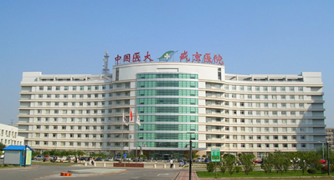
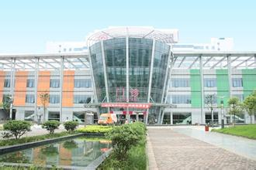
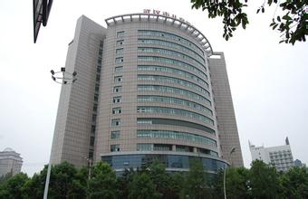
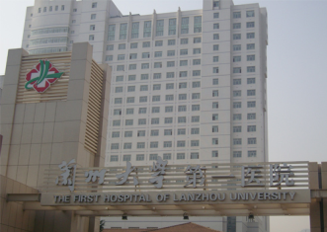
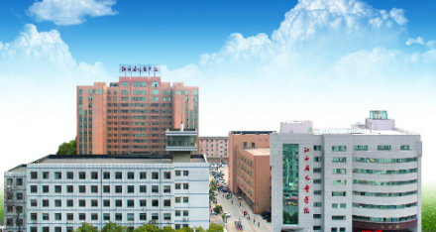
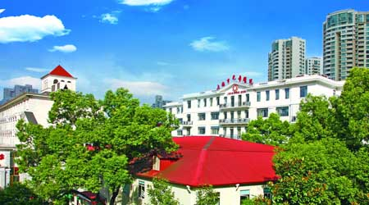
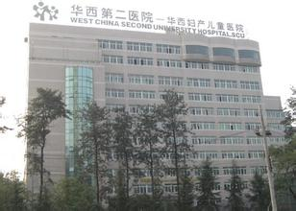
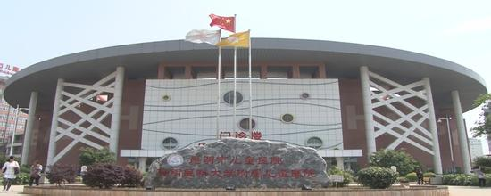
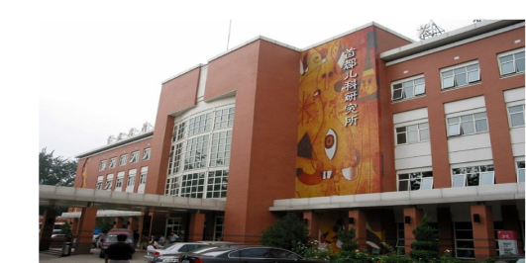
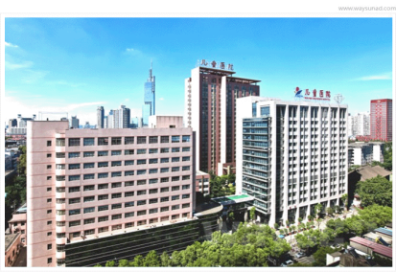
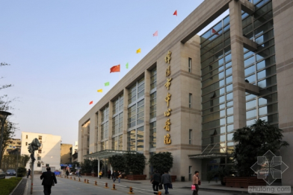

Efficacy & Safety Evaluation on IFN-α1b Inhalation for Bronchiolitis
--- Prospective, Random ,Controlled, Multicenter Clinical Study
Shengjing Hospital of China Medical University
Children's Hospital of Chongqing Medical University
Wuhan Children's Hospital
First Hospital of Lanzhou University
Jiangxi Children's Hospital
Children's Hospital of Shanghai Jiaotong University
West China Second Hospital
Kunming Children's Hospital
Capital Institute of Pediatrics,
Nanjing Children's Hospital
Mianyang Central Hospital
Shang YX,Huang Y,Liu EM,et al. A multicenter clinical study on the treatment for children’s acute bronchiolitis by nebulized recombinant human interferon α1b. Chinese Journal of Practical Pediatrics. 2014,29(11)840-4
Notes:
P33 下面要介绍的是一项干扰素a1b雾化吸入治疗儿童毛细支气管炎的疗效和安全性评价，这是一项前瞻性的，随机对照，多中心临床研究。共有全国十一家儿科临床研究机构参与了此项研究。
Next I will introduce an efficacy and safety evaluation of inhaled IFN-a1b for bronchiolitis in Children . It is a prospective ,random, controlled ,multicenter clinical study involving 11 pediatric hospital or institute.

Slide 38
Subjects
【Inclusion Criteria】
≤2 Years old, male or female;
With bronchiolitis, without serious complications or comorbidities;
Course <96h；
No immunomodulatory or antiviral reagent were used in 2 weeks before Diagnosis.
【 Exclusion Criteria 】
Known allergy to interferon;
With heart, respiratory, liver and kidney function insufficiency, severe malnutrition or other serious diseases;
With seizure or other CNS disorders;
Treated with other antiviral drugs during therapy.
Shang YX,Huang Y,Liu EM, et al. Chinese Journal of Practical Pediatrics. 2014,29(11)840-4
Notes:
P34 入排标准
Inclusion and exclusion critria

Slide 39
Groups
： 100 cases, basic management ( 5% salbutamol 0.25ml,
budesonide 0.5mg, atomization inhalation)
： 100 cases, basic Management + IFN-α1b 2.0μg/kg/time, atomization inhalation.
： 100 cases, basic Management + IFN-α1b 4.0μg/kg/time, atomization inhalation.
Control
IFN-α1b Low-dose
IFN-α1b High-dose
Atomization inhalation, bid., 5-7 days,
Shang YX,Huang Y,Liu EM,et al. Chinese Journal of Practical Pediatrics. 2014,29(11)840-4
Notes:
P35: 获得入选标准的患儿按启动顺序随机分配，按病例入组的的时间进行顺序随机入选，分为三组。
The selected patients were randomly assigned according to the start-up sequence and divided into three groups randomly.
Patients in control group accept basic management including 5% salbutamol 0.25ml, budesonide 0.5mg, atomization inhalation;
Besides basic treatment, the patients of observation group accept IFN-a1b atomization inhalation 2.0μg/kg/time or 4.0μg/kg/time , bid., 5-7 days

Slide 40
Efficacy Index & Evaluation
【 Efficacy Index 】
Primary efficacy index: gasping, wheezing, chest wall retraction sign
Secondary efficacy index: cough, bubbling
【Evaluation】 condition score
  0 points: Not observed;
  1 points: Mild;
  2 points: Moderate;
  3 points: Severe.
Improvement rate =（pre-treatment score - post-treatment score）/ pre-treatment score ×100%
Total improvement rate: Σ of Improvement rate of each symptom score.
Shang YX,Huang Y,Liu EM,et al. Chinese Journal of Practical Pediatrics. 2014,29(11)840-4
Notes:
P36: 临床症状和体征程度分级基于《中药新药临床研究指导原则（试行）》。四级分度评分标准：0-无咳嗽、喘息和肺部体征；1-轻度；2-中度；3-重度。
Clinical symptoms and signs of classification based on < Chinese medicine clinical research guiding principle (for Trial Implementation)>. Four levels of indexing criteria: 0 - no coughing, wheezing and lung signs; 1 mild; 2 - or moderate - severe.

Slide 41
Baseline Analysis
Group | Ages（Month） | Weight（kg） | Onset Time（Days） | Pre-treatment score
Control Group （n=109） | 6.76±4.00 | 8.25±1.80 | 3.36±1.13 | 9.26±2.52
IFN-α1b 2μg/kg （n=110） | 6.96±3.58 | 8.62±1.71 | 3.2±1.77 | 9.74±2.76
IFN-α1b 4μg/kg（n=110） | 6.12±2.69 | 8.00±1.48 | 3.2±0.85 | 9.13±2.64
Note: P >0.05 in each group.
330 cases enrolled ( 329 valid ) .
No statistically significant difference among groups.
Shang YX,Huang Y,Liu EM,et al. Chinese Journal of Practical Pediatrics. 2014,29(11)840-4
Notes:
P37 各组见患儿的年龄、体重、发病时间以及治疗前评分具有可比性。
The baseline of age, body weight, onset time and pre-treatment score of patients among groups are similar.
41

Slide 42

Total Improvement Rate
All index
Inhaled IFN-α1b is better than control （p<0.05
Primary index * *
4μg/kg is better than 2μg/kg （p<0.05）
% | All index | Primary index
Control | 85.3±6.4 | 85.1±5.6
2μg/ml | 92.3±4.5 | 93.2±3.3
4μg/ml | 95.0±4.9 | 97.7±3.2
* Comparison among groups: p<0.05
* * Gasping, wheezing, chest wall retaction
All index
Primary index
At the end of the treatment, the total improvement rate of the low dose group and high dose group was better than that of the control group. The total improvement rate of the primary efficacy in higher dose group was higher than that of the low dose group, and the low dose group was better than the control group.
Shang YX,Huang Y,Liu EM,et al. Chinese Journal of Practical Pediatrics. 2014,29(11)840-4
Notes:
P38: 治疗结束时，低剂量组和高剂量组的所有疗效指标的总改善率均优于对照组；分析主要疗效指标的总改善率，高剂量组优于低剂量组，低剂量组优于对照组。
At the end of the treatment, the total improvement rate of the low dose group and high dose group was better than that of the control group. The total improvement rate of the primary efficacy was higher than that of the low dose group, and the low dose group was better than the control group.

Slide 43

Daily Score of Efficacy Index
Gasping
Wheezing
Three Depre. Sign
Control
Control
Control
2 μg/kg
2 μg/kg
2 μg/kg
4 μg/kg
4 μg/kg
4 μg/kg
prior treatment
1st day
2nd day
3rd day
4th day
5th day
6th day
7th day
prior treatment
1st day
2nd day
3rd day
4th day
5th day
6th day
7th day
prior treatment
1st day
2nd day
3rd day
4th day
5th day
6th day
7th day
Inhaled IFN-α1b helps to relieve symptoms and signs , especially
chest wall retraction on day 3~4 .
Shang YX,Huang Y,Liu EM,et al. Chinese Journal of Practical Pediatrics. 2014,29(11)840-4
Notes:
P39: 在整个治疗过程中，用药组主要疗效指标评分下降较快，三凹症尤为明显。治疗第3~4天时，用药组疗效指标改善最为明显。治疗结束时，用药组的改善率仍显著优于对照组（P<0.05）。
In the whole course of treatment, the treatment group curative effect index score decreased rapidly, the three depressions disease is particularly evident. Treatment of 3 to 4 days, effect of medication group indicators improved the most obviously. At the end of treatment, the treatment group improved rate is significantly better than the control group (P < 0.05).

Slide 44
Duration of Symptoms and Signs
Inhaled IFN-α1b helps to shorten duration of symptoms and signs , especially chest wall retraction.
Groups （cases） | Primary Efficacy Index |  |  | Secondary Efficacy Index
 | Gasping | Wheezing | Chest wall retraction | Cough | Bubbling Sound
Control （n=109） | 6.7±1.9 | 6.2 ±2.0 | 4.9 ±2.2 | 7.3 ±1.8 | 6.1 ±2.1
IFN-α1b 2μg （n=110） | 5.7ª±1.5 | 5.3ª ±1.6 | 3.5^{c}±1.7 | 6.4ª±1.3 | 5.2ª±1.9
IFN-α1b 4μg （n=110） | 5.1^{b} ±1.4 | 4.5^{b} ±1.8 | 2.8^{cd}±1.5 | 6.0ª±1.3 | 4.7ª ±1.6
Note: a: vs control group, P<0.05; b: vs 2μg drug group and control group, both P<0.05;
c: vs control group, P<0.01; d: vs 2μg drug group, P<0.05.
Shang YX,Huang Y,Liu EM,et al. Chinese Journal of Practical Pediatrics. 2014,29(11)840-4
Notes:
P40: 观察组所有疗效指标消失时间明显缩短，其中三凹征消失时间缩短最明显（P＜0.01）。主要疗效指标的改善在高、低剂量组之间的差异具有统计学意义（P<0.05）,高剂量组病程更短；次要疗效指标具有同样的趋势。
Observation group for all outcomes disappeared time was shortened, and the time of the three depressions sign disappeared was shortened obviously(P < 0.01). Primary outcome measures improvement between the high and low dose group showed statistically significant difference (P < 0.05), high dose group had shorter disease duration; secondary efficacy was variables with the same trend.

Slide 45
Efficacy Comparison of Early vs Late Administration
-12.3
100.0
-7.8
Control
所有疗效指标总改善率
95.0
-9
2 μg/kg
-5.9
4 μg/kg
Total improvement
rate of major
efficacy indexes
90.0
85.0
* Comparison among groups: p<0.05
(%)
80.0
75.0
within 72 hrs after 72 hrs
Shang YX,Huang Y,Liu EM,et al. Chinese Journal of Practical Pediatrics. 2014,29(11)840-4
Notes:
P41: 以从发病到就诊治疗72小时为界限，对总体改善率进行分层分析结果见图表，发病72小时内用药和发病72小时后用药都显示出良好的治疗效果，无论是否超过72小时，用药组的改善率均显著高于对照组，但发病72小时内治疗的用药组改善率更佳。
From onset to treatment for 72 hours to the limit , total improvement rate of stratified analysis results are shown on the graph , within 72 hours of onset of medication and the incidence of 72 hours after treatment showed a good therapeutic effect on, whether or not more than 72 hours, the treatment group improved rate were significantly higher than those in the control group, but within 72 hours of onset treatment of treatment group improve better rate.

Slide 46
Efficacy Comparison between RSV (+) vs RSV(-)
100.0
Control
主要疗效指标总改善率
95.0
2 μg/kg
Total improvement
rate of major
efficacy indexes
90.0
4 μg/kg
85.0
80.0
(%)
75.0
* Comparison among groups: p<0.05
70.0
RSV(+) RSV (-)
Total improvement rate of RSV（+） is higher than RSV （-）.
Shang YX,Huang Y,Liu EM,et al. Chinese Journal of Practical Pediatrics. 2014,29(11)840-4
Notes:
P42: 共150例患儿在治疗前进行了RSV病毒学检测，RSV阳性检出率为42.7%。分层分析 RSV阳性和RSV阴性患儿的主要疗效指标的总改善率，结果如图所示，RSV阳性患儿的总改善率显著高于RSV阴性患儿，而对照组的水平无显著差异（P>0.05）。但无论是否确诊为RSV感染，用药组的总改善率均明显高于对照组（P<0.05）。
A total of 150 cases of children before the treatment of RSV detection of virus, RSV positive rate was 42.7%. Stratification analysis of the primary endpoint of the total improvement rate about RSV positive and RSV negative patients, results are shown in graph, which shows, RSV positive patients of the total improvement rate was significantly higher than that in children with RSV negative, while the control group no significant difference (P > 0.05). But whether or not a definitive diagnosis of RSV infection, treatment group the total improvement rate was significantly higher than that of the control group (P < 0.05).

Slide 47
Vital Sign Analysis Before and After Therapy
Vital Sign |  | Before | D1 | D2 | D3 | D4 | D5 | D6 | D7 | End
Temp | Control | 36.9±0.5 | 36.8±0.4 | 36.8±0.3 | 36.7±0.2 | 36.6±0.4 | 36.4±0.5 | 36.5±0.4 | 36.7±0.2 | 36.1±0.7
 | Low | 37.1±0.4 | 36.8±0.2 | 36.3±0.5 | 36.2±0.7 | 36.1±0.7 | 36.3±0.5 | 36.1±0.8 | 36.4±0.4 | 36.5±0.4
 | High | 37.2±0.5 | 36.8±0.2 | 36.3±0.5 | 36.1±0.3 | 36.3±0.4 | 36.2±0.4 | 36.2±0.3 | 36.1±0.3 | 36.0±0.2
HR | Control | 123.0±10.8 | 124.0±6.9 | 120±9.6 | 122.9±7.5 | 120.6±6.2 | 118.6±5.1 | 113.4±4.4 | 111.2±4.6 | 110±6.5
 | Low | 124.7±8.4 | 120.7±7.2 | 114.7±5.2 | 117±5.2 | 114.6±4.2 | 111.5±3.9 | 109±5.4 | 108±2.5 | 108.8±7.5
 | High | 120.0±12.1 | 117.1±8.6 | 110.2±4.6 | 115.3±8.6 | 113.9±8.6 | 110.2±6.2 | 106.5±5.7 | 107.7±5.5 | 109.2±4.5
Breath | Control | 36.7±4.2 | 35.8±4.7 | 33.7±3.3 | 32.1±2.4 | 30.8±2.2 | 30.1±1.8 | 29.9±1.8 | 29.0±2.0 | 30.0±3.3
 | Low | 37.1±3.5 | 35.3±4.9 | 35.0±4.4 | 34.0±3.5 | 30.8±2.2 | 30.0±1.8 | 28.6±1.6 | 29.2±1.1 | 29.5±1.1
 | High | 39.2±7.3 | 39.1±2.3 | 34.1±6.3 | 33.4±4.5 | 31.6±5.0 | 31.2±4.5 | 29.6±2.8 | 29.5±2.6 | 28.7±1.6
Temperature, heart rate and breathing were stable before, during and at the end of therapy in all groups.
Shang YX,Huang Y,Liu EM,et al. Chinese Journal of Practical Pediatrics. 2014,29(11)840-4
Notes:
P43: 治疗过程中，所有330例患儿均未发生严重不良事件。患儿的体温、呼吸、心率等生命体征，在用药前、用药期间和用药结束时均稳定，用药前后的心电图、尿常规、便常规检查未见异常。给药前、后的血液生化检测指标均在正常范围内。所有患儿的呼吸道局部及鼻粘膜检查均未见刺激症状。
In the course of treatment, all 330 cases showed no serious adverse events. Children's body temperature, respiration, heart rate and other vital signs, before treatment, during treatment and medication at the end of the were stable, before and after treatment, electrocardiogram (ECG), urine routine and routine examination were no abnormal. Before administration and after, the blood biochemical indicators were in the normal range. All the children of the local respiratory tract and examination of nasal mucous membrane showed no irritation.

Slide 48
Serum Biochemistry Before and After Therapy
Test Index | Test Time | Control Group | IFN-α1b 2μg/kg | IFN-α1b 4μg/kg
ALT(IU·L⁻¹) | Before | 27.9±7.7 | 24.2±10.4 | 30.4±3.2
 | After | 29.6±9.5 | 26.3±5.5 | 32.2±4.1
AST(IU·L⁻¹) | Before | 30.2±8.6 | 30.9±3.0 | 29.1±2.6
 | After | 30.1±7.5 | 32.1±4.1 | 32.5±6.2
TB(μmol·L⁻¹) | Before | 5.8±1.32 | 5.0±0.9 | 5.9±0.7
 | After | 5.7±1.32 | 4.8±1.1 | 5.3±0.8
TP(g·L⁻¹) | Before | 62.5±1.9 | 64.9±2.2 | 62.7±1.1
 | After | 59.9±1.4 | 62.3±1.7 | 59.4±1.3
Major biochemical indexes were within the normal range before/after therapy ; No abnormality was found in ECG, urine and stool routine examination.
Shang YX,Huang Y,Liu EM,et al. Chinese Journal of Practical Pediatrics. 2014,29(11)840-4
Notes:
P44: 用药前后常规检测指标均无较大差异，治疗前后检查结果未见异常。
Before and after treatment, there were no significant differences in routine test indexes, and there were no abnormal findings before and after treatment.
48

Slide 49
Summary of Adverse Events During Therapy
Adverse Event | Control Group |  |  | IFN-α1b 2μg/kg |  |  | IFN-α1b 4μg/kg
 | n | Degree | Relationship with investigational drug | n | Degree | Relationship with investigational drug | n | Degree | Relationship with investigational drug
Diarrhea | 3 | Moderate | Impossible relevant | 2 | Mild | May be irrelevant | 1 | Mild | May be irrelevant
Fever | 2 | Moderate | Impossible relevant | 1 | Moderate | May be irrelevant | 1 | Moderate | May be irrelevant
Neutro-phonia | 0 | - | - | 0 | - | - | 1 | Mild | May be relevant
Total | 5 |  |  | 3 |  |  | 3
Shang YX,Huang Y,Liu EM,et al. Chinese Journal of Practical Pediatrics. 2014,29(11)840-4
Notes:
P45: 不良事件统计见表，用药组不良事件发生率为2.7%，对照组为4.5%。治疗过程中，对照组有2例患儿由治疗前体温正常转为中度发热，低、高剂量组也各有1例患儿的体温出现相同情况，给予退热药治疗后，体温恢复正常，记为不良事件。治疗前体温异常的患儿，在治疗过程中发热程度逐渐减轻或维持原程度未再加重的，均不记为不良事件。治疗过程中，高剂量组1例患儿曾出现轻度的一过性中性粒细胞下降，未采取针对性治疗措施，也未停止干扰素治疗，该名患儿于次日检测恢复正常。各组患儿均未见呼吸道局部及鼻粘膜刺激症状。
The adverse event statistics is in Table , treatment group the incidence of adverse events was 2.7%, the control group was 4.5%. in the course of treatment, 2 cases in the control group were normal before treatment by the temperature was moderate fever, low dose and high dose group of each have one case that had fever. After giving antipyretics during treatment, the body temperature returned to normal, written as adverse events. Before the treatment of abnormal body temperature in the process in the treatment of fever gradually reduce or maintain the original degree did not increase, are not recorded as adverse events. The course of treatment, high dose group, one patient had mild transient in neutrophil decline, we did not take targeted treatment measures,and did not stop the interferon treatment. The next day the patient from test groups were normal. No local respiratory tract and nasal mucosal irritation was detected.

Slide 50
Summary
Inhaled IFN-α1b relieve clinical symptoms and shorten course of bronchiolitis significantly.
Earlier administration is more effective .
IFN-α1b atomization inhalation is well tolerated by children. No serious ADE observed.

Slide 51
Take Home Massage
1、RSV is the most common pathogen causing ALRTI hospitalization in children, especially <5yr.
2、IFN-α1b plays a RSV inhibition effect both in vitro and in vivo by anti-virus proteins induction and immunomodulation.
3、IFN-α1b stay in lung tissue with higher concentration and longer retention by inhalation.
4、 IFN-α1b atomization inhalation is an effective and safe therapy for bronchiolitis in children , especially those RSV (+).

Slide 52
Publication of Dr. Shen’s Lab
Liu et al. Adenovirus infection in children with acute lower respiratory tract infections in Beijing,China, 2007 to 2012. BMC Infectious Diseases (2015) 15:408
Xiang et al. Respiratory Infection with Enterovirus Genotype C117,China and Mongolia. Emer Infe Dis. ( 2014 ) ,Vol. 20, No. 6, 1075-7
Liu CY, Shen KL,et al. Pathogen analysis from ARTI children outpatient and hospitalization in 2010-2012. Chin J Pediatr. 2013, 51(4):255-259
Mao et al.Human Parainfluenza Virus-Associated Respiratory Tract Infection among Children and Genetic Analysis of HPIV-3 Strains in Beijing, China. PLOS ONE. ( 2012 ), Vol 7, No 8 ,e43893
Guo et al. Bocavirus in Children with Respiratory Tract Infections. Emerging Infectious Diseases. ( 2011 ), Vol. 17, No. 9, 1775-7
Ren et al. Human parainfluenza virus type 4 infection in Chinese children with lower respiratory tract infections: A comparison study. Journal of Clinical Virology 51 (2011) 209–212
Xiang et al. Human rhinovirus C infections mirror those of human rhinovirus A in children with community-acquired pneumonia. Journal of Clinical Virology 49 (2010) 94–99
Ren et al. Saffold Cardioviruses of 3 Lineages in Children with Respiratory Tract Infections, Beijing, China. Emerging Infectious Diseases . (2010) Vol. 16, No. 7, 1158-61
Xiang etl al. Human Rhinovirus Group C Infection in Children with Lower Respiratory Tract Infection. Emerging Infectious Diseases . ( 2008 ) , Vol. 14, No. 10,1665-6
Ren et al. WU and KI polyomavirus present in the respiratory tract of children, but not in immunocompetent adults. Journal of Clinical Virology. (2008) 43, 330–333

Slide 53
Publication of Dr. Shen’s Lab
Liu et al. BMC Infectious Diseases (2015) 15:408
Xiang et al. Emerging Infectious Diseases. ( 2014 ) ,Vol. 20, No. 6, 1075-7
Liu CY, Shen KL,et al. Chin J Pediatr. 2013, 51(4):255-259
Mao et al.Human Parainfluenza Virus-Associated Respiratory Tract Infection among Children and Genetic Analysis of HPIV-3 Strains in Beijing, China. PLOS ONE. ( 2012 ), Volume 7 ,Issue 8 ,e43893
Guo et al. Bocavirus in Children with Respiratory Tract Infections. Emerging Infectious Diseases. ( 2011 ),
Vol. 17, No. 9, 1775-7
Ren et al. Human parainfluenza virus type 4 infection in Chinese children with lower respiratory tract infections: A comparison study. Journal of Clinical Virology 51 (2011) 209–212
Xiang et al. Human rhinovirus C infections mirror those of human rhinovirus A in children with community-acquired pneumonia. Journal of Clinical Virology 49 (2010) 94–99
Ren et al. Saffold Cardioviruses of 3 Lineages in Children with Respiratory Tract Infections, Beijing, China. Emerging Infectious Diseases . (2010) Vol. 16, No. 7, 1158-61
Xiang etl al. Human Rhinovirus Group C Infection in Children with Lower Respiratory Tract Infection. Emerging Infectious Diseases . ( 2008 ) , Vol. 14, No. 10,1665-6
Ren et al. WU and KI polyomavirus present in the respiratory tract of children, but not in immunocompetent adults. Journal of Clinical Virology. (2008) 43, 330–333

Slide 54




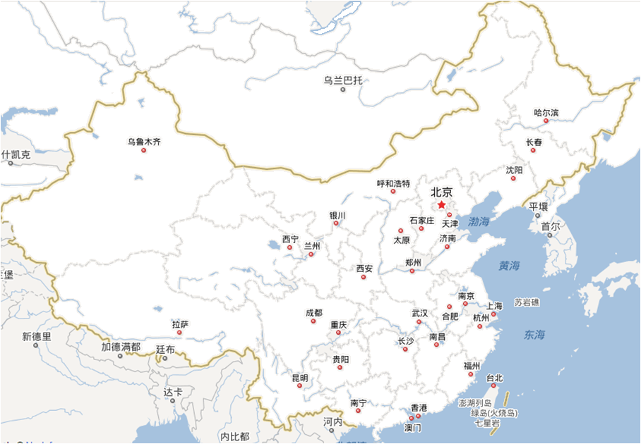








ACKNOWLEDGEMENT
Prof. Zhang Guocheng
Tianjin Children's Hospital of the Armed Police
Prof. Shen Kunling
Children’s hospital,
Capital University of Medical
Prof． Shang Yunxiao
Shengjing Hospital of
China Medical University
Prof． Li Xingwang
Beijing Ditan Hospital
Prof. Sun Xin
Xijing Hospital of Fourth Military Medical University
Prof Xu Xiwei
Children’s hospital,
Capital University of Medical
Prof. Fu Zhou
Children's Hospital of Chongqing Medical University
Prof． Liu Changshan
Second Hospital of Tianjin Medical University
Prof。Chen Qiang
Jiangxi Children's Hospital
Prof。 Zhao Deyu
Nanjing Children's Hospital
Prof． Bao Yixiao
Shanghai Jiaotong University Affiliated Xinhua Hospital

Slide 55

Thank You !

