Slide 1
R.A.C.E Against Workplace Bullying
Shelly Hurry,
Health & Safety Consultant, PSHSA
International Conference & Exhibition on Occupational Health & Safety
August 24th, 2015
Notes:
Welcome and thank you for attending my session on RACE against Workplace Bullying.

Slide 2


Who We Are
ESTABLISHED IN
WE PROVIDE OCCUPATIONAL
WE WORK WITH
2009
1.67+
HEALTH
MILLION WORKERS
NON-PROFIT
ASSOCIATION
10,000+
ORGANIZATIONS
ONTARIO’S PUBLIC &
BROADER PUBLIC SECTORS:
FUNDED
PARTNER
Education
Healthcare
Emergency Services
Government
First Nations
&
SAFETY
OF THE
Training
Ministry
of Labour
Resources
Consulting
Notes:
I would like to begin with a quick review of Who PSHSA is.
Public Services Health & Safety Association provides occupational health and safety training and consulting services to various Ontario public sectors. These include healthcare, education, municipalities, public safety and First Nations communities.
As a funded partner of the Ontario Ministry of Labour (MOL), we work to prevent and reduce workplace injuries and occupational diseases by helping organizations adopt best practices. To create safer workplaces, employers and employees must work together to identify potential hazards and eliminate or control risks before injuries occur.

Slide 3
Program……
Why?
Define “Counter Productive Behaviours”
Tools to R.A.C.E. against Bullying
Notes:
In this 20 minute high level session I will outline *Why the urgency in to address Workplace Bullying; *Definitions of Counter Productive Behaviours; and *outline resources to assist you further in addressing Workplace Bullying.

Slide 4

Workplace Bullying is not a new phenomenon.
Notes:
Workplace Bullying is not a new phenomenon.
It is an existing issue that continues to receive heightened attention from researchers, employers, unions and health & safety professionals.
To develop a culture of respect, civility, trust, and honesty it is critical for an organization to identify bullying behaviours, the conditions and stages that lead to them and the impact such behaviours can have on the workplace and those targeted.
This session will provide you with Prevalence, definitions and tools to consider.

Slide 5
Why?
35% of the U.S. work force experienced bullying in 2010 (Workplace Bullying Institute, 2010)
41% of bullied individuals never reported the event (Workplace Bullying Institute, 2007)
64% of the victims of bullying left their job or were terminated as a result of workplace bullying (Workplace Bullying Institute, 2007)
Notes:
A quick look at the literature: Read Slide.
Note: Workplace Bullying Institute is a US organization.

Slide 6
Why?
10% of all professions report “disruptive behaviours” however, the highest % is found in the healthcare profession = 30% (Bartholomew, 2012; www.hospitalnews.com)
80% of nurses surveyed had experienced workplace bullying over the previous year. (Stagg et.al., 2011)
Research has indicated that nurses that experience higher rates of burnout are likely to abuse other nurses (Rowe & Sherlock, 2005)
Notes:
2 reasons why disruptive behaviours are in HC
It is linked with high levels of stress (internally & externally),
major cause is power – when a group of people been without power to improve or change their situation over many decades, they unconsciously lash out at each other. www.hospitalnews.com

Slide 7
Why?
Dupont/Daniel Inquest (2005)
  Reports of stalking, harassment, & suicide attempts. With no processes in place a catastrophic event occurred.
The result: “The Bully Busting Bill” 2010, Amendment to the OHSA to include Workplace Violence and Workplace Harassment
Notes:
The worse case scenario: The Dupont/Daniel Inquest (2005) A relationship between 2 colleagues went sour leading to murder/suicide. Hotel-Dieu Grace Hospital, Windsor Ontario Nov. 2005
The literature states: Factors that discourage employees from reporting violent incidents include lack of concern, ineffective reporting mechanisms, poor documentation (Rippon,2000), peer pressure not to report, inconsistencies in defining violence, and a perception that violence is part of the job (McKoy & Smith, 2001).
Therefor in Ontario an employer as of June 2010 has the legal responsibility to develop a prevention program to deal with Workplace Harassment and Violence in the workplace.

Slide 8
What is in a Definition?
Counter Productive Behaviours:
Physical Violence
Bullying
Harassment
Incivility
Level of aggression and the frequency are to be considered. (Bartlett, 2001)
Notes:
To address the inconsistencies in defining workplace bullying an employer should consider “Counter Productive Behaviours”
Counter Productive Workplace Behaviours includes: incivility, harassment, bullying and physical violence. Each term is defined based on the level of aggression and frequency. (Sharone Bar-David, Bar-David Consulting & Emma Pavlov, University Health Network in the webinar “What kind of Workplace Do You Really Want to Have? Building Civility and Respect into your organizations DNA”)

Slide 9
Workplace Incivility
Defined:
Seemingly insignificant behaviour that is rude, discourteous, insensitive, or disrespectful, with ambiguous or unclear intent to harm (Sharone Bar-David, 2008)
Notes:
Incivilty is defined as – read slide……
Examples of Workplace Incivility
Examples at the more subtle end of the spectrum include:^{[1]}
giving somebody a "dirty look"
asking for input and then ignoring it
"forgetting" to share credit for a collaborative work
speaking with a condescending tone
interrupting others
not listening
waiting impatiently over someone's desk to gain their attention
side conversations during a formal business meeting/presentation
Ambiguous means-----unsure if there is an intent to harm

Slide 10
Workplace Harassment
Defined:
engaging in a course of vexatious comment or conduct against a worker in a workplace that is known or ought reasonably to be known to be unwelcome
(OHSA Section 1 (1))
10
Notes:
In Ontario Workplace Harassment has been defined by the Ontario Occupational Health & Safety Act as – read slide….
The comments or conducts could be sexual, racial, personal, age, etc…
Vexatious means: distressing or disturbing

Slide 11

Workplace Bullying
Defined:
‘Repeated and persistent negative acts towards one or more individual(s), which involve a perceived power imbalance and create a hostile work environment’ (Salin, 2003)
Bullying is a behaviour and
behaviour is a choice!
11
Notes:
Read Definition on slide….
*
Bullying is:
Deliberate- as yourself “would they do it when a supervisor was watching”
Disrespectful- Aggressive or passive aggressive
Repeated- over and over- not concerned about you and directed towards a target.
It is important to distinguish between normal worker conflict and workplace bullying.
Bullying should not be confused with tough management styles. It is negative and persistent abuse.
Bullying may also be known as mobbing, abuse, workplace aggression, horizontal or lateral violence, victimization and social undermining.

Slide 12
Workplace Violence
Define:
the exercise of physical force by a person against a worker in a workplace that causes or could cause physical injury to the worker,
an attempt to exercise physical force against a worker in a workplace that could cause physical injury to the worker, or
a statement or behaviour that it is reasonable for a worker to interpret as a threat to exercise physical force against the worker, in a workplace, that could cause physical injury to the worker.
(OHSA Section 1 (1))
12
Notes:
In Ontario Workplace Violence has been defined by the Ontario Occupational Health & Safety Act as – read slide….

Slide 13
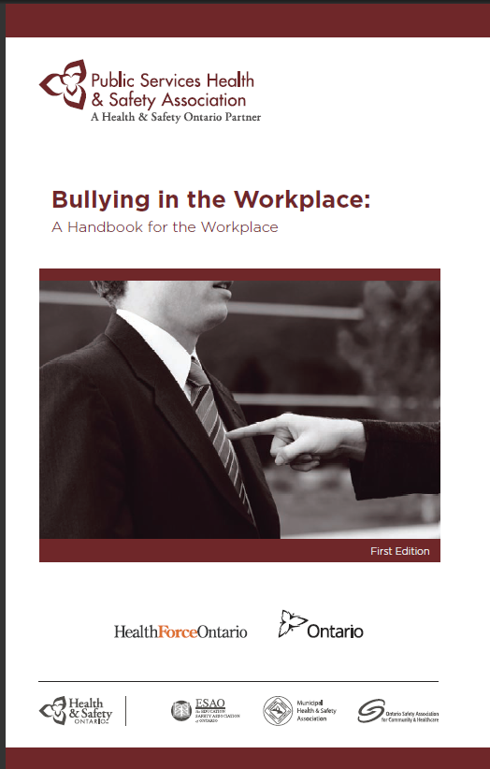
Our Focus will be……
Workplace Bullying…….
RACE Against
Workplace Bullying!
http://www.pshsa.ca/wp-content/uploads/2013/02/BullyWkplace.pdf
Notes:
For the remaining few minutes we will focus on *Workplace Bullying: impact on the organization, victim and some resources to * RACE against Workplace Bullying.
I will refer you to PSHSA’s *FREE to download *Bullying in the Workplace Handbook: many of the resources I will mention can be found in this booklet.

Slide 14
Impact…
Impacts on the organization
Productivity
Culture
Cost
Reputation
Notes:
Workplace Bullying has been found to impact the organizations productivity, cost, culture and reputation.
Productivity: absenteeism, decreased performance, missed deadlines, workplace errors
Cost: Health Plan increase, recruiting, turnover/retention, worker compensation claims
Culture: climate, ineffective teamwork, ineffective interpersonal relationships, work environment
Reputation: Customer relations

Slide 15
Impact…
Impacts on the Victim
Physically
Work Performance
Emotionally
Affective Domain
Notes:
Workplace Bullying has been found to impact the victims Physically, work performance, emotionally, and how people reactive emotionally
Physically: chronic disease, headaches, weight gain, substance abuse
Emotional: mental Health, PTSD, Suicide
Affective Domain: “how people react emotionally: ie anger/anxiety, concentration loss, humiliation, stress, self-confidence

Slide 16
R.A.C.E. Against Workplace Bullying
1
2
3
4
Recognize
Assess
Control
Evaluate
Signs & Symptoms
Management Style and Presence
Repeated and persistent observable behaviours
Written Standard
Communicate
Train
Evaluate
Improve
Enforce
Standard
Procedures
Training
16
Notes:
16
So lets RACE to against Workplace Bullying

Slide 17
R.A.C.E. Against Workplace Bullying
1
2
3
4
Recognize
Assess
Control
Evaluate
Signs & Symptoms
Management Style and Presence
Repeated and persistent observable behaviours
Written Standard
Communicate
Train
Evaluate
Improve
Enforce
Standard
Procedures
Training
17
Notes:
17
Step One- Recognize the scope of Workplace Bullying
You could:
Conduct a survey of employees on the issues of workplace bullying;
Monitor patterns of absenteeism, sick leave, staff turnover, grievances, injury reports
Monitor deterioration in workplace relationships
Monitor feedback from exit interviews of managers/supervisors /workers

Slide 18
Are you building a culture of dignity?
Recognize
Can your actions as a manager/supervisor decrease the potential for bullying?
Assess your management skills.
http://www.pshsa.ca/wp-content/uploads/2013/02/BullyWkplace.pdf
18
Notes:
As a manager are you building a culture of dignity? Do you consciously or unconsciously endorse and perhaps even encourage bullying behaviour?
You could refer to the questionnaire “How does your commitment to a culture of dignity in the workplace shape up?” foumd in the PSHSA Bullying in the Workplace Handbook

Slide 19
R.A.C.E. Against Workplace Bullying
1
2
3
4
Recognize
Assess
Control
Evaluate
Signs & Symptoms
Management Style and Presence
Repeated and persistent observable behaviours
Written Standard
Communicate
Train
Evaluate
Improve
Enforce
Standard
Procedures
Training
19
Notes:
19
Step 2 is to Assess Workplace bullying by identifying repeated and persistent observable behaviours.

Slide 20
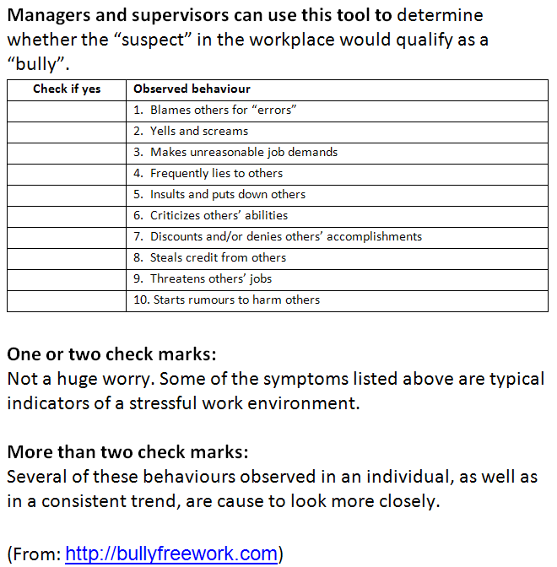
Do You Have a Bully in Your Department?
Assess
http://www.pshsa.ca/wp-content/uploads/2013/02/BullyWkplace.pdf
20
Notes:
Managers and supervisors can use this questionnaire to determine whether the “suspect” in the workplace would qualify as a “bully”

Slide 21
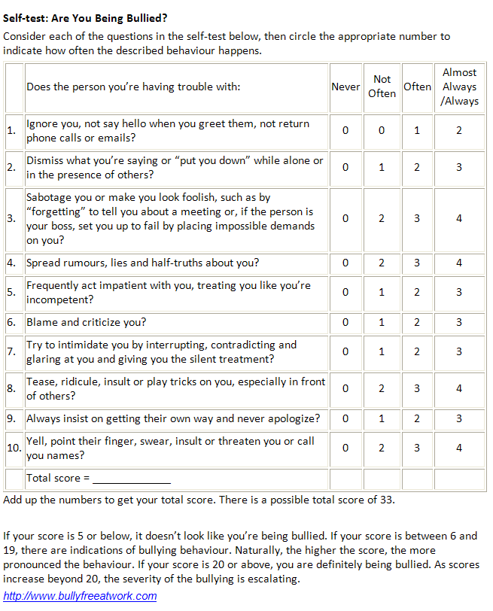
Assess: Are You Being Bullied?
Assess
  Not sure? Complete a self test!
http://www.pshsa.ca/wp-content/uploads/2013/02/BullyWkplace.pdf
21
Notes:
If you are still unsure, ask your employees to complete a self assessment. How do they feel, is there a bully in the department—do they feel they are being bullied?

Slide 22
R.A.C.E. Against Workplace Bullying
1
2
3
4
Recognize
Assess
Control
Evaluate
Signs & Symptoms
Management Style and Presence
Repeated and persistent observable behaviours
Written Standard
Communicate
Train
Evaluate
Improve
Enforce
Standard
Procedures
Training
22
Notes:
22
Step 3 is to Control Workplace Bullying.

Slide 23
Control
5 Steps to Manage Workplace Bullying
1. Written Standard
3. Training
4. Evaluation
5. Acknowledge Success and Make Improvements
2. Communication
Notes:
There are 5 Steps to Manage Workplace Bullying: read slide.

Slide 24
Cognitive Rehearsal
Program
Control
Identifying Common Bullying Behaviours
Cognitively rehearse responses
Practice new skills
Bullying is a behaviour and
behaviour is a choice!
Interviews one year later showed 100% bullying behaviours stopped (Stagg et. al., 2011)
Notes:
Cognitive Rehearsal Program is a specific training intervention that has been found most effective among the health care profession. Keys steps in this intervention is to identify Common Bullying Behaviours; Rehearse responses, and then continue to practice new skills.
*Remember Bullying is a behavior and behavior is a choice.
Added info for facilitator if required:
Cognitive Rehearsal Program (Note: used in with the Nursing Profession—to assist new nurses) helps to identify the problem and devises a solution for future occurrences (Cognitive Behavioural Therapy Techniques, 2011)
10 most common bullying behaviours are listed in Stagg’s article
As a group-- target’s responses are to be identified
Practice the responses
Practicing responses before actual situation helped to build self-confidence in performing the technique in difficult bullying situations
PRACTICE PRACTICE PRACTICE: MAKES IS MORE AUTOMATIC!
Evaluation of a Workplace Bullying Cognitive Rehearsal Program in a Hospital Setting, Stagg et al 2011
4 strategies to manage Bullying found in this article: Cognitive Rehearsal was the most effective.
Teamed nurse mentors with academic participants: culture of support, communication and conflict resolution
Instruction on assertiveness and aggression
Aggression and violence minimization modules

Slide 25
R.A.C.E. Against Workplace Bullying
1
2
3
4
Recognize
Assess
Control
Evaluate
Signs & Symptoms
Management Style and Presence
Repeated and persistent observable behaviours
Written Standard
Communicate
Train
Evaluate
Improve
Enforce
Standard
Procedures
Training
25
Notes:
25
Step 4 is evaluation.

Slide 26
Evaluate
  Ongoing review and evaluation of the specific strategies and plans
  Ensuring that strategies implemented are effective in preventing or minimizing incidents
  Consultation with the JHSC
Notes:
Review slide

Slide 27
Key Points
80% of nurses reported being bullied in the last year.
Recognize: Are you creating a culture of civility?
Assess: observable behaviours?
Control: Prevention Program and empower your employees with education.
Evaluate: What is working? How can improve?
Notes:
80% of nurses reported being bullied in the last year.
Recognize: Are you creating a culture of civility?
Assess: observable behaviours?
Control: Prevention Program and empower your employees with education.
Evaluate: What is working? How can improve?

Slide 28

http://www.pshsa.ca/workplace-violence/
Notes:
PSHSA offers many great free to download resources on Workplace Violence and Harassment.

Slide 29
THANK YOU!
If you still have questions, please contact me:
Shelly Hurry, Health & Safety Consultant
shurry@pshsa.ca
519-520-1579

