Slide 1
Role of Androgen Receptor in Epithelial to Mesenchymal Transition (EMT) in Prostate Cancer Cells
Sheeba Jacob
Primate Biology Department
National Institute for Research in Reproductive Health Mumbai, India

Slide 2
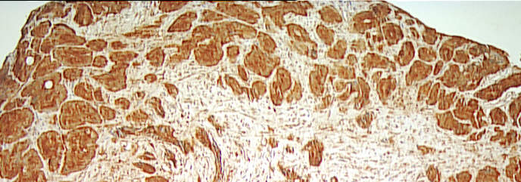
Challenges in Prostate Cancer Management
Distinguishing indolent versus aggressive disease
Treatment of androgen-independent or castration resistant prostate cancer
Metastasis

Slide 3
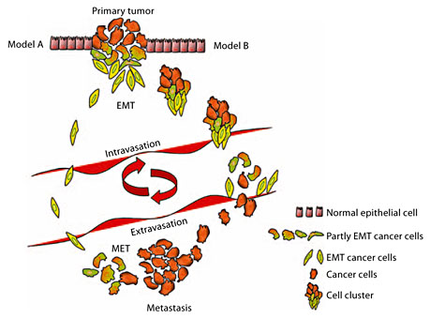
Epithelial to Mesenchymal Transition- EMT, a Major Event in Metastasis

Slide 4
Androgenic Stimuli - Facilitator of Inhibitor of EMT?
Androgens induce EMT activation in prostate cancer cells (Zhu and Kyprianou, 2010)
Androgen deprivation leads to EMT activation in mouse harboring human PCa xenografts (Sun et al., 2012)
Izumi et al. (2013) reported EMT activation in prostate cancer cells after AR silencing
The role of androgenic stimuli in EMT regulation remains to be established

Slide 5
Androgen & its Receptor (AR) as a Regulator of EMT in Prostate Cancer Cells

Slide 6
Queries ????
Whether modulation in the levels of androgen receptor (AR) alters the invasiveness of prostate cancer cells?
If yes, mechanisms underlying AR driven modulation in invasiveness?

Slide 7
Experimental Models
Androgen dependent prostate cancer cell line (LNCaP-FGC)
Androgen independent prostate cancer cell lines (PC3 and DU145)

Slide 8
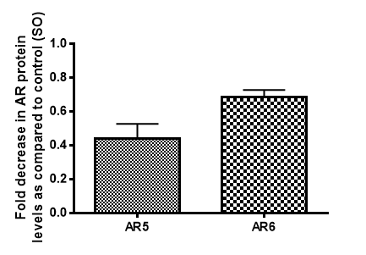
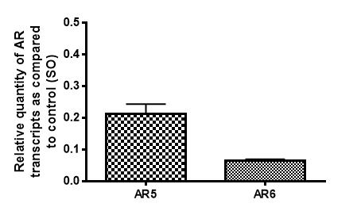
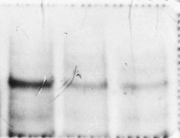


Effect on Invasion of Androgen-Dependent LNCaP cells
A. B. C.
***
****
AR
GAPDH
***
110kDa
37kDa
****
SO AR5 AR6
Matrigel Assay
AR silencing led to reduction in the invasiveness of androgen-dependent LNCaP cells.
**
*** p value < 0.001, **** p value < 0.0001

Slide 9

Microarray Analysis to Identify EMT/ Invasion
Associated Genes
6% differentially expressed genes
Twist 2
ZEB2 (Zinc Finger E Box Binding Homeobox 2) / SIP1
EVT
MMP-7
IGF-1
Cdc 42

Slide 10
ZEB2 and EMT
ZEB2 knockdown suppressed migration and invasion in glioma cells (Qi et al., 2012)
ZEB2 directly binds proximal E boxes within the E- cadherin gene and mediates transcriptional repression by recruiting co-repressor complexes (Postigo et al., 2003)

Slide 11
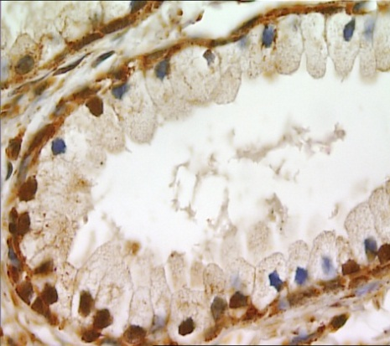
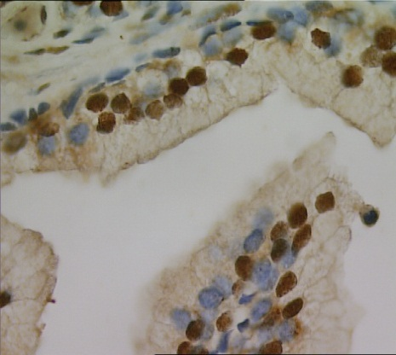
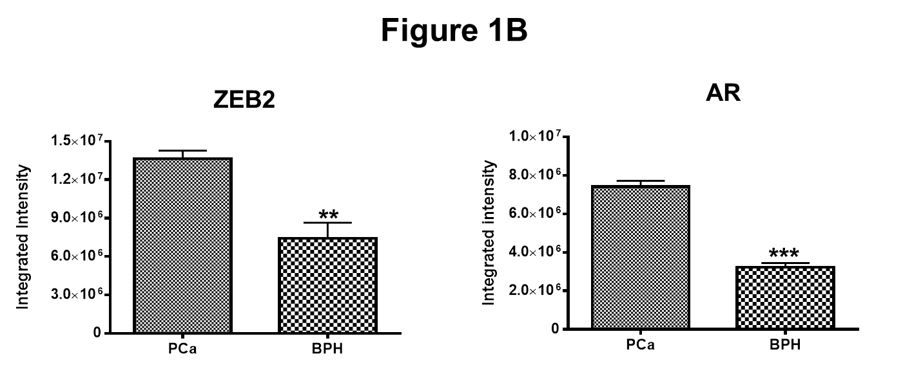
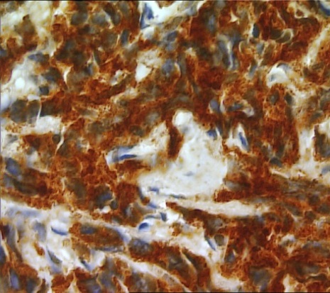
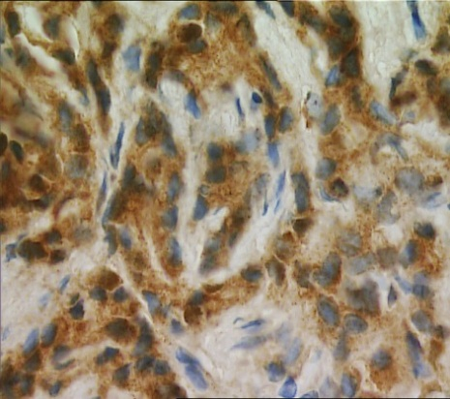
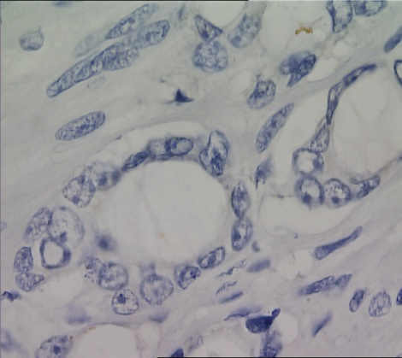
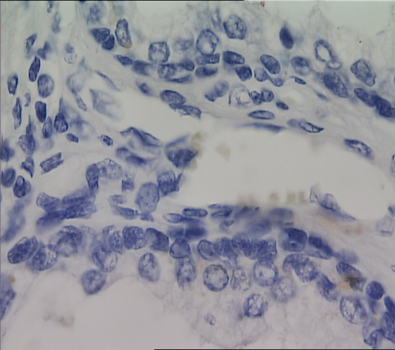
AR and ZEB2 Expression in Prostate Cancer
and Benign Prostatic Hyperplasia
ZEB2 AR
a
d
-ve PCa BPH
b
e
c
f

Slide 12
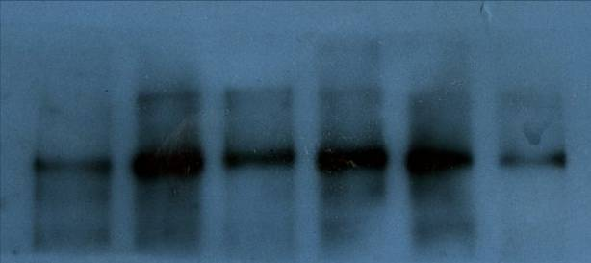
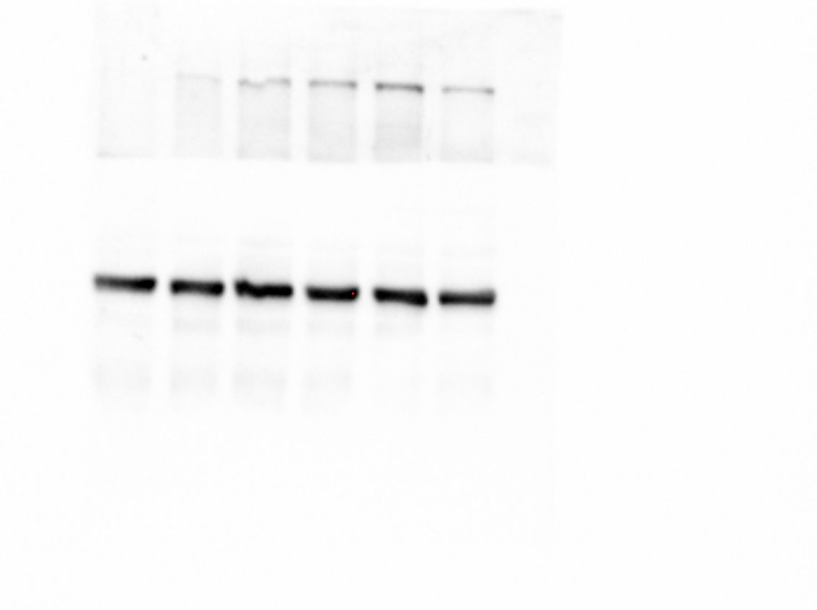
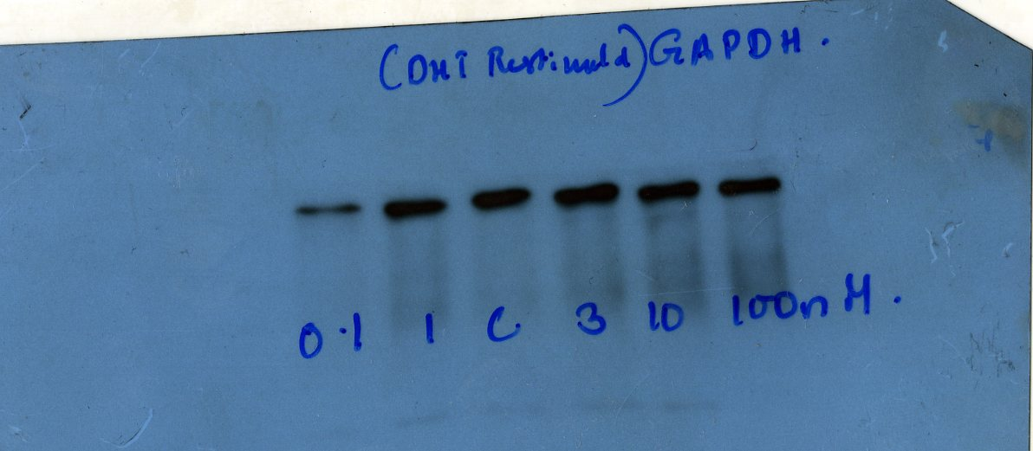
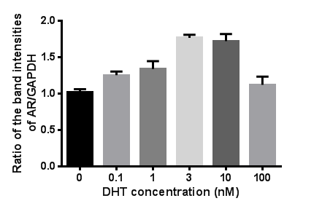
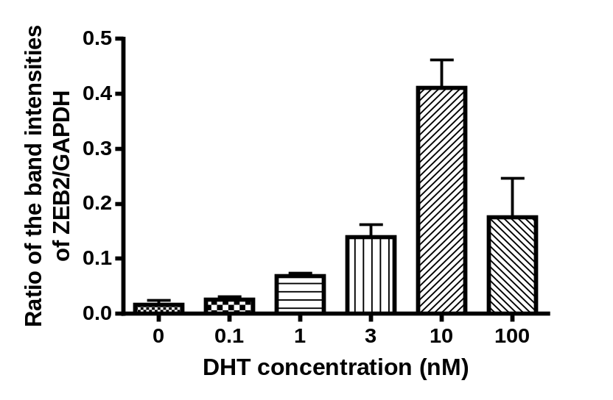
Androgen stimulates ZEB2 expression in androgen-dependent LNCaP cells
B.
A.
0.1 1 0 3 10 100 nM DHT
0 0.1 1 3 10 100 nM DHT
ZEB2
AR
110kDa
130kDa
GAPDH
37kDa
GAPDH
37kDa
D.
C.
**
**
**
*
*
*

Slide 13
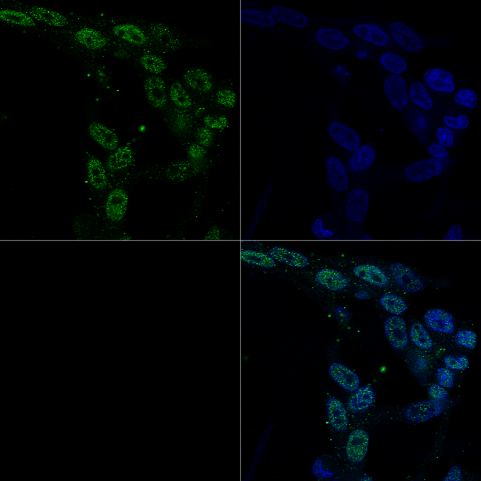
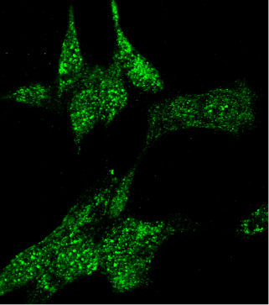
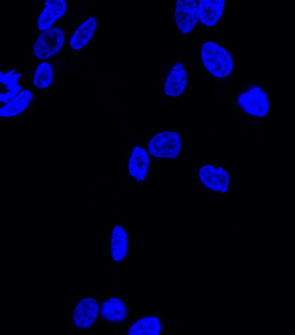
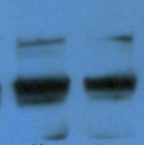
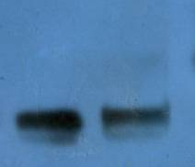
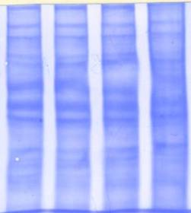
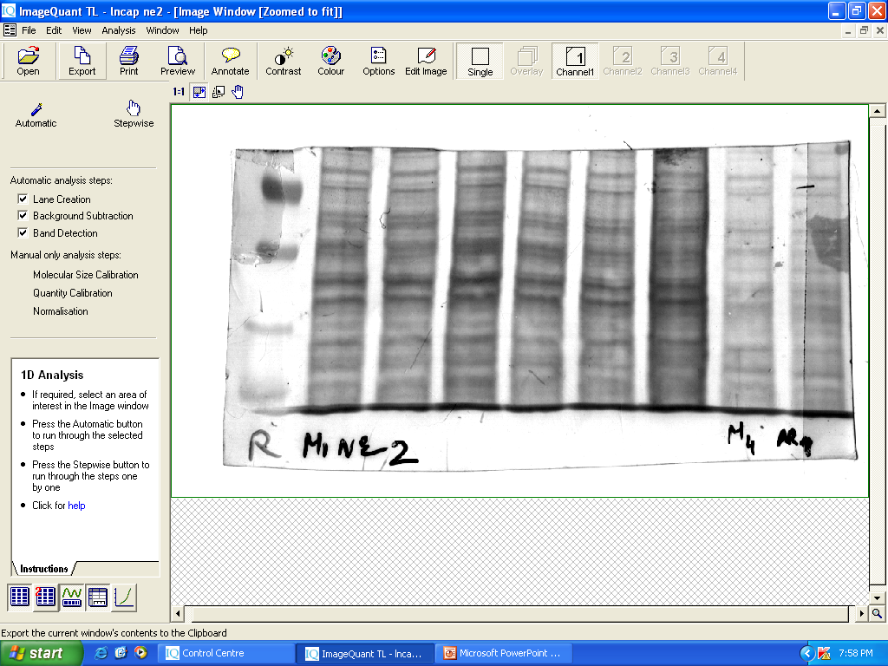
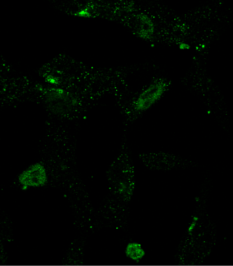
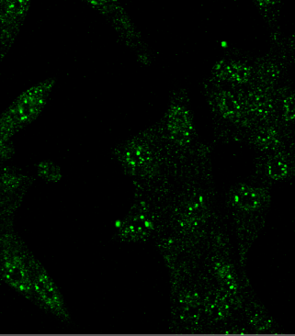
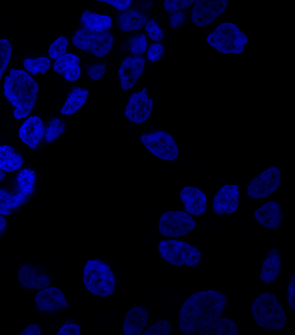
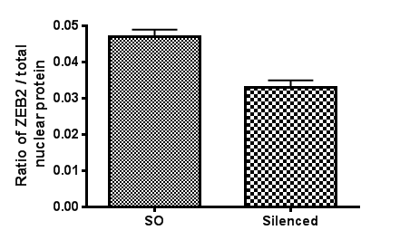
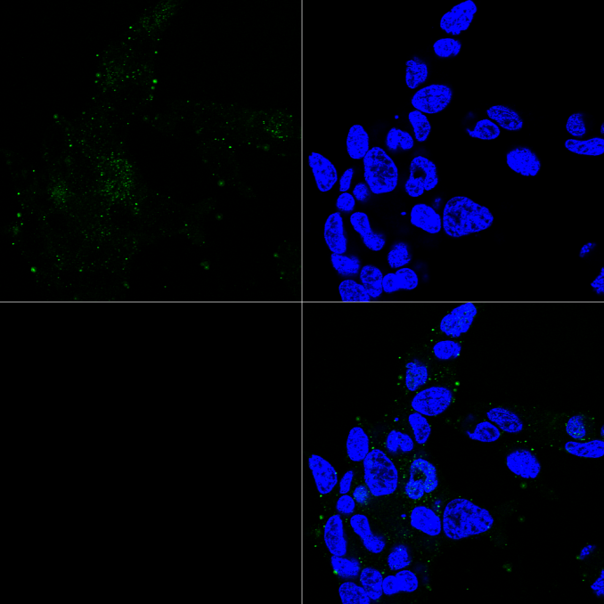
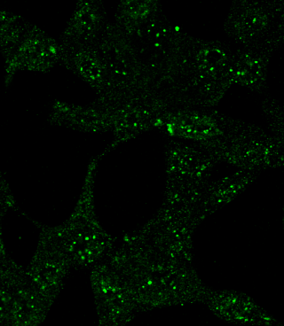
ZEB2 expression in AR silenced LNCaP cells
C.
AR
ZEB2
-ve
A.
SO AR6 SO AR6
ZEB2
SO
a
d
g
g
B.
AR5
h
*
b
e
h
AR6
c
f
AR positively regulates ZEB2 expression in androgen-
dependent LNCaP cells

Slide 14
Whether the levels of ZEB2 differ in androgen dependent (less metastatic) and androgen independent (more metastatic)
prostate cancer cell lines?

Slide 15
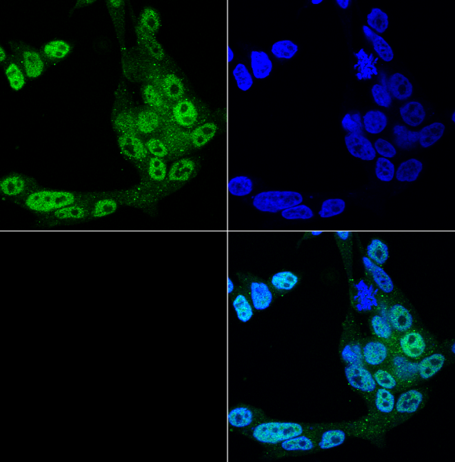
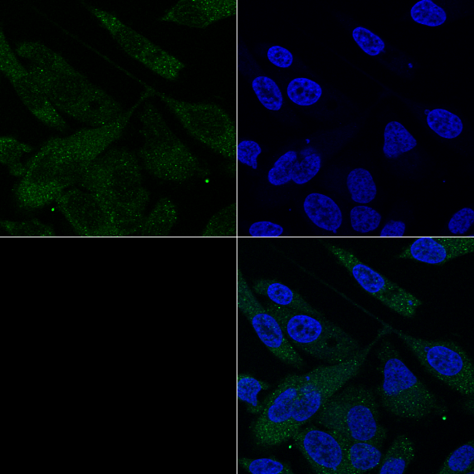
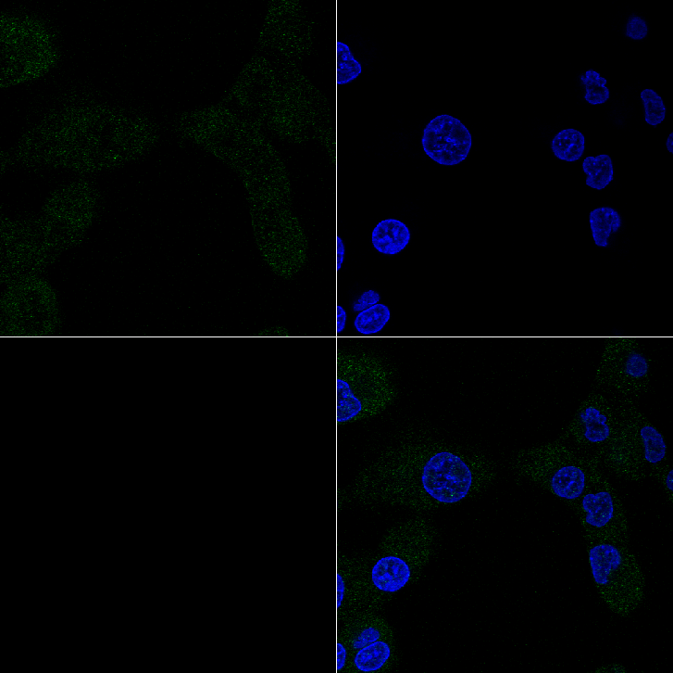
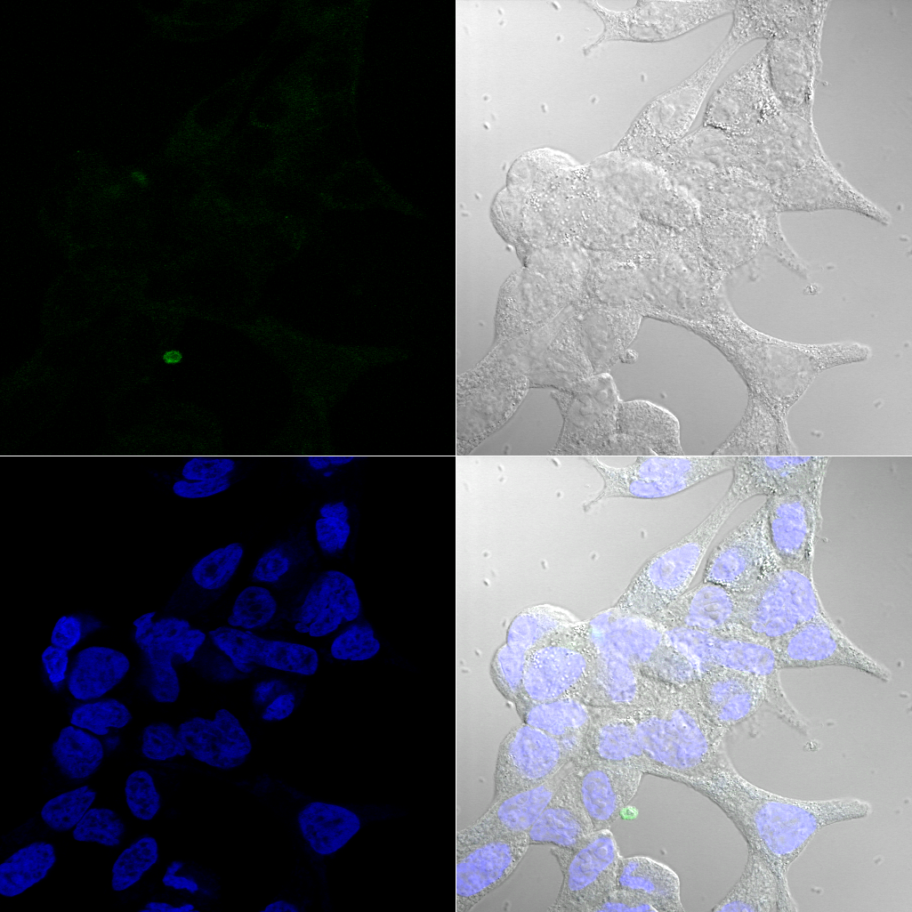
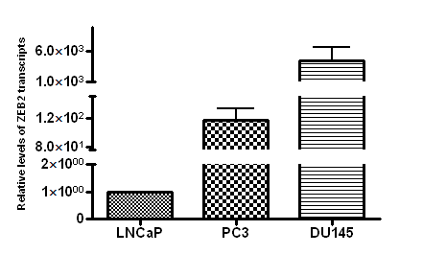
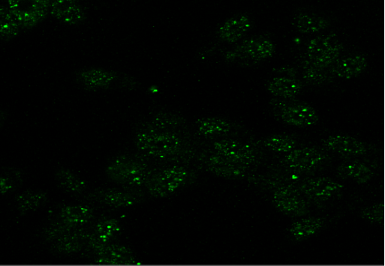
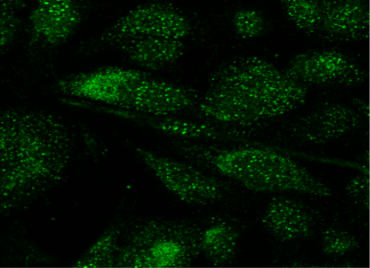
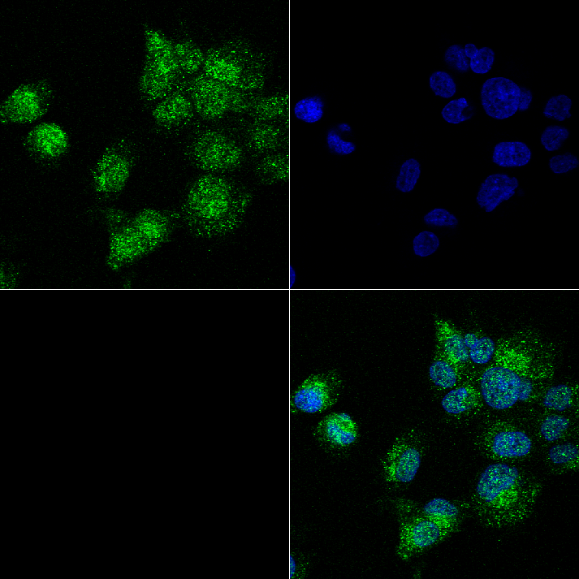
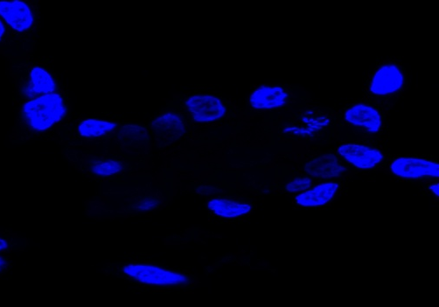
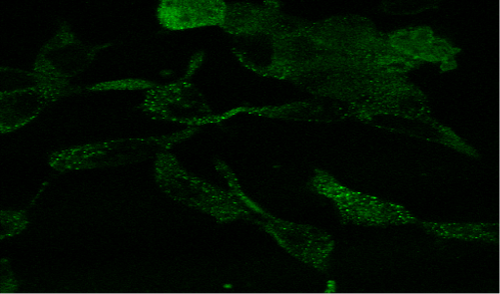
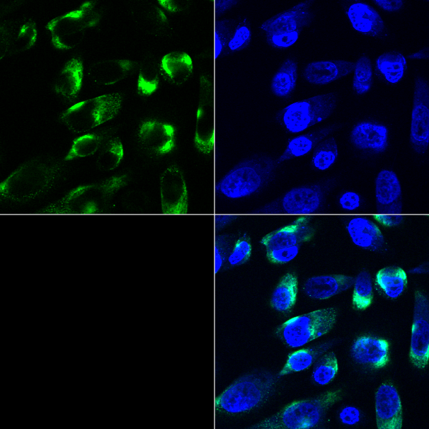
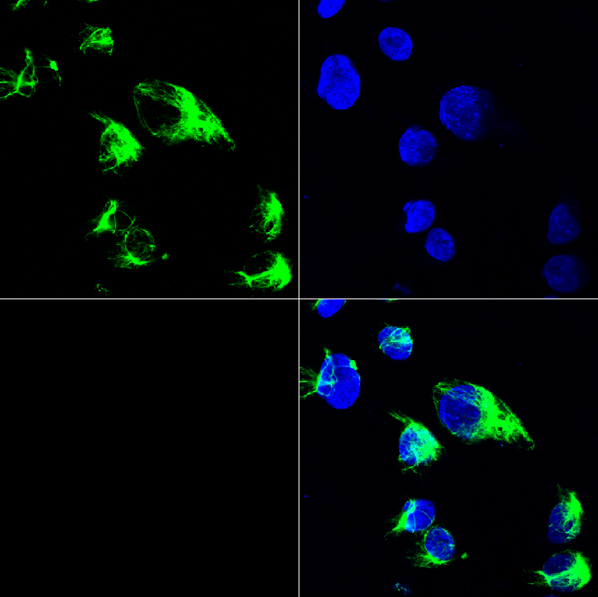
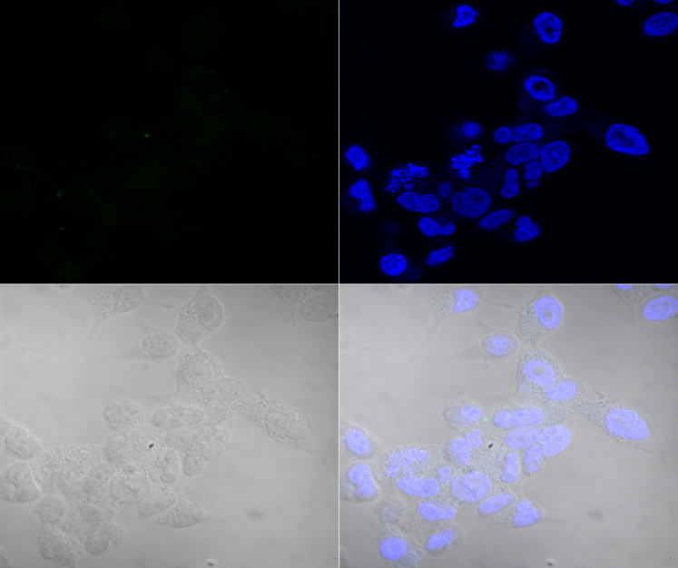
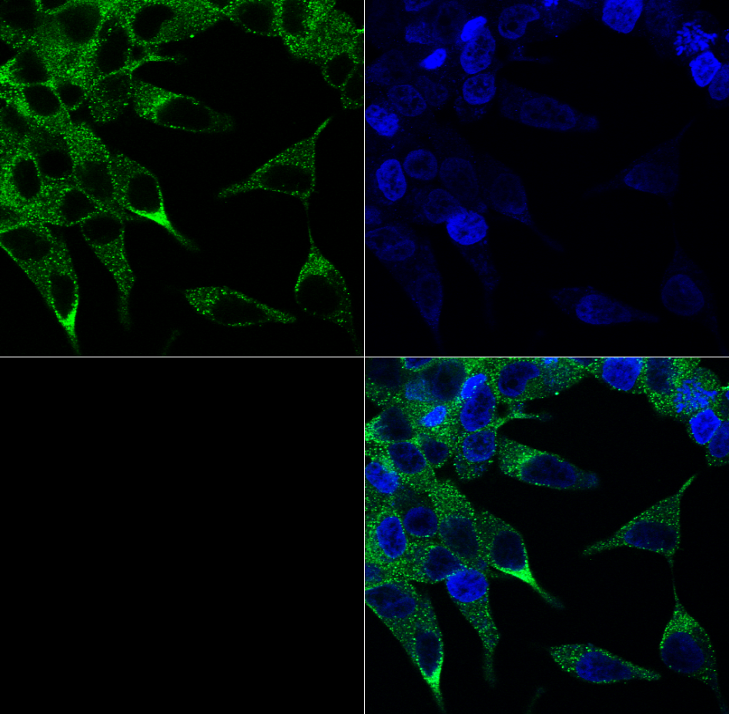
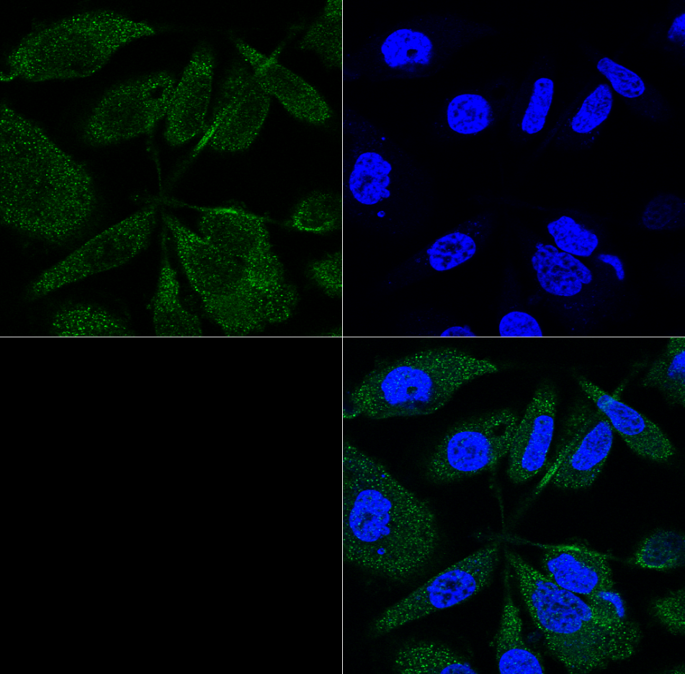
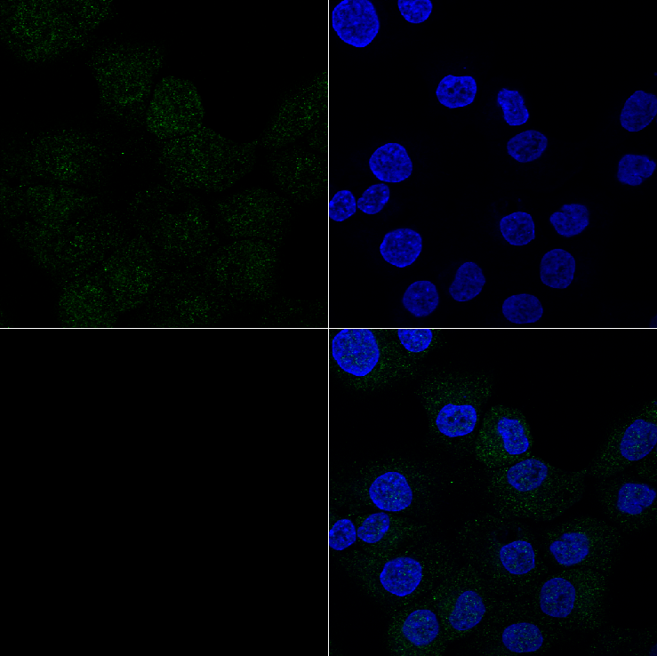
AR, ZEB2 and EMT in Androgen Dependent and Androgen Independent PCa Cell Lines
Relative Levels of ZEB2 Transcripts in Androgen
Dependent and Androgen Independent PCa Cell Lines
LNCaP PC3 DU145 - ve
**
ZEB2 AR
**
Vimentin
E-cadherin
** p value < 0.01

Slide 16
AR over-expression in androgen independent prostate cancer cells
ZEB2 levels?

Slide 17





Transcript Levels of AR and ZEB2 in AR transfected
PC3 and DU145 Cells
PC3
AR
DU145
AR
*
**
**
*
*
**
RQ of AR transcripts
RQ of AR transcripts
AR cDNA concentration (μg)
AR cDNA concentration (μg)
ZEB2
*
ZEB2
**
*
*
**
**
RQ of ZEB2 transcripts
RQ of ZEB2 transcripts
AR cDNA concentration (μg)
AR cDNA concentration (μg)
AR over-expression led to a decrease in ZEB2 transcript levels.
* p value < 0.05, ** p value < 0.01

Slide 18
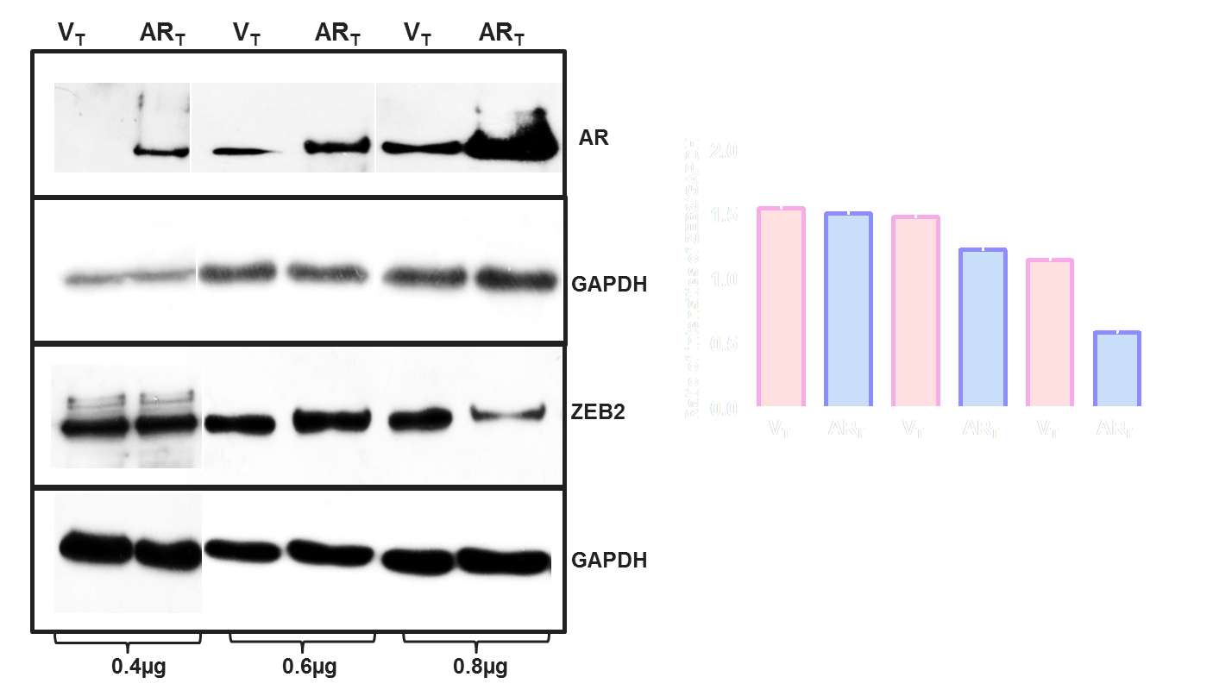
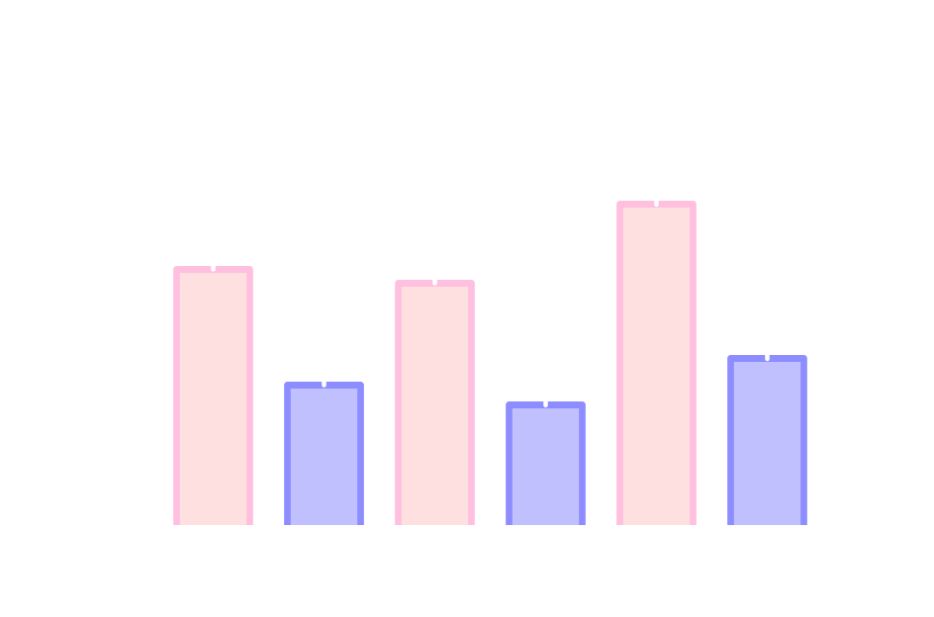
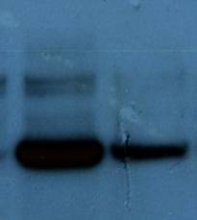
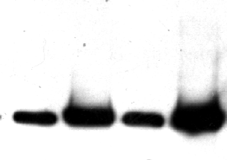








ZEB2 Protein Levels in AR Over-expressing Cells
DU145
PC3
V_{T} AR_{T} V_{T} AR_{T} V_{T} AR_{T}
*
*
**
AR
GAPDH
ZEB2
0.4µg 0.6µg 0.8µg
GAPDH
0.4µg 0.6µg 0.8µg

Slide 19






Expression of E-cadherin in AR Over-expressing
Androgen Independent Prostate Cancer Cells
PC3
DU145
-ve
-ve
Vector Transfected AR Transfected

Slide 20




Expression of E-cadherin in AR Overexpressing Androgen Independent Prostate Cancer Cells
V_{T} AR_{T}
V_{T} AR_{T}
E-cadherin
GAPDH
PC3 DU145
E-cadherin expression is increased following
AR over-expression.

Slide 21



Morphology of AR Over-expressing Androgen-independent Prostate Cancer Cells
PC3
DU145
Vector Transfected AR Transfected

Slide 22








Invasiveness of AR Expressing Androgen Independent Cells and Rescue by ZEB2 Over-expression
V_{T} AR_{T}
V_{T} AR_{T} AR+ZEB2_{T}
ZEB2
ZEB2
GAPDH
GAPDH
**
**
*
**
PC3
DU145
ZEB2 over-expression restores invasion in AR over-expressing androgen
independent prostate cancer cell lines

Slide 23














Migration of AR Over-expressing Androgen Independent PCa Cells and Restoration by ZEB2 Over-expression
0 hr 24 hr
0 hr 24 hr
V_{T}
**
**
AR_{T}
**
AR+ZEB2_{T}
**
PC3 DU145
AR over-expression leads to decrease in migration and ectopic expression
of ZEB2 restores the migration of AR over-expressing cells.

Slide 24
Conclusion
AR negatively regulates ZEB2 expression in androgen independent prostate cancer cells
Expression of E-cadherin is increased in AR over-expressing prostate cancer cells
Invasion and migration are adversely affected, following AR over-expression, in androgen independent prostate cancer cells

Slide 25

To summarize…
Androgen dependent
Androgen independent
Androgenic stimuli
Cells over expressing AR
EMT
EMT
ZEB2
Cells expressing AR
ZEB2

Slide 26
Take Home message…
Intermittent, rather than continuous androgen deprivation therapy Is more beneficial to patients with locally advanced metastatic prostate tumors.

Slide 27
Acknowledgement
Dr. Geetanjali Sachdeva, Ph. D
Mr. Sumeet Nayak (graduate student)
Dr. Donald Tindall, Mayo Clinic, US
Dr. Danny Huylebroeck, University of Leuven, Belgium
Indian Council of Medical Research (ICMR)
Department of Atomic Energy-BRNS
i)

Slide 28

In Silico Scanning for the Presence of ZEB2 Binding Sites in the Regulatory Regions of miR200a and 200b Genes

Slide 29

miR200a and 200b Levels in AR Over-expressing PC3 Cells
**
*
miR200a and miR200b levels are increased in AR over-expressing prostate cancer cells.

