Slide 1


Consumption of Fermented Beverages and their Influences on Health and Disease
Sharon Ross, PhD, MPH
rosssha@mail.nih.gov
Nutritional Science Research Group
Division of Cancer Prevention
National Cancer Institute
Bethesda, MD

Slide 2
Disclosures: No Relevant Financial Relationship to disclose.
Disclaimer: The views and opinions expressed in this presentation solely reflect my experience and perception and do not necessarily state or reflect those of the NCI, NIH, DHHS or U.S. Government.

Slide 3
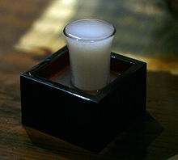
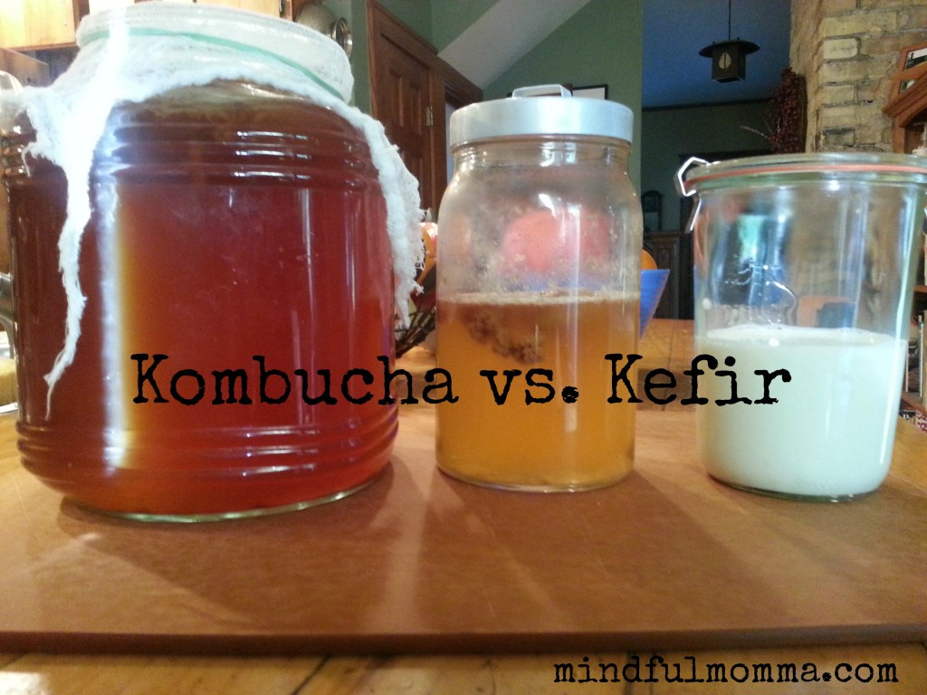
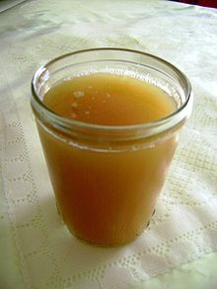
Types of fermented beverages
Fermented beverages include those that utilize grains (beer, rice wine, maize-based beverages), fruit (wine), tea (kombucha), and milk products (fermented mare’s milk, kefir).
Nigori, or unfiltered sake
https://en.wikipedia.org/wiki/Sake
Chicha de jora is a corn beer
https://en.wikipedia.org/wiki/Chicha_de_jora

Slide 4
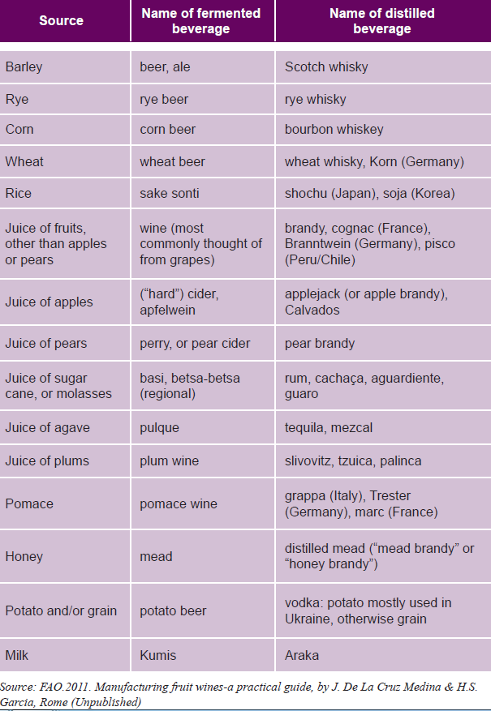
Fermented (alcoholic) beverages from around the world
Marshall E & Mejia D. Traditional fermented food and beverages for improved livelihoods. Rural Infrastructure and Agro-Industries Division, Food and Agriculture Organization of the United Nations Rome 2011

Slide 5
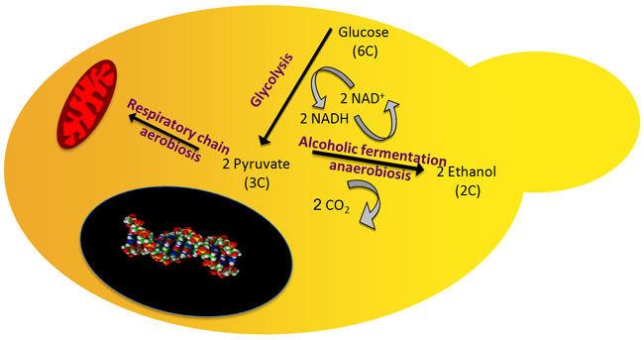
Alternative metabolic routes following glycolysis
Yeasts produce ethanol as the main fermentation product, and the main fermentation product of lactic acid bacteria is lactic acid. Fermentation by yeast is primarily an anaerobic process converting sugars, such as glucose, to other compounds like ethanol, while producing energy for the microorganism.
A budding yeast cell is shown with the aerobic and anaerobic metabolic pathways following glycolysis. The nucleus (black) and mitochondrion (red) are also shown.
© 2010 Nature Education All rights reserved.

Slide 6
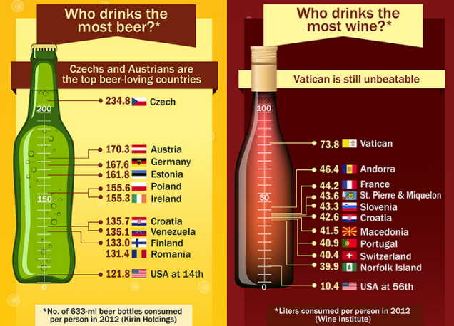
Drinking Data Shows U.S. at the Top by Volume, but Europe Dominates Per Capita - US News & World Report
Findings Need Replication
comparecamp Author: Robin Renford Designed by: comparecamp.com Author: Chris Sibbet
http://www.usnews.com/news/blogs/data-mine/2014/10/02/drinking-data-shows-us-at-the-top-by-volume-but-europe-dominates-per-capita

Slide 7
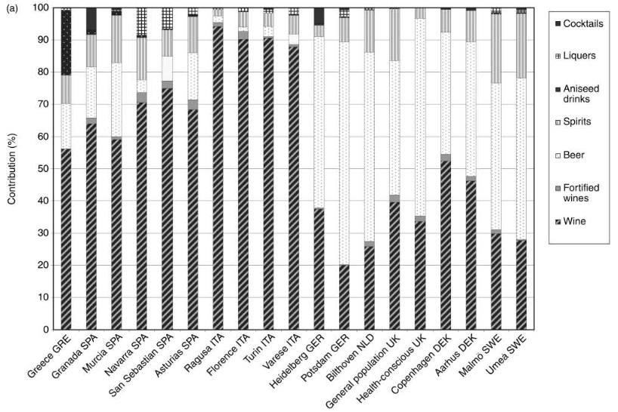
Main sources of alcohol intake for men by center in the European Prospective Investigation into Cancer and Nutrition (EPIC) project
Sieri S, et al. Public Health Nutr. 2002 Dec;5(6B):1287-96.

Slide 8
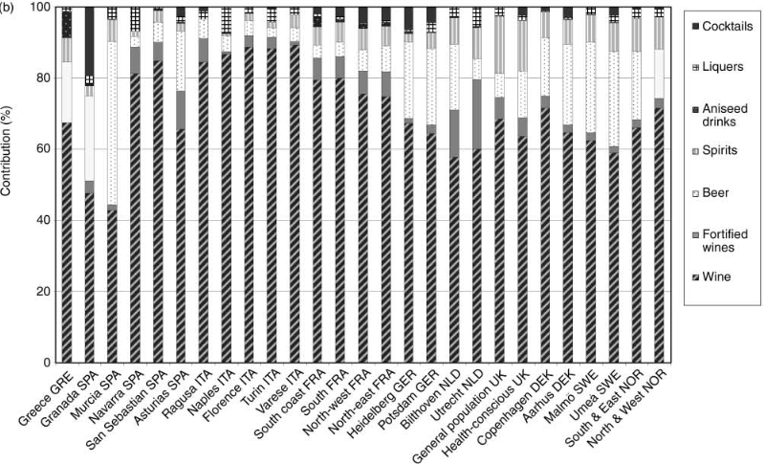
Main sources of alcohol intake for women by center in the European Prospective Investigation into Cancer and Nutrition (EPIC) project
Sieri S, et al. Public Health Nutr. 2002 Dec;5(6B):1287-96.

Slide 9
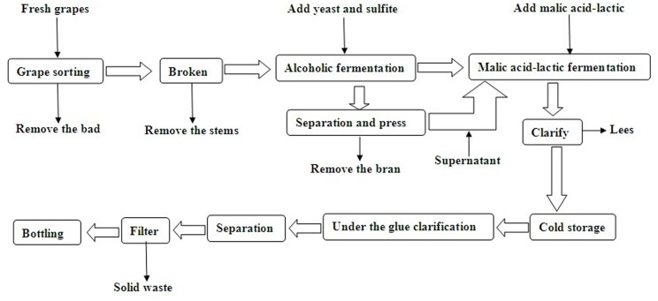
Wine making process schematic.
Saccharomyces cerevisiae
Wang R, et al. PLoS One. 2015; 10(2): e0116690.

Slide 10
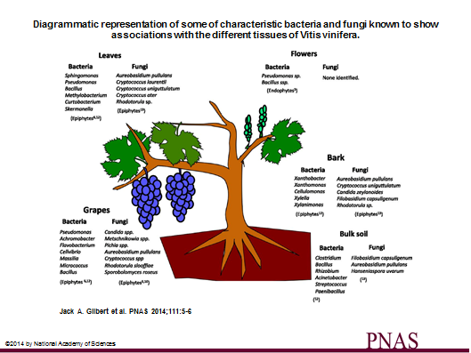
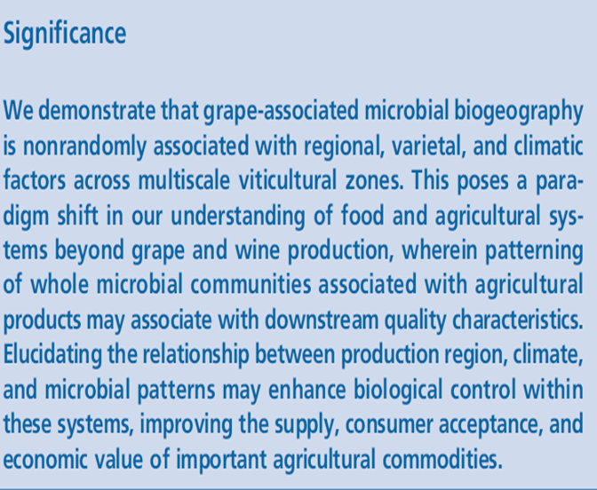
Microbial terroir for wine grapes
Nicholas A. Bokulich et al. PNAS 2014;111:E139-E148

Slide 11
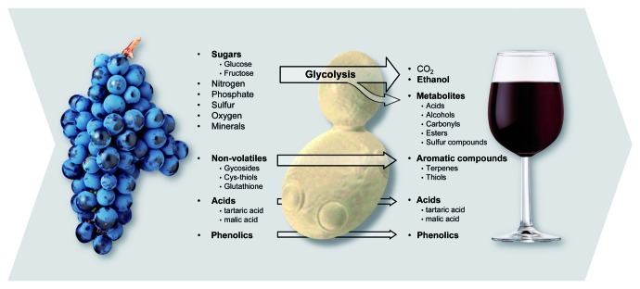
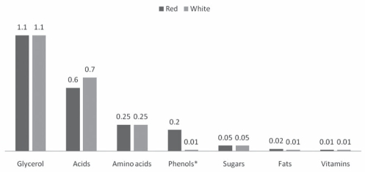
Components of Wine
Yeast is integral to crafting complex wines from simple, sugar-rich grape juice. Grape juice is converted into wine by the action of wine yeast. Some wine components are wholly generated by yeast as part of metabolism while others are essentially created by the grapevine. The large number of compounds synthesized or modified by wine yeast have a major impact on wine quality and style---possibly also on health and disease
Pretorius IS, et al. Bioeng Bugs. 2012 May 1; 3(3): 147–156.
Estimates of typical gross composition (percentage weight). *Phenols constitute the major compositional difference between red and white table wines. Water and ethanol content is similar for both types of wine (87% and 10%, respectively).
*
Cordova AC, et al., Int J Angiol. 2009 Autumn; 18(3): 111–117.

Slide 12
The phenolic content in wine
Phenolic compounds in wine a large group of several hundred chemical compounds that affect the taste, color and mouthfeel of wine.
These compounds include phenolic acids, stilbenoids, flavonols, dihydroflavonols, anthocyanins, flavanol monomers (catechins) and flavanol polymers (proanthocyanidins).
Broadly separated into two categories, flavonoids and non-flavonoids.
Flavonoids include the anthocyanins and tannins which contribute to the color and mouthfeel of the wine.
The non-flavonoids include the stilbenoids such as resveratrol and phenolic acids such as benzoic, caffeic and cinnamic acids.
Garrido J & Fernanda Borges F. Food Res Intern. 54:1844-1858, 2013.
https://en.wikipedia.org/wiki/Phenolic_content_in_wine

Slide 13
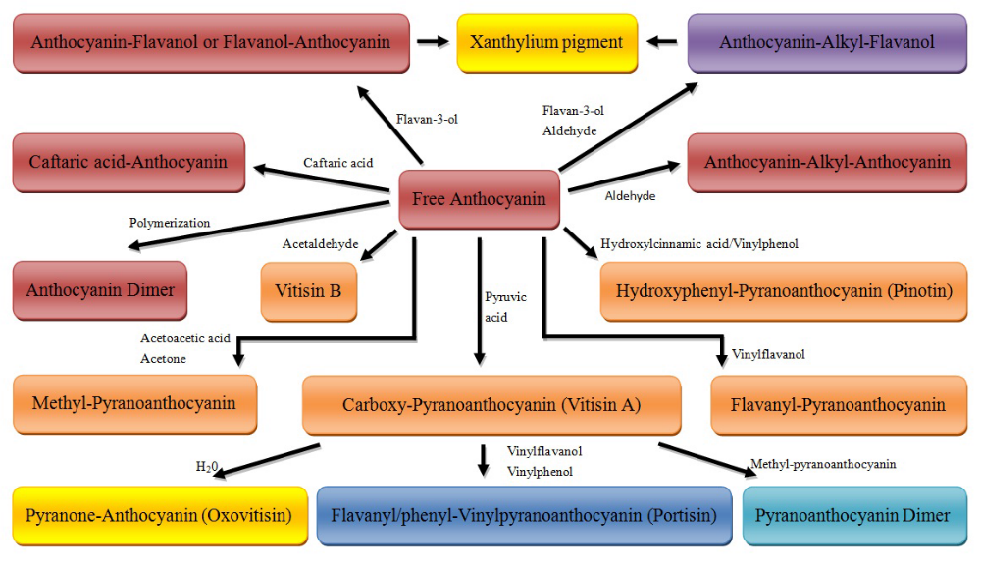
Evolution of anthocyanins in aged red wines
He F, et al. Molecules 2012, 17, 1483-1519;

Slide 14
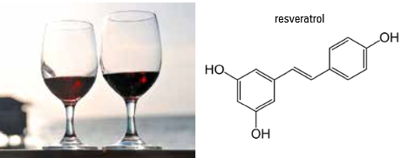
Bioactive Phenolics in Wine
Rossi T, et al. Pol Arch Med Wewn. 2014;124(12):713-22
Analysis of red wine originating from diverse countries show variation in ranges of resveratrol concentrations of up to 6.8 mg/ L.
Wenzel E & Somoza V. Mol Nutr Food Res. 2005 May;49(5):472-81.
Biological Response to Resveratrol:
The lower end of supplementation tends to be for cardiovascular health, insulin sensitivity, and longevity for individuals who are otherwise unhealthy is 5-10 mg daily. For persons who are otherwise healthy, dosages between the range of 150-445 mg have been used (with no clear indication for what is the optimal dose).
Supplementing for cerebral blood flow requires a dose in the 250-500mg range whereas supplementation for aromatase inhibition requires 500 mg as well.
http://examine.com/supplements/Resveratrol/

Slide 15
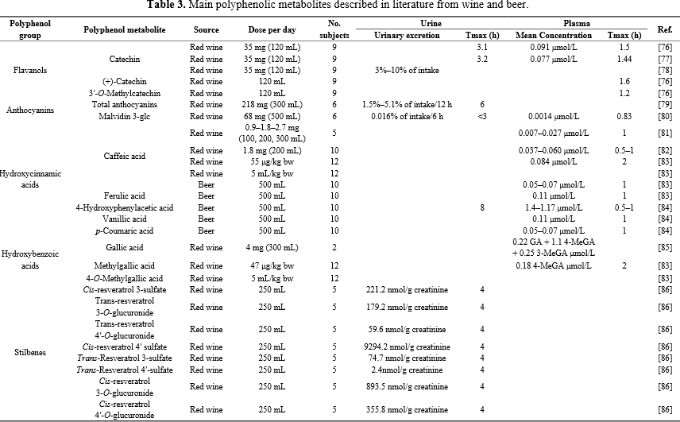
Data from several relevant reviews about levels of polyphenolic metabolites in plasma and urine after wine or beer consumption in adults suggest variability
Arranz S, et al. Nutrients. 2012 Jul;4(7):759-81.

Slide 16
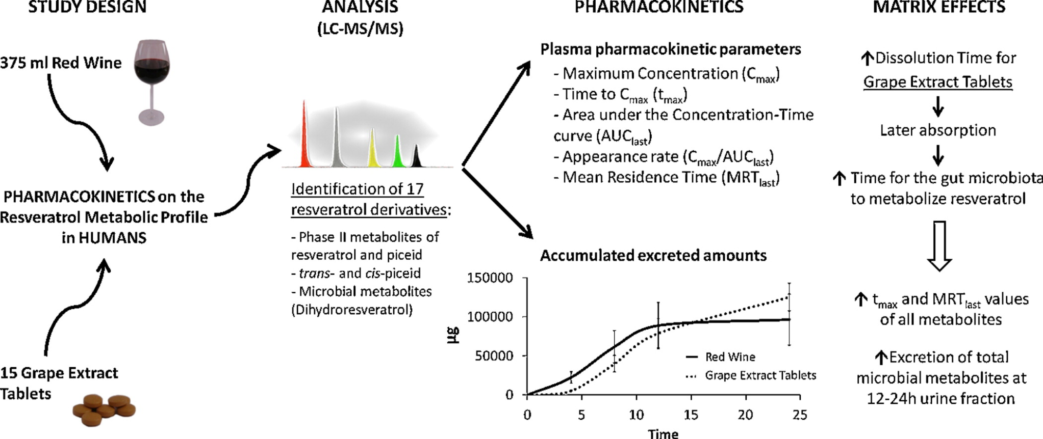
The bioavailability of resveratrol is influenced by several factors, including the food matrix
Rotches-Ribalta M, et al. Pharm Res 66:375-382, 2012.

Slide 17
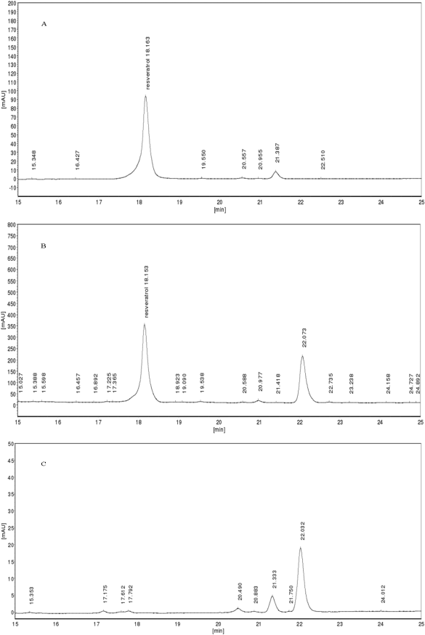
To increase resveratrol production in wines two expression vectors carrying 4-coumarate:coenzyme A ligase gene and resveratrol synthase gene were transformed into strains of Saccharomyces cerevisiae EC1118
Chromatogram A represents the authentic standard of trans-resveratrol
Chromatogram B represents extracts from the culture broth of recombinant
Chromatogram C represents extracts from the culture broth of the negative control
Resveratrol content of the wine fermented with engineered strains was twice higher than that of the control, indicating that engineered strains could increase the production of resveratrol during wine fermentation.
Biotechnology Progress
Volume 31, Issue 3, pages 650-655, 4 MAR 2015 DOI: 10.1002/btpr.2057
http://onlinelibrary.wiley.com/doi/10.1002/btpr.2057/full#btpr2057-fig-0003
Notes:
HPLC analyses of resveratrol produced by engineered S. cerevisiae EC1118.
© IF THIS IMAGE HAS BEEN PROVIDED BY OR IS OWNED BY A THIRD PARTY, AS INDICATED IN THE CAPTION LINE, THEN FURTHER PERMISSION MAY BE NEEDED BEFORE ANY FURTHER USE. PLEASE CONTACT WILEY'S PERMISSIONS DEPARTMENT ON PERMISSIONS@WILEY.COM OR USE THE RIGHTSLINK SERVICE BY CLICKING ON THE 'REQUEST PERMISSION' LINK ACCOMPANYING THIS ARTICLE. WILEY OR AUTHOR OWNED IMAGES MAY BE USED FOR NON-COMMERCIAL PURPOSES, SUBJECT TO PROPER CITATION OF THE ARTICLE, AUTHOR, AND PUBLISHER.

Slide 18
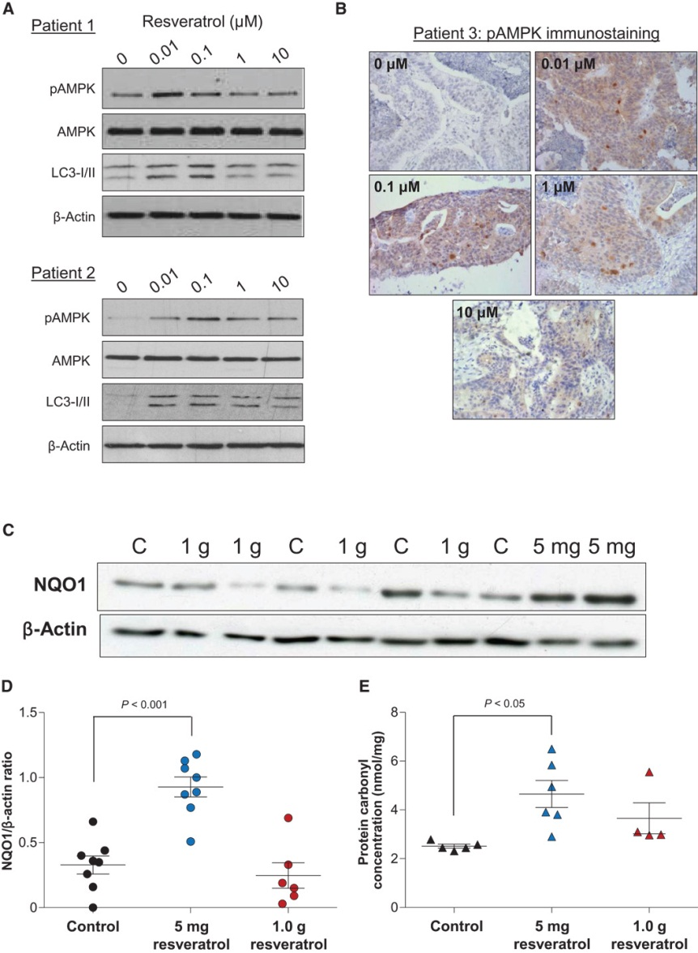

Low concentrations of resveratrol activate AMPK and increase markers of oxidative stress in human colorectal tissues.
In Apc^{Min} mice that received a
high-fat diet, a low resveratrol dose suppressed intestinal adenoma development more potently than did the higher dose.
Efficacy correlated with activation of adenosine monophosphate–activated protein kinase (AMPK) and increased expression of the senescence marker p21
In human colorectal tissues exposed to low dietary concentrations of resveratrol ex vivo, enhanced AMPK phosphorylation
and autophagy were observed.
The expression of the cytoprotective NAD(P)H dehydrogenase, quinone 1 (NQO1) enzyme was increased in tissues from cancer patients participating in a [14C]-resveratrol trial.
Hong Cai et al., Sci Transl Med 2015;7:298ra117
Published by AAAS

Slide 19
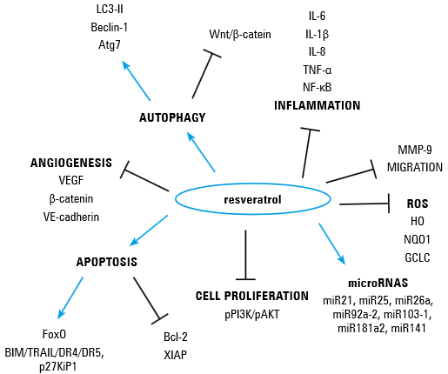
Cellular and molecular mechanisms involved in flavonoid associated (resveratrol) chemopreventive and angiopreventive activities
Rossi T, et al. Pol Arch Med Wewn. 2014;124(12):713-22

Slide 20
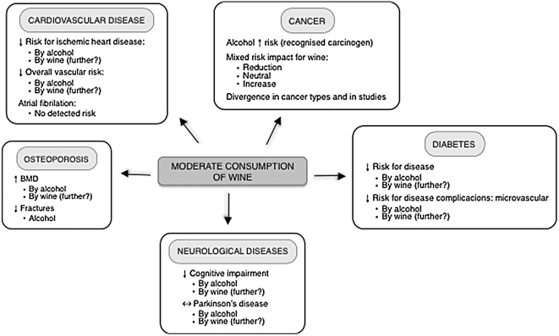
Effects of moderate wine consumption on different diseases, as reported in clinical observational studies.
Several studies cannot differentiate the observed effect of wine from that achieved by alcohol. The putative additive effect of wine has been shown with a question mark in the figure because there are unknowns/inconsistencies.
Ana Artero, Arturo Artero, Juan J. Tarín, Antonio Cano. Maturitas, Volume 80, Issue 1, 2015, 3–13.
http://dx.doi.org/10.1016/j.maturitas.2014.09.007

Slide 21
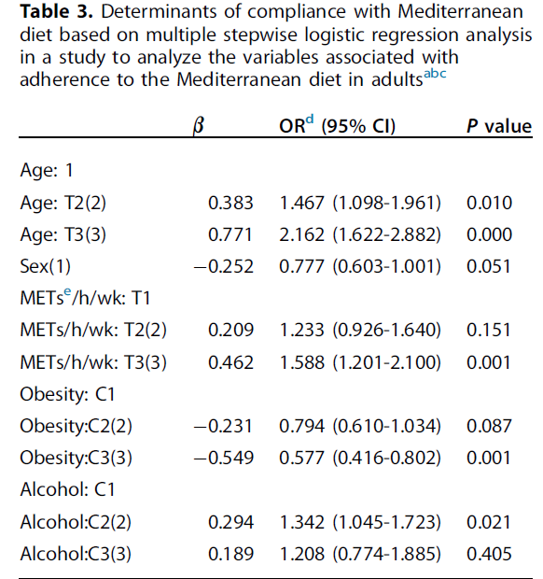
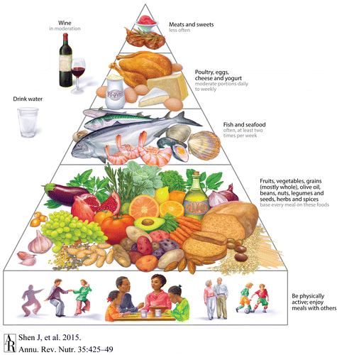
Moderate alcohol consumption (wine) and adherence to a Mediterranean dietary pattern
Shen J, et al. Annu Rev Nutr. 2015 Jul 17;35:425-49.
Patino-Alonso MC, et al. J Acad Nutr Diet. 2014 Apr;114(4):583-9

Slide 22
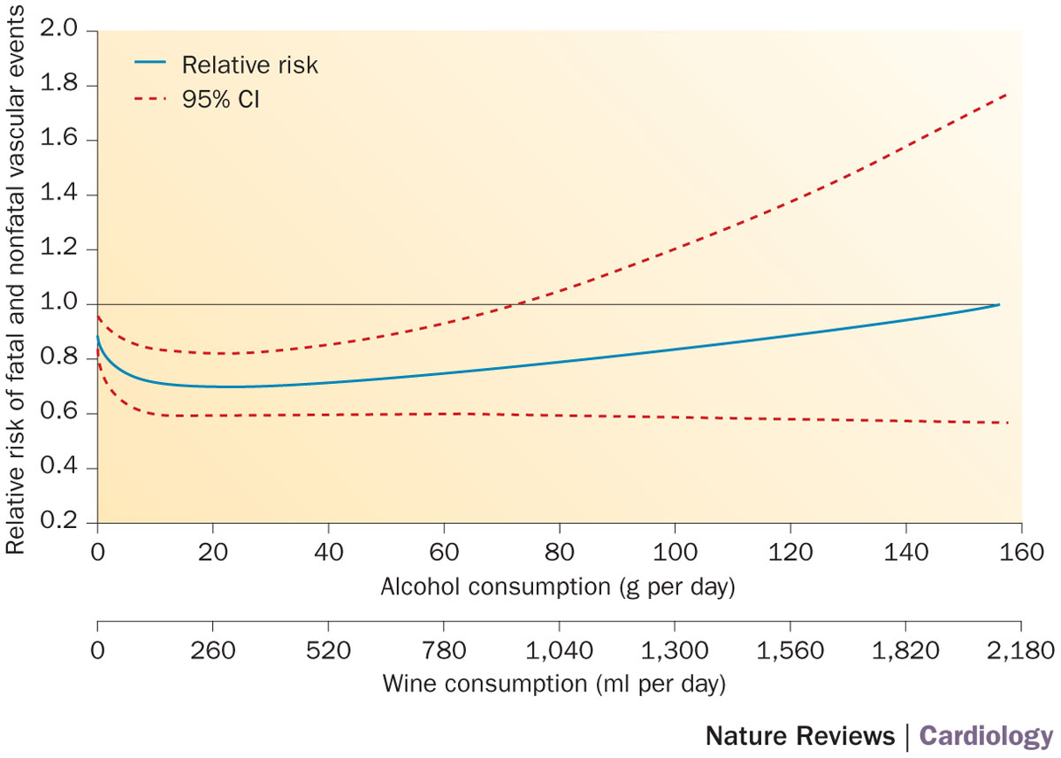
Pooled curves of relative risk of fatal and nonfatal vascular events and wine intake, extracted from 17 independent relationships using random models.: J shaped curve versus U-shaped curve
According to a dose–response analysis, the lowest risk of CHD mortality occurs with 0.5–2 drinks per day
Permission obtained from Springer Science+Business Media © Costanzo, S. et al. Wine, beer or spirit drinking in relation to fatal and non-fatal cardiovascular events: a meta-analysis. Eur. J. Epidemiol. 26, 833–850 (2011)
Fernández-Solà, J. (2015) Cardiovascular risks and benefits of moderate and heavy alcohol consumption
Nat. Rev. Cardiol. doi:10.1038/nrcardio.2015.91

Slide 23
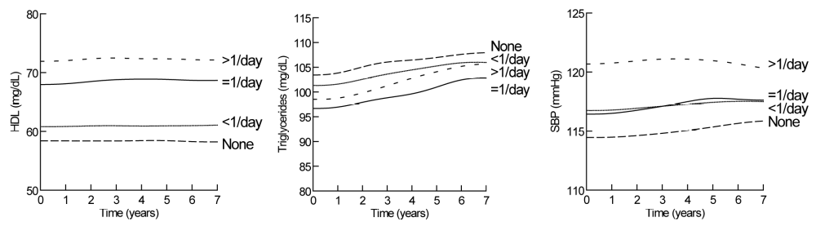
Components of Metabolic Syndrome by glasses of wine per day.
The strongest association between wine consumption and HDL cholesterol; the higher the wine consumption, the higher the HDL, with all pairwise comparisons being highly significant (p < 0.001).
Triglycerides were significantly lower for moderate wine consumers than abstinent women (p < 0.001).
Blood pressure was higher in women who consumed more than 1 glass of wine per day
Janssen I, et al. J Wine Res. 2011; 22(2): 113–117.

Slide 24
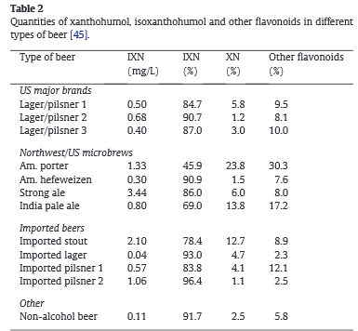
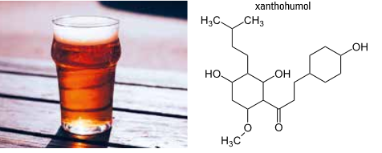
Bioactive Phenolics in Beer
Beer contains hops, which are used to add bitterness and flavor and are also important as a preservative/antimicrobial
Rossi T, et al. Pol Arch Med Wewn. 2014;124(12):713-22
The structural classes of polyphenols in beer include simple phenols, benzoic acid derivatives and cinnamic acid, coumarins, catechins, di- and tri-oligomeric proanthocyanidins, prenylated
chalcones and α- and iso-α acids derived from hops.
Żołnierczyk AK, et al. Fitoterapia. 2015 Jun;103:71-82.

Slide 25
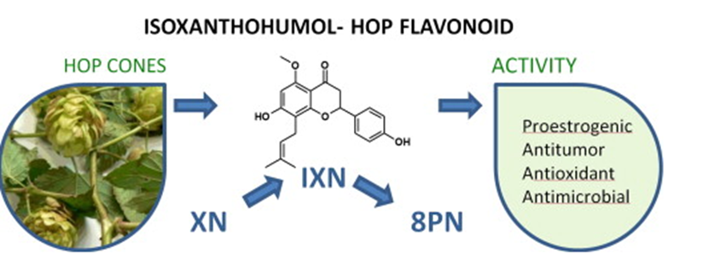
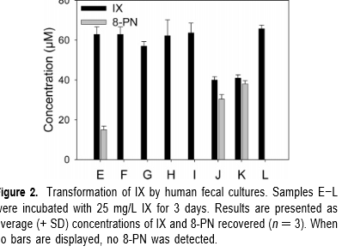
The value of hops is attributed to their characteristic secondary metabolites; these metabolites are precursors which are transformed during the brewing process
Żołnierczyk AK, et al. Fitoterapia. 2015 Jun;103:71-82
Activation of proestrogens from hops (Humulus lupulus L.) by intestinal microbiota; conversion of isoxanthohumol into 8-prenylnaringenin
Possemiers S, et al. J Agric Food Chem. 2005 Aug 10;53(16):6281-8.

Slide 26
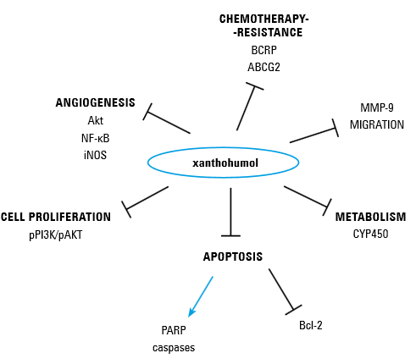
Cellular and molecular mechanisms involved in xanthohumol associated chemopreventive and angiopreventive activities
Rossi T, et al. Pol Arch Med Wewn. 2014;124(12):713-22

Slide 27
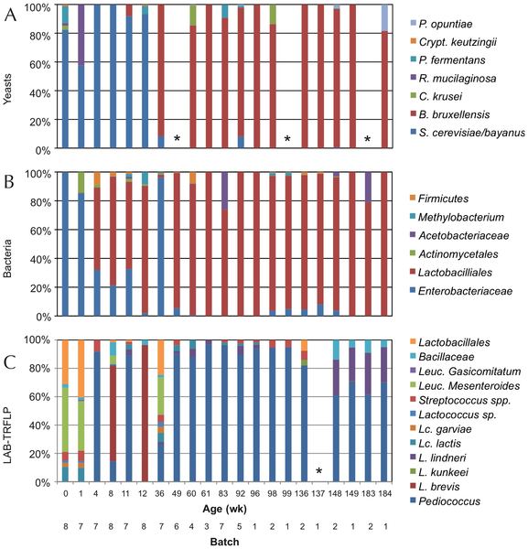

Brewhouse-Resident Microbiota Are Responsible for Multi-Stage Fermentation of American Coolship Ale
Microbial profile of spontaneous beer fermentations as a target for production control points and quality standards for these beers.
ACA fermentation involves a multiphase, core microbial profile, which is conserved batch-to-batch, supporting the presence of resident brewhouse microbiota responsible for conducting the fermentation.
Bokulich NA, Bamforth CW, Mills DA (2012) Brewhouse-Resident Microbiota Are Responsible for Multi-Stage Fermentation of American Coolship Ale. PLoS ONE 7(4): e35507. doi:10.1371/journal.pone.0035507
http://127.0.0.1:8081/plosone/article?id=info:doi/10.1371/journal.pone.0035507

Slide 28
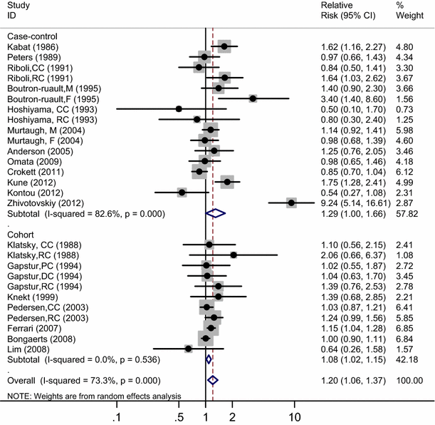
Meta-analysis results suggest that ≥2 drinks/day beer drinking may be associated with increased colorectal cancer risk.
Zhang C & Zhong M. Cancer Causes Control. 2015 Apr;26(4):549-60.

Slide 29
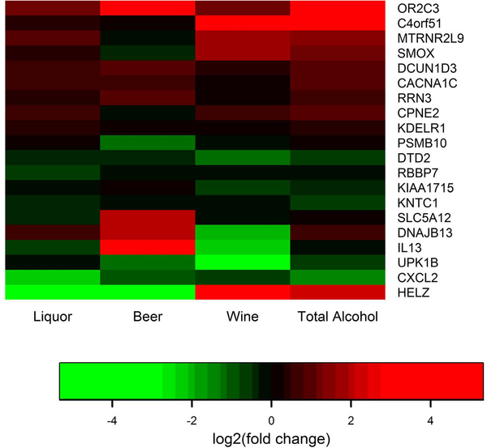
Differentially expressed genes by type of alcohol intake.
RNA-seq data from 144 colon cancer patients who had information on recent cigarette smoking, recent alcohol consumption, diet, and recent aspirin/non-steroidal anti-inflammatory use
Different differentially expressed genes were associated with type of alcohol intake; five genes were associated with total alcohol, six were associated with beer intake, six were associated with wine
intake, and four were associated with liquor consumption.
Slattery ML, Pellatt DF, Mullany LE, Wolff RK (2015) Differential Gene Expression in Colon Tissue Associated With Diet, Lifestyle, and Related Oxidative Stress. PLoS ONE 10(7): e0134406. doi:10.1371/journal.pone.0134406
http://127.0.0.1:8081/plosone/article?id=info:doi/10.1371/journal.pone.0134406

Slide 30
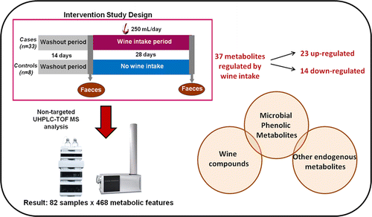
Fecal Metabolomic Fingerprint after Moderate Consumption of Red Wine by Healthy Subjects
37 metabolites related to wine intake, from which 20 could be tentatively or completely identified, including the following: (A) wine compounds, (B) microbial-derived metabolites of wine polyphenols, and (C) endogenous metabolites and/or others derived from other nutrient pathways.
After wine consumption, fecal metabolome was fortified in flavan-3-ols metabolites.
Down regulation of xanthine and bilirubin-derived metabolites such as urobilinogen and stercobilin after moderate wine consumption.
Jiménez-Girón A, at al. J Proteome Res. 2015 Feb 6;14(2):897-905

Slide 31
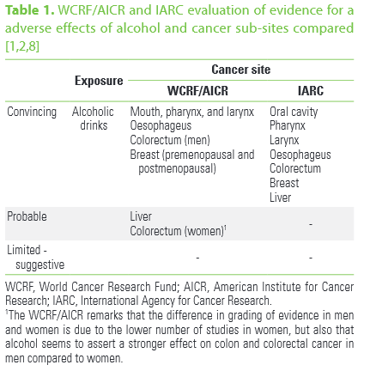
Alcohol as a risk factor for cancer
Roswall N & Weiderpass E. J Prev Med Public Health. 2015 Jan;48(1):1-9.

Slide 32
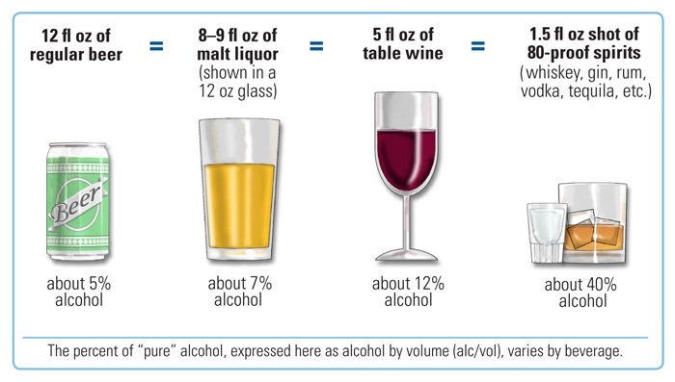
If alcohol is consumed, it should be consumed in moderation—up to one drink per day for women and two drinks per day for
men—and only by adults of legal drinking age.
http://health.gov/dietaryguidelines/dga2010/DietaryGuidelines2010.pdf
http://www.niaaa.nih.gov/alcohol-health/overview-alcohol-consumption/what-standard-drink

Slide 33
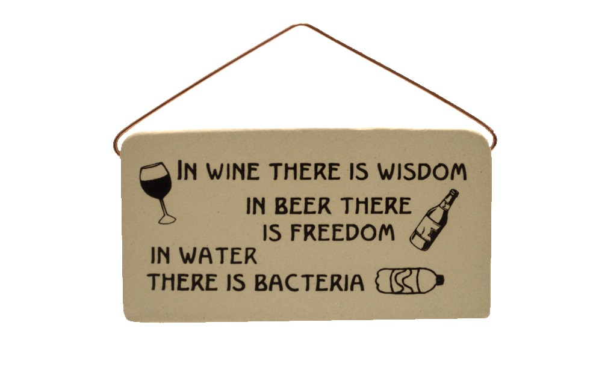
Benjamin Franklin? Olde German saying?
http://www.spiritedrepublic.org

Slide 35
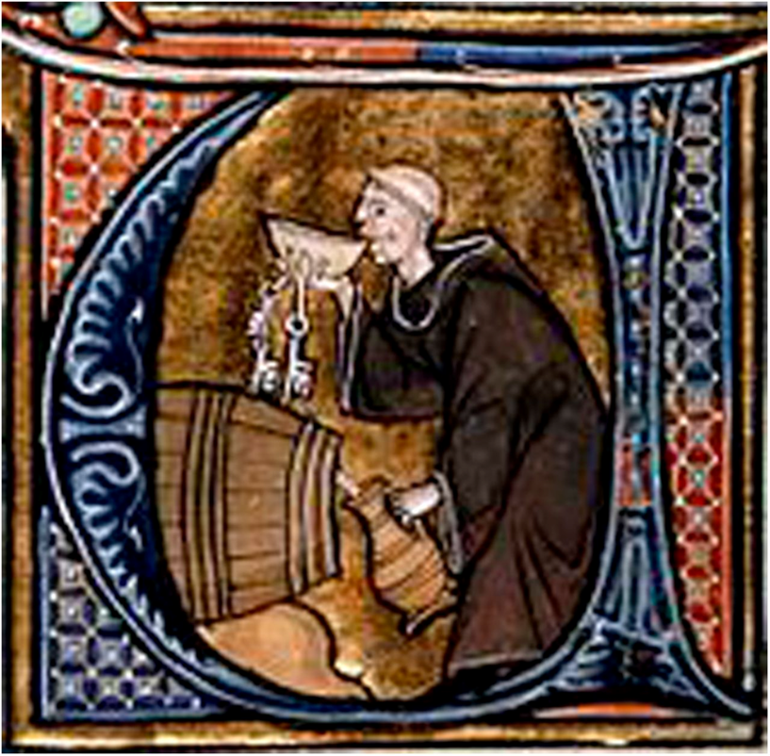
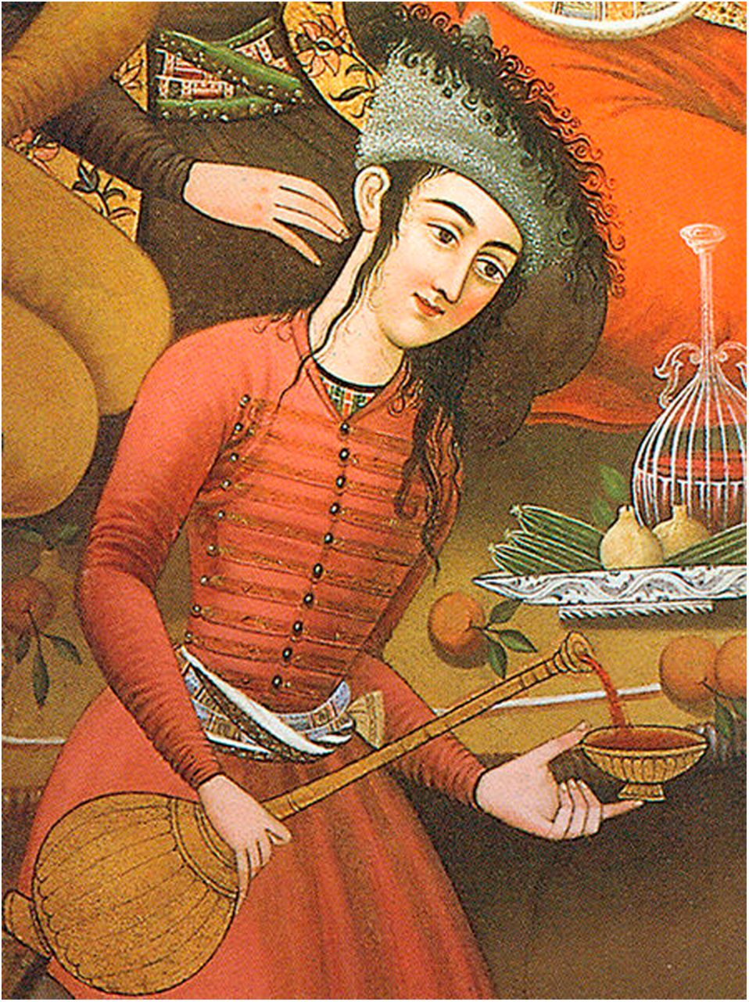

Conclusions
R. Paul Robertson Diabetes 2014;63:31-38
©2014 by American Diabetes Association
Notes:
A monk cellarer keeping track of the progress of his sacramental wine (probably white) in the Middle Ages (late 13th century, France). Source: From Li Livres dou Santé by Aldobrandino of Siena.
A Persian woman pouring a Persian red wine (mey) in the ancient world (17th century, Persia). From a wall painting inside the Chehel Sotoun palace, Isfahan, Iran. Photo by Zereshk.

Slide 36
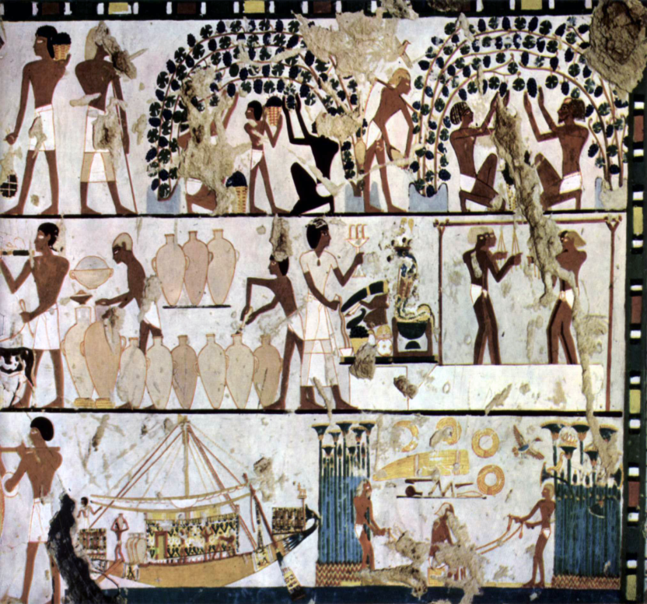
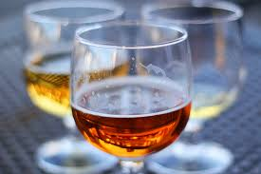
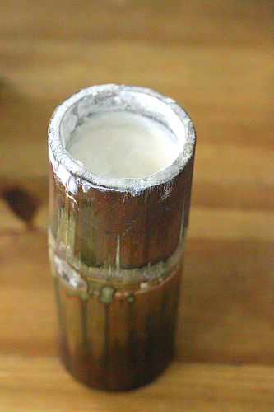

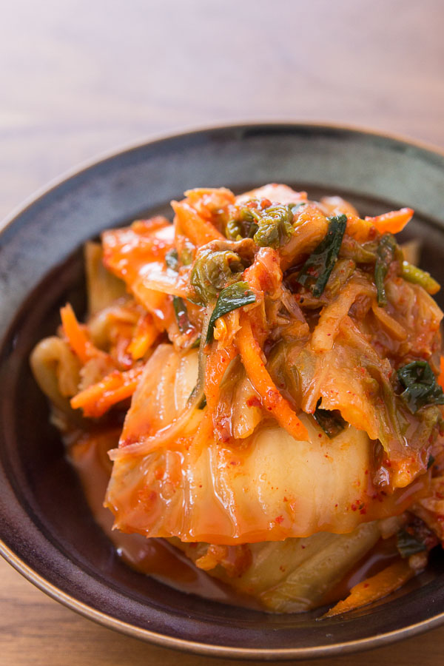
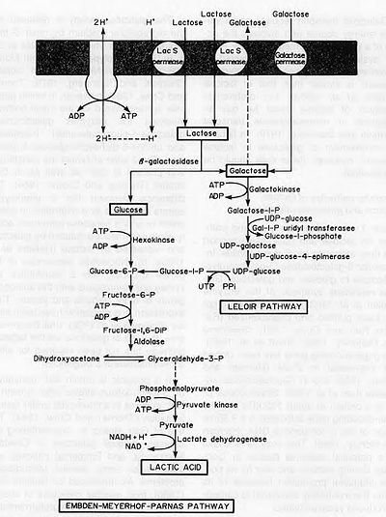
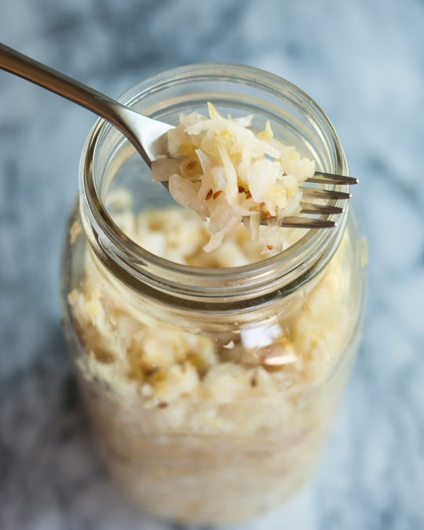

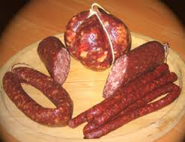

Slide 37

What fermented foods do we eat? legumes ▪ grains ▪ vegetables ▪ fruit ▪ milk ▪ fish ▪ meat
Western Europe & Russia
Sauerkraut
Sourdough breads
Salami
Cultured milk
North America
Sauerkraut
Relishes
Sourdough breads
Cultured milk
Mikyuk (Alaska)
Japan, Korea, China
Kimchi
Natto
Soy sauce
Fish
Fish sauces
Central &South America
Curdito
Chocolate
Africa & Mid-East
Grain gruels
Injera (Ethopia)
Kumi
Kefir
SE Asia
Paneer
Tempeh (Indonesia)
Idli (India)
Fish sauces
Courtesy Johanna W. Lampe, PhD, RD, Fred Hutchinson Cancer Research Center
Seattle, WA.
Steinkraus, KH (ed), Handbook of Indigenous Fermented Foods, 1983.
Notes:
In Germany some 85% of cabbage crop processed into sauerkraut, where as only 20% of US cabbage goes to kraut
gruels of maize, millet and sorghum
Not to mention tea, coffee, honey (mead)

Slide 38
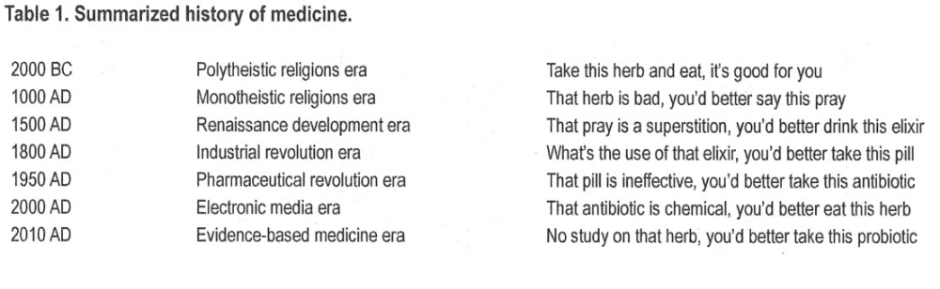
Ozen M & Dinleyici EC. Benef Microbes. 2015 Jan 1;6(2):159-65
Notes:
Probiotic, a word derived from Latin, means 'for life'. A long time before the awareness of probiotic microorganisms, fermented products, such as beer, bread, wine, kefir, kumis and cheese had been very frequently used for nutritional and therapeutic purposes. It is widely believed that fermented products were probably found, or better to say, discovered spontaneously. The legend tells that yoghurt is most likely resulted from a fermentation process within the animal skin bags used for transportation of water and milk in regions with low humidity and high temperatures (Middle Asia and Middle East). The history of probiotics goes paralel with the evolution of human race and, thanks to the sophisticated techniques at the moment, can be traced back to the ancient times, nearly 10,000 years ago. The aims of this review are to highlight the important events for probiotic history, to correct the widely available anonymous misinformation in the literature and to remind to the readers important characters in its history.

