Slide 1



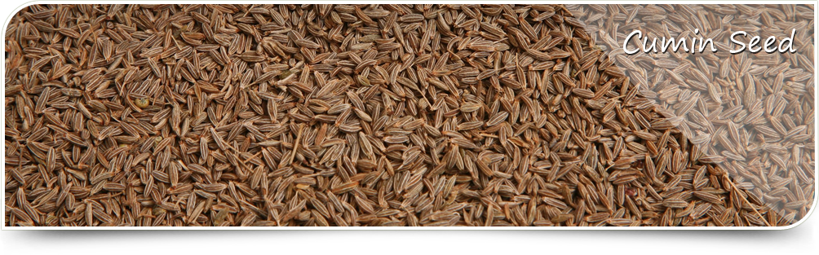
Molecular studies of Cumin (Cuminum cyminum L.), for diversity and modeling
National Research Centre on Seed Spices, Tabiji, Ajmer, Rajsthan-305206
Presented By:
Dr. Sharda Choudhary
Scientist

Slide 2
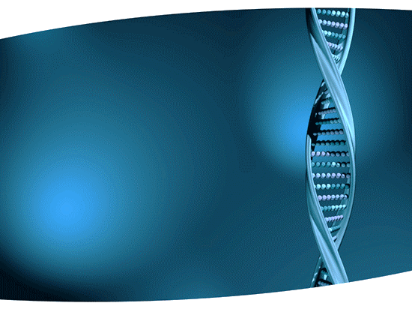
Introduction
Seed spice crops are the commercial crops grown by the poor farmers in the arid region of our country.
Seed Spices are annual herbs, whose dried seed or fruits are used as spices.
These are used for color, aroma, flavor, medicinal properties etc.
It is one of the oldest and economically most important seed spice with medicinal properties. Cumin is the most important and crucial, of all.

Slide 3
Cumin
Cumin (Cuminum cyminum L.) is a valuable seed spice belonging to the family Apiaceae.
It is a herbaceous, dicotyledonous annual plant, diploid (2n = 2x = 14) belongs to the family Apiaceae.
Cumin is locally known as “Zeera” in Hindi and is believed to be the native of the Mediterranean and near Eastern regions.
In India it is mainly cultivated in Rajasthan, Gujarat and in some parts of Madhya Pradesh, Uttar Pradesh and Tamil Nadu as a rabi crop.

Slide 4
Cumin seeds are preferred for their typical pleasant aroma due to an aromatic alcohol (animol) and spicy taste.
It is largely used in mixed spices and curry powders.
Inspite of its immense use as seed spice in our routine cooking, recent studies have indicated its pharmaceutical and medicinal importance.
Any new technique for the development of these crops will go a long way in improving the livelihood of the poor farmers and bring wealth to the country.

Slide 5
Molecular markers are the vital tool for genetic improvement of crops specially seed spices in which traditional breeding approaches are difficult to produce varieties resistant to various biotic and abiotic stresses.
Seed spices remain neglected for one or other reasons, hence limited work for variety development and quality improvement have been done.
Marker development for economically important characters is very important to apply biotechnological tools for improvement of seed spices crops.

Slide 6
Molecular Markers
Molecular markers (identified as genetic markers) are a fragment of DNA that is associated with a certain location within the genome.
Molecular markers are used in molecular biology and biotechnology to identify a particular sequence of DNA in a pool of unknown DNA.
Revealing variation at a DNA level
Characteristics:
  Co-dominant expression
  Nondestructive assay
  Complete penetrance
  Early onset of phenotypic expression
  High polymorphism
  Random distribution throughout the genome
  Assay can be automated

Slide 7
It has various applications in agriculture including Seed Spices:
Species Identification
Genetic variation and population structure study in natural populations
Comparison between wild and modified populations
Assessment of demographic bottleneck in natural population
Propagation assisted rehabilitation programmes. However, there still exists some limitations

Slide 8
Methodology

Slide 9
Materials And Methods
Plant Materials and DNA isolation
New protocol for DNA isolation
PCR program
Gel electrophoresis of the amplified products
Reproducibility of amplification patterns
Scoring and Data analysis

Slide 10
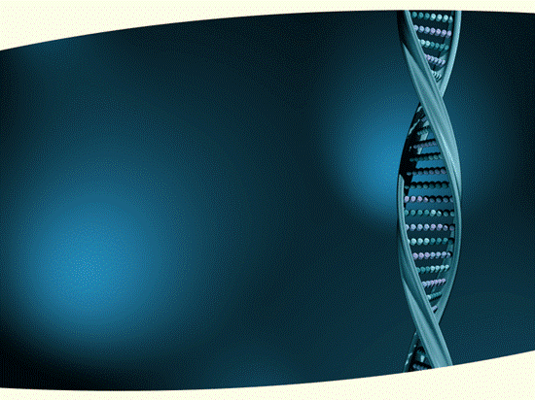
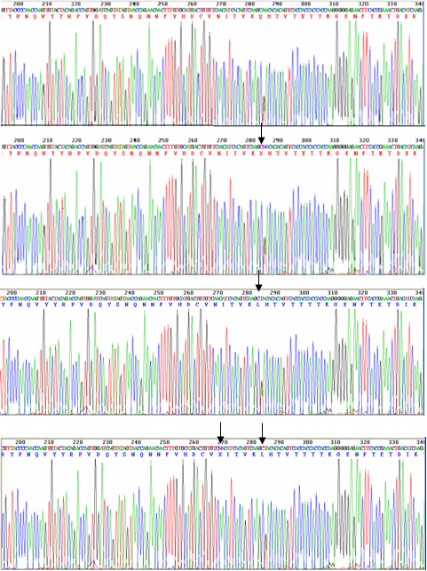
This graph was derived by CROMA software to derive the raw sequences.
Different colors in the graph shows 20 different amino acids.
The height of the peaks in the graph determine the amino acid to be selected
Chromatogram showing nucleotide sequences for cumin protein gq33

Slide 11
Physiochemical properties
The physiochemical properties for gq33 cumin protein were identified using Protparam.
Secondary Structure
For the prediction of secondary structure of protein FASTA sequence were used and prediction was performed using GOR IV, SOPMA, ProFunc and PDBSum.

Slide 12
Three Dimensional Structure
The modeling of the three dimensional structure of the protein was performed by ab-initio and threading Meta servers.
MEMSAT-SVM
MEMSAT-SVM was used to identify a channel in fenugreek

Slide 13
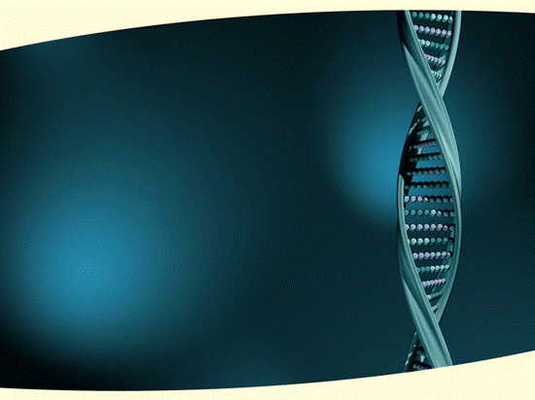
RESULTS
AND
DISCUSSION

Slide 14
In the present study, genetic similarity was assessed among fifty five cumin accessions, analysis of the data using 20 RAPD primers showed that 15 primers generated bright and reproducible amplified products which detected polymorphism among the accessions used.
Fifteen RAPD primers showed clear bands and polymorphism on profiling.
This indicates very low level (47%) of genetic diversity among genotypes.
Cluster analysis based on the resulting data was performed using UPGMA method and Dice's similarity coefficient by NTSYS software.

Slide 15
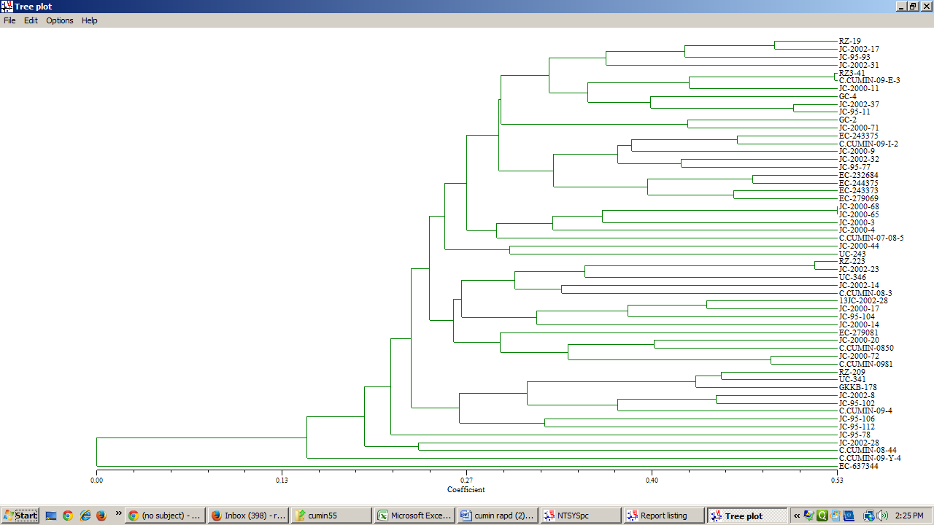
Dendogram showing Cluster analysis

Slide 16
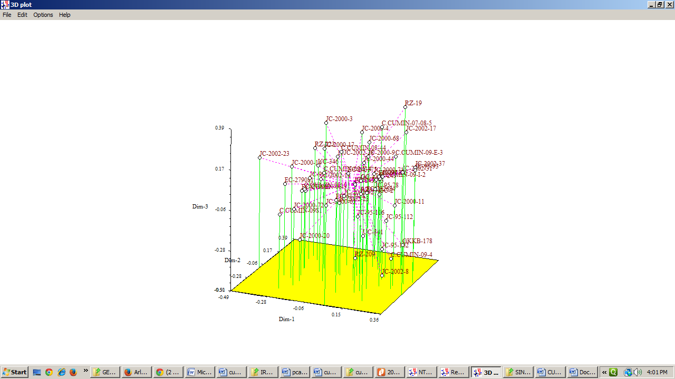
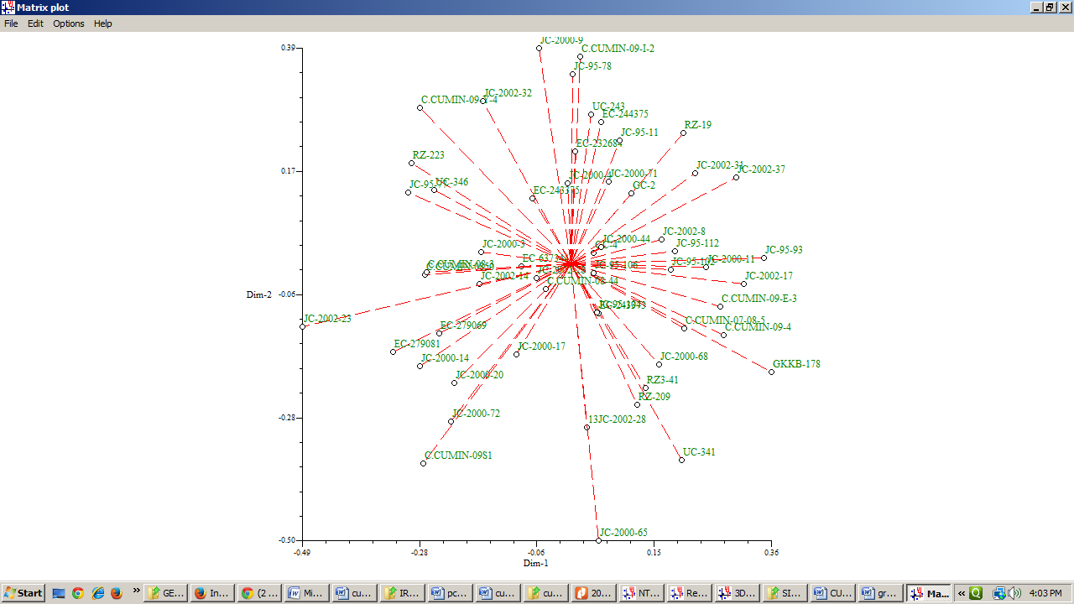
(a) 3D Plot (b) Line Graph, showing cluster analysis conducted by the software NTSYS-pc version 2.00

Slide 17
Thank You

