Slide 1
A Study On The Management Of Health Promoting Behavior Among Adolescents Through Adolescent Friendly Centre Services Approach In A Selected Private School
Mrs. Shanthi Ramasubramaniam
Msc,R.N.R.M, PGDET, PhD.
Clinical Instructor , University of Buraimi, Sultanate of Oman

Slide 2
INTRODUCTION
Promoting health through schools is a ‘life-course’ approach to promote healthy behavior among children.
Many of today’s and tomorrow’s leading causes of death, disease and disability can be significantly reduced by preventing behavior that is initiated during youth, through health education, understanding and motivation; and fostered by social and political policies and conditions.
Almost all children attend school and spend 6-7 hours of their time every day in that learning environment. Incorporating health into the school curriculum can have substantial influence on health promoting behaviors (HRIDAY PHFI report 2010).

Slide 3
Aim of the study:
The researcher wanted to examine the health promoting behavior among adolescents through the adolescent friendly center services initiated at school campus.
As this study was the first of its kind in school campus,the reseachers also wanted to investigate the receptiveness and perception of adolescent friendly services by parents, teachers and adolescents.

Slide 4
CONCEPTUALISATION OF RESEARCH PROBLEM:
Adolescents are recognized as a distinct group deserving programme and policy attention by the 10th five year plan in India. According to the national population policy 2000 adolescents are identified as the underserved population. The national youth policy 2003 identifies the age group 13-19 as distinct group to be provided with services from various sectors.
The IAP vision 2007 emphasizes that we need to increase the awareness amongst them about their needs and problems regarding health, psychology and knowledge. The programme of adolescent friendly school initiative has 2 components. One of the components addresses that, the knowledge regarding health and psychology to be imparted to adolescents in their schools. Hence the idea of initiating adolescent friendly services in a selected school was taken up in this study.

Slide 5
Methodology
Through the process of Triangulation the research design was formulated and applied to suit the concept of the study.

Slide 6
Setting, Population and Sampling:
The setting was a private school in a semi urban area of Coimbatore city.
The researcher included samples/students among the 9th, and 11th standard students. A total of 258 adolescents consisting of 101 boys and 158 girls, 160 parents and 21 teachers.
Figure -1 sample characteristics

Slide 7
Methods:
The data collection was done in three phases.
Phase-1 –interventions
Assessment of receptiveness and perception of adolescent friendly services by parents , teachers and adolescents was done using a likert scale.
Health promoting behavior of adolescents were assessed using MSLSS scale.
Medical screening
Structured health education on adolescent issues .
Pamphlets and sample menu plan were distributed to adolescents.
Exercises were demonstrated and made the adolescents to perform twice a week.

Slide 8
Data collection method: (cont)
Phase-2 –interventions:
After 1 month a guidance and counseling session was arranged.
One day workshop on “life skill training” was arranged in the school campus with advice on career choices.
Follow up of students who had health deviations.
Phase-3 –interventions:
After 45 days in the third phase the effectiveness of adolescent friendly services were assessed.
A post test was conducted to assess the knowledge gained after education.
The health promoting behavior was assessed using MSLSS scale.
Receptiveness and receptiveness of parents, teachers and adolescents were carried out.

Slide 9
Major findings of the study:
Baseline characteristics of students
The mean age of adolescents is 14.5years. Majority of the students (61%) are girls and 39% are boys.
Unfortunately a significant proportion of the adolescent girls 30.37% and 39.60% of the boys are found to be underweight, below the 5th percentile. Minimal percentage of the boys and girls are obese.
The menstrual history of adolescent girls shows that nearly 10% of the girls reported irregular menstruation and 15% of girls presented premenstrual symptoms and 3.2% of girls reported problems during menstruation.
2.2 % of adolescent girls and 1.8% boys had mild anemia .

Slide 10
Baseline characteristics of students
The main leisure time activity of adolescents is watching television.
Majority of adolescent boys (48) and girls (78) have not taken leave to school. The reason for being absent to school varied according to the situation, like social function, menstrual time , other sickness.
Majority of girls (62) and boys (42) skip breakfast. More girls skip meals which is not advisable.
The majority of the girls (112) engage only in school sports activities. While among boys 40% of them involve in school sports and equal amount of boys also involve in daily exercising ,like karate, gym etc.

Slide 11
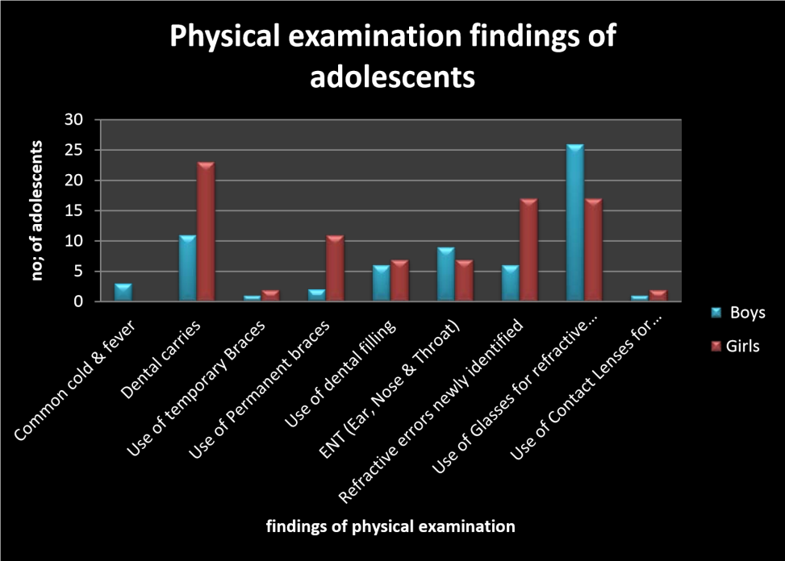
Figure -2. Findings of physical examination of adolescents.

Slide 12
Dental carries was the most common finding among boys (10.89%) and girls (14.55%).
Newly identified refractive errors were found to be 5.9% in boys and 10.75% among girls, 25.74% among boys and lesser in girls 10.75%.
Only 3 students were found to have skin problems.(tinea versicolor infection.)

Slide 13
MAIN FINDINGS OF THE STUDY
Majority (51.7%) of adolescents perception is that the parent is the suitable person to provide guidance and counseling to them.
Parents (76.3%) perceive the Principal/teacher as the best person to provide guidance and counseling to adolescents, while the teachers (71.4%) feel that health care person is the suitable person to provide guidance and counseling to adolescents.
All 3 categories of respondents(79% of teachers, 82% of adolescents and 69% of parents felt that school is the suitable place to provide adolescent friendly services and the services were helpful.

Slide 14
A greater number of parents, teachers and adolescents reported that the adolescent friendly service at the school premises created awareness among them.
On the whole there was a positive perception among parents, teachers and adolescents regarding the services and were very receptive.

Slide 15
The results of the study reveals that the two components of the MSLSS scale, “school and self” had a significant (at 0.01 levels) difference in the mean scores of the boys, obtained before and after the initiation of the Adolescent Friendly Center Service at school.
The results of the study reveal that the component of the MSLSS scale “self “had a significant (at 0.01 levels) difference in the mean scores of the girls, obtained before and after the initiation of the Adolescent Friendly Center Service at school.

Slide 16
The results of the study reveal that the knowledge score (on various adolescent health issues) in each individual component had a significant difference in the mean scores of the adolescents, obtained before and after the initiation of the Adolescent Friendly Center Service at school.

Slide 17
Table 2: ANALYSIS ON THE OVERALL KNOWLEDGE SCORES OF ADOLESCENTS BEFORE AND AFTER INTERVENTION
Assessment | Mean | Standard devaition | Standard error | Paired differences |  | Standard error mean | 95% confidence interval of the difference |  | “t” | Sig. 2 tailed
 |  |  |  | mean | Standard deviation
 |  |  |  |  |  |  | lower | upper
before | 4.7625 | 3.40321 | 0.21065
 |  |  |  | 3.32950 | 2.43021 | 0.15043 | 3.62572 | 3.03328 | 22.133* | 0.001
after | 8.0920 | 3.69708 | 0.22884

Slide 18
Feedback on Adolescent friendly center services by parents and teachers
Table 3. Positive feedback on adolescent friendly services by parents and teachers
Sl.No | Positive Feedback of adolescent friendly services | teachers % (n=21) | parents% (n=160 )
1. | Physical & Reproductive health benefits (medical checkup and education on adolescent issues) | 62% | 79%
2. | Guidance & Counseling (life skill training workshop) | 82% | 69%
3. | Created awareness | 46% | 72%
4. | Academic help, like tutorials and study techniques | 65% | 82%

Slide 19
FEEDBACK ON ADOLESCENT FRIENDLY SERVICES BY ADOLESCENTS:
Majority of adolescent boys (80.19%) and girls (87.34%) felt that information on reproductive health and physical health screening was very helpful to them.
75.24% of adolescent boys and 53.64% of girls felt the guidance and counseling services were beneficial. 55.44% of adolescent boys and 51.89% of girls felt that adolescent friendly services created self awareness among them.
Academic help including study skill checklist helped them to find out their study problems and techniques to improve studies were found to be beneficial for 60.39% of adolescent boys and 70.25% of girls.

Slide 20
Implications for future practice:
This study findings provide important guidance for parents, teachers, school authorities and local community that adolescents wish to have adolescent friendly services through school based approach.
These findings also suggest adolescent views, expectations and fears should be assessed in consultation to appropriately to respond to them.
Develop interventions to incorporate involvement of parents and teachers to be educated and be able to change their perceptions and attitude about adolescent health involving reproductive child health and show willingness to dialogue with their children.

Slide 21
Conclusion
Of late adolescent health has been included as a component of the reproductive health package in the RCH services program. However, there is no clear definition of strategic approach and activities to provide adolescent health care (ARH India report 2003).
The study brings to attention the need for professional help related to awareness of adolescent friendly services and ways to solve issues regarding adolescent health. The findings also call for integration of health promotion in schools using adolescent friendly approach involving parents, teachers and community.

Slide 22
Selected Bibliography:
Huebner, E. S. (2001). Manual for the Multidimensional Students' life Satisfaction Scale. Columbia: University of South Carolina. Document Number)
Mehta R. (2003) Establishing adolescent health services in a general health facility. In: Bott S, Jejeebhoy S J, Shah I, Puri C, editors. Towards adulthood: Exploring the sexual and Reproductive health of adolescents in South Asia. Geneva: WHO; . 213-5.
Nath A, Garg S. (2008) “Adolescent friendly health services in India: A need of the hour,” Indian Journal of Medical Sciences.;62(11) 465-72.
Reports : WHO’s Global School Health Initiative Available from URL http://www.who.int/school_youth_health/gshi/en/. Accessed on 30th April 2013
World Health (2003) Youth And Health Issues. Chapter IV- World youth Report. WHO (2008.) The millennium development Goals report

Slide 23
THANK YOU

