Slide 1
Semecarpus anacardium Linn. nut milk extract – A
Siddha medicine with potent therapeutic effect in
experimental mammary carcinoma
DR. P. SHANTHI MBBS, MD, Ph.D.,
Director , Professor & Head
Department of Pathology
DR.A.L.M Post-Graduate Institute of Basic Medical Sciences
University of Madras
Taramani campus, Chennai
Tamil Nadu
INDIA
ALLPPT.com _ Free PowerPoint Templates, Diagrams and Charts

Slide 2
ACKNOWLEDGEMENT
My grateful thanks to
Prof. T.P. Sachidanandam, PhD, D.Sc, Emeritus Professor.,
Department of Pathology and
Professor (Rtd), Dept. of Medical Biochemistry,
DR.A.L.M P-G IBMS
University of Madras
Taramani campus, Chennai
Tamil Nadu
INDIA

Slide 3


Slide 4
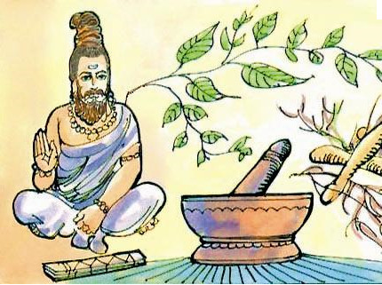
Siddha system of medicine
One of the oldest system of traditional medicine -
originated 5000 BC - Southern part of India.
Evolved with Dravidian culture - Dravidian system
of medicine.
Major contribution from 18 Siddhars or spiritual scientists.
Siddhars were sages – tremendous powers by way of
meditation, Yoga practice and rejuvenation.
Aim – to make the body perfect, imperishable and to promote
longevity-emphasis on prevention.
Drugs categorized into 3 groups: herbal products, minerals, animal
products (also physiotherapy and varma, similar to acupressure).

Slide 5
Siddha literature
Initially bequeathed to select disciples or “sidas" by word of mouth.
Oral tradition was transcribed on palm leaf manuscripts that now
serve as the major repository of the knowledge.
Steps are being taken by the government for collecting, screening,
analyzing and codifying the available manuscripts, printed books,
traditional recipes, etc.
Siddha medicine now incorporated into “AYUSH”.

Slide 6
Semecarpus anacardium Linn.
Found in Sub-Himalayan regions from Sutlej to Sikkim, tropical and
Central parts of India and Western Peninsula of East Archipelago,
Northern Australia
Called the ‘marking nut’ by Europeans, because it was used by
washermen as an indelible ink to mark clothes before washing.
‘Oriental cashew’.
‘Ballataka’, ‘Bhilawa’ are vernacular names of marking nut.

Slide 7
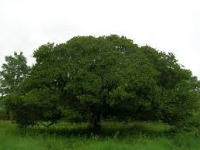
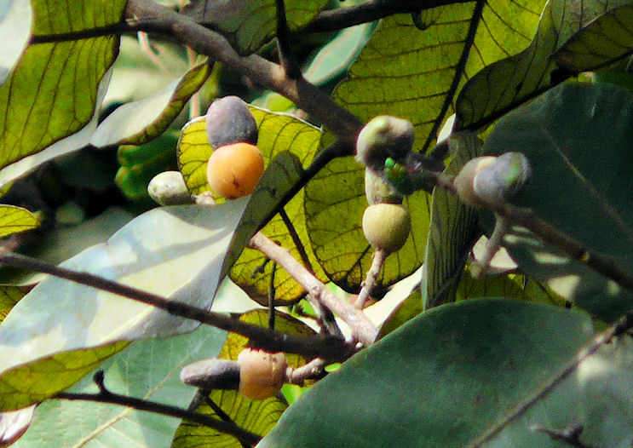
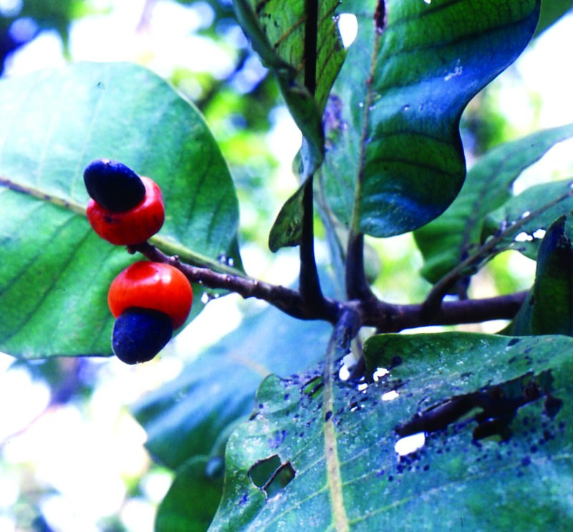
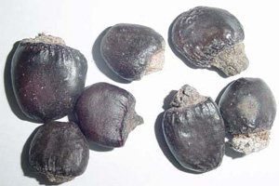
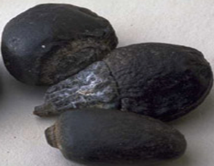
Semecarpus anacardium Linn.

Slide 8
SA-therapeutic effects
  Semecarpus anacardium Linn. (Family: Anacardiaceae) is a plant well-known for its medicinal value in Ayurveda, Siddha and even Homeopathy.
  In Ayurveda, the fruit is considered a rasayana for longevity and rejuvenation.
  Incorporated in prescriptions for
    Fevers, skin diseases such as vitiligo
    Excessive menstruation, vaginal discharge
    Malignant growth, haemoptysis
    Deficient lactation
    Constipation, intestinal parasites
    Cardiac disorders and asthma
    Peripheral neuritis, sciatica, facial paralysis and hemiplegia also used in traditional medicine as a neurotonic

Slide 9
SA therapeutic effects
Nuts and fruits can be used only after curing under medical
supervision as they are toxic.
These purification methods are known as “Shodhana” process in
traditional language.

Slide 10
SA- therapeutic effects
Extensive scientific investigation of the properties as well as scientific validation of the use of the extract of this fruit has been carried out by various investigators in different parts of the world.

Slide 11
Semecarpus anacardium Linn. Nut milk extract
Semecarpus anacardium Linn. nut milk extract (SAE) – a decoction
of SA in milk and ghee/clarified butter-Siddha drug (Formulary of
Siddha Medicine, 1972, IMCOPS).
Treatment of malignant tumors such as breast cancer, hepatocellular
carcinoma and BCR-ABL+ leukemia in experimental animals and
cell lines.
Adjuvant induced arthritis in rats.
Ongoing studies in our laboratory are aimed at investigating the
effects of SAE on streptozotocin induced diabetes mellitus and
atherosclerosis in rats.

Slide 12
Mammary Carcinoma
    The most common cancer among women –second leading cause of
    cancer death (after lung cancer) in women (US Cancer Statistics).
    Breast cancer is now the most common cancer in most cities in India,
    and 2nd most common in the rural areas.(National Cancer Registry
    Programme).
    It accounts for about one fourth of all cancers in Indian women and
    about half of all cancer related deaths {PBCR (Population Based
    Cancer Registry) website)}.

Slide 13
SAE
15-20 years
Phytochemical analysis.
Antioxidant and antimutagenic properties using cell free systems.
in vitro studies in mammary carcinoma-cell lines.
in vivo studies in experimental mammary carcinoma.
Toxicological studies in vivo and in vitro using human PBL.

Slide 14
SA-Phytochemistry
Protein (g) | 26.40
Fat (g) | 36.40
Minerals (g) | 3.60
Fiber (g) | 104.00
Carbohydrate (g) | 28.40
Energy (Kcal) | 58.70
Calcium (mg) | 29.50
Phosphorus (mg) | 836.00
Iron (mg) | 6.10
Carotene (mg) | 0.00
Thiamine (mg) | 0.38
Riboflavin (mg) | 0.15
Niacin (mg) | 2.70
Rich in flavonoids:
Semecarpuflavanone
Jeediflavanone
Galluflavanone
Nallaflavanone
Semecarpetin
Anacarduflavanone

Slide 15
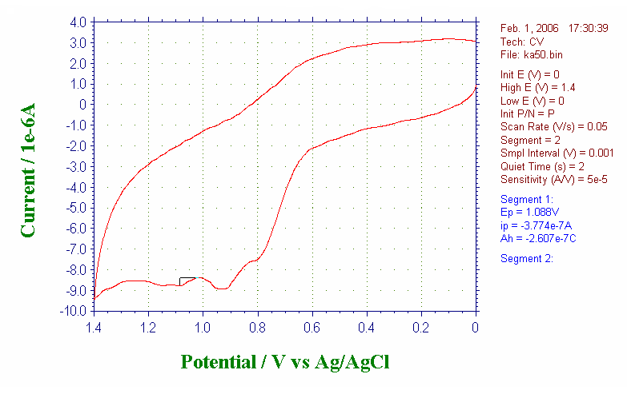
Assessment of Antioxidant activity of SAE - cell free systems
reducing power - Fe³⁺–Fe²⁺ transformation.
Cyclic voltammetry-antioxidant property
Reducing power by cyclic voltammetry

Slide 16
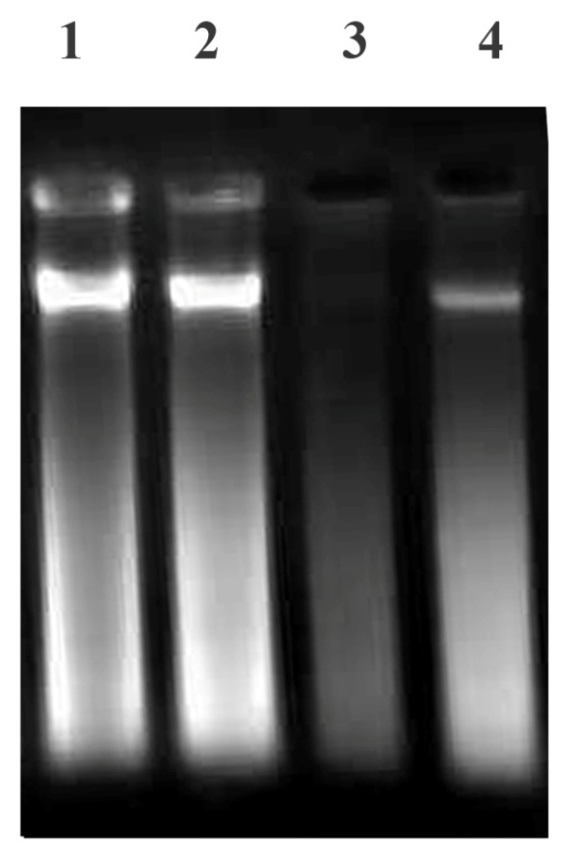
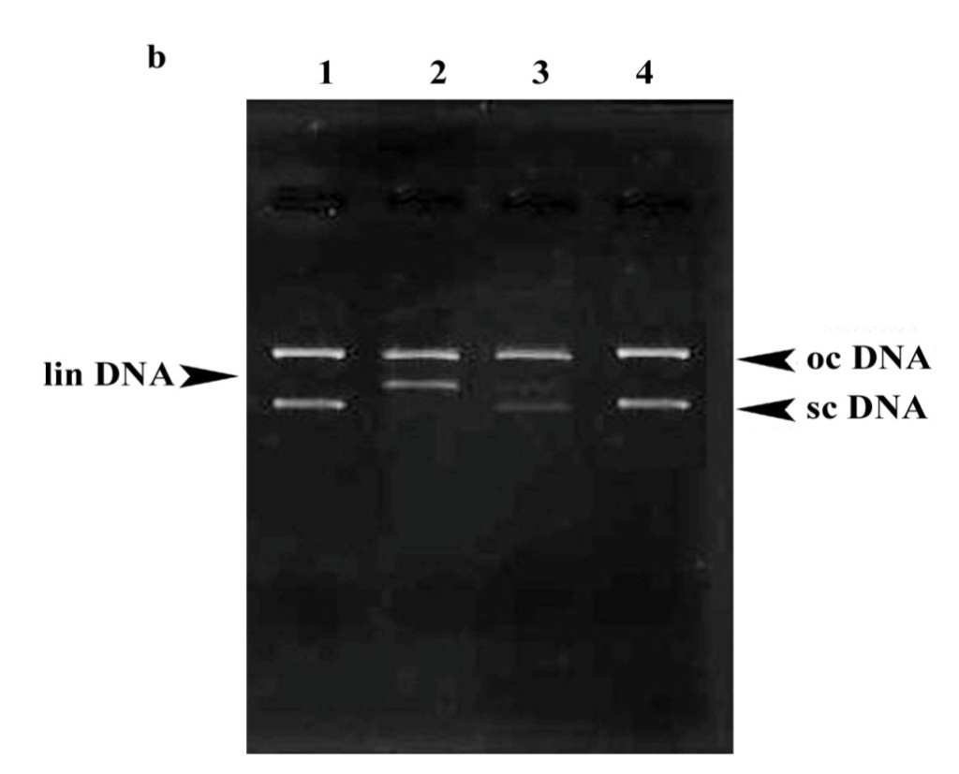
Antimutagenic effect of SAE
Lane 1 : Calf thymus DNA alone
Lane 2 : Calf thymus DNA with SAE
Lane 3 : Calf thymus DNA induced with
Fenton reagent
Lane 4 : Calf thymus DNA with SAE
induced with Fenton reagent
Lane 1 : pBR322 plasmid DNA
Lane 2 : pBR322 plasmid DNA with H₂O₂ exposed
to UV irradiation
Lane 3 : pBR322 plasmid DNA with SAE and
H₂O₂ exposed to UV irradiation
Lane 4 : pBR322 plasmid DNA with SAE alone

Slide 17
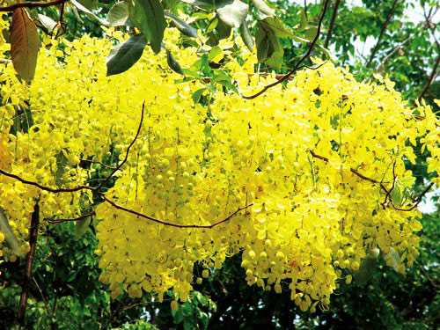
Toxicological studies

Slide 18
SAE–Effect on normal human PBL
Effect of SA on decreased cell viability induced by Fe²⁺and H₂O₂
Effect of SA on DNA damage induced by
Fe²⁺and H₂O₂
Effect of SA on ROS induced by Fe²⁺and H₂O₂

Slide 19
SAE –toxicological studies
No toxicity - in in vivo studies on BALB/c mice, Sprague-Dawley rats or Wistar albino rats - histopathological and biochemical parameters.

Slide 20
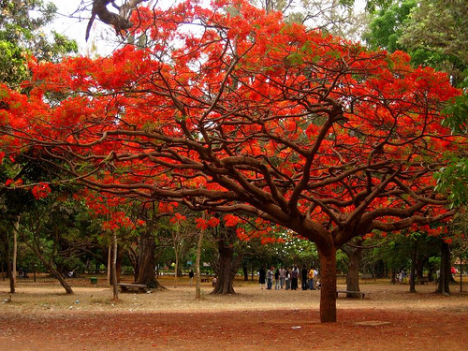
in vitro CELL LINE STUDIES

Slide 21
SAE - MCF-7 human breast cancer cell line
Experimental set up: in vitro studies
The cultured human breast cancer cells (MCF-7) were divided in to three groups.
Group I - Control (MCF-7)
Group II - DMSO control (0.02%)
Group III - Drug treated (45 μg/ml)
Studies were also carried out using T47D and MDA MB 231 (highly metastatic) breast cancer cell lines

Slide 22
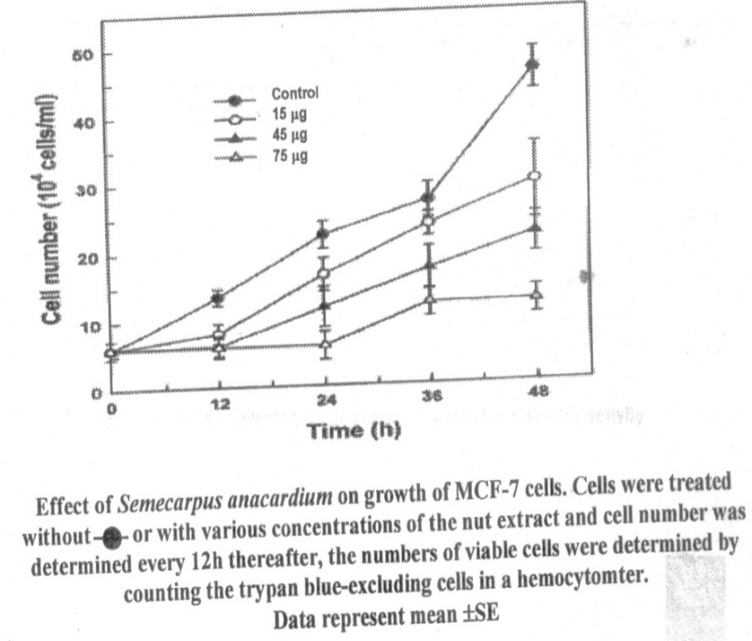
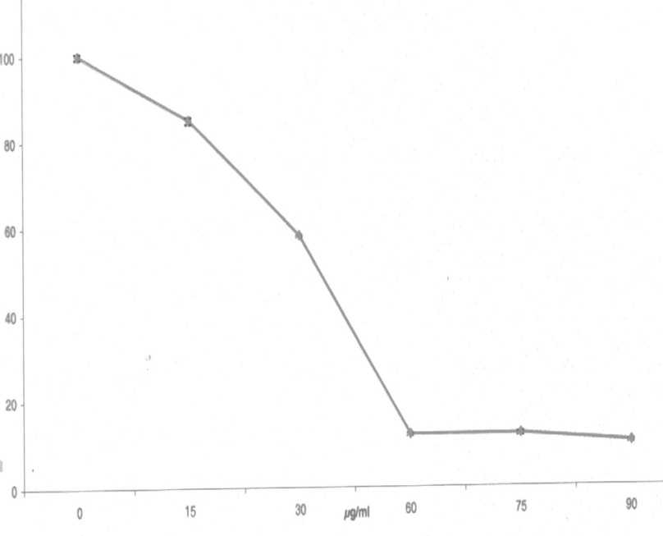
Effect of SAE on MCF-7 breast cancer cell line
Cell viability
Thymidine incorporation
LDH assay
MTT assay

Slide 23
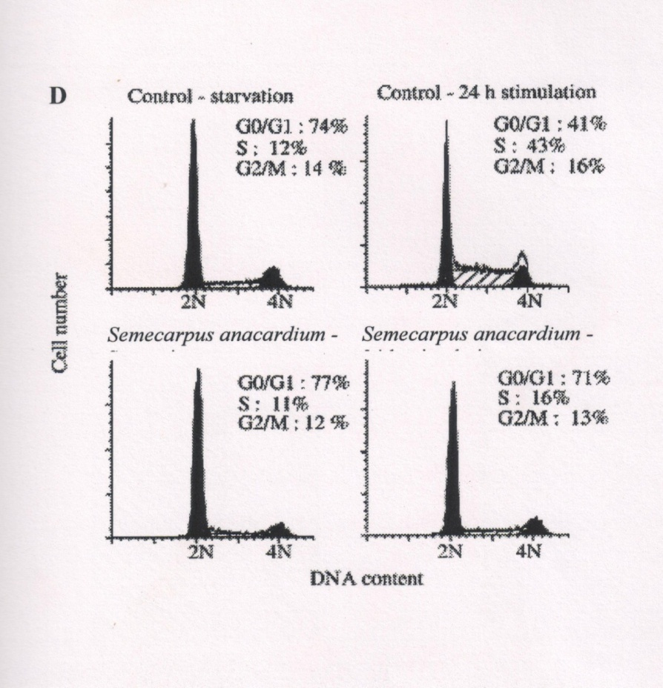
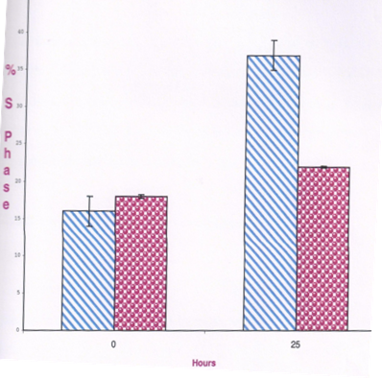
Mammary carcinoma &
Semecarpus anacardium
Cell cycle analysis
Exponentially growing MCF 7 cells were synchronized to G1 phase by serum deprivation (0.5%) in the presence and absence of the drug.

Slide 24
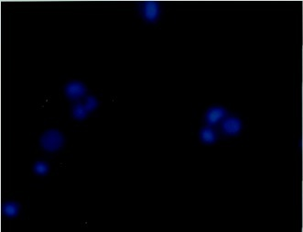
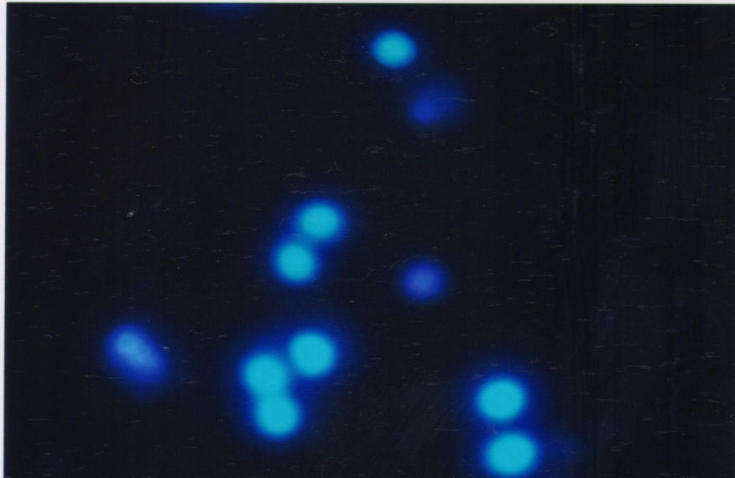
SAE-Effect on MCF-7 cell line
Apoptotic changes in breast cancer tissue treated with DMSO (0.2%)
Apoptotic changes in breast cancer tissue treated with SA (75 μg)

Slide 25
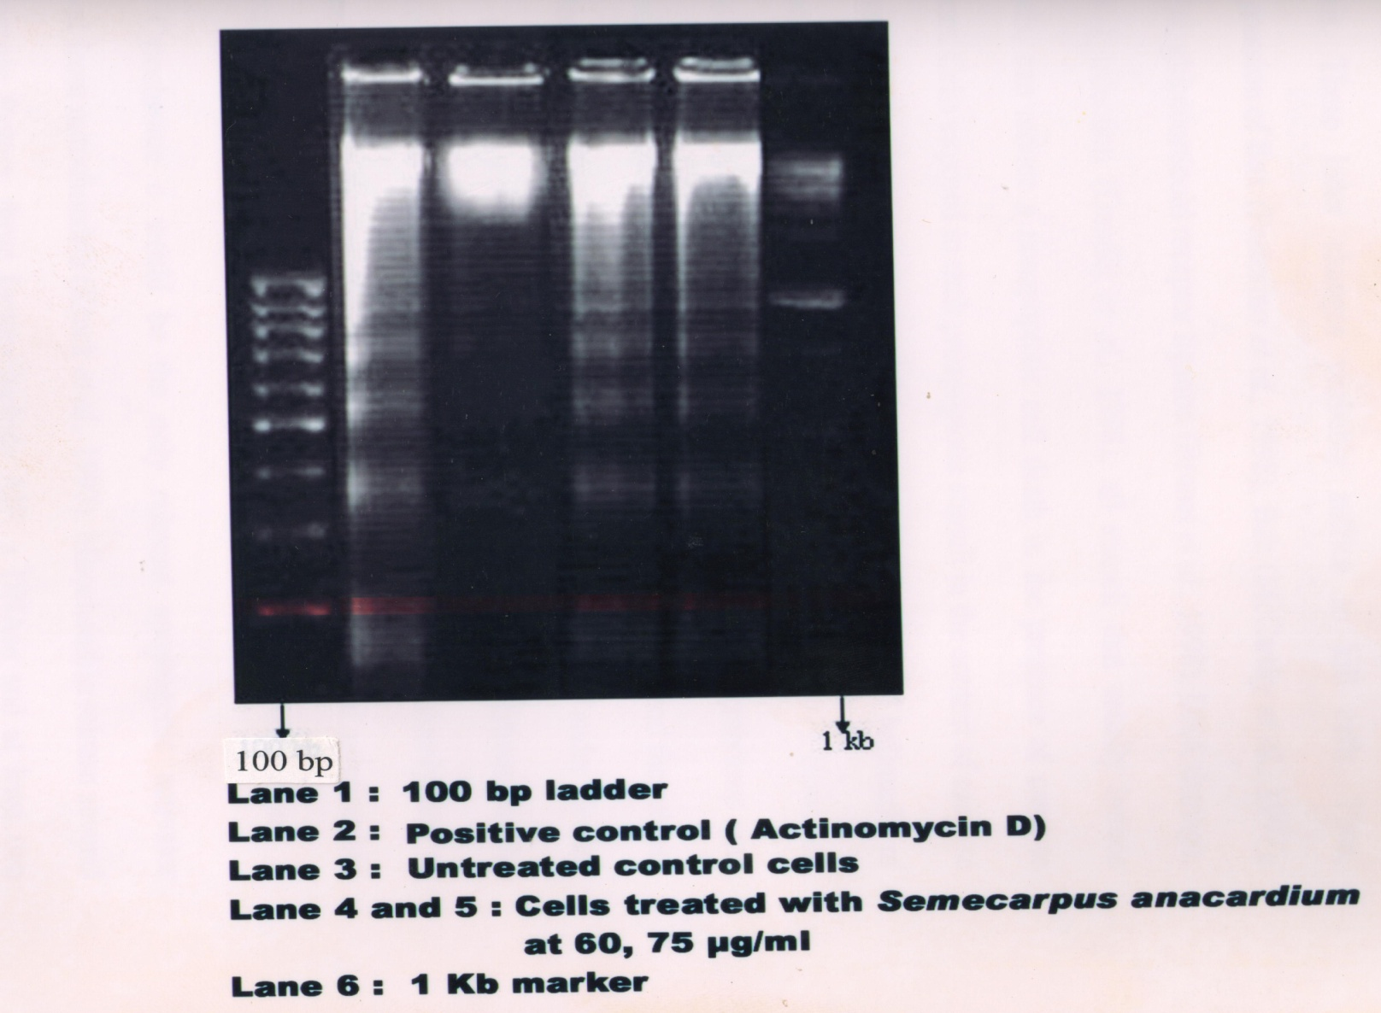
DNA fragmentation

Slide 26
MCF-7 : Effect of SAE
RT-PCR and Western blot was carried out for the following genes:
Bcl-2
Bax
Cytochrome c
Caspase - 3
Caspase - 9
SAE induces apoptosis in MCF-7 cells

Slide 27
Possible action of SA
in vitro studies have shown that SAE exhibits
antiproliferative activity, pro-oxidant activity and also
induces apoptosis in MCF-7 cells.

Slide 28
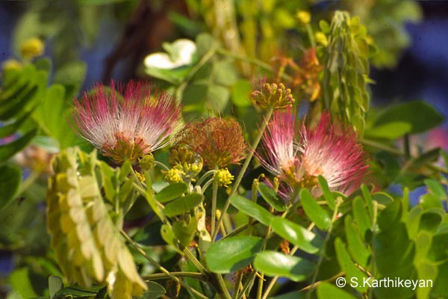
in vivo studies

Slide 29
Therapeutic effect of SAE in mammary carcinoma –in vivo
Experimental set up:
Female Sprague Dawley rats weighing (180 ± 10 g) divided into five groups of six animals each.
Group I : Normal healthy controls .
Group II : Mammary carcinoma induced with 7,12- dimethylbenz(a)anthracene (25mg) dissolved in 1ml of olive oil through gastric intubation.
Group III : Mammary carcinoma induced after three months, treatment was started orally with SAE (200mg/kg body weight) in olive oil for14 days daily.
Group IV : SA treated control –SAE alone.
Sujatha and Sachdanandam, 2002

Slide 30
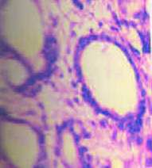
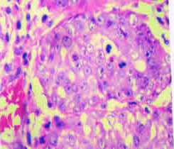
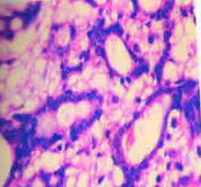
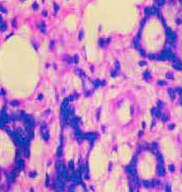
Mammary Carcinoma & SAE
Morphological alterations in breast tissue of control and experimental animals
GROUP I
GROUP II
GROUPIII
GROUP IV
Pharm Pharmacol Commun 6:375-379,2000

Slide 31
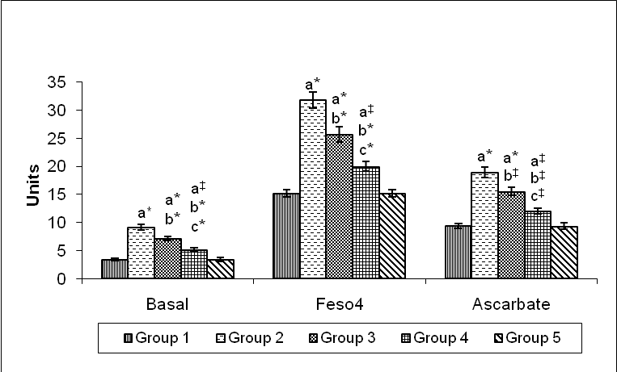
SAE-effect on Lipid peroxides & Antioxidants
Lipid peroxides
Parameters | Group I (Control) | Group II (DMBA) | Group III (DMBA + SA) | Group IV (SA)
SOD | 11.08 ± 1.09 | 6.22 ± 0.56^{a*} | 9.02 ±1.04^{a*b*cNS} | 11.01 ± 1.00
CAT | 120.17 ± 11.22 | 64.76 ± 6.75^{a*} | 102.42 ±10.48^{a‡b*c‡} | 126.56 ± 13.09
GPx | 27.61 ± 2.63 | 13.82 ± 1.37^{a*} | 22.75 ± 2.24^{a‡b*c‡} | 28.02 ± 2.86
Vit C | 1.98 ± 0.25 | 1.17 ± 0.13^{a*} | 1.74 ± 0.24^{a‡b*c†} | 2.01 ± 0.28
Vit E | 3.50 ± 0.35 | 1.17 ± 0.12^{a*} | 3.07 ± 0.32^{a†b*cNS} | 3.52 ± 0.46
GSH | 14.37 ± 1.57 | 8.04 ± 0.78^{a*} | 12.02 ± 1.39^{a‡b*c†} | 14.18 ± 1.30

Slide 32
SAE treatment led to restoration of antioxidants to near normal levels.
SAE-effect on Antioxidants

Slide 33
SAE-Biochemical parameters in vivo

Slide 34
SAE in mammary carcinoma- lysosomal enzymes
Parameters | Group I (Control) | Group II (DMBA) | Group III (DMBA + SA) | Group IV (SAE)
ACP | 8.36 ± 0.88 | 16.32 ± 1.64^{a*} | 12.38 ± 1.06^{a‡b†} | 8.67 ± 0.85
β-D-glu | 24.54 ± 2.00 | 47.44 ± 4.81^{a*} | 39.01 ± 3.94^{a*b‡} | 24.81 ± 2.85
β-D-gal | 36.01 ± 3.69 | 58.57 ± 5.82^{a*} | 46.03 ± 4.57^{a‡b*} | 36.84 ± 3.83
β-NAG | 38.16 ± 3.59 | 62.06 ± 5.91^{a*} | 53.49 ± 5.52^{a*b‡} | 38.38 ± 3.84
Cathepsin D | 53.83 ± 5.56 | 77.75 ± 7.40^{a*} | 69.37 ± 6.94^{a†b†} | 55.71 ± 5.59

Slide 35
SAE in mammary carcinoma -on marker enzymes
Parameters | Group I (Control) | Group II (DMBA) | Group III (DMBA + SAE) | Group IV (SAE)
SGOT | 32.52±3.34 | 15.35±1.50^{a*} | 22.13±2.06^{a*,b‡} | 31.76±2.85
SGPT | 14.27±1.40 | 6.28±0.62^{a*} | 9.59±0.85 ^{a*,b*} | 13.64±1.56
ALP | 4.13±0.54 | 11.62±1.26^{a*} | 8.02±0.78^{a*,b*} | 5.45±0.52
LDH | 2.95±0.25 | 5.63±0.44^{a*} | 4.30±0.38^{a‡,b*} | 2.96±0.39
γ-GT | 3.32±0.35 | 6.34±0.66^{a*} | 5.30±0.53^{a*,b‡} | 3.45±0.39
5’-nucleotidase | 2.87±0.49 | 5.33±0.56^{a*} | 4.48±0.67^{a‡,b‡} | 3.34±0.36

Slide 36
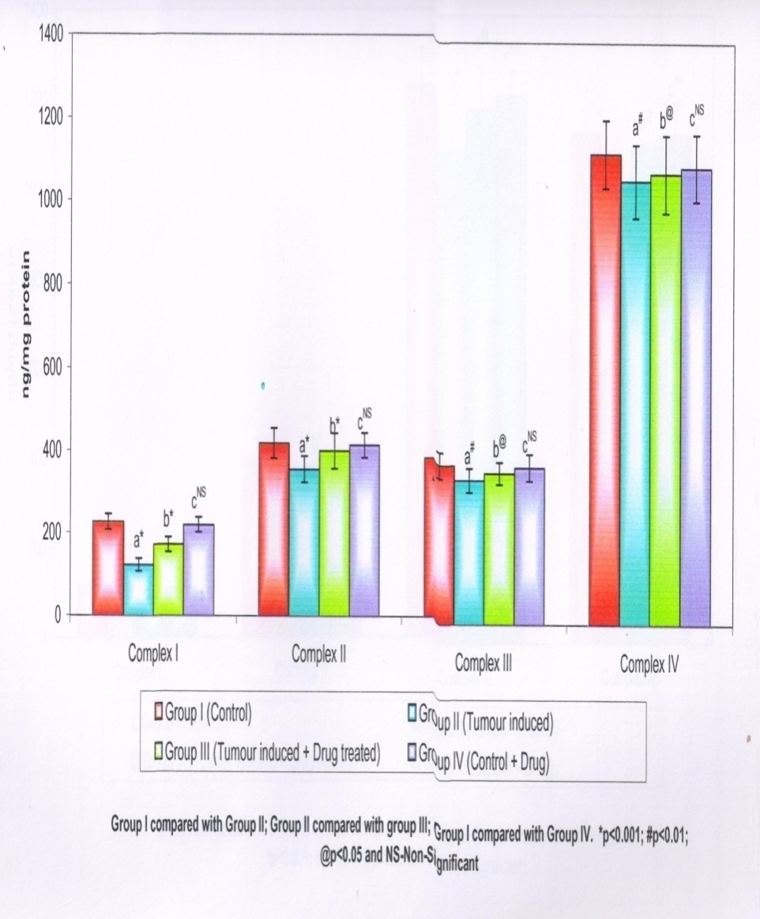
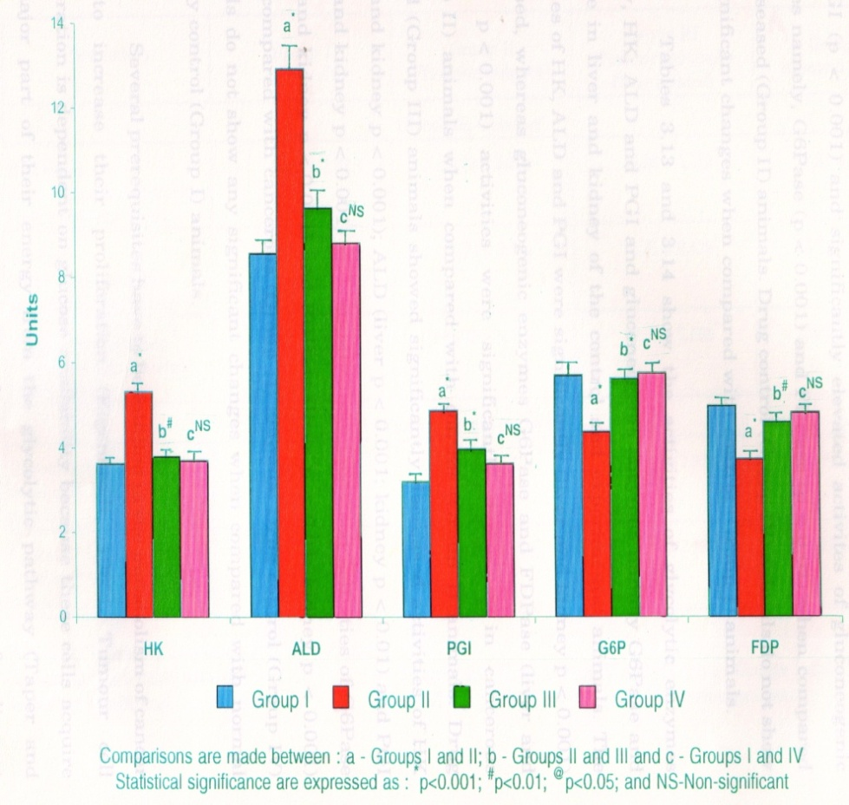
SAE –Effect on energy metabolism
Electron Transport Chain Complexes
Glycolytic & Gluconeogenic Enzymes

Slide 37
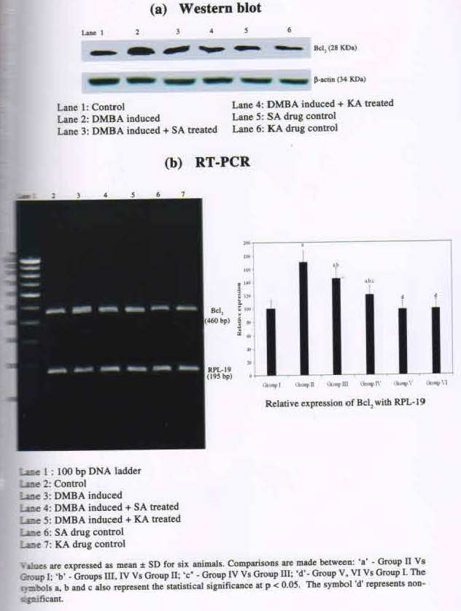
SAE - Effect on apoptosis
Bcl-2

Slide 38
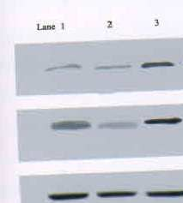
SAE - pro apoptotic effect
CASPASES
Caspase-3
Caspase-9
β-actin

Slide 39
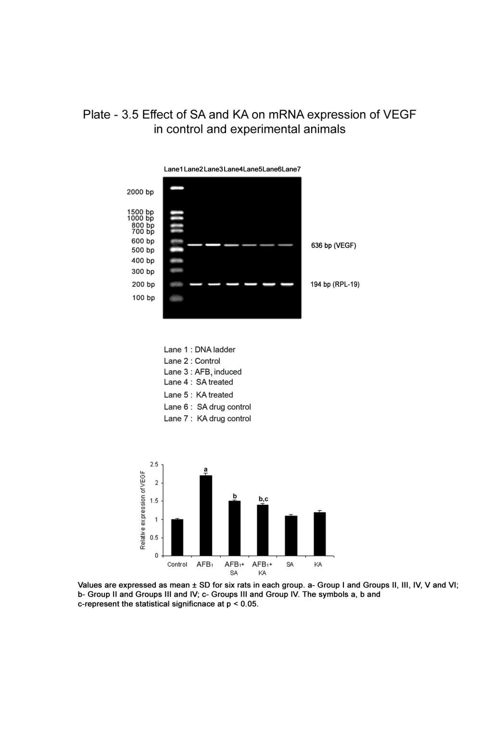
SAE- Antiangiogenic property
mRNA expression of VEGF
Lane 1 : Control
Lane 2 : Mammary carcinoma
induced
Lane 3 : SA treated
Lane 4 : Drug control

Slide 40
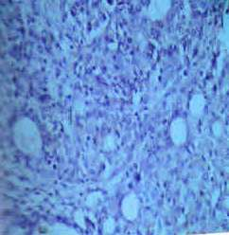
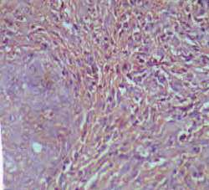
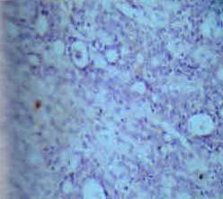
SAE in mammary carcinoma membrane stabilizing property
Immunohistochemical localization of MMP -9
Control
Carcinoma induced
Carcinoma treated with SAE
Vascular Pharmacology 2007 Jun;46(6): 419-26.

Slide 41
SAE-membrane stabilising effect
Activities of proteases
Glycohydrolases
Parameters /h/ 100mg protein | Normal | Cancerous rats tumour tissue surrounding tissue |  | Treated rats tumour tissue surrounding tissue
Collagenase μg hydroxyl proline/ | 8.1 ± 0.7 | 10.3 ± 0.9^{a*} | 11.8 ± 1.1^{a*} | 9.1 ±0.5^{c***} | 9.9 ± 0.6^{d**}
Cathepsin B μm p- nitro anline | 38.97 ± 3.78 | 51.82 ± 4.92^{a*} | 50.76± 3.76^{a*} | 43.06 ± 3.24^{c**} | 42.53 ± 3.94 ^{d**}
Cathepsin D μm tyrosine/ | 10.4 ± 0.70 | 16.7 ± 0.70^{a*} | 19.9 ± 1.03^{a*} | 12.13 ± 1.74^{c*} | 13.56 ± 1.24 ^{d**}
Collagenolytic cathepsin μm hydroxyl proline | 27.3 ± 1.7 | 45.97 ± 4.63^{a*} | 37.53 ± 2.61^{a*} | 34.57 ± 3.35^{c*} | 31.12 ± 2.84 ^{d**}
protein rameters Pa/h/100 mg | Normal | Cancerous rats Tumour tissue Surrounding tissue |  | Treated rats Tumour tissue Surrounding tissue
βglucosidase μm p-nitrophenol | 33.92± 2.98 | 65.9 ± 5.29^{a*} | 44.7 ± 3.15^{b*} | 39.72 ±3.52^{c*} | 38.17± 2.00^{d**}
βgalactosidase μm p-nitrophenol/ | 34.7± 3.3 | 54.8± 4.6^{a*} | 49.2±3.9 ^{b*} | 41.4 ± 3.2^{c*} | 2.6 ± 0.11 ^{d**}
βglucuronidase μm p-nitrophenol | 19.39 ± 1.97 | 27.5 ± 2.44^{a*} | 24.9 ± 1.78 ^{b*} | 21.3 ± 1.78^{c*} | 104.3 ± 4.9 ^{d*}
Nacetyl galactosaminidase μm p-nitrophenol/ | 25.17 ± 2.1 | 43.6 ± 3.27ª* | 38.5 ± 3.54 ^{b*} | 35.01 ± 3.46^{c}** | 0.45 ± 0.03 ^{d*}
Vascular Pharmacology 2007 Jun;46(6): 419-26.

Slide 42
SAE-membrane stabilising effect
Matrix Turnover Factors
Parameters | Normal | Cancerous rats Tumour tissue Surrounding tissue |  | Treated rats Tumour tissue Surrounding tissue
LOX (SFU/ mg protein) | 52.6 ± 3.9 | 86.5 ± 6.7^{a*} | 79.4 ± 6.2^{b*} | 69.5 ±1.4^{c*} | 64.7± 3.8^{d**}
ACE (U/ml) | 23.4± 1.6 | 40.2 ± 2.1^{a***} | 43.9±3.4 ^{b***} | 32.5 ± 1.9^{c***} | 30.8 ± 2.1 ^{d***}
Plasminogen Activator (ng of activated plg/h/50μl of homegenate) | 4.16 ± 3.9 | 6.8 ± 4.6^{a*} | 5.9 ± 3.7 ^{b*} | 5.06 ±3.3^{c**} | 5.12 ± 3.2 ^{d**}
TNF –α (ng/mg protein) | 1.1 ± 0.2 | 2.3 ± 0.3*** | 2.3 ± 0.3 ^{b***} | 1.9 ± 0.1^{c*}** | 1.3 ± 0.1 ^{d***}
Vascular Pharmacology 2007 Jun;46(6): 419-26.

Slide 43
SAE Immunomodulatory activity
  Cancer is associated with decreased immunocompetence.
  Contributes to progression of cancer.
  DMBA induces immunosuppression of both humoral and cell-
  mediated immunity in several different species .

Slide 44
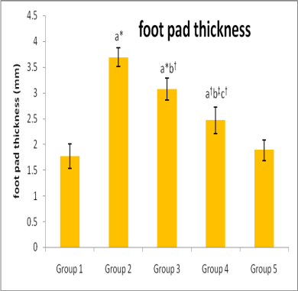
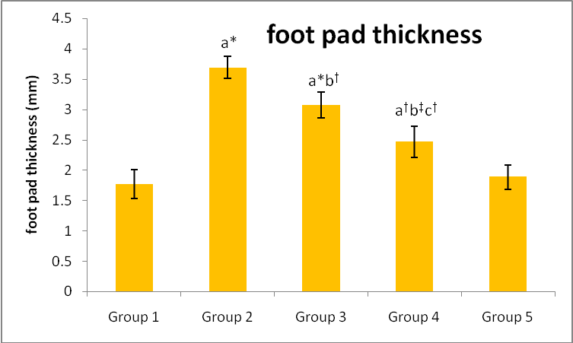
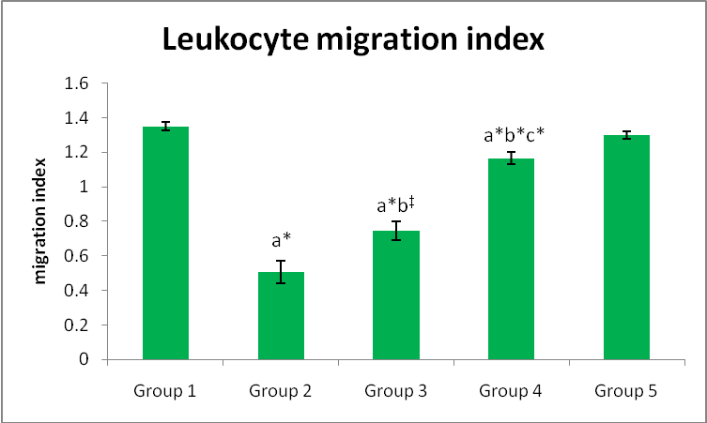
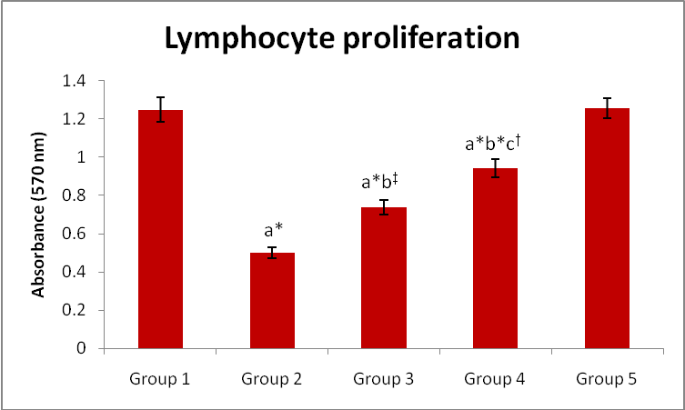
SAE-effect on cell mediated immunity
CD4 and CD8 counts
Foot pad
Leucocyte
Migration inhibition
Lymphocyte
proliferation
Parameters | Group I | Group II | Group III | Group IV
CD4⁺ | 24.98 ± 2.47 | 11.48 ± 1.13^{a*} | 15.93 ± 1.48^{a*b‡} | 19.86 ± 1.97^{a‡b‡c†}
CD8⁺ | 38.79 ± 3.51 | 16.92 ± 1.64^{a*} | 26.91 ± 2.61^{a*b*} | 31.80 ± 3.11^{a‡b*c†}
Cell mediated immunity was supressed in mammary carcinoma –reverted
significantly to near normal levels by treatment with SAE

Slide 45
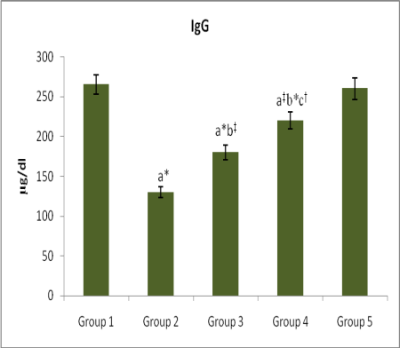
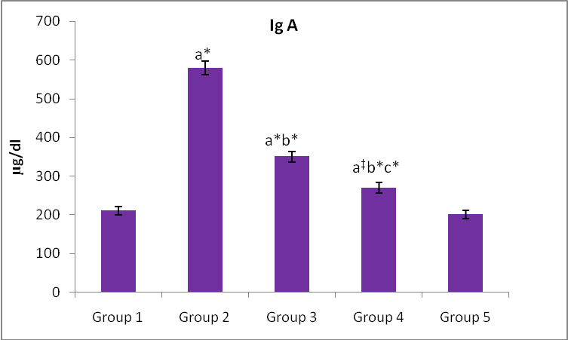
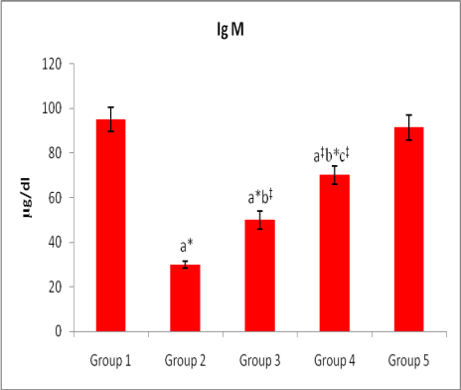
SAE Immunomodulatory activity –
Humoral immu nity
IgG
IgA
IgM
Humoral immunity & Antibody synthesis
Parameters | Group I | Group II | Group III | Group IV
Antibody titre-hemaggl utination | 76.08 ±7.69 | 44.47 ± 4.43^{a*} | 55.36 ± 5.56^{a*b†} | 65.88 ± 6.56^{a†b*c†}
PFC/10⁶ spleen | 685.25±77.79 | 445.89± 44.52^{a*} | 545.97± 45.72^{a‡b†} | 565.03±74.26^{a‡b†cNS}
Serum soluble immune complex (PEG indices) | 18.16±1.85 | 9.37± 0.95^{a*} | 12.59± 1.12^{a*b‡} | 15.72± 1.25^{a†b*c‡}
Humoral immunity was supressed in mammary ca –reverted significantly to near normal levels by treatment with SAE.
Notes:
Ig A alone is incresed WHY

Slide 46
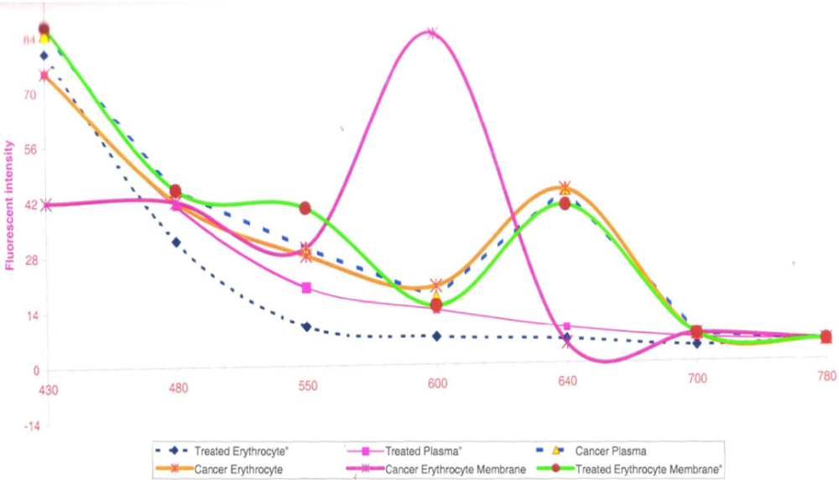
SAE effect on Erythrocyte Protoporphyrin Fluorescence as a Biomarker
It has been reported that erythrocytes may be the carriers of fluorophors that accumulate in cancer tissues. Erythrocyte Protoporphyrin Fluorescence is a biomarker and useful in the diagnosis and treatment of malignancies.
Fluorescence emission spectroscopy of blood components are altered in experimental mammary carcinoma and the drug effectively ameliorated these.
Parameters | Group I | Group II | Group III
Plasma | 4.00± 0.02 | 1.1±0.03^{a*} | 3.7±0.02 ^{b*}
Erythrocyte | 2.51± 0.01 | 0.3±0.04^{a*} | 1.9±0.01 ^{b*}
Erythrocyte membrane | 2.3±0.04 | 3.3±0.01 ^{a*} | 2.5±0.02 ^{b*}
Emission characteristics of plasma Erythrocyte and Erythrocyte membrane of the experimental animals excited at 400nm
J of Fluorescence, 2015

Slide 47
Effect of SAE on MUC 1 Expression in Mammary Carcinoma
The MUC1 gene which encodes a mucin glycoprotein(s) which is basally expressed in most epithelial cells. In a variety of epithelial tumors and breast adenocarcinoma its transcription is dramatically upregulated. with aberrant expression over the entire cell surface.
These alterations are considered to be relevant to the abnormal behaviour of cancer cells, such as altered adhesion metastasis.
This characteristic makes the MUC1 protein valuable as a marker in breast cancer diagnostics and prognosis.

Slide 48
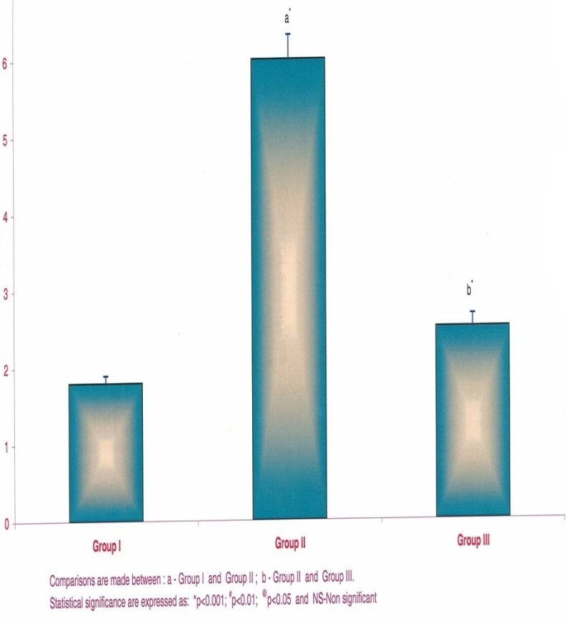
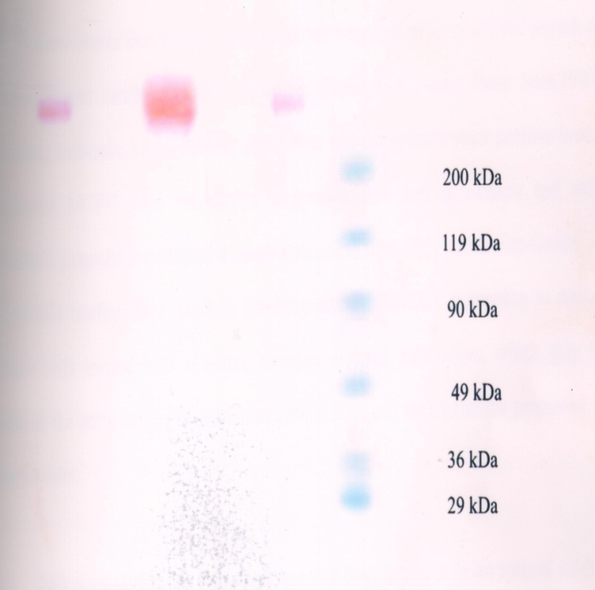
SAE-effect on MUC1 expression
Serum Mucin 1 levels
Mucin 1 expression in mammary tissue
Lane 1 - Control sample
Lane 2 - Tumour sample
Lane 3 - Treated sample
Lane 4 - Molecular weight marker

Slide 49
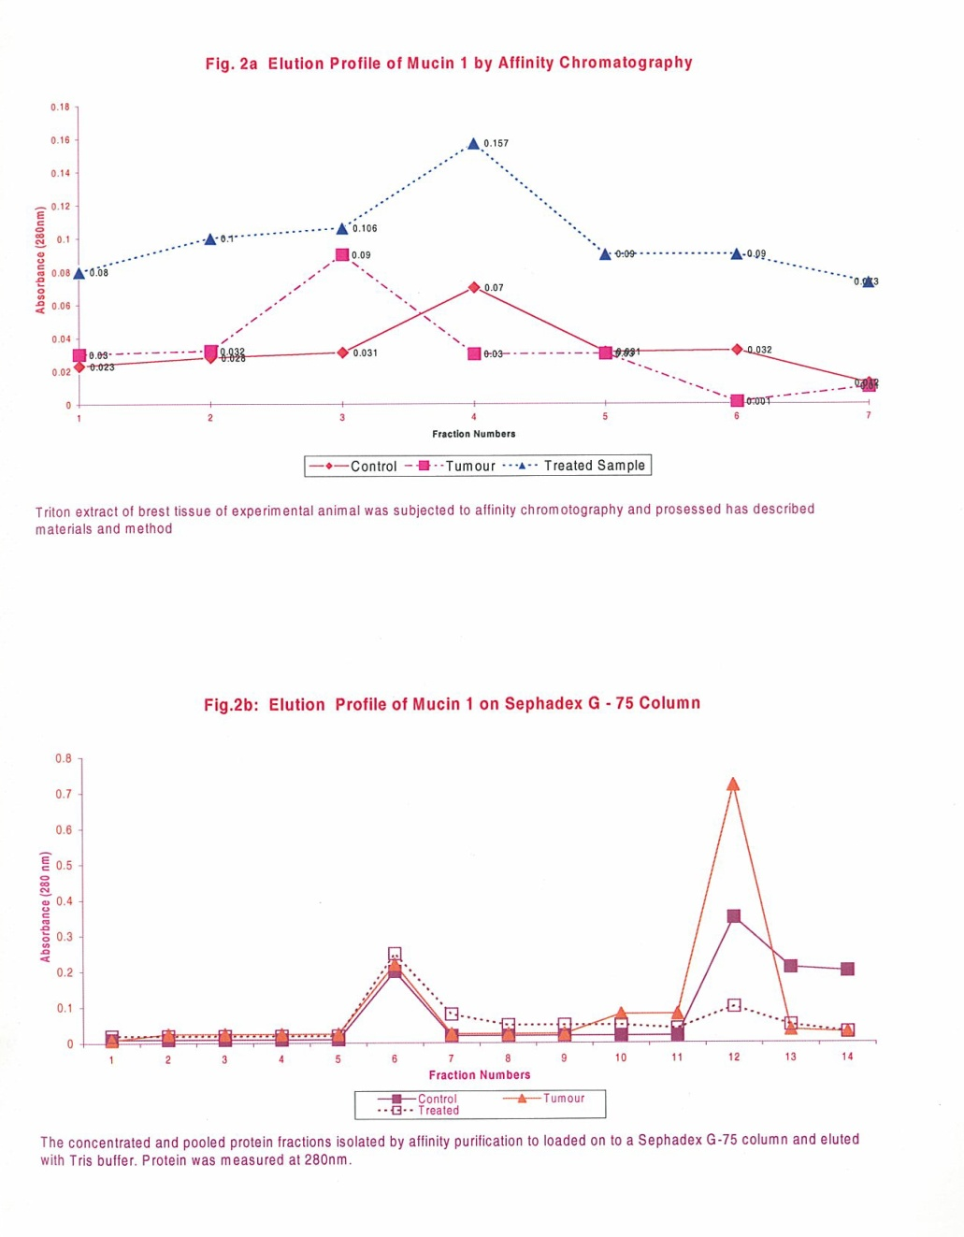
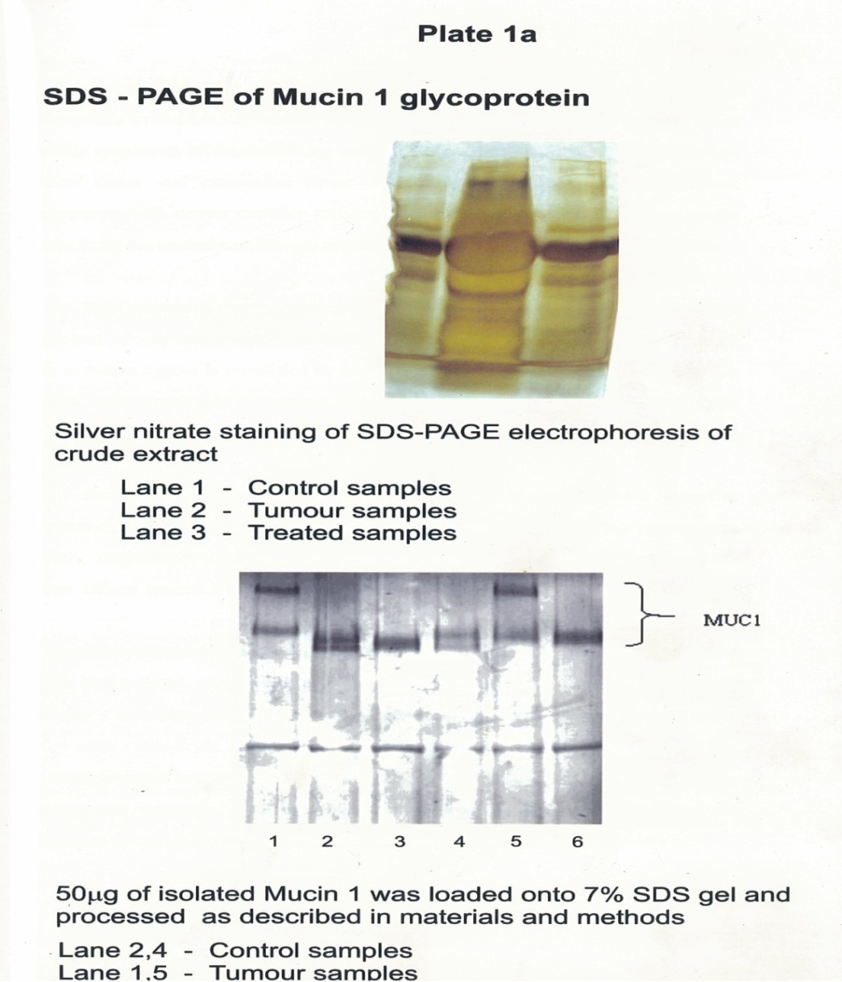
Mammary Carcinoma &
Semecarpus anacardium
MUC 1

Slide 50
Summary and Conclusions
Morphologic studies indicated remission of cancer on treatment with
SA.
Increased free radicals, decreased antioxidant status, increased
marker enzymes, altered membrane stability, aberrant MUC1
expression, deranged energy metabolism, and decreased immune
competence seen in the cancer state were all restored to near normal
on treatment with SA.
SA exerts these effects by virtue of the action of the constituent
flavonoids, polyphenols, glycosides, etc., which are present in high
concentrations.

Slide 51
Summary & Conclusions
Semecarpus anacardium Linn. nut milk extract, a Siddha formulation, exerts
a therapeutic effect in an animal model of mammary carcinoma.
The active principles which form the basis for these therapeutic properties
are yet to be identified.
Research to isolate the active principles, confirmation of the absence of toxic
effects and controlled clinical trials are potential areas for further research.

Slide 52
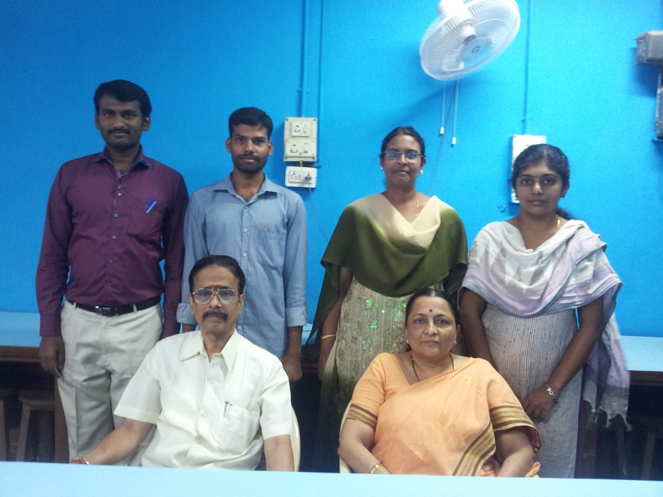

Slide 53
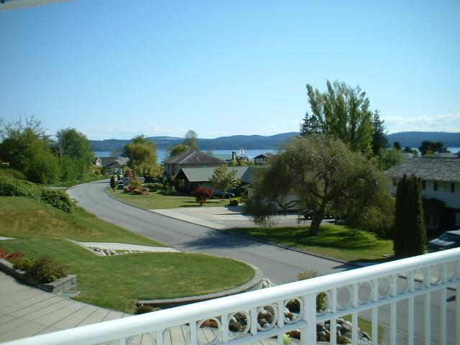
Conclusion
THANK YOU
The drug by means of its potent antioxidant, free radical quenching, antimutagenic, immunomodulatory, anti inflammatory, anti angiogenic and membrane stabilizing property has established its efficacy as a potent chemotherepeutic agent.
The drug SA fully satisfies this criteria as is evident from its protective nature and non toxic nature. These effects may be attributed to the various phytochemical components present in the drug.
Further studies are under way to isolate the major constituent contributing to this therepeutic effect.

Slide 54
Siddha Medicine
System or “Siddham” is the way of life which is the most ancient of all medical systems (Anonymous, 2011a) and can be considered as the most primordial one.
Siddha medicine is the conquest of death: “that which ensures prevention against mortality”
It is the oldest traditional treatment system generated from Dravidian culture.
It flourished in the period of Indus valley civilization (Mukherjee and Wahile, 2006).
It is the most ancient indigenous system of medicines of Indian origin practiced exclusively in Tamil Nadu and in some parts of the neighbouring states.
The first Tamil Siddha text is the Thirumandhiram written by Thirumoolar dating probably to around 6th or 7th century Christian Era or Current Era (C.E) (Zysk, 2008).

Slide 55
Effect of SAE on carbohydrate metabolism
Parameters | Group I (Control) | Group II (DMBA) | Group III (DMBA + SAE) | Group V (SAE)
Hexokinase | 18.29 ± 1.77 | 34.20 ± 3.43^{a*} | 26.60 ± 2.73^{a*b*} | 18.49 ± 1.80
Aldolase | 25.77 ± 2.57 | 43.43 ± 4.32^{a*} | 34.68 ± 4.35^{a*b‡} | 25.82 ± 2.76
Phosphoglucoisomerase | 21.99 ± 2.06 | 41.46 ± 4.11^{a*} | 32.27 ± 3.12^{a*b*} | 22.13 ± 2.04
Glucose-6-phosphatase | 38.91 ± 4.24 | 17.87 ± 1.89^{a*} | 25.73 ± 2.56^{a*b*} | 39.20 ± 4.13
Fructose-1,6-bisphosphatase | 50.79 ± 4.07 | 27.12 ± 2.68^{a*} | 36.98 ± 3.57^{a*b*} | 51.59 ± 4.26
Phytother Res 16 Suppl 1:S14-8, 2002
Notes:
Increases in glycolytic enzymes and decreases gluconeogenic enzymes are seen in malignant cells.
Flavonoids interfere with the generation of ADP and Pi which, inhibits glycolysis, leading to decreased lactate production and increase in gluconeogenic enzymes.

Slide 56
SAE-Toxicological study
No marked adverse alterations were observed in hematological and
biochemical parameters during the subacute toxicity studies (50, 100,
250 and 500 mg/kg body weight).
In the subacute treatment, the highest dose (500 mg/kg body weight)
alone showed a moderate increase in the level of blood glucose, plasma
urea, uric acid and creatinine. Histopathological examination of vital
organs showed normal architecture.

Slide 57
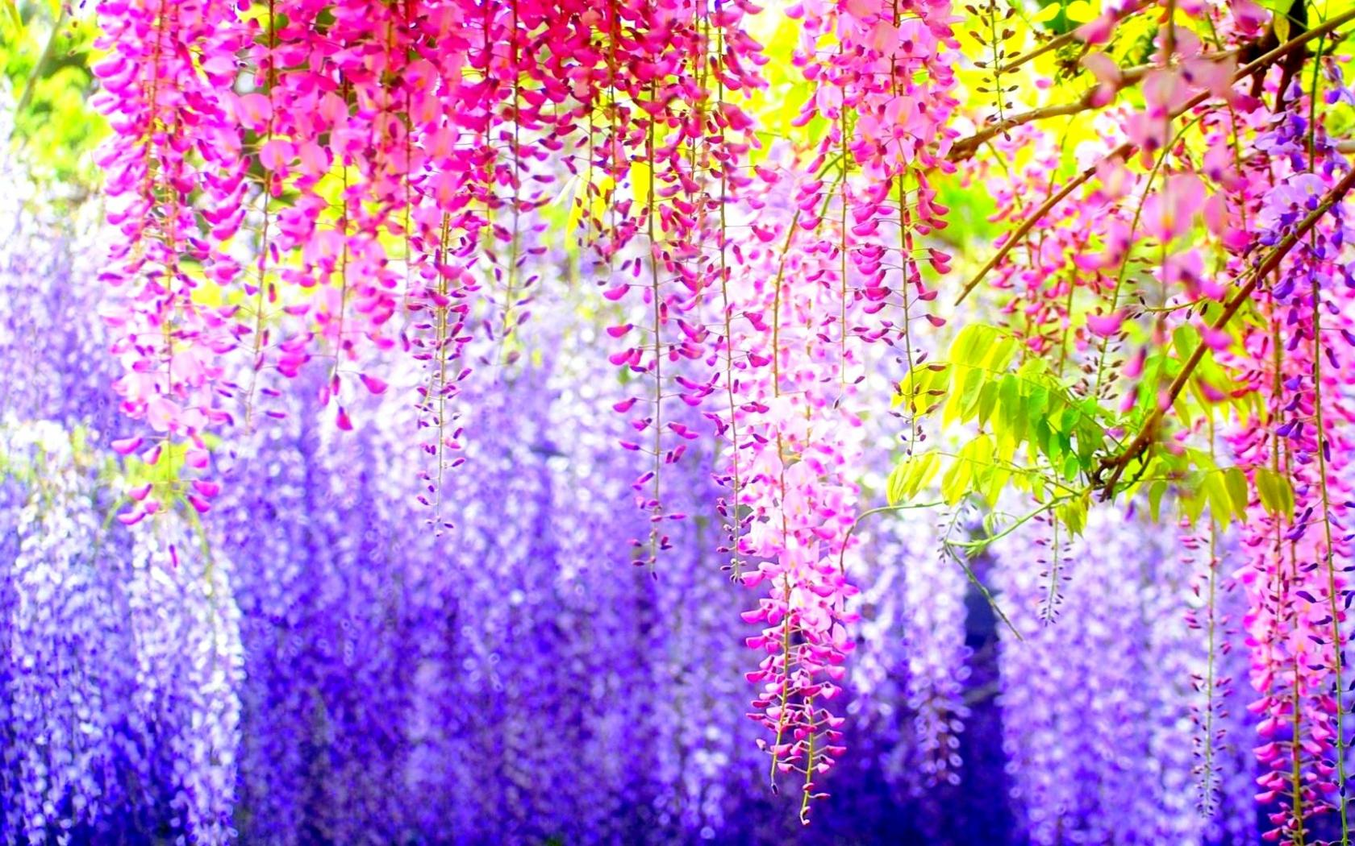
Thank You

Slide 58
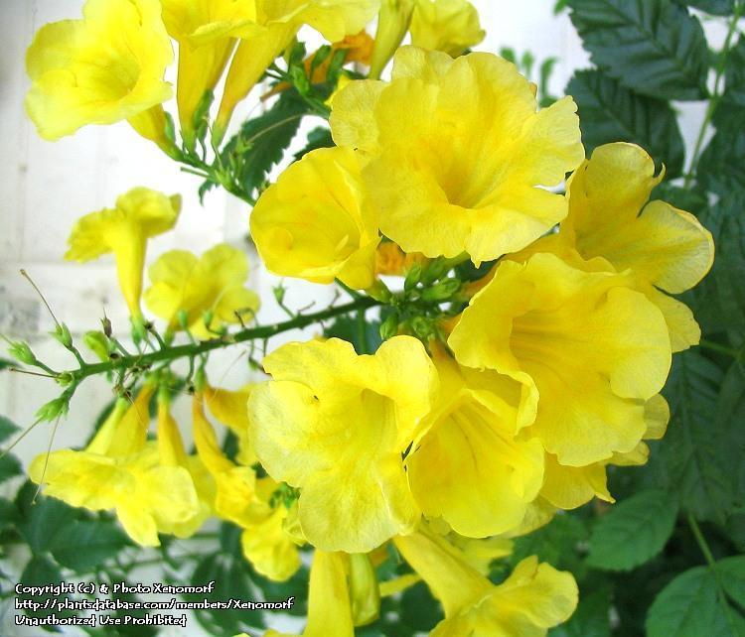

Slide 59
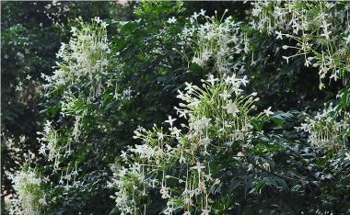
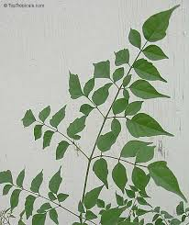




Slide 60


Complementary & Alternative Medicine
(CAM)
Complementary & Alternative medicine includes practices used in
conjunction with or to complement conventional medical treatments.
Herbal medicines are now considered part of CAM. WHO has launched
global strategy on Traditional medicine which provided a framework for
policy to assist and regulate CAM to make its use safer and more
accessible to more populations.
The importance of CAM is underlined by the fact that Institutes such as
Richard and Hinda Rosenthal Centre for CAM, Columbia University, New
York has been established and is involved in extensive scientific investigation
in various aspects of CAM.

Slide 61

CAM
&
CANCER
Complementary and Alternative Medicine use is more common among
cancer patients.
Among various types of CAM treatment, herbal medicines were by far
the most commonly used group of treatments.
Leading cancer centers in the world are integrating CAM into a holistic
approach in the treatment of malignant tumors exemplified by the
Complementary and Alternative Medicine Education (CIMER) website
of the MD Anderson Cancer Centre , Houston, USA meant for treating
cancer patients.

Slide 62


Siddha System of Medicine
System or “Siddham” is the way of life which is the most ancient of all medical systems
(Anonymous, 2011a) and can be considered as the most primordial one.
Siddha medicine is the conquest of death: “that which ensures prevention against
mortality”
It is the oldest traditional treatment system generated from Dravidian culture.
It flourished in the period of Indus valley civilization (Mukherjee and Wahile, 2006).
It is the most ancient indigenous system of medicines of Indian origin practiced
exclusively in Tamil Nadu and in some parts of the neighbouring states.
The first Tamil Siddha text is the Thirumandhiram written by Thirumoolar dating
probably to around 6th or 7th century Christian Era or Current Era (C.E) (Zysk, 2008).

Slide 63
SAE-Toxicological study
Toxicological study – rats - SAE.
The effect of acute (72 h) and subacute (30 days) treatment of the drug with
different dosage (75-2000 mg/kg body weight) on liver and kidney
functions and hematological parameters were studied.
The nut extract preparation does not show any detrimental, toxic external
symptoms or mortality up to a dose of 2,000 mg/body weight in laboratory
animals (Vijayalakshmi et al., 2000).
Journal of Ethnopharmacology 69(1):9-15;2000.

Slide 64


Semecarpus anacardium Linn. (Family: Anacardiaceae)
Commonly known as ‘marking nut’ or ‘Oriental cashew’.
‘Ballataka’, ‘Bhilawa’ are vernacular names of marking nut.
Found in Sub-Himalayan regions from Sutlej to Sikkim, tropic and Central parts
of India, Western Peninsula and North Australia.
Phytochemistry of Semecarpus anacardium Linn.
Revealed the presence of biflavonoids, phenolic compounds, bhilawanols, sterols
and glycosides.
TLC, HPLC and HPTLC analysis carried out with the nut and milk extract
confirmed the presence of the above said compounds (Sahoo et al., 2008; Aravind
et al., 2008; Shin et al., 1999; Nair et al., 2009).
Chemical and spectral data showed the presence of flavonoids that includes viz:
Semecapuflavanone Jeediflavanone
Galluflavanone Nallaflavanone
Semecarpetin Anacarduflavanone

Slide 65




Semecarpus anacardium Linn. (Family: Anacardiaceae)
HPTLC analysis of flavonoids at 254 nm
SA nut milk extract SA nut
HPTLC analysis of flavonoids at 550 nm
SA nut milk extract SA nut

Slide 66




Mammary carcinoma &
Semecarpus anacardium
Immunomodulatory activity
Cell mediated immunity
Parameters | Group I | Group II | Group III | Group IV
Antibody titre | 76.08 ±7.69 | 44.47 ± 4.43^{a*} | 55.36 ± 5.56^{a*b†} | 65.88 ± 6.56^{a†b*c†}
PFC/10⁶ spleen | 685.25±77.79 | 445.89± 44.52^{a*} | 545.97± 45.72^{a‡b†} | 565.03±74.26^{a‡b†cNS}
Serum soluble immune complex (PEG indices) | 18.16±1.85 | 9.37± 0.95^{a*} | 12.59± 1.12^{a*b‡} | 15.72± 1.25^{a†b*c‡}
Serum immunoglobulin levels
CD 4 and CD8 content
Parameters | Group I | Group II | Group III | Group IV
CD4⁺ | 24.98 ± 2.47 | 11.48 ± 1.13^{a*} | 15.93 ± 1.48^{a*b‡} | 19.86 ± 1.97^{a‡b‡c†}
CD8⁺ | 38.79 ± 3.51 | 16.92 ± 1.64^{a*} | 26.91 ± 2.61^{a*b*} | 31.80 ± 3.11^{a‡b*c†}
Effect of SA on antioxidant enzymes in spleen & thymus
Parameters | Group I (Control) | Group II (DMBA) | Group III (DMBA + SA) | Group IV (SA)
SOD | 18.04 ± 1.60 | 8.09 ± 0.74^{a*} | 13.35 ± 1.27^{a*b*} | 17.51 ± 1.73
CAT | 164.42 ± 15.98 | 108.63 ± 10.76^{a*} | 135.24± 13.67^{a*b*} | 169.70 ± 17.40
GPx | 36.62 ± 3.79 | 17.58 ± 1.82^{a*} | 26.53 ± 2.61^{a*b*} | 37.61 ± 3.94
Parameters | Group I (Control) | Group II (DMBA) | Group III (DMBA + SA) | Group IV
SOD | 11.08 ± 1.09 | 6.22 ± 0.56^{a*} | 8.37 ± 0.84^{a*b*} | 11.01 ± 1.00
CAT | 120.17 ± 11.22 | 64.76 ± 6.75^{a*} | 90.93± 9.14^{a*b‡} | 120.56 ± 11.19
GPx | 27.61 ± 2.63 | 13.82 ± 1.37^{a*} | 19.59± 2.03^{a*b*} | 27.52 ± 2.66
Comparative Clinical Pathology, 2012

Slide 67
SA-Phytochemistry
Revealed the presence of biflavonoids, phenolic compounds, bhilawanols,
sterols and glycosides.
TLC, HPLC and HPTLC analysis carried out with the nut and milk extract
confirmed the presence of the above said compounds (Sahoo et al., 2008;
Aravind et al., 2008; Shin et al., 1999; Nair et al., 2009).
Chemical and spectral data showed the presence of flavonoids that
includes,
Galluflavanone
Semecapuflavanone
Nallaflavanone
Semecarpetin
Jeediflavanone
Anacarduflavanone

