Slide 1



Evaluation and Assessment of Kosi River flood disaster using RemoteSensing and GIS Techniques
SHANKAR DAYAL
Senior Advisor (Natural Disasters),
Bihar State Disaster Management Authority,
India
SENIOR LECTURER
DEPARTMENT OF GEOGRAPHY
National University Of Singapore
D. S. PATTANAIK
ASSOCIATE PROFESSOR,
DEPARTMENT OF GEOLOGY,
UTKAl UNIVERSITY, INDIA

Slide 2
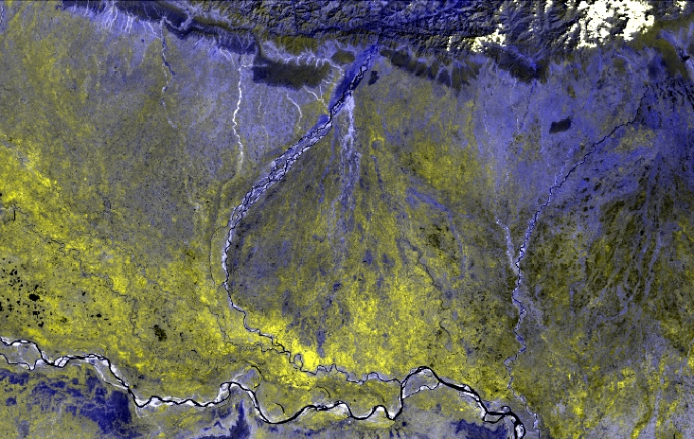
HIMALAYA
PIEDMONT ZONE
PIEDMONT ZONE
FAN APEX
KOSI MEGAFAN
FAN TOE
Ganga

Slide 3
Data used
The regional interpretation of the fluvial landforms have been carried out using IRS P6 (Resourcesat I) 1.AWiFS( 56 m resolution) multitemporal data.
Pre-monsoon : April ,2008
Monsoon : September, 2008
Post- monsoon : March , 2009
2. LISS IV ( 5.6 m resolution) for mapping detailed features.
SRTM DEM to generate slope data
Topographic maps ( SOI ) :Base maps
Prepared geomorphic maps have been used to calculate different parameters such as sinuosity, braid channel ratio, bar area etc.
Field observation: To characterize bed material texture, sediment character and structure inherent in them.

Slide 4
Detailed mapping of the major geomorphic units have been undertaken.
Broadly, two segments of the River basin are being mapped on different scale.
In stream:
1.Alluvial Island
2.Mid channel bar
3. Lateral bar
4.Point bar
5.Tributary bar
6. Transverse Bar
Fan surface / Flood plain:
1. wetland/ water body
2.Levee
3. Meander scroll, meander cut-off
4. Ox bow lake
Mapping of drainage and related parameters:
1. Direction/Trend
2.Length
3.Sinuosity
4.Braid-Channel ratio
5.Preferred alignment of rive
6.Sudden change in the direction of the river course.
7.Drainage Knick point
8.Straightening of the river course for appreciable length.

Slide 5
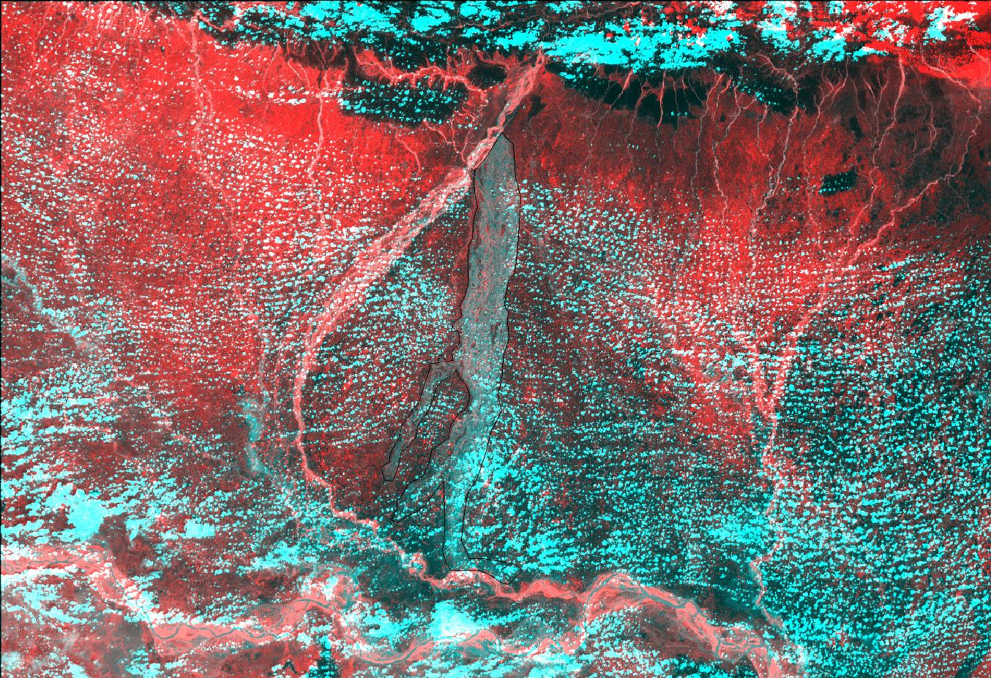
AWiFS
7 September, 2008
(Monsoon)
Inundation

Slide 6
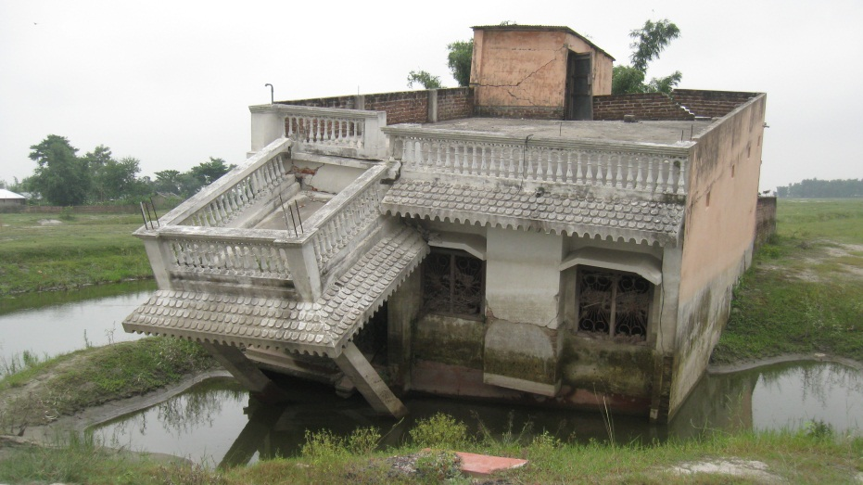
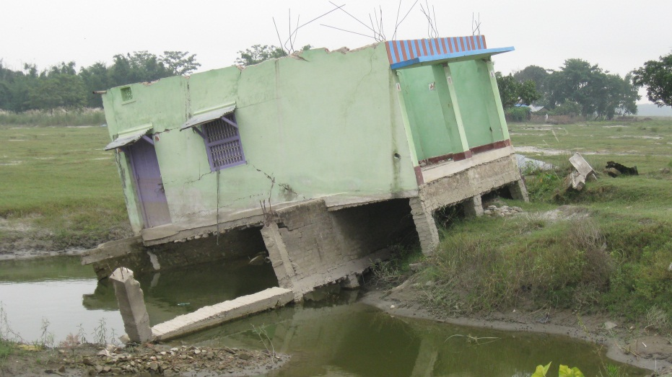
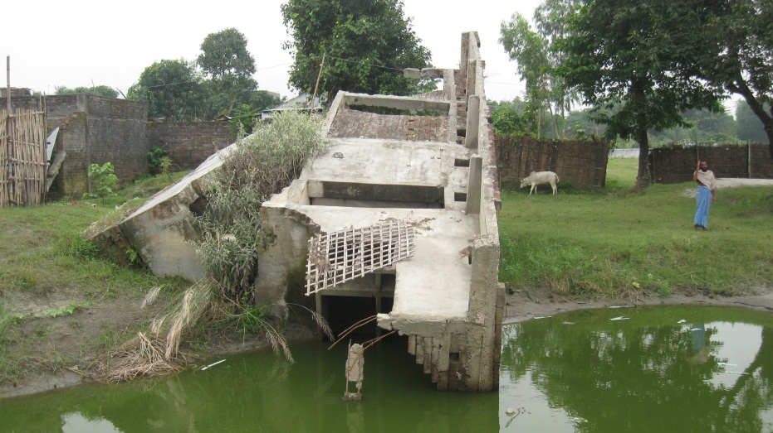
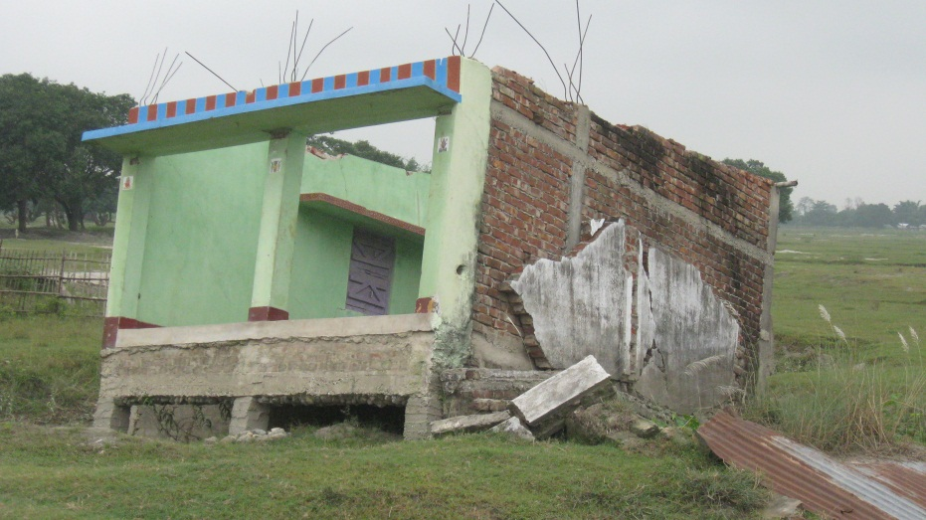
Devastation on August 18,2008

Slide 7
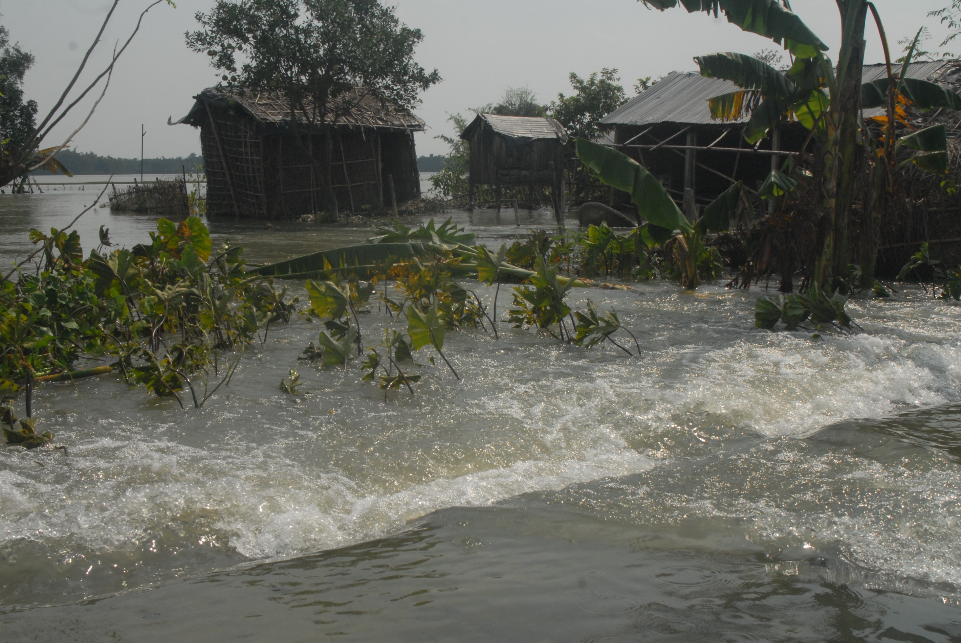

Slide 8
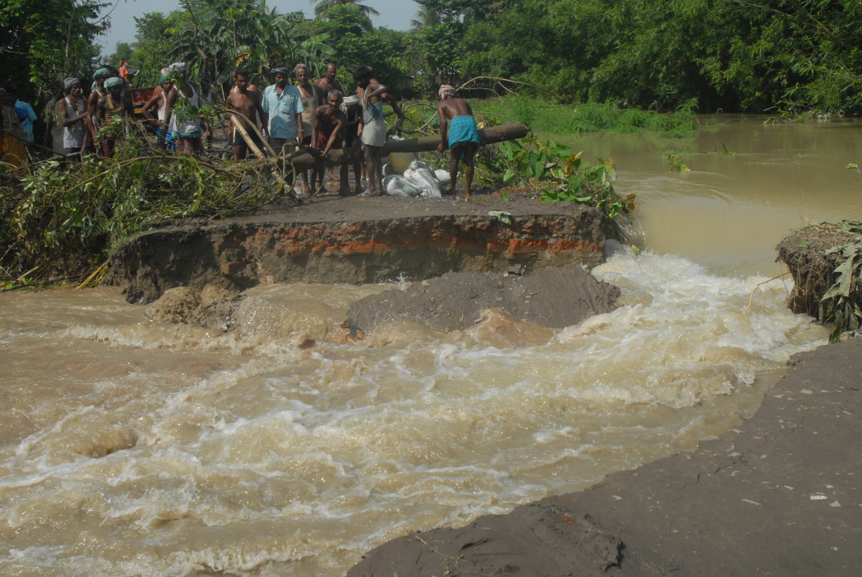

Slide 9
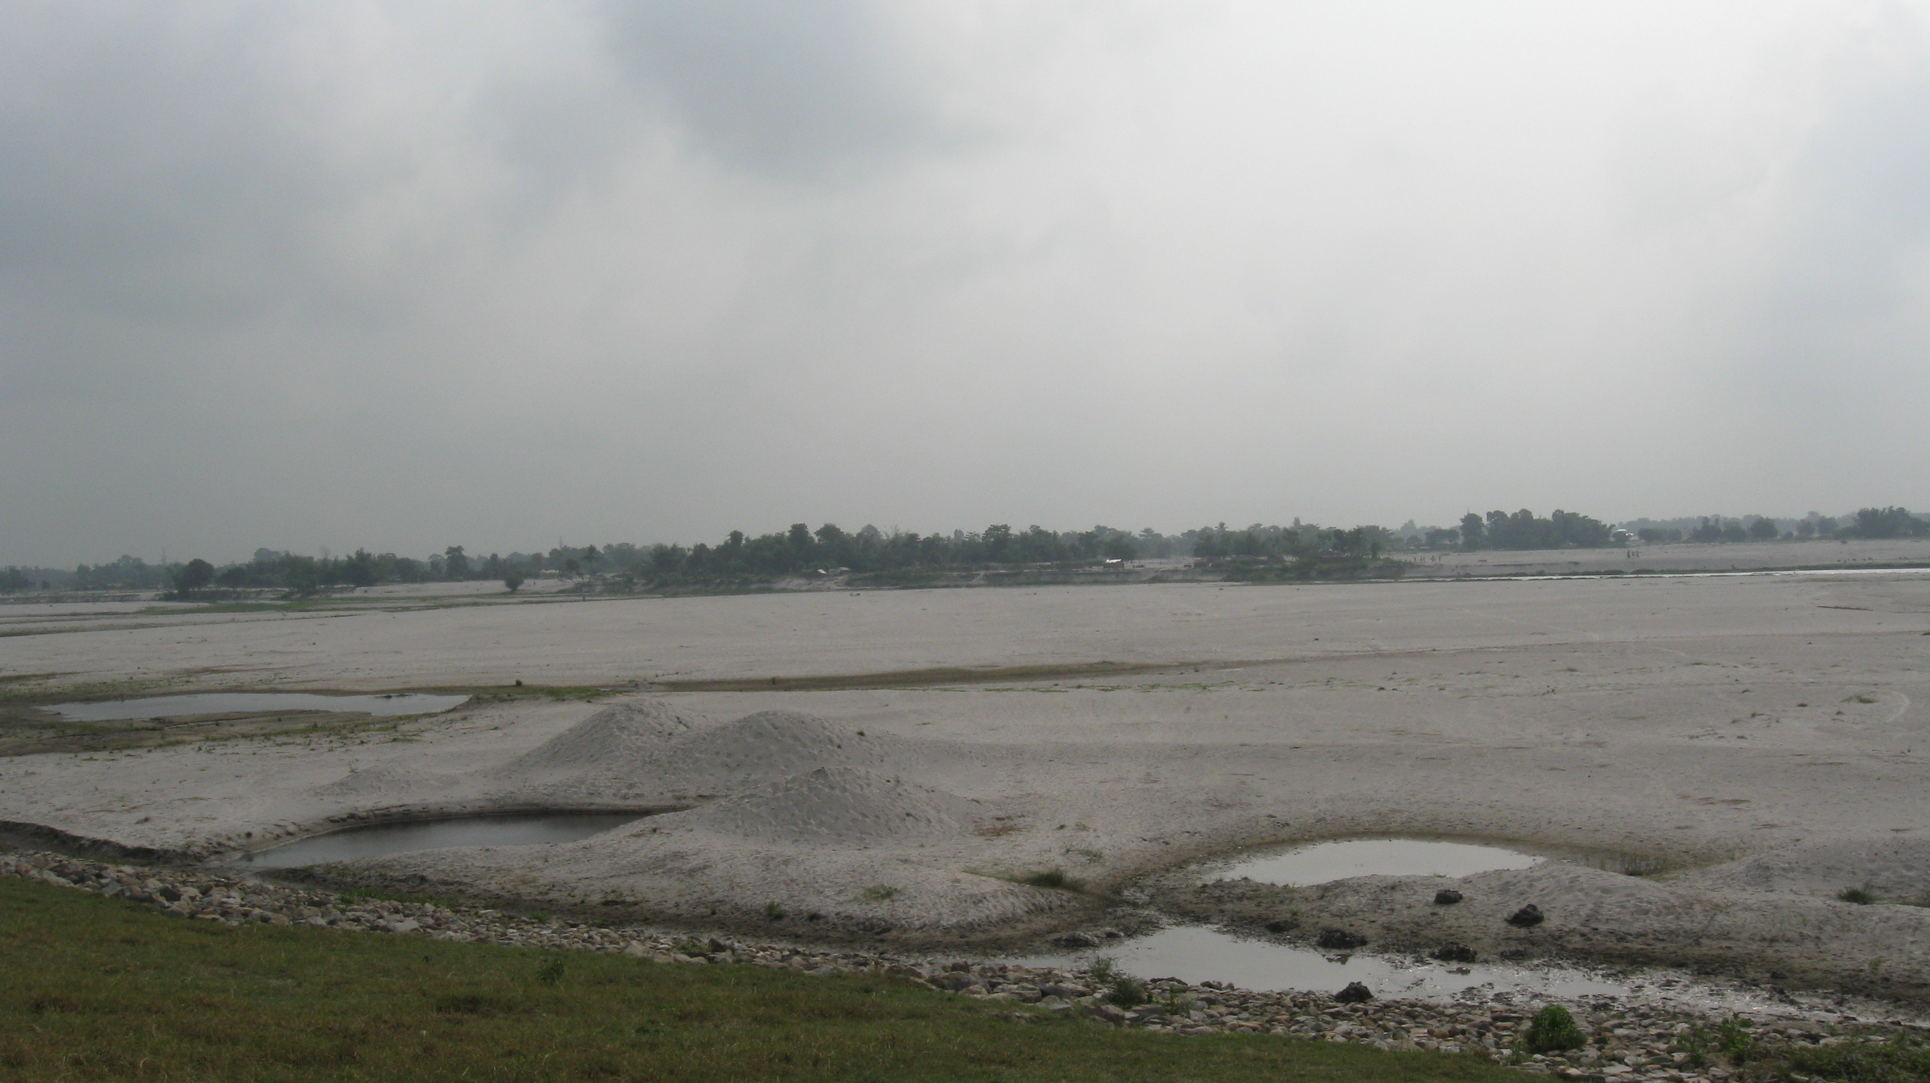

Slide 10
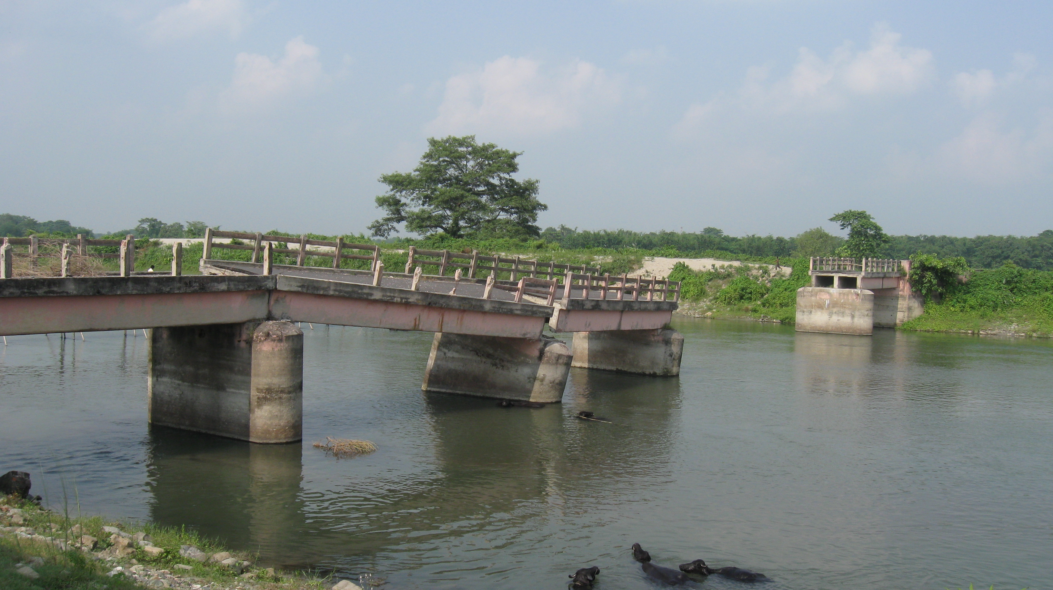

Slide 11
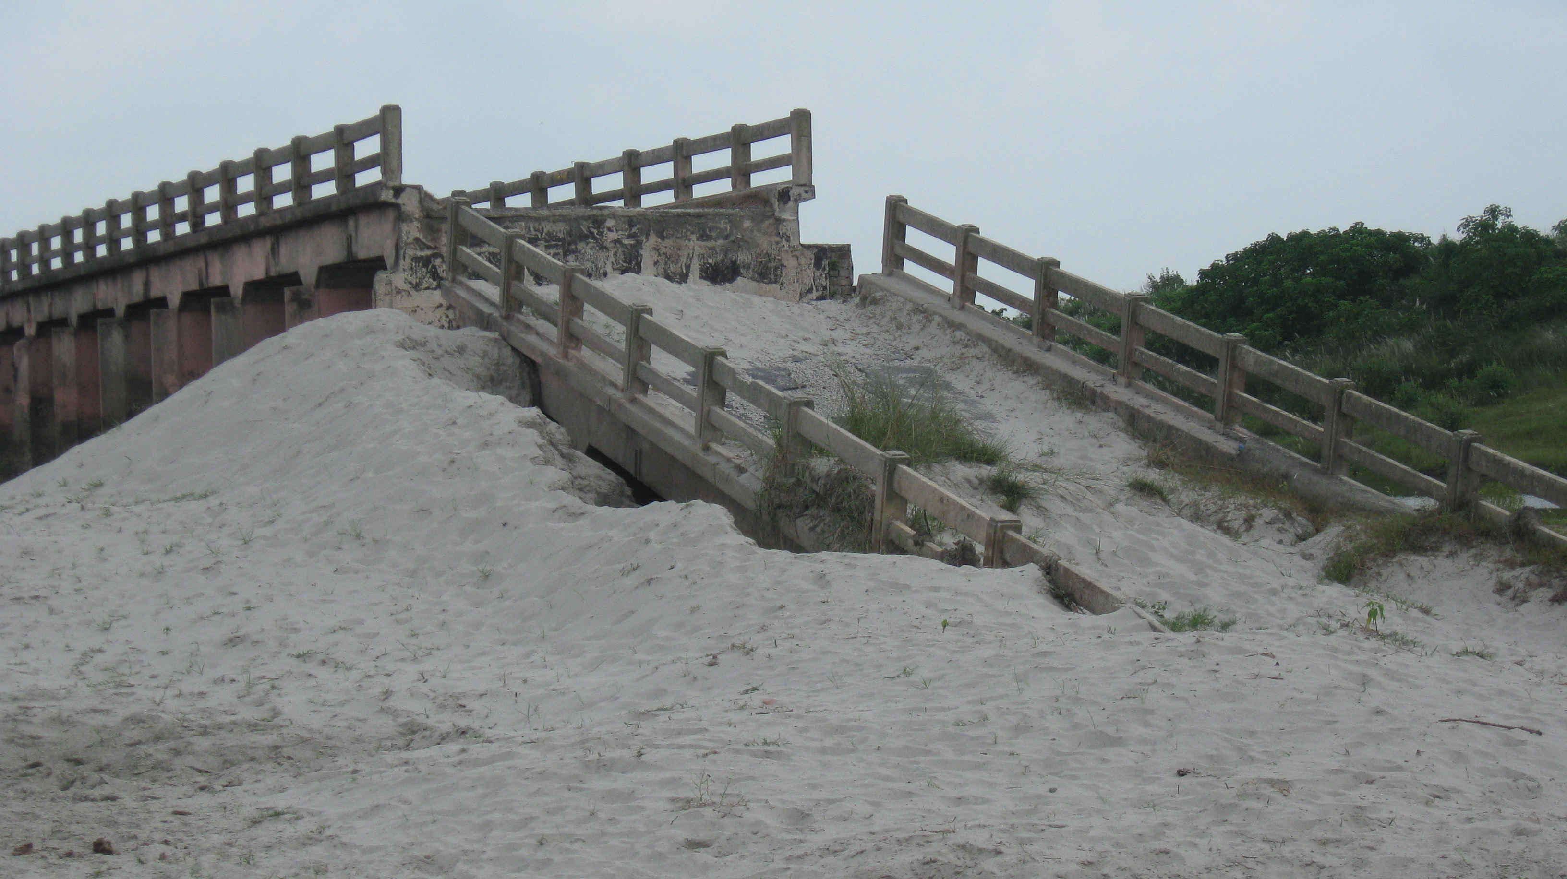

Slide 12
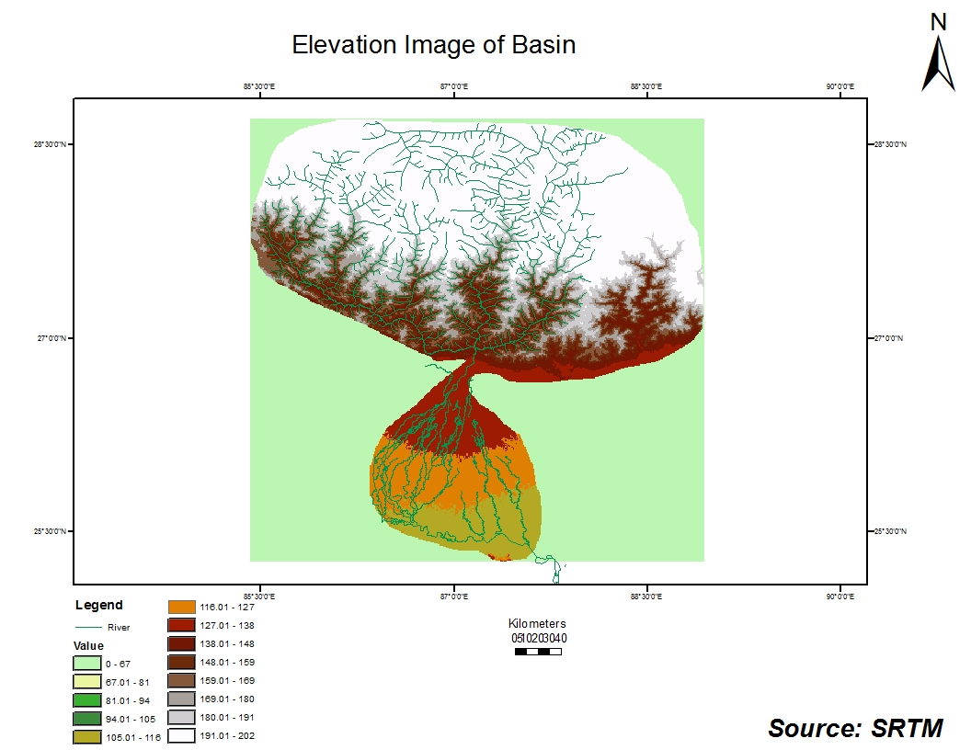

Slide 13
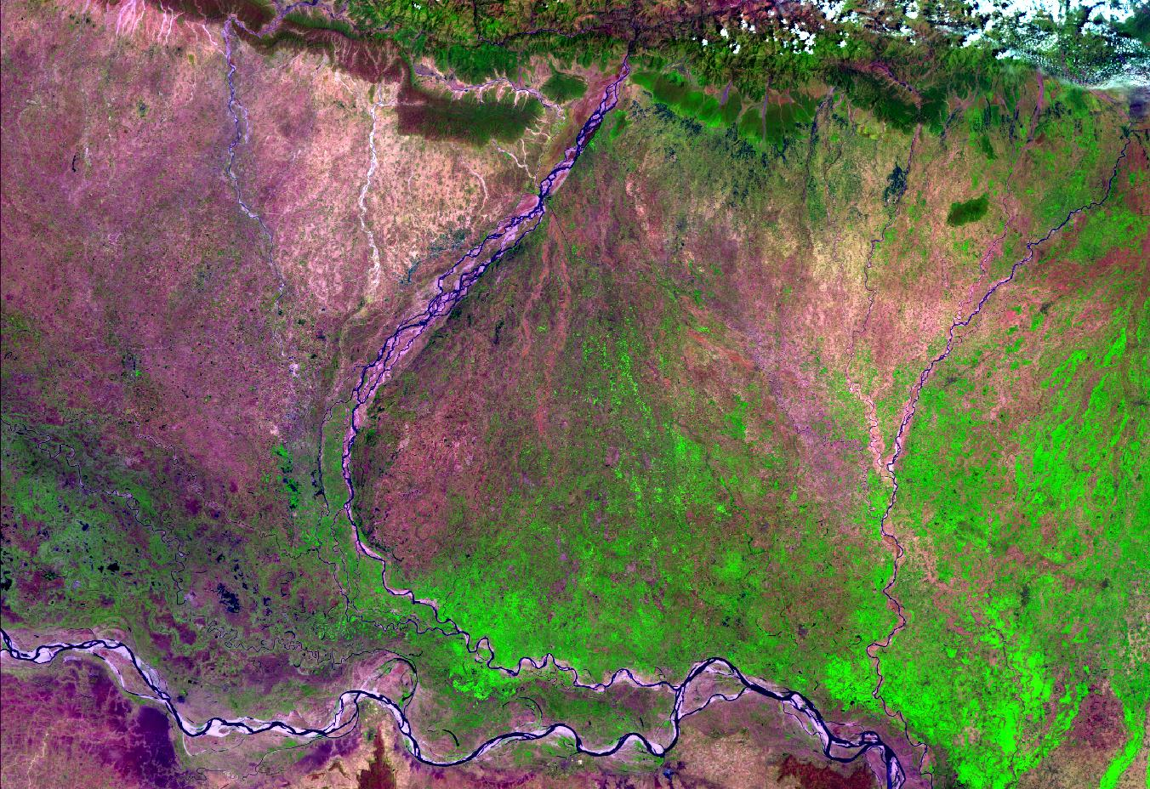
X
AWiFS
11 April , 2008
( Pre - monsoon)
BRAIDED ( Coarse sandy - Zone I)
A
B
BRAIDED ( Sandy - Zone II)
KOSI
A1
B1
STRAIGHT ( Sand / Mud - Zone III )
MEANDRING ( Sand / Mud - Zone - IV )
B2
YAZOO
A2
Y

Slide 14
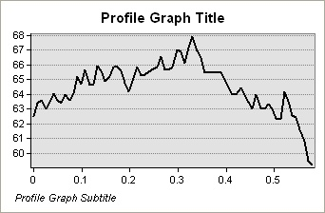
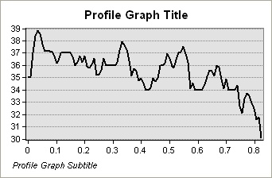
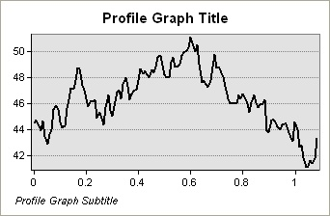
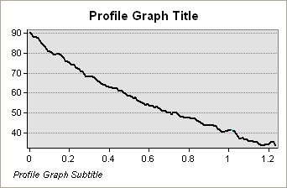
Cross Profile of Kosi Megafan
A2
A
B
B2
X
A1
B1
Y

Slide 15
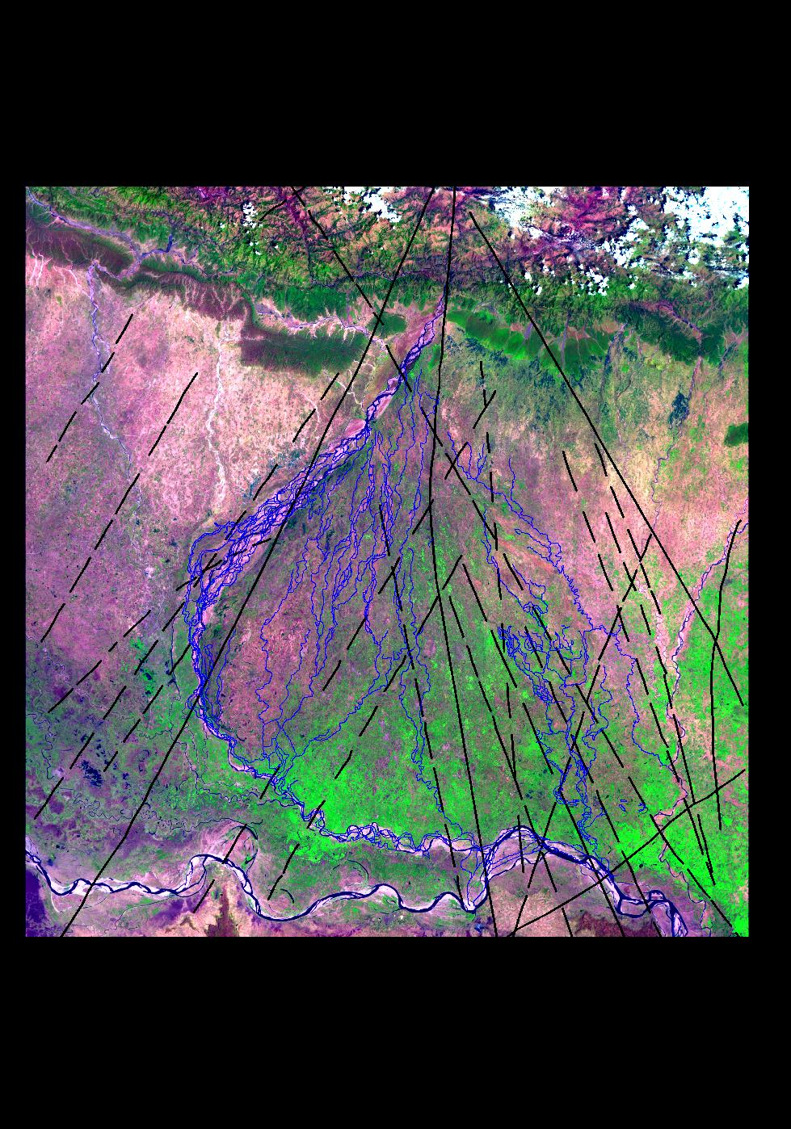
DRAINAGE - LINEAMENT CORRELATION
Kosi Dhars
MALDA FAULT
KISHANGANJ FAULT
BEGUSARAI FAULT
BHAWANIPUR FAULT

Slide 16
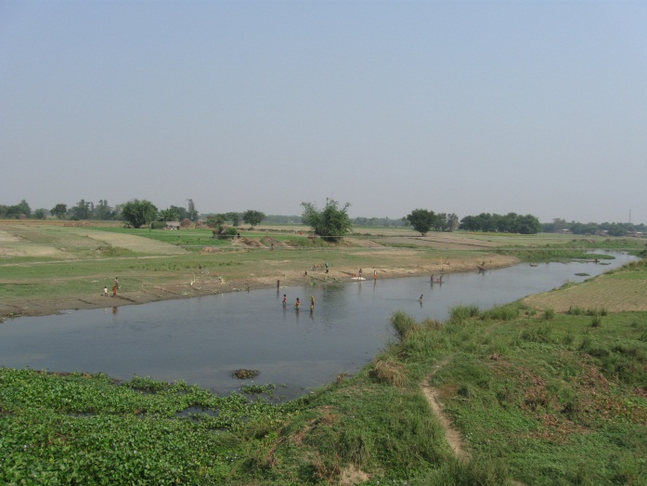
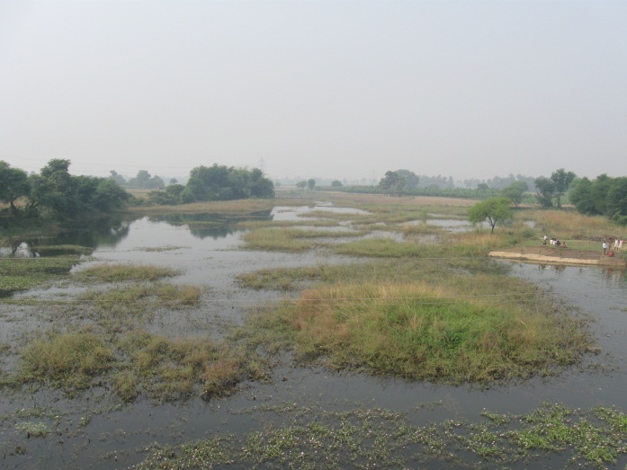
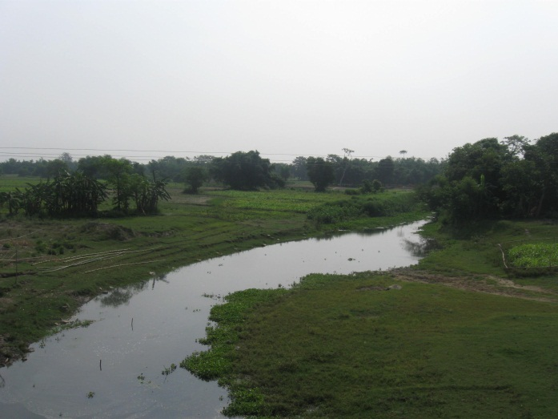
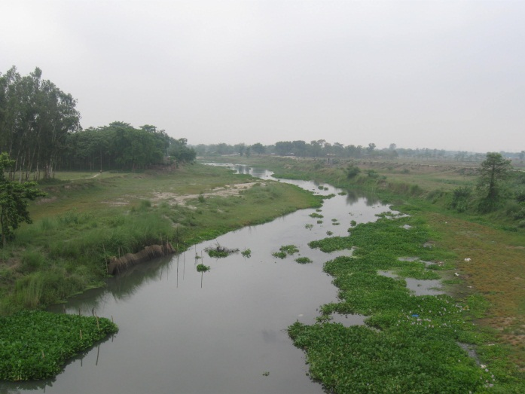
Dhars ( Streams )aligned N-S in the Kosi basin

Slide 17
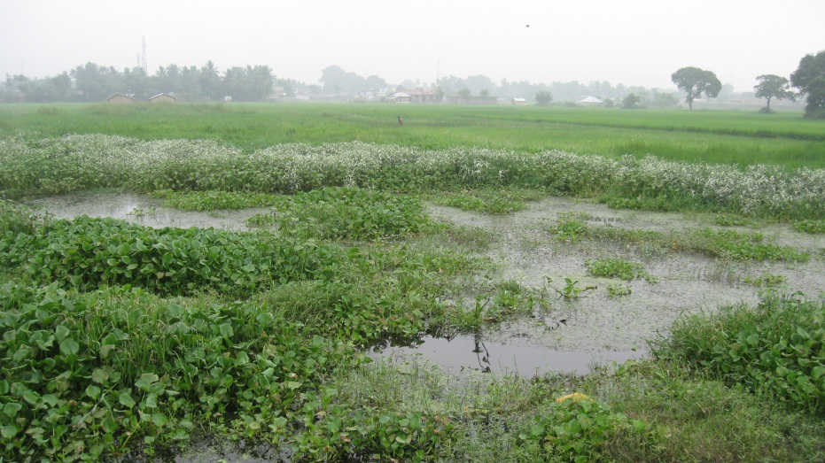
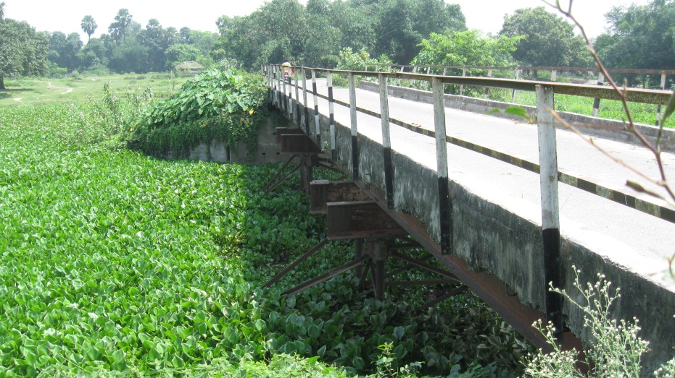
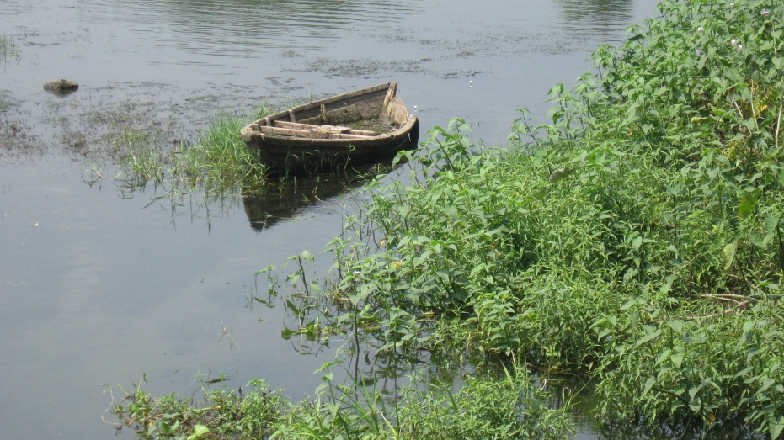
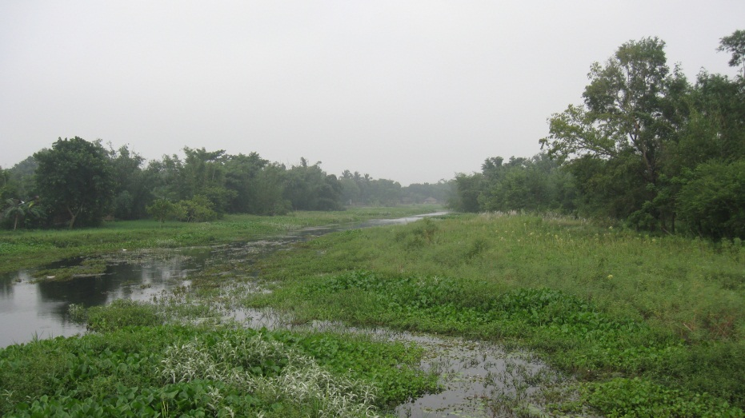
Streams full of Hyacinth

Slide 18
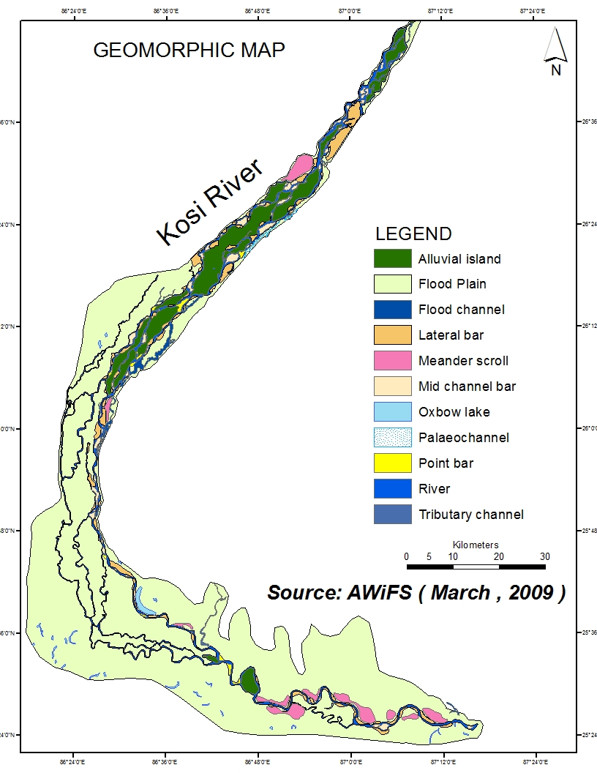
River Length: 272.27 km
Braided stretch: 111.10 km
Straight Stetch: 43.68 km
Meandering Stretch: 112.39 km

Slide 19
Channel Character:

Slide 20
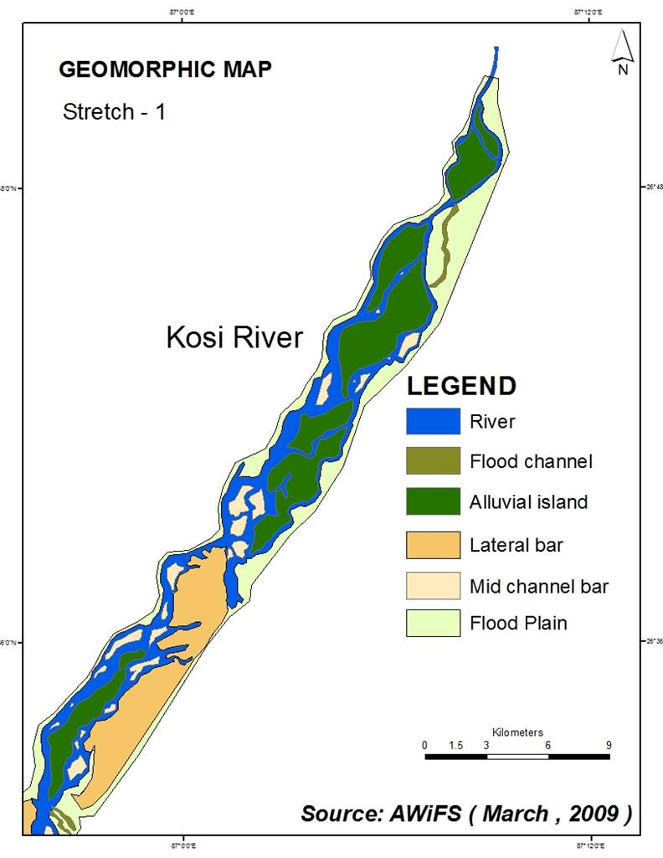
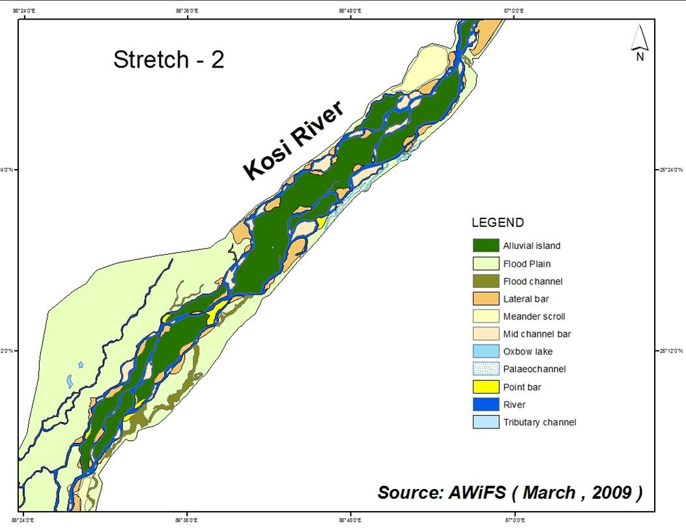
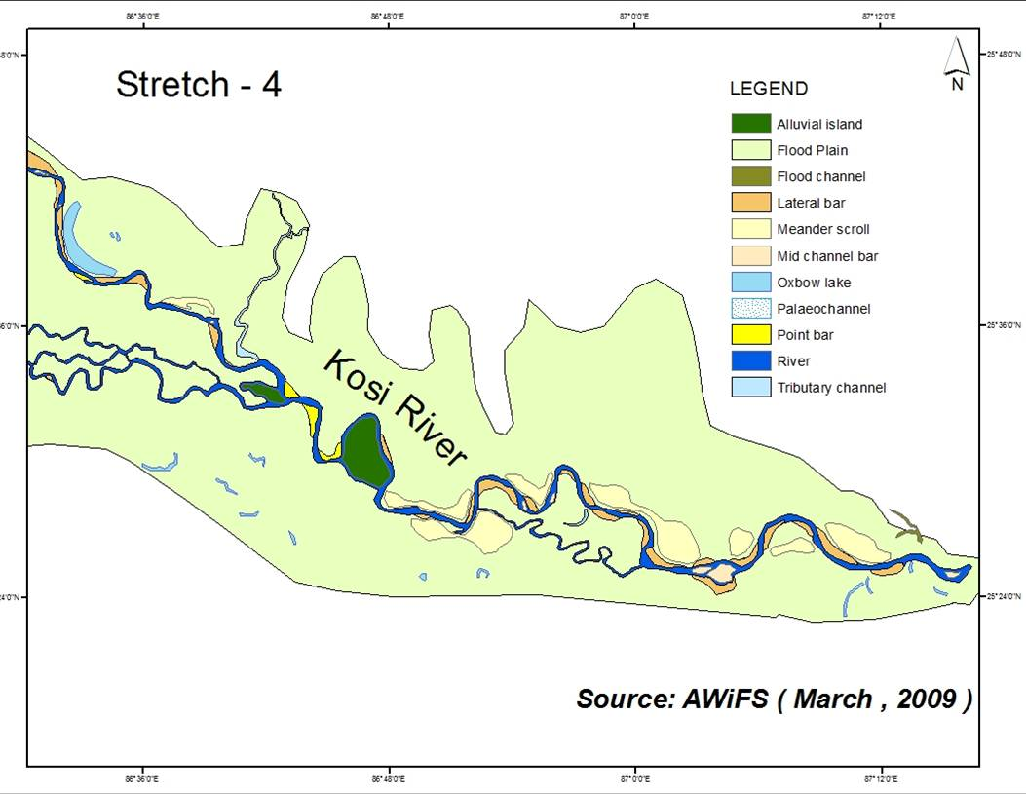
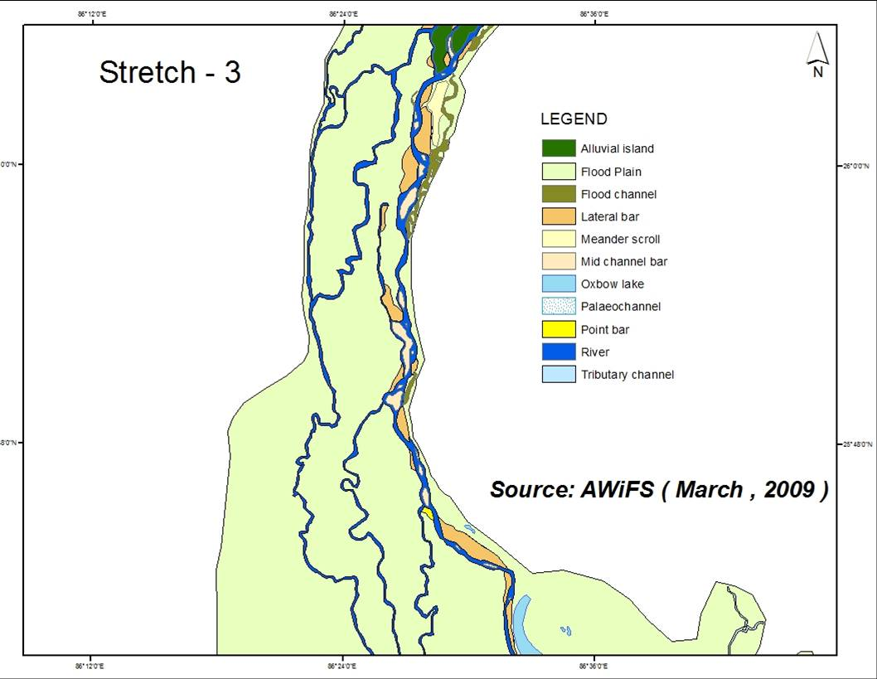

Slide 21
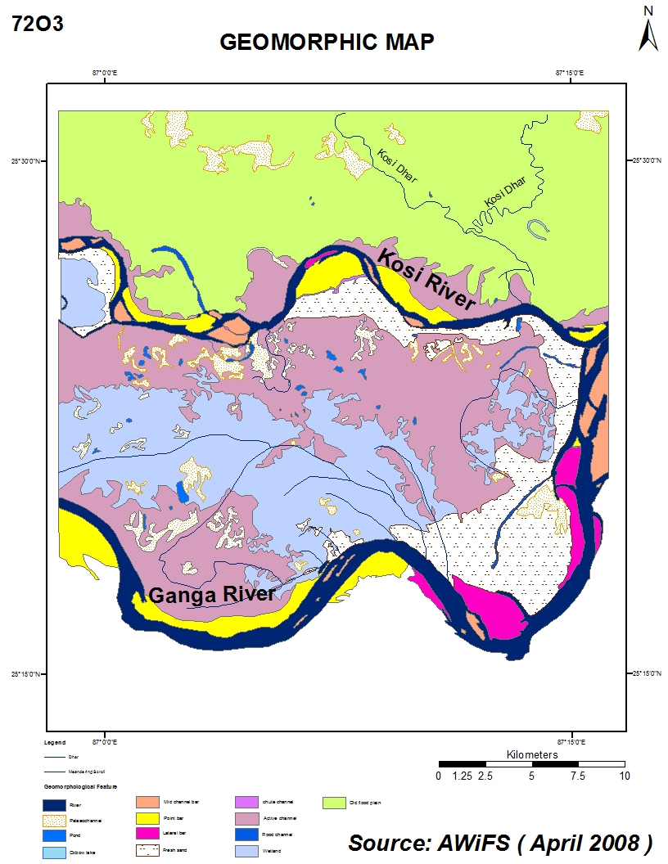
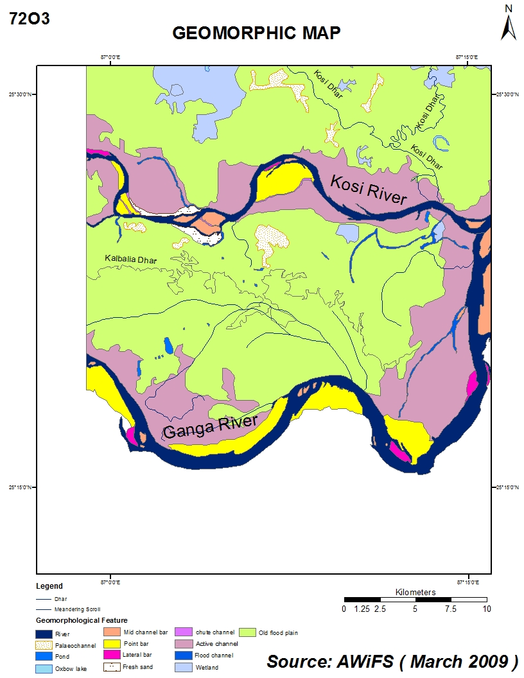

Slide 22
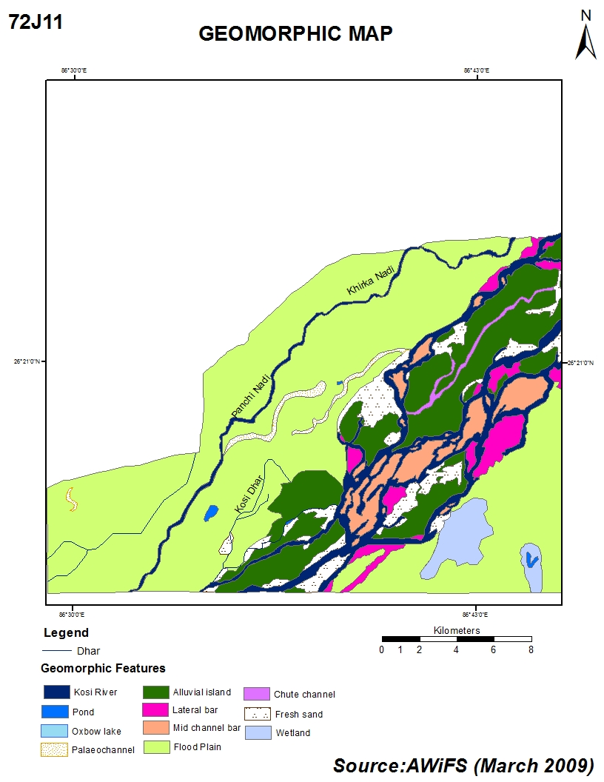
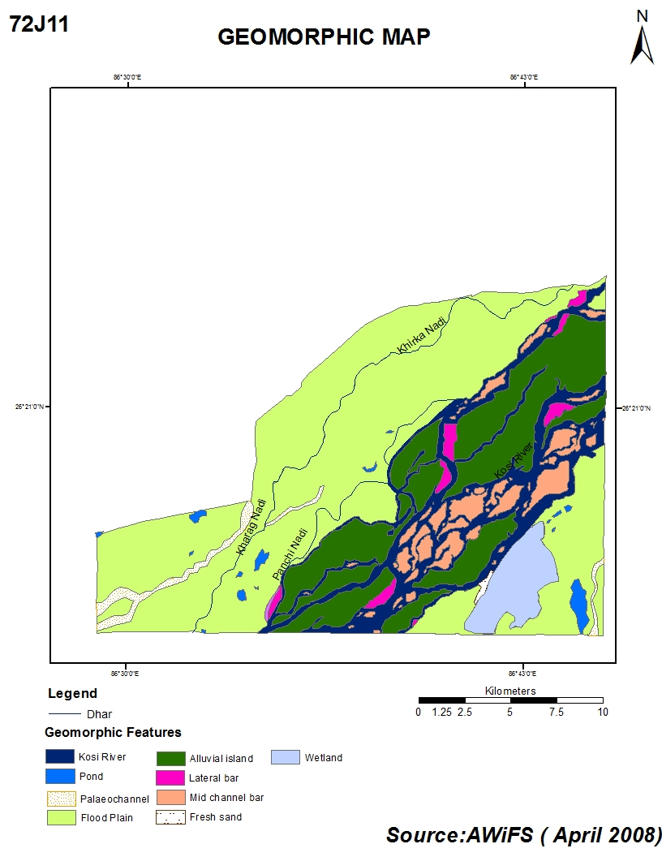

Slide 23
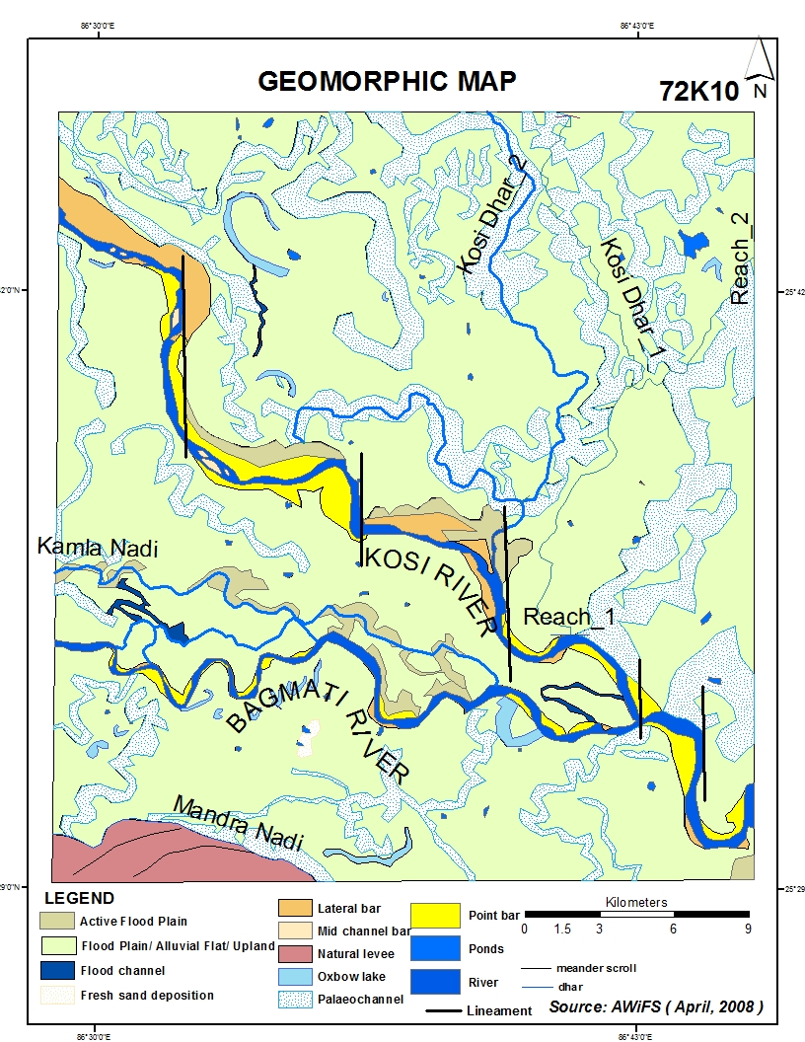
Toposheet No - 72K10
Data – AWiFS
Month – April
Total Area – 870.27 km²
Flood Plain (Area)-135.07km²
Fresh sand deposition-0.70km²

Slide 24
Channel Character:
River | Length ( km) | Flow direction | Mean. Width (metres) | Max. Width(metres) | Min. Width (metres) | Sinuosity | Braided channel ratio
Kosi River | 48.70 | NW- SE | 346.54 | 1738.53 | 100.50 | 1.32 | 1.00
Bagmati River | 33.74 | E-W | 240.11 | 603.64 | 74.36 | 1.40 | 1.00

Slide 25
Geomorphic Features:
Geomorphic Features | Number | Maximum (km²) Size | Minimum(km²) size
Point bar | 21 | 4.78 | 0.076
Pond | 36 | 0.74 | 0.00014
Mid channel bar | 6 | 0.21 | 0.02
Palaeochannel | 1
Lateral bar | 11 | 8.89 | 0.05
Natural levee | 1 | 17.95
Oxbow lake | 18 | 1.58 | 0.004
Active channel | 10 | 3.52 | 0.73
Flood channel | 3 | 1.52 | 0.40

Slide 26
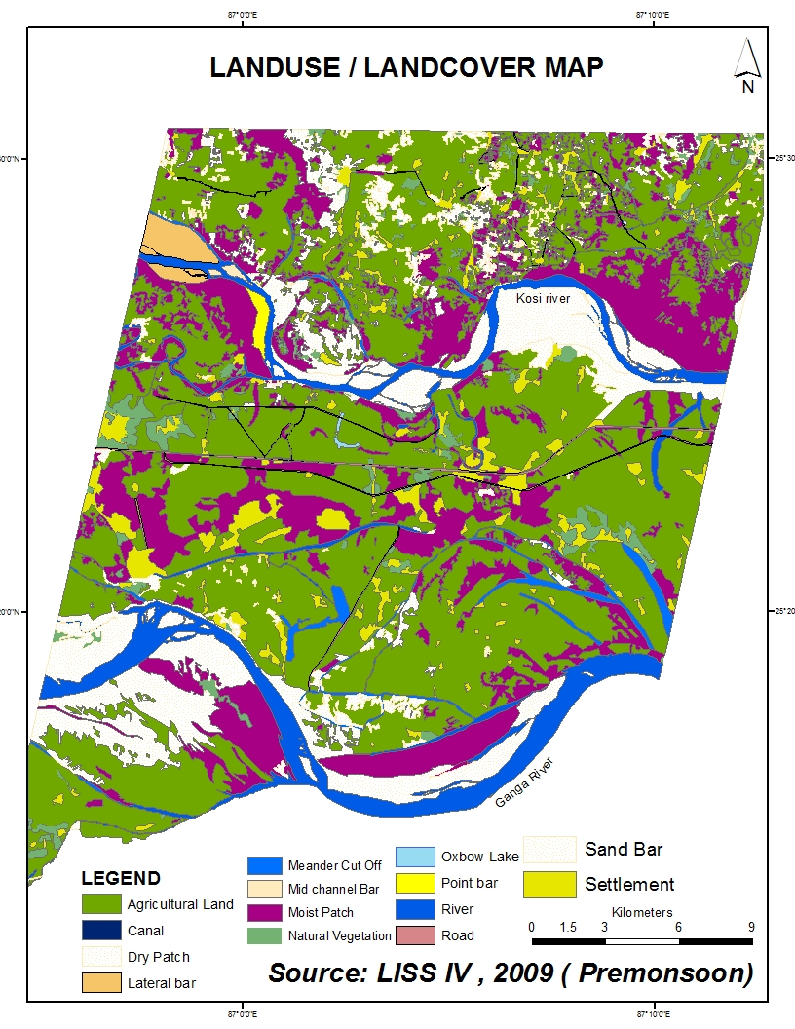

Slide 27
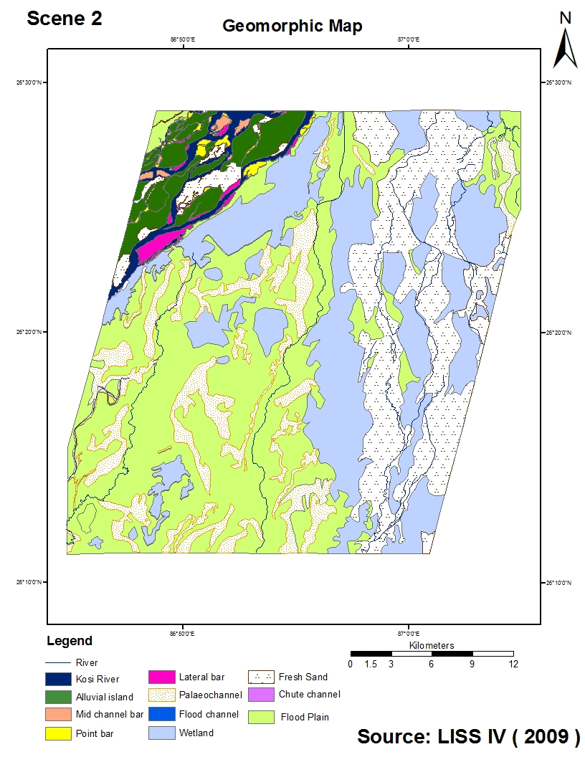

Slide 28
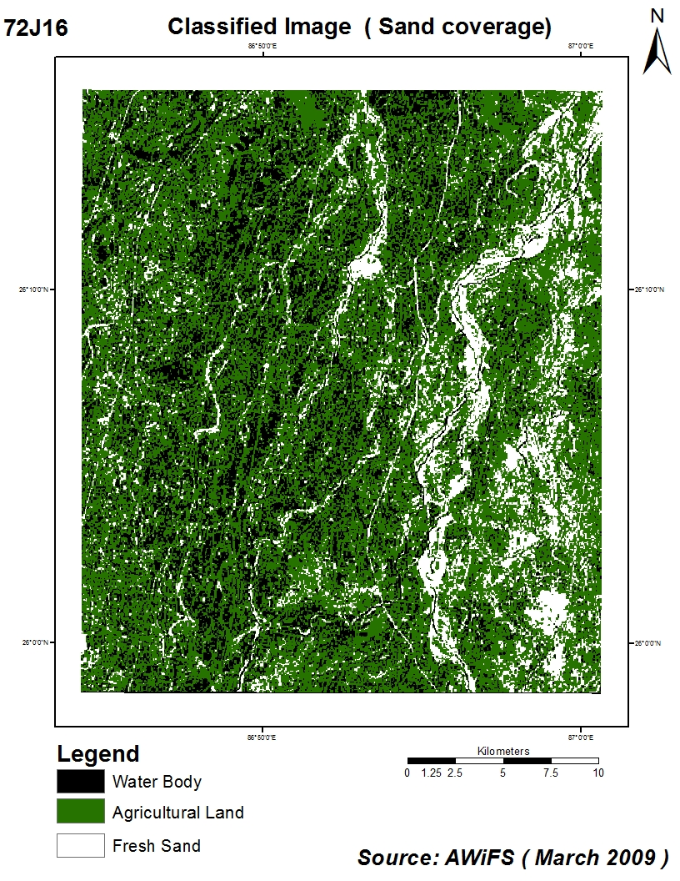

Slide 29
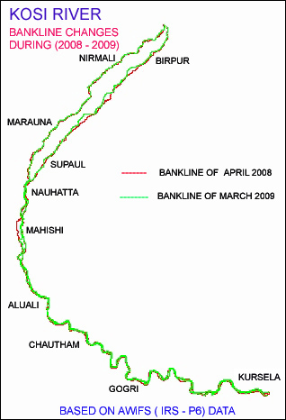

Slide 30
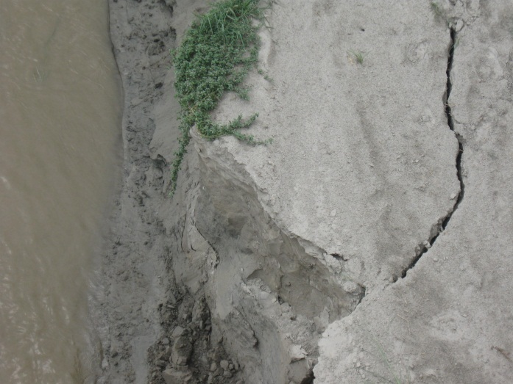
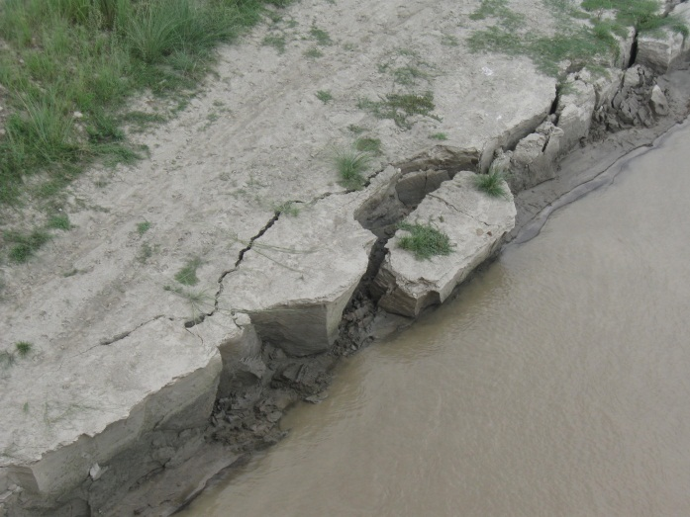
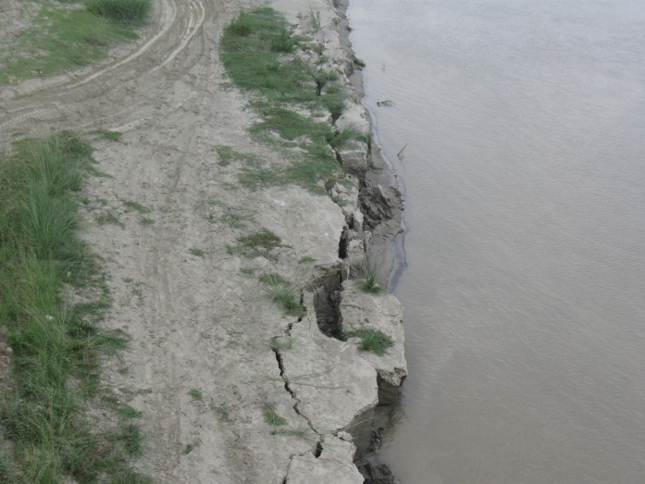
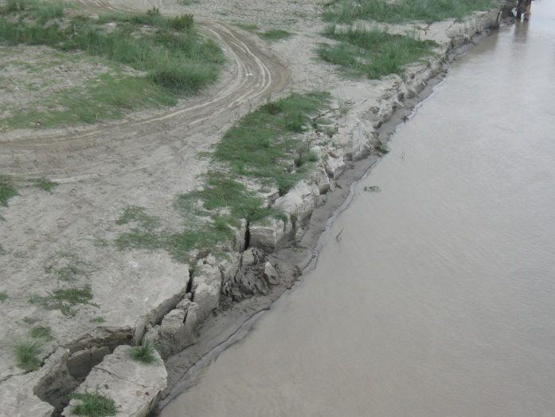
Lateral Erosion of Kosi River

Slide 31
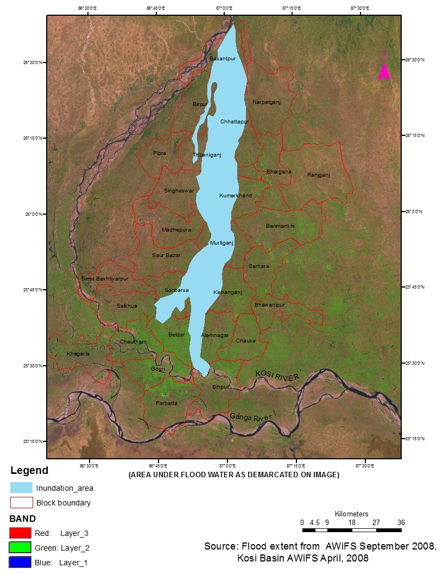

Slide 32
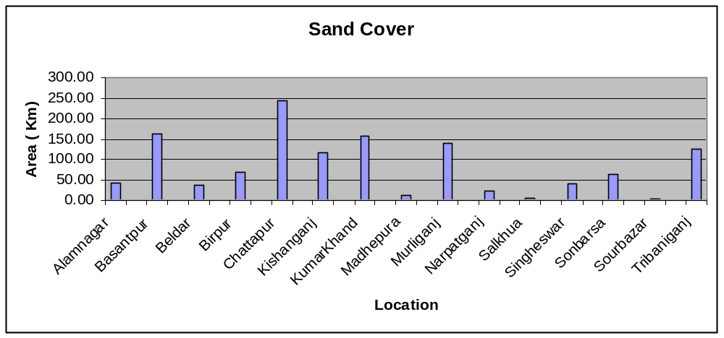
sandcover:due to floods

Slide 33
Conclusion
The integrated study using Remote sensing,Geological and Geophysical data and GIS has revealed that:
The subsurface structure have played a significant role in shaping the contemporary surface features of the Kosi megafan.
The Kosi megafan has a convex-up cross profile and cocave –up longitudnal profile.The maximum slope of the megafan is 0.05* near its apex and that near the toe it is 0.01*
A radiating network of abandoned and active channel is present on the megafan surface.
Presence of several types of channel on the megafan. These channels are incised upto 6-7 mts.on the megafan surface and are reworking the uppermost deposits of the megafan.Numerous other channel on the megafan are nearly dry or with stagnant hyacinth covered .

Slide 34

THANK YOU !

