Slide 1

Chemical Characterization of Coke Fouling
From Pipeline, Refinery and Upgrader Process Units.
Roxanne Shank, P.Chem. M.Sc.
shank.roxanne@cleanharbors.com

Slide 2
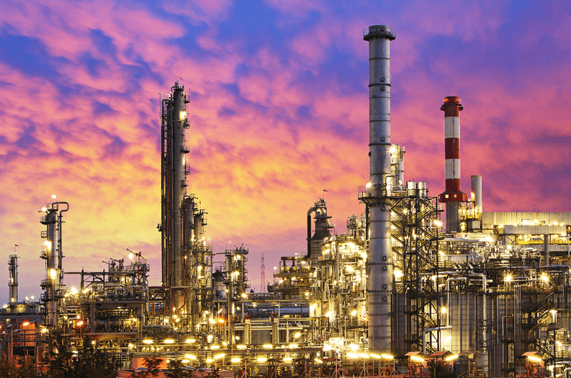
Introduction
One of the biggest fouling problems in refineries, upgraders and pipelines is coke fouling
Little Research
Mechanical Methods
Better Way?

Slide 3
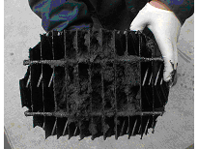
Coke Fouling
Largely misunderstood, often misinterpreted
Most of the fouling in the energy sector is attributed to coke
  Usually a mixture, iron sulfides likely
Sample research may be difficult
Feedstock changes
  Impurities
  Sulfur Content
  Asphaltene/Maltene content

Slide 4
Fouling Process
A number of models exist for the formation of coke fouling in the process stream.
Thermal Conversion Model
  Asphaltenes converted to ashaltene cores.
  Concentration < solubility, cores precipitate out as coke.
Thermal Cracking Model
  Hot Spots = thermal cracking = coke particles in fluid
Mechanisms of Coke Fouling
Free flowing particulates in the fluid, plugging off pipes and tubes
Coke precipitates and is deposited on the metal surface
Layer of coke forms at the metal surface and grows.

Slide 5
Temperature and Pressure
Temperature is a key factor in the process
  As temperature increase, coke formation increases rapidly
As the pressure increases, the temperature increases, but the fluid is not uniform
  Hot Spots arise in the fluid, resulting in spontaneous thermal cracking, and an increase in the formation of coke.

Slide 6
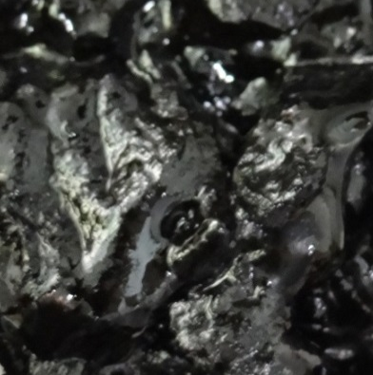
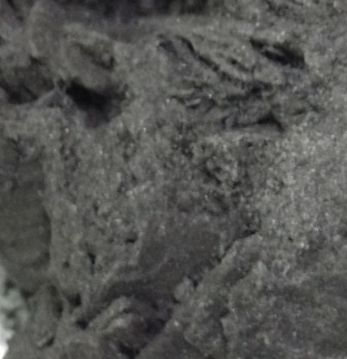
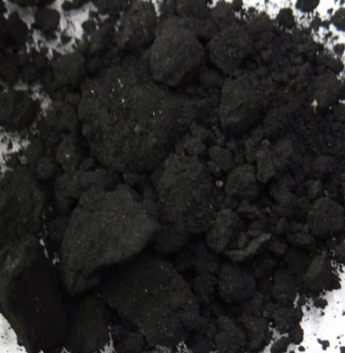
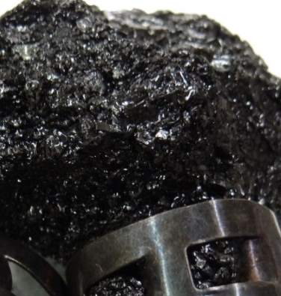
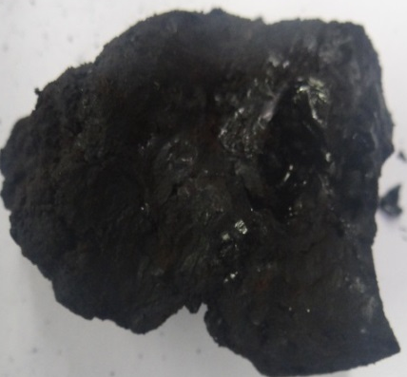
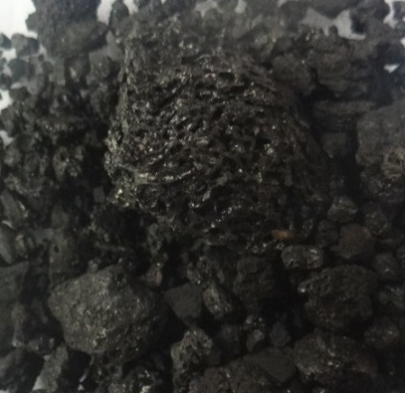
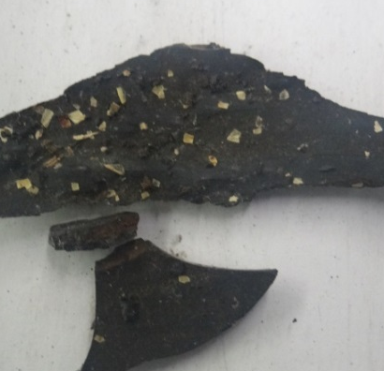
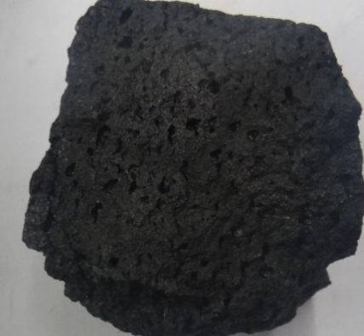
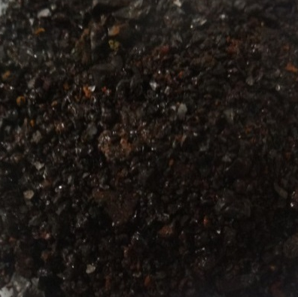
Samples
Over 60 samples have been collected over the past 20 years from various pipeline, refinery and upgraded process units worldwide, each deemed to be ‘coke’

Slide 7
Experimental Methods
Multi-part Chemical Analysis
  Organic extraction
  Inorganic Digestion
Instrumental Analysis of Inorganic Components
  X-Ray Fluorescence (XRF)
  Powder X-Ray Diffraction (XRD)
  Fourier Transform – InfraRed (FT-IR)

Slide 8
Chemical Analysis
A multi-stage approach is used distinguish the different fractions in the sample.
  Organic extractions
    Distinguish between light hydrocarbons, asphaltenes and heavy fractions, paraffin and water.
  Inorganic Digestion
    Digestion of the inorganic portion in various acids to determine composition.

Slide 9
X-Ray Fluorescence
The inorganic portion of the sample is analyzed by qualitative XRF (detects S to Se)
Background
Signal
Fe
S
Ca
Cu Zn

Slide 10
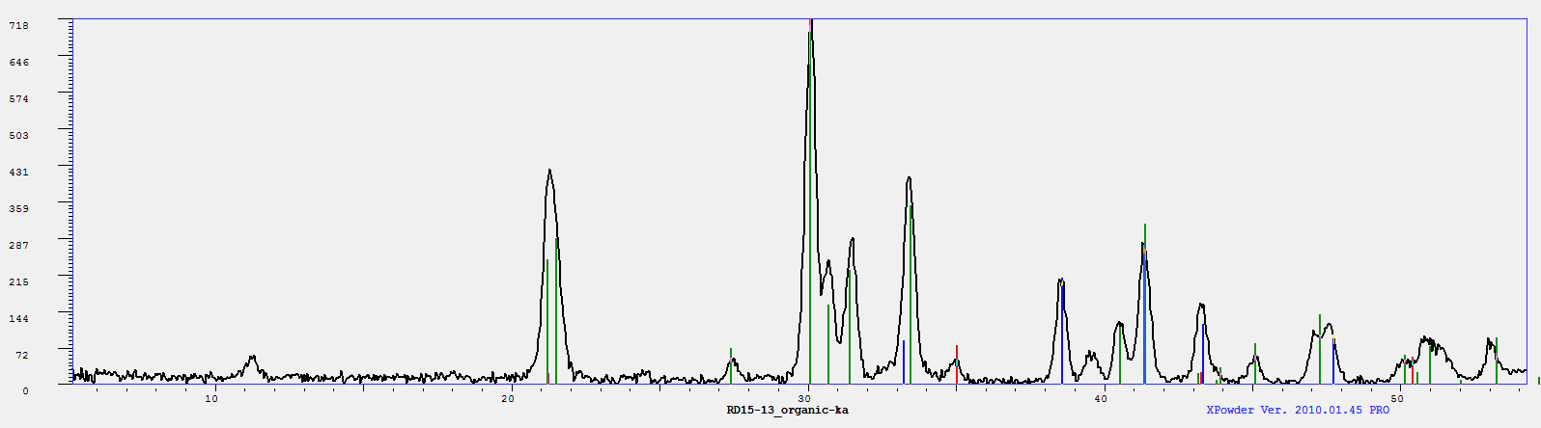
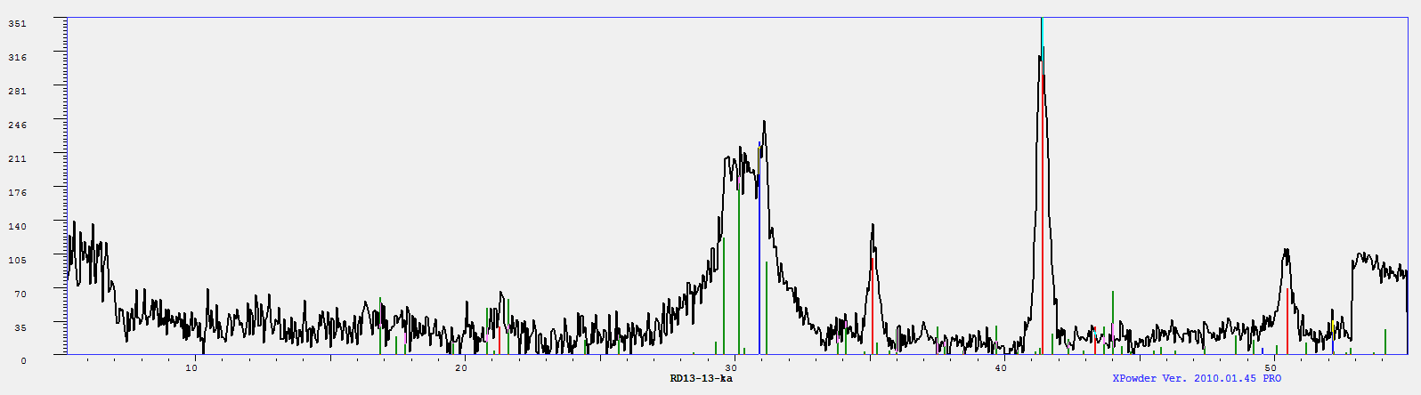
X-Ray Diffraction (Powder)
Inorganic Portion is crushed and assessed by XRD to determine composition.
Iron Sulfide - 9.3%
RD23-17
Iron Oxide) - 5.7%
Iron Sulphate – 70.8%
RD13-13
Iron Oxide – 8.5%
Crystalline Coke – 19.5%
Iron Sulphate – 52.7%

Slide 11
FT-IR
Samples are assessed by diamond ATR
FT-IR analysis before and after organic extraction
Notes:
Label this a little bit more

Slide 12
Results
A total of 62 samples were tested
  Varying levels of amorphous and crystalline carbon (coke or graphitic carbon)
  Nearly 70% of the samples contained sulfur in some form (elemental, iron sulfide, sulfates)
  Silicates (Sand) is a major contaminate in many samples
  Asphaltenes remain as a major carbon source in many of the samples.

Slide 13
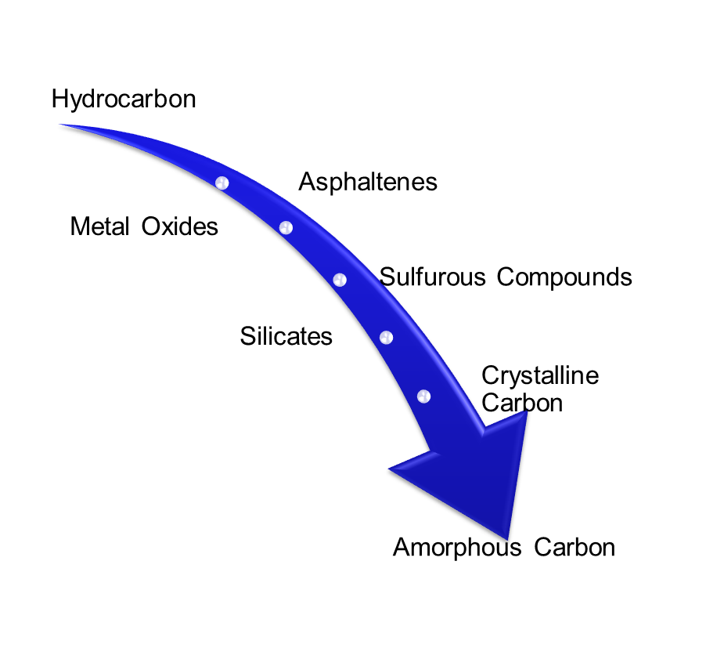
Coke Foulant Spectrum
The samples assessed could be broken up into 5 major categories
Primarily Amorphous Carbon
Primarily Asphaltic
Primarily Sulfurous
Silicate-based Scale
Mixture
Corrosion Products were also observed
Salts and Carbonates may also be present

Slide 14
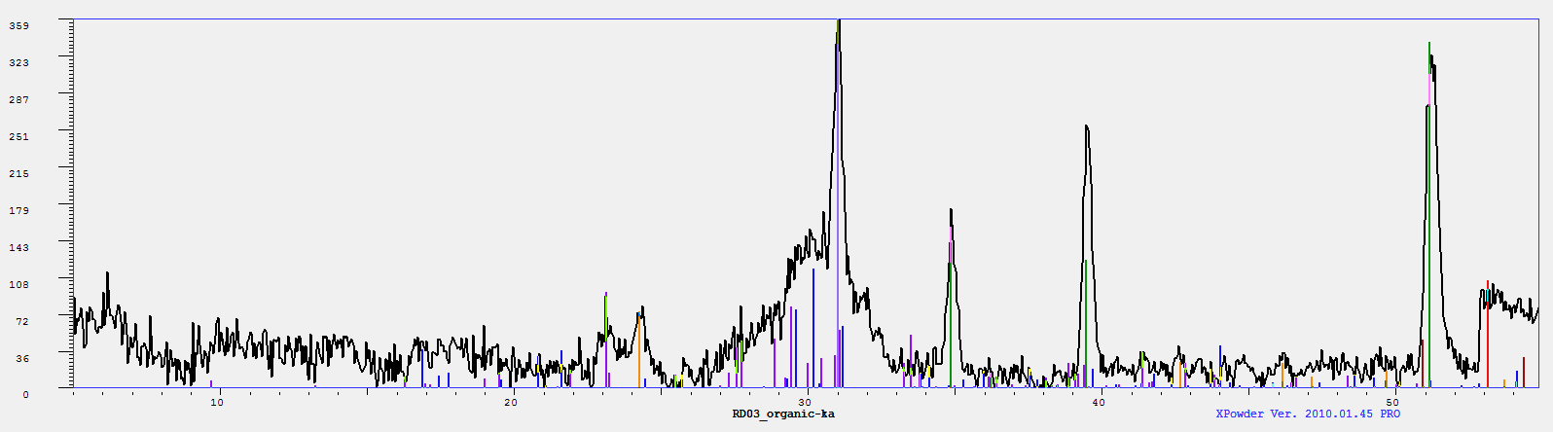
Category 1 – Primarily Amorphous Carbon
RD03-13
Fraction | %wt
Lt. Hydrocarbon | 0.44%
Paraffin | 0.10%
Asphaltenes | 0.78%
HCl Acid Soluble | 2.40%
Sulfurous | 2.19%
Silicates | 2.31%
Unreacted Residue | 91.78%
Background
Signal
Ti
Fe
V
Cr
S
Iron – 0.4%
Mereiterite – 14.6%
CrS – 6.6%
Quartz – 12.1%
Graphite – 18.5%
Sulfur – 24.2%
25/62 ~ 40% of samples

Slide 15
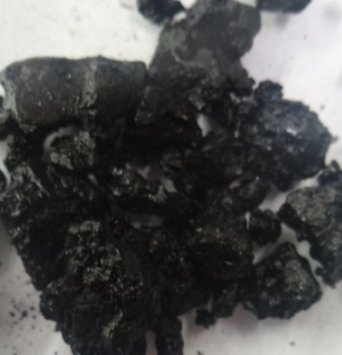
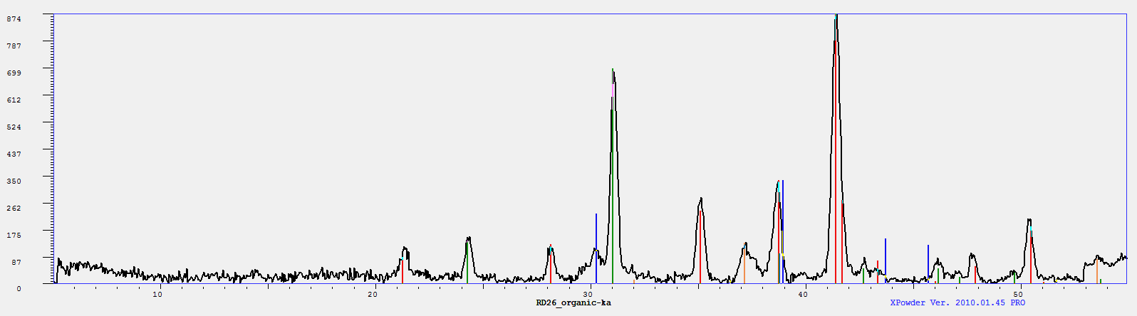
Category 2 – Primarily Asphaltic
RD26-17
Fraction | %wt
Lt. Hydrocarbon | 19.48%
Paraffin | 0.26%
Asphaltenes | 76.30%
HCl Acid Soluble | 2.75%
Sulfurous | 19.53%
Silicates | 0.00%
Unreacted Residue | 0.67%
Fe
Background
Signal
Ca
Sc Ti
V Cr
S
Iron Oxide – 27.2%
Iron Sulfide – 16.8%
Silicate – 34.8%
Salt – 7.9%
9/62 ~ 15% of samples

Slide 16
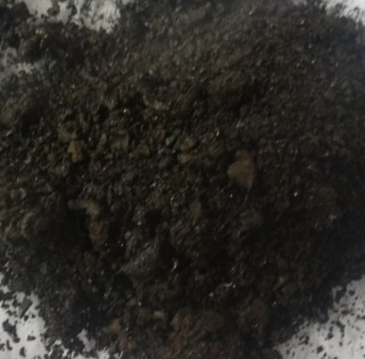
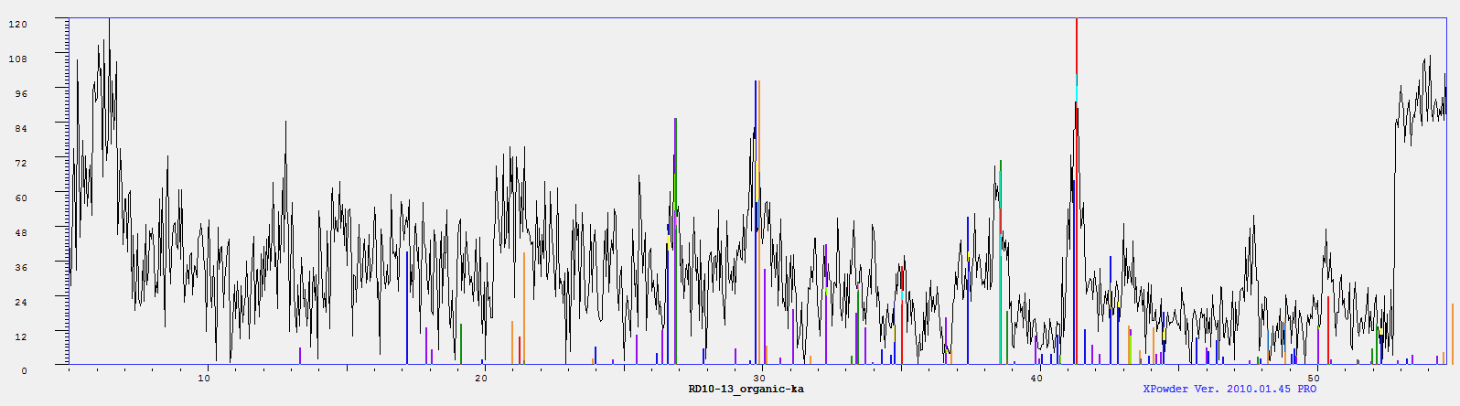
Category 3 – Primarily Sulfurous
RD11-13
Fraction | %wt
Lt. Hydrocarbon | 2.19%
Paraffin | 0.51%
Asphaltenes | 8.57%
HCl Acid Soluble | 4.30%
Sulfurous | 71.87%
Silicates | 1.16%
Unreacted Residue | 11.40%
Background
Signal
Fe
Ca
Cr
Iron Oxide/ Metal Oxide – 15.7%
Iron Phosphate – 11.7%
Sulfur/
Sulphur – 18.0%
10/62 ~ 16% of samples

Slide 17
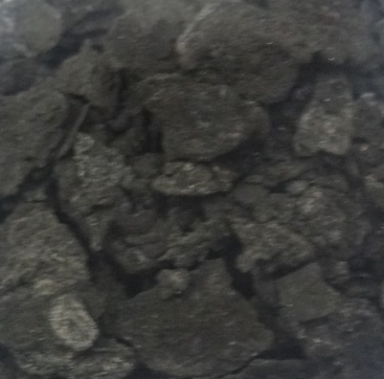
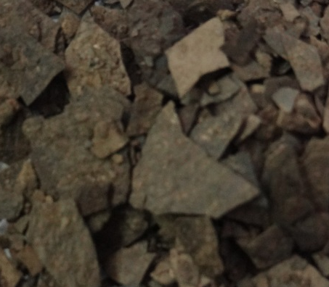
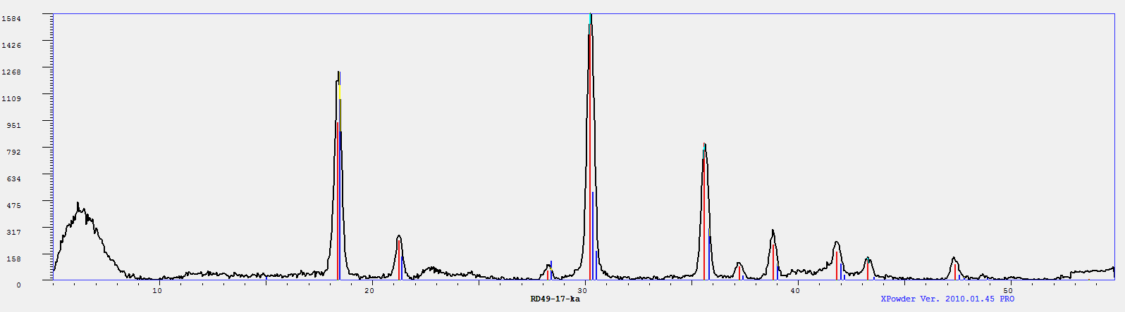
Category 4 – Silicate
Based Scale
RD49-17
Fraction | %wt
Lt. Hydrocarbon | 7.56%
Paraffin | 0.42%
Asphaltenes | 5.54%
HCl Acid Soluble | 14.76%
Sulfurous | 10.78%
Silicates | 55.04%
Unreacted Residue | 5.90%
Background
Signal
Fe
Cl
Cr
Ni Cu Zn
Silicate – 63.3%
Silicate – 25.4%
3/62 ~ 5% of samples

Slide 18
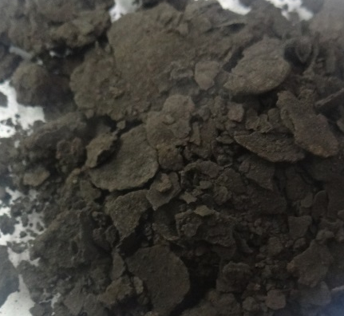
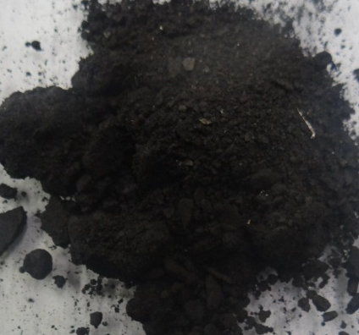
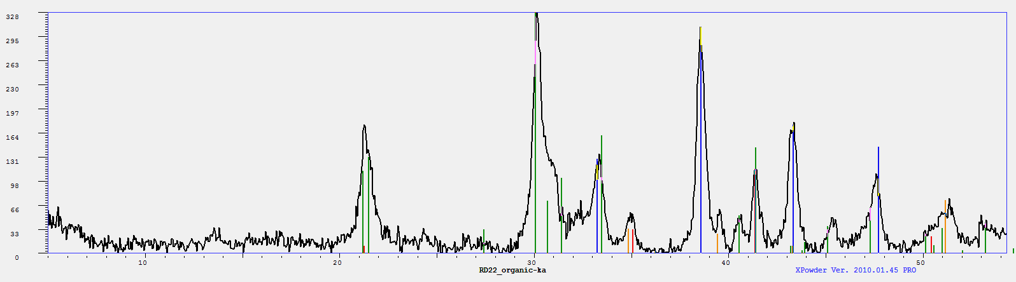
Category 5 – Mixture
RD22-13
Fe
Fraction | %wt
Lt. Hydrocarbon | 18.77%
Paraffin | 0.45%
Asphaltenes | 5.34%
HCl Acid Soluble | 13.95%
Sulfurous | 21.74%
Silicates | 7.82%
Unreacted Residue | 31.93%
Background
Signal
S
Ca
Cr
Iron Oxide – 3.6%
Iron Sulfide/ Metal Sulfide – 25.2%
Iron Sulphate – 49.7%
7/62 ~ 10% of samples

Slide 19
Conclusions
Fouling in refineries is often attributed to Coke
  Coke Fouling is more complex
  Spectrum of coke fouling can be derived
  It may be possible to map the fouling based on process to some degree
  Coke Fouling may be dealt with chemically, reducing cost/downtime of maintaining process units.
Hydrocarbon
Sulfurous Compounds
Silicates
Amorphous Carbon
Crystalline Carbon
Metal Oxides
Asphaltenes
Hydrocarbon
Sulfurous Compounds
Silicates
Amorphous Carbon
Crystalline Carbon
Metal Oxides
Asphaltenes
Hydrocarbon
Sulfurous Compounds
Silicates
Amorphous Carbon
Crystalline Carbon
Metal Oxides
Asphaltenes

Slide 20
Future Studies
CHNS, LOI, Ash Analysis
Elemental Analysis by AES-MP
DRIFTS FT-IR
Map the Foulant Spectrum
Chemical Cleaning Laboratory Studies
In-field Case Studies

Slide 21

Acknowledgements
I would like to thank my colleagues
  Thomas R. McCartney, P. Chem.
  Samar Gharaibeh, P. Chem. Ph.D.
  Darcy Granburg, R. Chem.
  Charlie Clune
Thank you to all companies who have provided samples over the years.

Slide 22


