Slide 1

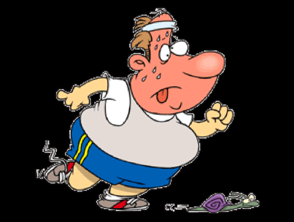
A simple tool to promote
Physical Activity in patients with COPD
Session Title : Oral Presentation
Date: 1st August, 2016
Shakila Devi Perumal, M.Sc.
Senior Respiratory Physiotherapist
Pulmonary rehab Co-coordinator
St. Vincent’s Healthcare Group
Ireland

Slide 2
Shakila Devi Perumal declares no conflict of interest.
“I have six honest serving men
They taught me all I knew
There names are What, and Where and When;
and Why and How and Who”.
– Rudyard Kipling (1865-1936).

Slide 3
Specific Goals
Examine the importance of physical activity in COPD
Illustrate the recommendations of physical activity
Differentiate between physical activity and exercise
Explore strategies to improve physical activity in COPD
Implications of evidence on the current study
Recommendations for future research

Slide 4
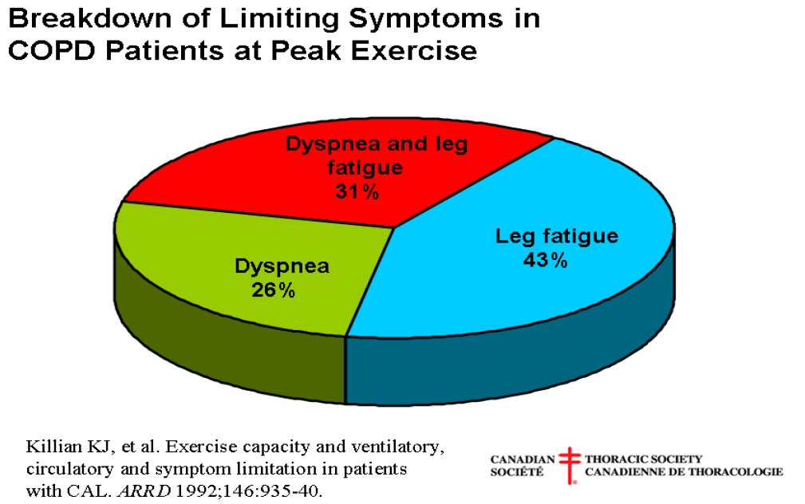

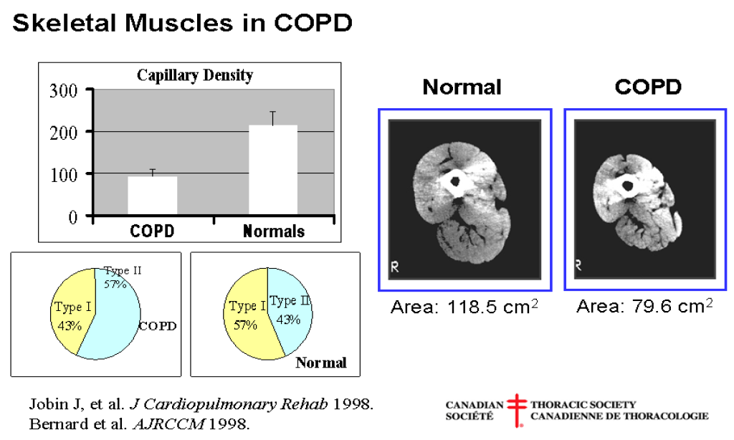
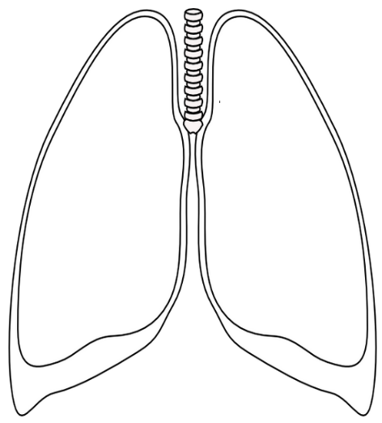

COPD
Exacerbation of Symptoms
Cough
Breathlessness
Fatigue
Chest Infection
Sedentary life style
Hospitalization
0-1, Group A-B
GOLD Stage-1:
FEV1 ≥ 80 % Pred.
GOLD Stage-4:
FEV1 < 30 % Pred.
Hospitalization
>2, Group C-D
GOLD Stage-2:
50% ≤ FEV1 ≤ 80% Pred.
GOLD Stage-3:
30% ≤ FEV1 ≤ 50% Pred.
Hyper Inflation
Physical activities
Social Isolation
GOLD Stage-3:
30% ≤ FEV1 ≤ 50% Pred.
GOLD Stage-2:
50% ≤ FEV1 ≤ 80% Pred.
Hospitalization
0-1, Group A-B
Hospitalization
>2, Group C-D
GOLD Stage-4:
FEV1 < 30 % Pred.
GOLD Stage-1:
FEV1 ≥ 80 % Pred.
Muscle weakness
Anxiety & Depression
Physical
Inactivity

Slide 5
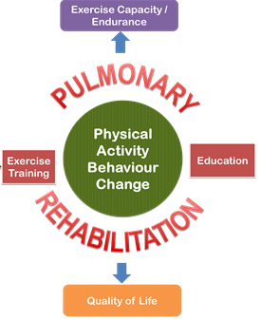
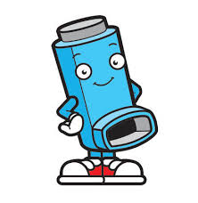
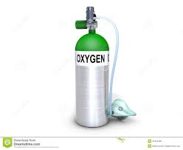
What are current management strategies for COPD
Non-Pharmacological
Management
COPD
Pharmacological
Management
ATS-ERS New statement on PR 2013
“Sustainable health enhancing behaviour change”
Spruit MA, Singh SJ, Garvey C, et al (2013) An official American Thoracic Society/European Respiratory Society statement: key concepts and advances in pulmonary rehabilitation. Am J Respir Crit Care Med; 188:e13-64

Slide 6
Why is Physical (In) Activity in COPD a
burning theme…
Exacerbations/ hospitalizations
Quality of life
FEV1
Co-morbidities
Dyspnea
Physical (in) activity
Physical Fitness
Psychological parameters
Systemic inflammation
Notes:
Percentage of patients who were active (physical activity level >1.70; ▪), predominantly sedentary (physical activity level 1.40–1.69; ▓) or very inactive (physical activity level <1.40; □) according to a) Global Initiative for Chronic Obstructive Lung Disease (GOLD) stages, b) BODE (body mass index, airway obstruction, dyspnoea, exercise capacity) score and c) the modified Medical Research Council (MMRC) dyspnoea scale. CB: chronic bronchitis.

Slide 7
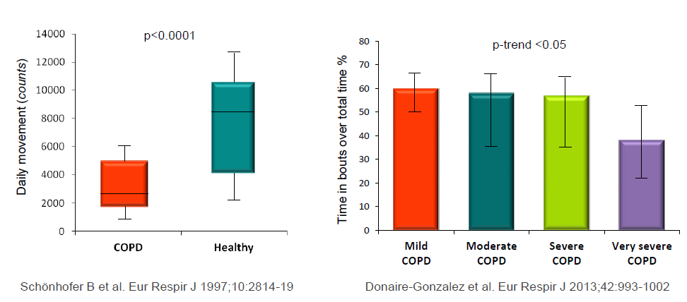
What does the data say……
COPD is a public health challenge and perceived to be the third leading cause of death in the world (Burney et al, 2010; Lozano et al, 2010)
European Respiratory Society

Slide 8
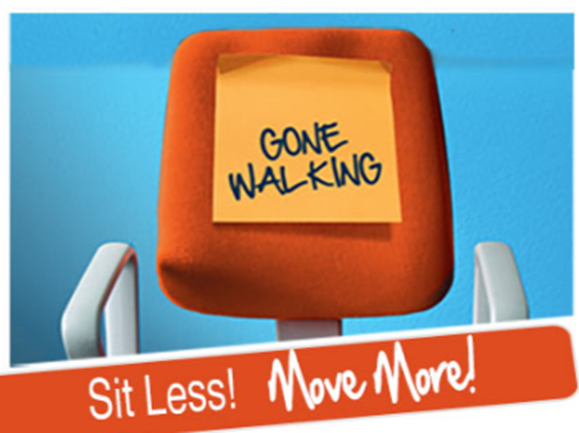
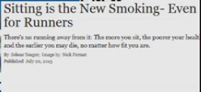
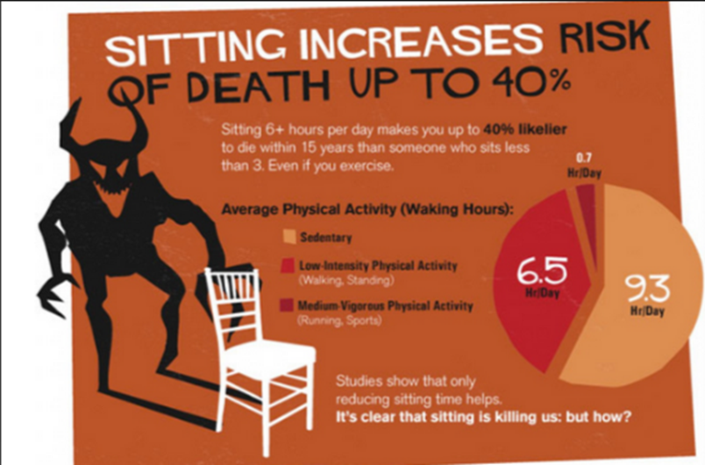


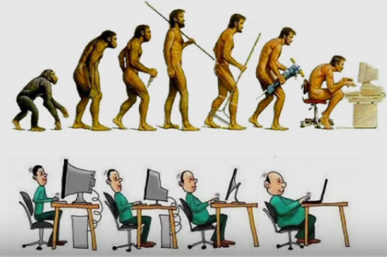

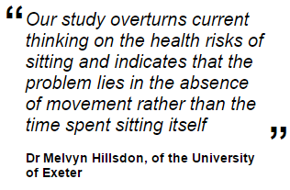
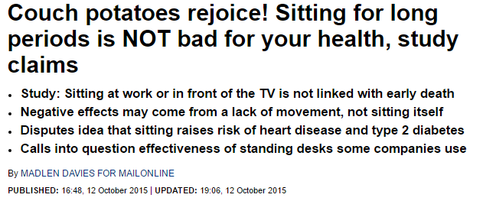
Sitting and Health
Google search- About 173,000,000 results (0.41 seconds)

Slide 9
Does pulmonary rehab address
Physical (in) Activity ?
Healthcare providers refer LESS THAN 13% of the potential candidates who would benefit (Johnston KN et al. 2013).
VARIATIONS persist in the pulmonary rehabilitation (PR) content, duration and format of delivery in different settings at national and international platform (Spruit et al, 2014)
DIFFERENTIAL RESPONSES to regular outcomes within COPD population (Spruit et al, 2015)

Slide 10
Does pulmonary rehab address
Physical (in) Activity ?
PR NON -COMPLETION rates are as high as 20-40% (Fischer MJ et al, 2009).
Benefits of a typical 9-12 week PR course with supervised exercise training DIMINISH to pre- intervention level as early as 3- 6 months post course (Beauchamp et al, 2013).
Lack of standardized physical activity assessments tools are perceived barriers to address physical (in) activity (Cindy et al, 2012; Watz et al, 2014).

Slide 11
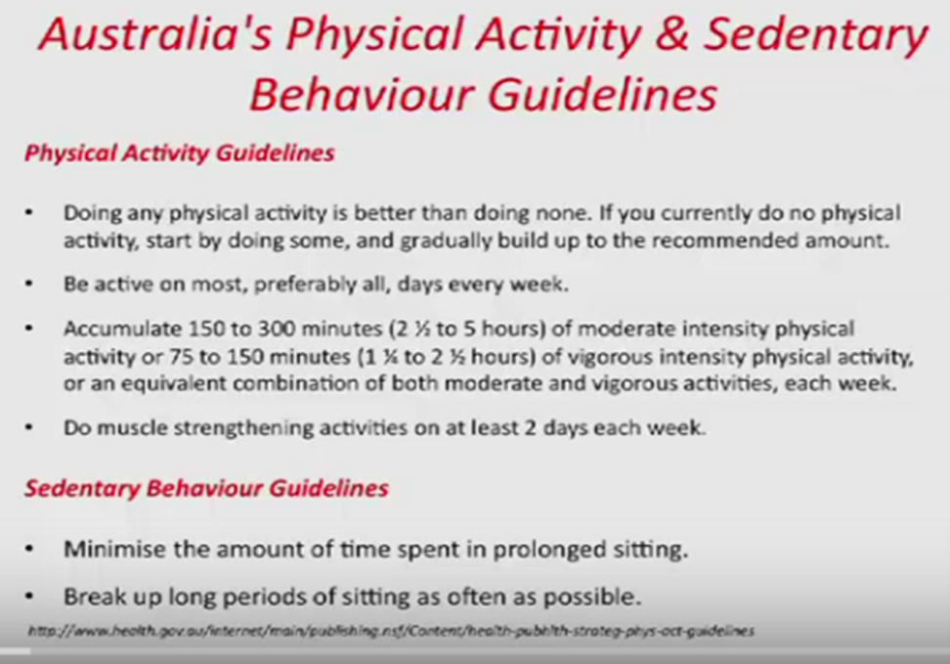
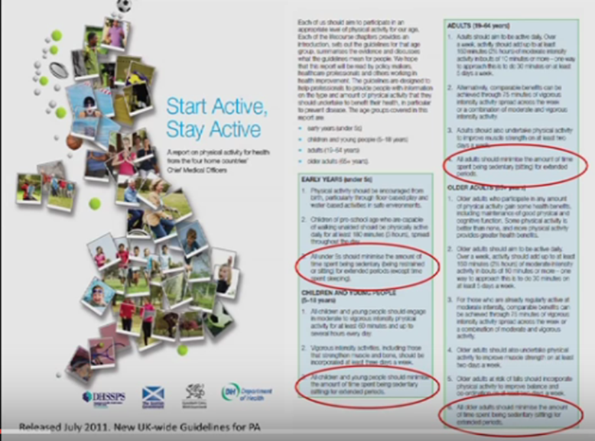
Physical Activity Recommendations
ACSM recommends COPD ( Stage 3 & 4)
“At least 15 minutes of moderate intensity (3 times per week) of physical activity”
But advice alone has a limited impact on modification of sedentary behaviour.
Guidelines on the recommended amount of physical activity to promote and maintain health for adults and specifically for older adults
Aerobic activity: 30 min of moderately intense aerobic physical activity at least 5 days a week or 20 min of vigorously intense aerobic physical activity at least 3 days a week, or an equivalent combination.
Muscular strength and endurance exercises at least 2 days each week.
Haskell WL, Lee IM, Pate RR et al. Physical activity and public health: updated recommendation for adults from the American College of Sports Medicine and the American Heart Association. Med. Sci. Sports Exerc. 39(8), 1423–1434 (2007).
Notes:
A health recommendation was published by the Centers for Disease Control and Prevention and the American College of Sports Medicine stating that every adult should perform 30 min of moderate-intensity physical activity
(in bouts of 10 mins) in addition to what sedentary persons normally perform on most, preferably all, days of the week.

Slide 12



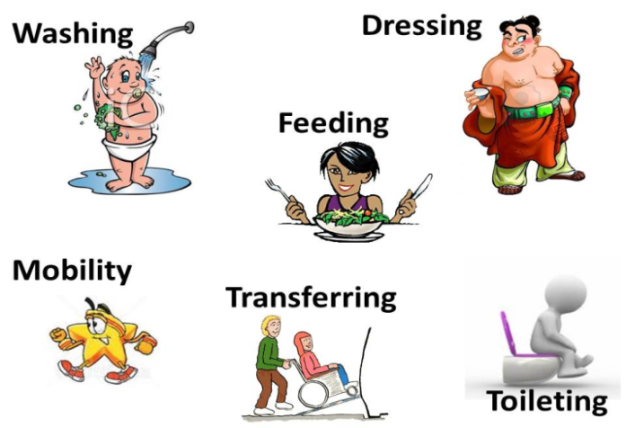
Do we understand right?
Physical activity = Functional Performance
Exercise = Functional Capacity
Activities of daily living

Slide 13
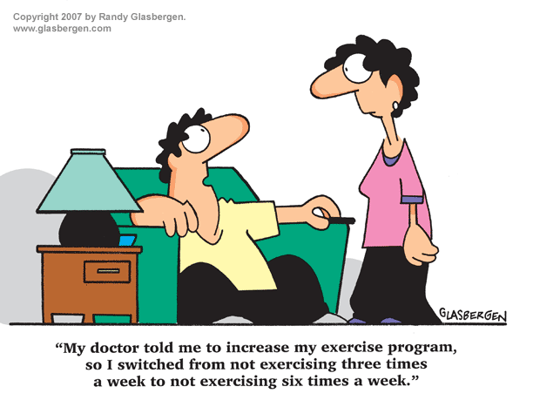
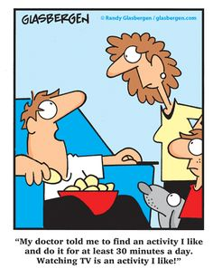
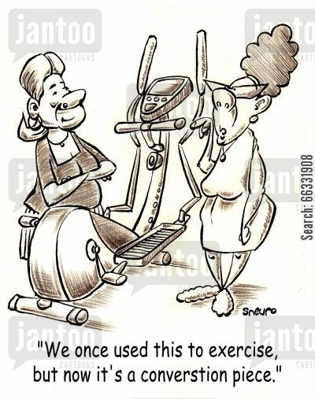
…….closer to reality…..

Slide 14
Are we assessing barriers for Physical Activity appropriately?
Disease related factors
External factors
Amount of physical activity
Symptoms during physical activity
Need for physical adaptations
Emotional Consequences
Social consequences
Dobbels F et al. Eur Respir J 2014; 44: 1223-33

Slide 15
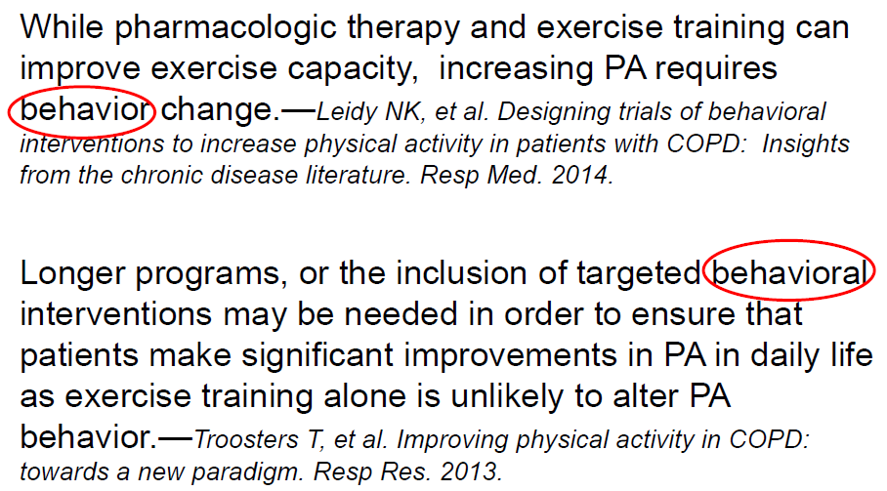
What does the evidence say…..

Slide 16
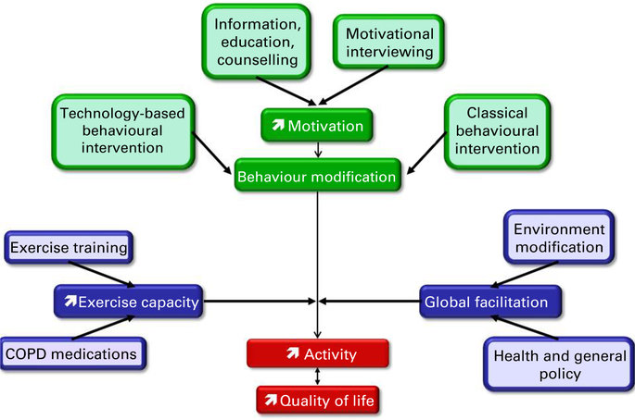
Strategies to improve Physical Activity
Hybrid Tool= Exercise Training + Behavioral interventions

Slide 17
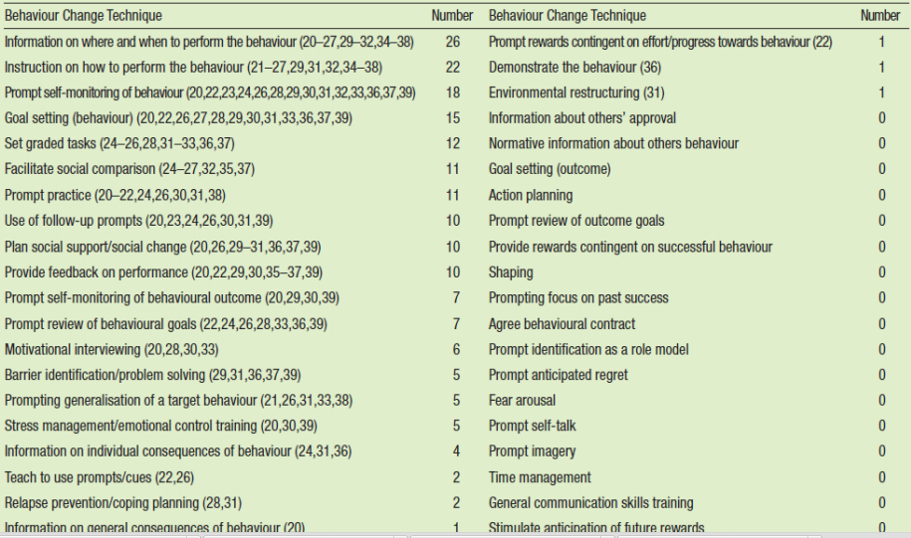
Behavioral Change Techniques
Wilson JJ., et al. Interventions to increase physical activity in patients with COPD: A comprehensive review. J of COPD. 2014.

Slide 18
Necessity is the mother of Invention
Cycling
Walking
Puente- Maestu et al, 2000
Hernandez et al, 2000
Leung et al, 2010
Breyer et al, 2010
Na Jo et al, 2005
Pleguezuelos et al, 2013
Wootton et al, 2014
Research Question
Does a ground based walking prescription during a comprehensive pulmonary rehabilitation (PR) enhance physical activity (PA) behavior change in patients with COPD?

Slide 19
Objective of Study
To explore the short-term effects (8 weeks) of ground based walking prescription during a comprehensive pulmonary rehabilitation (PR) on physical activity (PA) behaviour in patients with moderate to severe COPD.

Slide 20
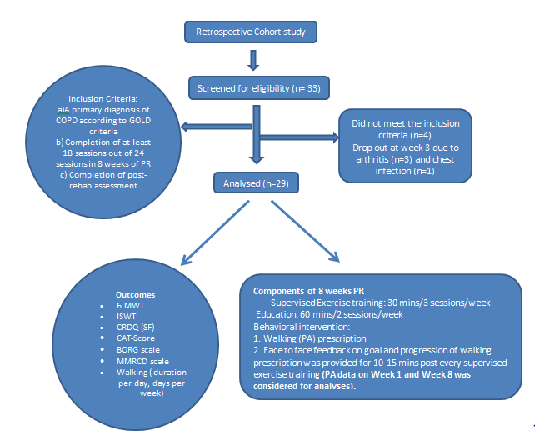
Study Design

Slide 21
Baseline Characteristics of Study Population
Variables | No/Mean(SD)
Patients | 29
Age(yrs) | 71(7.0)
Gender(M/F) | 10/19
Current Smokers | 3
Exacerbation per year | 4
FEV1(% perdicted) | 59(22)
FVC (% perdicted) | 97(18)
FEV1/FVC (% predicted) | 47(13)
Duration of ground based walking per week(mins) | 14(3)
Frequency of ground based walking per week(days) | 2(1)
Patients on ambulatory oxygen | 7
Data are presented as n, mean(SD) or n(%). FEV1: forced expiratory volume in 1s; FVC: forced vital capacity.

Slide 22
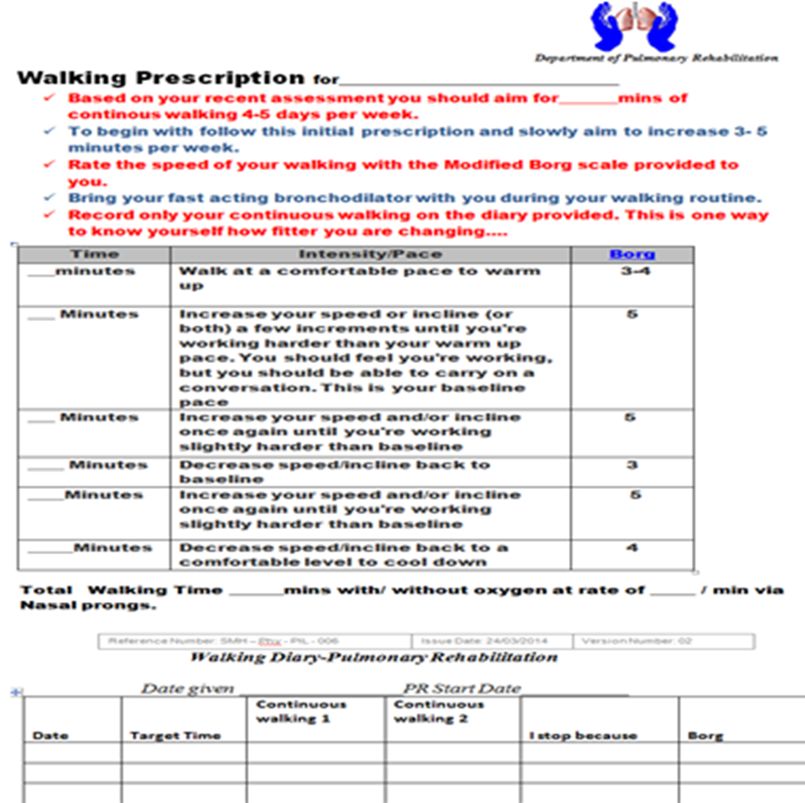
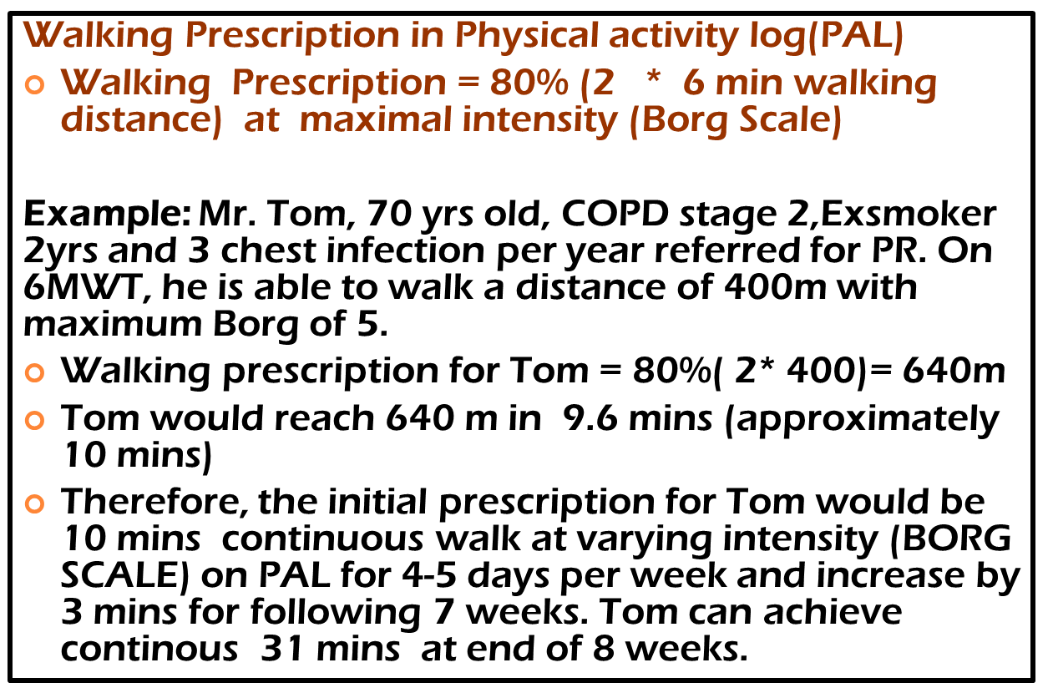
Walking Prescription + Log sheet

Slide 23
Pre and Post Rehab Results
Parameters | Pre-Rehab [Mean(SD)] | Post-Rehab [Mean(SD)] | Mean difference | P value
6MWT (meters) | 385.5 (65.2) | 472.1 (73.9) | 87 | < 0.0001
ISWT (meters) | 335.5 (146.0) | 399.7 (134.8) | 64 | 0.0081
PA (mins) | 14.1 (3.0) | 20.69 (7.9) | 7 | < 0.0001
PA(days per week) | 3.5 (0.7) | 4.1(0.5) | 1 | 0.0054
CAT-Score (points) | 23.6 (6.1) | 18.90 (7.9) | 5 | 0.0017
CRDQ (points) | 13.0 (3.6) | 17.70 (2.7) | 5 | 0.0002
Borg (points) | 5 (1.2) | 4 (0.9) | 1 | 0.0073
MRCD (points) | 4 (0.6) | 3 (0.6) | 1 | < 0.0001

Slide 24
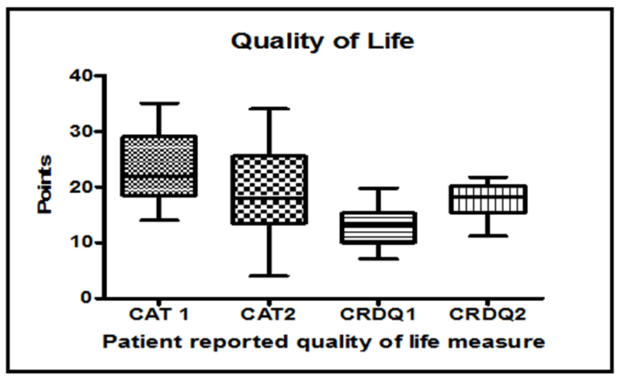
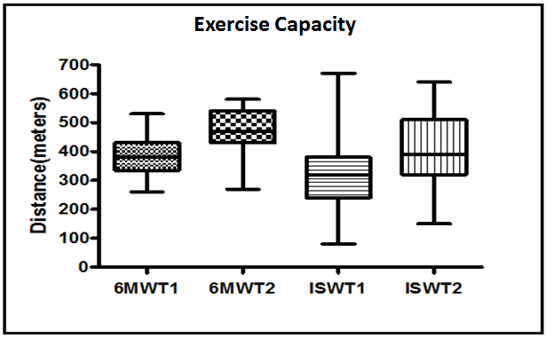
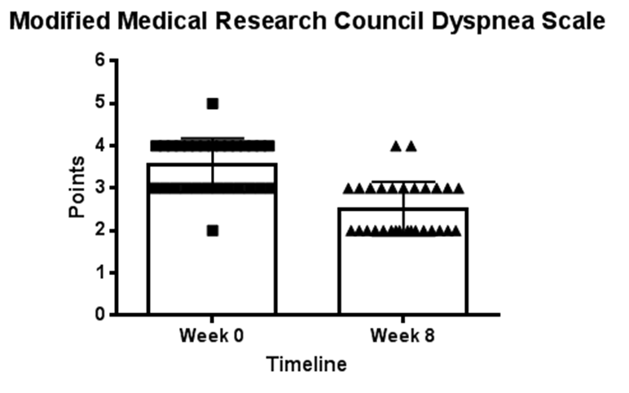
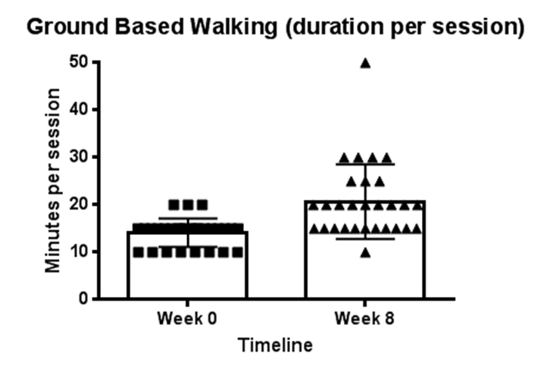
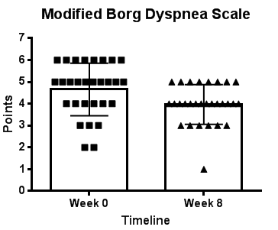
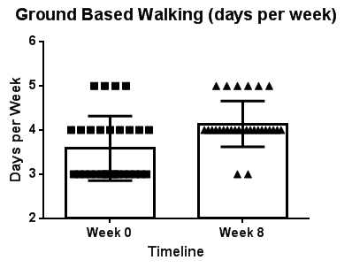
Results

Slide 25
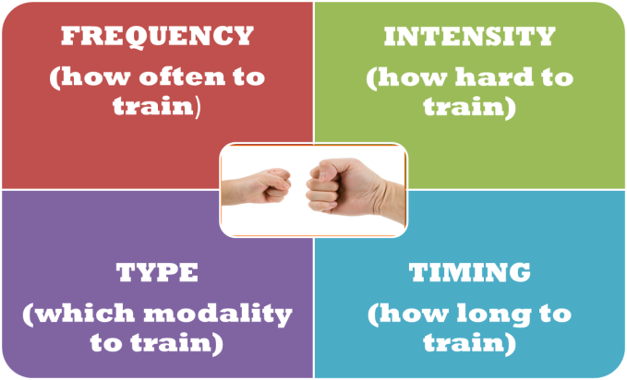
Strengths
First study in Ireland
Physical activity exceeded the ACSM recommendations for COPD.
Low drop-out rate of 12 %
Improved patient’s adherence and motivation towards physical activity.
No cost
Requires only small time to provide feedback (10 mins).
Notes:
A significant mean improvement in the ground walking duration [mean difference of 6 mins (360 seconds)] per day compared to baseline, confirming a positive change in physical activity behaviour compared to previous two studies (186s and 279 s) achieved (Wootton et al, 2014 and Leung et al, 2010).
Significant increase in physical activity from baseline exceeding the ACSM recommendations for COPD
Low drop-out rate of 12 % in contrast to high drop-out of 20 - 30 % in any pulmonary rehabilitation programme .
Improved patient’s adherence and motivation towards physical activity..
The word “Walking Prescription” possibly had a positive behavioral effect on their compliance to physical activity (ground-based walking).
No cost involved but need small time by health professionals to supervise walking prescription and provide feedback (10-15 mins).
Overall, our patient's compliance to both ground walking prescription and PRP was satisfactory. Of note, our patients (40 mins per day, 4 days per week) exceeded the minimal PA recommendations for COPD by American college of sports medicine (15 mins per day, 3 days per week).
Patients felt that the individualized goal setting on PA, supervision by health professional (physiotherapist) weekly and feedback on progression of PA had improved their motivation and adherence to daily PA behaviour

Slide 26
Limitations
No control group
Small sample size
Subjective data on PA
No physiological testing
Results cannot be generalized to all stages of COPD.
Only focused on short-term PA behaviour change.

Slide 27
Conclusion
Simple, Practical, Accessible, Communicative and Economical (SPACE) Tool to launch our mission on physical activity……
You don’t have to be GREAT to start, but you have to START to feel great….
So just START………….

Slide 28
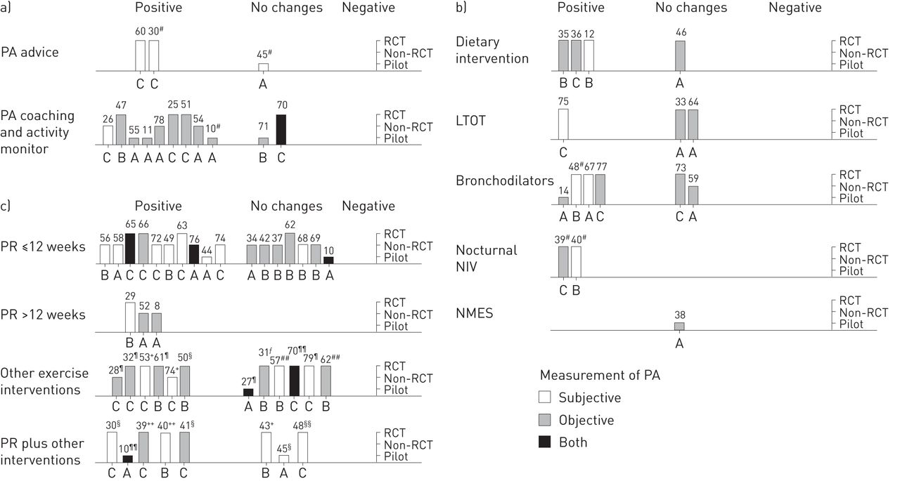
Future recommendations
Interventions to modify physical activity in patients with COPD: a systematic review
Leandro Cruz Mantoani, Noah Rubio, Brian McKinstry, William MacNee, Roberto A. Rabinovich
DOI: 10.1183/13993003.01744-2015 Published 21 April 2016

Slide 29

Email: shaki_bpt@yahoo.co.in
LinkedIn Profile: https://ie.linkedin.com/pub/shakila-devi-perumal/25/967/276
Research gate: https://www.researchgate.net/profile/Shakila_Devi_Perumal

