Slide 1


Association of Tightness of Glycemic Control with Biomarkers of Aging in Healthy and Diabetic Subjects
Shailaja Moodithaya, Shruthi Suvarna, Raghava Sharma
Additional Professor Lecturer Professor,
Department of Physiology Department of Physiology Department of Medicine
K.S. Hegde Medical Academy A J Institute of Medical Sciences K.S. Hegde Medical Academy
Nitte University, Mangalore. Mangalore
Karnataka, India,575018
Shailaja.moodithaya@nitte.edu.in
Notes:
1

Slide 2
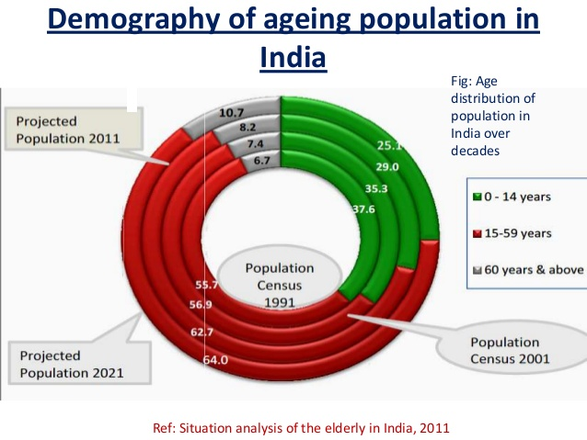

Background: Elderly in India-Facts
India |  | Urban N =1000
Chronic Disease |  | M | F
Cough |  | 179 | 142
Piles |  | 32 | 18
Joint Problems |  | 285 | 393
High/low BP |  | 200 | 251
Diabetes |  | 85 | 66
Heart disease |  | 68 | 53
Urinary Problem |  | 49 | 24
Cancer |  | 2 | 4
Any of the above |  | 528 | 560
National Sample Survey 52nd Round Survey
Notes:
The major thrust has been on improving the health status of children and women
Geriatric services are largely unorganized.
‘Expansion of morbidity’ even though increased life expectancy due to chronic non-communicable diseases.
The major thrust has been on improving the health status of children and women
Geriatric services are largely unorganized.
‘Expansion of morbidity’ even though increased life expectancy due to chronic non-communicable diseases.
Longer duration of diabetes leads to greater complications and this could threaten the national economy.
India carries the highest burden of diabetes with escalating prevalence in both urban and rural populations.
Indians develop diabetes at a younger age, younger than 45 years accounts for 36% of all diabetics in India.
Longer duration of diabetes leads to greater complications and this could threaten the national economy.

Slide 3
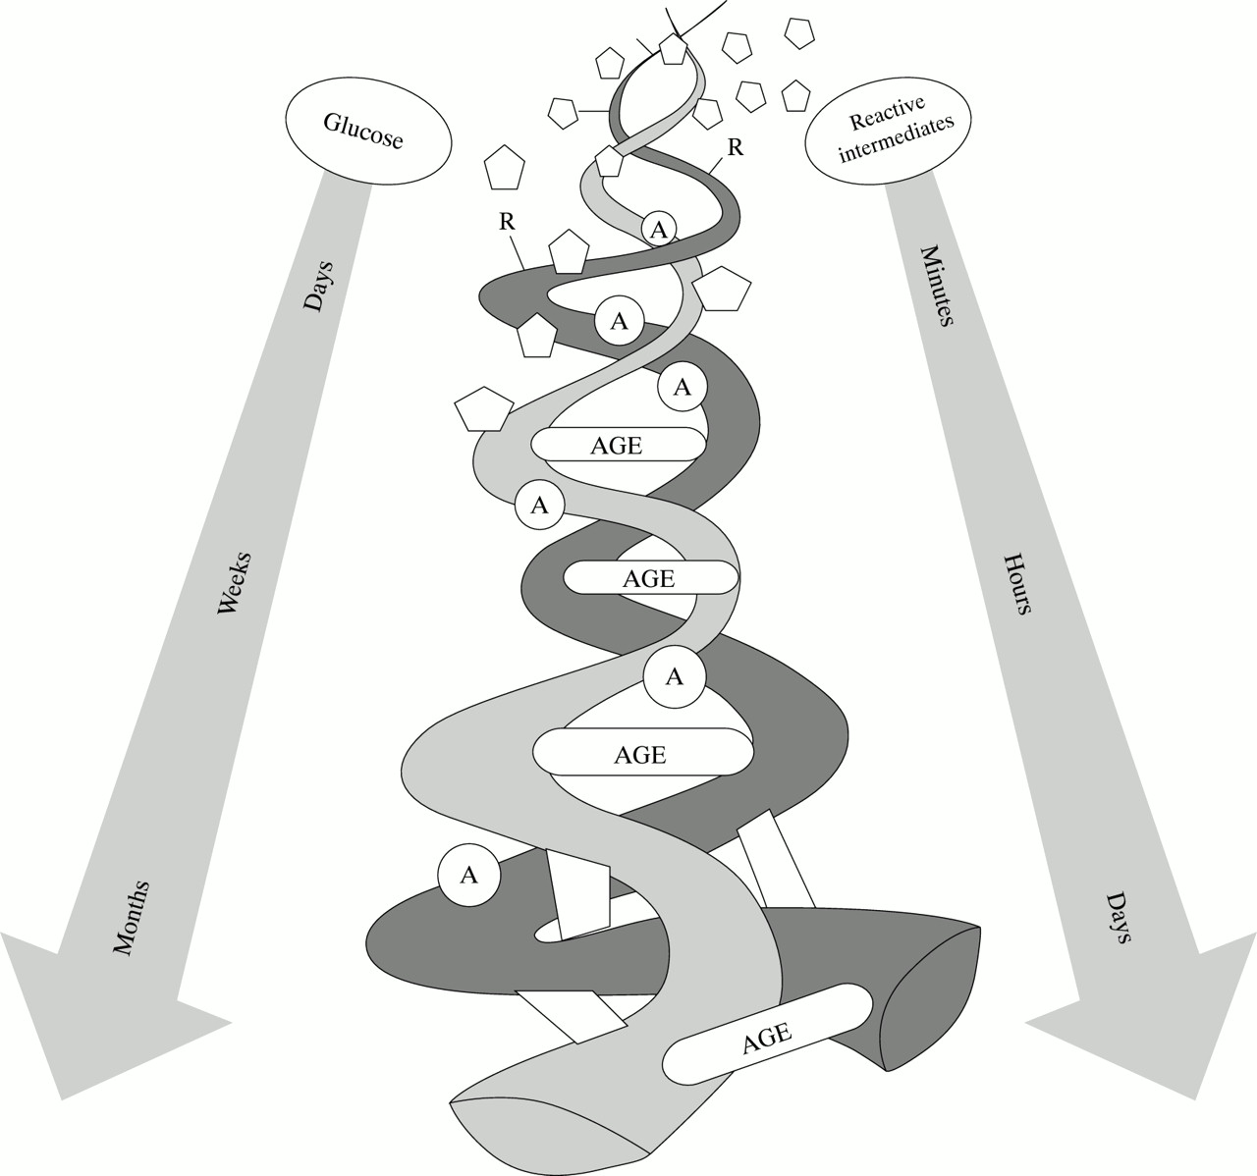

Background: Glycation
Common biological processes, shared by both aging and diabetes.
Glycated haemoglobin (HbA1c) is one of the markers to assess age-related physiological changes
Also established that endogenous AGEs are generated at higher levels in diabetes.
Notes:
Glycation is a fact of life. It’s happening right now, to all of us
it is not only those with diabetes or pre-diabetes who should be concerned about the damaging effects of Glycation
damage inflicted by advanced Glycation end-products (AGEs) is more as the age advances

Slide 4
Research Hypothesis
Biomarkers of aging which are the surrogate of metabolic and cardiovascular function would be inversely related with the level of glycemic control.
Objectives
To compare the Metabolic and Cardiovascular aging biomarkers of T2DM patients with the age and gender matched normal controls
To evaluate the association of HbA1c with Metabolic and Cardiovascular aging biomarkers.
Notes:
…all people age, but not at the same rate
Assessing. the biological ageing is more rational for categorizing a person’s age.

Slide 5
Methodology
Sample size : n =220
Study population :
a) Patients with T2DM (n=110)
b)Age (40-60yrs) and gender matched healthy subjects (n=110)
Informed consent
Medical History
Sample collection
Metabolic
ageing indices
BMI, Fat percent, W/H ratio
Lipid profile
Glycated Hb
CVS indices
Resting HR
SBP, DBP
mean BP
HRV
Eileen C .et al. Biomarkers related to aging in human populations.
ADVANCES IN CLINICAL CHEMISTRY.. 2008
Notes:
Study design: Case-control observation study
Study setting: OPD, Department of Medicine K. S Hegde Hospital, Nitte University
Elevated levels of HbA1c is regarded as an independent risk factor for cardiovascular outcomes and mortality in individuals with or without diabetes.
Epidemiological study has shown that imbalances in metabolic homeostasis play an important role age-related morbidity.

Slide 6
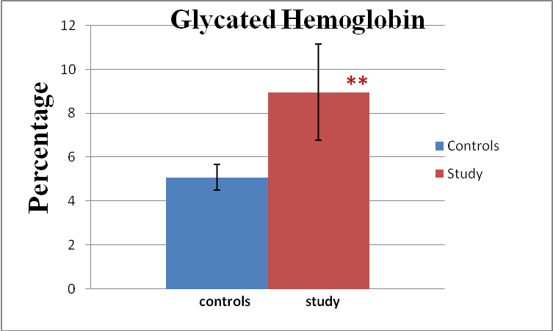
Results: Comparison of biomarkers of ageing between the groups
Variables | Control group (n= 110 ) | T2DM (n = 110 )
Age(years) | 50.01 + 8.08 | 51.12 + 6.16
BMI (kg/mt²) | 24.12 + 3.83 | 24.25 + 3.91
WHR | 0.80 + 0.08 | 0.86 + 0.05**
FBS (mg/dl) | 92.71 + 8.07 | 173.02 + 49.13**
TG (mg/dl) | 129.10 + 4.82 | 165.99 + 6.93**
LDL/HDL-C ratio | 2.75 + 0.10 | 3.07 + 0.11*
TC / HDL-C ratio | 4.26 + 0.12 | 4.86 + 0.13**
Variables | Control group (n= 110 ) | T2DM (n = 110)
Systolic (mmHg) | 120 + 10.37 | 134 + 11.84 **
Diastolic (mmHg) | 77 + 4.73 | 82 + 5.77**
PP(mmHg) | 43 + 8.54 | 51 + 9.88**
MBP (mmHg) | 91 + 5.88 | 100 + 6.87**
HR | 70 + 9.73 | 76 + 10.49*
TP | 1340 + 1466.55 | 588 + 628.95**
LF / HF | 1.13 + 1.20 | 1.90 + 2.06**
Data expressed as mean±SD:; Analysis using Unpaired t test
*Statistically Significant with P >0.05:**Statistically significant with P >0.01

Slide 7
Results: Correlation of HbA1c with aging biomarkers
        Analysis using Partial correlation coefficient adjusted for chronological age *Statistically Significant with P >0.05:
Other significant (P<0.05) correlations with HbA1c:
Systolic BP (mmHg), 0.368; RHR (bts/min): 0.377; LF/HF, 0.242; TG (mg/dl), 0.297; LDL-C/HDL-C, 0.224

Slide 8

Discussion
This study, for the first time, evaluated the association of HbA1c with both metabolic, cardiovascular biomarkers of ageing in a population consisting of healthy as well as T2DM patients.
The results of the present study showed a significant difference in all the variables of metabolic and cardiovascular ageing indices between the two study groups.
Further, the study also demonstrated that after adjusting for chronological age, there is a significant association of metabolic and cardiovascular indices with the level of Glycosylated Haemoglobin.

Slide 9
Discussion (contd..)
The increased WHR, impaired lipid profile, significant reduction in overall fluctuations in autonomic input to the heart and sympathetic dominance denote a greater risk for cardiovascular morbidity among T2DM group compared to their age–matched counterparts.
Earlier, studies have demonstrated that normative aging and T2DM are accompanied by overall reduction in autonomic control of heart, diminished vagal tone and predominant sympathetic tone.
Jagmeet P Singh, et al .( The Framingham Heart Study). American Journal of cardiology. August 2000;
Gerritsen J, et al. (Hoorn Study.) Diabetologia. 2000;

Slide 10
Discussion (contd..)
A positive correlation of HbA1c with WHR and dyslipidemia observed in this study suggests that controlling the glycemic levels may significantly reduce the risk of CVD due to dyslipidemia.
A significant positive correlation of LF to HF ratio with HbA1c shows that sympathetic dominance is significantly associated with tightness of glycemic control.
Studies have shown that elevated glycemic values have an unfavourable effect on cardiac autonomic function.
Khaw KT,et al. Br Med J. 2001;
Mika P T et al.Computing in Cardiology, 2012
Notes:
Reducing HbA1c level by 0.2% could lower the mortality by10 %The finding of the study indicates that there is significant acceleration of ageing in patients with T2DM compared to that of non-T2DM group as assessed by metabolic and cardiovascular ageing indices.
Aging is a multi-dimensional process and cardio-vascular and metabolic biomarkers could be used to monitor and identify the development of age-associated disease providing new anti-aging strategies.
Tightness of glycemic control, minimize glycation induced damage and therefore could play a key factor for longevity.

Slide 11
Conclusions
There is significant acceleration of aging in patients with T2DM compared to that of non-T2DM group.
Further, study demonstrates the association of metabolic and cardiovascular biomarkers with the level of Glycosylated Haemoglobin.
Tightness of glycemic control minimizes glycation induced damage and therefore, could play a key factor for longevity.
Notes:
This would help in promoting healthy ageing which is likely to have a significant impact on the quality of life.
Above all to examine how to prolong the “health span” of aging populations and convert them into a national asset.

