Slide 1

Dr Shah Taj Khan
M.B.B.S,DCP,FCPS
Consultant Hematologist.
Rehman Medical Institute, Peshawar. Pakistan

Slide 2
STUDY
Glucose 6 Phosphate Dehydrogenase (G6PD) EnzymeDeficiency in jaundiced infants in Khyber Pakhtoonkhwa
Shahtaj Khan¹, Awal Mir², Inam³, Baber Rehman⁴, Fazl e Raziq⁵ Khawaja Tassawor.Nadia Altaf.

Slide 3
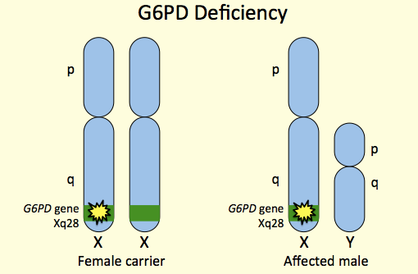
INTRODUCTION
G6PD deficiency is X-linked recessive hereditary disease characterized by abnormally low levels of glucose-6-phosphate-dehydrogenase

Slide 4
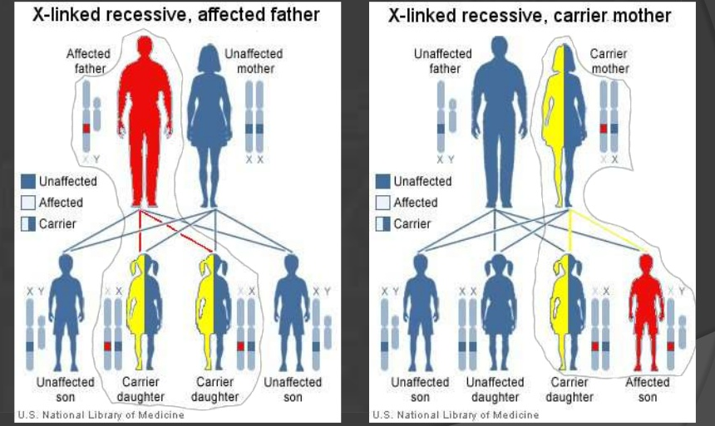
MODE OF INHERITANCE IN G6PD

Slide 5
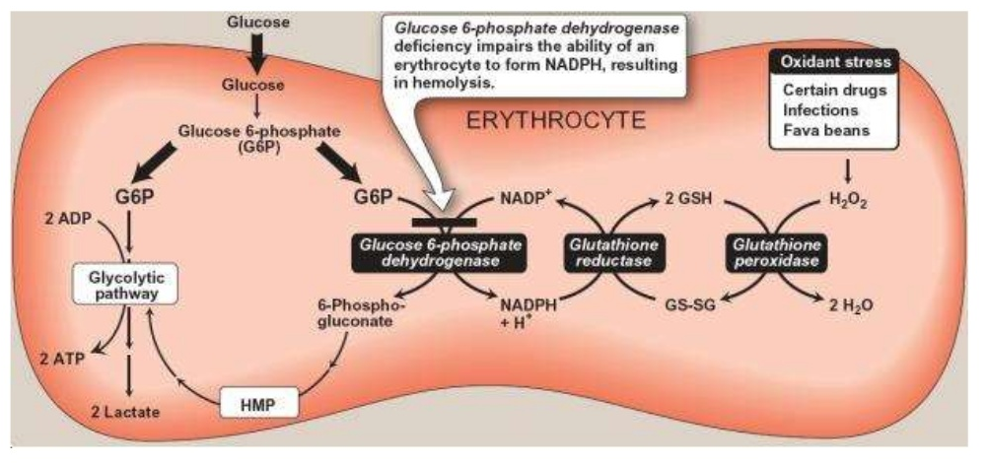
What Happens In G6PD Deficiency?

Slide 6
CLINICAL MANISFESTATIONS
Neonatal Jaundice
Acute vs Chronic Hemolysis
Infection,oxidant drugs, fava beans, chemical agents
Keep in mind other blood cells require G6pd as well
Phagocytosis could be impaired

Slide 7
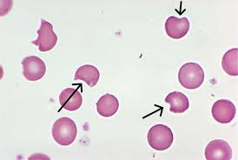
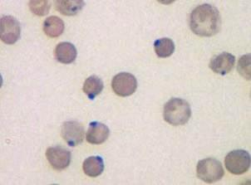
Peripheral Blood Findings

Slide 8

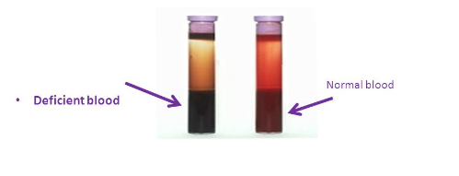
Screening Tests For G6PD deficiency
Fluorescent Spot Test
Methemoglobin reduction Test

Slide 9
DEFINITIVE DIAGNOSIS IS DONE ON G6PD DEFICIENCY

Slide 10
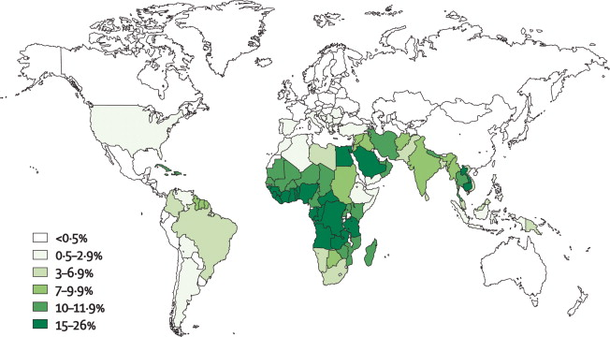
Global Distribution Of G6pd Deficiency

Slide 11
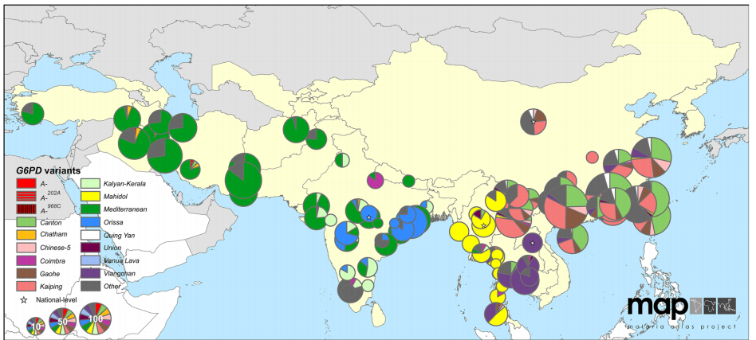
G6PD deficiency variant proportion in Asia

Slide 12
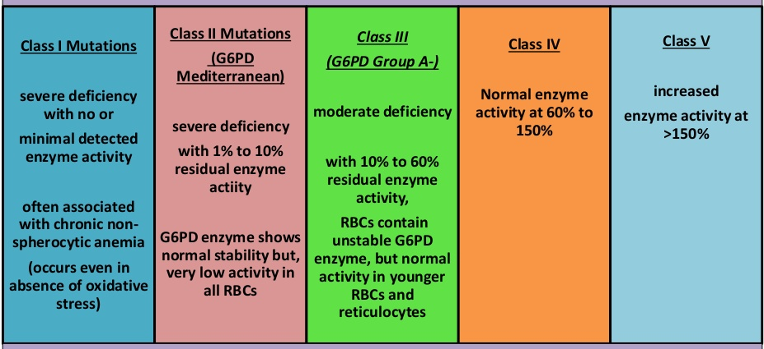
CLASSIFICATION OF G6PD VARIANTS

Slide 13
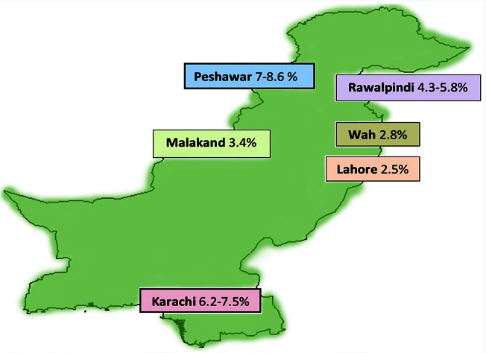
Prevalence of G6PD deficiency in Pakistan
Moiz B. A review of G6PD deficiency in Pakistani perspective. J Pak Med Assoc. 2013Apr;63(4):501-3.

Slide 14
Epidemiology And Malaria
50 % reduction in severe malaria in African children
In female heterozygotes there are more malarial parasites in G6pd replete cells as compared to deficient
Invasion appears to be similar but growth is retarded in G6pd cells
Possible mechanism is oxidant stress leading to cell death or membrane damage leading to phagocytosis

Slide 15
OBJECTIVE
The aim of this study was to evaluate the prevalence of G6PD deficiency by G6PD quantitative method in jaundiced infants coming from different districts of Khyber Pakhtoon Khwa (KPK)

Slide 16
MATERIALS AND METHODS
Study design:
Descriptive cross sectional study
Study setting and duration:
Rehman Medical Institute Hayatabad Peshawar- Febuary 2015-September 2015 (8 months)
Sampling technique:
Non-consecutive probability sampling

Slide 17
MATERIALS AND METHODS
Inclusion/ Exclusion criteria:
Infants of <1 year age having hyperbilirubinemia

Slide 18
MATERIALS AND METHODS
Data collection:
By aseptic technique 4 ml blood was collected from all infants, 2 ml blood in EDTA tube (Purple Top) for G6PD quantitative enzyme assay and 2 ml in non anticoagulated tube ( Red Top) to determine serum bilirubin profile.
Serum bilirubin profile was determined by Diazo reaction method using Architect plus ci8200 (Abbott, USA).
G6PD quantitative assay was measured by ultraviolet kinetic method (Trinity biotech kit, USA).

Slide 19
MATERIALS AND METHODS
Data Analysis:
The data was collected and analyzed in SPSS-20.

Slide 20
RESULTS

Slide 21
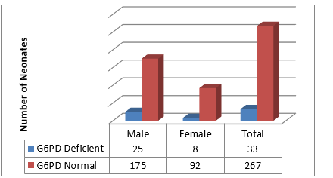
Prevalence of G6PD deficiency anemia in different gender neonates

Slide 22
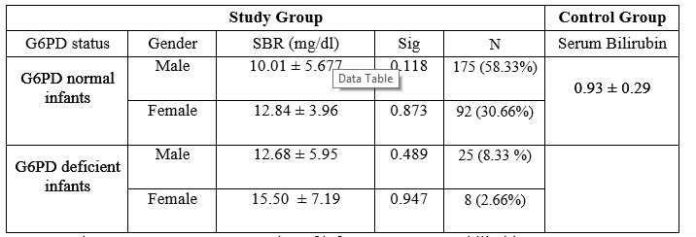
Serum Bilirubin Comparative Analysis

Slide 23
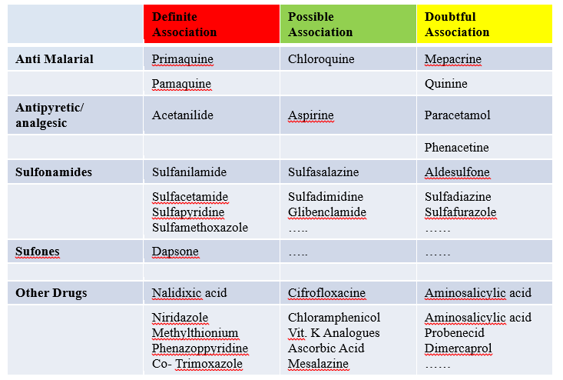
Medicines Associated With Hemolysis in
G6PD deficiency patients

Slide 24
COMPARITIVE STUDIES
STUDY | COUNTRY | NO OF PATIENTS | RESULT
Pahlavanzadeh M et all 2013. | IRAN | 105 | 18.1% 29.4% boys 7.4% girls
Yang Q, Wang Q et all 2014 | CHINA | 2500 | 2.68% 3.2% boys 2.03% girls

Slide 25
CONCLUSION
11% of infants presenting with jaundice were G6PD deficient.
Quantitative G6PD levels should be done at least prior to anti malarial therapy in every infant.

Slide 26
POINT TO BE FOCUSSED…
As the study was conducted in our area, which is endemic for malaria and poverty leads to frequent episodes of infection, certain drugs can cause fatal hemolysis. So as per WHO protocol our population needs routine screening for G6PD deficiency.

Slide 27
THANK YOU

