Slide 1

About OMICS Group
OMICS Group International is an amalgamation of Open Access publications and worldwide international science conferences and events. Established in the year 2007 with the sole aim of making the information on Sciences and technology ‘Open Access’, OMICS Group publishes 400 online open access scholarly journals in all aspects of Science, Engineering, Management and Technology journals. OMICS Group has been instrumental in taking the knowledge on Science & technology to the doorsteps of ordinary men and women. Research Scholars, Students, Libraries, Educational Institutions, Research centers and the industry are main stakeholders that benefitted greatly from this knowledge dissemination. OMICS Group also organizes 300 International conferences annually across the globe, where knowledge transfer takes place through debates, round table discussions, poster presentations, workshops, symposia and exhibitions.

Slide 2
About OMICS Group Conferences
OMICS Group International is a pioneer and leading science event organizer, which publishes around 400 open access journals and conducts over 300 Medical, Clinical, Engineering, Life Sciences, Pharma scientific conferences all over the globe annually with the support of more than 1000 scientific associations and 30,000 editorial board members and 3.5 million followers to its credit.
OMICS Group has organized 500 conferences, workshops and national symposiums across the major cities including San Francisco, Las Vegas, San Antonio, Omaha, Orlando, Raleigh, Santa Clara, Chicago, Philadelphia, Baltimore, United Kingdom, Valencia, Dubai, Beijing, Hyderabad, Bengaluru and Mumbai.

Slide 3
Development of Efficient Patterned Vertical Axis Wind Turbine Farms
Shaaban Abdallah abdallsa@mail.uc.edu
Department of Aerospace Engineering and Engineering Mechanics
University of Cincinnati, Cincinnati, Oh 45221
Mech-Aero Conference, Oct. 5, 2015

Slide 4
Outlines
Introduction
Motivation and Problem Definition
Contribution to Knowledge
Strategy for Problem Solution
Results
Conclusion

Slide 5

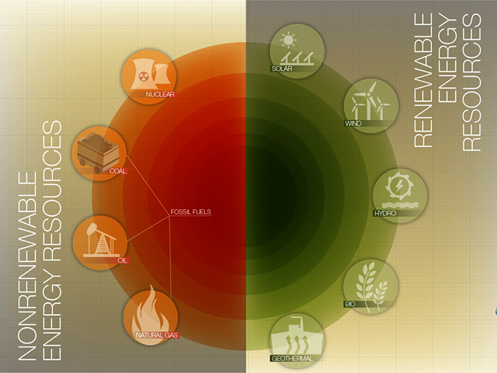
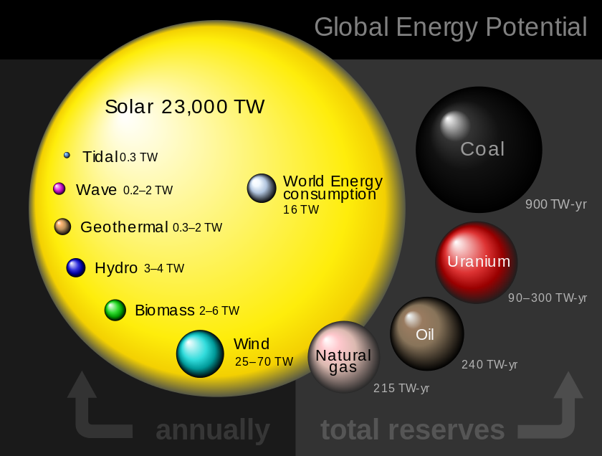
Introduction
Nonrenewable and Renewable Energy Resources:
Based on REN21’s 2014 report, renewable energy contributed by 19% to global energy consumption and 22 % to electricity generation
The annual available wind energy is 25-70 TW

Slide 6

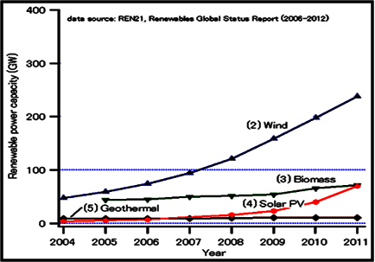
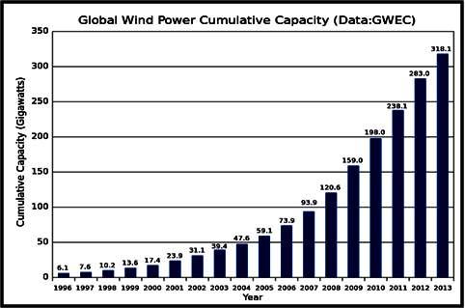
Global Wind Energy Capacity
“Of all the forces of nature, I should think the wind contains the largest amount of motive power "
“ Abraham Lincoln (1860)”
The Wind energy has the fastest growing renewable power capacity
“ Renewables Global Report (2006-2012)”
The total worldwide wind capacity installed was 360 GW at the end of 2014, this provided 4% of the global electricity demand
“ World Wind Energy Association 2014 half year report (August 2014)”

Slide 7
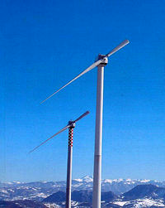
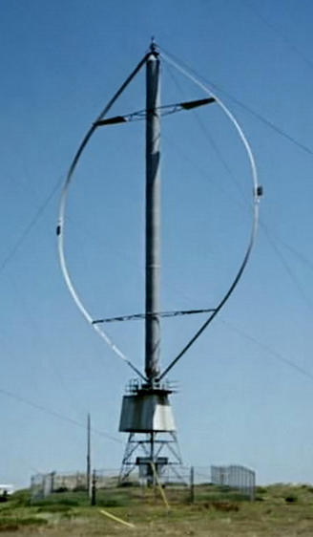
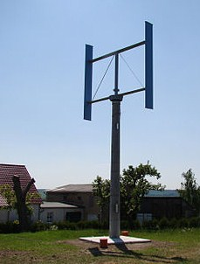
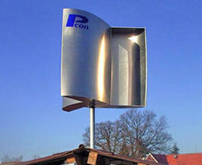
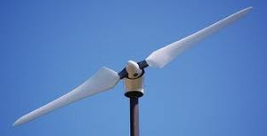
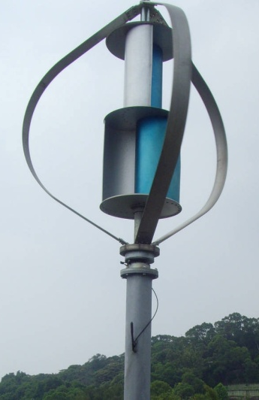
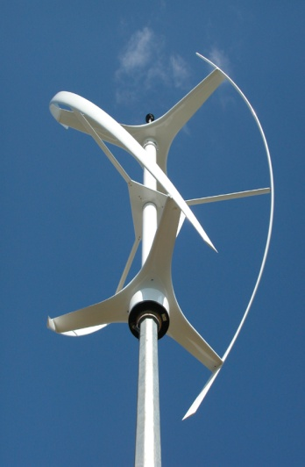
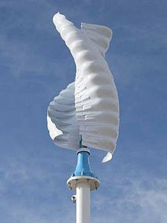
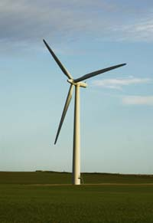
Types of Wind Turbines:
Horizontal Axis Wind Turbines
Vertical Axis Wind Turbines
Single Blade:
Tower shadow effects
Counter weights
Less stability
Two Blades:
less stability
Low strength to wind
shocks
Darrieus H-Rotor Savonius
Three Blades:
Higher strength to wind
storms.
Less effect of tower
shadow.
Produces high output

Slide 8
Comparison Between Differences Types of Wind Turbines:
 | Savonius | H-rotor | Darrieus | HAWT
Power Coefficient | 0.15 - 0.2 | 0.35 | 0.4 | 0.45
Blade profile | Simple | Simple | Complicated | Complicated
Yaw mechanism needed | No | No | No | Yes
Pitch mechanism possible | No | Yes | No | Yes
Tower | Yes | Yes | No | Yes
Guy wires | No | Optional | Yes | No
Tip Speed Ratio | Low | Low | Moderate | High
Noise | Low | Low | Moderate | High
Blade area | Large | Moderate | Large | Small
Generator position | On ground | On ground | On ground | On top of tower
Blade load | Moderate | Moderate | Low | High
Self starting | Yes | No | Yes if helical | Yes
Tower interference | Small | Small | Small | Large
Foundation | Simple | Moderate | Simple | Extensive
Overall structure | Simple | Simple | Simple | Complicated
S. Eriksson, H. Bernhoff and M. Leijon, “Evaluation of different concepts for wind power”, Journal for Renewable and Sustainable Energy (12): 1419 -1434, (2008)

Slide 9
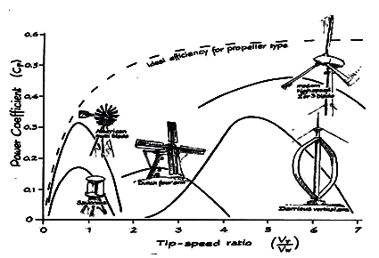
Horizontal Axis Wind Turbines (HAWTs) Farms:
An isolated HAWT has the highest power coefficient Cp (0.4–0.45) defined as the extracted power compared to the available power
74% of the wind manufacturers invest in HAWTs while only 18% adopt the Vertical Axis Wind Turbines (VAWTs)
Almost, all the existing wind turbine farms consists of HAWTs
In close proximity to neighboring turbines, HAWTs suffer from a reduced power coefficient cause by the effect of the wake of upstream turbines

Slide 10
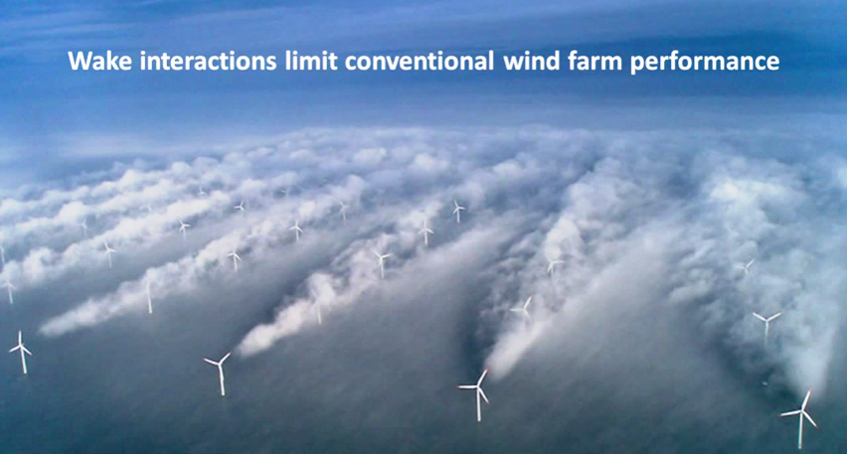
Wake interactions limit Conventional Horizontal Axis Wind Turbine Farm performance

Slide 11

Wind Farm Power Density:
The power density (P.D.) of a wind farm is defined as the total power it can generate per unit land area it occupies

Slide 12
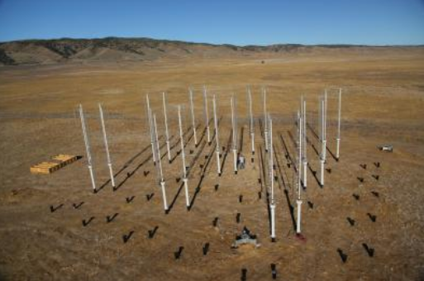
Vertical Axis Wind Turbine Farms
Vertical axis wind turbines (VAWTs) are proposed as an alternative to the more commonly used horizontal axis wind turbines (HAWTs) due to the potential increase in power density that is possible with VAWTs.
Experimental researches at CalTech found that the power density of H-rotor VAWT farms can be increased up to 10x HAWT farms by optimizing the placement of the turbines that enables them to extract energy from adjacent turbines wakes
John O. Dabiri, “ Potential order-of-magnitude enhancement of wind farm power density via counter-rotating vertical-axis wind turbine arrays,” Journal Of Renewable And Sustainable Energy 3: 043104 (2011)

Slide 13
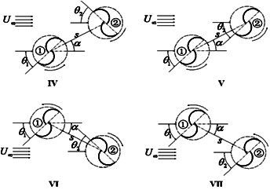
A Numerical study on two dimensional Savonius turbine clusters, showed that a mutual enhancement between closely arranged turbines occurs as a function of :
Relative direction of rotation.
- Gap Distance between rotors (S).
Relative phase angle between the rotors:
ϕ = θ1 - θ2
Xiaojing Sun, Daihai Luo, Diangui Huang and Guoqing Wu,“Numerical study on coupling effects among multiple Savonius turbines,” Journal of Renewable and Sustainable Energy 4: 053107 (2012)

Slide 14
Motivation and Problem Definition
Motivation:
Previous studies showed that VAWTs in close separation distances mutually enhance their power coefficients resulting in higher power output for individual turbines and higher power density if arranged in a wind farm
Problem (1):
All the previous studies did not extended the results for efficient layouts of VAWTs to develop larger efficient farms that generate the highest possible power output keeping a high power density
Problem (2):
Using non isolated turbines in a farm will make the prediction of a farm performance to become a complicated job as each turbine will have a different performance

Slide 15
Contribution to Knowledge
Solution (1):
This study introduces the idea of the efficient VAWT cluster as a building unit for an efficient VAWT farm that generates the highest possible power using the mutual enhancement between individual turbines and has a high power density compared to isolated counter-part
Solution (2):
Using the efficient cluster as a building unit for the development of efficient and patterned VAWT farms which have the same geometric topology of the cluster provides the capability of predicting the performance of a farm having a geometric progression of the efficient cluster.

Slide 16
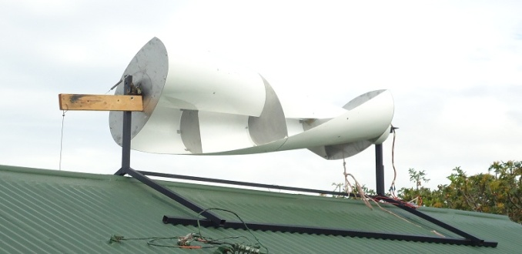
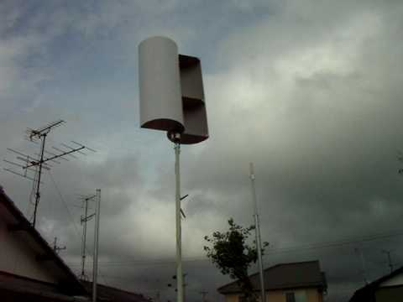
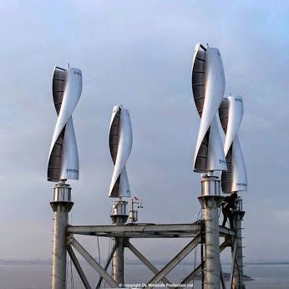
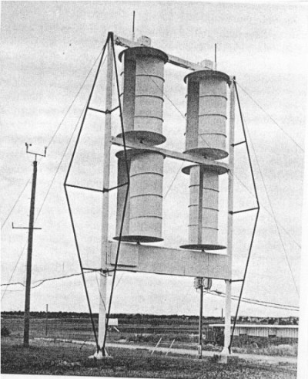
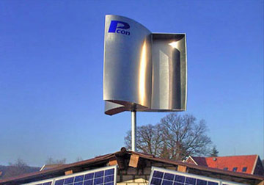
Case Study (I)
Savonius Wind Turbine

Slide 17
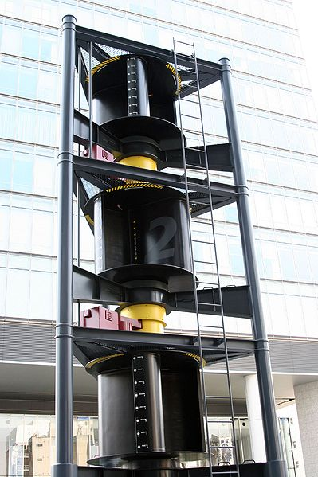
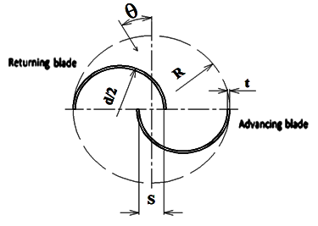

Savonius Wind Turbine
The Savonius wind turbine was invented 1929
It is has a Simple Construction
It is a drag-type device
Consists of two or three buckets
It has self starting capability
Low noise levels due to operation at low tips speed ratio
Savonius turbines have low efficiencies 15-20%
A. Shigetomi, Y. Murai, Y. Tasaka, Y. Takeda, “Interactive flow field around two Savonius turbines,” Renewable Energy 36: 536-545, (2011)

Slide 18
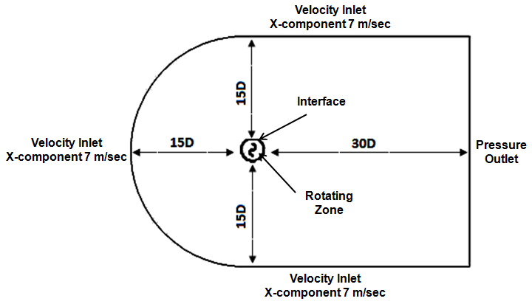
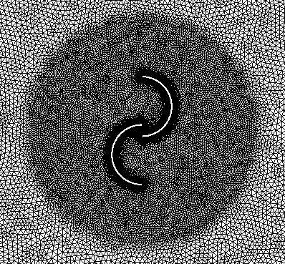
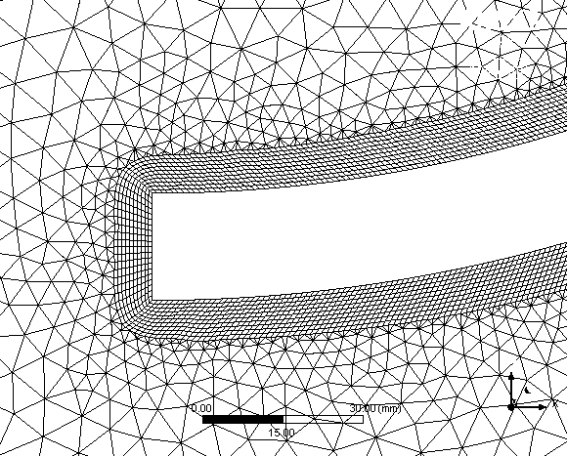
Computational Domain:
2
1
Grid Generation:
The grid structure consists of a non conformal mesh with unstructured triangular elements generated using ANSYS meshing.
An inflation of 10 levels of quad. cells is imposed to account for the boundary layer with a maximum thickness of 1 mm to achieve a y+ < 1 as required by the transition SST turbulence model [36, 37].

Slide 19
Numerical Model Validation:
Three models has been checked:
- K-ε model
- K-ω SST model
- Transition SST model
The transition SST turbulence model shows closer agreement to the experiments data in the numerical results for:
Static torque coefficient at different
azimuth angles (θ)
Power coefficient at different tip speed
ratios (λ)
The maximum power coefficient:
Cp_{max} = 0.23 at λ = 1

Slide 20
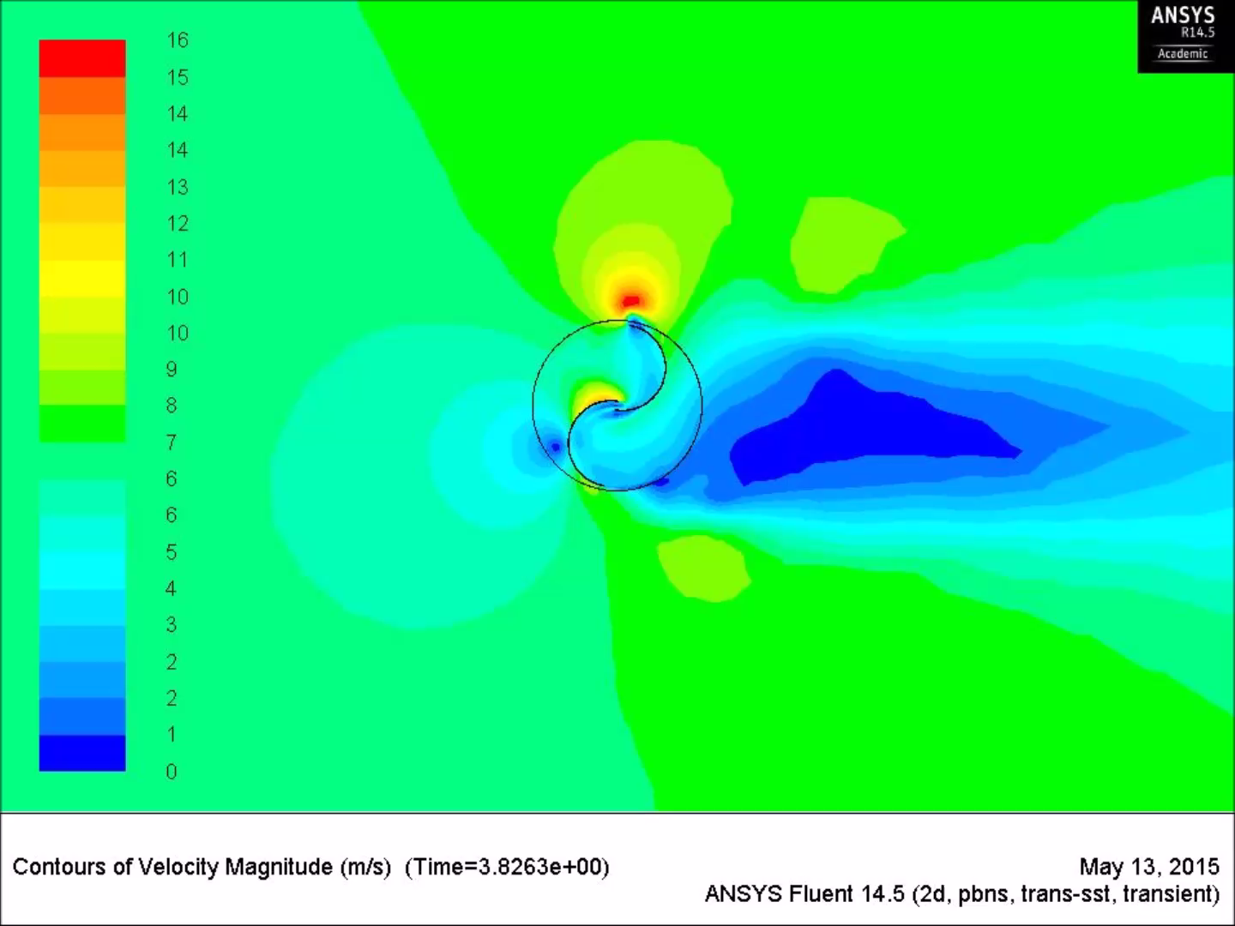
Velocity Contours: Single Savonius Turbine

Slide 21
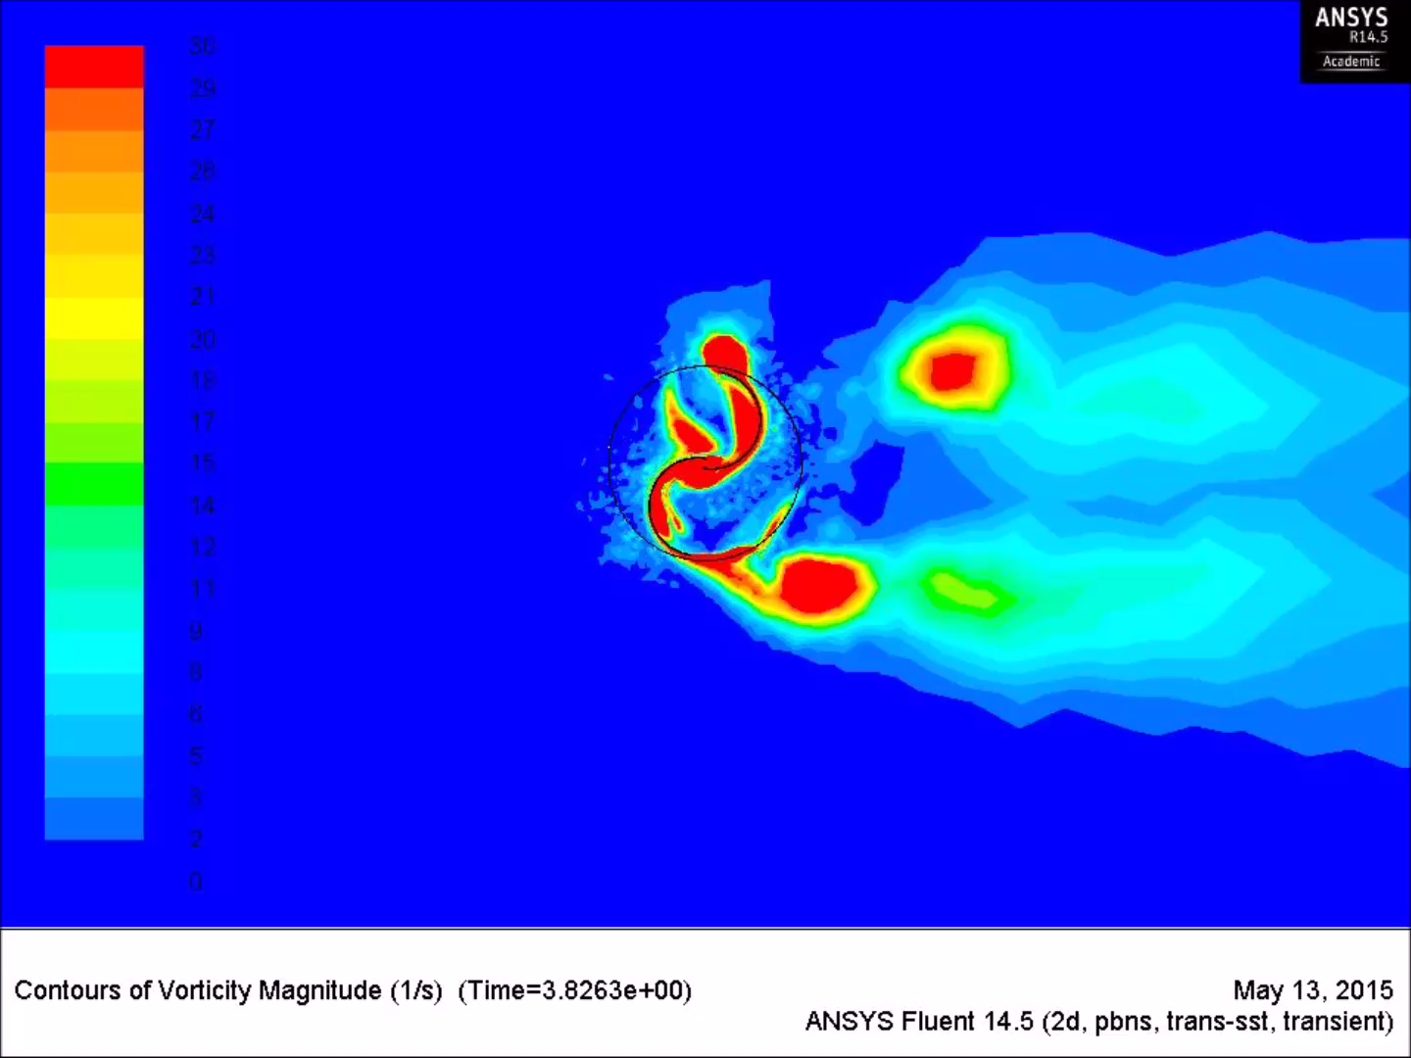
Vorticity Contours: Single Savonius Turbine

Slide 22
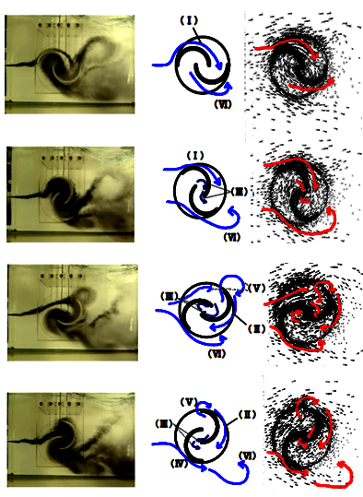
Flow Pattern around a Single Savonius Rotor
The flow patterns around the rotor are identified and found comparable to the experimental data:
Flow (I): Coanda flow (Attached to the advancing blade convex side).
Flow (II): Dragging flow (from the advancing blade convex side to the returning blade concave side).
Flow (III): Overlap flow though the overlapping area.
Flow (IV): Stagnation flow from upstream to the returning blade convex side.
Flow (V): Shedding vortex at the advancing blade tip.
Flow (VI): Shedding vortex from the returning blade tip.
Nakajima, M., IIO, S., Ikeda, T., Performance of double-step Savonius rotor for environmentally friendly hydraulic turbine. Journal of Fluid Science and Technology 3, (2008)

Slide 23
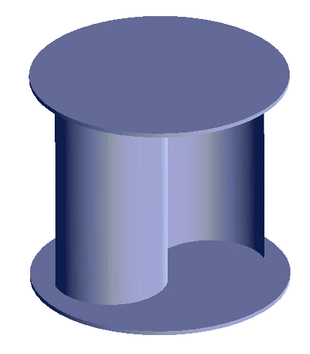
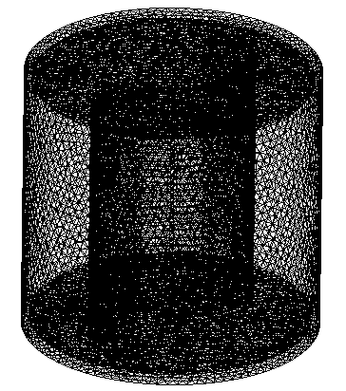
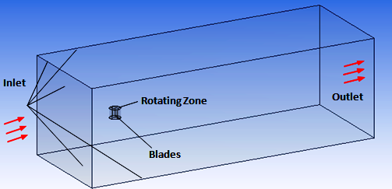
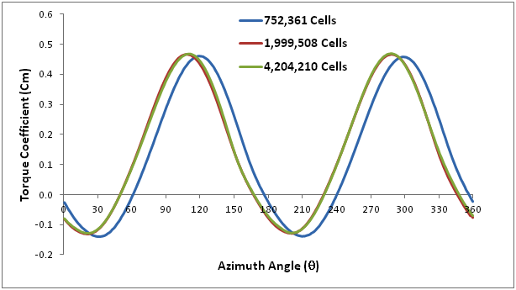
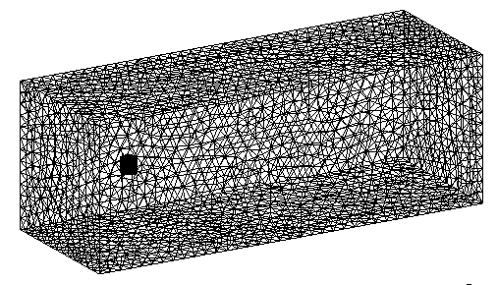
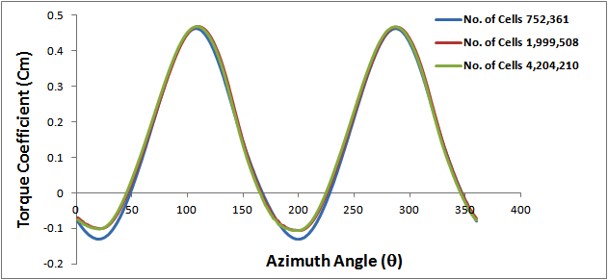
3D Validation for a Single Savonius Turbine
Trans. SST
DES
Grid Level | No. of Cells | Cm Transition SST | Cm DES
1 | 752,361 | 0.1461 | 0.1806
2 | 1,999,508 | 0.1561 | 0.1909
3 | 4,204,210 | 0.1557 | 0.1901

Slide 24
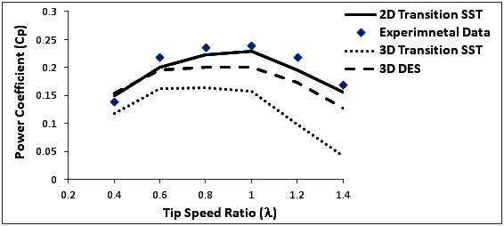
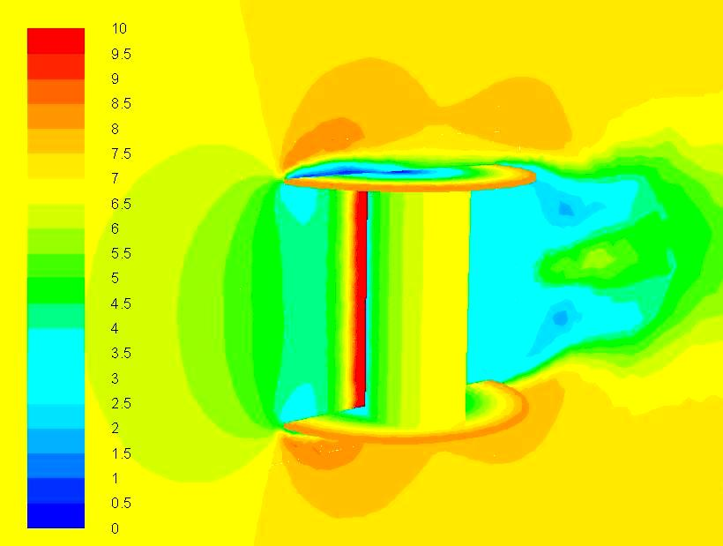
Transition SST model in the 3D Solution under predicted the single turbine performance compared to experimental data, this results are in consistence with the literature review on 3D solutions
To obtain better rsults, detached eddy simulation (DES) model is used for the flow simulation, the obtained results are closer to the experimental data for different TSR
The max. difference between DES and experimental data is about 15%
Velocity Contours

Slide 25
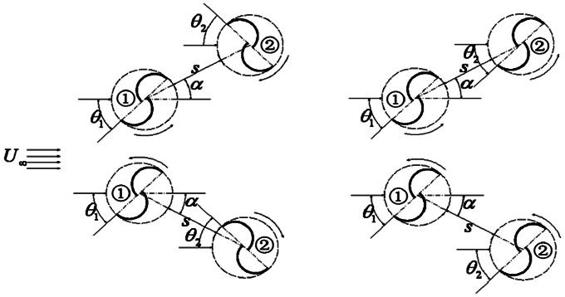
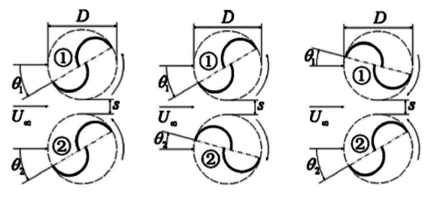
Numerical Solution of Two Savonius Wind Turbine Clusters
The development of an efficient cluster requires the study of different possibilities of multiple turbine cluster
Two Co-rotating and Counter-rotating turbine clusters in parallel and oblique configurations are numerically simulated
Co
Counter
Counter
Co
Parallel Configurations
Oblique Configurations

Slide 26
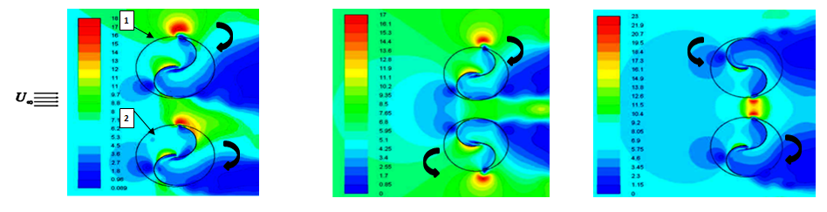
    1- Two Parallel Co-Rotating Savonius Turbines:
Rotor (1) has higher efficiency enhancement than Rotor (2) due to the direction of rotation
Cp_{avg} max is 0.3 at 0.2D gap distance enhancement of 30% higher than isolated turbines
Reaches isolated turbine performance placed at approximately 5-6 D

Slide 27
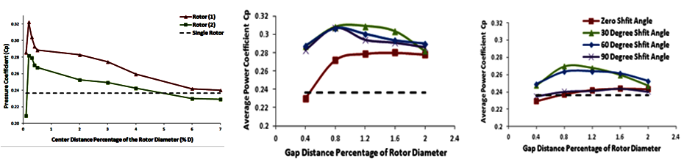
    2- Two Parallel Counter-Rotating Savonius Turbines
Wind Direction
Wind Direction
Case (A)
Case (B)
Cp_{avg} max is 0.26 at 0.8D gap distance
Cp_{avg} max is 0.3 at 0.8D gap distance

Slide 28
Comparison Between Co- and Counter-Rotating Two Parallel Turbines
case (B) for counter-rotating rotors at a relative phase angle 30º is the most efficient for two parallel counter-rotating Savonius rotors, where the inward buckets are advancing buckets

Slide 29
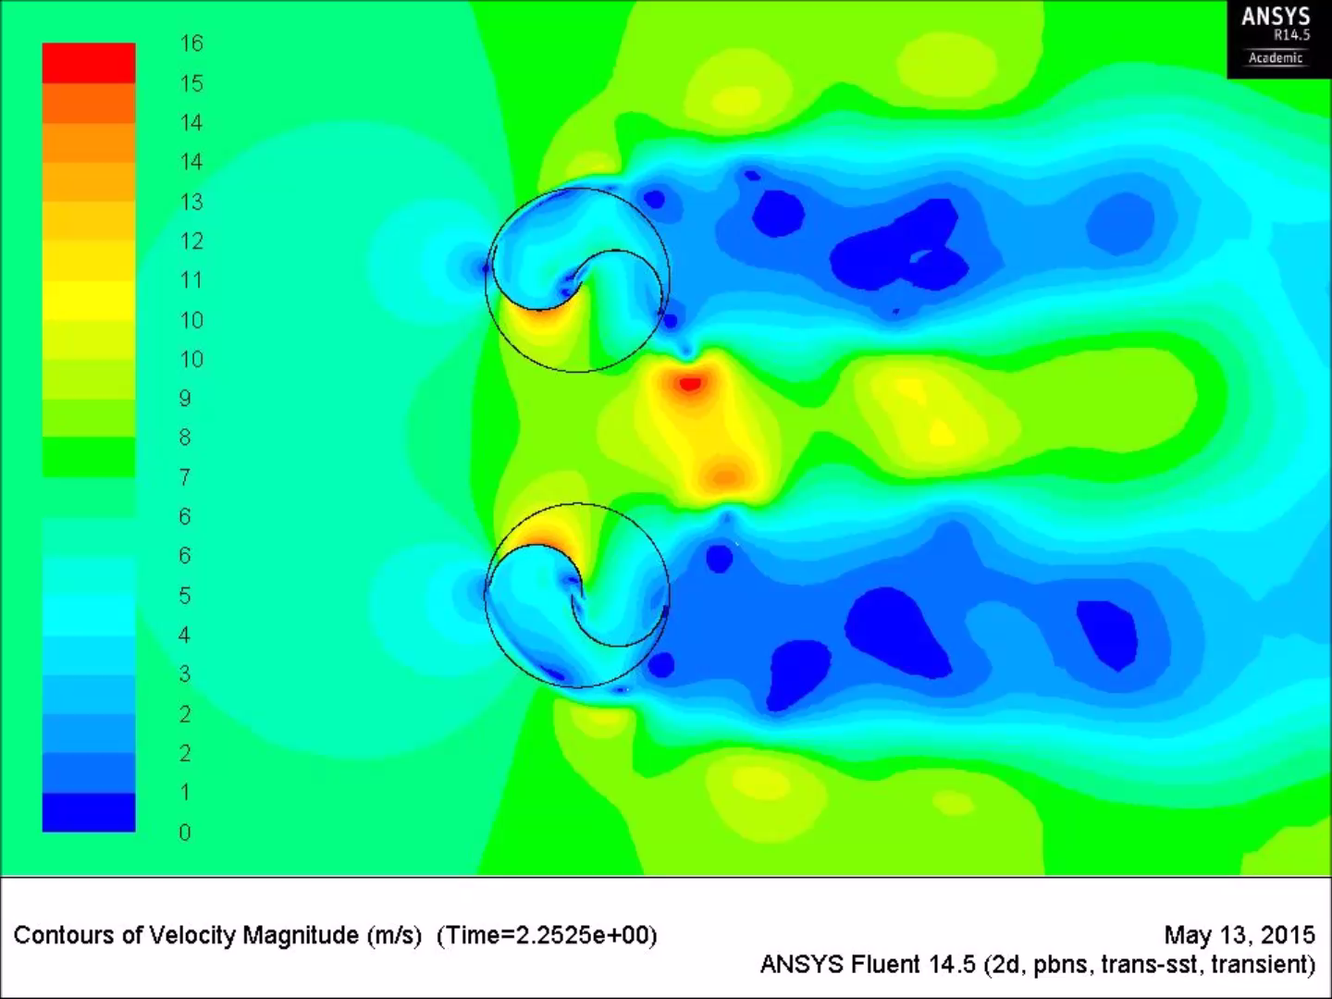
Velocity Contours: Two Parallel Counter-Rotating Savonius Turbines

Slide 30
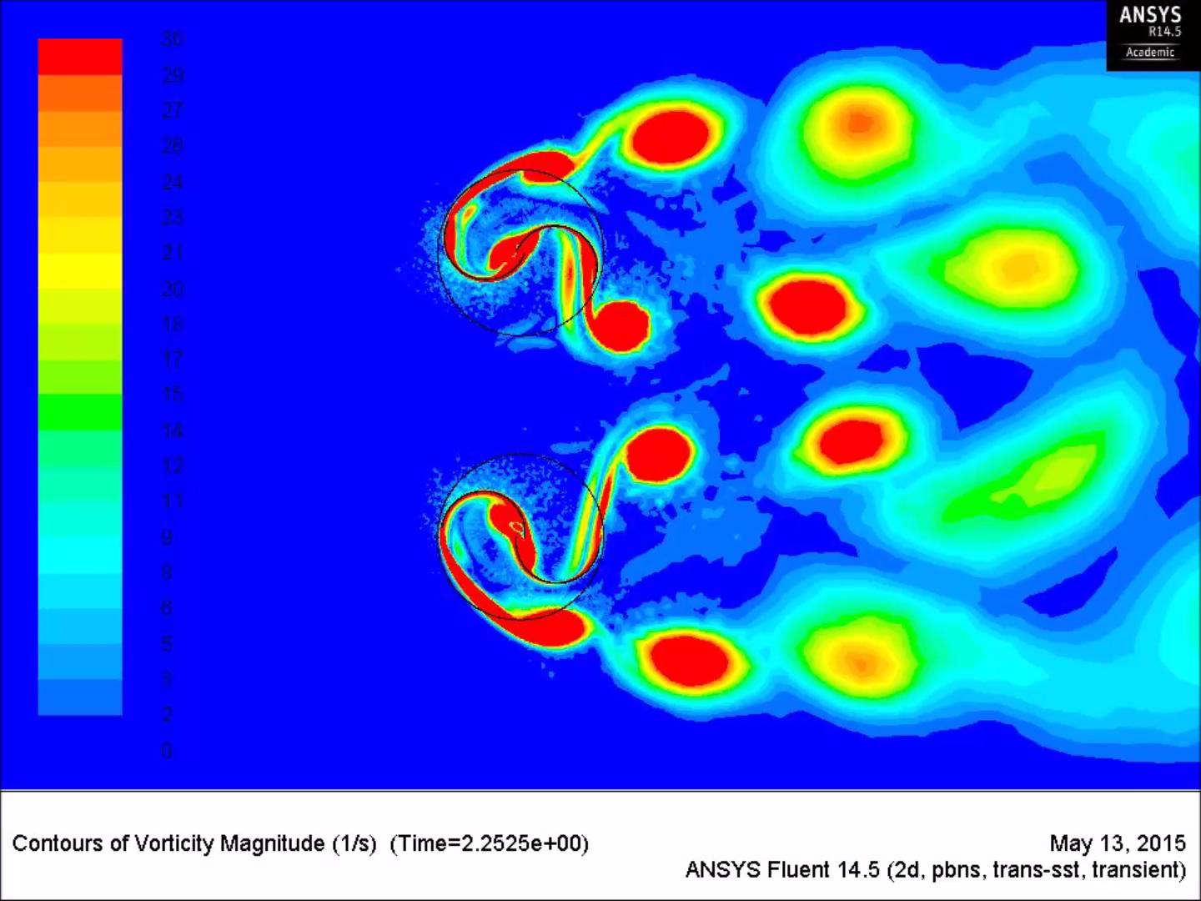
Vorticity Contours: Two Parallel Counter-Rotating Savonius Turbines

Slide 31
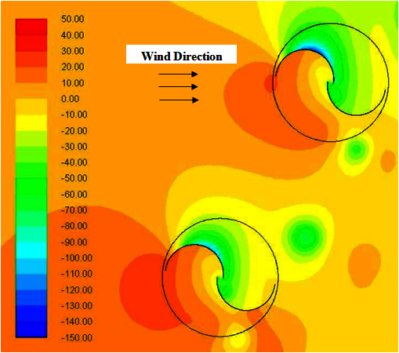
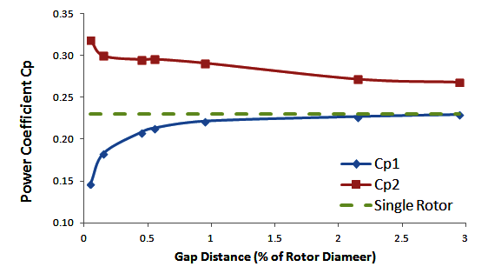
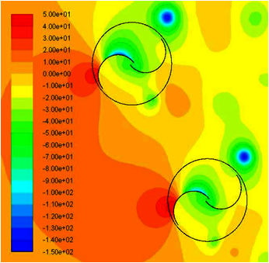
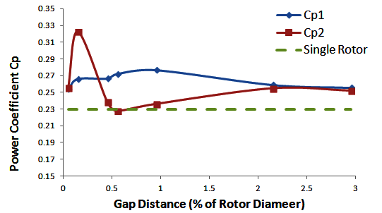
    3- Two Oblique Co-Rotating Savonius Turbine Clusters
Cp_{avg} max is 0.26 at 1.0 D
2
Case (A)
1
1
Cp_{avg} max is 0.3 at 0.2 D
Case (B)
2

Slide 32
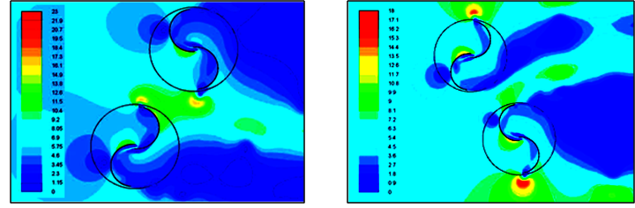
    4- Two Oblique Counter-Rotating Savonius Turbine Clusters
Case (C)
Case (D)
Cp_{avg} max is 0.35 at 0.4D
Cp_{avg} max is 0.25 at 1.6D

Slide 33
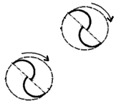






Co-rotating
Case (A)
Counter-rotating
Case (C)
Co-rotating
Case (B)
Counter-rotating
Case (D)

Slide 34





    Numerical Simulation of Three Turbine Savonius Clusters
    Co-Rotating
    Co-Rotating
    Cluster
    Cp = 0.29
    Hybrid
    Comparison
    Hybrid
    Cluster
    Cp=0.3

Slide 35

Velocity Contours: Three Co-Rotating Turbine Cluster

Slide 36

Vorticity Contours: Three Co-Rotating Turbine Cluster

Slide 37



    Three Turbine Cluster Performance Confirmation
Co-Rotating Three turbine Cluster has an enhancement in average power coefficient of 26 % compared to isolated turbines
 | Isolated Rotor | Rotor (1) | Rotor (2) | Rotor (3)
Power Coefficient (Cp) | 0.23 | 0.26 | 0.327 | 0.289
Enhancement % Compared to Isolated Rotor |  | 13% | 42% | 25%
Ratio Compared to Rotor (1) |  | 1 | 1.23 | 1.07
The results show that the ratio 1:1.2:1 between the power coefficients of the three rotors is consistent for λ>0.6
We focus here on the flow field at λ>0.6 in order to observe the flow-inducing action of the turbine revolutions rather than the flow-stagnating action at lower tip-speed ratios
At λ=1, Cp_{max} = 0.286

Slide 38

Development of Patterned Vertical Axis Wind Turbine Farm

Slide 39

    Nine Savonius Wind Turbine Farm
The nine turbine farm is triangular and has the same topology of the three turbine cluster
Each vertex of the triangle has a three turbine cluster
The domain, solver setting and turbulence model are similar to that of the three turbine cluster simulation
The same grid topology is used, this results in a grid having a number of cells equal to 817,253 cells for the nine turbine farm simulation
The simulation time is about 32 hours

Slide 40

    Numerical Results for the Nine Savonius Wind Turbine Farm
B
The ratio between Cp of the clusters (A:B:C) is 1:1.2:1
The ratio between Cp of individual turbines is (1:1.2:1)
The average power coefficient achieved by the developed nine turbine farm at λ=1 is 26% higher than that of isolated nine turbine farm
A
Cluster A | Isolated Rotor | Rotor (1) | Rotor (2) | Rotor (3)
Power Coefficient (Cp) | 0.23 | 0.24 | 0.3 | 0.26
Enhancement % Compared to Isolated Rotor |  | 4% | 30% | 13%
Ratio Compared to Rotor (1) |  | 1 | 1.25 | 1.08
Cluster B | Isolated Rotor | Rotor (4) | Rotor (5) | Rotor (6)
Power Coefficient (Cp) | 0.23 | 0.31 | 0.36 | 0.32
Enhancement % Compared to Isolated Rotor |  | 34% | 56% | 39%
Ratio Compared to Rotor (4) |  | 1 | 1.16 | 1.03
Cluster C | Isolated Rotor | Rotor (7) | Rotor (8) | Rotor (9)
Power Coefficient (Cp) | 0.23 | 0.26 | 0.32 | 0.27
Enhancement % Compared to Isolated Rotor |  | 13% | 39% | 17%
Ratio Compared to Rotor (7) |  | 1 | 1.23 | 1.03
C
Cp_{avg} max = 0.29
 | Cluster (A) | Cluster (B) | Cluster (C)
Power Coefficient (Cp) | 0.26 | 0.33 | 0.28
Ratio Compared to Cluster (A) | 1 | 1.23 | 1.04

Slide 41
The nine turbine farm is patterned, the performance of the farm can be predicted by simulation of a three turbine cluster
Using the ratio 1:1.2:1 and the results of the three turbine cluster, the nine turbine farm efficiency is predicted and compared to the calculated results
The error in the predicted average power coefficient (Cp=0.3) of the farm compared to the calculated value (Cp=0.292) is less than 2%

Slide 42

Velocity Contours: Co-Rotating Nine Savonius Turbine Farm

Slide 43

Vorticity Contours: Co-Rotating Nine Savonius Turbine Farm

Slide 44


    Numerical Results for the Twenty-Seven Savonius Wind Turbine Farm
I
The ratio between Cp of individual turbines is (1:1.2:1)
The ratio between average Cp of the clusters is 1:1.2:1
The ratio between average Cp of the nine turbine farms I, II and III is 1:1.2:1
The average power coefficient achieved by the developed nine turbine farms at λ=1 is 39% higher than that of isolated nine turbine farm
II
 | Total Power (watt) | Ratio Compared to Cluster (A)
Cluster (A) | 170 | 1
Cluster (B) | 208 | 1.22
Cluster (C) | 182 | 1.07
 | Total Power (watt) | Ratio Compared to Cluster (D)
Cluster (D) | 214 | 1
Cluster (E) | 233 | 1.09
Cluster (F) | 226 | 1.05
 | Total Power (watt) | Ratio Compared to Cluster (A)
Cluster (G) | 181 | 1
Cluster (H) | 233 | 1.27
Cluster (I) | 195 | 1.06
III
The average power achieved by the developed twenty-seven turbine farm is 0.32 at λ =1
 | Cluster (I) | Cluster (II) | Cluster (II)
Total Power (watt) | 567 | 680 | 604
Ratio Compared to Cluster (I) | 1 | 1.2 | 1.06

Slide 45
The 27 turbine farm is patterned, this means that the performance of the farm can be predicted by simulation of only three turbines.
Using the ratio 1:1.2:1 and the results of the simulation of the three turbine cluster, the 27 turbine farm efficiency is predicted and compared to the calculated results.
The error in the predicted average power coefficient (Cp=0.326) of the farm compared to the calculated value (Cp=0.325) is less than 0.4%

Slide 46
    Power and Power Density of the Developed VS Isolated Farms
    (One meter Diameter and One meter Height Turbines)
 | Power (W/m) |  | Enhancement In Power | Power Density (W/m²) |  | Enhancement In Power Density
 | Developed | Isolated |  | Developed | Isolated
3 Turbines | 182 | 145 | 26% | 17 | 13 | 1.3 times
9 Turbines | 554 | 435 | 26% | 10 | 1.3 | 7 times
27 Turbines | 1841 | 1304 | 39% | 4.5 | 1.1 | 4 times

Slide 47




Case Study (II)
Darrieus Wind Turbine

Slide 48




Numerical Unsteady Simulation
Solution of a Single Darrieus Wind Turbine
Computational Domain:
Aerfoil: NACA 0021
Grid independence Study:
Grid level | Number of cells | Cm | Cp
1 | 47,591 | 0.059 | 0.166
2 | 81,034 | 0.093 | 0.259
3 | 173,768 | 0.129 | 0.362
4 | 235,451 | 0.131 | 0.367
5 | 492,605 | 0.129 | 0.361
y+ < 1 as required by the transition SST turbulence model

Slide 49


2D Numerical Model Validation:
The transition SST turbulence shows closer agreement to the experiments data in the numerical results for Power coefficient at different tip speed ratios (λ)
Velocity Contours
Peak Cp=0.36 at λ=2.8

Slide 50

Velocity Contours Around Single Darrieus Turbine

Slide 51

Vorticity Contours Around Single Darrieus Turbine

Slide 52
A preliminary analysis of the mean velocity field around the turbine blades at tip speed ratios is obtained
The mean tangential velocity distribution is studied by plotting the mean x-velocity component on the Y-axis and the mean y-velocity component on the X-axis
The mean x-velocity is a combination of the undisturbed free stream velocity, the velocity induced due to the expansion of the streamlines and an additional component due to the rotational flow which is generated due to a vortex similar to a non-perfect Rankine vortex
The undisturbed flow component is taken out of the x-velocity plot

Slide 53


Combining the mean x-velocity on both the positive and negative Y-axes on one plot, they are found to approximately fit a perfect Rankine vortex having a circulation (Γ) 4.3
This provides a preliminary description of the Darrieus turbine as a Rankine vortex combined with the free stream. A further analysis will be done in a future work in order to give a detailed and more accurate vortex modeling for the Darrieus turbine.

Slide 54


3D Validation for a Single DarrieusTurbine
Vorticity Contours
Grid Level | No. of Cells | Cm | Cp
1 | 1,968,927 | 0.1807 | 0.506
2 | 2,588,998 | 0.1125 | 0.315
3 | 5,362,450 | 0.1121 | 0.314

Slide 55







Numerical Solution of Two Darrieus Wind Turbine Clusters
The development of an efficient cluster requires the study of different possibilities of multiple turbine cluster
Two Co-rotating and Counter-rotating turbine clusters in parallel and oblique configurations are numerically simulated
Co-Rotating
Counter-Rotating
Parallel Configurations
Oblique Configurations

Slide 56


Two Parallel Turbines
Co-Rotating
Cpmax = 0.42 for Case (C)
Velocity Contours
Counter-Rotating (Case C)
Counter-Rotating (Case D)

Slide 57

Velocity Contours: Two Parallel Counter Rotating Darrieus Turbines

Slide 58

Vorticity Contours: Two Parallel Counter Rotating Darrieus Turbines

Slide 59

Two Oblique Co-Rotating Turbines:
Co-Rotating (Case A)
Counter-Rotating (Case B)

Slide 60

Two Oblique Counter-Rotating Turbines:
Counter-Rotating (Case E)
Counter-Rotating (Case F)

Slide 61

Numerical Simulation of Three Turbine Clusters
Three Co-Rotating Turbine Cluster (I):
Cp_{max} = 0.377 at 0.5D gap distance
5% higher than isolated turbines

Slide 62

Three Turbine Hybrid Clusters (II):
Cp_{max} = 0.47 at 0.6D
30% higher than isolated turbines

Slide 63
Comparison between Counter-Rotating (Hybrid) and Co-Rotating Triangular Darrieus Three Turbine Clusters
The counter rotating cluster (II) is the most efficient triangular cluster to be used as a building unit for an efficient triangular Darrieus wind turbine farm
The efficient cluster (II) height is 0.6D and base 2D with an average power coefficient of 0.47, this represents an enhancement of 30% compared to a isolated turbines.
The ratio between the power coefficients of the three turbines (1), (2) and (3) is 1 : 1.1 : 1

Slide 64
    Hybrid Three Turbine Cluster (II) Performance Confirmation
To confirm the enhancement, the cluster is simulated at different tip speed ratios
The ratio between the power coefficients of its three rotors (1),(2) and (3) is approximately 1:1.1:1 respectively
The results show that the ratio 1:1.1:1 between the power coefficients of the three rotors is consistent for λ>2.4
The developed three turbine cluster is 30% higher than three isolated turbines, and has 4 times their power density
At λ=2.8, Cp_{avg} =0.47

Slide 65

Velocity Contours: Three Counter Rotating Darrieus Turbine Cluster

Slide 66

Vorticity Contours: Three Counter Rotating Darrieus Turbine Cluster

Slide 67

    Patterned Savonius Wind Turbine Farms

Slide 68

    Nine Darrieus Vertical Axis Wind Turbine Farm
The three Darrieus turbine cluster (II) is used as a building unit for efficient Darrieus VAWT farms having the same topology of the cluster
The same grid topology of the three turbine cluster is used, this results in 1,304,115 cells and computation time in 100 hrs for each tip speed ratio
The ratio between the power coefficients of the clusters (A),(B) and (C) is approximately 1:1.1:1 respectively
The ratio between the power coefficients of the three turbines in each cluster is approximately 1:1.1:1

Slide 69
The maximum average power coefficient of the developed nine turbine farm is 0.46 which is 28% higher than that of isolated nine turbine farm

Slide 70
The nine turbine farm is patterned, this means that the performance of the farm can be predicted by simulation of only three turbines.
Using the ratio 1:1.1:1 and the results of the simulation of the three turbine cluster, the nine turbine farm efficiency is predicted and compared to the calculated results.
The error in the predicted average power coefficient (Cp=0.446) of the farm compared to the calculated value (Cp=0.453) is less than 2%
The power ratio is used to predict the performance of larger farms with the same topology to save processing time and man power

Slide 71
    Power and Power Density of the Developed VS Isolated Farms
 | Power (watt) |  | Enhancement In Efficiency | Power Density (watt/m²) |  | Enhancement In Power Density
 | Developed | Isolated |  | Developed | Isolated
3 Turbines | 926 | 702 | 30% | 248 | 61 | 4 times
9 Turbines | 2711 | 2017 | 28% | 108 | 8 | 13 times

Slide 72

Velocity Contours: Nine Darrieus Turbine Farm

Slide 73

Vorticity Contours: Nine Darrieus Turbine Farm

Slide 74
Summary of Savonius Turbine Clusters (Single Turbine Cp= 0.23 at λ=1)
 | Co-Rotating |  |  |  | Counter-Rotating |  |  |  |  | Farms
 | Two Turbines |  |  | Three Turbines | Two Turbines |  |  |  | Three Turbines | Nine Turbines | 27 Turbines
 | Parallel | Oblique |  |  | Parallel |  | Oblique
 |  | Case A | Case B |  | Case A | Case B | Case C | Case D
Cp | 0.3 | 0.26 | 0.32 | 0.29 | 0.26 | 0.3 | 0.35 | 0.25 | 0.3 | 0.3 | 0.32
Gap Distance | 0.2D | 1.0D | 0.2D | 2.2D | 0.8D | 0.8D | 0.4D | 1.6D | 2.2D
Summary of Darrieus Turbine Clusters
(Single Turbine Cp= 0.36 at λ=2.8)
 | Co-Rotating |  |  |  | Counter-Rotating
 | Two Turbines |  |  | Three Turbines | Two Turbines |  |  |  | Three Turbines | Nine Turbines
 | Parallel | Oblique |  |  | Parallel |  | Oblique
 |  | Case A | Case B |  | Case C | Case D | Case E | Case F
Cp | 0.41 | 0.35 | 0.37 | 0.37 | 0.42 | 0.4 | 0.4 | 0.39 | 0.47 | 0.46
Gap Distance | 0.5D | 0.5D | 0.5D | 0.5D | 0.5D | 0.5D | 0.5D | 0.5D | 0.5D

Slide 75
    Conclusion
Multiple Vertical axis wind Turbines arranged in closely configuration
show enhancement in their performance compared to their isolated
counter parts.
The close arrangement enables to construct farms of higher power
densities compared to conventional aligned isolated farms
Two types of VAWTS are numerically studied:
Savonius and Darrieus turbines
The enhanced performance is numerically studied for two parallel and
oblique co-rotating and counter rotating configurations
The numerical results are used to develop an efficient triangular three
turbine cluster

Slide 76
The performance of the Savonius three Turbine cluster is higher than
three isolated turbines by 26% , and its power density is 1.5 times the
isolated turbines at λ=1
The performance of the Darrieus three Turbine cluster is higher than three
isolated turbines by 30% , and its power density is 4 times the isolated
turbines at λ=2.8
The clusters performance is confirmed at different tip speed ratios, and
the power ratio between the turbines is 1:1.2:1 for the Savonius cluster
and 1:1.1:1 for the Darrieus cluster
The efficient three turbine clusters are used to build efficient patterned
Vertical axis wind turbine farms having the same geometric topology of
the cluster and the same power ratio enhancement
The pattern is confirmed by solving 9 and 27 Savonius turbine farms and
a 9 turbine Darrieus farm

Slide 77
The developed farms are patterned and have the same power ratios of the
three turbine clusters
The power density of the Savonius nine turbine farm is about 7 times a nine
isolated turbine farm, and the power density of the twenty-seven turbine
farm is 4 times a twenty-seven isolated turbine farm
The power density of the Darrieus nine turbine farm is more than 13 times a
nine isolated turbine farm
The advantage of the patterned farm appears is the power ratio achieved by
the clusters and confirmed by the farms
This power ratio is used to predict the performance of larger farms with the
same topology to save processing time and man power

Slide 78
The developed farms have smaller structure size, wind farm signature,
material and manufacturing costs than conventional HAWTs
The developed farms are simpler in logistics of installation, operation and
maintenance
The developed farms are safer for birds, produce lower noise, and have a
lower impact on radar signals
A preliminary analysis of the mean velocity field around the turbine blades
at different tip speed ratios shows a velocity distribution close to the
structure of a Rankine vortex
A future work will be considered for numerical modeling of the Darrieus
turbine as a combination of the free stream with a Rankine vortex.
The solution of adjacent vortices can be used to determine the
performance of closely oriented Darrieus turbines and represented a farm
by a group of vortices

Slide 79



Slide 80
References
[1] Betz A. Introduction to the theory of flow machines. (D. G. Randall, Trans.). Oxford: Pergamon Press, 1966.
[2] World Wind Energy Association. 2014 half year report. August 2014.
[3] U.S. Department of Energy. 20% Wind Energy by 2030 - Increasing Wing Energy's Contribution to U.S. Electricity Supply. July 2008.
[4] MacKay D.J.C. Sustainable Energy—Without the Hot Air. UIT Cambridge Ltd., Cambridge, UK, 2009.
[5] John O. Dabiri. Potential order-of-magnitude enhancement of wind farm power density via counter-rotating vertical-axis wind turbine arrays. Journal Of Renewable And Sustainable Energy, 3: 043104, 2011.
[6] Robert W Whittlesey, Sebastian Liska and John O Dabiri. Fish schooling as a basis for vertical axis wind turbine farm design. Bioinspiration & biomimetics, 5: 035005, 2010.
[7] Lih-Shyng Shyu. A pilot study of vertical-axis turbine wind farm layout planning. Advanced Materials Research, 953-954: 395-399, 2014.
[8] R. Ganesh Rajagopalan, Ted L. Ricke. Aerodynamic interference of two vertical axis wind turbines. AIAA Applied Aerodynamics Conference; 6: 174-184, 1988.
[9] P.R. Schatzle, P.C. Klimas, and H.R. Spahr. Aerodynamic interference between two darrieus wind turbines. Journal of Energy, 5: 84-88, 1981.
[10] Zhou, T., Rempfer, D. Numerical study of detailed flow field and performance of Savonius wind turbines. Renewable Energy, 51: 373-381, 2013.
[11] Xiaojing, S., Daihai, L., Diangui, H., Guoqing, W. Numerical study on coupling effects among multiple Savonius turbines. Journal of Renewable and Sustainable Energy 4: 053107, 2012.

Slide 81
[12] Renewables 2014 Global Status Report "REN21".
[13] http://iipdigital.usembassy.gov/st/english/article/2013
[14] U.S. Department of Energy. 2013 Market report on wind technologies in distributed applications energy. Efficiency and Renewable Energy, 2014.
[15] The inside of a wind turbine. US Department of Energy, Office of Energy Efficiency & Renewable Energy, http://energy.gov/eere/wind/inside-wind-turbine-0
[16] Sandra Eriksson, Hans Bernhoff and Mats Leijon. Evaluation of different concepts for wind power, Renewable and Sustainable Energy, 12: 1419-1434, 2008.
[17] Windspire 1.2. Windspire Energy. Ark Alloy, LLC.
[18] Wikipedia the free encyclopedia. Savonius wind turbine, http://en.wikipedia.org/wiki/Savonius_wind_turbine
[19] R. Howell, N. Qin, J. Edwards, N. Durrani. Wind tunnel and numerical study of a small vertical axis wind turbine, Renewable Energy 35: 412–422, 2010.
[20] A. Shigetomi, Y. Murai, Y. Tasaka, Y. Takeda. Interactive flow field around two Savonius turbines, Renewable Energy, 36: 536-545, 2011.
[21] R. E. Sheldahl, B. F. Blackwell, and L. V. Feltz. Wind tunnel performance data for two- and three-bucket Savonius rotors, Sandia Report, SAND 77-0131, 1977.
[22] B. D. Altan, M. Atilgan, and A. Ozdamar. An experimental study on improvement of a Savonius rotor performance with curtaining, Exp. Therm. Fluid Sci. 32(8): 1673–1678, 2008.
[23] B. Kirke. Development in ducted water current turbines, www.Cyberiad.net.
[24] N. Fujisawa. On the torque mechanism of Savonius rotors, J. Wind Eng. Ind. Aerodyn. 40(2): 277–292, 1992.
[25] Dixon, K. R. The Near Wake Structure of a Vertical Axis Wind Turbine. Thesis. Delft University of Technology, 2008.

Slide 82
[26] Tong, Wei. Wind Power Generation and Wind Turbine Design. Southampton: WIT, 2010.
[27] K. Pope, G.F. Naterer, I. Dincer and E. Tsang. Power correlation for vertical axis wind turbines with varying geometries, International Journal Of Energy Research, 35: 423–435, 2011.
[28] H. Riegler. HAWT Versus VAST Small VAWTs Find a Clear Niche. Refocus 4: 44–46, 2003.
[29] http://www.windturbine-analysis.netfirms.com
[30] D'Ambrosio M., Medaglia M. Vertical Axis Wind Turbines: History, Technology and Applications: Master thesis, (2010).
[31] Ajedegba J.O. Effect of Blade Configuration on Flow Distribution and Power Output of a Zephir Vertical Axis Wind Turbine, University of Ontario Institute of Technology: Master thesis, 2008.
[32] Shepherd W., Zhang L., Electricity Generation using Wind Power, World scientific, 2011.
[33] Yaoa. J, Wanga J., Yuanb W., Wanga H. & Caoa L. Analysis on the influence of Turbulence model changes to aerodynamic performance of vertical axis wind turbine, International Conference on Advances in Computational Modeling and Simulation, 31: 213-219, 2011
[34] K. N. Morshed, M. Rahman, G. Molina and M. Ahmed. Wind tunnel testing and numerical simulation on aerodynamic performance of a three-bladed Savonius wind turbine, International Journal of Energy and Environmental Engineering, 4-18, 2013.
[35] Uzarraga-Rodriguez N. Cristobal, Gallegos-Muñoz A. and Riesco Ávila J. Manuel. Numerical Analysis of A Rooftop Vertical Axis Wind Turbine, International Conference on Energy Sustainability, ES2011-54173, 2011.

Slide 83
[36] K. Kacprzak, G. Liskiewicz, K. Sobczak. Numerical investigation of conventional and modified Savonius wind turbines, Renewable Energy, 60: 578-585, 2013.
[37] M.H Mohamed, G. Janiga, E. Pap, D. Thévenin. Optimal Blade Shape of a Modified Savonius Turbine using an Obstacle Shielding the Returning Blade, Energy Conversion and Management 52(1): 236-242, 2011.
[38] R. Lanzafame, S. Mauro, M. Messina, “ 2D CFD Modeling of H-Darrieus Wind Turbines using a Transition Turbulence Model,” Energy Procedia 45 ( 2014 ) 131–140
[39] F. R. Menter, “Two Equation Eddy Viscosity Turbulence Models for Engineering Applications,” AIAA Journal Vol. 32, No. 8, August 1994.
[40] Langtry R.B., Menter F.R., Likki S.R., Suzen Y.B., Huang P.G., Völker S. A correlation based transition model using local variables part I: model formulation, ASME GT 2004 - 53452, 2006
[41] McLaren KW. A numerical and experimental study of unsteady loading of high solidity vertical axis wind turbines, McMaster: McMaster University, 2011. Open Access Dissertations and Theses Paper 6091. http://digitalcommons.mcmaster.ca/opendissertations
[42] J. M. Edwards, L. A. Danao and R. J. Howell. Novel Experimental Power Curve Determination and Computational Methods for the Performance Analysis of Vertical Axis Wind Turbines, Journal of Solar Energy Engineering, 134: 031008-1, 2012.
[43] M. Nakajima, S. IIO and T. Ikeda. Performance of Double-step Savonius Rotor for Environmentally Friendly Hydraulic Turbine, Journal of Fluid Science and Technology 3, 2008.
[44] N. Fujisawa and F. Gotoh. Visualization study of the flow in and around a Savonius rotor, Experiments in Fluids, 12: 407-412, 1992.
[45] Ivan Dobrev, Fawaz Massouh. CFD and PIV investigation of unsteady flow through Savonius wind turbine, Energy Procedia, 6:711–720, 2011.

Slide 84
[46] Zullah M.A, Prasad D, Choi Y.D, Lee Y.H. Study on the performance of helical Savonius rotor for wave energy conversion, AIP Conf. Proc,1225: 641-649, 2010.
[47] Kang, C., Zhang, F., Mao, X. Comparison study of a vertical-axis spiral rotor and a conventional Savonius rotor, APPEEC, Art. No. 5448791, 2010.
[48] Yaakob O.B, Tawi, K.B, Sunanto, D.T.S. Computer Simulation Studies on the effect overlap ratio for Savonius type vertical axis marine current turbine, ” Int. J. of Eng., Trans. A: Basics, 23(1): 79-88, 2010.
[49] J. V. Akwaa,H. A. Vielmob, A. P. Petry. A Review on The Performance of Savonius Wind Turbines, Renewable and Sustainable Energy Reviews, 16: 3054 – 3064, 2012.
[50] Taher G. Abu-El-Yazied, Hossam N. Doghiem, Ahmad M. Ali, and Islam M. Hassan,“ Investigation of the Aerodynamic Performance of Darrieus Vertical Axis Wind Turbine,” IOSR Journal of Engineering (2014) 4: 18-29
[51] R. Lanzafame, S. Mauro, M. Messina, “ 2D CFD Modeling of H-Darrieus Wind Turbines using a Transition Turbulence Model,” Energy Procedia ( 2014 ) 45: 131 – 140
[52] E. Amet, T. Maitre, C. Pellone, J. L. Achard “ 2D Numerical Simulations of Blade-Vortex Interaction in a Darrieus Turbine,” Journal of Fluids Engineering (2009) 131: 111103-1
[53] Lanzafame R., Mauro S., Messina M. Wind turbine CFD modeling using a correlation-based transitional model. Renewable Energy 52 (2013) 31 - 39
[54] K. Kacprzak, G. Liskiewicz, K. Sobczak, “ Numerical investigation of conventional and modified Savonius wind turbines,” Renewable Energy (2013) 60: 578-585
[55] I. Paraschivoiu, “ Wind Turbine Design With Emphasis on Darrieus Concept,” Polytechnic, Brooklyn, NY, (2002).

Slide 85
[56] J.H. Strickland, B.T. Webster, and T. Nguyen, “A Vortex Model of the Darrieus Turbine: An Analytical and Experimental Study,” American Society of Mechanical Engineers (1979) 79- WA/FE-6.
[57] R. Rajagopalan and T. Rickerl, “Aerodynamic Interference of Vertical Axis Wind Turbines,” Journal of Propulsion (1990) 6: 645-653
[58] Kailash Golecha, T. I. Eldho, and S. V. Prabhu , “ Study on the Interaction between Two Hydrokinetic Savonius Turbines”, International Journal of Rotating Machinery (2012) Article ID 581658

Slide 86
Publications
Published Journal Papers:
M. Shaheen , M. El-Sayed, and Shaaban Abdallah, “Numerical Study of Two-Bucket Savonius Wind Turbine Cluster” Journal of Wind Engineering & Industrial Aerodynamics.
Reviewers Comments:
In fact, the reviewer acknowledges the authors for doing very well in the manuscript.
Without any doubt, the authors tackle a highly interesting problem in the field of VAWTs and the numerical approach sounds extremely inviting.
It is my impression that this is a well written paper and is of a quality/standard worth publishing

Slide 87
Bending Journal and Conference Papers
M. Shaheen and Shaaban Abdallah, “Efficient Clusters and Patterned Farms for Darrieus Wind Turbines ,” Journal of Renewable Energy
M. Shaheen and Shaaban Abdallah, “ Development of Efficient Savonius Vertical Axis Wind Turbine Clustered Farms ,” Journal of Sustainable Energy
M. Shaheen and Shaaban Abdallah, “A Numerical Comparison Study between Co-Rotating and Counter-Rotating Savonius Wind Turbine Clusters ” 3rd International Conference and Exhibition on Mechanical & Aerospace Engineering 2015, US, Los Angeles
Poster Presentation:
M. Shaheen , M. El-Sayed, and Shaaban Abdallah, “Numerical Study of Two-Bucket Savonius Wind Turbine Cluster,” 2nd International Conference and Exhibition on Mechanical & Aerospace Engineering. September 08-10, 2014 Philadelphia, USA
M. Shaheen , and Shaaban Abdallah, “ A Novel Clustered and Patterned Vertical axis Wind Turbine Farm ,” Graduate Student Expo & Poster Forum 2015, University of Cincinnati.
Under Construction
“ Physical Insights for vortex modeling of Darrieus Vertical Axis Wind Turbines”

Slide 88

Force Analysis on Darrieus Turbine

Slide 89

Variation in Angle of Attack Vs Tip Speed Ratio

Slide 90

Transition in VAWTs

Slide 91

Effect of Turbine Radius on The Power Coefficient
At low tip speed ratios there is no effect for the turbine radius on the Power Coefficient

Slide 92



Induced Speed Vs Azimuth Angle

Slide 93




Slide 94
Why the Savonius turbine
cannot be modeled with simple momentum theory
The performance of a single Savonius turbine utilizes the interactive
flow between the two blades:
The flow attachment to the convex surface of the advancing blade produces a low-pressure region above it to pull the blade in torque-adding direction, i.e. the lift effect at a low tip-speed ratio
3) A large vortex is slowly shed behind the returning blade, which produces low-pressure downstream of the advancing blade.

Slide 95



Second Row
Case A
Case B

Slide 96




Vorticity equation

Slide 97



Two-dimensional flow equation

Slide 98



Axial Induction Factor
The fraction by which the axial component of velocity is reduced is known as the axial induction factor (a).
If the free stream velocity is U∞ and the axial velocity at the rotor plane is U₁ , then the axial induction factor is,
The power W extracted by the wind turbine is related to the axial induction factor (a):

Slide 99

Tangential induction factor
The tangential induction factor (a’) which is due to rotation of the flow in the wake.
where Ω is the angular speed of the rotor and ω is the angular velocity at which the wake rotates.

Slide 100



Wall Functions vs. Near-Wall Model
Numerous experiments have shown that the near-wall region can be largely subdivided into three layers. In the innermost layer, called the “viscous sub-layer”, the flow is almost laminar, and the (molecular) viscosity plays a dominant role in momentum
“wall functions” are used to bridge the viscosity-affected region between
the wall and the fully-turbulent region.

Slide 101


Dimensionless wall distance (y plus)
friction velocity at the nearest wall
the distance to the nearest wall
the local kinematic viscosity of the fluid
wall spacing
http://www.pointwise.com/yplus/

Slide 102




Intermittency Contours
For point surfaces, the value is interpolated from all the mesh nodes of the cell containing the point
static
Rotating
Average Intermittency on the blades 0.9
Average Intermittency on the blades 0.4

Slide 103



Contours of Turbulence Intensity
K-w (SST model) full turbulent
K-w (Trans SST model)
Magnification of Transition Position

Slide 104


Slide 105


Slide 106



Experimental Data Correction
An object placed in a wind tunnel produces some "tunnel blockage"
This causes the local wind velocity in the test section to increase.
This increase has to be accounted for by determining a tunnel blockage factor (ε)
The total tunnel blockage correction be determined by applying the following
equation:
Pope, A. and Harper, J.J., Low Speed Wind Tunnel Testing, John Wiley, New York, 1966.

Slide 107
My Status
Arrived at USA on 23 September 2012
Did written qualifier exam on November 2013
Finished courses on December 2013, with GPA: 3.833
Did oral qualifying exam on January 2014
Did proposal defense on October 2014

