Slide 1

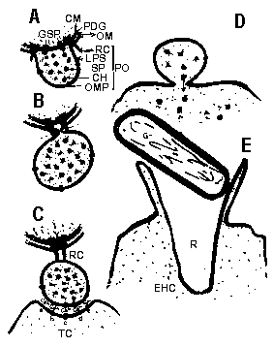
Outer Membrane Vesicle of Bacteria: Friend or Foe?
Presented by:
Seyed Davar Siadat (Ph.D)
Pasteur Institute of Iran

Slide 2
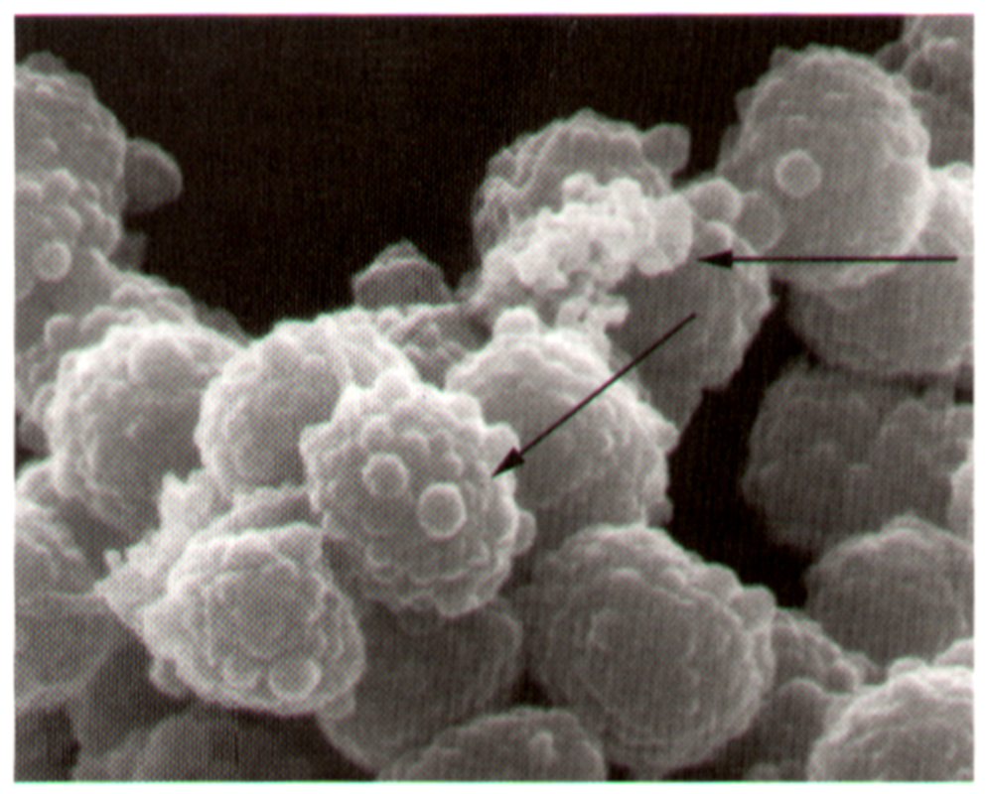
WHAT ARE OMVs?
BASIC RESEARC!
1- Small spherical structures 20–250 nm in diameter.
2- Produced by growing cells, not products of cell lysis or cell death .
3- In a variety of environments including liquid culture, solid culture, and in biofilms as well as during periods of bacterial stress.
4- consists of two membranes, called the inner and outer membranes (phospholipids), OMPs, PG layer, LPS, and the periplasm.
OMVs consists of the protein and lipids of the OM and periplasm and do not contain IM and cytoplasmic components

Slide 3
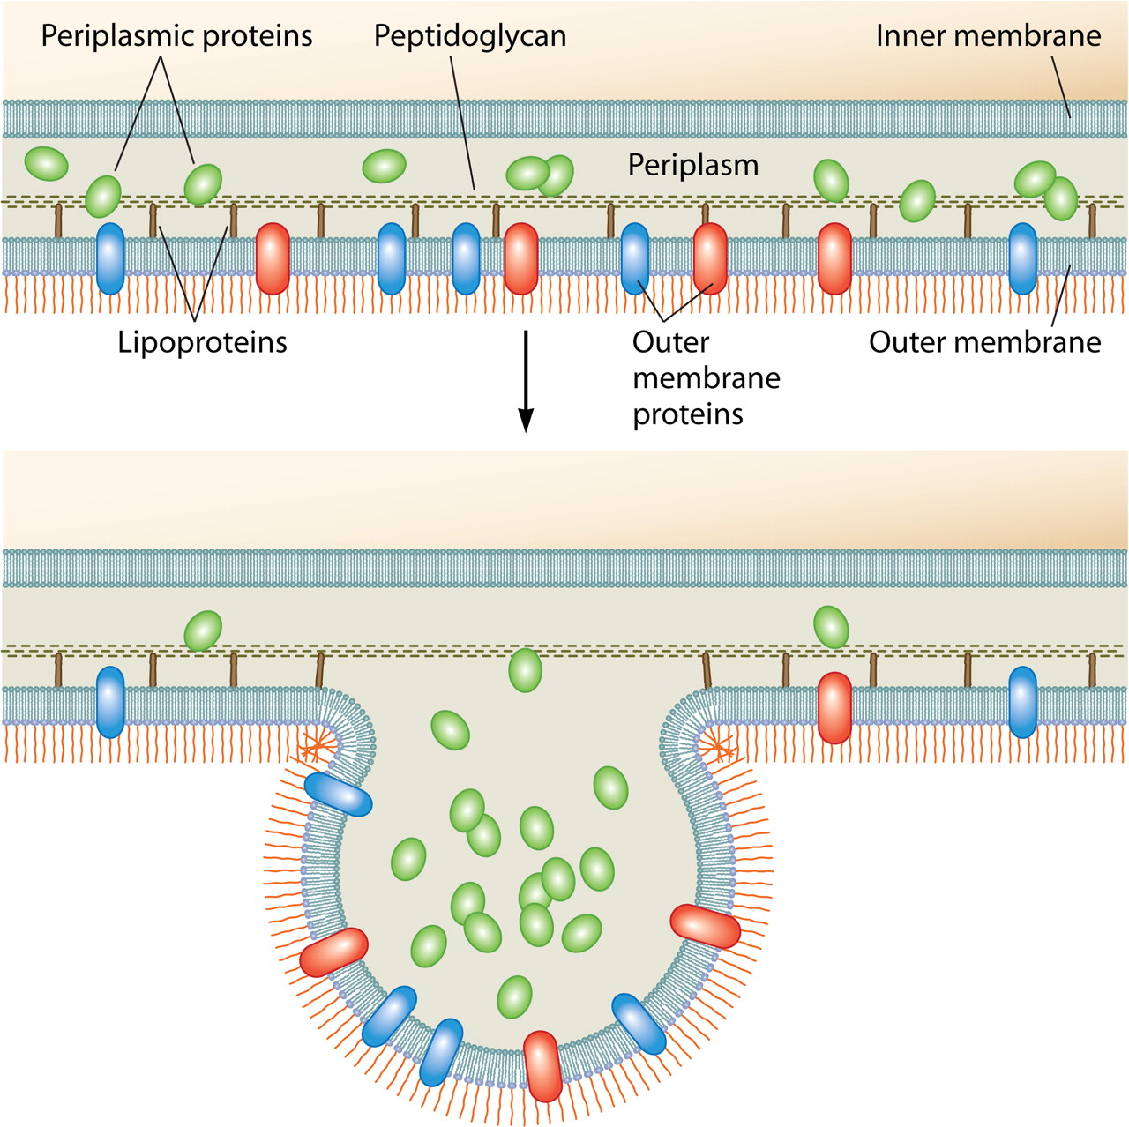
OMV secretion: the secretion of bacterial lipids, membrane proteins, and other insoluble compounds.
For instance, vesicles produced by typical laboratory cultures of growing and dividing P. aeruginosa and E. coli account for ∼1% of the OM material in the culture. In contrast, N. meningitidis produces abundant numbers of vesicles, constituting 8 to 12% of radiolabeled protein and endotoxin in log-phase cultures.
BASIC RESEARC!

Slide 4
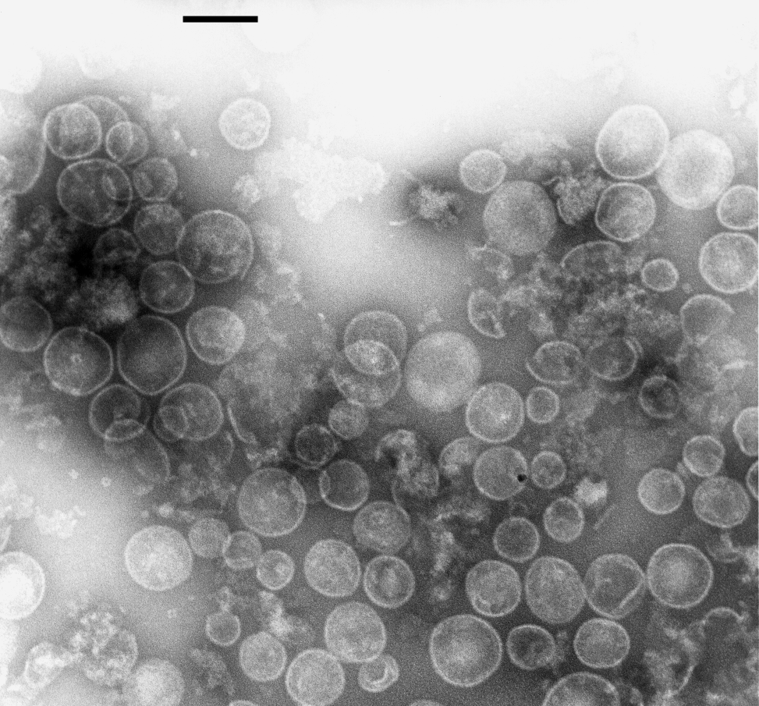
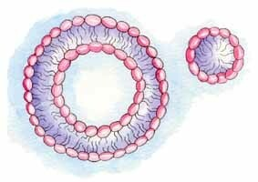
Both pathogenic and nonpathogenic species of Gram-negative bacteria secrete vesicles
In general, pathogenic bacteria produce more vesicles than their nonpathogenic counterparts .
Enterotoxigenic E. coli(ETEC) produce ∼10-fold more vesicles than nonpathogenic E. coli .
Similar patterns in vesicle production occur for leukotoxic and nonleukotoxic Actinobacillus actinomycetemcomitans: The pathogenic strains produce >25-fold more vesicles.
BASIC RESEARC!

Slide 5
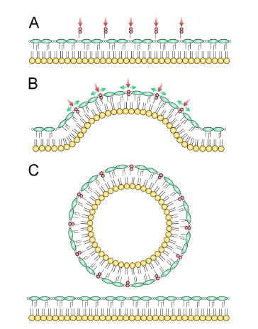
Functional Roles For OMV
BASIC RESEARC!
A Secretion and Delivery System
OMV-mediated secretion
Toxins & other virulence factors
OMV-mediated delivery
spontaneously Lyse & attach to the target and
deliver content by proximal lysis, internalization, or fusion
OMV-Enabled Bacterial Survival
Defense and resistance
OMV production can quickly remove a surface-attacking agent from bacteria. For example,
OMV production increases the survival of bacteria treated with lytic phage
OMVs also absorb other molecules, such as complement and antibiotics.
Nutrient acquisition
some OMV have been found to contain scavenging proteases, xylanase, and cellulase , which can aid in nutrient acquisition and thereby provide a survival advantage.
Biofilm OMVs
OMVs in Bacterial Pathogenesis
Secreted OMVs can play a role in pathogenesis, quorum signaling, nutrient acquisition, and Host parasite Intraction.

Slide 6
Immunomodulatory Activities
BASIC RESEARC!
The composition of OMVs makes them significant activators of host innate and acquired immune response pathways. In addition to the potent immunomodulatory molecule LPS, vesicles contain OMPs and other important innate immune-activating ligands. Together, vesicle components could be act synergistically to modulate the host response in ways that can either stimulate the clearance of the pathogen, enhance the virulence of the infection, or both. In addition, the immunogenic properties of OMSs lead to protective mucosal and systemic bactericidal antibody responses that have been exploited for vaccine purposes.
OMV from Salmonella enterica serovar Typhimurium :stimulators of proinflammatory cytokine secretion and immune cell activation.
Salmonella OMV activate macrophages and dendritic cells to increase levels of surface MHC-II expression as well as the production of the proinflammatory mediators TNF-α and IL-12. OMVs also activated CD4⁺ T cells.
A proinflammatory response:
H. pylori OMVs elicit an IL-8 response, as do P. aeruginosa vesicles.
Detergent-generated vesicles from N. meningitidis have been shown to trigger the production of numerous proinflammatory cytokines from PMNs, including TNF-α, IL-1β, IL-8, MIP-1β and IP-10.
Immunological Aspect of Meningococcal disease: An overview in Host- Bacteria Interaction. Siadat et al. International J of Mol Clin Microbiol 1-8.2011.
Serum Bactericidal Antibody Response 1 Year after Meningococcal Polysaccharide Vaccination of Patients with Common Variable Immunodeficiency. Siadat et al.Clin Vaccine Immunol (CVI), 17(4): 524-528, 2010.
Virulence and Immunomodulatory Roles of Bacterial Outer Membrane Vesicles. Terri N.E. & Meta J K. Microbiol Mol Biol Rev.; 74(1): 81–94,2010.

Slide 7

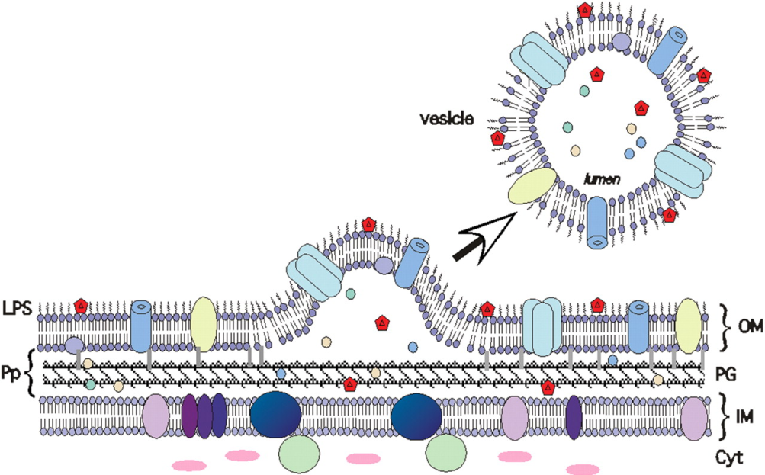
Outer membrane vesicles (OMVs)
natural vesicles for transfer of proteins
GOAL
Native as well as engineered vesicles
to correctly fold and stabilize proteins
Optimize antigen presentation to APCs
APPLICATIONS
Expression/stabilization/delivery of
conformational antigens
(Vaccine candidate)
Novel adjuvants to enhance existing
or poorly effective vaccines
http://www.molbiol.umu.se/forskning/wai/
Periplasmic proteins are entrapped within the OMV lumen
LPS
OM
Per
PG
IM
Cyt
Kuehn and Kesty (2005) Genes Dev 19: 2645-55

Slide 8

So What?
Application research!
Outer membrane vesicle based vaccines
(Neisseria meningitidis, Vibrio spp, Bordetella pertussis, Francisella tularensis, Brucella spp., Acintobacter spp., Shigella spp., Salmonella spp. B. burgdorferi , etc)
All preparations of Neisseria vesicle vaccines stimulate protective mucosal and systemic bactericidal antibody responses, with the antibody response being generated predominantly to the outer membrane porins PorA and PorB . Research is currently focused on engineering bacterial strains to produce OMVs containing multiple PorA proteins derived from different strains in the hope of developing a global N. meningitidis serogroup B vaccine
Outer Membrane Vesicle of Neisseria meningitidis Serogroup B as an Adjuvant to Induce Specific Antibody Response against the Lipopolysaccharide of Brucella abortus S99. Siadat et al . Ann of Microbiol. 59(1): 145-149,2009.

Slide 9
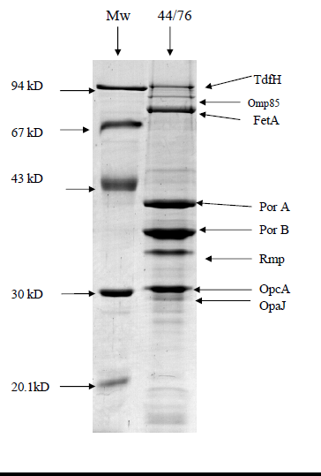
Outer Membrane Vesicles Derived From a
Group A Meningococcal
Siadat SD, et al. Biological and Immunological Evaluation of Neisseria meningitidis Serogroup A Outer Membrane Vesicle as Vaccine Candidates. Jundishapur J Microbiol. 6(4):e5007,2013.

Slide 10
Universal adjuvant properties of OMV
(Cancer vaccines, Brucellosis vaccine, TB vaccine, Meningococcal vaccine, Influenza virus, Hbs vaccine, HIV vaccine, etc).
The most of the classic and introduced adjuvants cause local and systemic hypersensitivity reactions and are not licensed for human use; According to these drawbacks of currently applied adjuvants, OMV would be a safe adjuvant with a high potency to induce a typical secondary response, since the OMV used in our vaccine formulation has been used previously in human trials and was found to be safe. Several reports have described that polysaccharide antigens stimulate immunologic memory when combined to OMV because has been shown to have T helper mitogenic activity. Thus, the availability of such OMV component with adjuvant properties will be of great importance for the development of improved and combined vaccines for a wide variety of diseases.
In addition, the adjuvant properties of OMV-derived particles have been demonstrated for potential cancer vaccines.
Outer membrane vesicle: a macromolecule with multifunctional activity.Siadat et al. Hum Vaccin Immunother. 8(7):953-5, 2012..
Application of Outer Membrane Vesicle of Neisseria meningitidis Serogroup B as a New Adjuvant to Induce Strongly Th1-Oriented Responses Against HIV-1.Siadat et al. Current HIV Research,2011.

Slide 11
OMV as a carrier in conjugated vaccines
So What? Count’
Application research!
H. influenzae type b: PRP- OMV conjugated vaccine, Meningococcal vaccine, LPS based vaccines in Acintobacter spp. Brucella spp. Salmonella spp.)
While the adjuvant properties of meningococcal OMV were expected the potency of OMV as a carrier (conjugated to a hapten) is now proved. It has been documented that polysaccharide(PS) (from bacterial capsule or LPS)-protein conjugates are usually immunogens in mice and rabbits as well as in humans. Many studies have shown that these conjugated vaccines elicit humoral and cellular to many pathogens in humans including N. meningitidis, V. cholera, H. influenzae, S. sonnei, as well as Brucella . Covalent linkage of the PS to carriers i.e. proteins produce glycoconjugates which are T-dependent antigens and prime for boosting either with the glycoconjugate or the LPS. On the other hand, PS or LPS – protein conjugate has been proven to be effective in several cases, and well- defined glycoconjugate vaccines have also been explored with a view to elicit discriminating immune responses
Bactericidal Activity Specific for Neisseria meningitidis Serogroup A and B : Effect of Immunization with Neisseria meningitidis SerogroupA Polysaccharide and Serogroup B Outer Membrane Vesicle Conjugate as a Bivalent Meningococcus Vaccine Candidate. Siadat et al.Res J Microbiol. 2 (5): 436-444,2007.
Measurement of Opsonophagocytic Activity of Antibodies Specific to Neisseria meningitidis Serogroup A Capsular Polysaccharide-Serogroup B Outer Membrane Vesicle Conjugate in Animal Model. Siadat et al. Ann of Microbiol. 59(4): 801-806, 2009.
Biological and Immunological Evaluation of Neisseria meningitidis Serogroup A Outer Membrane Vesicle as Vaccine Candidates. . Siadat et al. JJ Microbiol. 6(4):e5007,2013.

Slide 12
OMV as nano-sized drug delivery vehicles
We could mimic the design and synthetically produce OMV or even better, use appropriately engineered bacteria themselves to produce large quantities of secreted OMV with a content and specificity of choice.

Slide 13
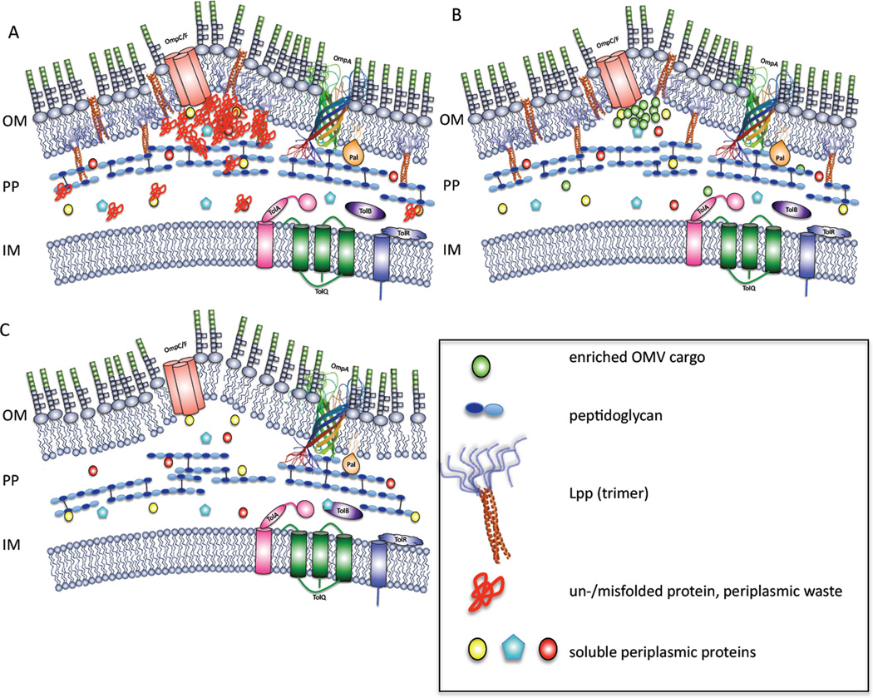
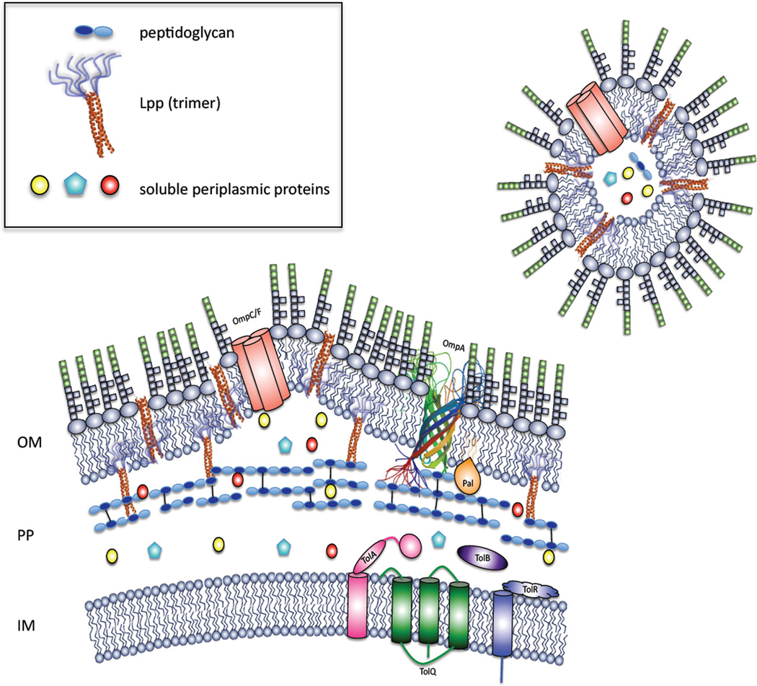
FUTURE DIRECTIONS
R & D!
Targeting Vesicles To Reduce Virulence & Taking Advantage of OM Vesicles
The utilization of OMVs as a complex of antigens in their native context with a natural adjuvant has already proven successful for human vaccines. The presence of LPS in OMV-based vaccines has emphasized the ability of LPS to act as a natural adjuvant to the immune system. Future efforts will likely result in OMV vaccines engineered to reduce endotoxicity and to include multispecies-specific antigens.
Delivery of foreign antigens by engineered outer membrane vesicle vaccines

Slide 14
Bioengineered Bacterial Outer Membrane Vesicles as Cell-Specific Drug-Delivery Vehicles for Cancer Therapy,.Vipul Gujrati et al. ACS Nano, 8 (2), pp 1525–1537, 2014
This work propose that bioengineered OMVs have great potential as cell-specific drug-delivery vehicles for treating various cancers.
The well example of communicable vaccines research linked to noncmmunicable vaccines research.

Slide 15
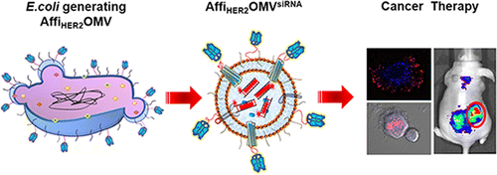
Bioengineered bacterial outer membrane vesicles (OMVs) with low immunogenicity (a mutant E. coli strain that exhibits reduced endotoxicity toward human cells was engineered to generate OMVs )
Displaying a human epidermal growth factor receptor 2 (HER2)-specific affibody in the membrane as a targeting ligand (Affibody molecules are small proteins being developed by a Swedish biotechnology company, Affibody AB. They are engineered to bind to a large number of target proteins or peptides with high affinity, imitating monoclonal antibodies, and are therefore a member of the family of antibody mimetics. Affibody molecules are used in biochemical research and are being developed as potential new biopharmaceutical drugs.)
by delivering small interfering RNA (siRNA) targeting kinesin spindle protein (KSP)

Slide 16

Conclusion
OMVs: a macromolecule with multifunctional activity
Basic research: Pathogenesis, quorum signaling, nutrient acquisition, and Host parasite Intraction.
Application research: OMVs based vaccines, new adjuvant development , drug deliveries, etc……….???!!
R & D:…….??!!

Slide 17
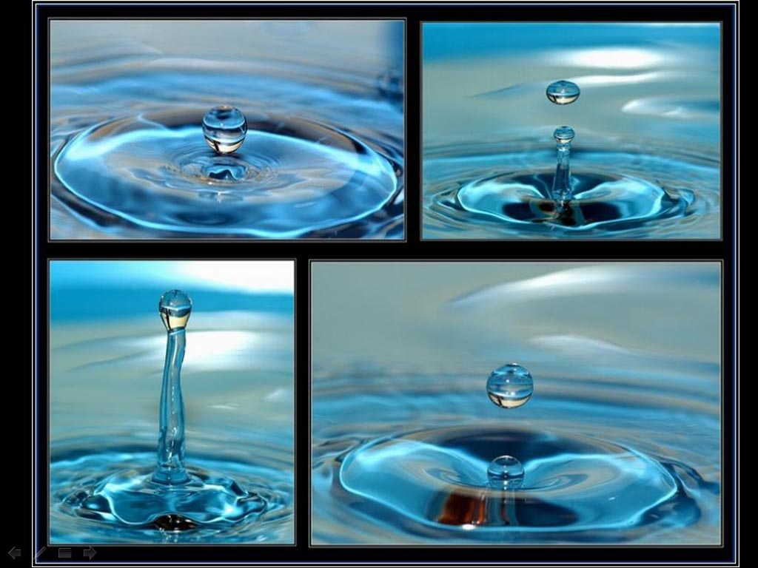
Thank you

