Slide 1

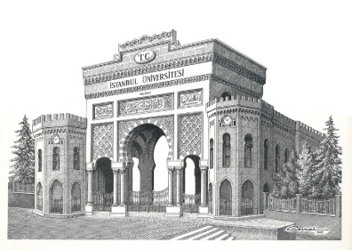
Mıcelles as nanosızed carrıers for skın delıvery of drugs
Sevgi Güngör
Istanbul University, Faculty of Pharmacy,
Department of Pharmaceutical Technology
4th International Conference on Nanotek&Expo ,01-03 December 2014,
San Francisco, USA

Slide 2
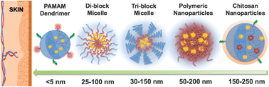
Polymeric Micelles
Polymeric micelles have potential applications in drug delivery as nanocarriers.
Micelles are assemblies of nanoscale size (25 to 150 nm in diameter) from amphiphilic block polymers.
Notes:
Polymer micelles are of interest to both scientific and industry community due to their potential applications in drug delivery as nanocarriers. They are assemblies of nanoscale size (25 to 150 nm in diameter) from amphiphilic block polymers.

Slide 3
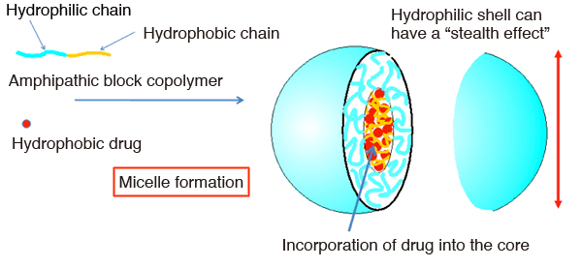
Polymeric Micelles
The polymer micelles characterize by core-shell morphology.
The hydrophobic internal core is capable of incorporating hydrophobic molecules, making it a candidate for «Drug Delivery System» applications for taking in drugs with poor water-solubility.
J. American Chem. Soc.135, 2574–2582, 2013.
Notes:
The hydrophobic internal core is capable of incorporating hydrophobic molecules, making it a candidate for Drug Delivery System carrier applications for taking in drugs with poor water-solubility. The hydrophilic outer shell exerts an effect of staving off immunological rejection inside the body, resulting in a stealth effect. However, these systems occur only above a threshold concentration, called the critical micellar. They exist as unimers below CMC in water.

Slide 4
Advantageous of polymeric micelles in topical drug delivery
The localization of drugs in the skin due to nano-size of micelles
especially in hair follicules and inflammed areas
Decreased the skin irritation
because of encapsulated BPO in micelle cores
Increased aqueous solubility of hydrophobic drugs
Enhanced efficacy from prolonged release of drugs and less application frequency.
Conventional dermatological products typically provide active ingredients in relatively high concentrations but with a short duration of action.
Improved chemical stability of drugs
Particularly, when the drugs combined with other compounds.

Slide 5
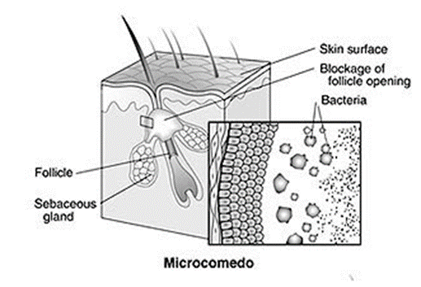
Acne
Acne is the most common cutaneous disorder of multifactorial origin.
It is a disease of the pilosebaceous unit-hair follicles in the skin that are associated with an oil gland.
http://www.skincarephysicians.com/acnenet/acne.html

Slide 6
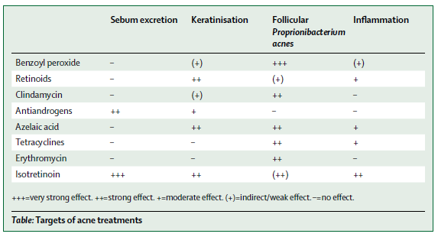
Topical Therapy
Topical therapy plays a crucial role in the treatment of acne.
to targeting the site of infection
to reduce the risk of sytemic side effects
Topical therapy include;
Benzoyl peroxide, retinoids and antibiotics, ….
H.C. Williams, R.P. Dellavalle and S. Garner, Acne Vulgaris, Lancet 2012, 379: 361-372.
Notes:
Drugs applied topically inhibit the formation of microcomedones and reduce non-inflammatory and inflammatory lesions.
Topical acne treatment also prevents the systemic side effects of drugs.

Slide 7
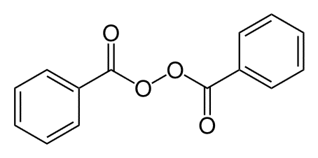
Benzoyl Peroxide (BPO)
BPO is one of the effective topical agent used in the treatment of acne.
It has been widely used since 1960s.
It is one of comedolitics
The main mode of action of BPO in acne is related to its antimicrobial activity against P. acnes in sebaceous follicle.
BPO is a moderately lipophilic molecule and it has low aqueous solubility.
It has major side effects such as local irritation and burning effect.
It has also chemical stability problem.
Physicochemical properties
  MW: 242.23
  Log P: 3.43
Chemical structure

Slide 8
Combination Therapy
The multifactorial nature of acne often requires a combination of topical compounds for successful management.
- The addition of a topical antibiotic into BPO can increase efficacy of acne therapy.
Clindamycin (CLN) is one of the most commonly used antibiotics in the treatment of acne.
- Combined use of BPO+a topical antibiotic can reduce bacterial resistance.
It is useful combination of comedolitic and topical antibiotic
- But it has some stability problems. Particularly, BPO is not stabil chemically in the presence of nucleophilic agents.
Once opened, these combination products have a short shelf-life due to chemical degradation problem.
- İt requires cold chain transport and storage.

Slide 9
Limitations of Topical Treatment
- the main barrier of skin: stratum corneum
Stratum corneum (horny layer) has «brick and mortar» model (Elias, 1981)
It is a rate limiting barrier to deliver drugs to target layers of skin
Corneocytes: the „bricks“
Intercellular Lipids: the „mortar“
- side effects of drugs on skin
Common Topical Acne Treatments | Cutaneous Side-effects
Retinoids (e.g., adapalene, tazarotene, tretinoin) | Burning, peeling, erythema, dryness, photosensitivity
Benzoyl peroxide | Dryness, erythema, peeling, hair and clothing discoloration
Clindamycin phosphate | Erythema, dryness, allergic contact dermatitis
Erythromycin | Dryness, erythema, peeling, allergic contact dermatitis
Salicylic acid | Dryness, erythema, peeling
Notes:
The barrier nature of stratum corneum depends on its unique constitituents %75-80 is protein, %-15 is lipid and %5-10 unidentified
The proetin is located primarly located whitin keratinocytes and Protein layer of skin is very resistant to chemical compounds. The keratinocyte protein layer has a key role in structuring and ordering the intercellular lipid lamellae of stratum corneum.
Human stratum corneum contains a unique mixture of lipids and most of drugs the continous multiply bilayered lipid content of stratum corneum is key in regulating drug flux through the skin.
The major componenets of the lipid domain are ceramides, fatty acids, cholesterol, cholesterol sulfate and sterol/wax esters.
Thae stratum corneum lipids are arranged in multiple bilayers

Slide 10
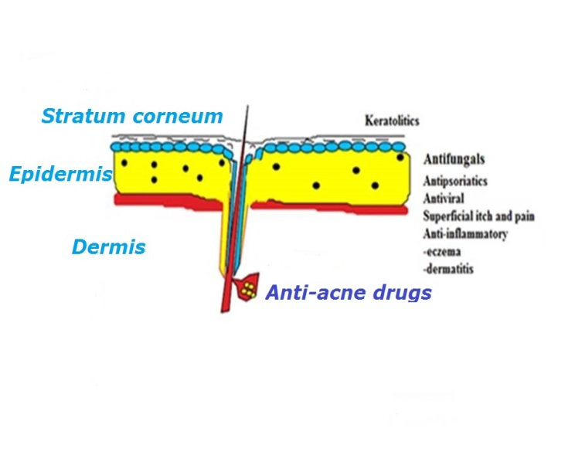
Challenges for the optimization of a topical product to deliver acne drugs
* Skin Penetration
- to achieve adequate skin deposition of drugs
- to get drugs into the hair follicles and pilosabaceous units
* Stability
- to provide a stable chemical environment in in vehicle for drugs intended to be delivered vehicle for drugs intended to be delivered
* Cosmetic Acceptability
- to overcome the additional physical effects on the skin, such as drying, occluding, or moisturizing
- to optimize the ideal vehicle which would leave minimal residue or oiliness.

Slide 11
Dermatopharmaceutical Research
Novel drug delivery strategies can play an important role in improving the topical delivery of drugs by
- modulating its physicochemical&biopharmaceutical properties.
LIPOSOMES
MICROSPHERES/
MICROSPONGES
NANOPARTICLES
MICELLES
- Biocompatibility
- Nano-sized
- Non-toxic, polymeric drug delivery systems
Notes:
During the past several years great efforts have been made in dermatopharmaceutical research for the development of new drug delivery systems having a colloidal phase as key pre-requisite for their effectiveness.
Among micelles, nanoparticles, and liposomes, micropongenges are the porous microspheres play the most important role and represent a promising alternative to conventional formulations.

Slide 12
Background and Aim of the Study
BPO is a highly lipophilic compound, it can easily partition into the lipid–rich intercellular layer of stratum corneum.
the challenge is to develop a stable formulation that facilitates drug release into skin.
In acne therapy, aqueous formulations are desired.
- due to the lipophilic character and poor water solubility of BPO, polymeric micelles could be considered as carrier system.
BPO has some side effects such as dryness, erhythema on skin
- its side effects would be decreased or minimized by incorporating of drugs into micelles .
and chemical degradation problem
- chemical degradation would be prevented by encapsulation of BPO in micellar nano-carriers

Slide 13
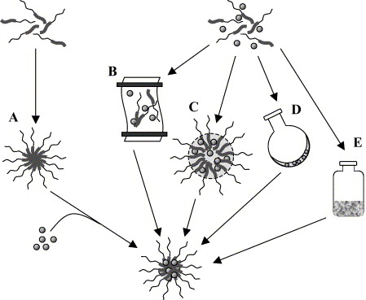
Preparation Methods of Polymeric Micelles
The common procedures for drug-loading into micelles
simple equilibrium,
dialysis,
o/w emulsion,
solution casting, and
freeze-drying.
Gaucher et al. J. Control Rel., 109, 169-188, 2005.
Among these methods, we used solution casting method for preparation of BPO-loaded polymeric micelles.
Notes:
Among these methods, we used solution casting method for preparation of BPO-loaded polymeric micelles. Firstly, Pluronic F127 and BPO were solved acetonitril/aseton/THF/DCM and organic solventl was evaporated at rotary evaporator until it occured a thin film layer. Then the thin film layer hydrated with clindamycin solution (1 %, w/w) and it was filtrated with 0,45 Regenerated cellulose filter. For storage, we lyophilisated formulation by adding trehalose solution (10 %, w/h) after 72 hours.

Slide 14
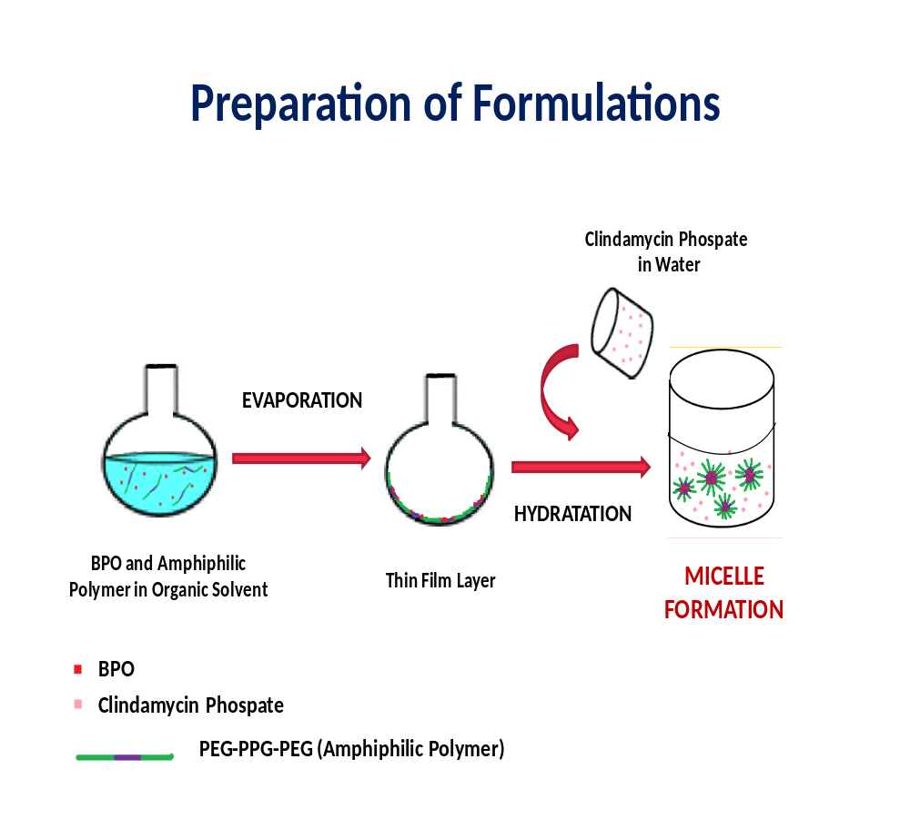
Preparation of BPO loaded Polymeric Micelles
Firstly, Pluronic F127 and BPO were solved organic solvent.
It was evaporated at rotary evaporator until occuring a thin film layer.
Then, the thin film layer hydrated with clindamycin solution (1 %, w/w).
It was filtrated (0.45 µm).
For the storage, it was lyophilisated by adding trehalose solution (10 %, w/h) after 72 hours.

Slide 15
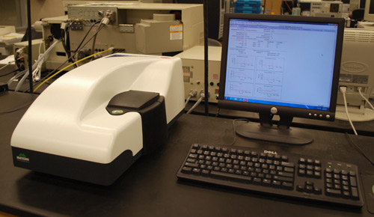
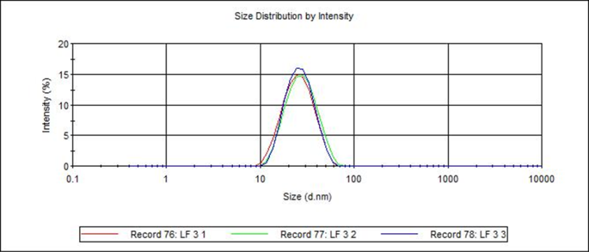
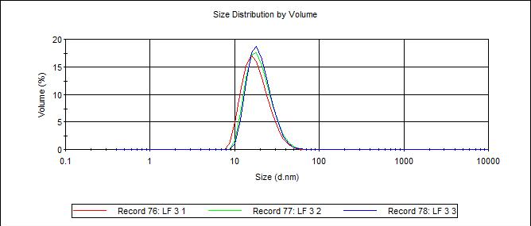
Characterization of
BPO loaded Polymeric Micelles
1. Size and Size Distribution
Organic Solvent | Size-0. hour (d.nm) | PDI-0. hour (d.nm) | Size-48. hours (d.nm) | PDI-48. hours (d.nm)
Aceton | 25.89±0.11 | 0.216±0.010 | 30.44±2.38 | 0.324±0.042
Dicloromethan | 29.46±0.15 | 0.345±0.006 | 31.72±0.85 | 0.778±0.056
Tetrahydrofuran | 25.89±0.68 | 0.210±0.021 | 31.52±1.88 | 0.384±0.031
Acetonitril | 24.77±0.31 | 0.176±0.009 | 25.49±0.31* | 0.300±0.026*
*after 72 hours
After 48 hours, we decided that acetonitril was the most proper organic solvent for our study due to its higher stabilty than the other solvents.

Slide 16
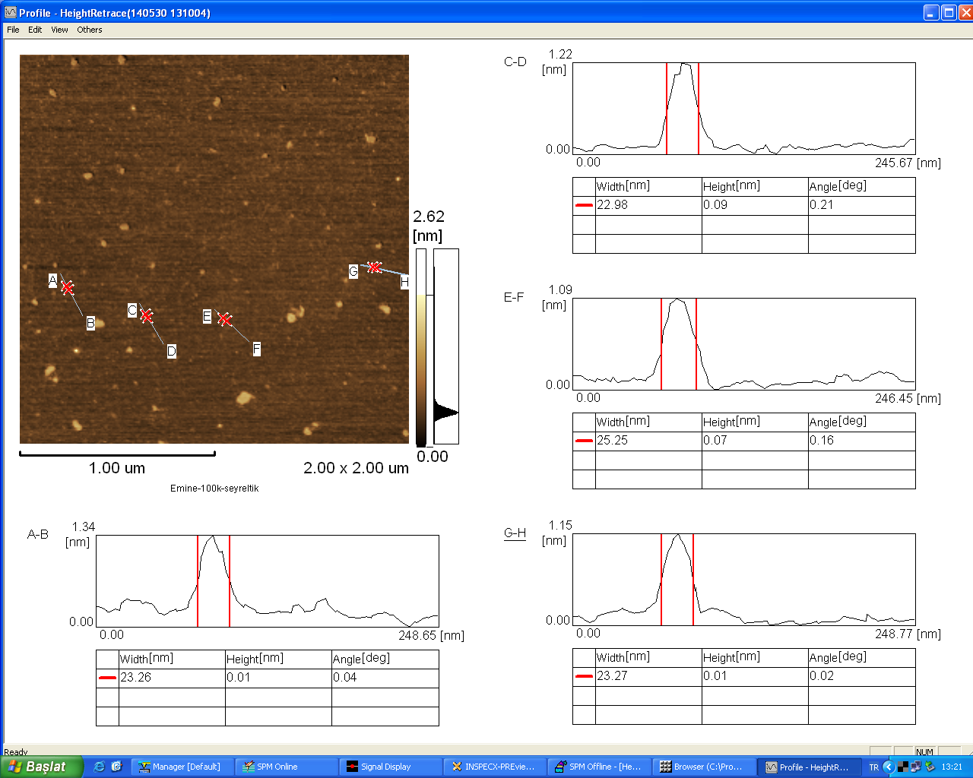
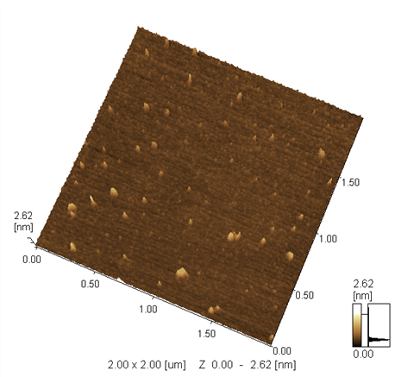
Characterization of Polymeric Micelles
2. Atomic Force Microscopy
Morphology of polymeric micelles should be spherical shape because of kinetic stability.
AFM data correlated to ZetaSizer size measurements.
Notes:
Morphology of polymeric micelles should be sherical shapes because of kinetical stability. In our study, AFM date correlated to ZetaSizer size measurements.

Slide 17
Characterization of Polymeric Micelles
3. Zeta Potential
4.% Encapsulation Efficiency
Organic Solvent | Zeta Potantial (mV)
Aceton | -15.01±1.23
Tetrahyrofuran | -7.36±2.01
Acetonitril | -7.63±0.68
Polymer:Drug Ratio (w/w) | % Encapsulation Efficiency
1:0.015 | 81.937±3.816
1:0.030 | 18. 570±2.654
1:0.050 | 4.342±0.982
After % EE measurements, micelles composed of polymer:drug ratio (1:0.015) was selected further studies due to the higher EE (% ) than the others.
Notes:
After % EE measurements, we decided to continue by using Polymer:Drug ratio (1:0.015) due to higher % EE than others.

Slide 18
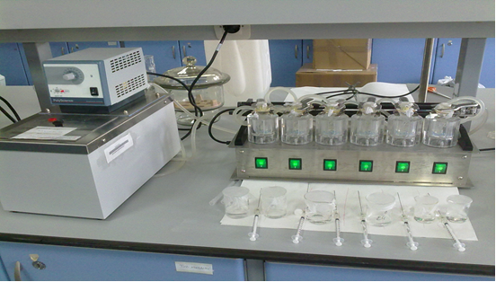
In vitro evaluation of BPO&CLN in deposition in skin
Donor phase:
  BPO&CLN micelle-gel formulation
  MC I: Micelle: water: propylene glycol; (5:5:5, w/w)
  MC I: Micelle: water: propylene glycol; (5:7:3, w/w)
  Effective diffusion area:1.77 cm²
Stirred at 250 rpm at 37ºC
Receptor phase:
(PBS, pH 7.4, 12 mL)
Pig skin (dermatomed to a thickness of 750 µm)
  Effective diffusion area:1.77 cm²
Notes:
Skin samples were equilibrated in PBS, pH 7.4 for 30 min and mounted on Franz-type diffusion cells. The receptor compartment was filled with PBS, pH 7.4.

Slide 19
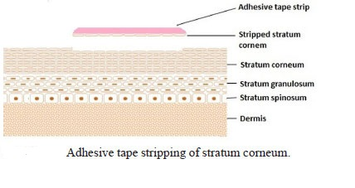
Evaluation of BPO/CLN Deposition in Skin
After skin was blotted dry, the cutaneous penetration of BPO&CLN was investigated using sequential tape stripping in the SC.
The treated area on each skin was tape stripped 20 times using Scotch® Book Tape 845 (3M, USA) strips.
The tapes were extracted (overnight), and samples were analyzed using HPLC.
Notes:
The treated area on each skin was tape stripped 20 times using Scotch® Book Tape 845 (3M, USA) strips in order to determine the SC absorption of BPO.
The tapes were extracted with 3 mL of acetonitril at ambient temperature for 24 hours while shaking on a Thermo Forma orbital shaker (USA).
Samples were filtered through 0.45 µM Millex LH filters (Japan) and directly analyzed using HPLC.

Slide 20
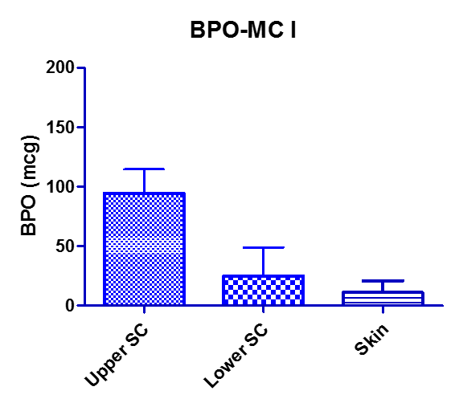
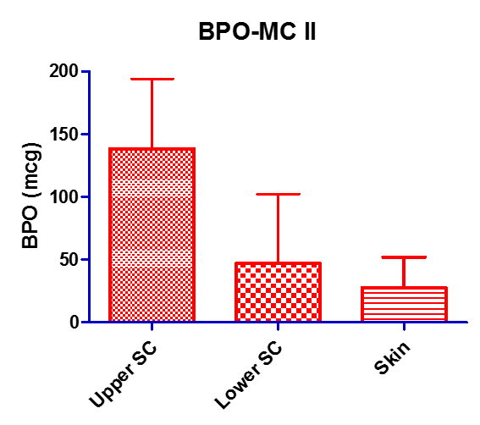
Skin deposition of BPO after 24 hours
The data showed that BPO was in the lower layers of the skin.

Slide 21
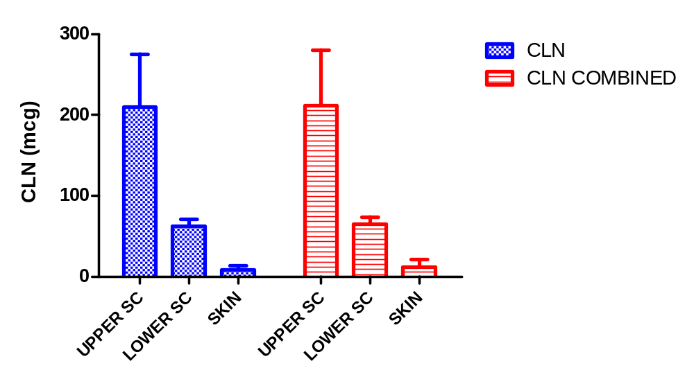
Skin deposition of CLN after 24 hours
The data showed that CLN was in the lower layers of the skin.

Slide 22
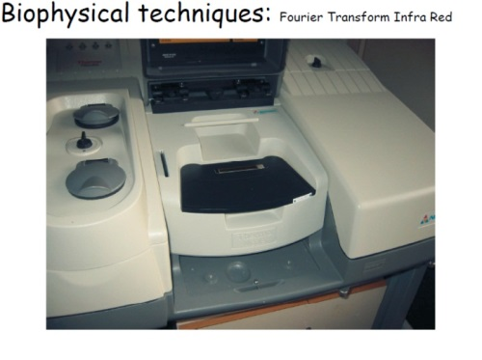
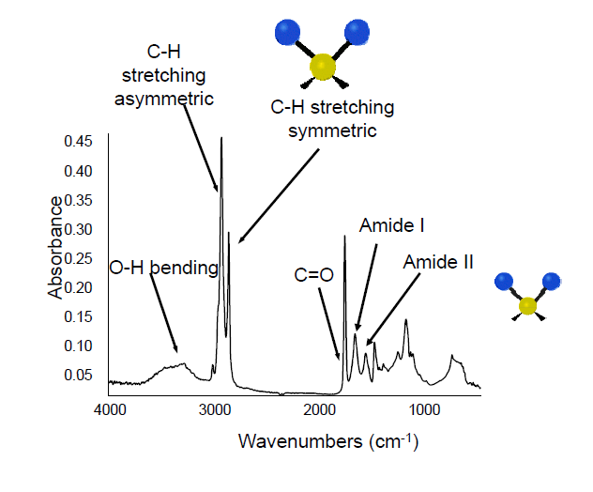
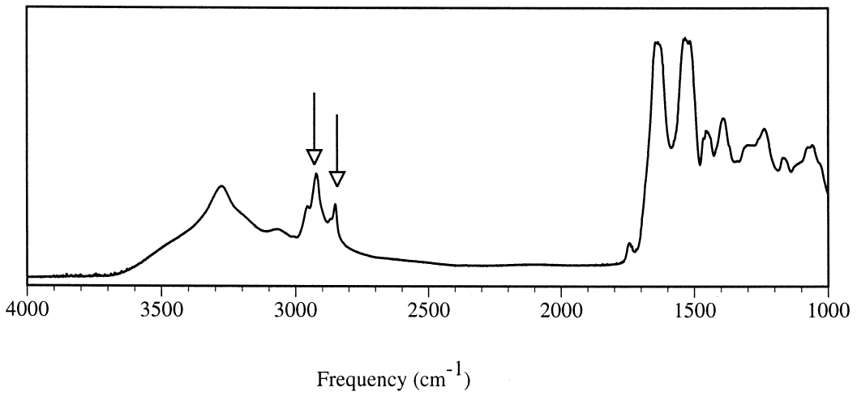
ATR-FTIR Spectroscopy
The peaks near 2850 and 2920 cm⁻¹ due to the symmetric and asymmetric C-H stretching vibrations (ASSV & SSV), respectively, are sensitive to perturbations in the amount and the conformational order of the SC intercellular lipids.
ATR-FTIR Spectroscopy is a powerful tool to study biophysical properties of the SC.
Skin spektrum
Notes:
ATR-FTIR was employed to investigate the biophysical changes in the stratum corneum lipids after treatment with formulations.
After the skin was removed from Franz diffusion cells, excess of formulation was removed and skin was blotted dry.
The skin pieces were mounted SC side down onto the ATR crystal of the spectrometer.
To ensure reproducible contact between the skin and the crystal, always the same pressure on top of samples was applied (force gauge 80 N).
ATR-FTIR Studies:
All spectra were collected using a Perkin Elmer Spectrum 100 FT-IR spectrometer (USA) equipped with a diamond-ZnSe ATR crystal.
Each spectrum was an average of 40 scans.
Perkin Elmer Spectrum Version 6.0.2 software was used for calculations with ±0.1cm⁻¹ accuracy.
Baseline correction and normalization was performed.
Each sample served as its own control.

Slide 23
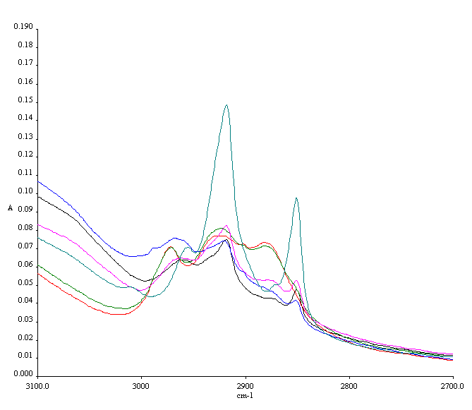
ASSV & SSV CH2 Peak Positions Following Permeation Study: BPO-MC I
cause a blue shift of +4 cm⁻¹ in the ASSV and SSV CH₂ stretching peaks

Slide 24
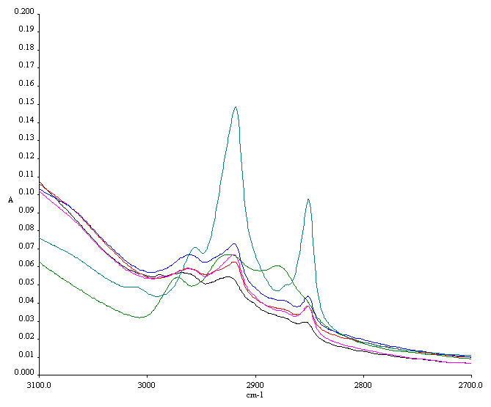
ASSV & SSV CH2 Peak Positions Following Permeation Study: BPO-MC II
cause a blue shift of +4 cm⁻¹ in the ASSV and SSV CH₂ stretching peaks

Slide 25
ASSV & SSV CH₂ Peak Positions Following Permeation Study
BPO-loaded micellar carriers led to a blue shift shifts to higher frequency for the ASSV and SSV CH₂ peaks especially on the upper skin surface.
This effect was evident in the lower layers of stratum corneum when compared with non-treated control skin.
The decrease in peak areas of the CH2 stretching absorbances after treatment with formulation suggest that it also affect the lipid extraction from the stratum corneum to some extent.
Notes:
ATR-FTIR Studies:
Blue shifts are associated usually with a higher disorder of the SC lipid system or to the occurrence of phase separation with fluid domains of oils.
The enhanced conformational disorder observed is attributable to the partitioning of the microemulsion components to the intercellular lipid bilayers of stratum corneum.

Slide 26
Conclusion
The results demonstrate that polymeric micelles optimized had relatively small particle size (~25 µm), and high encapsulation efficiency (>80%).
The encapsulation of BPO in micellar nanocarriers has overcomed its chemical degradation problem, when it is combined with CLN.
The shelf-life of the product has been increased without cold-chain transportation and storage.
BPO delivery with micellar carriers resulted in significantly high drug deposition in skin.
ATR-FTIR data indicated that micellar formulation affect the lipid extraction from SC to some extent.
That data supported that BPO passes across lipid domain of SC and both drugs can reach lower layers of skin.
The micellar nanocarriers can be considered as an appropriate carriers for topical delivery of BPO.

Slide 27
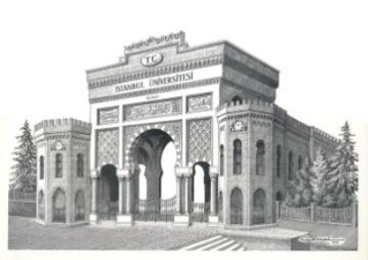


Acknowledgement
Istanbul University Research Fund
Embil Drug Company, Turkey
Topical&Transdermal Drug Delivery Group
Prof. Yıldız Özsoy
MSc.Pharm. Emine Kahraman

Slide 28
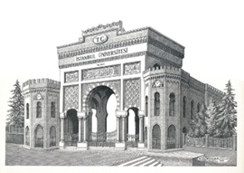
Thank you for your attention!
4th International Conference on Nanotek&Expo ,01-03 December 2014,
San Francisco, USA

