Slide 1


Developing New Detection and Verification Methods for Oxidized Mercury
Seth Lyman
Trevor O’Neil
Tanner Allen
July 2014
bingham entrepreneurship & energy research center

Slide 2
New Oxidized Mercury Instrumentation is Needed to Break Through Barriers
Automated field-deployable calibrator
  For verification of measurements in field conditions using multiple mercury compounds
Cryofocusing/GC-MS system
  For identification and quantification of ambient mercury compounds
Notes:
2

Slide 3
Calibrators for Oxidized Mercury Have Been Successfully Deployed
Lab permeation of mercury compounds
  Landis et al., 2002, Environ. Sci. Tech. 36, 3000-3009
  Lyman et al., 2010, Atmos. Chem. Phys. 10, 8197-8204
  Huang et al., 2013, Environ. Sci. Tech. 47, 7307-7316
  And Several Others
Field permeation to test oxidized mercury instruments
  Finley et al., 2013, Environ. Sci. Tech. 47, 7277-7284
Advantages: Certainty, simplicity
Disadvantages: Unstable permeation rate (sometimes)
Notes:
3

Slide 4
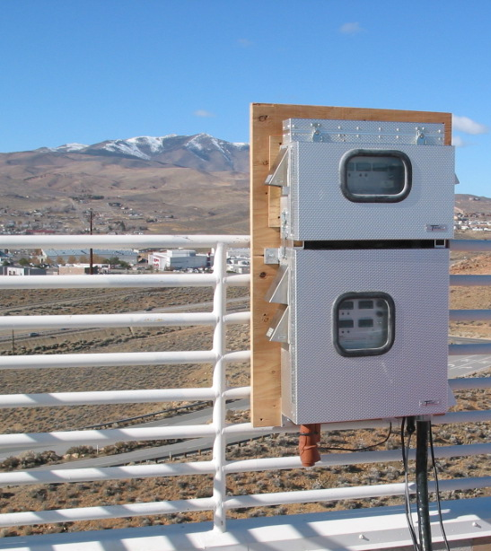
Automated Field Calibrator to Verify
Ambient measurements
Automated
Oxidized Hg Calibrator
Notes:
4

Slide 5

Automated Field Calibrator to Verify
Ambient measurements
Permeation
Oven
Critical Orifi
Heated Zone
Vent
Tekran 1135
Valve
Pressure
Controller
Valve
Pyrolyzer
Tekran 1130
Electronic
Control
Heated Line
Integrated Control
and Logging
Tekran 2537
UHP
Ar
Tekran Pump
Module
Notes:
5

Slide 6
Automated Field Calibrator to Verify
Ambient measurements
Permeation
Oven
Critical Orifi
Heated Zone
Vent
Tekran 1135
Valve
Pressure
Controller
But we don’t know which oxidized mercury compounds are in ambient air, so how can we know which oxidized mercury compounds to permeate?
Valve
Pyrolyzer
Tekran 1130
Electronic
Control
Heated Line
Integrated Control
and Logging
Tekran 2537
UHP
Ar
Tekran Pump
Module
Notes:
6

Slide 7
GC/MS System to Identify Individual Mercury Compounds: Sample Collection
Pump
Inert Collection Surface
Notes:
7

Slide 8
GC/MS System to Identify Individual Mercury Compounds: Sample Analysis
Chromatographic
Column
0ºC
Cryogenically-cooled
Sample Trap
Mass
Spectrometer
160ºC
Notes:
8

Slide 9
GC/MS System to Identify Individual Mercury Compounds: Sample Analysis
Chromatographic
Column
180ºC
Cryogenically-cooled
Sample Trap
Mass
Spectrometer
Notes:
9

Slide 10
GC/MS System to Identify Individual Mercury Compounds: Flow diagram
Permeation
Oven
UHP He
Critical Orifi
Valve
Valve
UHP He
GC
Mass
Spec
Sample
Desorber
Crygenic
Concentrator
Vent
Pyrolyzer
Tekran 2537
Notes:
10

Slide 11
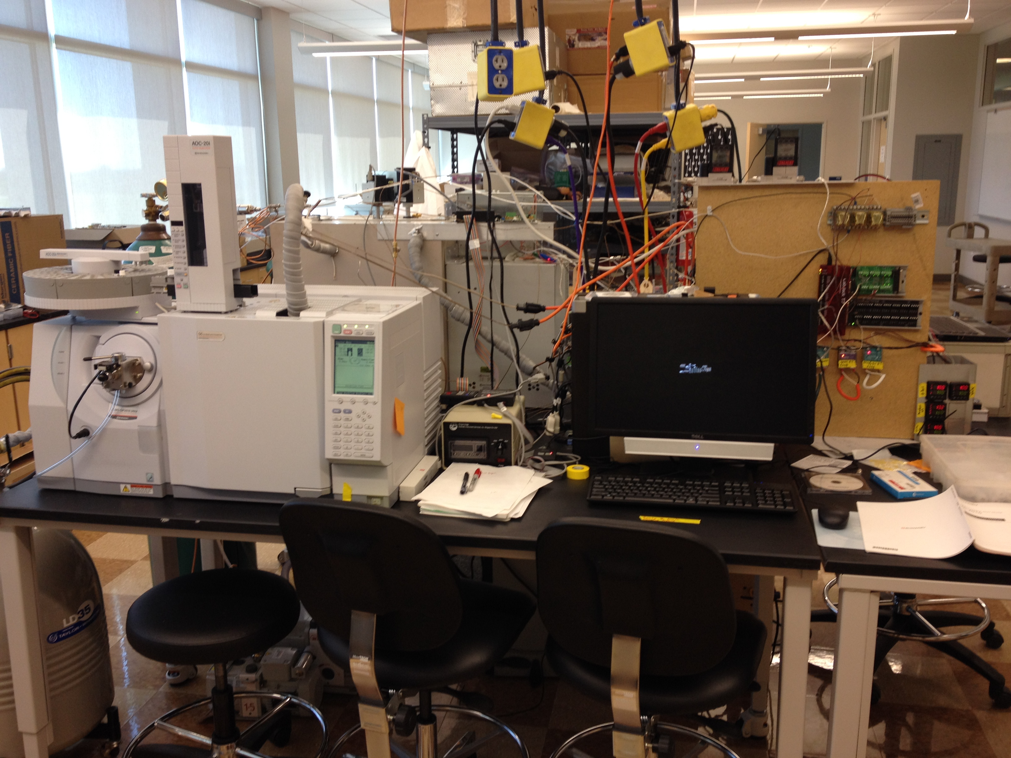
GC/MS System to Identify
Individual Mercury Compounds
Notes:
11

Slide 12
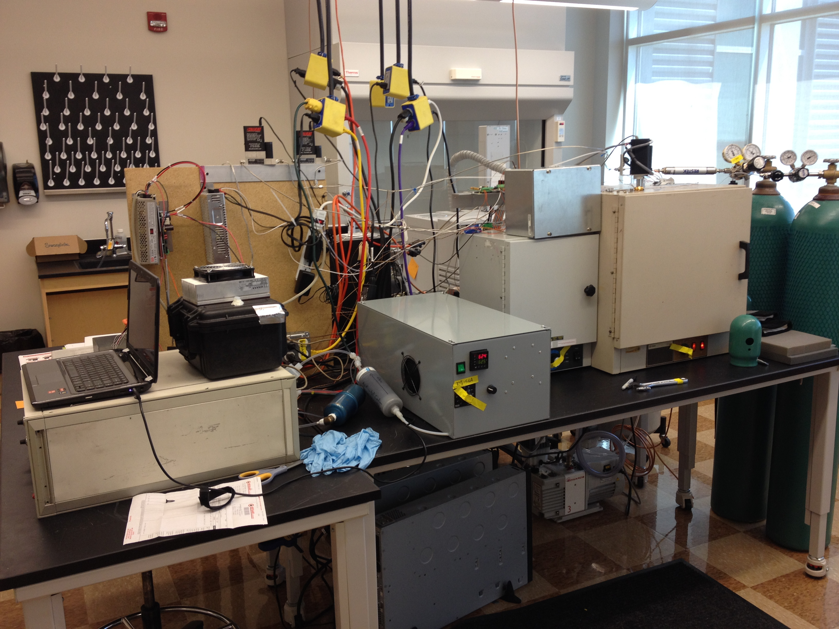
GC/MS System to Identify
Individual Mercury Compounds
Notes:
12

Slide 13
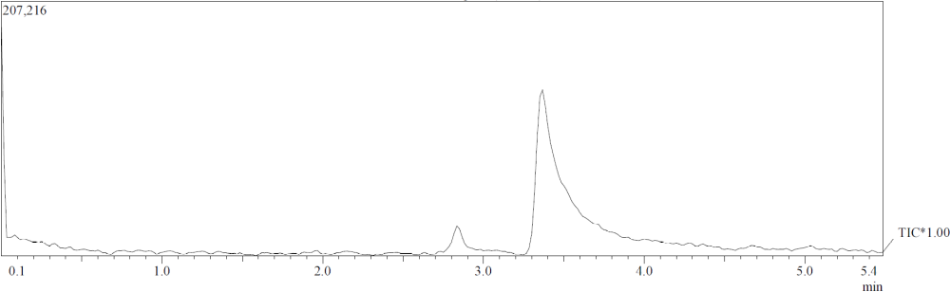
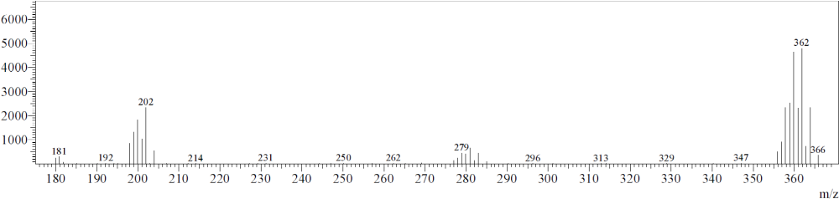
Clear Identification of HgBr₂ by MS
HgBr₂
Elemental Hg
m/z 362
²⁰²Hg
²⁰²Hg+⁷⁹Br+⁸¹Br
m/z 202
²⁰²Hg+⁷⁹Br
m/z 281
Notes:
13

Slide 14
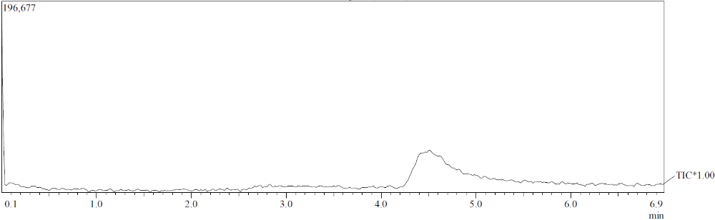
System Optimization is Improving Detection
Temperatures at 160ºC, detector not optimized, cryotrap collection at -25ºC
Temperatures at 200ºC, sensitivity optimized, cryotrap collection at 0ºC
Peak tailing is still a problem
Notes:
14

Slide 15
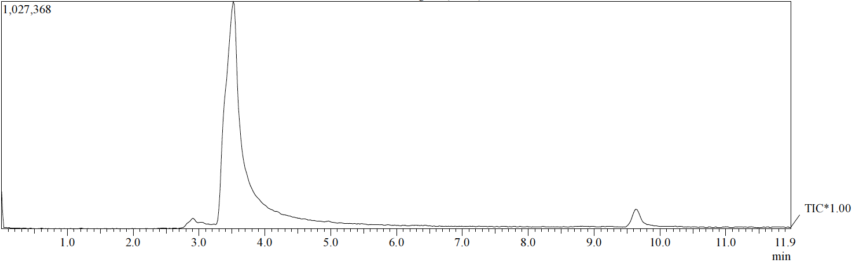
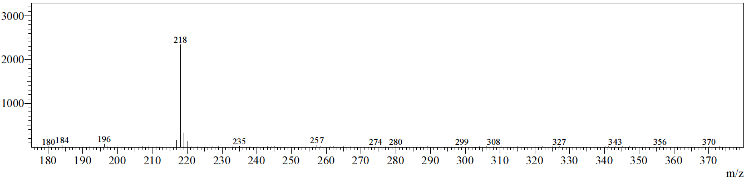
GC-MS can Separate
Different Mercury Compounds
HgBr₂
HgO
Notes:
15

Slide 16
GC-MS can Separate
Different Mercury Compounds
HgBr₂
This provides strong evidence for gas-phase HgO
Published HgO vapor pressures are ~70 years old, not reliable
HgO
Notes:
16

Slide 17
Worries
What about chemical transformation/decomposition during ambient air collection? (from Jerry Lin)
What if ambient air oxidized Hg is some compound(s) we don’t know about yet?
  What if whatever it is is too reactive to make it through the GC/MS system?
Will semivolatile organics interfere with oxidized mercury cryotrapping or detection?
Won’t we have to sample a boatload of ambient air to overcome detection limits?
Notes:
17

Slide 18
Thank You
Funding from National Science Foundation award number 1324781
Thanks to Mae Gustin, Jiaoyan Huang, and others at UNR for collaboration and support
Notes:
18

