Slide 1

Brain free hemoglobin increase is different among anticoagulant classes
Sergey Brodsky MD, PhD
The Ohio State University, Columbus, OH

Slide 2
● Anticoagulant therapy is the standard of care in patients at high risk for thromboembolic events, most notably with atrial fibrillation or venous thromboembolism.
● Warfarin is the most commonly prescribed anticoagulant, with rapid market uptake of direct oral anticoagulants in recent years. Warfarin provides reliable protection against thromboembolic events.
● However, this benefit comes at a cost, which is a hemorrhage resulting from warfarin-related coagulopathy. Perhaps the most feared hemorrhagic event related to warfarin is intracranial hemorrhage.
● The incidence of warfarin-associated intracranial hemorrhage is 1-5% and it accounts for 10-12% of all intracranial hemorrhages. The mortality rate in these patients is as high as 50%.
● Direct oral anticoagulants (DOAC), such as direct thrombin inhibitors (dabigatran) and Factor Xa inhibitors (rivaroxaban and apixaban) reduce, but not completely prevent the risk of intracranial hemorrhages².

Slide 3
The aim of this study was to investigate whether intracranial hemorrhages are dependent on the class of anticoagulant in experimental animals.

Slide 4
Several anticoagulant classes were used:
vitamin K antagonists: Brodifacoum (BDF) and warfarin
direct thrombin inhibitor dabigatran (Pradaxa)
Factor Xa antagonist rivaroxaban (Xarelto)
Indirect thrombin and Factor Xa inhibitor heparin

Slide 5
The following routes and doses were used for the medications:
BDF: oral gavage, single administration 0.4 mg/kg (LD50)
warfarin per os in drinking water 2 mg/kg/day for 5 days
dabigatran: oral gavage, single administration 150 mg/kg (LD50)
rivaroxaban: oral gavage, single administration 20 mg/kg (LD50)
heparin: subcutaneous single injection 100KU/kg (LD50).

Slide 6
Intracranial hemorrhages were assessed by histologic examination of the brains and the free hemoglobin concentration in the brain parenchyma. Free hemoglobin was measured using Drabkin’s Reagent based on a modified manufacturer protocol. The total hemoglobin concentration was calculated per gm of brain tissue from the calibration curve.

Slide 7
All rats underwent autopsy, craniotomy was performed, brain was extracted and cut at the middle sagittal plane. The left half of the brain was divided into 3 parts: anterior brain (including the frontal lobes), posterior brain (including the parietal, temporal and occipital lobes) and the cerebellum.

Slide 8
Grossly, intracranial hemorrhages were not appreciated at autopsy in either of the treatment groups. However, microscopic examination showed microscopic interstitial hemorrhages in animals treated with BDF, but not other anticoagulants

Slide 12
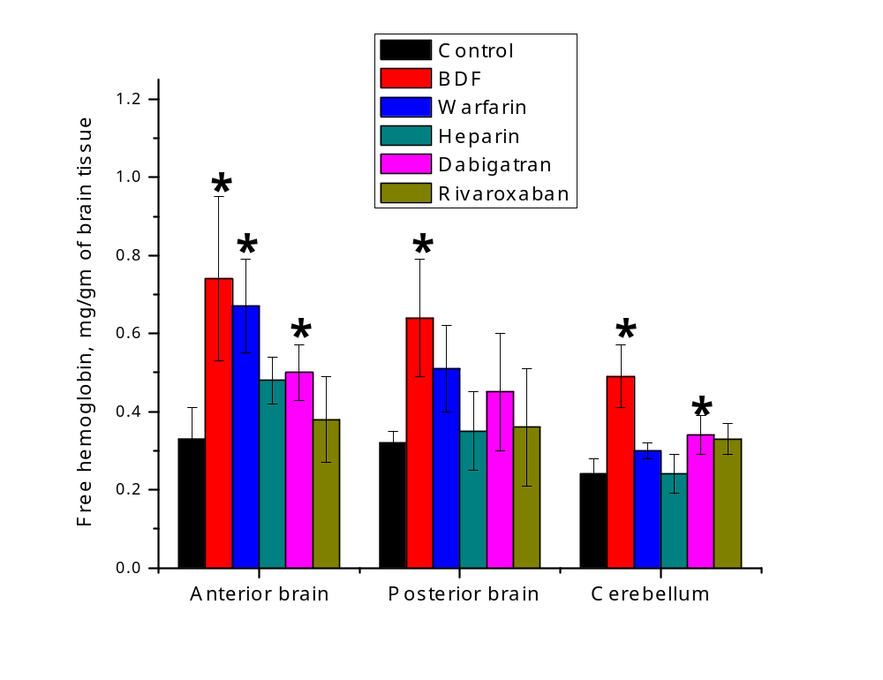

Slide 13
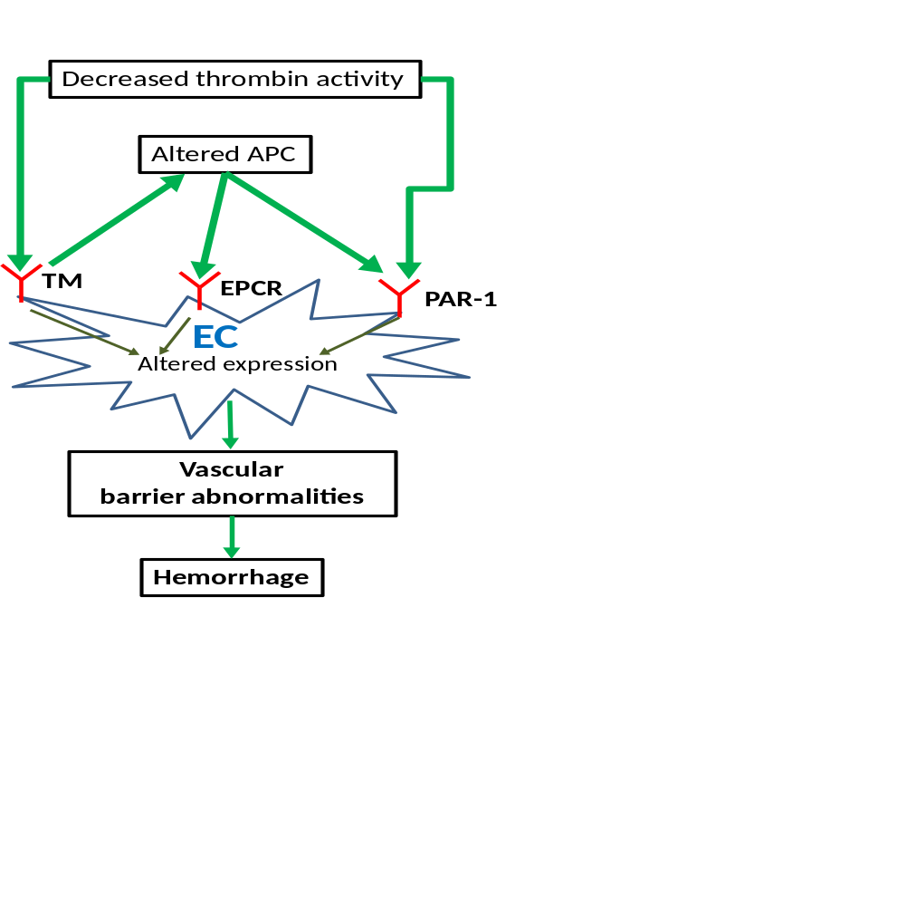
Possible pathogenesis of anticoagulant-related vasculopathy.
Thrombin acts on thrombomodulin (TM) on endothelial cells (EC). This results in protein C activation. Also, thrombin binds and activates protease-activated receptor 1 (PAR-1), which is expressed on EC. Activated protein C (APC) may affect endothelial protein C receptor (EPCR) and/or PAR-1. We propose that activation of PAR-1 and/or EPCR is necessary to preserve the vascular barrier. Underlying vasculopathy results in altered expression of PAR-1, EPCR and/or TM. Decreased thrombin activity, as the result of anticoagulation, lowers APC expression. The decrease in both thrombin and APC reduces stimulation of PAR-1, EPCR, and/or TM. This causes a disruption of endothelial barrier integrity and leads to hemorrhage.

Slide 14
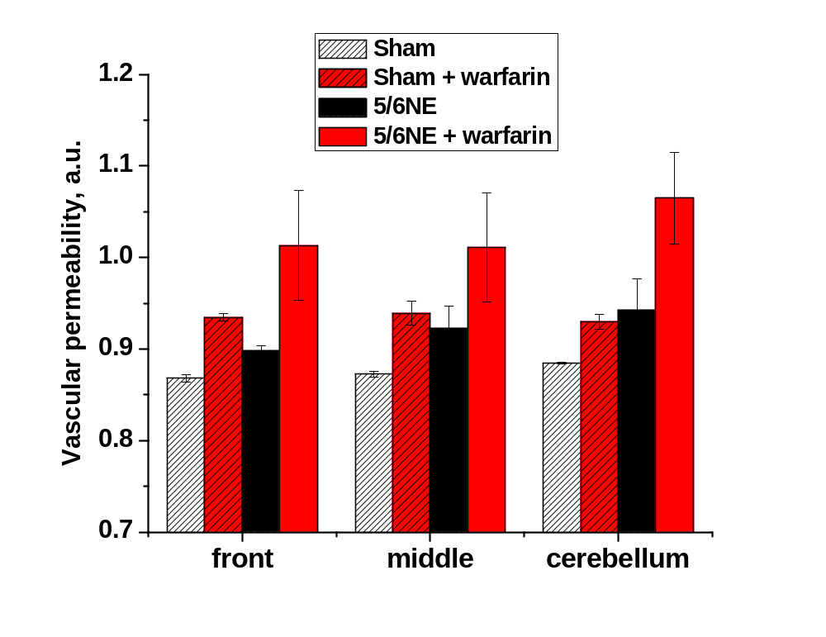
Vascular permeability in the brain vessels in animals treated with warfarin. Vascular permeability was measured by Evans blue contents in the brain after 1 week of treatment with 0.74mg/kg/day of warfarin, as described . Sham operated (Sham) and 5/6 nephrectomy (5/6NE) 3 weeks after the ablative surgery were studied. Different areas of the brain were analyzed. Front – frontal lobes of the cerebrum, middle – the middle brain and the cerebellum. N=3 in each group.

Slide 15
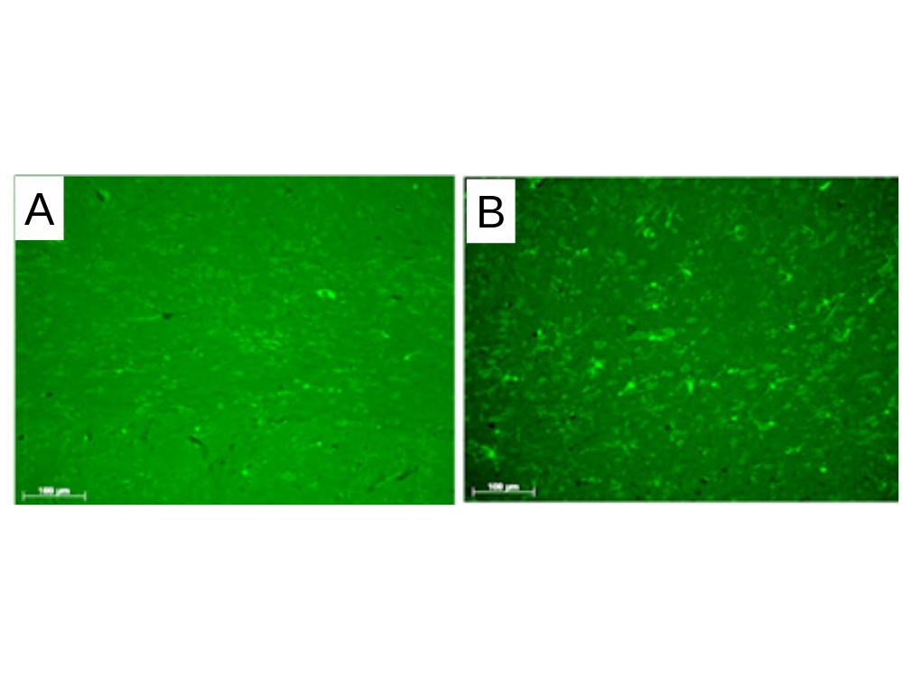
Microglial cells in the brain obtained from 5/6 nephrectomy rats treated with warfarin. 5/6 nephrectomy rats were treated with 0.74 mg/kg/day warfarin for 7 days. Microglial cells were detected in sections of paraffin embedded tissue by immunofluorescence using an lba1 antibody. A – non-treated B – warfarin treated rat.

Slide 16
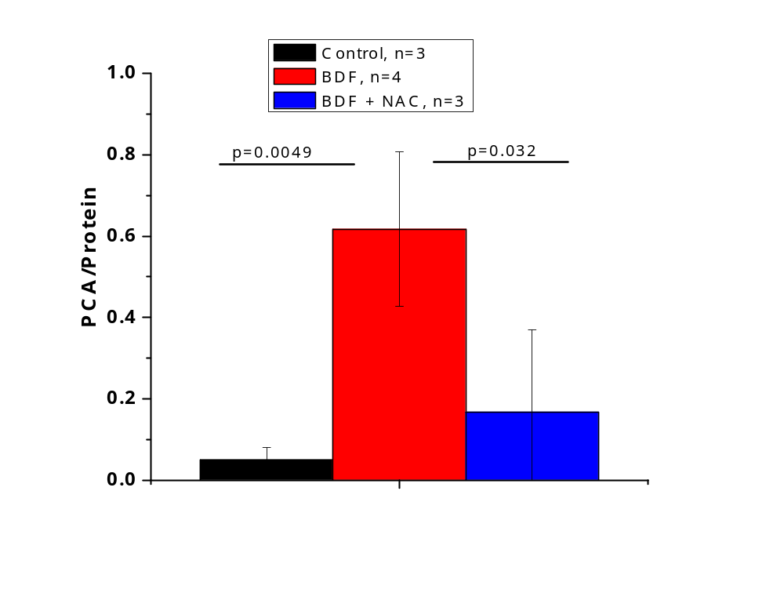
Oxidized proteins (measured as protein carbonyl (PCA) in the brain in animals treated with brodifacoum (BDF).
Protein Carbonyl Assay (Cayman Chemical Company, MI) was used to detect oxidized proteins in the brain. PCA/protein ratio is shown. BDF was given in the dose of 0.4 mg/kg per os. N-acetylcysteine (NAC) was given 24-hours prior to BDF (combined data from 30 mg/kg and 100 mg/kg are shown). Control animals received vehicle only.

Slide 17
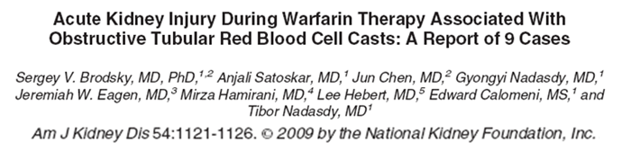
Warfarin related nephropathy – WRN. Key features of WRN in this cohort:
AKI: Cr 4.3±0.8 mg/dl, baseline 1.3 ±0.3 mg/dl.
At presentation with AKI, the INR was above the therapeutic range (4.4±0.7)
Kidney biopsy:
  acute tubular injury
  glomerular hemorrhage (RBC in the Bowman’s space and occlusive RBC casts in tubules).
  An underlying kidney disease (mild glomerular immune complex deposits, FSGS, thickened GBM).
Outcome: six of nine patients did not recover from AKI

Slide 18
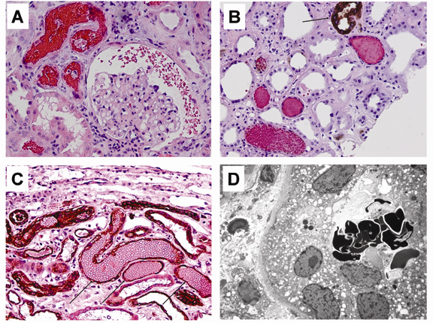
Red blood cells (RBC) in different compartments of the kidney in patients on warfarin therapy and acute kidney injury. A – numerous RBC and RBC occlusive casts were noticed in tubules and in Bowman’s space (Hematoxylin & Eosin stain, magnification 200x). B – Immunohistochemical stain for Tamm—Horsfall protein reveals that the majority of the RBC casts do not contain Tamm—Horsfall protein. Arrow – positively-stained thick ascending loop of Henle. C – Immunohistochemical stain for cytokeratin AE1/AE3 (arrows, dark brown) highlights distal tubules with occlusive RBC casts (counterstain with hematoxylin/eosin, magnification 200x). D – Dysmorphic RBC were noticed in several tubules by electron microscopy, (Uranyl Acetate, Lead Citrate stain, magnification 3000x).

Slide 19
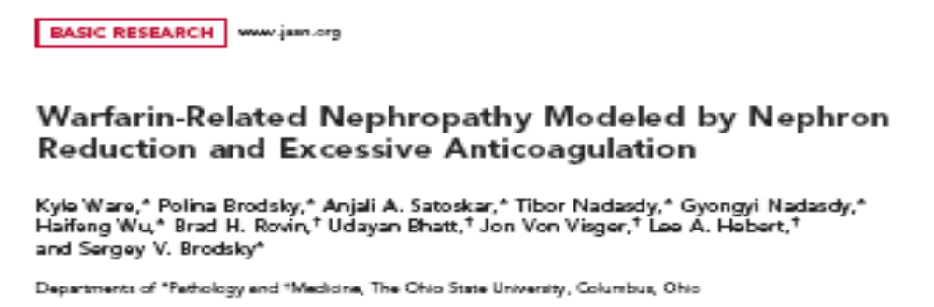

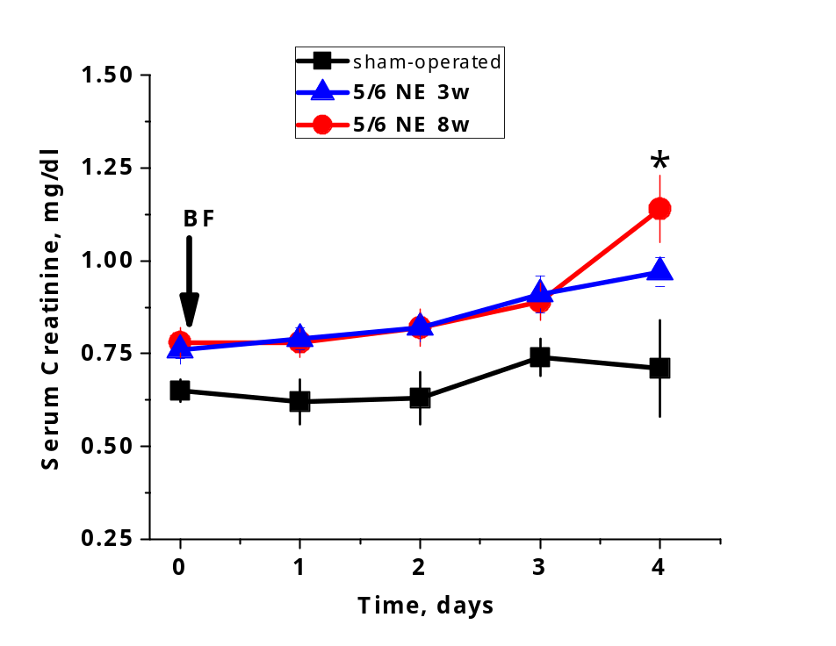
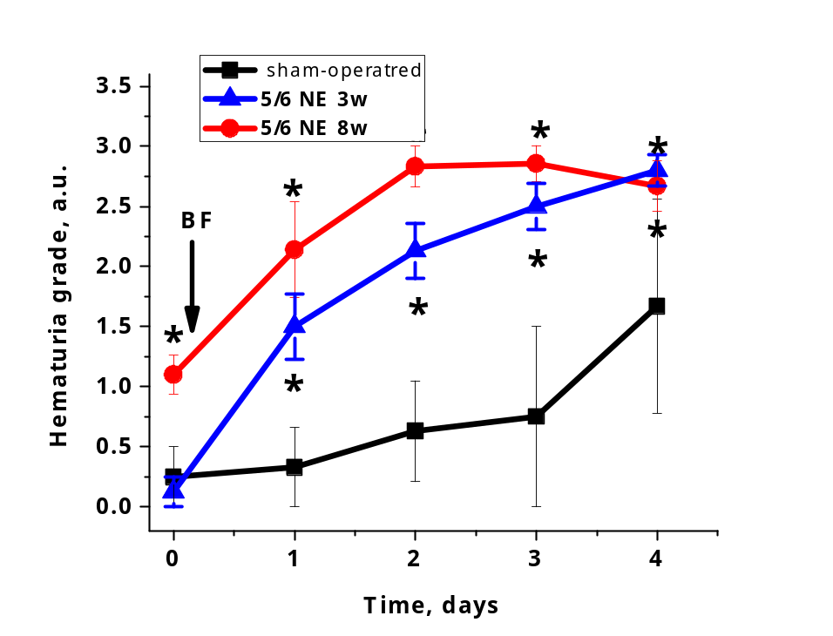
Scr increased in 5/6 NE, but not control
Hematuria after brodifacoum (BF)treatment

Slide 20
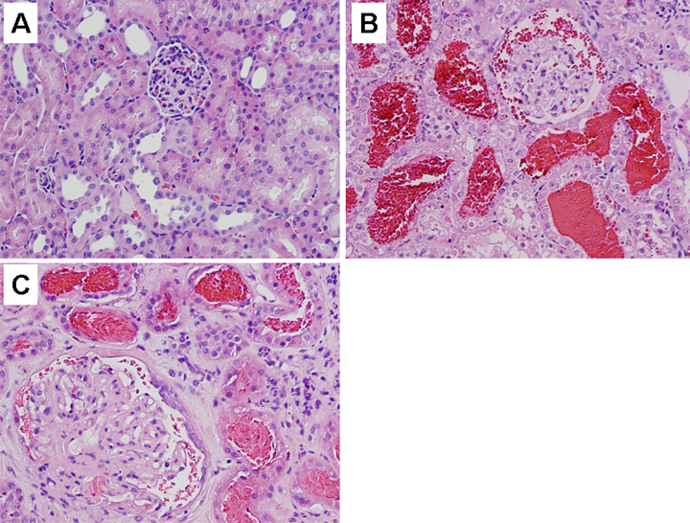
No surgery, BF treatment
5/6 NE, BF treatment
Patient, WRN

Slide 21
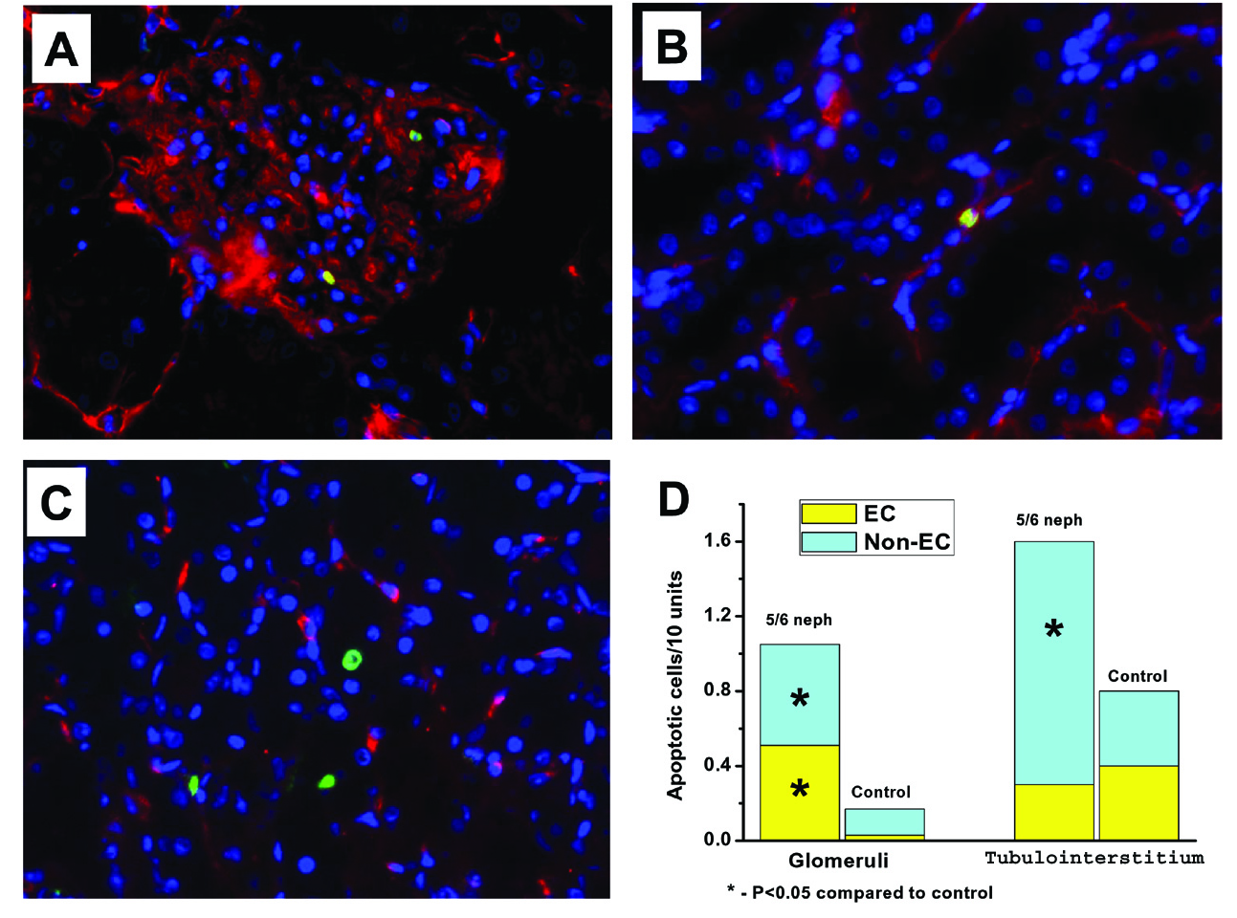
Acute over-anticoagulation results in endothelial cell apoptosis. Kidneys obtained from animals treated with brodifacoum (5/6 nephrectomy shown) were stained with antibodies against CD31 (red), the TUNEL enzymatic labeling assay (green) and Hoechst (blue). Apoptotic cells were detected in glomeruli (A), peritubular capillaries (B) and tubules (C). The number of apoptotic cells was counted in different compartments of the kidney and by their origin (C). Magnification 400x.

Slide 22
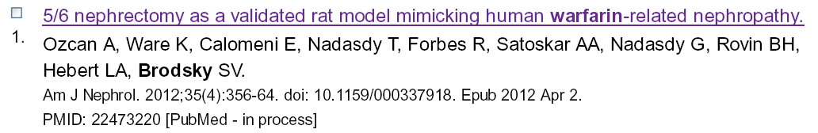
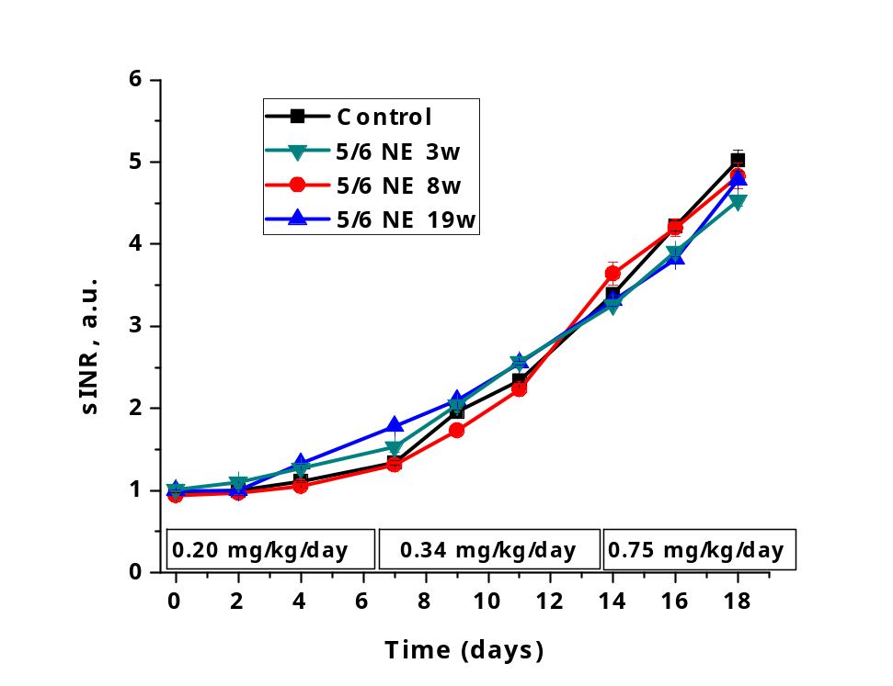
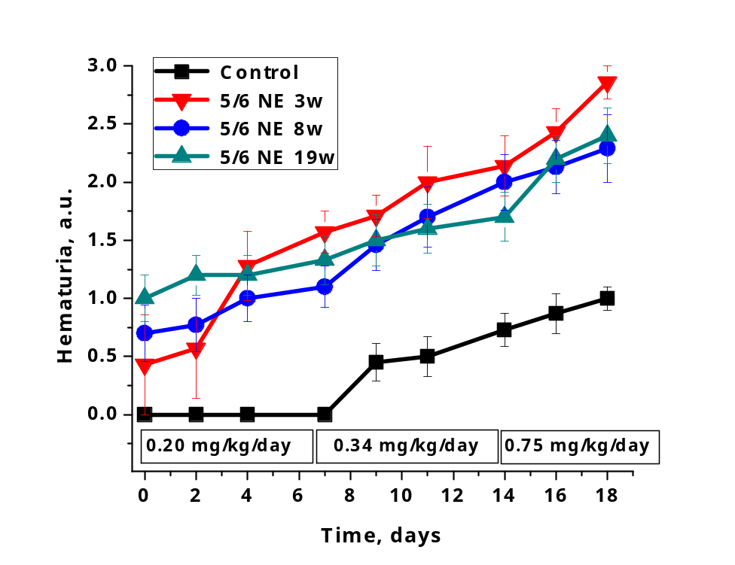
PT increased in all groups
Hematuria after warfarin treatment
A
B

Slide 23
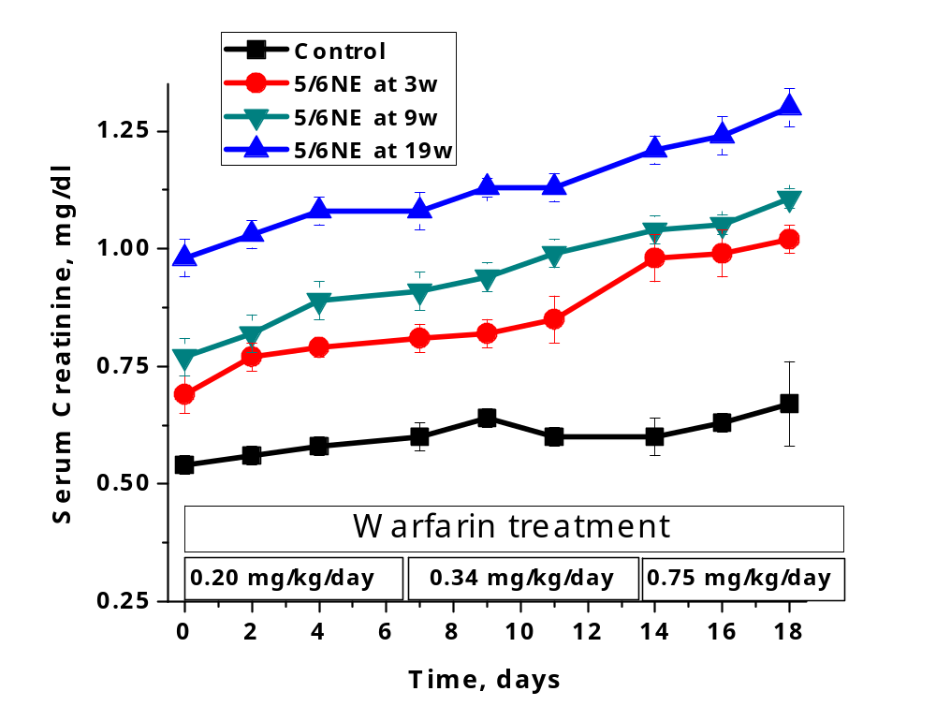
Scr did not increase in control, but increased in 5/6 NE rats
regardless of the time after the surgery

Slide 24
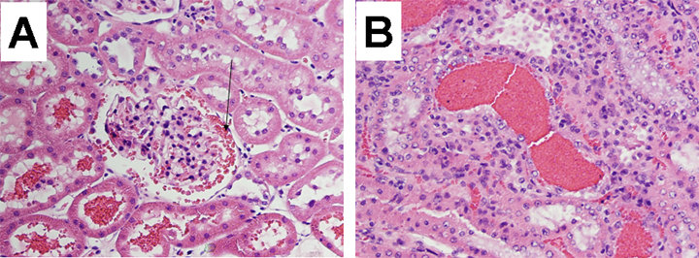
Warfarin results in glomerular hemorrhage and RBC cast formation in 5/6 NE rats

Slide 25
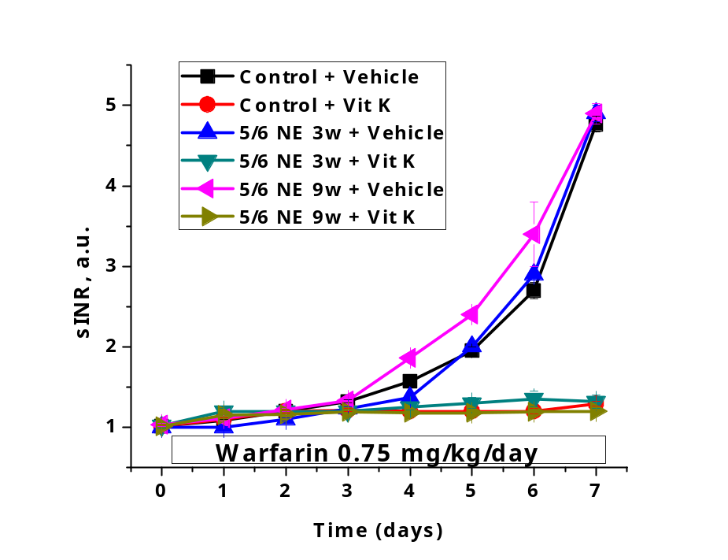
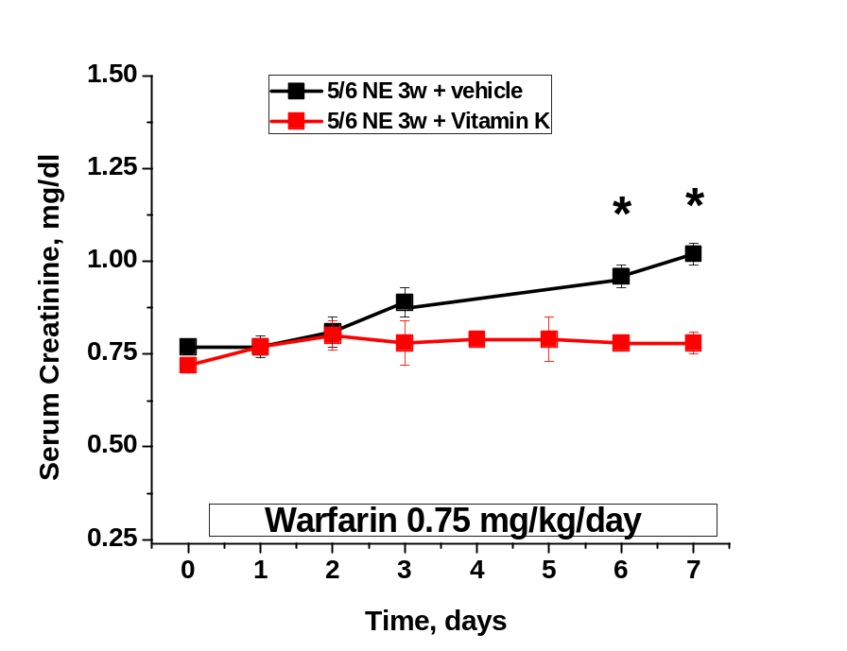
Vitamin K prevented PT increase
Vitamin K prevented Scr increase in 5/6 NE

Slide 26
Pathogenesis of WRN:
Direct effects
Vitamin K dependent
Warfarin
Oxidative stress ???
Glomerular hemorrhage
RBC tubular casts
Oxidative stress ???
ATN

Slide 27
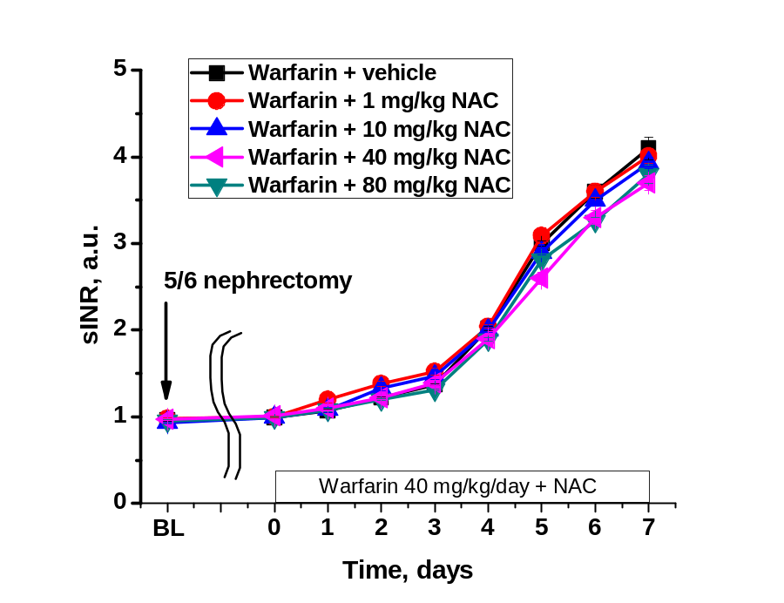
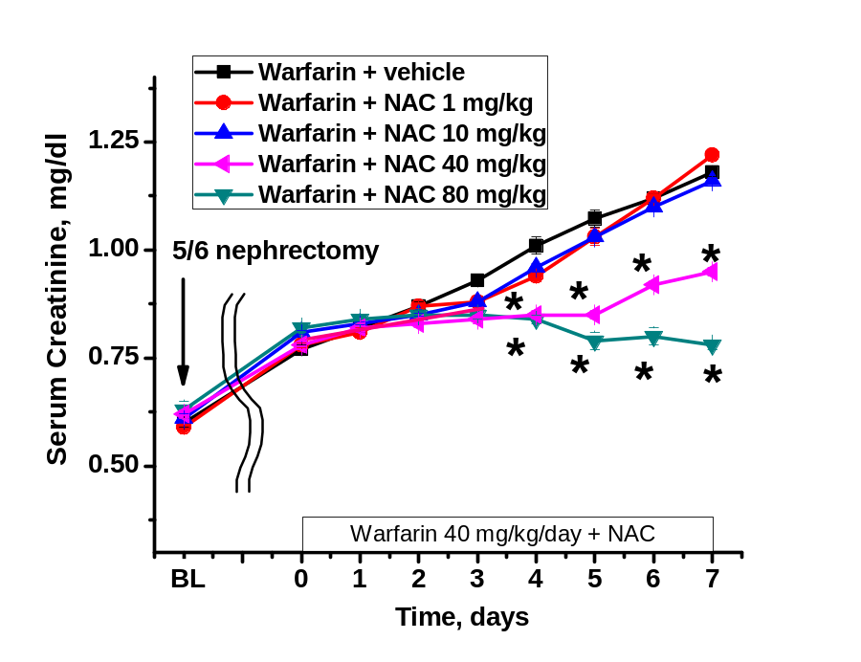
N-acetylcysteine (NAC) Ameliorates Acute Kidney Injury In 5/6 Nephrectomy Rats Treated With Warfarin
NAC did not effect PT increase
NAC prevented Scr increase in WRN

Slide 28
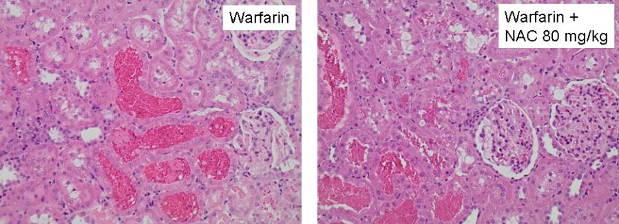
NAC did not prevent RBC cast formation in 5/6 NE rats

Slide 29
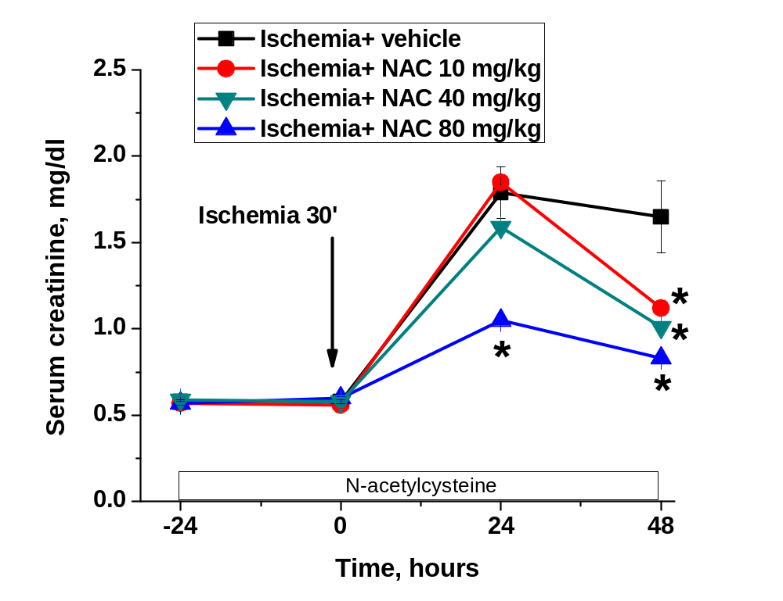
N-acetylcysteine (NAC) ameliorates acute kidney injury in an ischemia-reperfusion model

Slide 30
Direct effects
Vitamin K dependent
Warfarin
Oxidative stress
Glomerular hemorrhage
RBC tubular casts
Oxidative stress
ATN

Slide 31
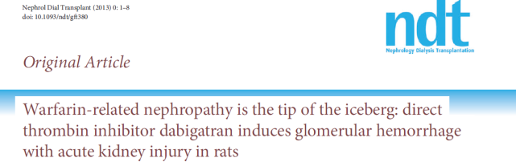
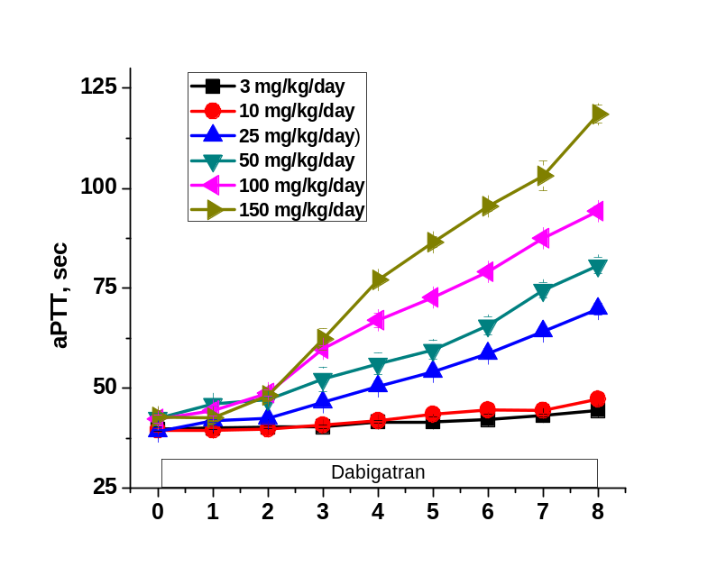
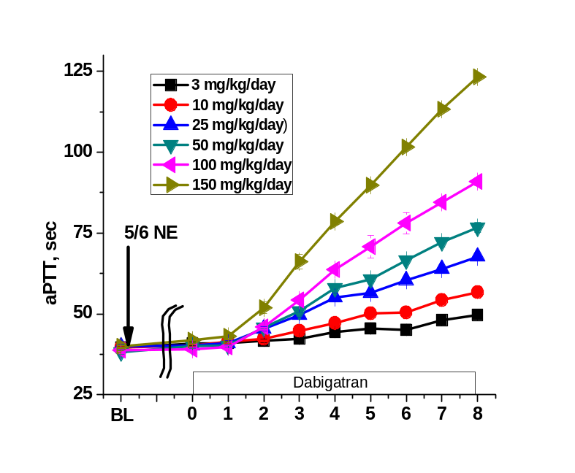
Dabigatran effects on coagulation
sham-operated
5/6 nephrectomy

Slide 32
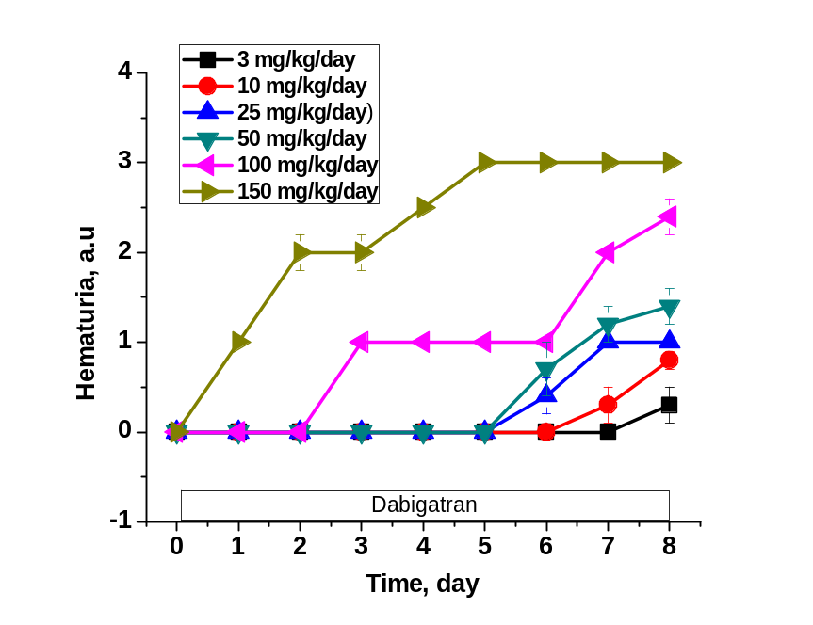
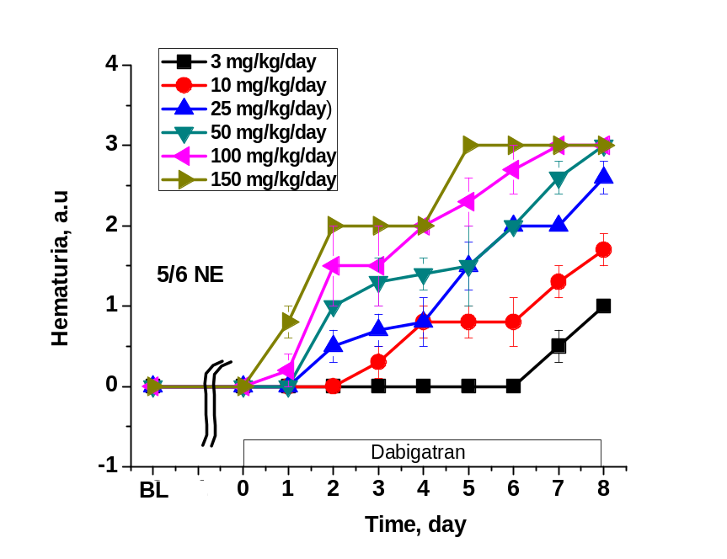
Dabigatran effects on hematuria
control
5/6 nephrectomy

Slide 33
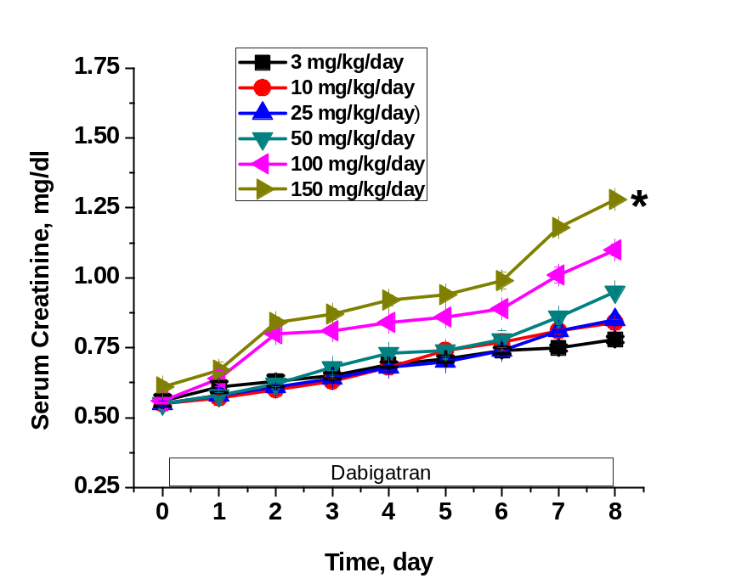
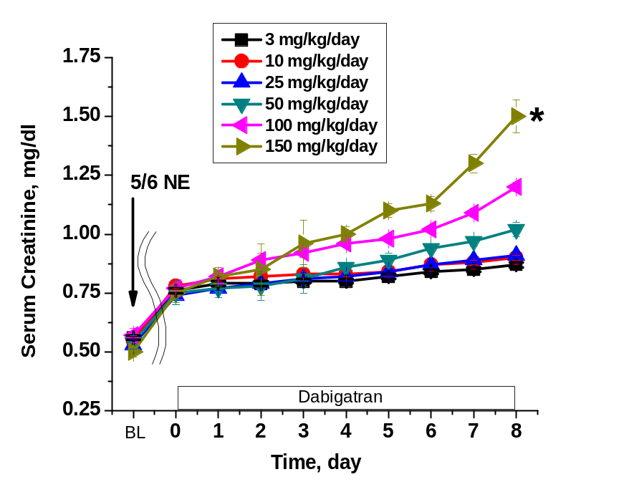
Dabigatran effects on serum creatinine
control
5/6 nephrectomy

Slide 34
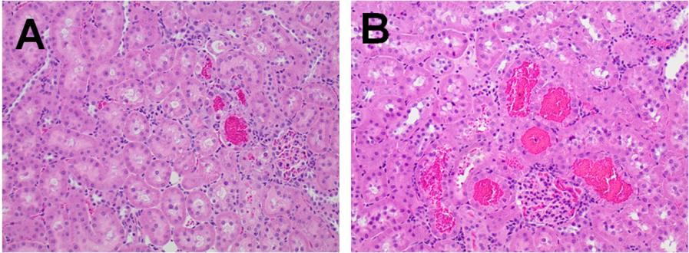
control
5/6 nephrectomy

Slide 35
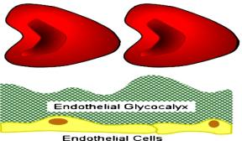

Anticoagulants
Reactive oxygen species
Endothelial cell dysfunction
Nitric oxide
Peroxynitrite
+ ROS
injury
Thrombin
activity
RBC
PAR
TM
Vascular barrier
Hemorrhage

Slide 36

The Ohio State University:
Dr. Lee Hebert
Dr. Brad Rovin
Dr. Tibor Nadasdy
Dr. Anjali Satoskar
Dr. Haifeng Wu*
Kyle Ware
New York Medical College
Dr. Michael Goligorsky
Dr. Jun Chen

