Slide 1
Screening of a wide range of pre-treatments for improving the algal biomass solubilization and biogas potential
Serge R. Guiot, Caroline Roy and Jean-Claude Frigon
Biofuels and Bioenergy,
August 25-27, 2015
Valencia, Spain

Slide 2
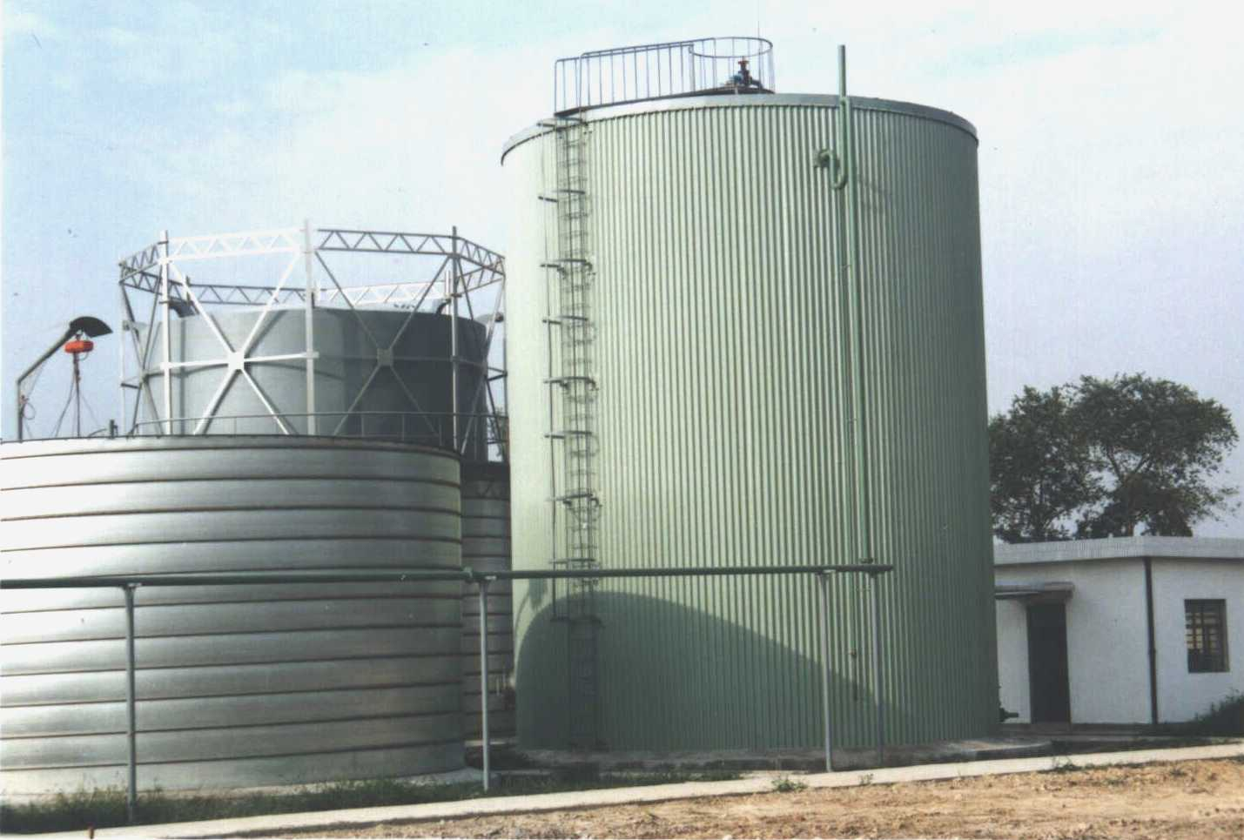
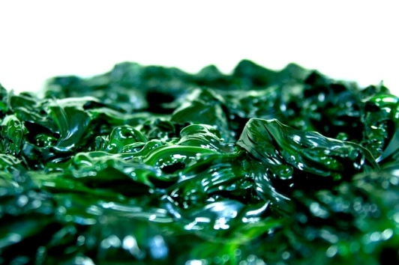
Anaerobic digestion (AD) of algal biomass
AD: microbiological conversion of organic material in the absence of oxygen, that results in the production of biogas (renewable energy) and digestate (fertilizer)
Part of an algal biorefinery approach
    Tap CO₂ from an emitter;
    Grow biomass in wastewater (free N and P);
    Generate added value with a bioproduct (or not);
    AD of whole or residual algae : renewable energy;
    Closed-loop. Effluent recirculation upstream.
Mitigated yield: 50% conversion;
Hydrolysis is the limiting-step;
Apply pretreatment to improve hydrolysis ⇒ higher CH₄ yield; better stabilized digestate

Slide 3
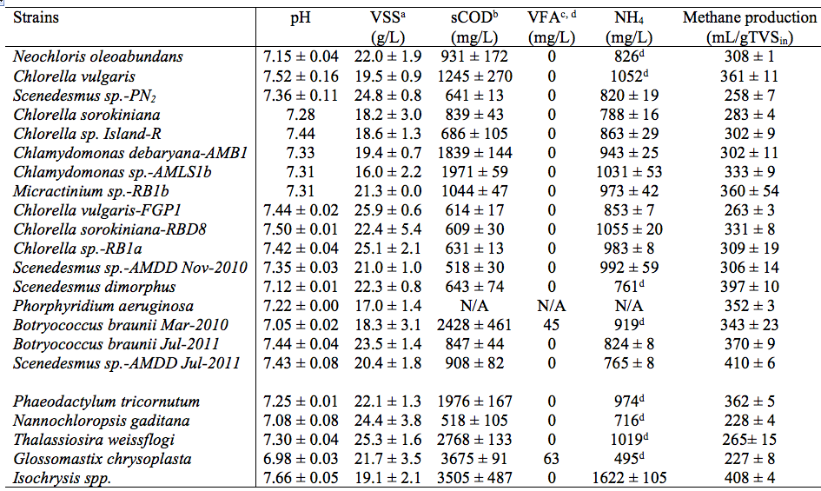
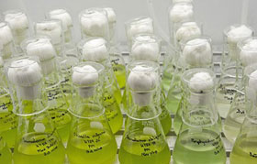
Scenedesmus sp.-AMDD
Why this strain ?
High biomass yield. Robust.
Experience with larger-scale growth in wastewater;
High methane potential: top 3 from a screening of > 20 strains.
J.-C. Frigon, F. Matteau-Lebrun, R. Ganda Bachir, P.J. McGinn, S. O'Leary &d S.R. Guiot. 2013. Screening microagae strains for their productivity in methane following anaerobic digestion. Applied Energy, 108:100-107.

Slide 4
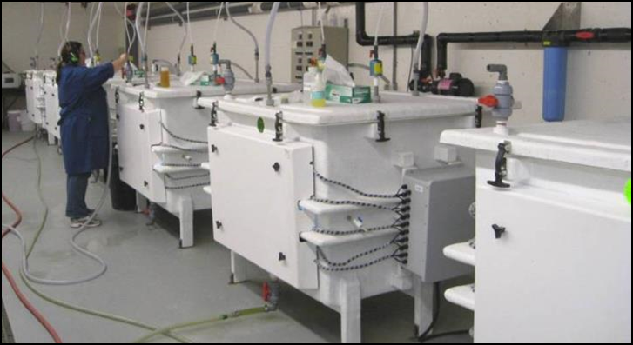

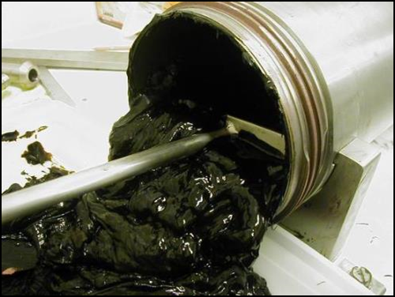
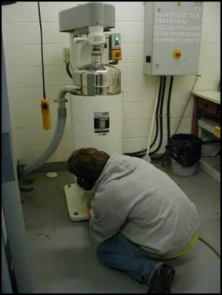
Culture of Scenedesmus
300 L Brite-BoxTM PBR;
Growth rate 0.3-0.4 d⁻¹;
Continuous operation;
Algal cell density 7-10 X 10⁶;
CO₂ on demand; pH 7.0;
T°: 25°C.
Paste at ~ 280 gVS/kg
Szumski R., A. Patrzykat. Value proposition alternatives for the industrial cultivation of microalgae in Canada. 3rd International Conference on Algal Biomass, Biofuels and Bioproducts, Toronto, CAN, June 2013.

Slide 5
Pretreatments
30 different assays: single and combined pretreatment;
Monitoring TS, TVS, SS, VSS, pH, sCOD, VFA, NH₄.
Enzymatic | Chemical | Physical - thermal
Pectate-lyase (PL) | NaOH | Autoclave (121°C, 30 minutes)
Cellulase (C) | H₂SO₄ | Microwave
Commercial mix | H₂O₂ | Pressure vessel (PV) (2000 psi)
2 PL loading (1400, 4600 U/gVS) | 2 NaOH concentration (0.2N, 0.6N) | 2 microwave temperature (175 – 300°C)
2 reaction time (3h, 24h) | 2 reaction time (2h, 24h) | 4 PV temperature (25-180°C)

Slide 6
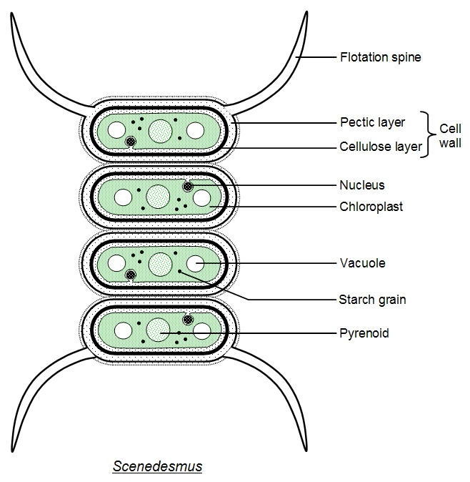
Justification of enzymatic pretreatment
Chemical or thermal: non specific attack;
Cell wall: pectic and cellulose layer;
Pectate-lyase / cellulases.
Cronodon. (2015). Algae - building bodies from balls, chains, sheets and tubes. Retrieved June 24th 2015, from http://cronodon.com/BioTech/Algal_Bodies.html

Slide 7
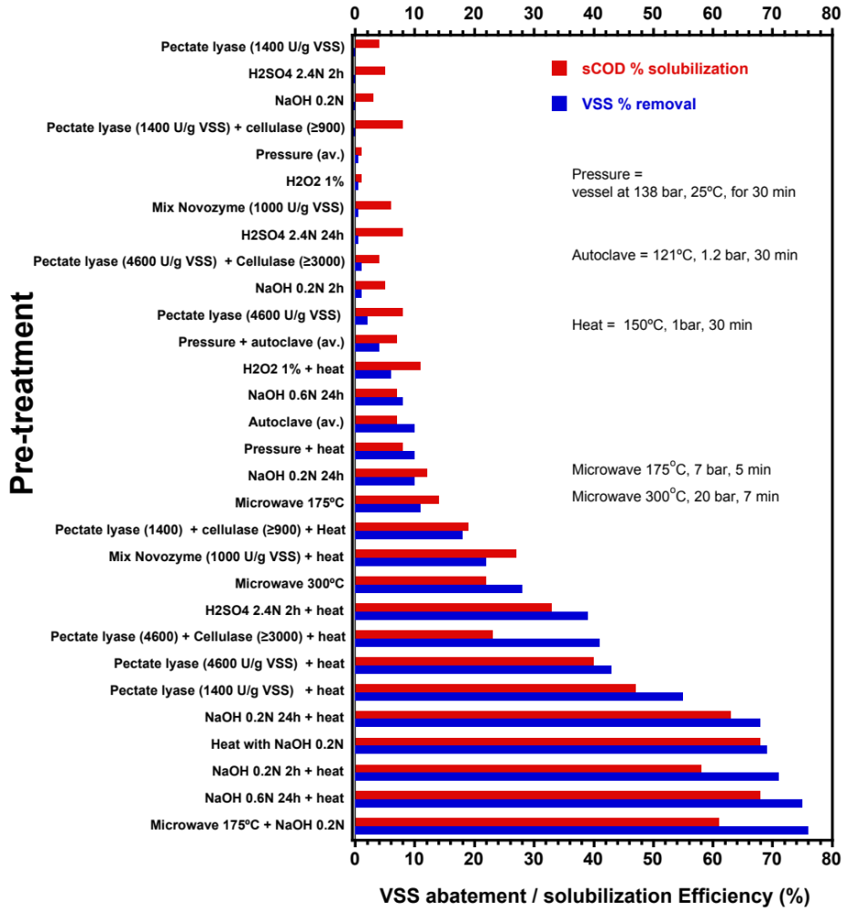
Pretreatment tests : solubilisation results
Combined > Single
Best practical conditions:
Enzymes (PL + cellulase) and thermal;
NaoH 0.2N and thermal.
75% solubilisation on a
sCOD/TVS basis

Slide 8
Pretreatment results: examples
 | VS (g/kg) | sCOD (g/kg)
Suspension | 49.3 | 11.8
Pretreatment
Pectate-lyase (PL) | 46.5 | 28.7
PL + Cellulase + T (150°C) | 30.5 | 107.8
NaOH 0.2N 2h | 48.8 | 16.8
NaOH 0.2N 24h + T (150°C) | 15.6 | 78.2
Microwave 175°C | 44.0 | 27.9
Microwave + NaOH | 11.3 | 72.5

Slide 9
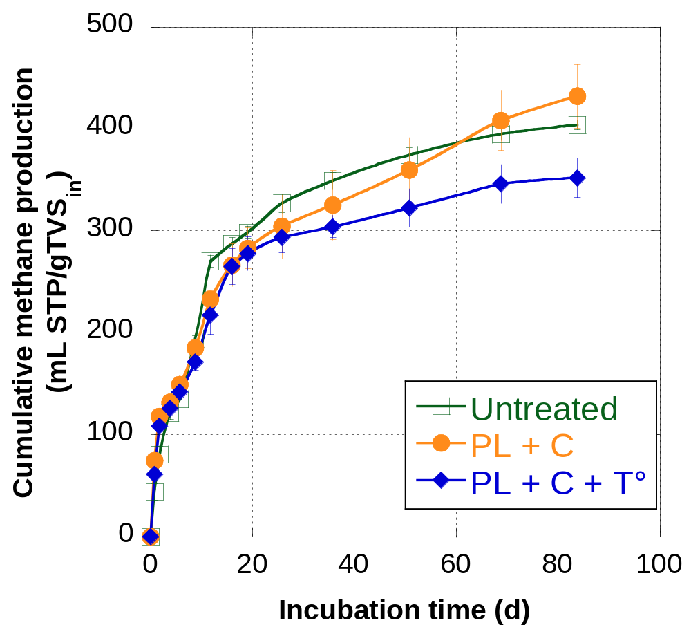
Solubilisation vs methane production
No substantial improvement of biodegradation and methane yield, following pretreatment, at best 19 %
Sometimes, negative at higher T°
Heating/solubilisation: releasing inhibitors ?
Solubilized yet non-degraded organic matter in the AD effluent: soluble proteins
(150°C)

Slide 10
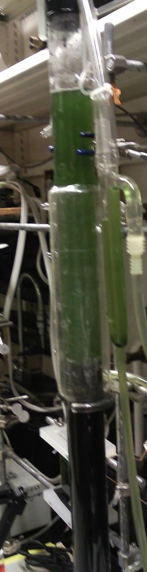
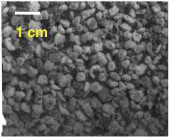
UASB digesting pretreated Scenedesmus biomass
Upflow anaerobic sludge bed (UASB) reactor:
high density of bacteria
Short HRT compared to CSTR: 6 d
Higher OLR: up to 5 g TVS/L_{rxr}·d
Without pre-treatment: TVS degradation efficiency : approaching 50%
Anaerobic granule = aggregate of bacteria, auto-immobilization
Working volume: 3.5 L;
effluent recirculation, liquid v_{UP}: 2 m/h

Slide 11
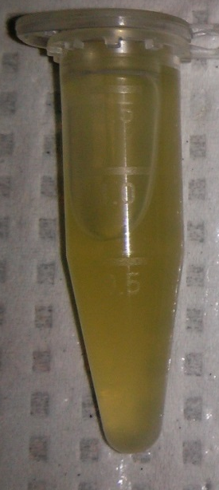

UASB digesting pretreated Scenedesmus biomass
(cont’d)
Pre-treatments selected
Enzymatic {24 h}
  pectate-lyase [1340 U/gTVS]
  + cellulase [970 U/gTVS]
Raw algal suspension
Enzymatic {24 h} + thermal (121°C − 150°C) {30 min}

Slide 12
UASB digesting pretreated Scenedesmus biomass
(cont’d)
Parameters | Control UASB | UASB after pretreatment
 |  | Phase 1 | Phase 2 | Phase 3 | Phase 4 | Phase 5
Operational time |  | Weeks 1 - 5 | Weeks 6-10 | Weeks 11-24 | Weeks 25-30 | Weeks 31-35
Pre-treatment | No | Enzymatic | Enzymatic + thermal (121°C) |  | Enzymatic + thermal (150°C)
Solubilization % (sCOD/TVS) | n/a | 77 ± 23 | 79 ± 5 | 55 ± 14 | 86 ± 8 | 98 ± 9
HRT (d) | 4.1 | 6.2 | 6.4 | 6.1 | 6.3 | 6.2
OLR (gTVS/L_{RXR}.d) | 2.95 | 1.28 ± 0.44 | 2.48 ± 0.69 | 4.73 ± 1.16 | 2.20 ± 0.09 | 4.2 ± 0.1
pH | 7.2 - 7.6 | 7.2 ± 0.3 | 7.1 ± 0.1 | 7.3 ± 0.1 | 7.3 ± 0.2 | 7.2
Degradation % (1-TVSeff/TVSin) | 52 | 49 ± 6 | 52 ± 14 | 49 ± 11 | 44 ± 11 | 59 ± 4
sCOD (g/L) | 0.1 - 0.2 | 0.42 ± 0.09 | 1.13 ± 0.31 | 2.43 ± 0.77 | 2.62 ± 0.89 | 4.85 ± 1.3
VFA (g/L) | <0.05 | < 0.05 | < 0.05 | 0.14 | 0.05 | 0.14
NH₄ (mg/L) | 100 - 250 | 189 ± 35 | 514 ± 161 | 952 ± 138 | 813 ± 147 | 1090 ± 57
Q CH₄ (L/L_{RXR}.d) | 0.53 | 0.27 | 0.57 | 0.80 | 0.55 | 1.13
Y CH₄ (L/TVS_{in}) | 0.18 | 0.21 ± 0.08 | 0.23 ± 0.08 | 0.18 ± 0.06 | 0.27 ± 0.02 | 0.24
high solubilisation
≅ HRT
↗︎ load
no substantial improvement of degradation efficiency
and methane production

Slide 13
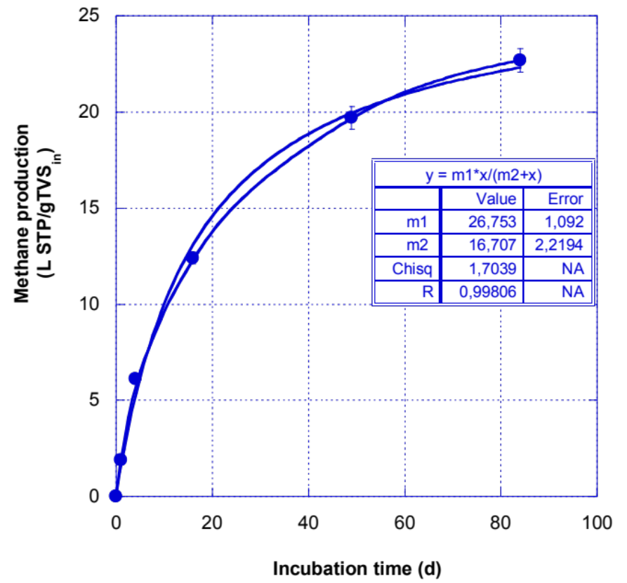
Residual methane potential from the UASB effluent
methane produced after 12 weeks of incubation, which reached 23 mL_{STP} CH₄/g TVS_{in}
i.e. only 9% of the methane produced in 6 days in the UASB
UASB digester efficient at extracting most of the methane potential from the algal biomass (in less than half the time)

Slide 14
Concluding remarks
Pretreatments increases hydrolysis, solubilisation of algal biomass :
    Combination including thermal: best impact;
    Up to 75% solubilisation.
Conversion efficiency and methane yield of the hydrolyzed algal biomass, usually only marginally higher, 35% at best
    Possible inhibitors at high temperature;
    Solubilized yet non-degraded organic matter: soluble proteins
    Revise pretreatment scheme to target protein, e.g. thermal followed by enzymes, incl. peptidases
Main benefit:
    Allows for operating a high-rate digester on pretreated algal biomass : much shorter time to produce the methane, e.g. 6 days vs 15-28 days.

Slide 15


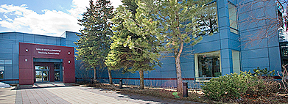
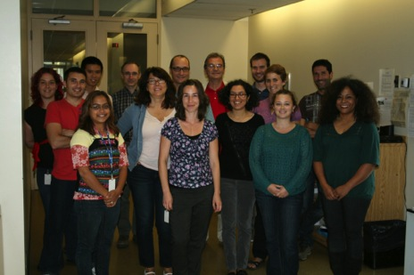


Bioengineering Group
Energy, Mining & Environment
6100 Royalmount Avenue,
Montreal, H4P 2R2 Canada
Email: serge.guiot@cnrc-nrc.gc.ca
15

