Slide 1
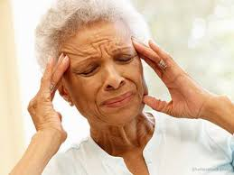
Effects of Cold Band Application Treatment on Pain and Quality of Life in Migraineurs
Şengül ÜZEN CURA
Rengin ACAROĞLU

Slide 2
Aim of this study was to examine the effect of applying cold band treatment to migraineurs on the duration and severity of migraine headaches, and on migraine-specific life quality.

Slide 3
METHODS
Study Design and Sampling; The study was completed within one year using self-administered pre-test and post-test research design at a single center. It was supported by Istanbul University Scientific Research Projects Unit. No charges were made to the patients. Ethical approval from Medipol University Clinical Research Ethics Committee was obtained. (Aproved Number: 108400987-379)

Slide 4
After the research sample was determined, an effect test was performed using the VAS (Visual Analog Scale) scores from the study results previously obtained by Suprouse-Blum and colleagues (2013). Based on these calculations, it was considered necessary to include 22 migraineurs in the sample with 0.80 power value, 0.05 level of significance, ± 0.05 deviation.
The study was carried out with a total cohort of 30 migraineurs.

Slide 5
Data Collection
Data collected from June 2015 to July 2016. The following items were employed in the data collection process: Patient Information Form, Patient Inspection Form, Visual Pain Scale (VPS) and The 24-hour Migraine Quality of Life Questionnaire .

Slide 6
Patient Information Form: It consisted of three parts. Part 1 included participants’ personal details (age, gender, marital status, occupation and educational status). Part 2 featured questions regarding the duration & location of the migraine attack Part 3 contained questions about the effect of the cold application in relieving pain.
Patient Inspection Forms: These were prepared separately for the pre-application and application periods. They listed the contact details of the researcher and specified the type of data the patients were required to enter in the course of the attacks.

Slide 7
Pre-application Inspection Form was designed to record the patients’ own descriptive account of the starting-point and end-point of migraine attacks and their experience of pain levels.
Application Period Inspection Form collected the patients’ descriptions of their experience at the start and end of the cold application period.

Slide 8
Visual Analogue Scale (VAS), was used to translate the participants’ subjective judgements into numerical values. The participants were required to indicate their perception of the pain level experienced on a 10 cm (100 mm) ruler. This registered the complete absence of pain at one end and severe pain at the other.
The 24-hour Migraine Quality of Life Questionnaire (24 h MQoLQ), is a migraine-specific questionnaire which aims to quantify short-term changes in quality of life within the 24-hour period after the onset of pain. There are fifteen items in total covering five pre-defined subscales of quality of life: Migraine Symptoms, Emotions-Anxiety, Work Functionality, Social Functioning and Energy/Vitality.

Slide 9
APPLICATION
Individuals participating in the survey were observed during four migraine attacks: two before the cold application and two after.
During the pre-application period, the first and second parts of the Patient Information Form were introduced to the participants, followed by the Pre-application Patient Observation Form, Visual Analogue Scale and the 24-hour Quality of Life Questionnaire. The forms were explained in detail and any points requiring clarification were answered.

Slide 10
During the application period, the information on the Patient Information Form was reviewed and any changes were recorded. The Application Period Patient Observation Form, Visual Analogue Scale and the 24-hour Migraine Quality of Life Questionnaire were then issued. Instruction was provided on how to complete the forms. The cold application process was demonstrated and explanatory information provided about it and the material to be used. Feedback was received from the patients. The ‘Cold Migraine Bands’, with a form explaining the application method, were distributed to the participants so that they could apply them to their foreheads as directed as soon as the pain started.

Slide 11
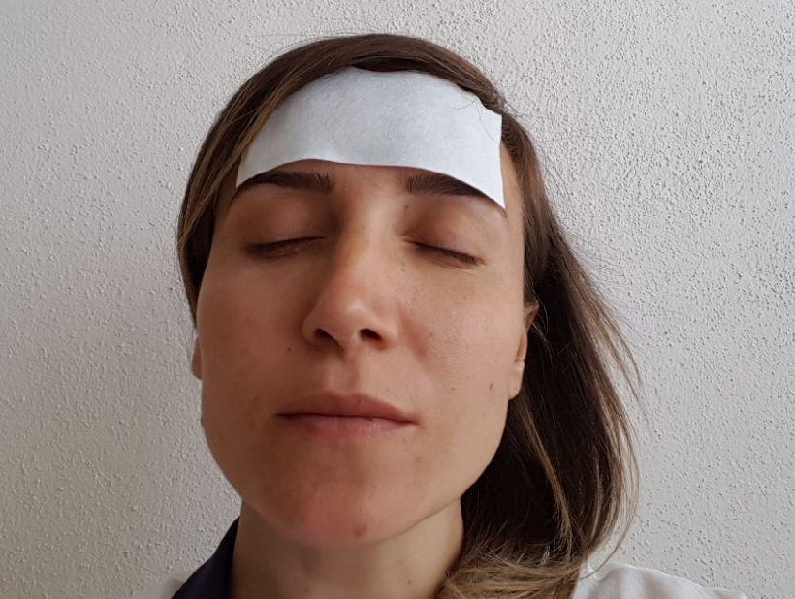
Application of Cold Migraine Band

Slide 12
Statistical Analysis
The data were analyzed using SPSS for Windows (Version 16.0). Descriptive statistics, such as mean, SD, number, and frequency, were used to characterize the research participants. The Wilcoxon Marked-Rank Test was employed to test the difference between groups in non-parametric data. Since the samples were collected independently from each other, the t test and ANOVA were used to determine whether the results were rational. The results were evaluated at 95% confidence interval, and at p <0.05 significance level.

Slide 13
RESULTS
The average age of the patients included in the research was 35.47±8.95. 23 of the patients were women, 16 had a university degree, 15 were government officers, and 16 were married.

Slide 14
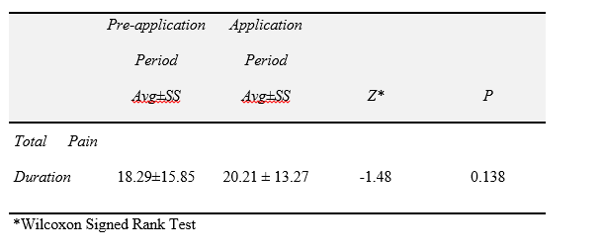
Table-1 Comparison of Pain Duration Averages During Pre-application and Application Periods
When the pain duration experienced in the pre-application and application periods was compared, no significant difference was detected (p > 0.05).

Slide 15
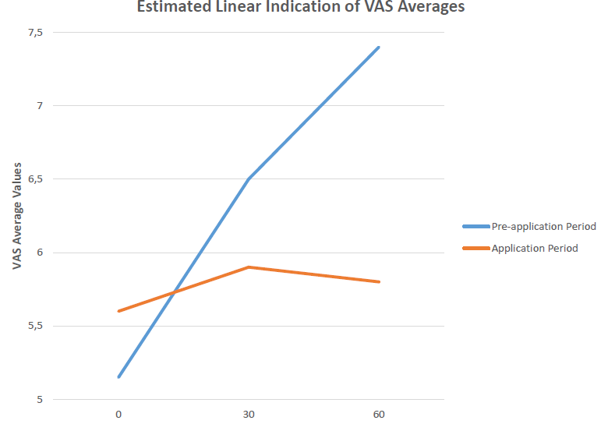
Figure 1: Comparison of Pain Level Averages in the Pre-application and Application Periods
When the pain level averages in the pre-application and application periods were compared, no statistically significant difference was observed between them at the beginning (0 min), (p=0.113). The application period pain level at the 30. and 60. mins. points dropped by a significant level compared to the pre-application period (p<0.05).

Slide 16
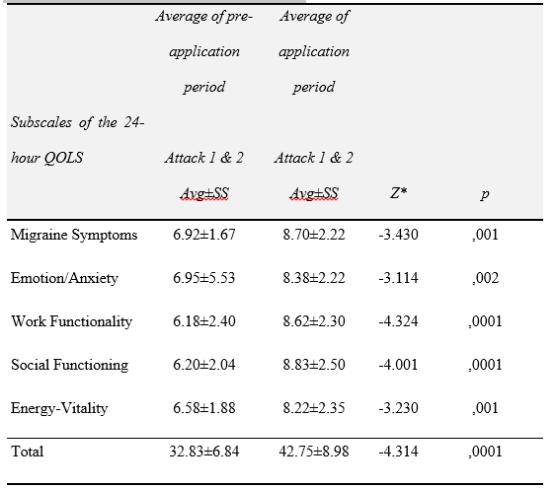
Table 2. Comparison of Point Averages in the 24-hour Migraine QOLS during the Pre-application and Application Periods
It was noted that there was a statistically meaningful increase in the total points averages of the 24-hour Migraine Quality of Life Questionnaire in the application period compared to the pre-application period (z=4.314, p=0.0001).

Slide 17
CONCLUSION AND RECOMMENDATIONS
In conclusion, the application of a cold band to the forehead of migraineurs was found to be an effective intervention in reducing the level of pain and improving migraine- related quality of life, but it had no effect on the duration of pain. It is recommended that a further study should be carried out with migraine patients, using different non-pharmacological methods to relieve the pain and then the results compared.

Slide 18
REFERENCES
Adams, J., Barbery, G., & Lui, C. W. (2013). Complementary and alternative medicine use for headache and migraine: a critical review of the literature. Headache: The Journal of Head and Face Pain, 53(3), 459-473. https://doi.org/10.1111/j.1526-4610.2012.02271.x
Arankalle, D., Wardle, J., & Nair, P. M. (2016). Alternate hot and cold application in the management of heel pain: A pilot study. The Foot, 29, 25-28. https://doi.org/ 10.1016/j.foot.2016.09.007
Bag, B., & Karabulut, N. (2005). Pain-relieving factors in migraine and tension-type headache. International Journal of Clinical Practice, 7, 760-763. https://doi.org/ 10.1111/j.1368-5031.2005.00535.x
Bakar, N. A., Tanprawate, S., Lambru, G., Torkamani M., Jahanshahi, M., & Matharu, M. (2016). Quality of life in primary headache disorders: A review. Cephalalgia, 36(1) 67–9. https://doi.org/ 10.1177/0333102415580099.
Dehghan, M., & Farahbod, F. (2014). The efficacy of thermotherapy and cryotherapy on pain relief in patients with acute low back pain, a clinical trial study. Obstetrics and Gynecology, 50-61. https://doi.org/ 10.7860/JCDR/2014/7404.4818
Demir, Y., & Khorshid, L. (2010). The effect of cold application in combination with standard analgesic administration on pain and anxiety during chest tube removal: a singleblinded, randomized, double-controlled study. Pain Management Nursing, 11 (3), 186-196. https://doi.org/10.1016/j.pmn.2009.09.002
Evans, RW. (2006). Natural or alternative medication for migraine prevention. Headache, 1012-1018. https://doi.org/10.1111/j.1526-4610.2006.00473.x
Frederick, G., & Freitag, DO. (2007). The cycle of migraine: patients' quality of life during and between migraine attacks. Clinical Therapeutics, https://doi.org/939-946. 10.1016/j.clinthera.2007.05.008
Friedman, MH., Peterson, SJ., Behar, CF., & Zaidi, Z. (2001). Intraoral chilling versus oral sumatriptan for acute migraine. Heart Disease Journal, 3:357-61.
Gloolsby, MJ. (2003). Clinical practice guidlines migraine headache. Journal of American Academy of Nurse Practitioners, 15:12. https://doi.org/10.1111/j.1745-7599.2003.tb00344.x

Slide 19
Gül, S., & Mollaoğlu, M. (2011). Migrenli bireylerde ağrının özellikleri ve bireyin günlük aktiviteleri üzerindeki etkisi. Yeni Symposium, 49, 153-158. (Original Work Published in Turkish)
Hartmaier, SL., Santanello, NC., Epstein, RS., & Silberstein, SD. (1995). Development of a brief 24- hour migraine- specific quality of life questionnaire. Headache, 35:320-329. https://doi.org/10.1111/j.1526-4610.1995.hed3506320.x
İltuş, F., & Karadakovan, A. (2008). The reliability and validity of Turkish form of "the 24-hour migraine quality of life questionnaire". Türkiye Klinikleri Journal of Neurology. 3, 59-63. (Original Work Published in Turkish)
İnan, Ç., & Kıyak, E. (2014). The Effect of Hot and Cold Application on Pain, Stiffness and Physical Function in Patients with Knee Osteoarthritis. Hemşirelikte Araştırma Geliştirme Dergisi, 16(2), 1-10. (Original Work Published in Turkish)
Kazan, EE. (2011). Cold Application and Nursing Care. Hacettepe University Faculty of Health Sciences Nursing Journal, 73-82. (Original Work Published in Turkish)
Lance, J.W. (1988). The controlled application of cold and heat by a new device (Migra-lief apparatus) in the treatment of headache. Headache, 28, 458-61. https://doi.org/10.1111/j.1526-4610.1988.hed2807458.x
Leroux, E. (2013). Impact of a Nurse for Migraine Management: the IMPACT Project (IMPACT). National Institutes of Health. (https://clinicaltrials.gov/ct2/show/NCT01804517)
Mollaoğlu, M. (2012) Trigger factors in migraine patients. Journal of Health Pyschology, 18(7), 984–994. https://doi.org/10.1177/1359105312446773
Özkan, İ. G., & Ongun, N. (2017). The relationship between self efficacy, general self disease management strategies in coping with pain and quality of life in migraine patients: Testing a theoretical method. International Journal of Human Sciences, 14(4),3389-3404. https://doi.org/10.14687/jhs.v14i4.4787
Powers, S.W., Patton, S.R., & Hommel, K.A. (2013). Quality of life in childhood migraines: clinical ımpact and comparison to other chronic ıllnesses. Pedıatrıcs, 112(1), 1-6.

Slide 20
Silberstein, S., Lipton, R., Dodick D. (2008). Wolff’s headache and other head pain. New York: Oxford University Press.
Sprouse-Blum, S.A., Gabrial, K.A., Brown, J.P., & Yee, M.H. (2013). Randomized controlled trial: targeted neck cooling in the treatment of the migraine patient. Hawaii Journal of Medicine & Public Health,72(7), 237-241.
The Effects of Migraine on Mental Health. Cold Therapy. (2016). https://migraine.com/topic/cold-therapy/ Accessed 15 July 2016.
Unger, J., (2006). Migraine headaches: a historical perspective, a glimpse into the future and migraine epidemiology. Dis Mon, 52 (10), 367-384.
Üçler, S., Coşkun, O., Inan, L.E., & Kanatlı, Y. (2006). Cold therapy in migraine patients: open-label, non-controlled, pilot study. Evidence-Based Complementary and Alternative Medicine, 3(4), 489-493.
Vanderpol, J., Bishop, B., Matharu, M., & Glencorse, M. (2015). Therapeutic effect of intranasal evaporative cooling in patients with migraine: a pilot study. The Journal of Headache and Pain,16(5), 1129-2377. https://doi.org/10.1186/1129-2377-16-5
Watkins, A., Johnson, T.V., Shrewsberry, B.A., Nourparvar, P., Madri, T., Watkisn, C.J., Master, V.A. (2014). Ice packs reduce postoperative midline ıncision pain and narcotic use: a randomized controlled trial. J Am Coll Surg, 219 (3), 511-517. https://doi.org/10.1016/j.jamcollsurg.2014.03.057
Wells, R. E., Bertisch, S. M., Buettner, C., Phillips, R. S., & McCarthy, E. P. (2011). Complementary and alternative medicine use among adults with migraines/severe headaches. Headache: The Journal of Head and Face Pain, 51(7), 1087-1097. https://doi.org/10.1111/j.1526-4610.2011.01917.x
Wright, W. (2008). Impairment during and between migraine attacks. The Journal for Nurse Practitioners, 4 (3), 201-207.

Slide 21

Thank You for Listening…

