Slide 1
DRUG UTILIZATION STUDY OF ANTI-EPILEPTICS DRUGS IN PEDIATRIC POPULATION
Dr. Sengottuvel Viswanathan
Delhi University
Delhi

Slide 2

INTRODUCTION
Epilepsy- recurrent seizures due to chronic underlying process
Incidence is 5 to 7 per 10,000 children .
5 among 1,000 children have epilepsy .
Various etiologies.

Slide 3
ILEA Classification 2010.
Generalized seizures
Tonic clonic, absence, clonic, tonic, atonic,myoclonic.
Focal seizures.
Unknown : epileptic spasms.
Clinical diagnosis is supported by neuro-imaging and electro physiological studies.
Management: Anti epileptic drugs ( AEDs)

Slide 4
Drug utilization study
Definition
WHO in 1977 defined drug utilization as marketing, distribution, prescription and use of drugs in a society with special emphasis on the resulting medical, social and economic consequences.
Types
Cross sectional
Longitudinal
Continuous longitudinal.

Slide 5
Aim and Objectives
To study the drug utilization pattern of anti-epileptic drugs in pediatric population.
Objectives:
Prescribing pattern
Seizure control and adverse effects
Cost of therapy and financial burden.

Slide 6
Study settings
Hospital based descriptive study
200 pediatric patients on AEDs
Data collected in suitably designed from
Inclusion criteria: 3 months to 12 years diagnosed with epilepsy and receiving oral AEDs.
Exclusion criteria: patients unwilling to participate.

Slide 7
Study Method
Age, sex , weight , duration of treatment, diagnosis were noted.
Prescribing pattern of AEDs was assessed according to WHO indicators.
Patients followed up at 3 months for seizure control and adverse drug reactions.
ADRs were documented and reported.

Slide 8
Results
Demographic profile (n=200)
Boys - 59% ( n=118)
Girls - 41% (n= 82)
Mean age = 7.14 yrs.

Slide 9
Results
Type of seizure
GTCS 61.5% (N=123)
Complex partial 30% (N= 60)
Simple partial 5% (N=10)
Myoclonic 3% (N=6)
Absence 0.5% (N=1)

Slide 10
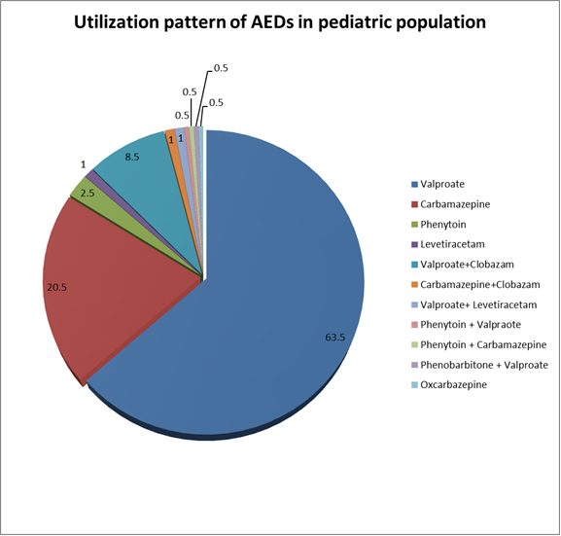

Slide 11
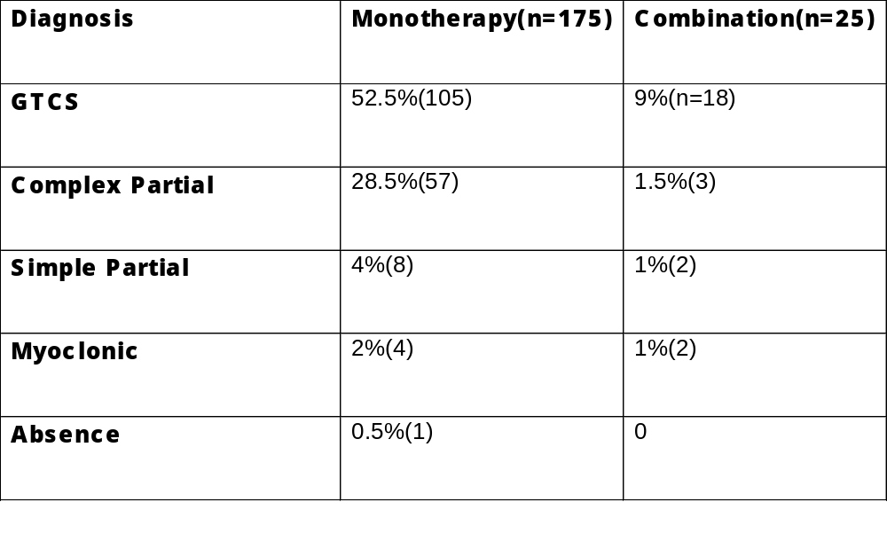
Monotherapy Vs Combination therapy
Total (N=200)

Slide 12
Seizure control Monotherapy Vs Combination therapy
Type of seizure | Seizure control with Monotherapy (n=175) |  | Seizure control with Combination therapy (n=25)
 | Good | Poor | Good | Poor
GTCS M=105 C =18 | 89.5%(n=94) | 3.8%(n=4) | 50%(n=9) | 16.7%(n=3)
Complex partial M =57 C =3 | 98.24%(n=56) |  | 66.7%(2)
Simple partial M=8 C=2 | 100%(n=8) |  | 100%(n=2)
Myoclonic M =4 C =2 | 25%(1) | 50%(n=2) |  | 100%(n=2)

Slide 13
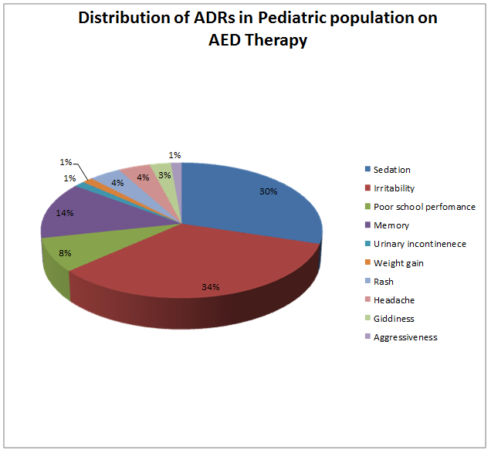

Slide 15
Discussion
Utilization pattern:
Valpraote - 63.5% monotherapy
- 8.5% combination.
Carbamazepine - 20.5% monotherapy
- 1% combination.
Phenytoin - 2.5% monotherapy
- 1 combination.

Slide 16
Conclusion
Utilization pattern of AEDs documented.
Monotherapy more common than combination .
Seizure control better with monotherapy than combination.
Monotherapy is better tolerated with little ADRs .

Slide 17
Supervisors
Dr. SK Bhattacharya
Dr. Anju Aggarwal
Dr. Neeta Wardhan
Dr. Rachna Gupta.
Department of Pharmacology and Pediatrics
University College of Medical Sciences
Delhi University.

