Slide 1


«The healing power of preoperative education in patients undergoing cardiac surgery»
18th World Congress on
Clinical Nursing and Practice
September 21-22, 2018 Prague, Czech Republic | Panorama Hotel Prague Milevska 7, 140 63 Praha 4 Czech Republic
Selda MERT BOĞA
Kocaeli University, TURKEY
seldamertboga@gmail.com

Slide 2

Presentation Content
1. The global burden of cardiovascular disease
2. Anxiety and depression among cardiac surgery patients
3. Importance of preoperative education
4. Components and methods of preoperative education
5. Role of the nurses in preoperative education
6. Some literature research on the effectiveness of preoperative education (and explanation of Table 1)
7. Conclusion

Slide 3


1. The global burden of cardiovascular disease
Cardiovascular diseases (CVDs) are a global public health issue that causes a severe economic burden at the societal level, affecting physical and psychosocial functioning, health-related quality of life and symptom management of the individuals.
Guo, P (2012). A preoperative education intervention to reduce anxiety and improve recovery among Chinese cardiac patients: a randomised controlled trial. PhD thesis.
WHO, (2017). Cardiovascular diseases (CVDs). http://www.who.int/cardiovascular_diseases/about_cvd/en/

Slide 4

1. The global burden of cardiovascular disease continued…
According to the World Health Organization (WHO), approximately 17.7 million individuals, representing 31% of all global deaths, died because of CVDs in 2015, it was reported that 7.4 million of these deaths were due to coronary heart disease and 6.7 million were due to stroke. It is also anticipated that until the year 2030, approximately 23.6 million individuals, mainly due to heart disease and stroke, will die of CVDs.
17.7
WHO, 2017

Slide 5

1. The global burden of cardiovascular disease continued…
Effective and cheap medicines are available to treat almost all cardiovascular diseases, however if the symptoms of these diseases can not be controlled by pharmacological treatment, surgical treatment is appropriate for the management of these diseases. Cardiac surgery is typically the preferred treatment for many congenital or acquired heart diseases.
Guo et al (2012). A preoperative education intervention to reduce anxiety and improve recovery among Chinese cardiac patients: a randomized controlled trial.
Al-Qalah et al (2015). Effectiveness of Planned Preoperative Teaching on Self-Care Activities for Patients Undergoing Cardiac Surgery.

Slide 6

1. The global burden of cardiovascular disease continued…
Although cardiac surgical treatment has shown superiority over medical treatment with major advances in care and surgical techniques in the past 20 years it is classified as high risk due to the complexity compared to other minimal invasive cardiac procedures such as balloon angioplasty and stenting, longer recovery time, higher postoperative complications and mortality risks.
Granton & Cheng (2008). Risk stratification models for cardiac surgery.
Guo 2012; Al-Qalah 2015

Slide 7

2.Anxiety and depression among cardiac surgery patients
Cardiac surgery is a challenging and saddening event also for patients and their families. It is stated that 60-80% of the patients who underwent surgical intervention develop anxiety in the preoperative period and the experienced anxiety affects the emotional, physiological and cognitive states.
Guo, P. (2012). A preoperative education intervention to reduce anxiety and improve recovery among Chinese cardiac patients: a randomised controlled trial. PhD thesis.
Arlı (2017). Evaluation of the preoperative anxiety with apais and stai-i scales.
Gomes and Bezerra (2017). Anxiety and depression in the preoperative period of cardiac
Surgery.
Ramesh et al. (2017). Effect of preoperative education on postoperative outcomes among patients undergoing cardiac surgery: a systematic review and meta-analysis.

Slide 8
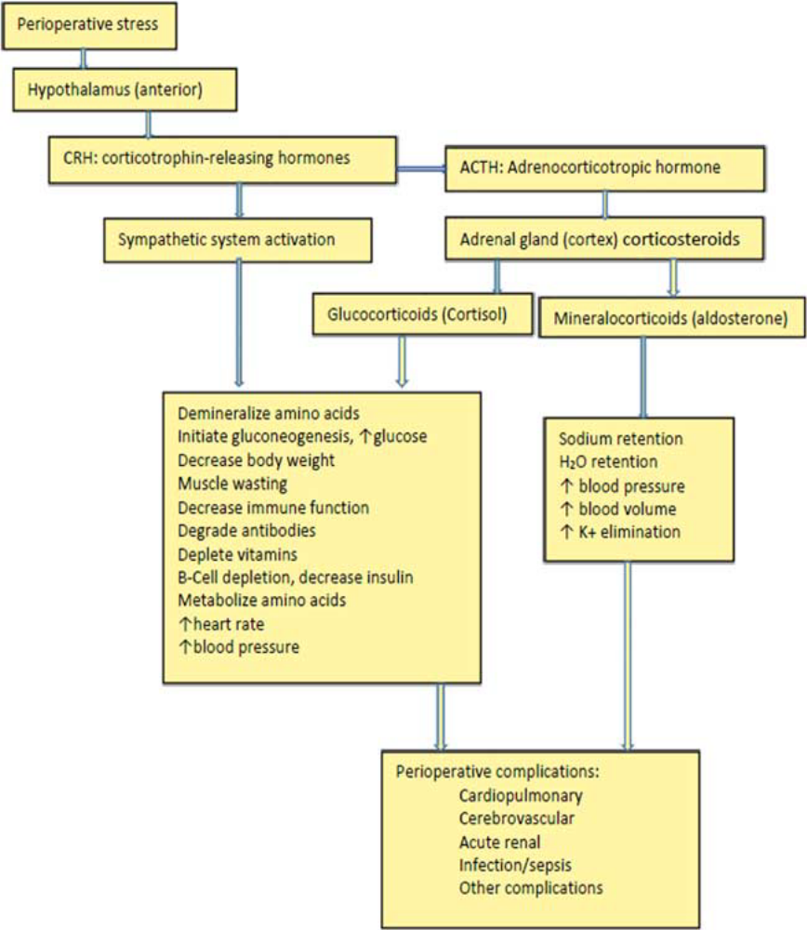
2.Anxiety and depression among cardiac surgery patients continued..
Many studies on cardiac reactivity against psychological stress factors have shown that anxiety can affect the regulation of autonomic nervous system, platelet activation, hypothalamic-pituitary-adrenal axis activity and myocardial effusion, which increases blood pressure, heart rate and cardiac outflow, inhibits gastrointestinal activity and decreases immune function.
Yang et al (2017). Enhanced recovery after cardiac surgery: an update on clinical ımplications.
Figure 1. Perioperative stress induces pathophysiological changes

Slide 9

2.Anxiety and depression among cardiac surgery patients continued..
exacerbation of symptoms of cardiovascular disease
increased analgesic need
increased postoperative pain
increased use of anesthetic during surgery
delayed wound healing
abnormal vital signs cause
decreased immune response
fluid and electrolyte imbalance
depression, increase in readmission to the hospital and complications
increased infection rate
Also, preoperative anxiety has been associated with;
Gouin and Kiecolt-Glaser (2011) .The Impact of Psychological Stress on Wound Healing: Methods
and Mechanisms.
Loghmani and Monfared (2018). The effect of preoperative training on postoperative depression in patients undergoing open heart surgery (2017)..
Malek et al. (2018). Effects of Nurse-Led Intervention on Patients’ Anxiety and Sleep Before
Coronary Artery Bypass Grafting.
Yılmaz and Aydın 2013; Guo 2014; Redžek et al. 2015; Kalogianni et al. 2016; Ramesh et al. 2017

Slide 10
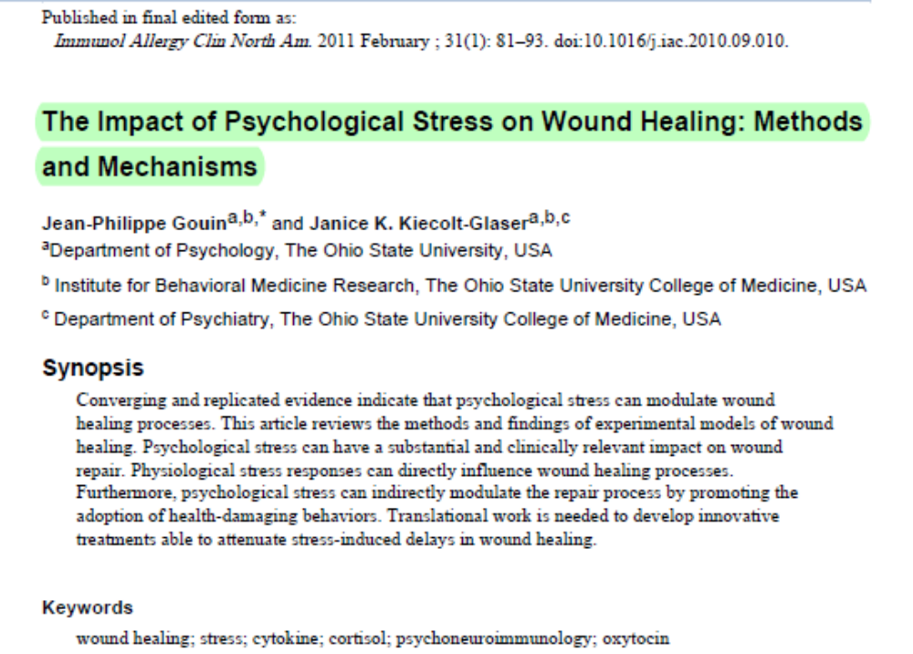
2.Anxiety and depression among cardiac surgery patients continued..
An example..

Slide 11

2.Anxiety and depression among cardiac surgery patients continued..
There are many reasons for the development of anxiety prior to surgery. These are being in the hospital, waiting for surgical intervention, preoperative preparation, lack of control, worry about recovery process, pain and discomfort after surgery, complications, fear of unknown procedures during postoperative care, uncertainty about daily life and return to work.
Guo (2014). Preoperative education interventions to reduce anxiety and improve recovery among cardiac surgery patients: a review of randomised controlled trials.
Woollen et al. (2016). Patient Experiences Using an Inpatient Personal Health Record.

Slide 12

2.Anxiety and depression among cardiac surgery patients continued..
Concerns during preoperative period may encourage patients to ask questions about treatment and care, and may cause them to ask for help from health care providers.
Berth et al. (2007) reported that the anxiety level of the patients with more preoperative education needs is higher.
In a qualitative study conducted with twenty male cardiac surgery patients, it was indicated that the symptoms of preoperative anxiety and depression increased when patients' concerns were not adequately addressed by health care providers
Vargas et al (2006). Patient feelings during the preoperative period for cardiac surgery.
Guo, 2012

Slide 13


2.Anxiety and depression among cardiac surgery patients continued..
Health care providers play an important role in helping patients prepare for surgery by determining possible solutions for identifying, preventing, or reducing the causes of anxiety and monitoring patients' concerns. However, some studies on the subject have showed that preoperative education is not adequately implemented by health professionals.
Guo 2014; East 2013, Gurlek and Yavuz 2013

Slide 14
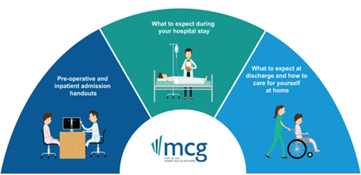
3. Importance of preoperative education
In addition to providing information and explanation about surgical procedures, expected patient behavior and anticipated sensations, PE is regarded as an interactive process providing appropriate assurance and psychosocial support to the patient who is going to be operated.
Fredericks et al. (2010). Postoperative patient education: a systematic review.
Yavuz 2010; Guo et al. 2012;; Ronco et al. 2012; Ramesh et al. 2017

Slide 15
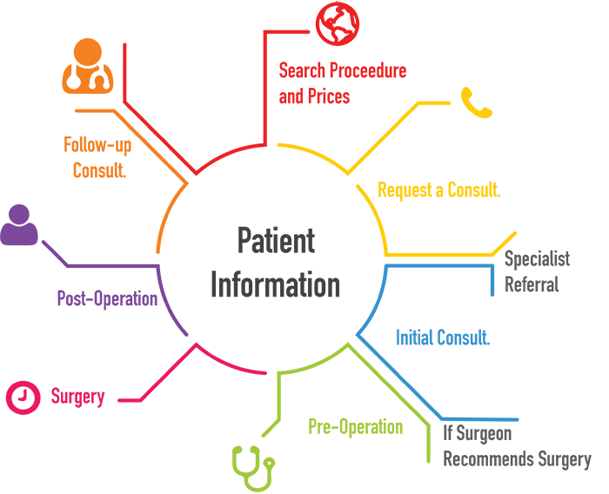
3. Importance of preoperative education continued…
Preoperative education positively affect patient to know what will happen in each stage of the surgery, feel better physically and mentally, improve the outcome of the surgery as well as helping them understand the role and responsibilities of own individual care and correcting misconceptions.
Fredericks et al. (2010). Postoperative patient education: a systematic review.
Yavuz 2010; Guo et al. 2012;; Ronco et al. 2012; Ramesh et al. 2017

Slide 16

3. Importance of preoperative education continued…
Preoperative education is very important for anxious patients waiting for surgery. Because preoperative education can reduce anxiety by making the unknown known. Although the preoperative education needs of patients vary, most of the surgical patients prefer to receive comprehensive information about own health during preoperative period.
Moene et al. (2006). Patients’ existential situation prior to colorectal surgery.
Aquilina and Baldacchino (2007). An exploratory study of Maltese patients’ perceptions of their preparation for total joint replacement at the pre-admission clinic.
Guo, 2012

Slide 17
Components and Methods of Preoperative Education
Traditionally, information is given to patients to understand the experiences that they will encounter during surgery, and this information is divided into three categories: procedural, sensory, and coping information.
Procedural information (causes and consequences of the surgery, specific surgical procedures, instructions given in the postoperative period, and discharge)
Sensory information (feelings that patients experience during or after the operation, such as pain and discomfort)
Coping information (exercises such as deep breathing and coughing exercises to minimize complications and improve postoperative function)
Guo, 2012

Slide 18

Components and Methods of Preoperative Education continued..
Preoperative education is applied in a variety of approaches and formats, such as written materials, audio-visual presentations, oral information in the form of individual counseling or group discussion, or combinations of some or all of these. Each approach has both advantages and limitations.

Slide 19


Components and Methods of Preoperative Education continued..
In addition, it has been shown that the information given in written form without the oral explanation is perceived as complicated and difficult to understand by the patients For this reason, it was reported that the provision of written materials, together with the oral information, is more effective in preoperative education.
Ivarsson et al (2005). Patients perceptions of information about risks at cardiac surgery.
Ferrús-Torres et al (2011). Informed consent in oral surgery: the value of written information.
Guo 2012

Slide 20

Components and Methods of Preoperative Education continued..
In addition, the use of information brochures in emergency care services is strongly recommended to increase patient satisfaction.
It is necessary to provide the appropriate amount of information for the patients undergoing surgery. However, it is very important that the information is given to the patient in an adequate manner with an appropriate method, according to the individual requirement that the patient feels comfortable.
Guo 2012; Ronco et al. 2012

Slide 21
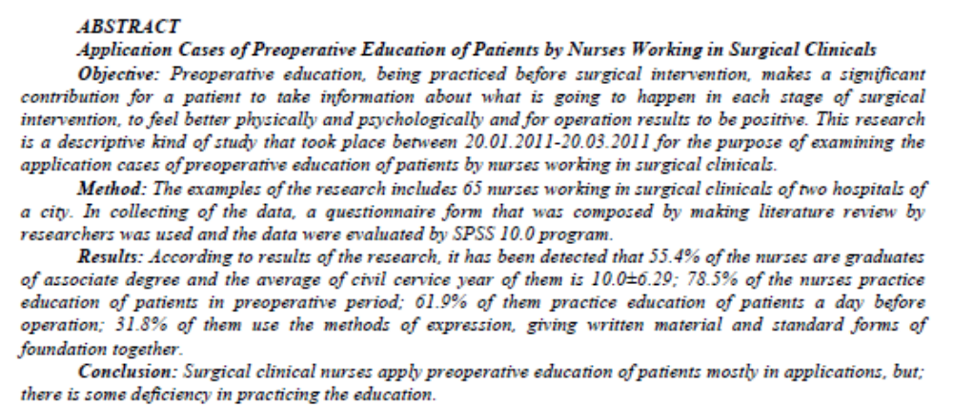
Role of the Nurses in Preoperative Education
Nurses who have roles in the diagnosis, treatment and care of the patients and who are in constant communication with them play an active role in patient education. Nurses need to identify and meet the preoperative educuation needs of patients.
Ong et al. (2009). Effect of a preoperative instructional digital video disc on patient knowledge and preparedness for engaging in postoperative care
activities.
Erturk and Unlu (2018). Effects of pre-operative individualized education on anxiety and pain severity in patients following open-heart surgery

Slide 22

Role of the Nurses in Preoperative Education continued..
Preoperative education is one of the most important nursing interventions and an indispensable part of preoperative patient care. Meeting the education needs of patients is also an indication of quality patient care outcomes.
Walker 2007. What İs The Effect of Preoperative Information on Patient Satisfaction?

Slide 23
Role of the Nurses in Preoperative Education continued..
The patient to be operated and the relatives of the patient have concerns and fears about anesthesia, surgical intervention, and the applications to be performed. It is stated that the patient and his/her family need to be informed in order to cope with these difficulties.
The surgical nurse who has deep and comprehensive knowledge to coordinate the care of the surgical patient should inform the patient and the family about the applications and possibilities to be performed before, during and after the surgery.
Donmez and Ozbayir (2008). Examination of the validity and reliability of the "good perioperative nursing care scale" for the Turkish nurses and patients .
Gurlek and Yavuz 2013

Slide 24
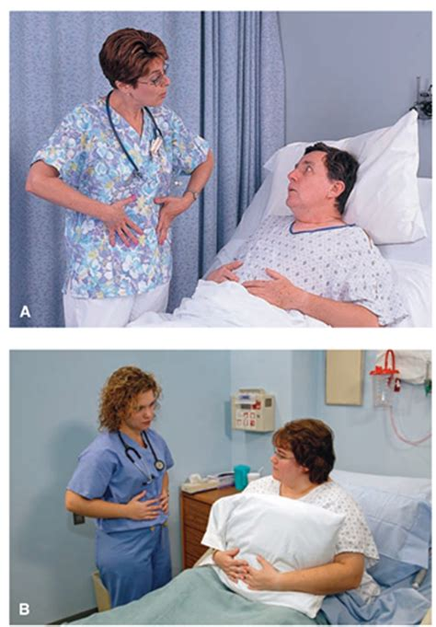
Role of the Nurses in Preoperative Education continued..
The topics that patients and their relatives are required to be informed before surgery can be listed as;
--diagnosis;
--preoperative diagnostic procedures;
--preparations; treatment;
--duration of operation,
--materials;
--frequency of visit;
--time that can be spent with patient;
--those who will give care to the patient after surgery;
--where they can wait during surgery;
--ways of communicating with the operation room and receiving information;
--tubes, drains, medications,
--possible complications that may occur after surgery;
--cardiac rehabilitation exercises (exercises that should be done; walking, breathing, coughing, etc.),
--and restrictions.
Donmez and Ozbayir 2008; Gurlek and Yavuz 2013

Slide 25

Role of the Nurses in Preoperative Education continued..
Studies show that preoperative education reduces patients' anxiety and analgesic need, increases satisfaction, shortens hospital stay time, and improves mental and physical healing by increasing quality of life.
Walker 2007, Gräwe et al. 2010; Jlala et al. 2010; McKenzie et al. 2010; Guo 2012; Ronco et al. 2012; Zhang et al. 2012; Doğu 2013; Lemanu et al. 2013; Snowdon et al. 2014; Kalogianni et al. 2016; Fredericksa and Yaub 2017; Ramesh et al. 2017; Erturk and Unlu 2018; Loghmani and Monfared 2018

Slide 26

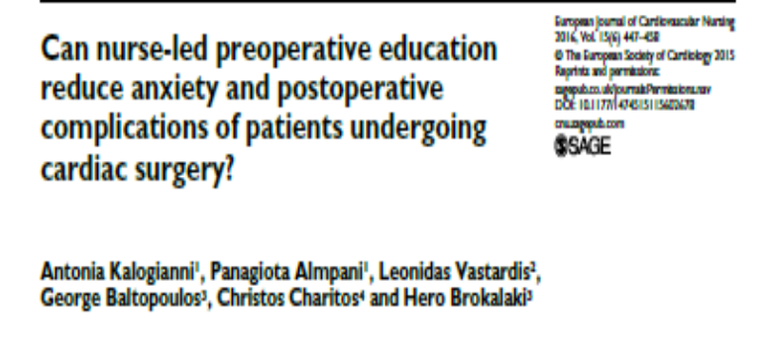
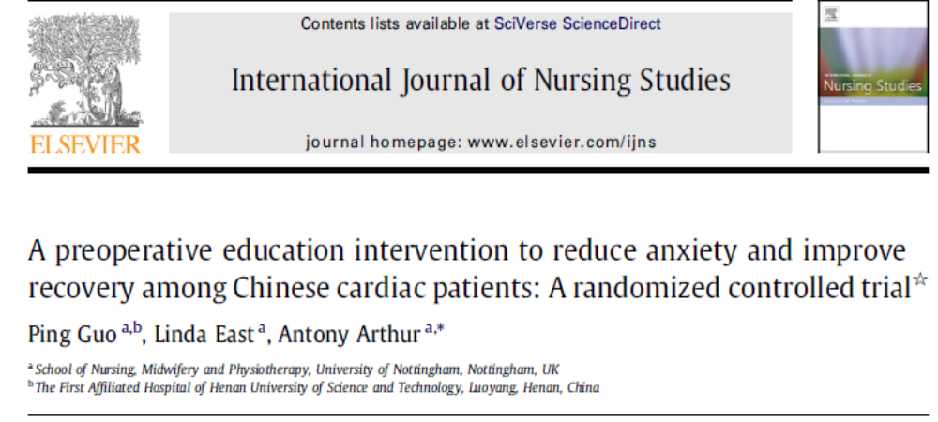
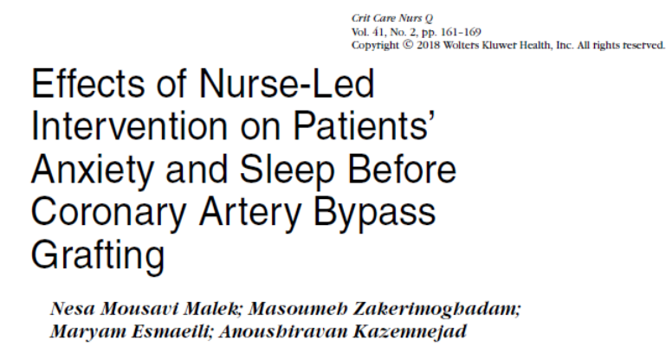
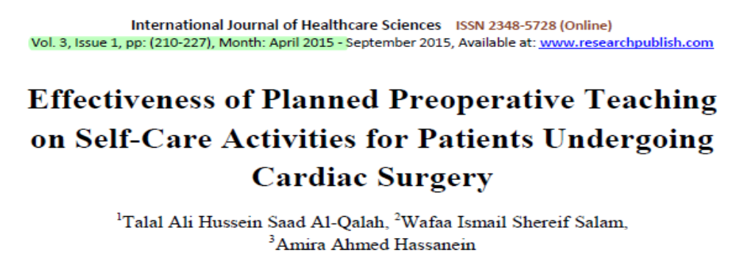
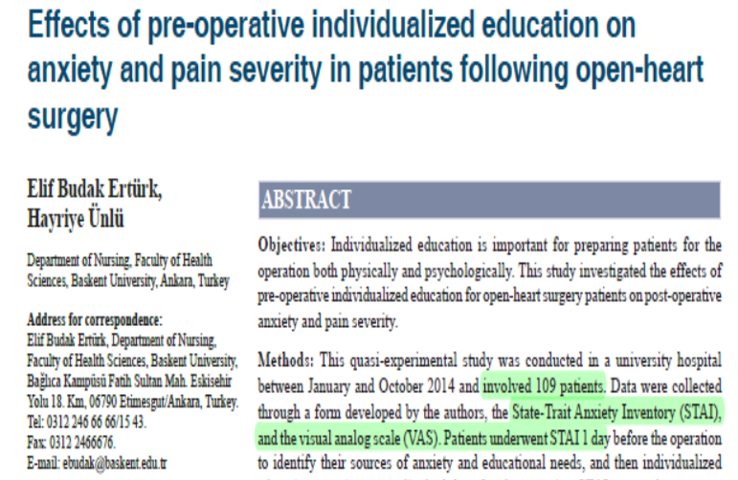

Some literature research on the effectiveness of preoperative education

Slide 27
Table 1. Outcomes of preoperative education in patients undergoing cardiac surgery
Studies Outcomes | Al-Qalah et al. QES, 2015, n=100 | Ertürk and Ünlü, QES, 2018, n=109 | Fredericks and Yaub, Systematic review, 2016, n=585 studies | Guo et al. RCT, 2012, n=153 | Hosein et al. RCT, 2013, n=70 | Loghmani and Monfared, analytical study, 2018, n=80 | Kalogianni et al. RCT, 2016, n=395 | Malek et al. RCT, 2018, n=160 | Matthias and Samarasekera, a prospective study, 2012, n=100
Fear
Anxiety |  | ↓ | ↓ | ↓ | ↓ |  | ↓ | ↓ | ↓
Depression |  |  | ↓ |  | ↓ | ↓
Pain | ↓ | ↓ |  | =
Analgesia requirement | ↓
Knowledge and self efficacy | ↑
Early extubation | ↑
Sleep Quality |  |  |  |  |  |  |  | ↑
Patient satisfaction
Postoperative stay | ↓
ICU stay | ↓
Hospital stay |  |  |  |  |  |  | =
Hospital readmission |  |  | ↓ |  |  |  | =
Complications | ↓ |  |  |  |  |  | ↓
Recovery
ICU: Intensive Care Unit; QES: Quasi-experimental study; RCT: Randomised Controlled Study
= : No difference between control and experimental groups
↓: Significant decrease in the experimental group ↑: Significant increase in the experimental group

Slide 28
Table 1. Continued..
Studies Outcomes | Martorella et al. RCT, 2012, n=52 | Ortiz et al. A survey, 2015 | Ramesh et al. Systematic review and meta-analysis, 2017 | Shahmansouri et al. RCT, 2014, n=60 | Sorlie et al. RCT, 2007, n=109 | Utriyaprasit et al. RCT, 2010, n= 120 | Varaei et al. RCT, 2014, n=60 | Zhang et al. Prospective and Randomized trial, 2012, n=40
Fear |  |  |  | ↓
Anxiety |  | = | ↓ | = | ↓ |  |  | ↓
Depression |  |  | = |  | ↓
Pain | ↓ |  | =
Analgesia requirement
Knowledge and self efficacy |  |  |  |  |  |  | ↑
Early extubation
Sleep Quality
Patient satisfaction |  | ↑
Postoperative stay
ICU stay
Hospital stay |  |  | =
Hospital readmission |  |  |  |  |  |  | ↓
Complications |  |  |  |  |  |  |  | ↓
Recovery |  |  |  |  |  | ↑

Slide 29
Conclusion
Many studies have investigated whether preoperative education interventions are successful in improving postoperative outcomes and whether physical and psychological healing is improved after cardiac surgery.
In addition, the effectiveness of preoperative education on postoperative outcomes in patients undergoing cardiac surgery has not been clearly identified.

Slide 30
Conclusion
For the patients undergoing cardiac surgery, it was observed that higher quality randomized studies are needed to provide stronger evidence for preoperative education interventions to improve the postoperative outcomes. Although the preoperative education is not at the required level to increase the health status, it can be concluded that the written and oral preoperative education applied by a nurse has important contribution to the patient outcomes.

Slide 31



