Slide 1
About OMICS Group
OMICS Group International is an amalgamation of Open Access publications and worldwide international science conferences and events. Established in the year 2007 with the sole aim of making the information on Sciences and technology ‘Open Access’, OMICS Group publishes 400 online open access scholarly journals in all aspects of Science, Engineering, Management and Technology journals. OMICS Group has been instrumental in taking the knowledge on Science & technology to the doorsteps of ordinary men and women. Research Scholars, Students, Libraries, Educational Institutions, Research centers and the industry are main stakeholders that benefitted greatly from this knowledge dissemination. OMICS Group also organizes 300 International conferences annually across the globe, where knowledge transfer takes place through debates, round table discussions, poster presentations, workshops, symposia and exhibitions.

Slide 2
About OMICS Group Conferences
OMICS Group International is a pioneer and leading science event organizer, which publishes around 400 open access journals and conducts over 300 Medical, Clinical, Engineering, Life Sciences, Phrama scientific conferences all over the globe annually with the support of more than 1000 scientific associations and 30,000 editorial board members and 3.5 million followers to its credit.
OMICS Group has organized 500 conferences, workshops and national symposiums across the major cities including San Francisco, Las Vegas, San Antonio, Omaha, Orlando, Raleigh, Santa Clara, Chicago, Philadelphia, Baltimore, United Kingdom, Valencia, Dubai, Beijing, Hyderabad, Bengaluru and Mumbai.

Slide 3
Function of the phased A-tracts upstream of the phospholipase C gene promoter in Clostridium perfringens
On 17th November 2014 at Double Tree by Hilton Hotel Chicago - North Shore , USA
Seiichi Katayama
Okayama University of Science, Japan

Slide 4
Introduction

Slide 5
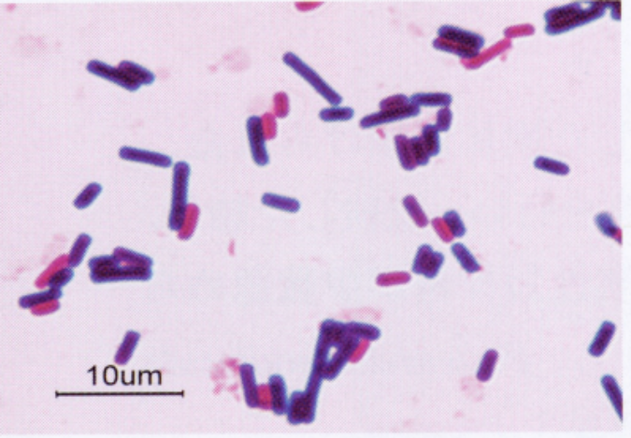
Clostridium perfringens
Gram positive rod
Spore-forming
Obligate anaerobe
Living in animal intestinal tracts and soil
Pathogen for humans and animals
gas gangrene ← α-toxin
food poisoning ← enterotoxin

Slide 6
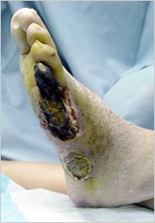
Gas gangrene
Wound, injury of surgery → infection →
α-toxin (phospholipase C ) produced by C. perfringens → destructions of cell membranes
→ damages of tissues
Treatment → Cut open of the wound
Antibiotics
High-pressure oxygen

Slide 7
α−toxin (plc) gene expression (NCTC8237)
Table 1. Levels of plc mRNA and PLC activity in C. perfringens
Temperature | plc mRNA | PLC activity
(°C) | (%) | (nmol/min/mg/cellular protein) | Ratio (%)
25 | 100 | 6.51 ± 0.01 | 100
37 | 47 ± 2.5 | 4.92 ± 0.11 | 75.6
45 | 23 ± 0.5 | 2.63 ± 0.06 | 40.4
The plc gene expression increased at lower temperatures.

Slide 8
The phased A-tracts upstream of the plc gene promoter

Slide 9
The phased A-tracts upstream of phopholipase C (plc) gene promoter
NCTC8237 (=ATCC13124)
-79 3 phased A-tracts ( -66 to -44 ) -35 plc promoter -10 +1
TTGAATTGTATTCAAAAATATTTTAAAAAATATTCAAAAATTTAGTGAGCTTATGGTAATTATATGGTATAATTTCAGTG
The phased A-tracts are almost conserved among C. perfringens strains.
What is the effect of the phased A-tracts on the plc gene expression?

Slide 10
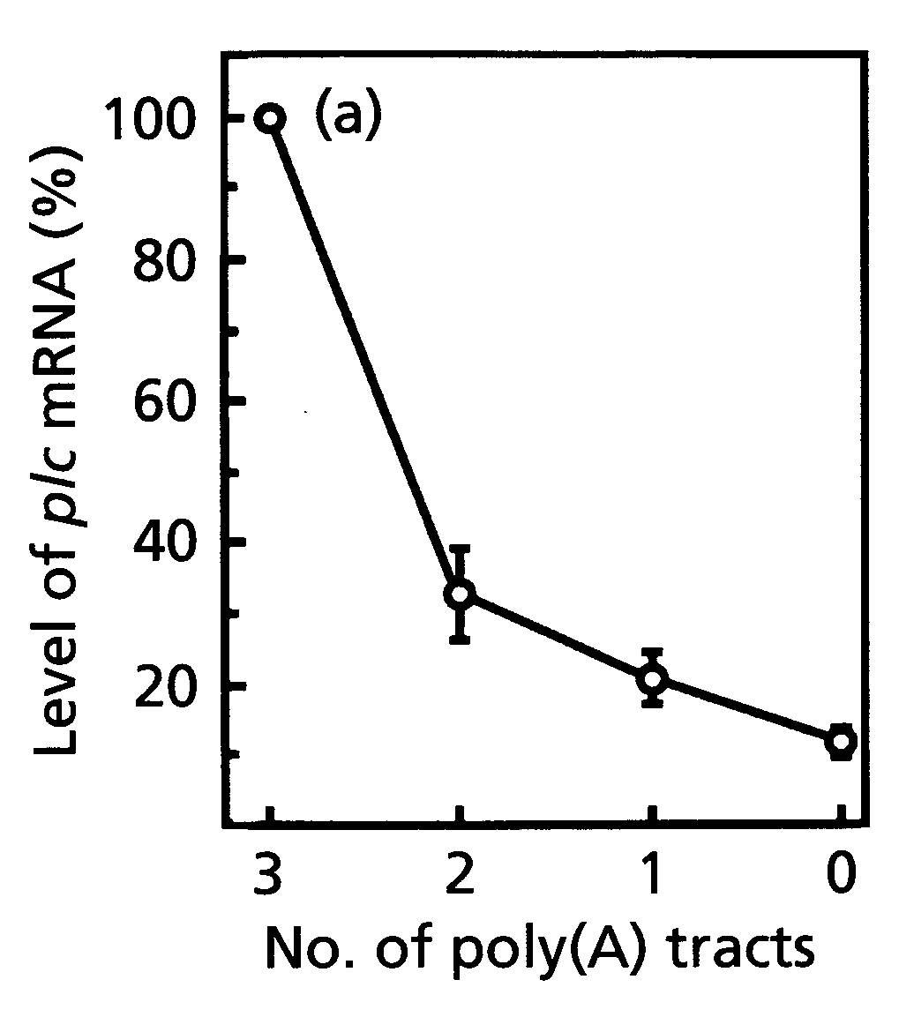
plc gene expression in vivo
plc
C. Perfringens PLC– strain
3 phased A-tracts (–66 to –44)
plc promoter –35
3Ap
0Ap
The A-tracts promoted the plc gene expression,
in vivo.
[ Matsushita, et al. Microbiology 142: 2561-2566. 1996 ]

Slide 11
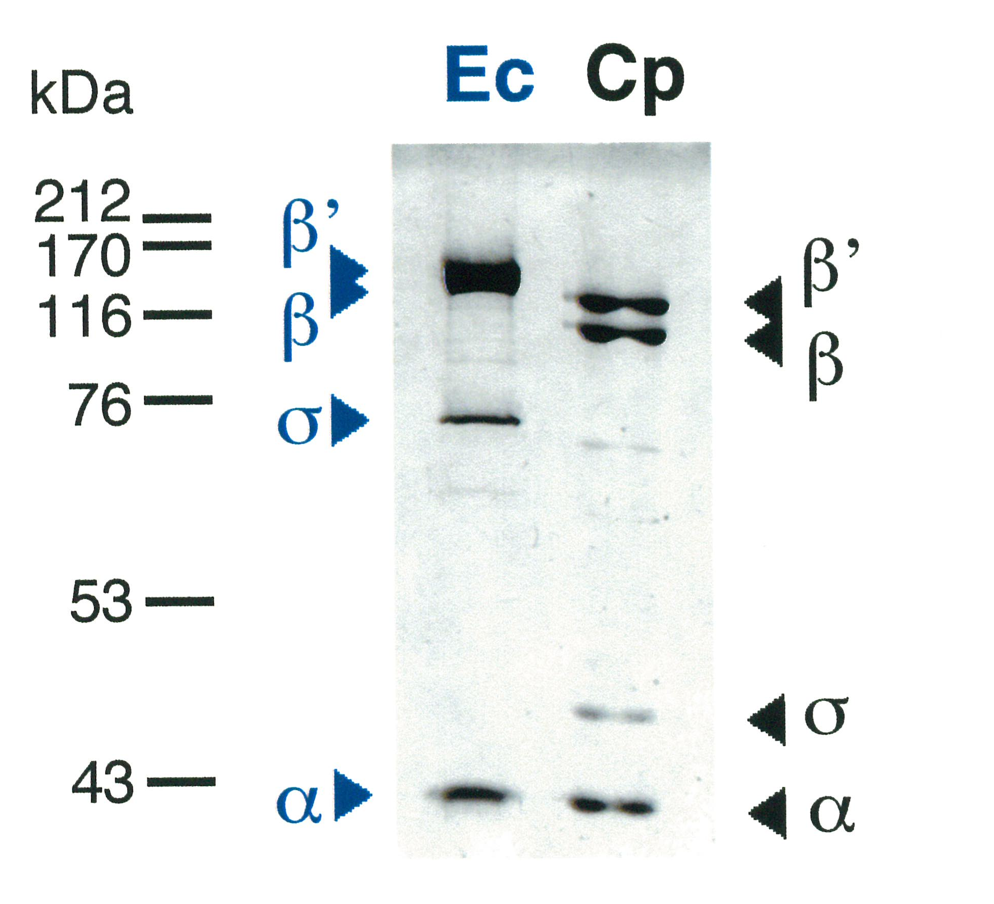

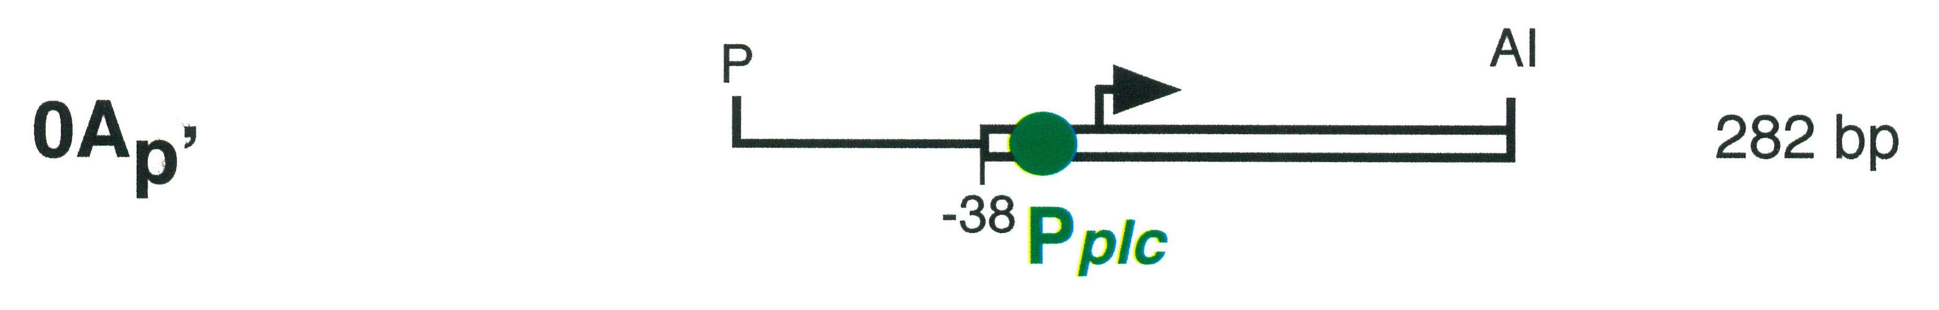
Promoter competition assay 1
3 phased A-tracts
Fig. 2 Template DNAs used
in promoter competition assays.
Fig. 1 Purified RNA polymerase.
Ec : Escherichia coli, Cp: C. perfringens
In vitro transcription with two promoters on DNA fragments, RNA polymerase, and NTPs was done.

Slide 12
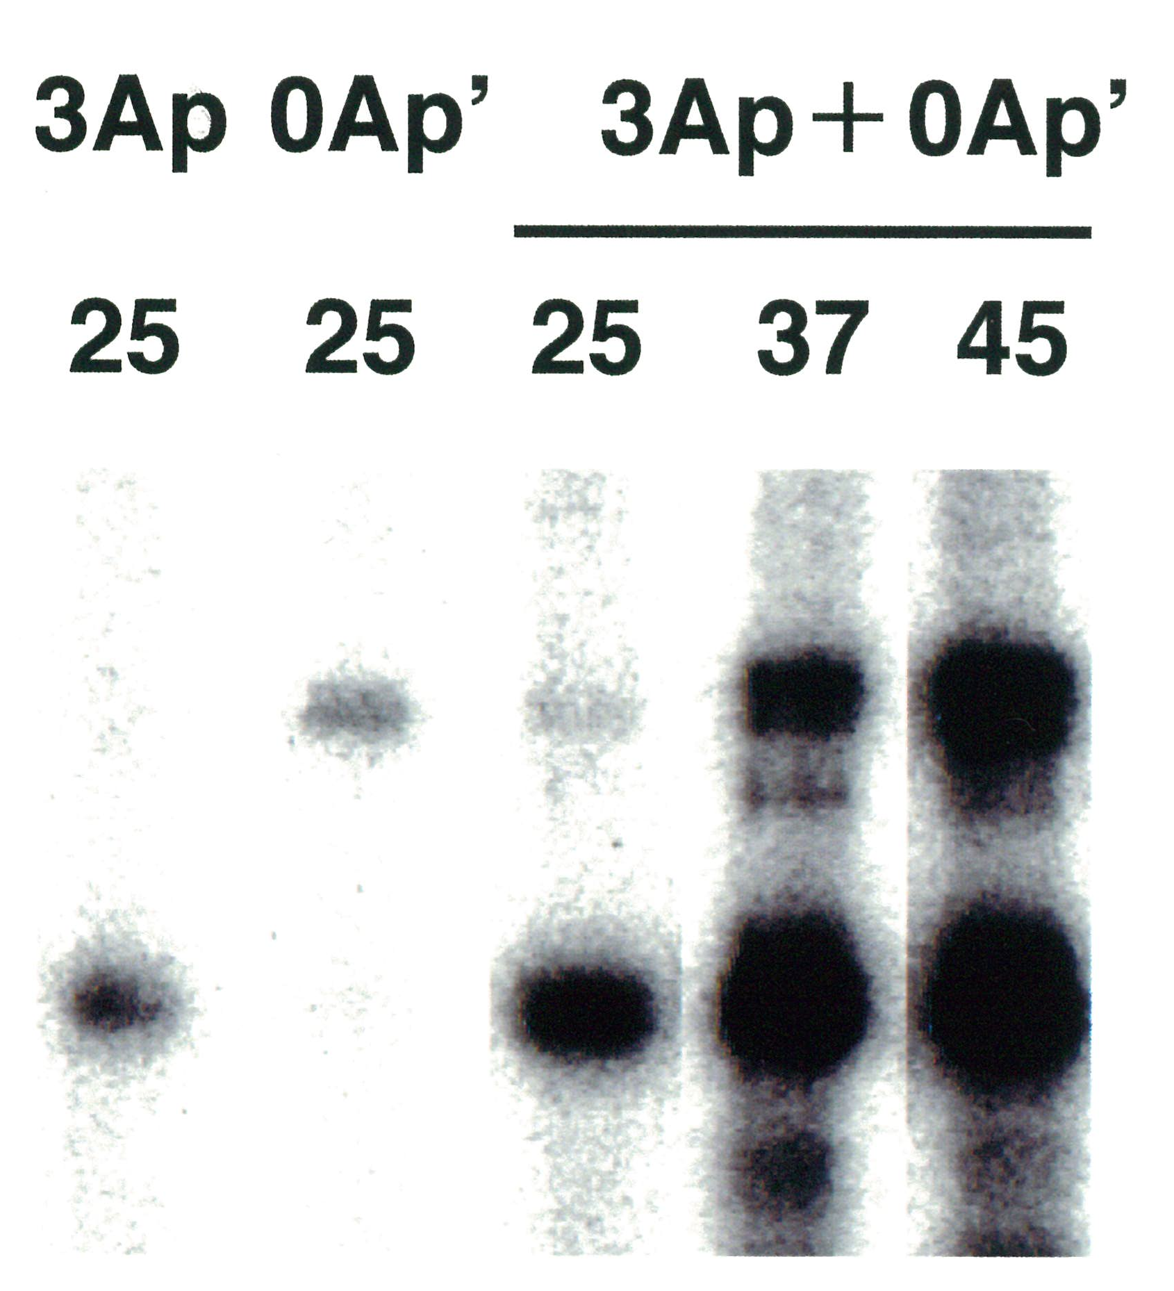
Promoter competition assay 2
Templates
Temperature (°C)
Temperature (°C) | Ratio of mRNA levels (3Ap/0Ap’)
25 | 30.8 ± 4.3
37 | 4.6 ± 0.8
45 | 1.9 ± 0.2
0Ap’
transcripts
3Ap
transcripts
The phased A-tracts enhanced the plc gene expression at lower temperatures.
[ Katayama, et al. EMBO J 18:3442-3450, 1999 ]

Slide 13
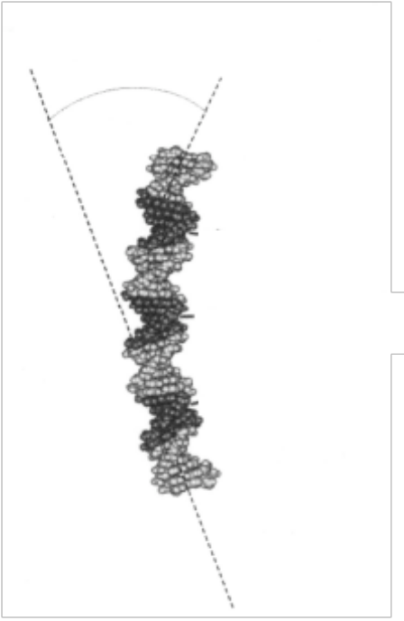
Phased A-tracts can bend
Bending angle
The bending angle of 3 phased A-tracts
Temperature | Bending centre | Bending angle
(°C) | (bp) | (°)
15 | -17 ± 2 | 46.6 ± 1.3
25 | -25 ± 1.3 | 40.3 ± 0.8
37 | -29 ± 5.2 | 35.9 ± 0.6
3 phased
A-tracts
The 3 phased A-tracts can bend at lower temperatures.
[ Katayama, et al. Unpublished data]

Slide 14
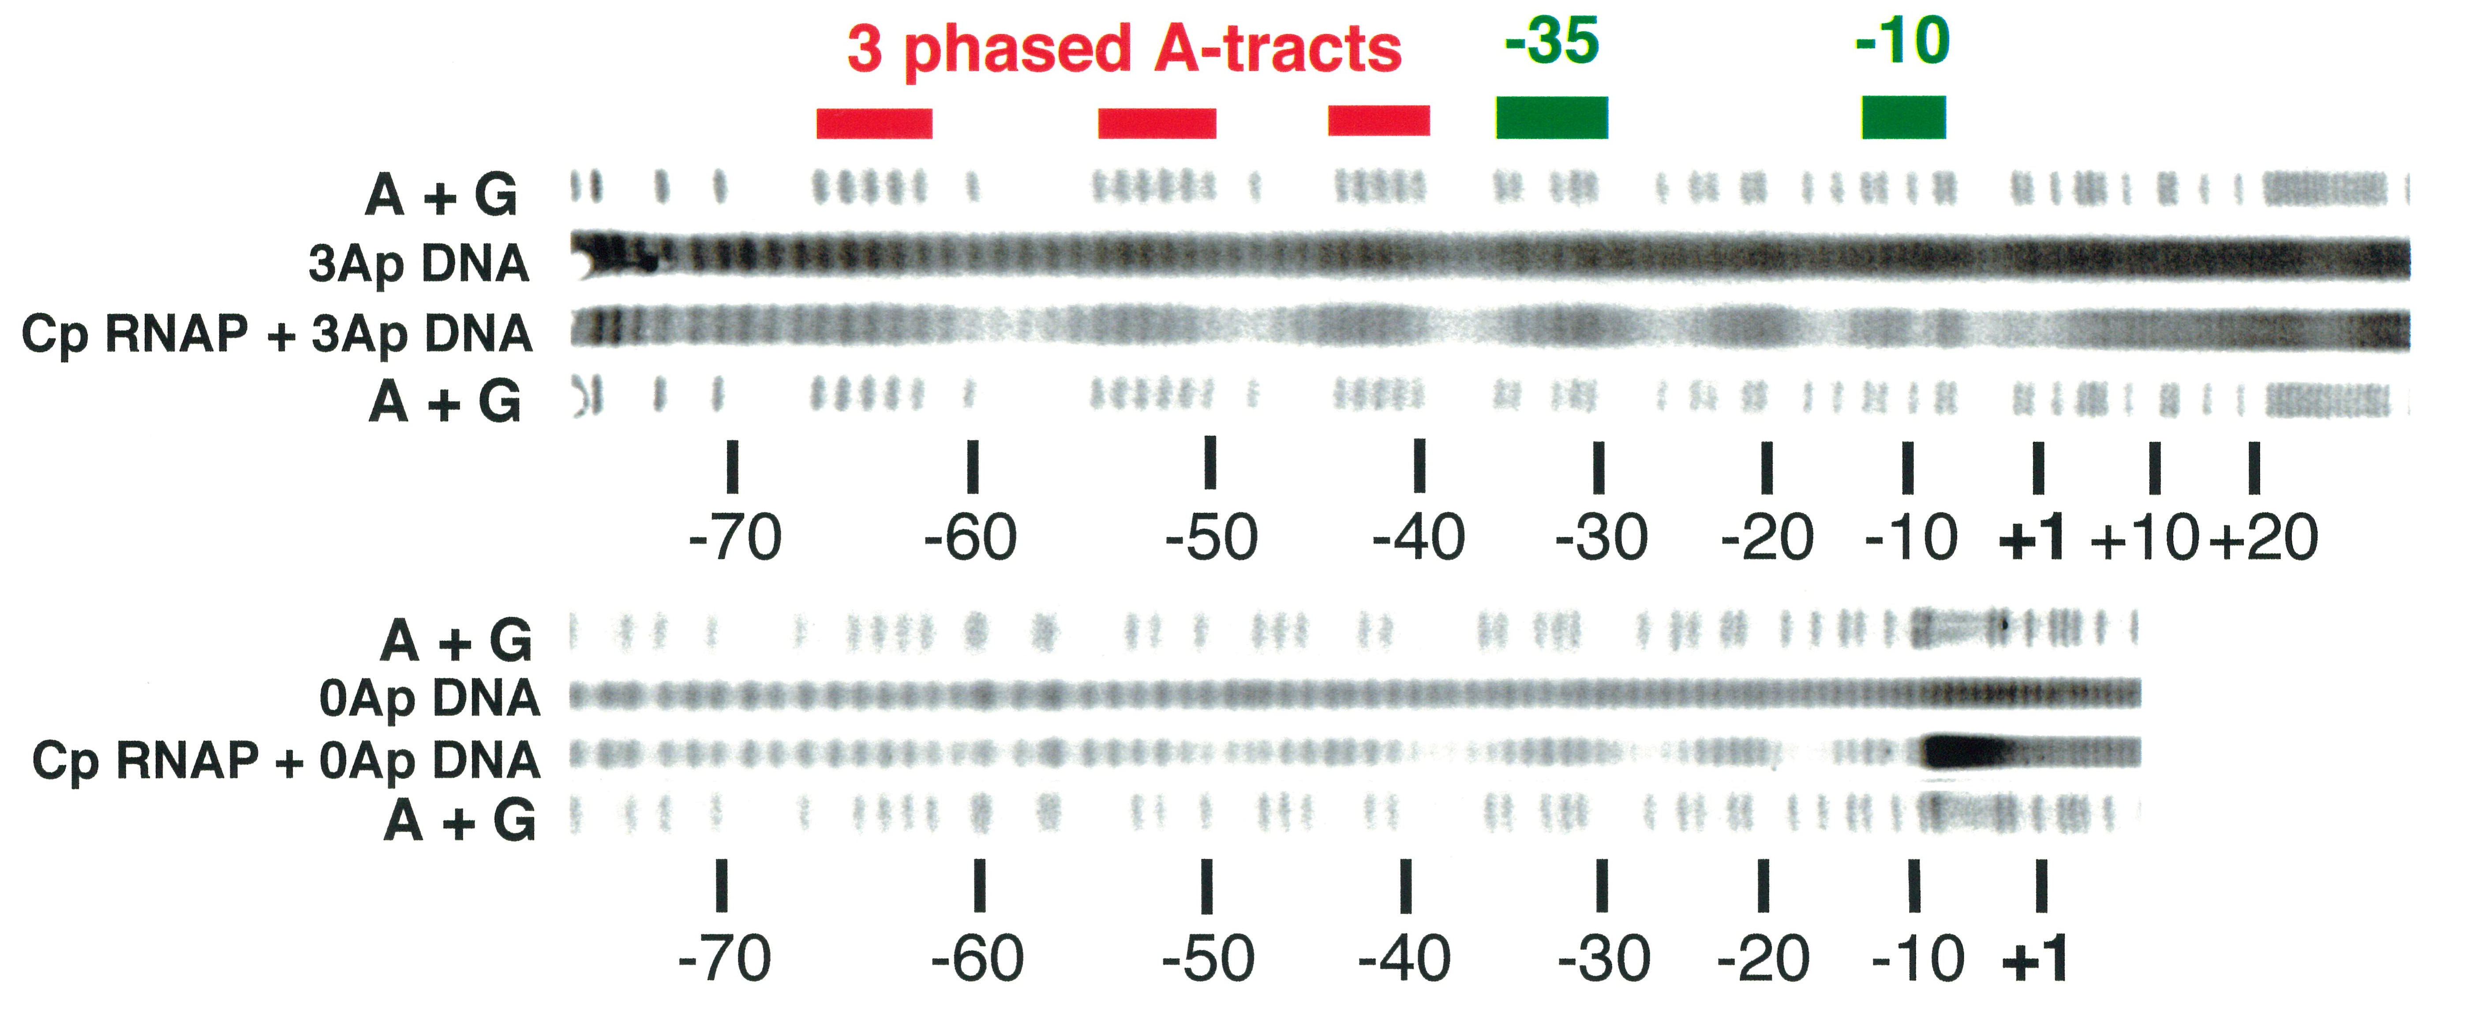
Hydroxyl radical footprinting
Protected region
(bp)
-64 to -1
-54 to -1
3 phased A-tracts extended the contact region with RNA polymerase.

Slide 15
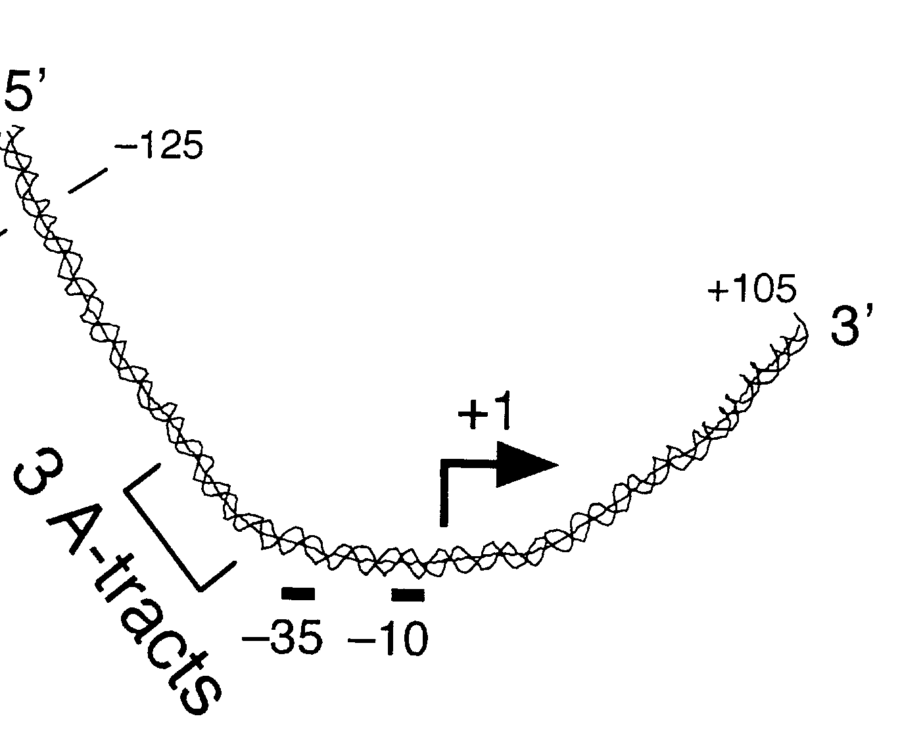
Scheme of contact of RNA polymerase with the phased A-tracts
RNA polymerase
β’
α
α
β
σ
α subunits bind to the A-tracts?

Slide 16
Binding of the α subunits of
Cp RNA polymerase to the phased
A-tracts

Slide 17
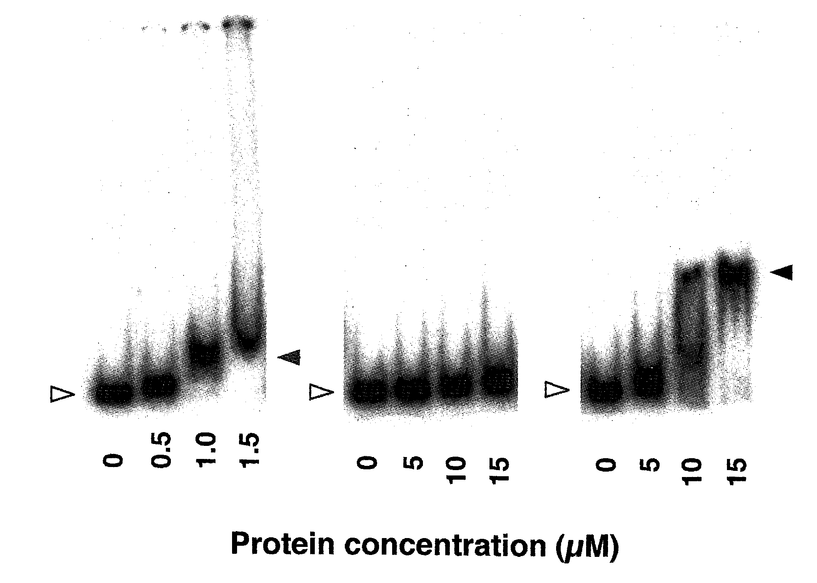
Gel shift assay for binding of the Cp α subunits to 3A DNA
α -WT
αNTD
αCTD
The C-termnal domain of the α subunit (αCTD) of Cp RNA polymerase bound to the phased A-tracts.
[ Katayama, et al. FEBS Lett 509: 235-238, 2001 ]

Slide 18
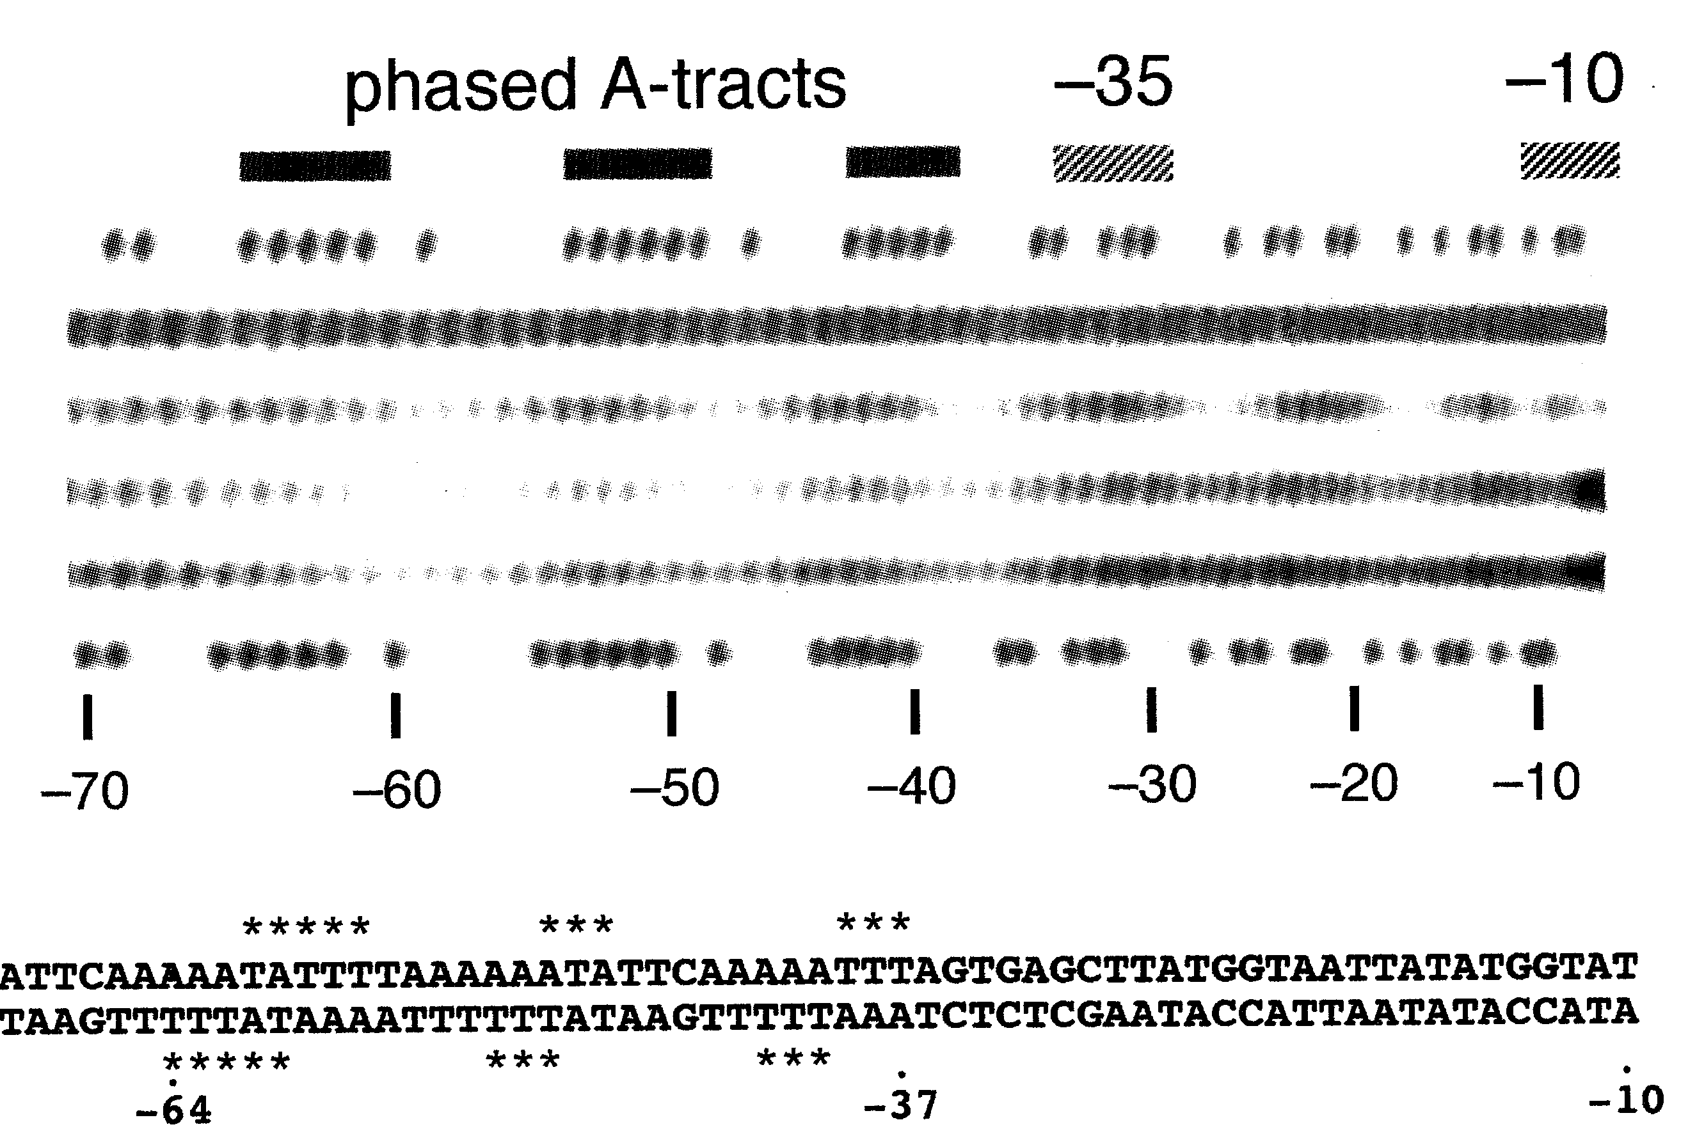
Hydroxyl radical footprinting
A/G
DNA
DNA +Cp RNAP
DNA + α subunit
DNA + α CTD
A/G
*Protected nucleotides
by α subunits of Cp RNAP
Cp α subunits and α CTD protected the region of the phased A-tracts.

Slide 19
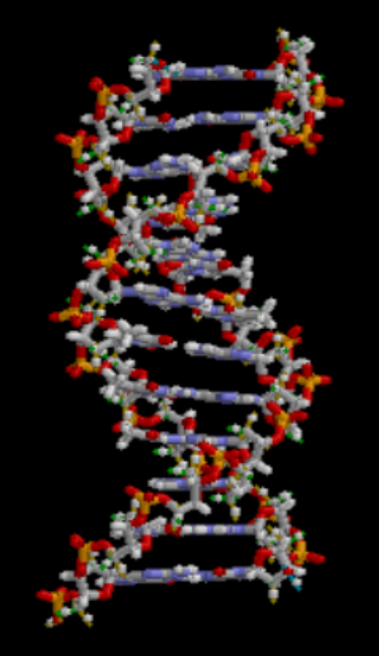
Chemicals binding to DNA
Minor groove
Major groove
DAPI
(4’6-diammidino-2-phenyllindole)
Methyl green
Structure of DNA

Slide 20
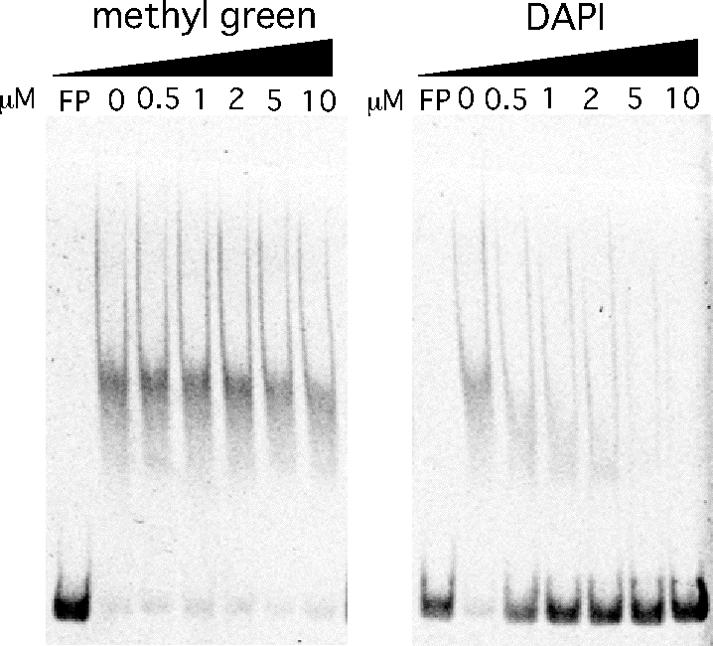
Gel shift assay using methyl green and DAPI
FITC-3Ap DNA 25 nM,
Cp α-WT ４ μM
+ inhibitor
⇩
Incubation 25℃, 30 min
⇩
5% PAGE
FP:free probe
DAPI inhibited the binding of the α subunit to the phased A-tracts.
The α-CTD binds to the minor groove of 3A.

Slide 21
Affinity of the phased A-tracts to the α subunits of Cp RNA polymerase
Table 3. Affinity of C. perfringens α subumit to 3A or 0A DNA
DNA (25 μM) | Dissociation constant* Kd （M) | Ratio
3A | 6.1 ± 0.3 X 10^{–8} | 1.0
0A | 1.5 ± 0.1 X 10^{–6} | 24.1
*Measuerd by surface plasmon resonance (SPR)
[ Katayama, et al. Anaerobe 23: 62-69, 2013 ]
The affinity was of the same order magnitude as that of
H-NS proteins (E. coli) binding to a DNA fragment containing
A₅A₆ sequence (Kd = 2.7 X 10^{–8} M), measured by SPR.
[Bouffartgues, et al. Nucleic Acids Research 35:e39, 2007.]

Slide 22
The contact path of the α subunit of C. perfringens RNA polymerase with the phased A-tracts

Slide 23
UP element of E. coli
Upstream (UP) element is an A/T rich sequence upstream of the rrnB P1 promoter (16S rRNA gene).
UP element enhances the promoter activity,
which contacts with αCTD of Ec RNA polymerase.
[Ross, et al. Science 262:1407-1413. 1993.]

Slide 24
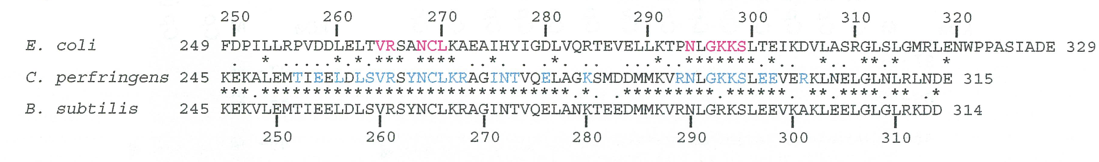
The positions of alanine substitutions in αCTD
Red: the amino acid residues involved in binding of E. coli αCTD to UP element
Cyan: the amino acid residues in Cp αCTD substituted to alanine.
To identify the amino acid residues involved in the binding to the phased A- tracts, 27 alanine substitutions in Cp αCTD were done.
[Katayama, et al. Anaerobe 23:62-69. 2013.]

Slide 25
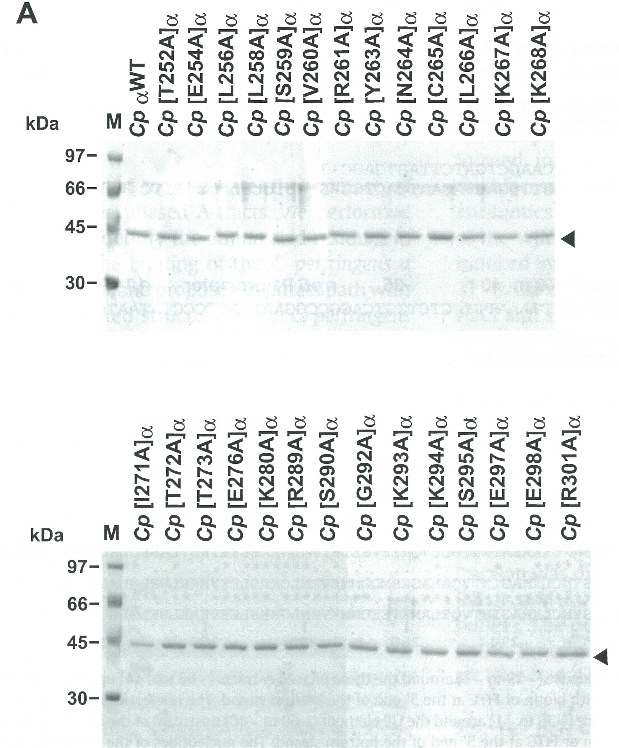
Purified recombinant α subunits
All α subunits were purified using a His₆-tag.

Slide 26
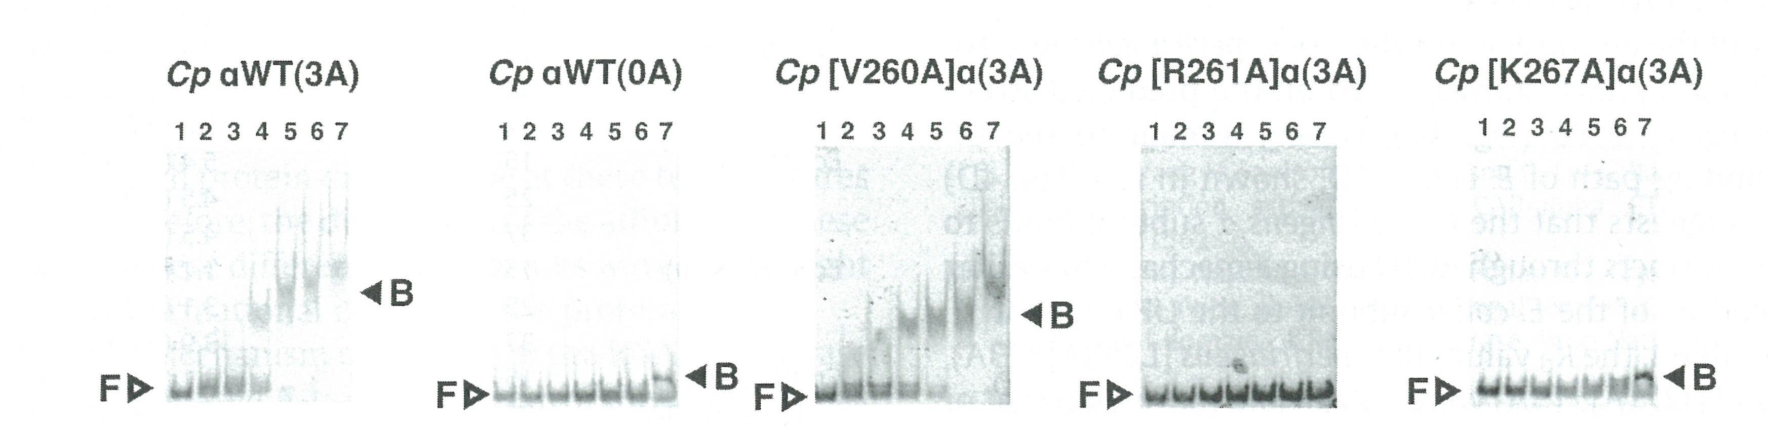
Gel shift assays with the mutated α subunits
Five representative results were shown.

Slide 27
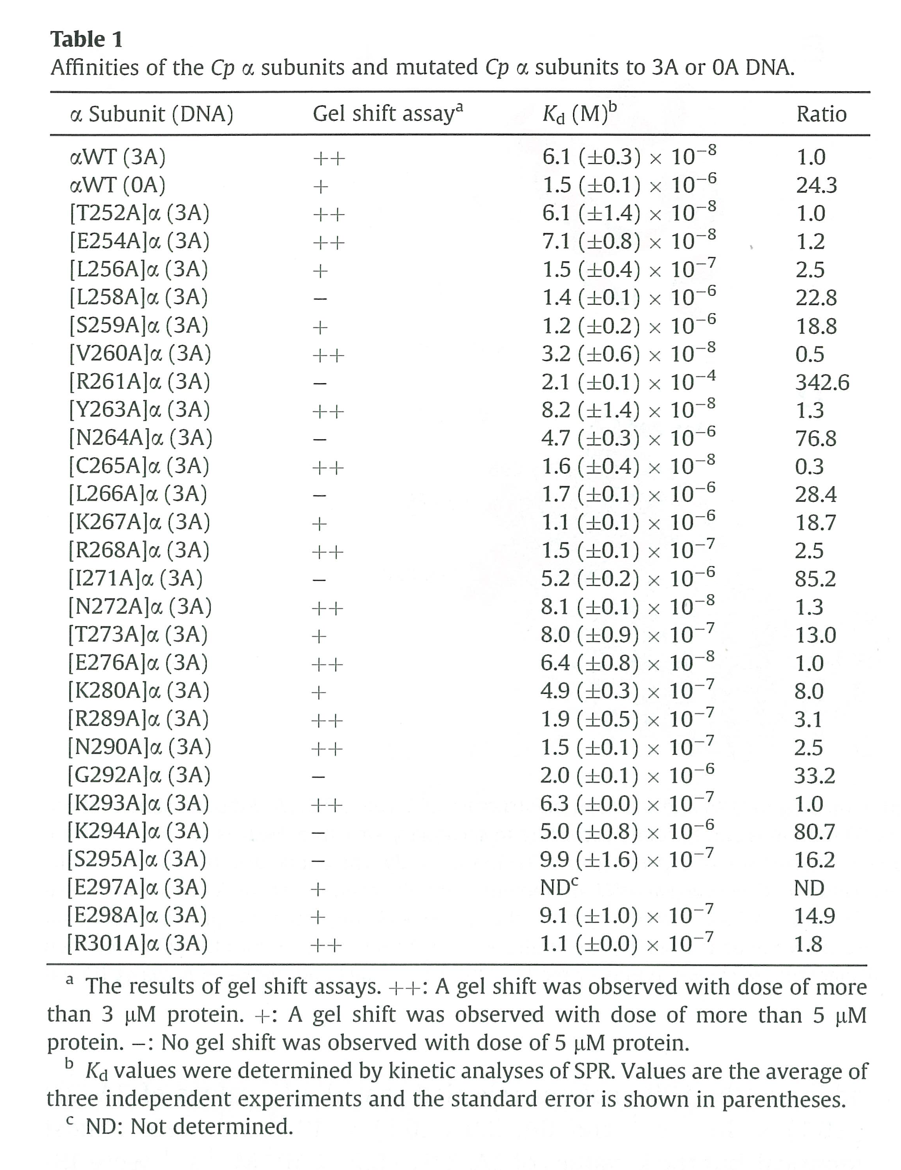
The results of gel shift assays and Kd values estimated by SPR
The results of gel shift assays were related to the dissociation constants (Kd)

Slide 28
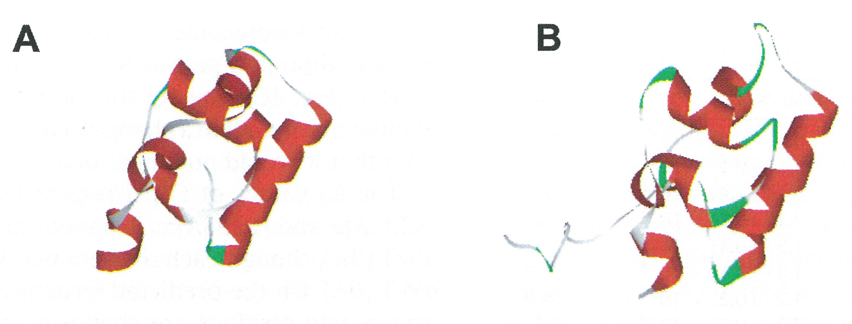
The predicted structure of
Cp αCTD
(A) C. perfringens αCTD
(B) E. coli αCTD
The structure of Cp αCTD was predicted from that of Bacillus subtilis αCTD.

Slide 29
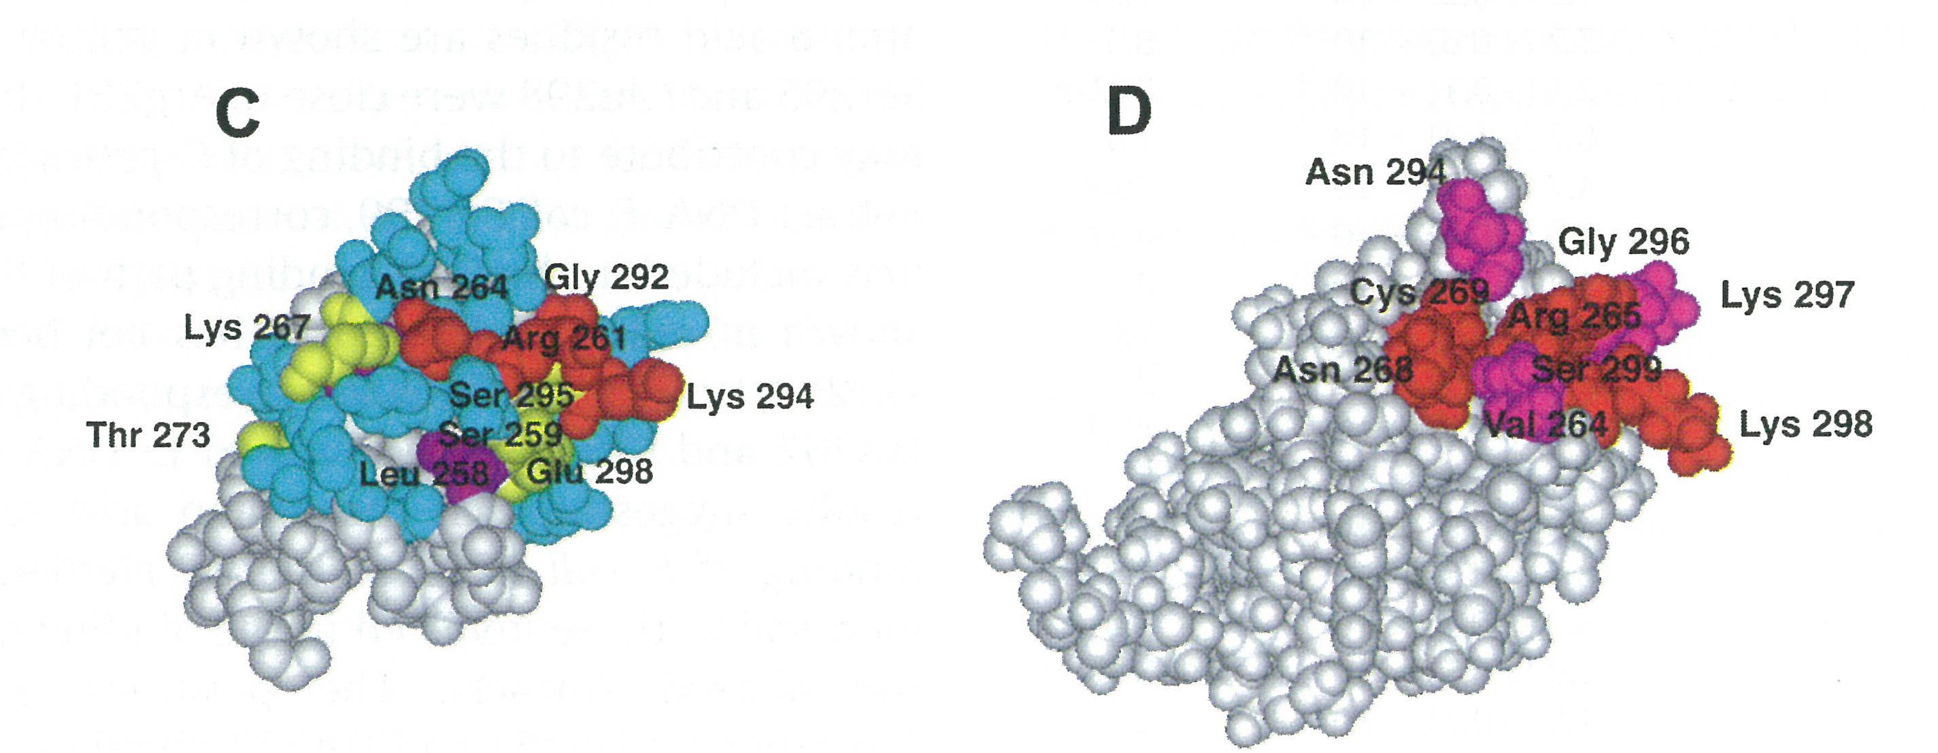
Mapping of amino acid residues substituted to alanine
(C) C. perfringens αCTD
Red : The values of Kd increased
more 30-folds than that of αWT.
Yellow : The values of Kd increased
more 8-folds than that of αWT.
Purple : important for the protein folding.
(D) E. coli αCTD
Red : The contact path between E. coli
αCTD and the UPelement.
Pink: The amino acid residues involved in
contact with the UP element.
[Gourse et al. Mol Microbiol 37:687-695, 2000]
Both contact paths were similar.

Slide 30
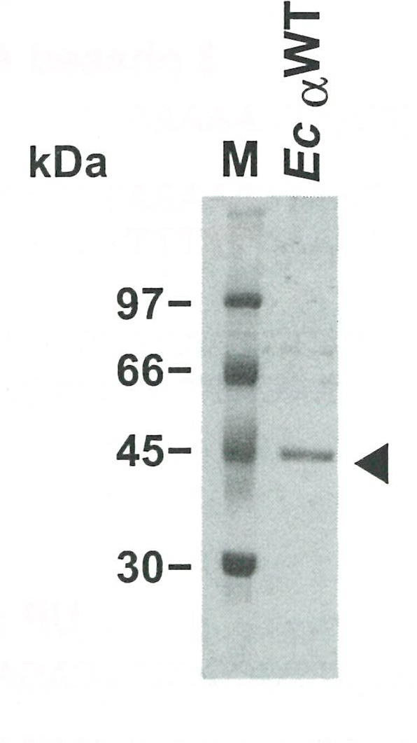
Affinities of the α subunits to DNA at various temperatures
α subunit (DNA) | Temperature (°C) | Kd (M) | Ratio
Cp αWT (3A) | 15 | 1.5 ± 0.1 X 10⁻⁸ | 1.0
 | 25 | 6.1 ± 0.3 X 10⁻⁸ | 4.1
 | 37 | 4.4 ± 0.3 X 10⁻⁷ | 30.8
Cp αWT (0A) | 15 | 6.5 ± 0.5 X 10⁻⁷ | 1.0
 | 25 | 1.5 ± 0.1 X 10⁻⁶ | 2.3
 | 37 | 9.8 ± 0.6 X 10⁻⁷ | 1.5
Ec αWT (UP) | 15 | 5.4 ± 0.1 X 10⁻⁹ | 1.0
 | 25 | 4.5 ± 0.3 X 10⁻⁹ | 0.8
 | 37 | 4.5 ± 0.9 X 10⁻⁹ | 0.8
・The phased A-tracts was not simply a subset of UP element.

Slide 31
Summary
Three phased A₅₋₆-tracts (–66 to –40) lie upstream of plc gene promoter in C. perfringens
The αCTD of C. perfringens RNA polymerase
The minor grooves of the phased A-tracts
The plc gene expression
The phased A-tracts in a lowtemperature-
dependent manner.

Slide 32
plc expression at room temperature may be important for C. perfringens
Animals, insects etc. on the ground
Death
C. perfringens, living in soil, happen to meet the dead body.
It is likely that they need much phopholipase C at room temperature to digest it.

Slide 33
Acknowledgements
Akinobu Okabe MD. PhD. [Chugoku University, Japan]
Osamu Matsushita MD. PhD.
Chieko Matsushita
Kazuyoshi Gotoh PhD.
[Okayama University, Graduate school of Medicine, Japan]
Kotaro Ishibashi M.S.
Daisuke Nakamura M.S.
Chiharu Tanaka M.S.
[Okayama University of Science, Graduate School of Science, Japan]

Slide 34
Thank you for your attention.

Slide 35
Let Us Meet Again
We welcome you all to our future conferences of OMICS Group International
Please Visit:
www.omicsgroup.com
www.conferenceseries.com

