Slide 1
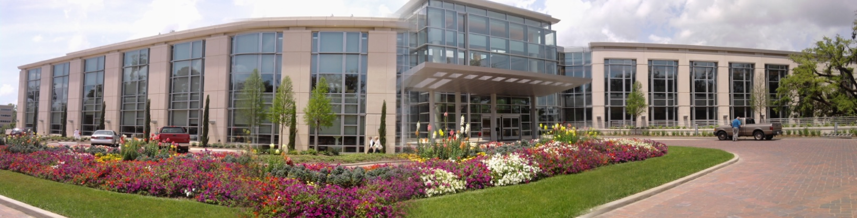

Chemo-protective Action of Silver Nanoparticles Against UVB-Induced Skin Carcinogenesis
Seema Singh, Ph.D.
Department of Oncologic Sciences
Mitchell Cancer Institute, University of South Alabama,
Mobile, Alabama, USA.

Slide 2
Skin Cancer: Burning Facts
Each year there are more new cases (> 1 million) of skin cancer than the combined incidence of the breast, prostate, lung and colon cancers
Although mortality to incidence ratio for skin cancer is relatively low, but it does contributes to the pain and sufferings, disfigurement and burden of medical costs
Exposure to Ultraviolet (UV) Radiation is the most established epidemiological cause of skin carcinogenesis.
Higher incidence recorded in areas, which are maximally-exposed to UV radiation i.e. coastal areas
(American Cancer Society, Cancer Facts & Figures, 2013; Chang et al., 2010)

Slide 3
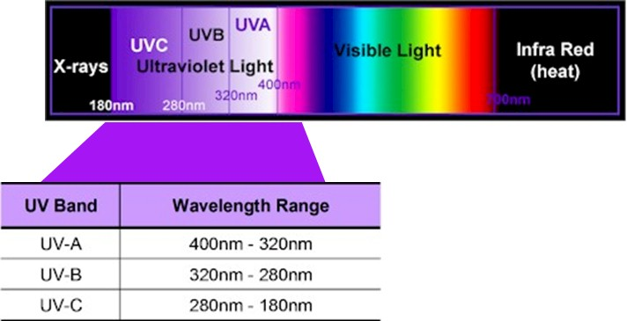
UV-Radiation
Weak Carcinogen, cause wrinkling of skin.
Major cause of skin cancer.
Effectively blocked from reaching the earth’s surface by stratospheric ozone layer.

Slide 4

Skin Cancer Formation
UV rays hit the epidermis, reaching cellular DNA.
DNA in skin cells is damaged.
DNA damage, if not repaired, can give rise to oncogenic mutation.
Accumulation of oncogenic mutations leads to neoplastic transformation of the skin cells either in short or long duration depending upon the frequency and time of UV exposure.
DNA Damage
Mutations
Photo-
chemicals
Cyclobutane pyrimidine dimers (CPDs),
cytosine photohydrates and purine photoproduct
UV Signature
C-T
G-T
T-G
UV
SKIN
CANCER
Oxidative
DNA damage
(8-OH-G, TG)
ROS

Slide 5
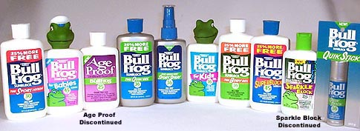
Protection From UV-radiation
Sun Screens!
Organic UV filters
Absorb and filter UV rays.
Can be inactivated by UV radiations.
Generate ROS with or without UV light stimulation.
Penetrate deeper skin cells and blood vessels, leading to undesirable side effects.
Inorganic UV filters
Reflect UV radiations and can also absorb a part of UV radiations.
Use of TiO₂ and ZnO leads to thick formulations thus leaving white marks on the skin.
Cause inflammatory/toxic effects to normal skin cells.
(Newman et al., 2009; Krause et al., 2012; Smijs et al., 2011; Yu et al., 2013; Ghosh et al., 2013)

Slide 6
Even though the sunscreens have been used since 1928,
they have failed in limiting the UV-induced skin cancer occurrence
(Newman et al., 2009; Krause et al., 2012; Ghosh et al., 2013; Yu et al., 2013)

Slide 7

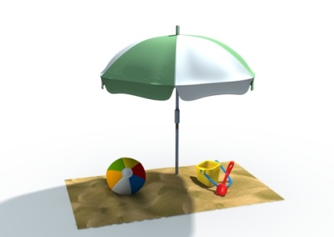

So, what do we do???
Avoid exposure to UV radiation
(stop going to the beaches)
X
Develop a novel, safe and effective formulation to prevent UV-induced skin cancer
Notes:
To find a possible alternative to the current UV protecting agents used in sunscreens:

Slide 8
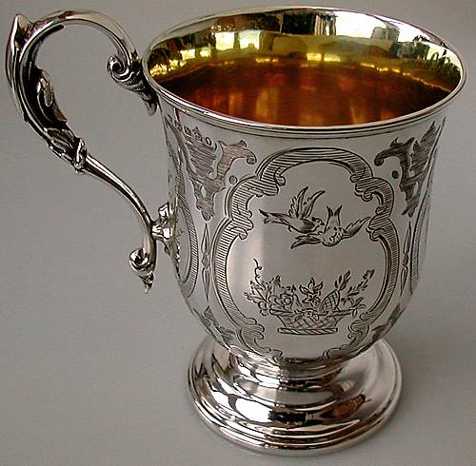
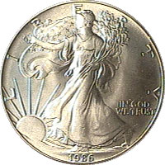
There is more to silver than its pretty shine
Silver is a known for wound healing agent since ages

Slide 9
Uses of Silver
Medicine and Health:
1884 | Crede uses 1% silver nitrate solution on neonates to prevent ocular infections.
1887 | Von Behring shows that 0.25% and 0.01% silver nitrate solution are effective against typhoid and anthrax bacilli.
1900s | Hammered foils and colloidal silver are used to treat non-healing wounds.
1920s | Colloidal silver is accepted by the FDA as a wound treatment.
1960s | Moyer and Monafo start using 0.5% silver nitrate solutions on burn wounds.
1968 | Fox introduces 1% silver sulfadiazine cream
Today | NASA uses silver to purify drinking water in space flights.
    (Tian et al., 2007; Jung et al., 2008; Elechiguerra et al., 2009 ; Eby et al., 2009)

Slide 10
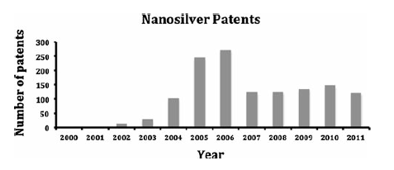
Uses of Silver Nanoparticles
30% of the nanotechnology-based products contain silver nanoparticles
Silver nanoparticles based dressings, catheters and medical devices are used in the clinics.
Household/Industry: Hair straighteners, toothbrush, toothpaste, disinfecting, pet products, sheets and pillowcases, watch chains, water taps, shower ﬁlters, baby carriages, air ﬁlters, food containers, vacuum cleaners, washing machines, clothing (socks, shirts, underwear, etc.), mouthwash, laundry detergent, shampoos, soaps, swimming pool disinfectants, carpets, curtains etc.
(Lv et al., 2009; Schluesener et al., 2013; Graff et al., 2014)
Patents
(http://www.epo.org/searching/free/espacenet.html)

Slide 11
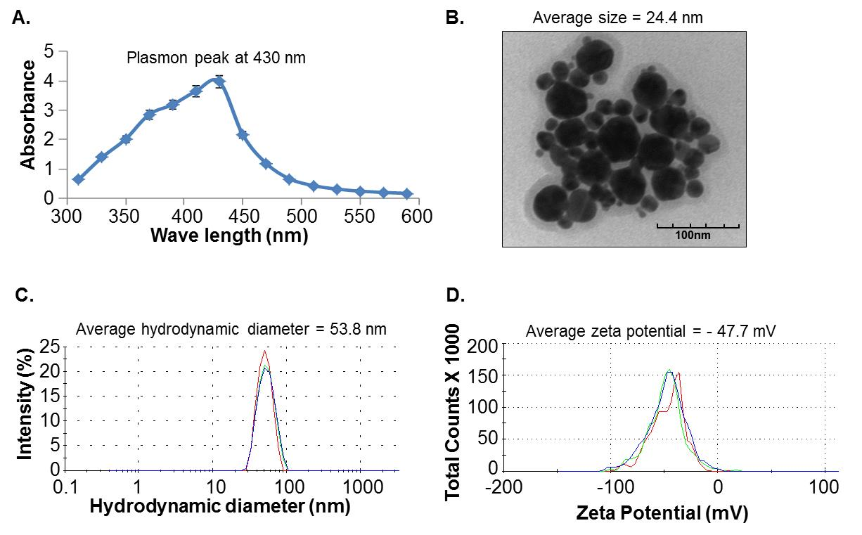
Silver Nanoparticles (AgNPs) synthesis and characterization

Slide 12
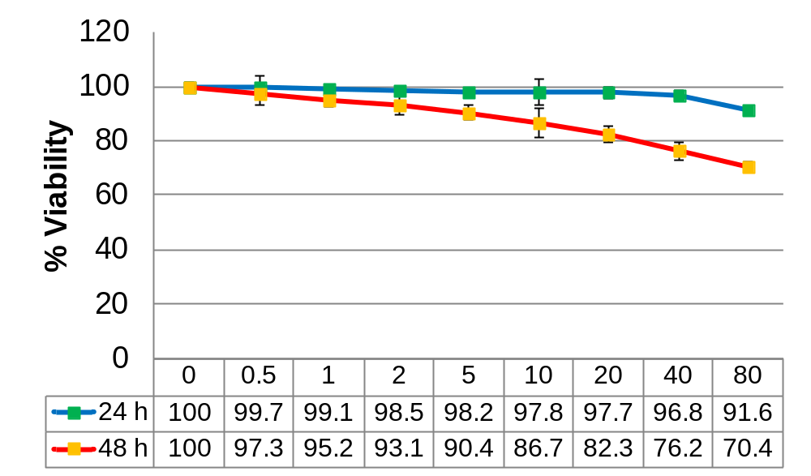
Effect of AgNPs on Cell Viability
AgNPs (μg/mL)
HaCaT: Normal immortalized human keratinocytes

Slide 13
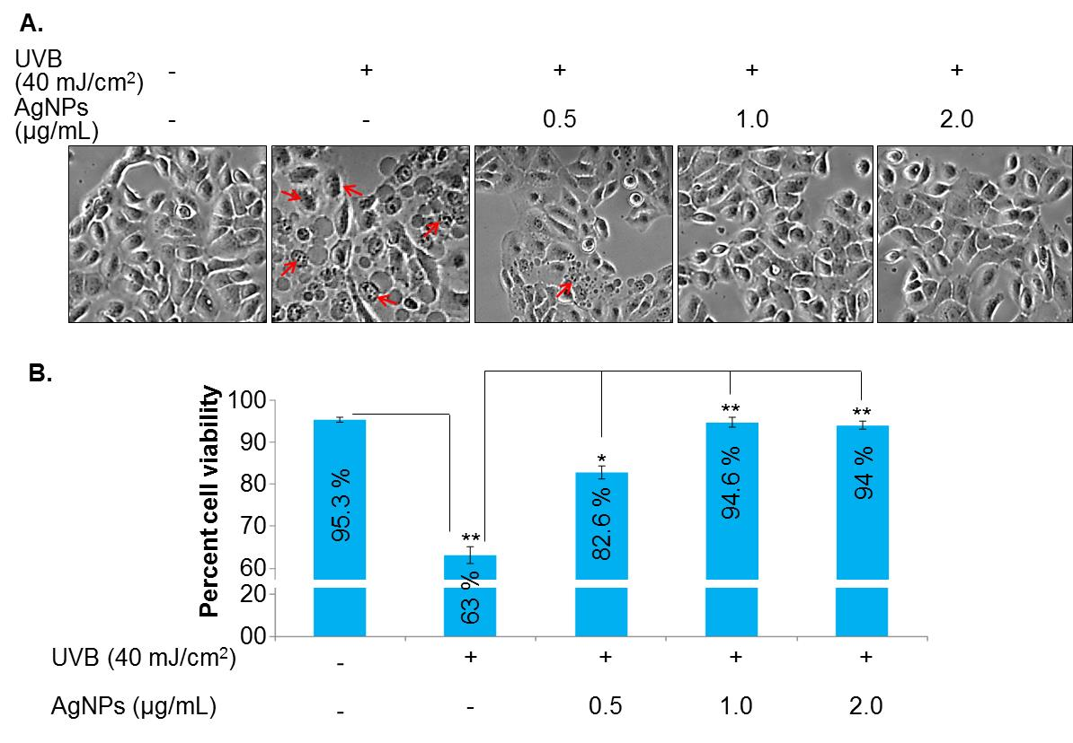
UVB-induced cell death is inhibited by silver nanoparticles

Slide 14
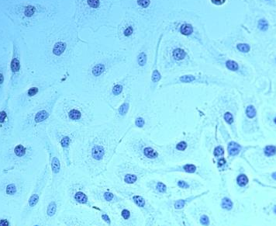
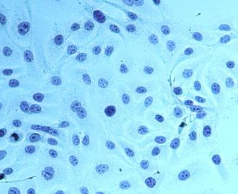
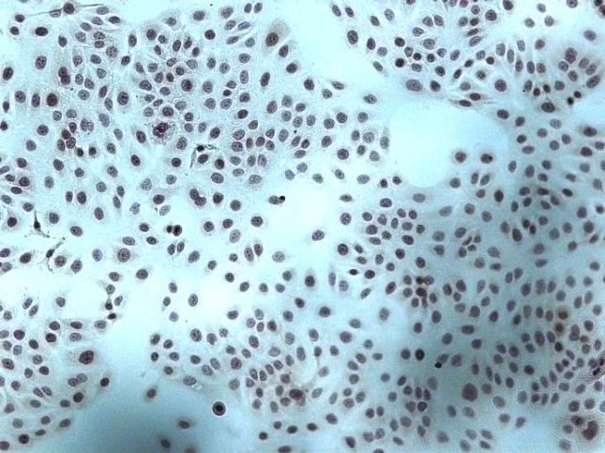
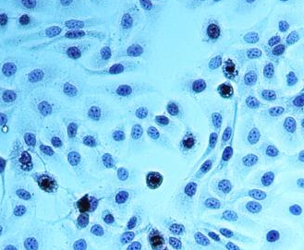
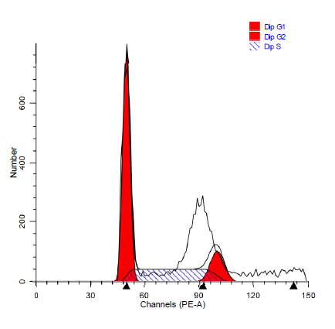
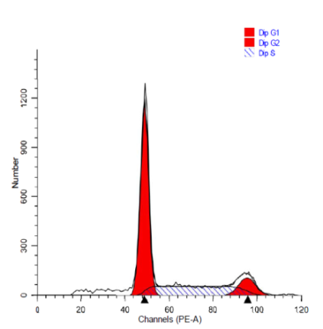
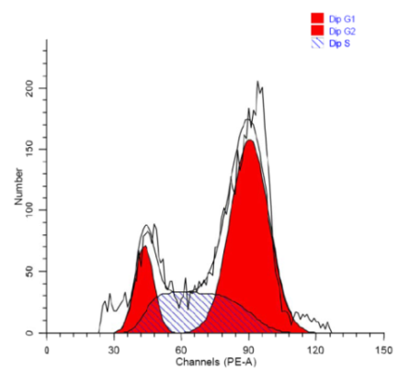
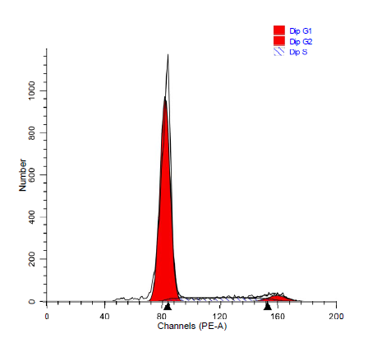
AgNPs reduce the formation and/or repair of CPDs in UVB-exposed Keratinocytes by arresting cells in G1 phase of cell cycle
UVB (40 mJ/cm²) | - | - | + | +
AgNPs (1μg/mL) | - | + | - | +
CPDs
Control AgNPs UVB AgNPs+ UVB
G1: 54.29
S: 31.32
G2: 14.38
G1: 60.96
S: 27.93
G2: 11.11
G1: 13.49
S: 26.92
G2: 59.59
G1: 81.37
S: 13.39
G2: 4.85

Slide 15
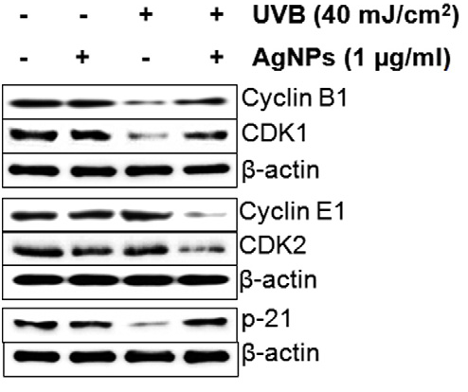
Silver nanoparticles treatment modulates the expression of cell cycle-related proteins
in human keratinocytes

Slide 16
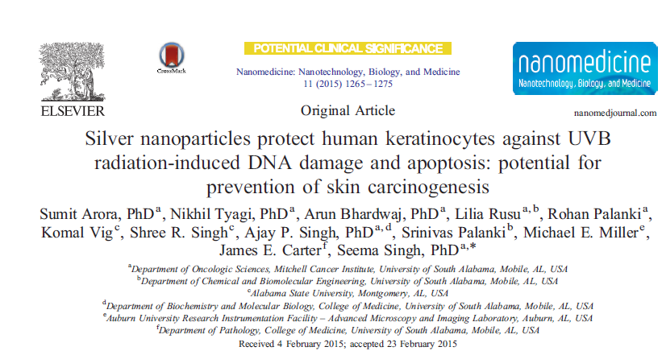
Notes:
To find a possible alternative to the current UV protecting agents used in sunscreens:

Slide 17
Comparative analysis of the protective efficacy of AgNPs, ZnONPs and TiO2NPs in human keratinocytes against UVB radiation-induced DNA damage
Notes:
To find a possible alternative to the current UV protecting agents used in sunscreens:

Slide 18
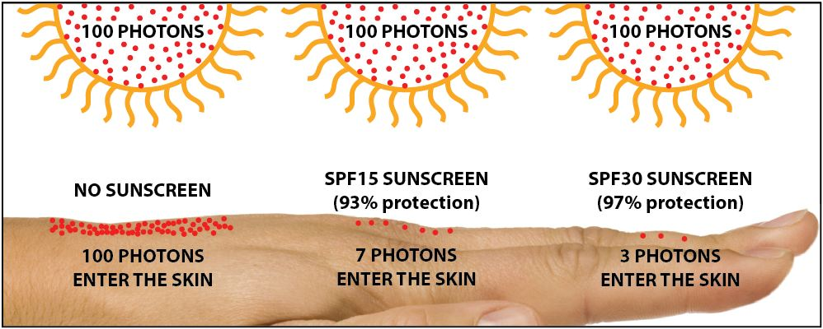
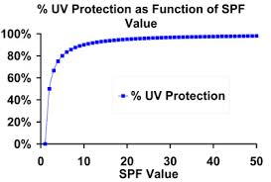
Sun Protection Factor (SPF)
SPF is a measure of a sunscreen's ability to prevent UVB from damaging the skin.
Here's how it works:
If it takes 20 minutes for your unprotected skin to start turning red, using an SPF 15 sunscreen theoretically prevents reddening 15 times longer — about five hours.
  But If you apply SPF30 sunscreen cream then it does not mean that it will provide the double protection than SPF15 sunscreen.

Slide 19

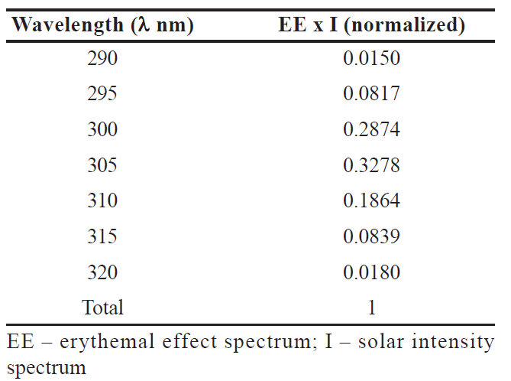
How SPF is Calculated ?
In vitro methods,
1. Absorbance:

Slide 20
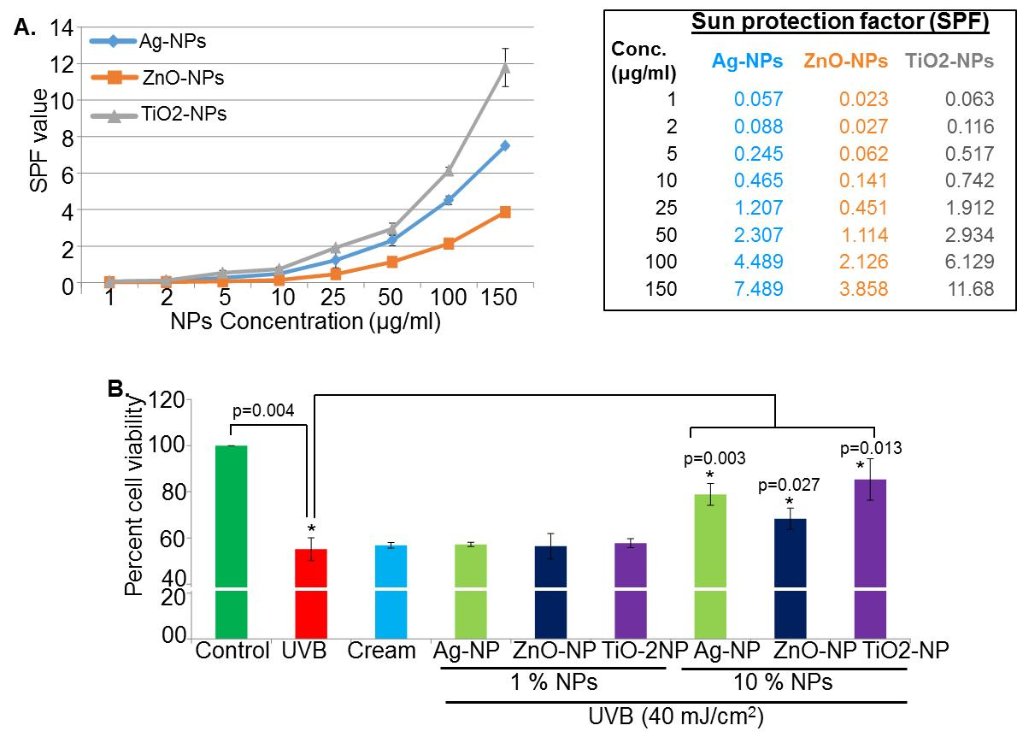
Sun Protection factor (SPF) of Zinc oxide, titanium dioxide and silver nanoparticles

Slide 21
Photoprotective efficacy of Zinc oxide, titanium dioxide and silver nanoparticles

Slide 22
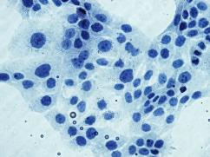
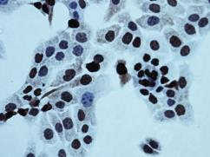
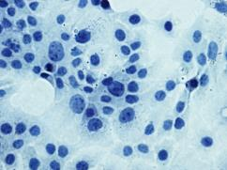
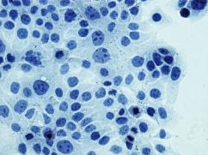
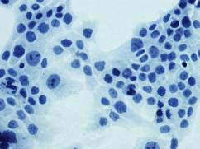
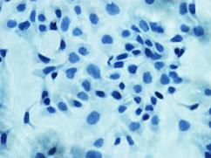
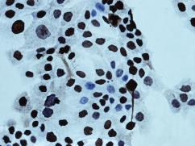
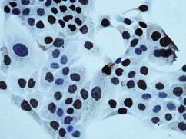
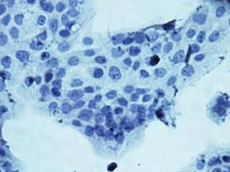
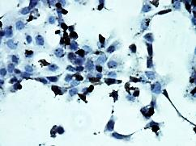
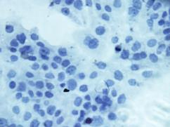
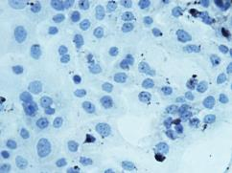
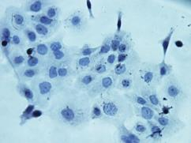
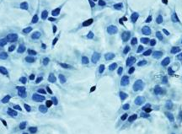
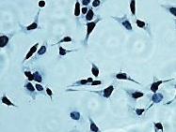
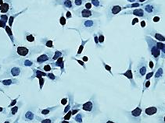
Protective efficacy of silver, zinc oxide and titanium dioxide nanoparticles against UVB-induced direct DNA damage
(-) UVB
(+) UVB
Control
UVB
Ag-NPs
ZnO-NPs
TiO-2NPs
Ag-NPs
ZnO-NPs
TiO2-NPs
CPDs
6-4-PPs

Slide 23
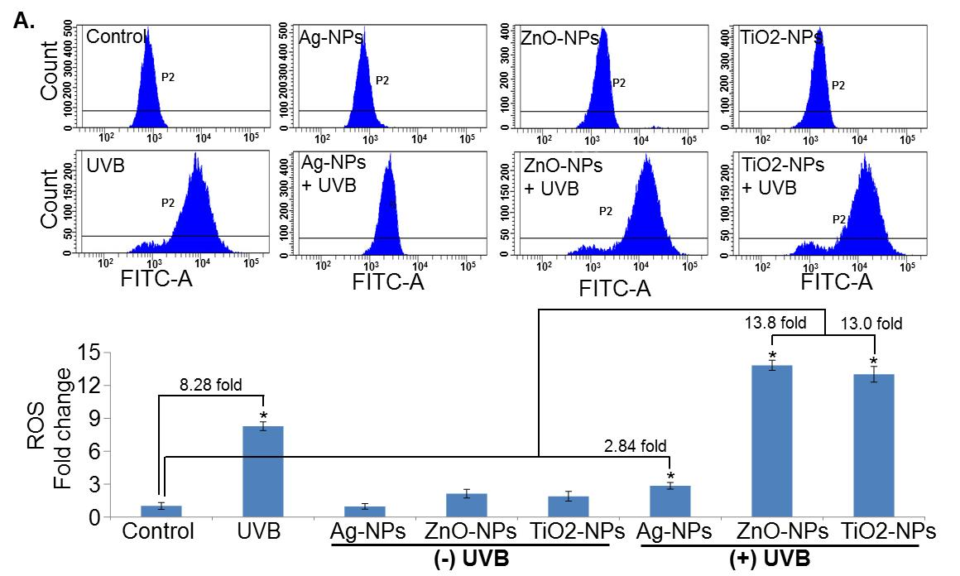
Zinc oxide and titanium dioxide nanoparticles trigger while silver nanoparticles suppress
ROS generation

Slide 24
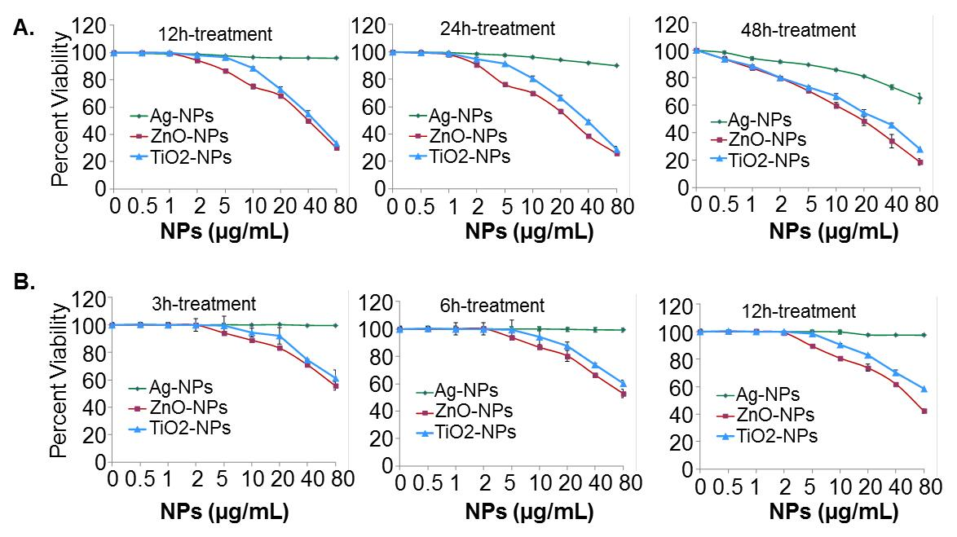
Toxicity evaluation of silver, zinc oxide and
titanium dioxide nanoparticles in
HaCaT cells
Cells were treated with nanoparticles for 12, 24 and 48 h and cell viability was measured.
Cells were pre treated with nanoparticles for 3, 6 and 12 h and cell viability was measured at 48 h.

Slide 25
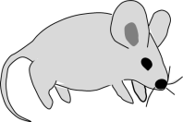
Experimental design
SKH-1 hairless
5 groups:
10 mice/group
UVB-exposure:
(180 mJ/cm²)
AgNPs:
Cream base
applied 30 min
prior to UVB
exposure
UVB irradiation:
thrice/week
Treatment:
29 weeks
Wk=29
Wk=3
Number of weeks
Wk=2
Wk=1

Slide 26
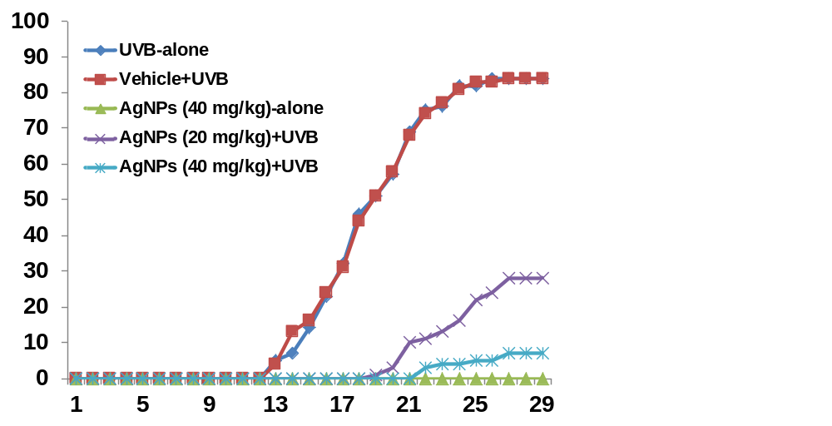
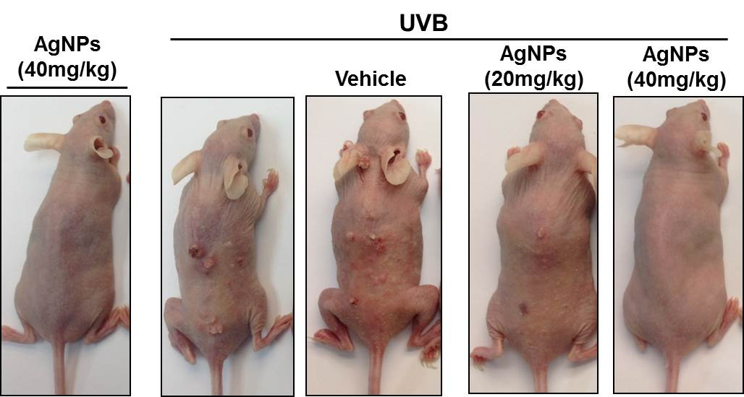
AgNPs inhibit UVB-induced skin carcinogenesis
UVB (40 mJ/cm²)
Cream base
AgNPs
(20 mg/ml)
AgNPs
(40 mg/ml)
AgNPs only
(40 mg/ml)
UVB only
Total number of tumors per group
Weeks of treatment

Slide 27
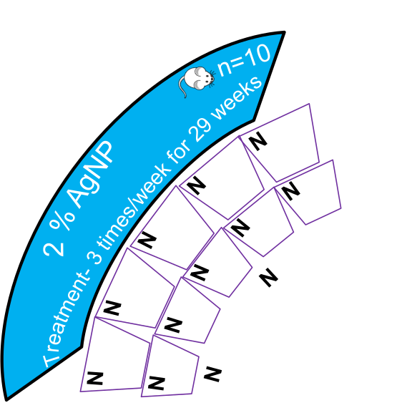
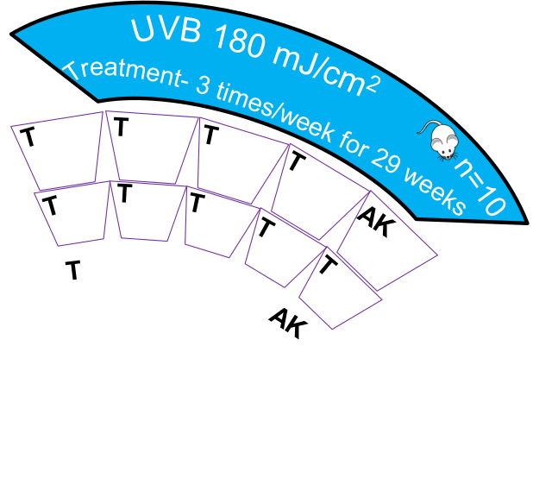
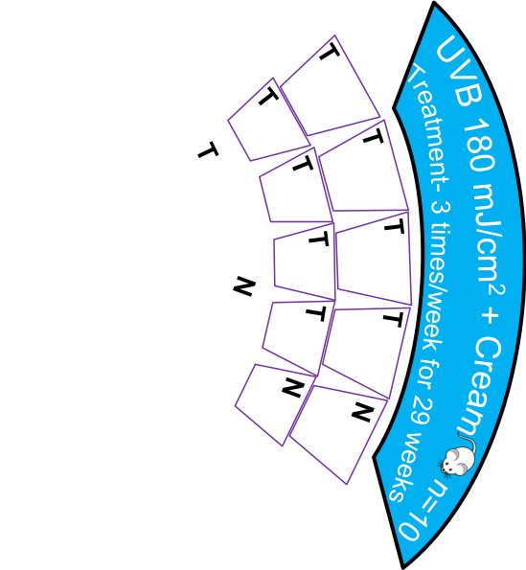
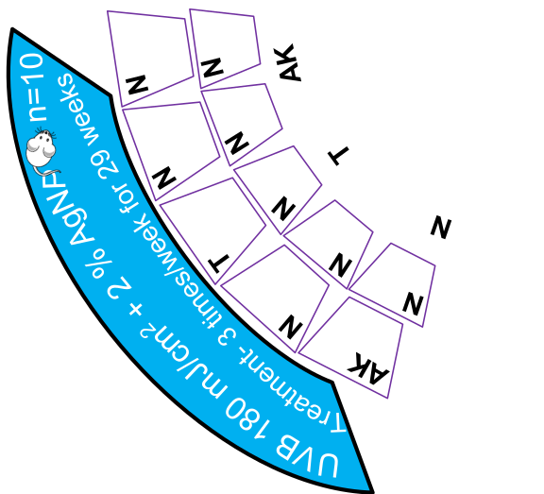
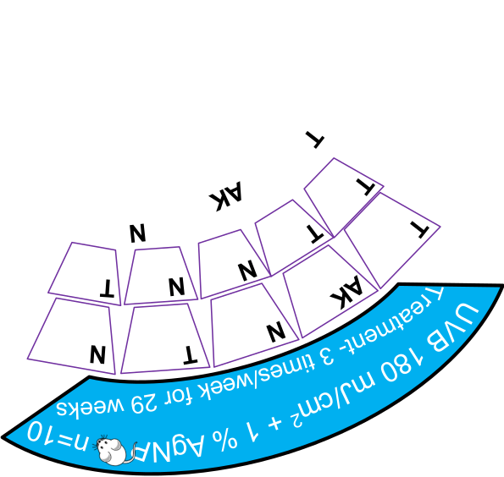
Histopathological analysis of
skin in mice
N-Normal
T-Tumor
AK-Actinic Keratosis
1. UVB only
N-0
T-9
AK-1
2. UVB + Cream
N-2
T-8
AK-0
3. UVB+ 1% AgNP
N-4
T-5
AK-1
4. UVB+ 2% AgNP
N-8
T-1
AK-1
5. 2% AgNP
N-10
T-0
AK-0

Slide 28
Summary
Pretreatment of human keratinocytes (HaCaT) with AgNPs protects the keratinocytes from UVB radiation-induced cell death
AgNPs pretreatment leads to reduced formation of cyclobutane pyrimidine dimers (CPDs) upon exposure to UVB radiation
These effects are correlated with G1 phase arrest of cell cycle
Silver nanoparticles provide protection against UVB-induced DNA damage by repairing CPDs as well as reducing the level of UVB-induced ROS. In contrast, ZnO- and TiO2-NPs failed to provide any direct protection from DNA-damage, and rather enhanced the oxidative-DNA-damage by increasing ROS production
Topical treatment of mouse skin with AgNPs prevents UVB-induced skin tumor development in terms of tumor multiplicity, tumor incidence and the growth of tumors

Slide 29
Conclusion
Silver nanoparticles can be efficiently used as novel chemopreventive agents against UVB irradiation-induced skin carcinogenesis, thus may open a door for the use of silver nanoparticle as a novel agents for human applications.

Slide 30






Acknowledgements
USA Mitchell Cancer Institute
LAB MEMBERS
USA Mitchell Cancer Institute
Dr. Nikhil Tyagi
Dr. Sachin Deshmukh
Dr. Suhash Chavva
Dr. Rajashekhar Kanchanapally
Mr. Ahmed AL Ghadhban
USAMCI Core Facility
Dr. Joel Andrews (Microscopy)
Steve McClellan (Flow cytometry)
Nikhil Tyagi, PhD
Sumit Arora, PhD
USA College of Medicine
Ajay Singh, PhD
FUNDING SUPPORT ($$$)
Elliot Carter, M.D
USAMCI & NCI/NIH

Slide 31



Slide 32


How SPF is Calculated ?
According to COLIPA and USFDA regulations,
MED-minimal erythemal dose
UV
UV
MED in sunscreen-protected skin
1 cm
1 cm
SPF =
MED in unprotected skin
1 cm
1 cm
Time consuming
Complex
Health concerns for volunteers
Sunscreen protected
(2mg/cm²)
Unprotected
COLIPA
USFDA
Boots STATR Rating
2. Transmittance:
Sunscreen Analyzer

Slide 33

Nucleotide Excision Repair (NER) Mechanism
CPDs and 6-4-PPs
Formation of DNA dimers
DNA damage
recognizing
proteins
RPA
Recognition of dimer
XPA
XPC
Helicase
XPB
XPD
Unwinding of DNA
Endonuclease
XPG
XPF
Excision of dimer
Polymerase
Gap filled by DNA polymerase

Slide 34

Nucleotide excision repair (NER) mechanism is involved in repair of CPDs and 6-4-PPs

Slide 35

Silver nanoparticles enhances the anti-oxidant capacity of HaCaT cells by increasing SOD/CAT/GPX activity to counterbalance the oxidative stress generated by UVB exposure

Slide 36
Toxicity evaluation of silver, zinc oxide and titanium dioxide nanoparticles in HaCaT cells

Slide 37
Reactive oxygen species (ROS) are chemically reactive molecules containing oxygen. Examples include peroxides, superoxide, hydroxyl radical, and singlet oxygen.
They are natural byproduct of the normal metabolism of oxygen and have important roles in cell signaling and homeostasis.
Environmental stress (e.g., UV or heat exposure) can increase ROS and may result in significant damage to cell structures. Cumulatively, this is known as oxidative stress
Under normal physiologic conditions, cells control ROS levels by balancing the generation of ROS with their elimination by scavenging system. But under oxidative stress conditions, excessive ROS can damage cellular proteins, lipids and DNA, leading to fatal lesions in cell that contribute to carcinogenesis.
Cancer cells exhibit greater ROS stress than normal cells do, partly due to oncogenic stimulation, increased metabolic activity and mitochondrial malfunction.
ROS is a double-edged sword. On one hand, at low levels, ROS facilitates cancer cell survival, on the other hand, a high level of ROS can suppress tumor growth through the sustained activation of cell-cycle inhibitor and induction of cell death.
In fact, most of the chemotherapeutic and radiotherapeutic agents kill cancer cells by augmenting ROS stress.
The ability of cancer cells to distinguish between ROS as a survival or apoptotic signal is controlled by the dosage, duration, type, and site of ROS production.
Modest levels of ROS are required for cancer cells to survive, whereas excessive levels kill them.

Slide 38
Gap 1 phase: First of four phases of the cell cycle . During G₁ phase, the cell grows in size and synthesizes mRNA and proteins (Known as histones) that are required for DNA synthesis.
During G₁ phase, the G₁/S cyclin activity rises significantly near the end of the G₁ phase.
Cyclin B is a mitotic cyclin. The amount of cyclin B (which binds to Cdk1) and the activity of the cyclin B-Cdk complex rise through the cell cycle^{[2]} until mitosis, where they fall abruptly due to degradation of cyclin B (Cdk1 is constitutively present).^{[3]} The complex of Cdk and cyclin B is called maturation promoting factor or mitosis promoting factor (MPF). Cyclin B is necessary for the progression of the cells into and out of M phase of the cell cycle.
Cyclin E binds to G₁ phase Cdk2, which is required for the transition from G₁ to S phase of the cell cycle that determines cell division. The Cyclin E/CDK2 complex phosphorylates p27^{Kip1} (an inhibitor of Cyclin D), tagging it for degradation, thus promoting expression of Cyclin A, allowing progression to S phase.
p21 is a potent cyclin-dependent kinase inhibitor (CKI). The p21 (CIP1/WAF1) protein binds to and inhibits the activity of cyclin-CDK2, -CDK1, and -CDK4/6 complexes, and thus functions as a regulator of cell cycle progression at G₁ and S phase.^{[5]} In addition to growth arrest, p21 can mediate cellular senescence. One of the ways it was discovered was as a senescent cell-derived inhibitor. The expression of this gene is tightly controlled by the tumor suppressor protein p53, can act independent of it as well.

Slide 39


