Slide 1


SHOULD THERAPEUTIC
AGENTS FOR SEPSIS TARGET THE GLYCOCALYX?
Dr. Seema Bhargava
Senior Consultant & Chairperson
Department of Biochemistry &
Professor, GRIPMER
Sir Ganga Ram Hospital
New Delhi, India
Sir Ganga Ram Hospital
New Delhi, India
Ganga Ram Institute of Postgraduate Medical Education and Research

Slide 2
Systemic Inflammatory Response Syndrome (SIRS)/Sepsis
ACCP/SCCM Consensus Conference (1992) Crit Care Med 1992; 20:864–874
Definitions for sepsis and organ failure and guidelines for the use of innovative therapies in sepsis.
  Criteria for Dx of SIRS
  Core temperature >38.3°C / <36°C
  Heart rate >90 bpm / >2SD
  Respiratory rate >30 bpm
  or
  PaCO2 <32 mm Hg
  WBC count >12,000 cells/mm³
  or
  <4,000 cells/mm³
  or
  >10% immature neutrophils
Burns
Pancreatitis
INFECTION
SIRS
Trauma
Other
Sepsis
=
Known or suspected infection
+
≥2 SIRS criteria

Slide 3

SIRS, Sepsis, Severe Sepsis and Septic shock
Severe Sepsis
Sepsis + ≥1 organ dysfunction
Septic Shock
Severe Sepsis
+
Hypotension despite fluid resuscitation
Other
Pancreatitis
INFECTION
SIRS
Trauma
Burns
ACCP/SCCM Consensus Conference (1992)
Definitions for sepsis and organ failure and guidelines for the use of innovative therapies in sepsis. Crit Care Med 1992; 20:864–874
Notes:
The organ systems affected commonly include the heart, kidneys, lungs, liver, central nervous system, and coagulation system. The consequences are myocardial dysfunction, acute renal failure, adult respiratory distress syndrome, hepatic failure, and disseminated intravascular coagulation.

Slide 4
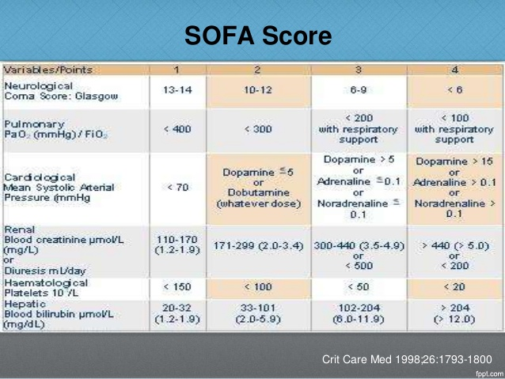

Slide 5
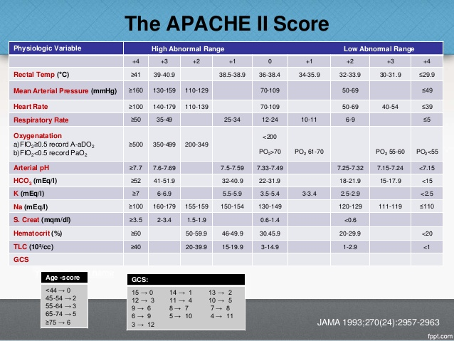

Slide 6
Dilemmas in sepsis
Early diagnosis
Segregation into sepsis and SIRS
Differentiation between sepsis, severe sepsis and
septic shock
Prognosis
Increased morbidity and mortality
Refractory hypotension and organ failure

Slide 7
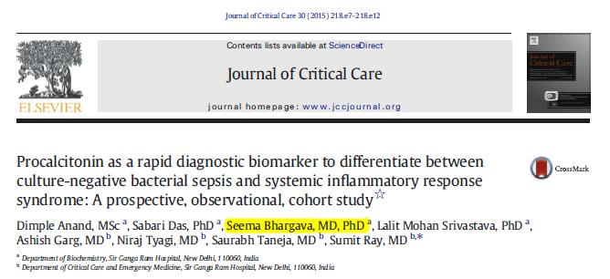
Publication
Impact Factor: 2.5
Salient findings:
PCT differentiates culture-negative sepsis from SIRS at a cut off of 1.43
ng/ml, with 92% sensitivity and 83% negative predictive value (AUC 0.892)
PCT differentiates culture-positive sepsis from SIRS at a cut off of 2.49
ng/ml, with 94.4% sensitivity and 91.5% negative predictive value (AUC 0.959)

Slide 8
Next Question
Identification of a marker or markers to effectively differentiate between sepsis, severe sepsis and septic shock
HOW?
Pathophysiology of sepsis
Disruption of the glycocalyx is a known event

Slide 9



The Glycocalyx
Basement membrane
Endothelial cell lining
Phospholipid bilayer of endothelial cell
Glycocalyx with its comprising components in a latticework
Blood vessel with its vessel wall and blood components
TNFα
IL-10

Slide 10
The Glycocalyx
Basement membrane
Endothelial cell lining
Phospholipid bilayer of endothelial cell
Glycocalyx with its comprising components in a latticework
Blood vessel with its vessel wall and blood components
TNFα
IL-10

Slide 11
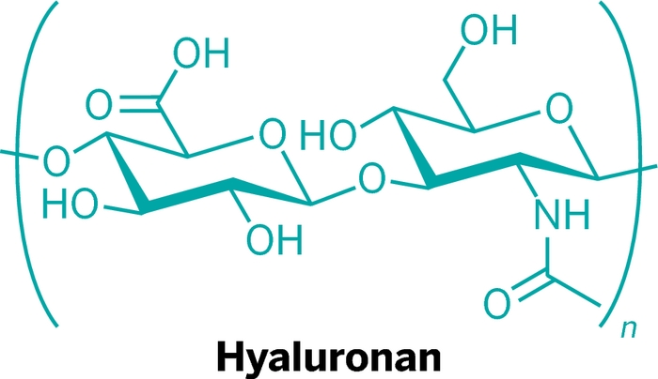
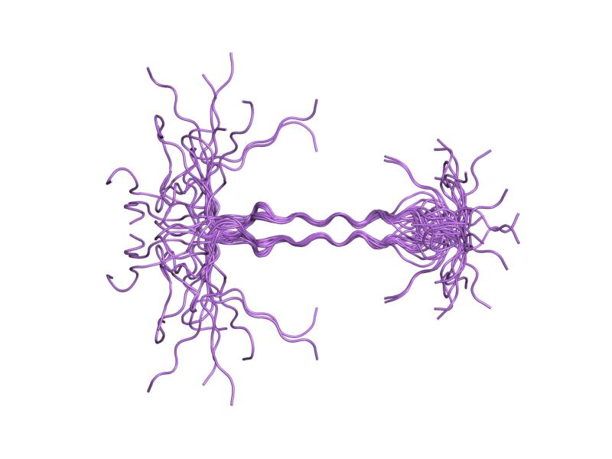
Hyaluronan & Syndecan
Glycocalyx components
Syndecan
Widely distributed anionic non-sulphated GAG
Single transmembrane domain GAG
G-protein coupled receptors

Slide 12
Study Objectives
1.To study the evolution of hyaluronan and syndecan (glycocalyx components) as prognostic markers for sepsis
2. To correlate their serum levels with
Progression of disease
Survival status
Organ failure
Inflammatory mediators

Slide 13
Methods: Inclusion & Exclusion criteria
Inclusion Criteria
  Age ≥18 years
  Patients admitted to the intensive care unit with community acquired Sepsis, Severe sepsis or Septic shock
Exclusion Criteria
  Post-operative patients
  Lethal condition
  Malignancy
  Immunocompromised
  Transferred from other ICU’s
Notes:
For eligibility central subfield thickness on OCT must be:
Zeiss Stratus: ≥250;
Zeiss Cirrus and Optovue RTVue: Men ≥305; Women ≥290;
Heidelberg Spectralis: Men ≥ 320; Women ≥305

Slide 14
Methodology
  Days 1,3,5, and 7 Blood drawn from all subjects Following analytes estimated in serum:
  Hyaluronan- Competitive Enzyme Linked Immunosorbent Assay (Teco Medical, Switzerland)
  Syndecan- Solid Phase Sandwich Elisa
  (Diaclone, Besancom Cedex, France)
  TNF-α - Chemiluminescent Immunoasasy (Immulite, Siemens)
  Interleukin-10 - Solid Phase Sandwich Elisa
  (Diaclone, Besancom Cedex, France)
  SOFA and APACHE II scores

Slide 15
RESULTS

Slide 16
Patient baseline characteristics
 | Sepsis (N = 15) | Severe Sepsis (N = 45) | Septic Shock (N = 90) | p Value
Age, Mean + S.D | 52.2 + 16.3 | 53.4 + 16 | 54 + 16.5 | ns
Gender (M/F) | 8/7 | 27/18 | 56/34 | ns
Mortality– N (%) | 1 (6.66%) | 6 (13.3%) | 34 (37.7%) | 0.002
APACHE II Mean + S.D. | 9 + 6.2 | 20.1 + 7.0 | 25.1 + 7.4 | 0.004
SOFA SCORE Mean + S.D. | 4.8 + 2.1 | 8.5 + 3.7 | 12.1 + 3.5 | <0.001
Notes:
*Missing Hemoglobin A1c data: aflibercept (5) and ranibizumab (1).
†Severe hemorrhage includes hemoptysis, epistaxis, gastrointestinal bleeding, or vaginal bleeding.
‡Each participant value was a result of 3 sets of measurements yielding 3 mean arterial blood pressure values [diastolic + 1/3(systolic-diastolic)] averaged together for a single participant value.
§Missing Albumin/Creatinine data: aflibercept (3), bevacizumab (1), ranibizumab (2).
ǁMissing body mass index data: aflibercept (17), bevacizumab (22), and ranibizumab (23).

Slide 18
DAY 1
DAY 3
DAY 5
DAY 7

Slide 23
Receiver Operating Characteristic Curve
Notes:
All baseline and 1-year optical coherence tomography (OCT) scans were graded by Duke Reading Center. In addition, a random sample of OCT images from other visits and images for which the investigator believed central grading was needed also were graded by Duke Reading Center.
In addition to participants missing the 1-year visit, 3 in the aflibercept group, 3 in the bevacizumab group, and 5 in the ranibizumab group had 1-year visits but unusable OCT data to compute change due to the scan being missing or ungradable at either baseline or 1 year.
Baseline CSF values were converted from the thickness value measured on a Spectralis or Cirrus OCT machine to a Stratus equivalent value for 583 scans. One-year CSF values were converted from a thickness value measured on a Spectralis or Cirrus OCT machine to a Stratus equivalent value for 604 scans. When calculating change in CSF thickness, measurements taken on the same machine at both visits were not converted, since the conversion equation slope is nearly 1 and the constant difference does not affect the change calculation. Therefore, change in CSF thickness was calculated after converting either the baseline and/or follow-up thickness value from Spectralis or Cirrus to a Stratus equivalent value in 26 eyes.
Treatment group comparison results are from ANCOVA on observed data, adjusted for continuous baseline visual acuity and continuous baseline CSF or from Poisson regression models with robust variance estimation using identity link,4 adjusted for categorical baseline visual acuity and categorical baseline CSF. Reported P-values have been adjusted for multiple treatment group comparisons to account for an overall Type 1 error rate of 0.049 (see Hochberg for computation of the Hochberg-adjusted P-values²) and corresponding (1-α/i)*100% confidence intervals were reported, where i is the rank (1, 2, or 3) of the Hochberg-adjusted P-value from among the descending ordered raw pairwise P-values. This could result in identical P-values for all three pairwise comparisons.
Tests for treatment group interaction with baseline visual acuity from ANCOVA model for mean change in visual acuity adjusted for baseline visual acuity and continuous baseline CSF:
- P-value for interaction, treating baseline visual acuity as continuous = <0.001.
- P-value for interaction, treating baseline visual acuity as categorical (<69 versus >69) = <0.001.

Slide 24
Receiver Operating Characterstics of Hyaluronan
Survivors vs Non-Survivors
Days | Variable | Cut Off | Sensitivity % | Specificity % | PPV % | NPV%
Day 1 | 220 | 0.573 (0.47-0.67) | 73 | 44 | 33 | 81.3
Day 3 | 344 | 0.671 (0.55-0.79) | 64 | 71.3 | 47 | 84
Day 5 | 321 | 0.720 (0.61-0.82) | 71 | 76 | 49.02 | 89.13
Day 7 | 441 | 0.827 (0.73-0.91) | 61 | 90 | 62 | 90

Slide 25
Receiver Operating Characterstics of Syndecan
Survivors vs Non-Survivors
Days | AUC | Cut Off | Sensitivity% | Specificity% | PPV % | NPV %
Day 1 | 625 | 0.644 (0.54-0.74) | 56 | 71 | 42 | 81
Day 3 | 389 | 0.756 (0.66-0.84) | 85.4 | 55 | 41.7 | 91
Day 5 | 898 | 0.801 (0.71-0.98) | 52.9 | 94 | 72 | 86.3
Day 7 | 455 | 0.751 (0.621-0.881) | 59 | 86 | 48.1 | 91

Slide 26
Hyaluronan: Association with Mortality, Organ Dysfunction scores and inflammatory markers at all Time-points
Hyaluronan | Day 1 | Day 3 | Day 5 | Day 7
APACHE II | r=0.387 p<0.001
SOFA | r=0.387 p<0.001 | r=0.406 p<0.001 | r=0.327 p<0.001 | r=0.289 p=0.002
TNF- α | r=0.338 p=0.001 | r=0.341 p=0.002 | r=0.258 p=0.043 | r=0.256 p=0.033
IL-10 | r=0.232 p=0.032 | r=0.264 p=0.017 | r=0.260 p=0.023 | r=0.256 p=0.049

Slide 27
Syndecan: Association with Mortality, Organ Dysfunction scores and inflammatory markers at all Time-points
Syndecan | Day 1 | Day 3 | Day 5 | Day 7
APACHE II | r=0.294 p<0.001
SOFA | r=0.437 p<0.001 | r=0.354 p=0.003 | r=0.494 p<0.001 | r=0.217 p=0.026
TNF- α | r=0.234 p=0.029 | r=0.321 p=0.010 | r=0.382 p=0.001 | p=ns
IL-10 | r=0.215 p=0.05 | r=0.229 p=0.050 | r=0.354 p=0.004 | r=0.266 p=0.044

Slide 28
Summary
Serum levels of Hyaluronan and Syndecan
Both markers show a significant positive correlation with –
Organ dysfunction
Mortality scores
Pro- & Anti-inflammatory
markers
Serum levels on admission categorize the patient into sepsis, severe sepsis and septic shock
Serial measurements
differentiate survivors from
non-survivors with the following:
 | Cut-off | Specificity | NPV
H | 441 ng/ml | 90% | 90%
S | 898 ng/ml | 94% | 86%

Slide 29
Conclusions
Glycocalyx components [hyaluronan and syndecan]
could be used for diagnosis i.e. to differentiate
between sepsis, severe sepsis and septic shock.
Hyaluronan and syndecan could also be used for prognosis i.e. to identify survivors and non-survivors.
Required: Further multicentric studies on these as
well as other glycocalyx components to demonstrate
comparative clinical utility of these markers. Also
this would give further direction as to the usefulness
of therapy targetting these markers

Slide 30
Acknowledgements
Ms Dimple Anand PhD student
Dr. Sumit Ray Critical Care Intensivist
Patients Enrolled subjects
ICMR [Indian Council of Medical Research] for funding the project

Slide 31
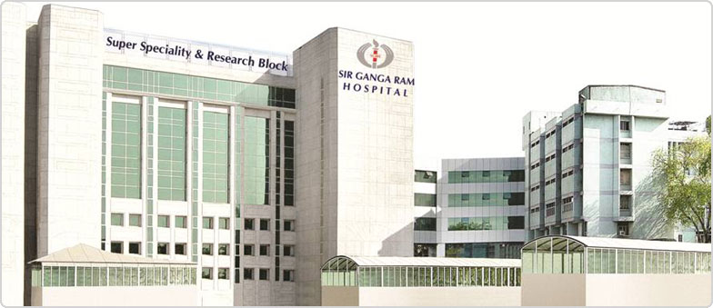
THANK YOU

