Slide 1
Treatment With Pioglitazone, A Thiazolidinedione Insulin Sensitizer, and/or β-carotene and Diet Control Ameliorate Liver Function and Metabolic Markers in Hyperlipidemic Rats
Prof. Sayed H. Seif el-Din
Pharmacology Department
Theodor Bilharz Research Institute

Slide 2


Slide 3
Definition
Nonalcoholic fatty liver disease (NAFLD)
(a) there is evidence of fat accumulation in the liver (>5-10%), steatosis, either by imaging or by histology.
(b) there are no causes for secondary hepatic fat accumulation such as significant alcohol consumption, use of steatogenic medication or hereditary disorders.
NAFLD is histologically further categorized into:
Nonalcoholic fatty liver (NAFL).
Nonalcoholic steatohepatitis (NASH).
Notes:
NAFL: is defined as the presence of hepatic steatosis with no evidence of hepatocellular injury in the form of ballooning of the hepatocytes. NASH: is defined as the presence of hepatic steatosis and inflammation with hepatocyte injury (ballooning) with or without fibrosis.

Slide 4
According to NAFLD
Normal healthy liver tissue becomes replaced with unhealthy fats, so that less healthy liver tissue remains.
The fatty liver is often enlarged & swollen with fat, which gives it a yellow greasy appearance.
Fatty liver is a very serious epidemic – it can lead to obesity, diabetes, cirrhosis & liver failure.
It produces symptoms which greatly reduce quality of life.
It is the most common disease & the greatest cause of liver transplant.
If detected in early to medium stage, it responds very well to correct treatment & is reversible.

Slide 5
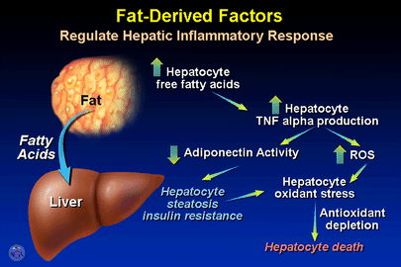
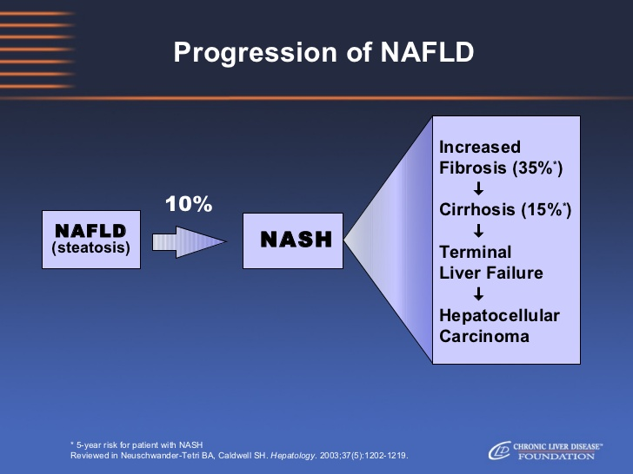
NAFLD Spectrum
Cytokines/adipokines
NASH and/or fibrosis/cirrhosis
1st hit
FFA TG
Steatosis
2nd hit
Mitochondrial dysfunction
NAFLD & IR
Oxidative stress
Notes:
Steatosis represents the ‘first hit’, which then sensitizes the liver to injury mediated by ‘second hits’

Slide 6
How to Treat NAFLD
βC
Statins & Fibrates
Antihyperlipidemics
Insulin sensitizers
Met & TZDs (Tro-Ros-Pio)
Vitamins E & C
Antioxidants
Hepatoprotectives
Betaine-UDC-PTX
Cytokines/adipokines
NASH and/or fibrosis/cirrhosis
FFA TG
Steatosis
2nd hit
Mitochondrial dysfunction
1st hit
NAFLD & IR
Oxidative stress
Diet & Exercise
Lifestyle
Weight Loss
3-5% & >10%
Notes:
Weight loss generally reduces hepatic steatosis, achieved either by hypo-caloric diet alone or in conjunction with increased physical activity. Loss of at least 3-5% of body weight appears necessary to improve steatosis, but a greater weight loss (up to 10%) may be needed to improve necroinflammation.

Slide 7
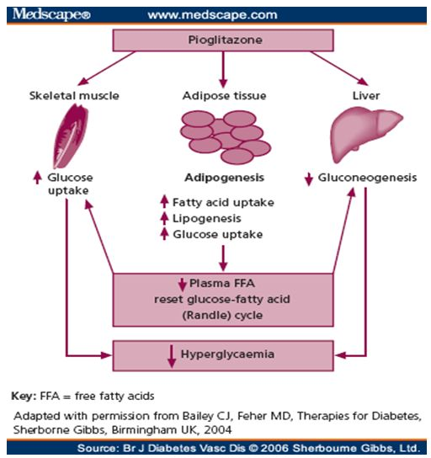
TZDs (Glitazones): MOA
Rosiglitazone Pioglitazone
They are selective agonists of PPAR-γ that:
Activate insulin responsive genes.
Regulate carbohydrate & lipid metabolism in peripheral tissues and liver.
TZDs exert effects on muscle/liver cells to ↑ insulin sensitivity and ↓ plasma glucose.
TZDs ↑ lipogenesis in adipocyte thus ↓ FFA & TG.
TZDs ↑ subcutaneous adipose tissue mass and body weight.
Notes:
TZDs are insulin sensetizing agents that reduce IR and enhance the biological response to endogenously produced insulin.
TZDs increase lipogenesis in adipocyte thus lowering serum FFA & TG levels.
TZDs exert effects on muscle/liver cells to ↑ insulin sensitivity and ↓ plasma glucose.
TZDs increase subcutaneous adipose tissue mass and body weight.

Slide 8
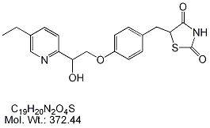
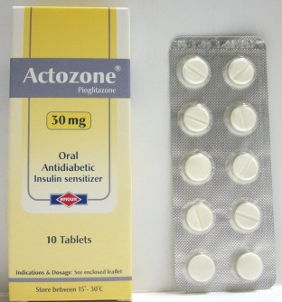
Pioglitazone (PGZ)
It is the currently available PPAR-γ agonist.
PGZ was found to promote the distribution of fats from the liver and muscle cells to adipocytes.
Consequently, PGZ ↓ circulating FFA concentrations in the liver and thus restore insulin sensitivity.
Notes:
Troglitazone and rosiglitazone were drawn from the market by FDA because their bad adverse effects on the heart.

Slide 9
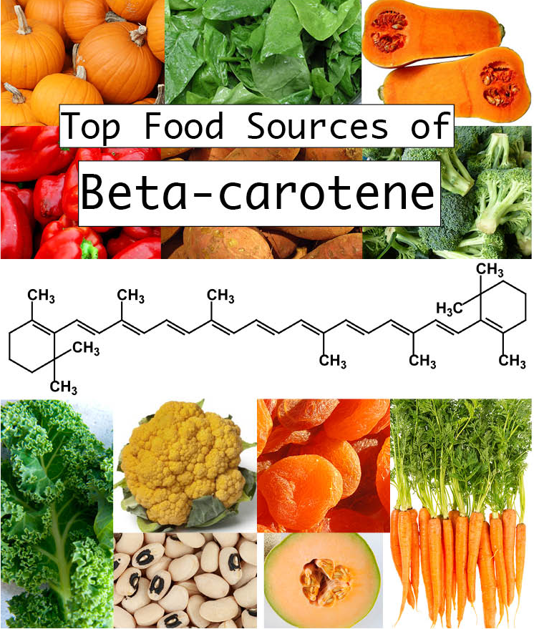

β-carotene (βC)
It is a lipid-soluble antioxidant.
It is function as a precursor of vitamin A.
It has a direct impact on cholesterol synthesis.
βC protect organisms against oxidative stress (OS), consequently, preventing damages and tissue lesions related to several chronic diseases.

Slide 10
Aim of the Study
To evaluate whether the addition of βC as a supplement to PGZ could improve NAFLD and prevent its progression in rats subjected to different lifestyles.

Slide 11

Methods
PGZ
10 mg/kg 5d/wk/4 wks
PGZ+βC
NAFLD-RD
12 + 4 wks tt
PGZ
10 mg/kg 5d/wk/4 wks
βC
70 mg/kg for 4 wks
βC
70 mg/kg for 4 wks
PGZ+βC
Normal control
NAFLD-HFD
16 wks (4 wks tt)

Slide 12
Parameters assessed
Hepatic growth manifestations
Body weight, liver weight & index.
Biochemical assays
Liver function: AST, ALT, ALP and GGT.
Lipid profile: TG, TC, HDL, LDL and VLDL.
Adipocytokines: Leptin, Adeponectin, TNF-α and TGF-β.
Oxidative stress markers
GSH, SOD and MDA.
Histopathological examinations
H&E liver sections.

Slide 13
Results

Slide 14
Table 1: Effect of pioglitazone alone and in combination with β-carotene on liver gross manifestations in NAFLD-induced rats.
 |  | Body weight | Liver weight | Liver weight index (%)
 | Normal control | 175.5±13.9 | 5.00±0.61 | 2.85±0.11
HFD | NAFLD Control | 239.41±12.83ª | 12.86±0.92ª | 5.40±0.52 ª
 | PGZ | 194.13±10.2^{b} | 12.95±1.02ª | 6.70±0.92^{ab}
 | βC | 148.11±11.49^{b} | 7.59±0.87^{ab} | 5.12±0.61ª
 | PGZ+βC | 134.25±4.42^{bc} | 10.15±0.56^{ab} | 7.60±0.42^{ab}
RD | NAFLD Control | 195.64±16.85 | 6.98±0.69 | 3.57±0.32
 | PGZ | 220.25 ±13.39ª | 7.98±2.82ª | 3.63±0.13
 | βC | 145.35±15.22^{b} | 5.11±0.15 | 3.52±0.51
 | PGZ+βC | 139.75±9.47^{bc} | 5.80±0.48 | 4.23±0.32
Values are presented as mean ± SEM (n = 8).
ª Significant difference from normal at P<0.05.
^{b} Significant difference from corresponding NAFLD control at P<0.05.
^{c} Significant difference from corresponding PGZ at P<0.05.

Slide 15
Effect of pioglitazone alone and in combination with β-carotene on liver functions in NAFLD-induced rats.
Values are presented as mean ± SEM (n = 8).
ª Significant difference from normal at P<0.05.
^{b} Significant difference from corresponding NAFLD control at P<0.05.

Slide 16
Effect of pioglitazone alone and in combination with β-carotene on lipid profile in NAFLD-induced rats.
Values are presented as mean ± SEM (n = 8).
ª Significant difference from normal at P<0.05.
^{b} Significant difference from corresponding NAFLD control at P<0.05.
^{c} Significant difference from corresponding PGZ at P<0.05.

Slide 17
Effect of pioglitazone alone and in combination with β-carotene on adipocytokine markers in NAFLD-induced rats.
Values are presented as mean ± SEM, (n = 8).
ª Significant difference from normal at P<0.05.
^{b} Significant difference from corresponding NAFLD control at P<0.05.

Slide 18
Effect of pioglitazone alone and in combination with β-carotene on oxidative stress parameters in NAFLD-induced rats.
Values are presented as mean ± SEM (n = 8).
ª Significant difference from normal at P<0.05.
^{b} Significant difference from corresponding NAFLD control at P<0.05.

Slide 19
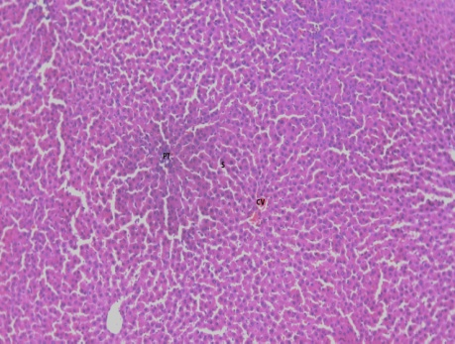
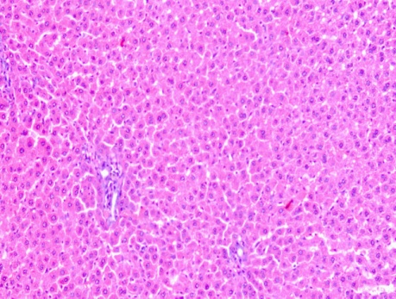
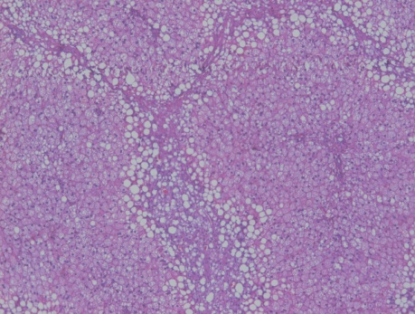
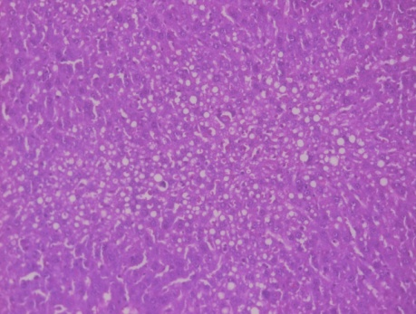
Histopathological examinations
Normal x100
Normal x200
A
B
NAFLD-HFD x200
NAFLD-RD x200
C
D

Slide 20
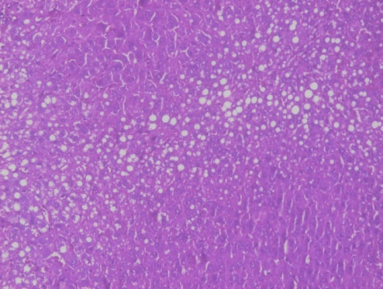
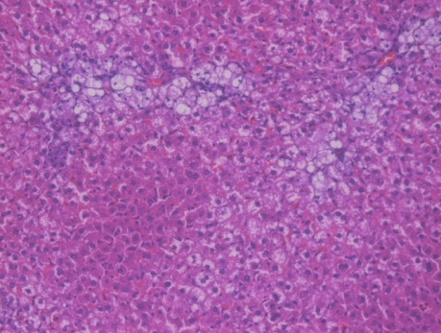
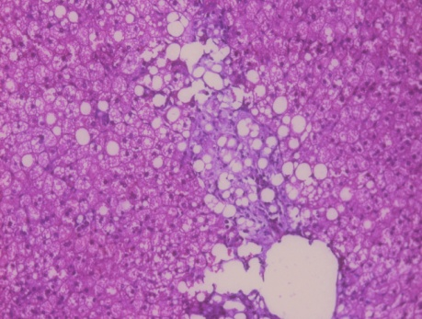
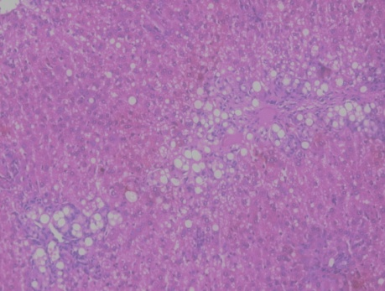
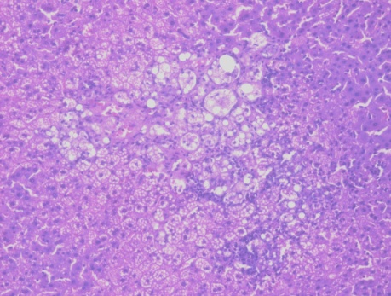
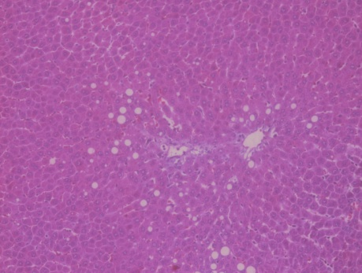
Histopathological examinations
PGZ-HFD x200
PGZ-RD x200
E
F
βC-HFD x200
βC-RD x200
G
H
PGZ+βC-HFD x200
PGZ+βC-RD x200
I
J

Slide 21
CONCLUSION

Slide 22
Conclusion
As hypertriglyceridemia and hypercholesterolemia coupled with IR is often associated with NAFLD, hence using the effective insulin sensitizer PGZ in its management is recommended.
Weight loss through dietary control is one of the most effective therapeutic strategies and is the first step in NAFLD management .
Administration of PGZ and/or βC almost improves all NAFLD-related biochemical disturbances. Moreover, hepatic steatosis was decreased and inflammation markedly ameliorated with reduction of TNF-α and TGF-β.

Slide 23
Conclusion
βC recognized as the most potent retinol precursor and provitamin A, which responsible for most of its antioxidative and pharmacological effects. Accordingly, the combined administration of PGZ and βC in this study has an enhancement effect in modulating the biochemical and histological markers related to NAFLD disease compared to each drug alone.
Combined treatment with PGZ and βC has a modulating effect on the extent of fatty infiltration and on lipid peroxidation compared with each drug alone.
PGZ and βC could be beneficial for the treatment and prevention of NAFLD.

Slide 24
Acknowledgements
Naglaa M. El-Lakkany | Pharmacology Dept. TBRI.
Fatma A. Ebeid | Pharmacology Dept. TBRI.
Abeer A. Al-Nagar | Pharmacology Dept. TBRI.
Olfat A. Hammam | Pathology Dept. TBRI.
Hekma A. Abdel-Latif | Pharmacology Dept. Cairo University.
Afaf A. Ain-Shoka | Pharmacology Dept. Cairo University.

Slide 25
THANK YOU

Slide 26
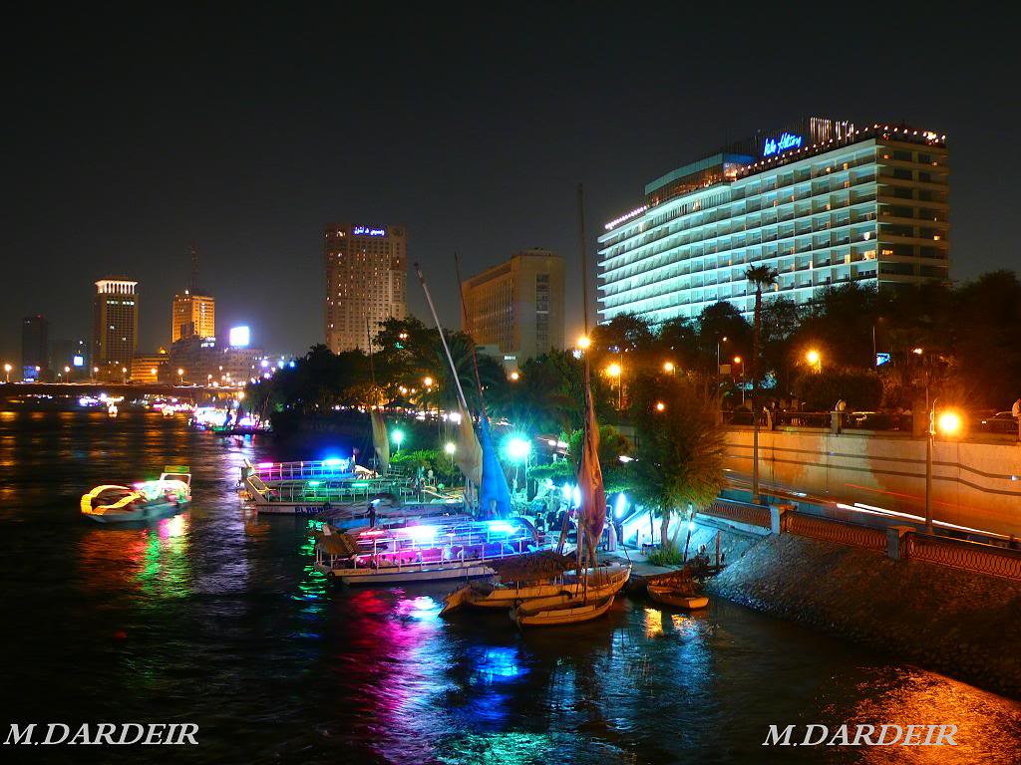
Nile river and Cairo by night

