Slide 1

Percutaneous Image Guided Lumbar Decompression: An Innovative Treatment for LSS
Sayed Emal Wahezi, MD
Program Director, Pain Fellowship
Department of Rehabilitation Medicine
Department of Anesthesia
Montefiore Medical Center

Slide 2
Disclosures
None

Slide 3
mild® = PILD
For the purposes of this talk mild® will be referred to as PILD
mild® is a percutaneous lumbar decompression tool kit produced by Vertos® medical
PILD acronym for Percutaneous Image Guided Lumbar Decompression coined by CMS

Slide 4
Goals
Understand Lumbar Spinal Stenosis
  Clinical
  Economics
Understand future of Interventional Pain Management
  Cost
    Open surgery
    Percutaneous
  Medicare Initiatives for Device Investigation
    Coverage with Evidence Development (CED)

Slide 5
Introduction
Introduce LSS
  Clinical
    Treatment Options
      Medication
      Physiotherapy
      ESI
      Surgery
  LSS Epidemiology
Treatment Gap
  Patients who have failed conservative therapy
  Patients who do not want surgery
  Patients who cannot have surgery
PILD
  Technical Aspects
  Research
  History
    Past
    Present
    Future
Wrap-up
  MiDAS ENCORE

Slide 6
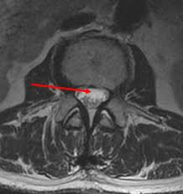
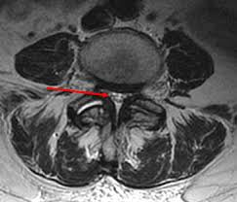
Lumbar Spinal Stenosis
Clinical Diagnosis
  Walking Intolerance
  Standing Intolerance
  Improved with rest
  Improved with mild truncal flexion
  Must have Imaging Correlates
    MRI
    CT
      Listhesis
      Hypertrophic Facets
      Short Pedicles
      Disc bugle
      Ligamentum Flavum Hypertrophy
        >90% of patients

Slide 7
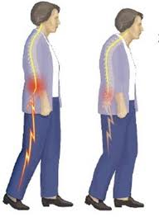
Lumbar Spinal Stenosis
Most commonly seen in patients > 50 y/o
Growing epidemic in US because of aging population
  ‘Baby Boomers’ are reaching geriatric age.
Incidence is 8-11% of the US population
1.3 million patients in active treatment
Estimated 2.4million affected Americans by 2021
Most patients undergo surgery in their 6th and 7th decades of life
80% improve with surgical care
Most common reason why spine surgery is performed in elderly
  135/1 E⁵/year Medicare Beneficiaries in 2007
  Currently 50million Medicare beneficiaries
  $15K – $80K for spine surgery
  $2.7 E⁹ per year on LSS surgery
<$10K for conservative Treatment
Rampersaud Raja Y, et al. Outcomes and cost-utility following surgical treatment of focal lumbar spinal stenosis compared with osteoarthritis of the hip or knee: part 2—estimated lifetime incremental cost-utility ratios. The Spine Journal. Feb 2013. 14;2. 244-254

Slide 8
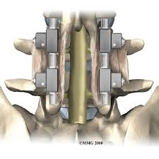
Surgical Gap for LSS
Side Effects
  Nerve root damage (1 in 1,000) or bowel/bladder incontinence (1 in 10,000).
  Cerebrospinal fluid leak (1% to 3% of the time).
  Infections (about 1% of any elective cases).
  Postoperative instability of the operated level (5 to 10% of cases).
  No improvement of pain (10-40%)
  Infection (5-10%)
  Pseudoarthrosis (5-40%)
  Pain from graft site (15-30%)

Slide 9
Surgical Gap for LSS
Poor Candidates
  COPD
  CHF
  Uncontrolled HTN
  Osteoporosis
  Diabetics
  Obese
  Patients using high dose and chronic opiates
  Low BMI
Patients do not want surgery

Slide 10
Conservative Treatment Gap for LSS
Less than 40% of patients with moderate to severe LSS with claudication improve long-term with conservative Tx
  PT
  Medications
  ESI
Patients may improve, but they want longer periods of non-treatment

Slide 11
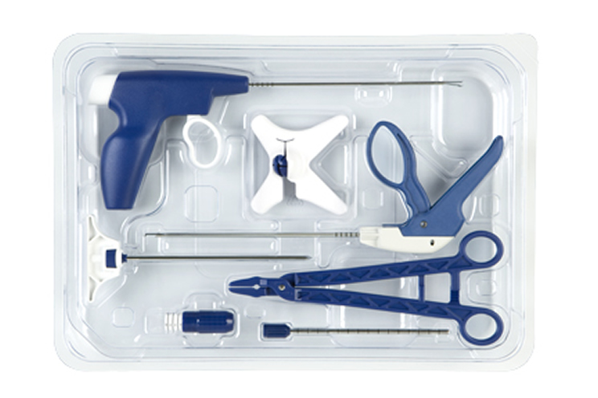
PILD

Slide 12
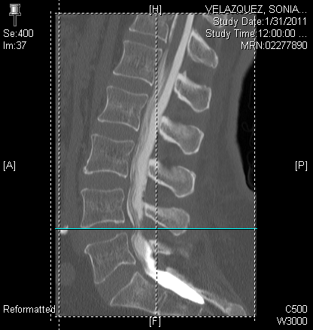
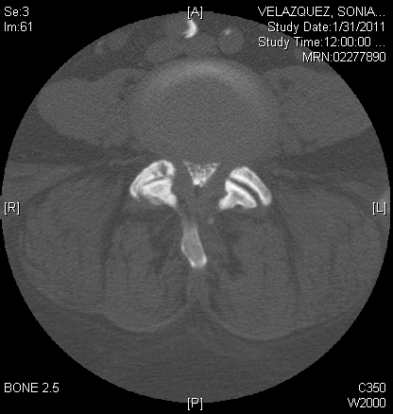
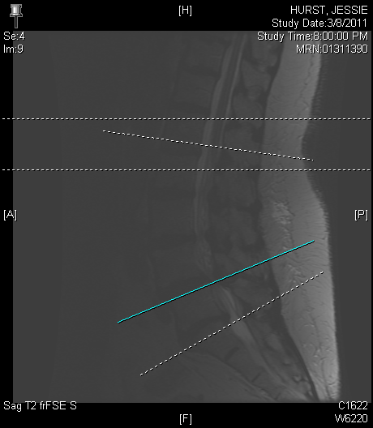
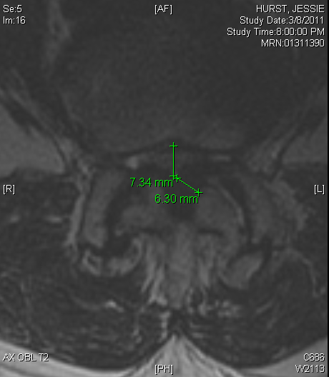
PILD Indications
Percutaneous Option for patients with Lumbar Spinal Stenosis
  Incidence = 1.2 million persons
  Walking and standing intolerance with temporally associated pain in the legs resolved with rest
Indicated in select cohort of patients
  LSS primarily due to Ligamentum Flavum Hypertrophyy
    94% patients with LSS have symptoms due to LFH
  DDD, disc bulge, facet hypertrophy should be ruled out as cause of symptoms
  Failed oral pharmaceuticals, PT, Epidurals
  *Patients with standing and walking pain as primary quality of life limitation
Hall S, Bartleson JD, Onofrio BM, Baker HL, Okazaki H, O’Duffy JD. Lumbar spinal stenosis. Clinical features, diagnostic procedures and results of surgical treatment in 68 patients. Ann Intern Med 1985;103(2):271–5.

Slide 13
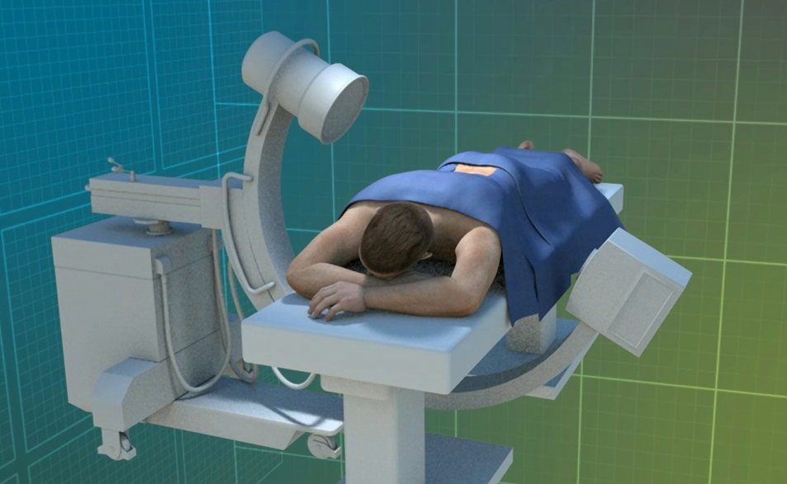
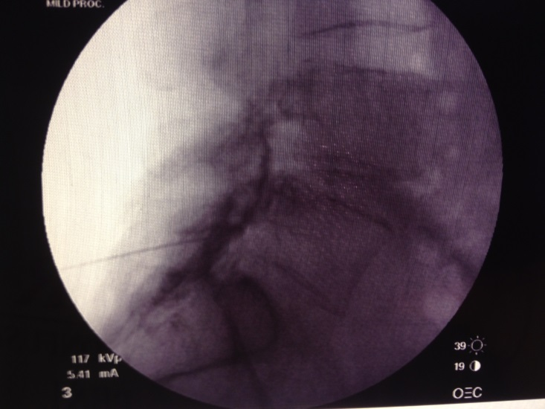
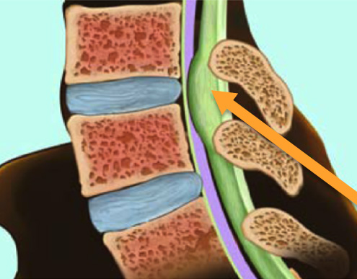

PILD
Patient Patient Preparation
Patient Positioning for Procedure
  Prone
  Elimination of lumbar lordosis
  Conscious Sedation
  Epidural needle placed at, or below, working level
  Inject contrast into epidural space until contrast flows into epidural space at working level
  Begin PILD on left or right side
    Procedure has laterality

Slide 14
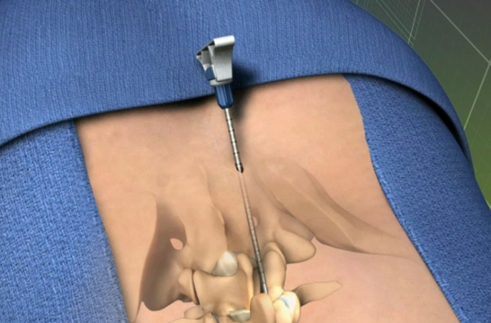
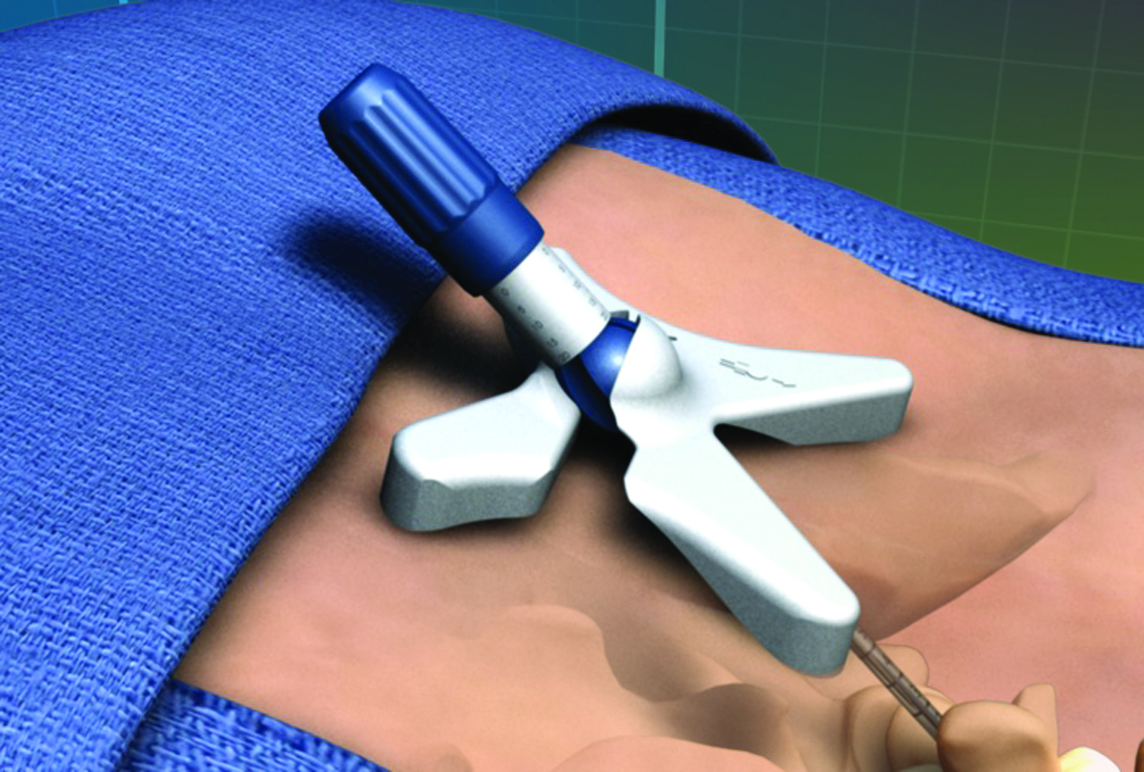
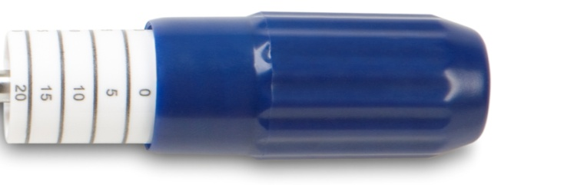
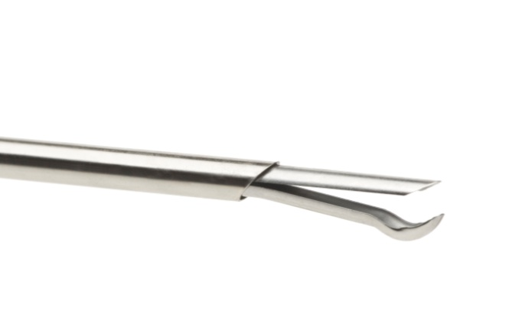
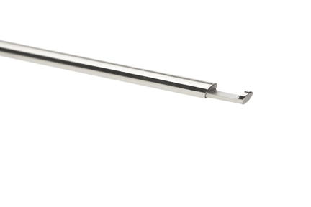
PILD Instruments
Portal
Portal Stabilizer
Depth Guide
Bone Rongeur
Tissue Sculptor
5.1mm Portal
Portal Stabilizer
Depth Guide
Bone Rongeur
And Tissue Sculptor

Slide 15
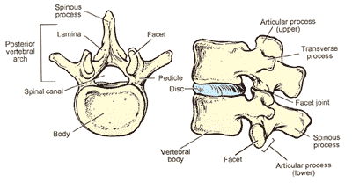
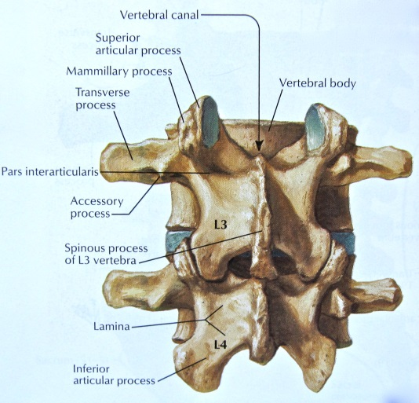
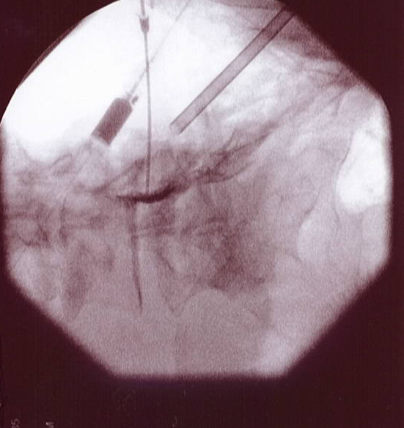
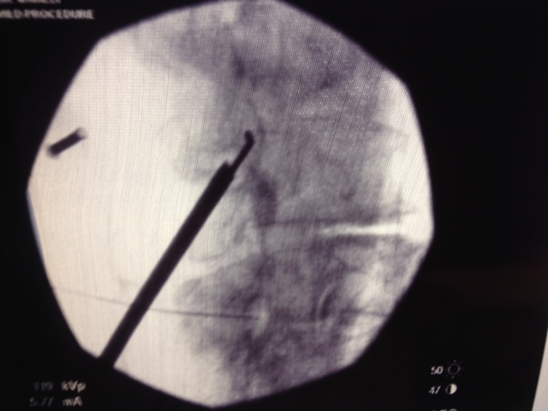
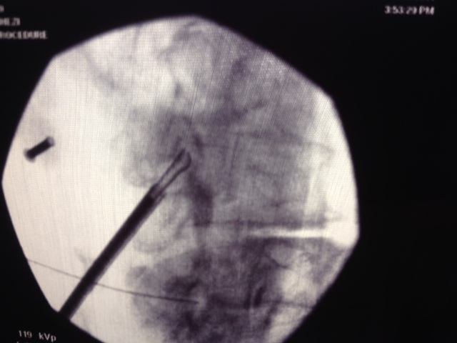
PILD Performance
Contralateral Oblique View
Allows visualization of
  Lamina
  Laminar Depth
  Interlaminar space
  Spinal Can al Depth
Assess post decompression contrast flow

Slide 16
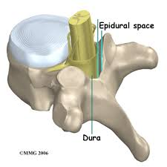
PILD Complications
Adverse events within clinical trials (830 patients):
None (Dural tear, Hematoma, Neural avulsions, Blood loss-transfusions)
*Adverse events outside of clinical trials (> 10,500 patients):
FDA Maude report http://www.accessdata.fda.gov/scripts/cdrh/cfdocs/cfMAUDE/Results.cfm?RequestTimeout=500
2 dural tears (1 repaired with blood patch and 1 repaired with dural drain-both patients had good long term outcomes sp procedure)
1 90 yo patient who had pain sp procedure and DC to acute rehab following procedure
Fall one week sp MILD, Rx with oral steroids. Good long term outcomes. MRI was (-) for hematoma or dural intra-canal
Not published in Maude report:
Report of nerve tear and epidural tear in 2/58 patients in one review
  ?previous laminectomy
  ?poor epidurogram

Slide 17
PILD^{Pro} Research
Paper | Synopsis
Pain Physician Journal MiDAS I (mild® Decompression Alternative to Open Surgery): A Preliminary Report of a Prospective, Multi-Center Clinical Study Bohdan Chopko, David L. Caraway | 75 patient series showed statistically and clinically significant reduction of pain as measured by VAS, ZCQ, and SF-12v2. In addition, improvement in physical function and mobility as measured by ODI, ZCQ, and SF-12v2 was statistically and clinically significant in this study.
Pain Physician Journal New Image-Guided Ultra-Minimally Invasive Lumbar Decompression Method: The mild Procedure Timothy R. Deer, Leonardo Kapural 2010;13:35-41. Multi-Center Clinical Study | Results: Of 90 procedures reviewed, there were no major adverse events or complications related to the devices or procedure. No incidents of dural puncture or tear, blood transfusion, nerve injury, epidural bleeding, or hematoma were observed.
Pain Physician Journal Retrospective Review of Patient Self-Reported Improvement and Post-Procedure Findings for mild Richard Lingreen, Jay S. Grider 2010;13:555-560 | 42 patient series. Visual analog pain scores were significantly decreased by 40% from baseline. Eighty-six percent of the patients reported that they would recommend the mild procedure to others.
Journal of Neurosurgical Review Minimally Invasive Lumbar Decompression for Spinal Stenosis Timothy R. Deer, Nagy Mekhail, Gabriel Lopez, Kasra Amirdelfan Issue: JNR 2011; 1(S1): 29-32 | The LSS treatment algorithm contains a gap of under-treated patients between epidural steroid injections (ESI) and open surgery.
The Neuroradiology Journal mild Lumbar Decompression for the Treatment of Lumbar Spinal Stenosis Donald Schomer, David Solsberg, Wade Wong, Bohdan Chopko 2011;24:620-626 | Meta analysis. 250 consecutive patients. 3 month FUP. VAS,ODI, PRO demonstrated statistically significant improvement from baseline
Pain Practice Journal Long-Term Results of Percutaneous Lumbar Decompression mild for Spinal Stenosis Nagy Mekhail, Ricardo Vallejo, Mark H. Coleman, Ramsin M. Benyamin 2012;12:184–193. | 58 patients. One-year data showed significant reduction of pain. Significant as measured by ZCQ, SF-12v2, and ODI.

Slide 18
PILD^{Pro} Research
Paper | Synopsis
Pain Practice Journal A Double-blind, Randomized, Prospective Study of Epidural Steroid Injection vs. The mild® Procedure in Patients with Symptomatic Lumbar Spinal Stenosis Lora L. Brown Published online:25 JAN 2012 [DOI: 10.1111/j.1533-2500.2011.00518.x]. | 38 patients. Randomized mild® vs ESI (ESI group had trochar placed at lamina and no decompression was performed). VAS, ODI, ZCQ statistically significantly better pain reduction and improved functional mobility vs. treatment with ESI.
Pain Practice. Functional and patient-reported outcomes in symptomatic lumbar spinal stenosis following percutaneous Mekhail N, Costandi S, Abraham B, Samuel SW. decompression. 2012 Jul;12(6):417-25. doi: 10.1111/j.1533-2500.2012.00565.x. Epub 2012 Jun 1. | 40 patients. 1 year FUP. Efficacy was demonstrated using the Pain Disability Index (PDI) and Roland-Morris Disability Questionnaire. Pre- and post procedure Standing Time, Walking Distance, and Visual Analog Score (VAS)
Mekhail N, Vallejo R, Coleman MH, Benyamin RM. Long-term results of percutaneous lumbar decompression mild(®) for spinal stenosis. Pain Pract. 2012 Mar;12(3):184-93. doi: 10.1111/j.1533-2500.2011.00481.x. Epub 2011 Jun 16. | 11 sites. 58 patients. 1 year FUP. VAS, ZCQ, SF-12, ODI all statistically improved from baseline.
Deer TR, Kim CK, Bowman RG 2nd, Ranson MT, Yee BS. Study of percutaneous lumbar decompression and treatment algorithm for patients suffering from neurogenic claudication. Pain Physician. 2012 Nov-Dec;15(6):451-60. | Single center. No control. 46 patients enrolled. 35 patients evaluated VAS, ZCQ, ODI, SF-12. Statistically significant from baseline at 1 year. No change btwn 3month and 1year FUP.
Wong WH. mild Interlaminar decompression for the treatment of lumbar spinal stenosis: procedure description and case series with 1-year follow-up. Clin J Pain. 2012 Jul;28(6):534-8. doi: 10.1097/AJP.0b013e31823aaa9d. | 17 patients. 1 year FUP. VAS and ODI statistically significant at one year.
The Clinical Journal of Pain mild Procedure: Single-site Prospective Sanghamitra Basu 2012; 28(3):254-258. | Single center. 27 patients. VAS, ZCQ, and ODI improved at 6months
Chopko BW. Long-term Results of Percutaneous Lumbar Decompression for LSS: Two-Year Outcomes.Clin J Pain. 2013 Feb 26. [Epub ahead of print | 2 year data. 45 patients. 11 sites. VAS, ODI, ZCQ all statistically significantly reduced from baseline.

Slide 19
PILD^{Con} Research
Paper | Synopsis
Wilkinson JS, Fourney DR.Failure of percutaneous remodeling of the ligamentum flavum and lamina for neurogenic claudication.Neurosurgery. 2012 Jul;71(1):86-92. doi: 10.1227/NEU.0b013e31825356f5. | 10 patients. VAS, ODI, SF-12 assessed over 18 months. Mean VAS and disability scores reduced (statistically significant) at 26 weeks. No change in Post procedure MRI at 12 weeks. 4/10 patients required surgery. 6/10 had improved ODI after PILD “Failure rate was unacceptably high.” “4/10 patients who improved must have been because of increasing pain meds.” No pain medication was followed in study.
New York Times article. A clash over a spine treatment. 9/2012 | Fourney vs Vertos. Vertos sues Dr. Fourney for releasing data after study was complete.
Luis M. Tumialan-Neurosugery. Pain Practice. Letter to the Editor. In response to “Mekhail-Long term results of PILD as a treatment of LSS.” 7/2012 | 10 complications in 58 patients. Mekhail reported 0 in his series “safe and effective treatment.” 8 refractory neurogenic claudication, 2 dural tear (1with transected nerve roots)

Slide 20
PILD History
?
PILD performed Nationally
Appeals to Admin Law Judge (ALJ)
>90% Medicare claims denied were overturned
Public Comment Period
99/114 +
Non Coverage Determination
2009
2012
2013
2014
2015
PILD Introduced/
Device cleared
CMS initiates Nat. Coverage Analysis (NCA)
Public Comment Period
185/200 +
  PILD Research and Data Collection
  <<<<---------------------- 16 peer review articles produced-------------------->>>
LCD without
NCD
Coverage with Evidence Development (CED)

Slide 21
MiDAS ENCORE Protocol
MILD® Percutaneous Image-Guided Lumbar Decompression Versus Epidural Steroid Injections in Patients With Lumbar Spinal Stenosis Exhibiting Neurogenic Claudication
Randomized, multi-center, comparative outcomes study of MILD vs. ESI
Medicare patients, 65+ years, suffering from lumbar spinal stenosis (LSS) with neurogenic claudication
  300 patients to be enrolled
    Montefiore largest academic enroller
Primary Endpoint:
  Oswestry Disability Index (ODI)
  Statistical superiority of the proportion of ODI responders from Baseline to 1 Year. (Responder = ODI change ≥10)
Secondary Endpoints:
  Zurich Claudication Questionnaire (ZCQ)
  Numeric Pain Rating Scale (NPRS)
Timeframes: 6 Months & 1 Year Required
(2-Year follow-up for MILD arm is Supplemental. It is desired by CMS, but not a required endpoint for the study)

Slide 22
MiDAS ENCORE Protocol
65 yo
Medicare Beneficiary
Sx clinically cw LSS x 3months
No Hx ESI in 3 months
ESI
PILD
FU 6,12 months
ODI
ZCQ
NPRS
Co-Interventions
Narcotic usage
Adverse Event
FU 6,12, 24 months
ODI
ZCQ
NPRS
Co-Interventions
Narcotic usage
Adverse Event

Slide 23
MiDAS ENCORE Protocol
Inclusion Criteria
65+ years and Medicare beneficiaries
Patients experiencing neurogenic claudication symptoms for at least 3 months’ duration, which has failed to respond or poorly responded to physical therapy, home exercise programs, and oral analgesics
  LSS with neurogenic claudication diagnosed via:
  Symptomatic diagnosis
Radiologic evidence of LSS with unilateral or bilateral ligamentum flavum >2.5mm confirmed by pre-op MRI or CT performed within 12 months of baseline visit
Patients with comorbid conditions commonly associated with spinal stenosis, such as osteophytes, facet hypertrophy, minor spondylolisthesis, foraminal stenosis, and/or disk protrusion may be included unless the treating physician has determined that the condition is too advanced
Willing to complete 6 Month and 1 Year follow-up visits

Slide 24
MIDAS ENCORE
Symptomatic Diagnosis will use the following screening criteria, which will be documented in source and Case Report Form:
Pain/discomfort in legs, buttocks, or lower back while walking or standing
Bending forward or sitting down provides relief
Flexes forward while walking
Unable to stand unaided without bending at the waist for > 15 minutes
Unable to walk unaided without bending at the waist for more than ¼ mile
History of symptoms is ≥ 12 weeks
“YES” must be answered for every question for a patient to be considered a candidate for the study.

Slide 25
MiDAS ENCORE
Enrolled 302 patients in 13months
Last patient enrolled 2/19/15
Last patient procedure 2/26/15
151 ESI
151 MILD
Adverse outcomes in ESI arm
  Fracture
  Hyperglycemia
  DKA
  Hypertensive emergency
Adverse outcomes in PILD arm
Will publish 6month data 6months from last enrolled procedure

Slide 26
Thank You
“We are clinicians in a technical field, not technicians in a clinical field.”
-Sayed Emal Wahezi, MD
Montefiore Medical Center

