Slide 1



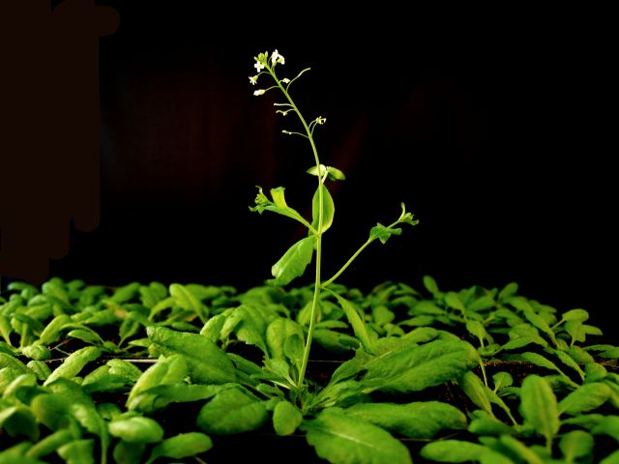
Transcriptome Analysis Identifies Candidate Genes in Response to Biotic and Abiotic Stresses in Arabidopsis
Dr. Synan AbuQamar

Slide 2


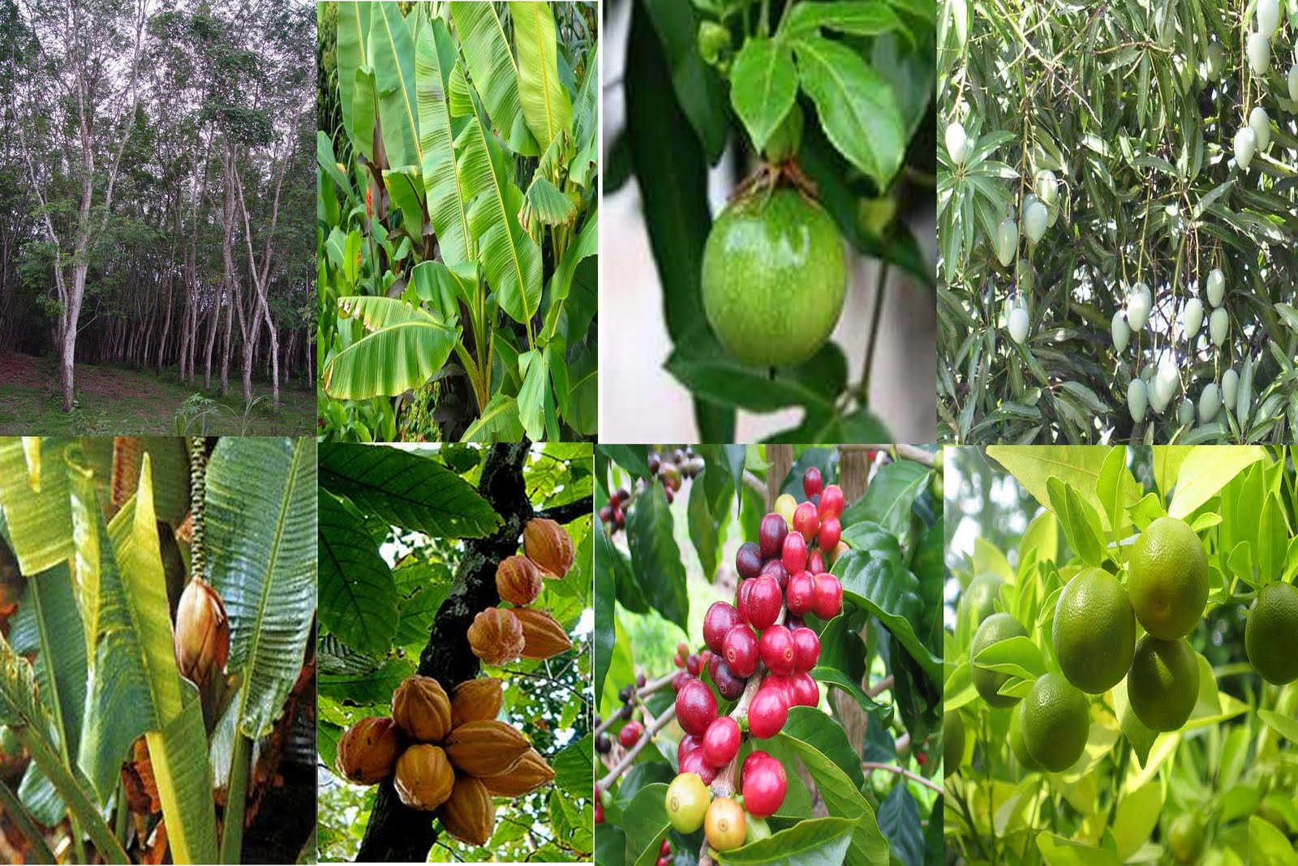
Plants are exposed to various environmental stresses
Fungi (i.e. Botrytis cinerea)
Osmotic
Heat
Nematodes
Salinity
bacteria
Drought
Insects
Cold
Animal
Oxidative
viruses
Abiotic Stresses
Biotic Stresses
06/10/2015
6th BWC
2

Slide 3
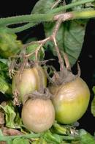
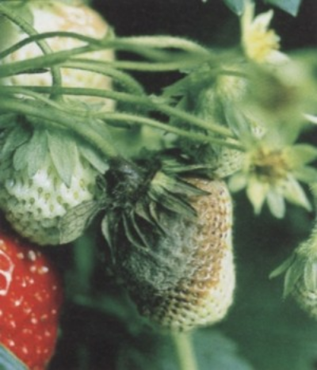
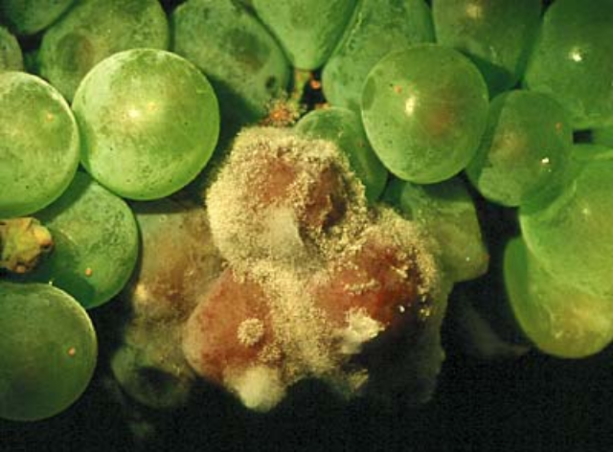
Botrytis cinerea is a major disease problem
* Botrytis is a necrotrophic pathogen
A broad host range
Grey mold under diverse conditions
Significant yield losses
* Disease management-Fungicide application
tomato
* No G-F-G Interaction
* JA/ET- & ABA-mediated
necrotroph
strawberry
grape
06/10/2015
6th BWC
3

Slide 4
Plant Defense Mechanisms
Passive
Active
(induced when the plant is challenged by a pathogen)
Physical
Chemical
cuticle, cell wall
phenolics, alkaloids
06/10/2015
6th BWC
4

Slide 5
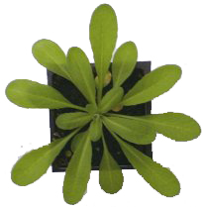
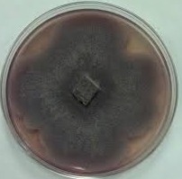

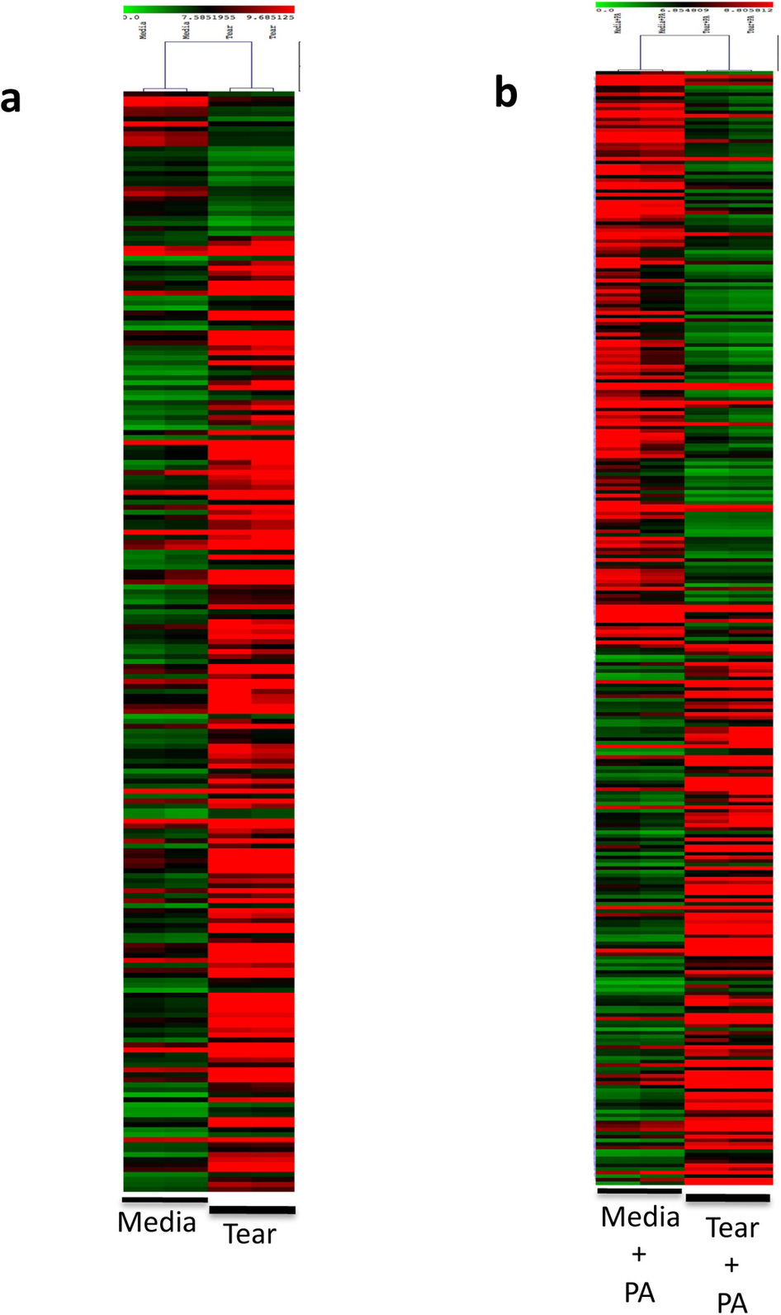
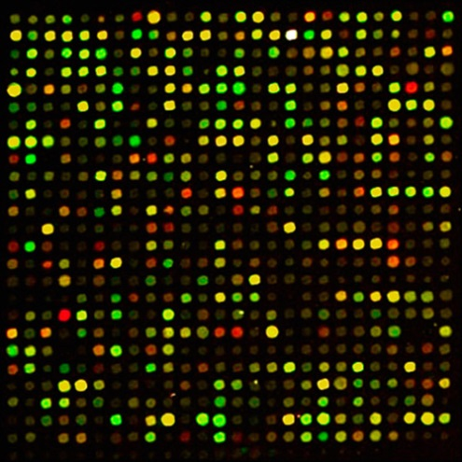
Research Scheme – Reverse Genetics
Arabidopsis
Stress - B. cinerea
Microarray chip
?
Function
Data analysis
Microarray hybridization
5

Slide 6
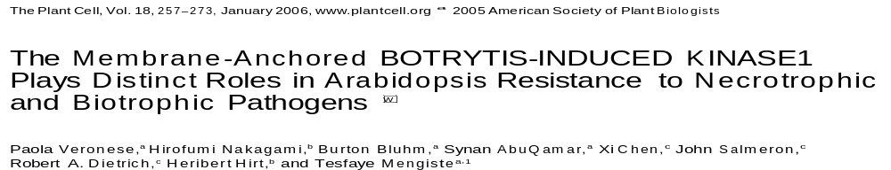



Previous work on Arabidopsis and tomato
06/10/2015
6th BWC
6

Slide 7
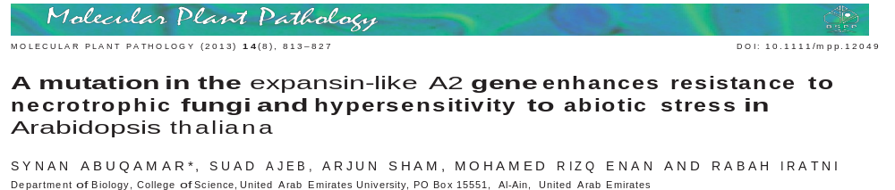
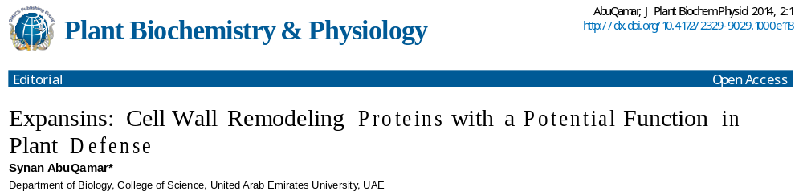
Previous work on Arabidopsis and tomato
06/10/2015
6th BWC
7

Slide 8
Transcriptome Analysis Reveals Genes Commonly Induced by Botrytis cinerea Infection and Major Abiotic Stresses in Arabidopsis
06/10/2015
6th BWC
8

Slide 9
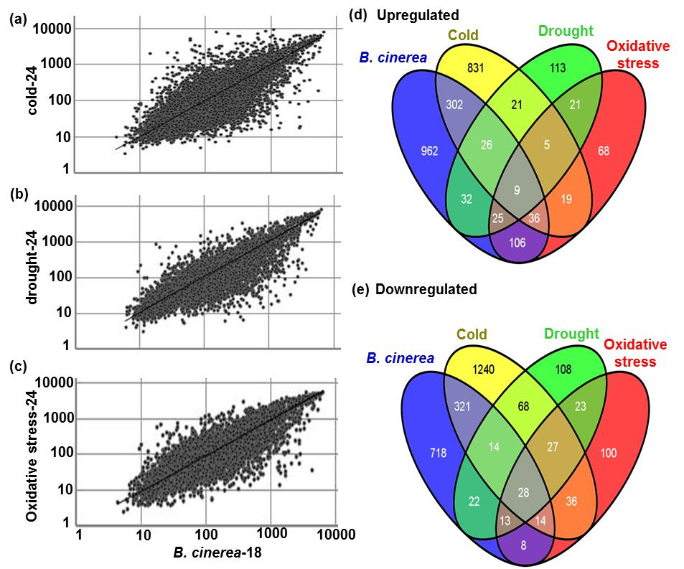
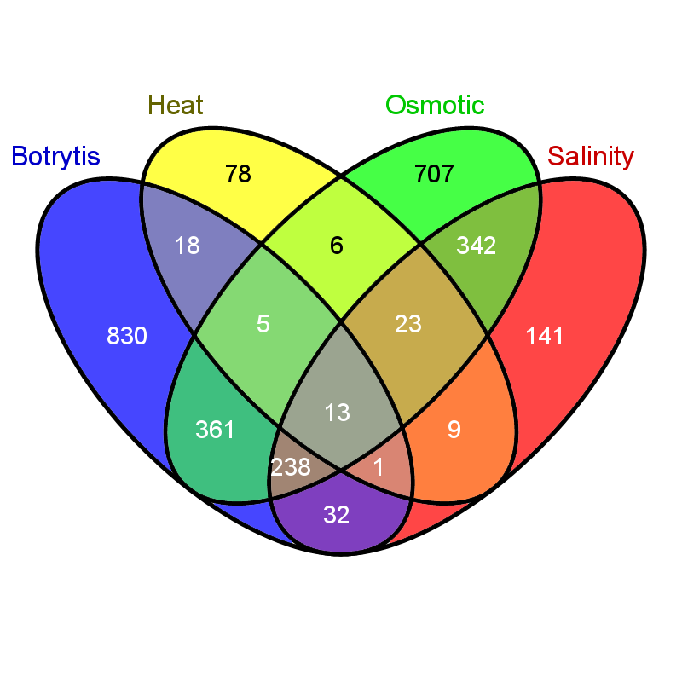

Highly conserved expression status of genes common to B. cinerea and abiotic stress responses
Upregulated
Osmotic stress
Heat
B. cinerea
Salinity
Downregulated
Osmotic stress
Heat
B. cinerea
Salinity
06/10/2015
6th BWC
9

Slide 10
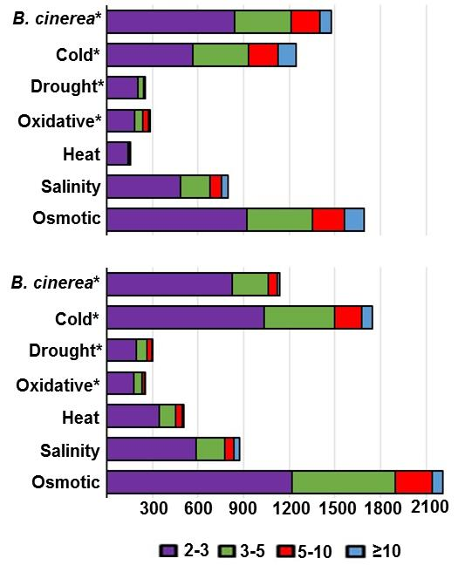
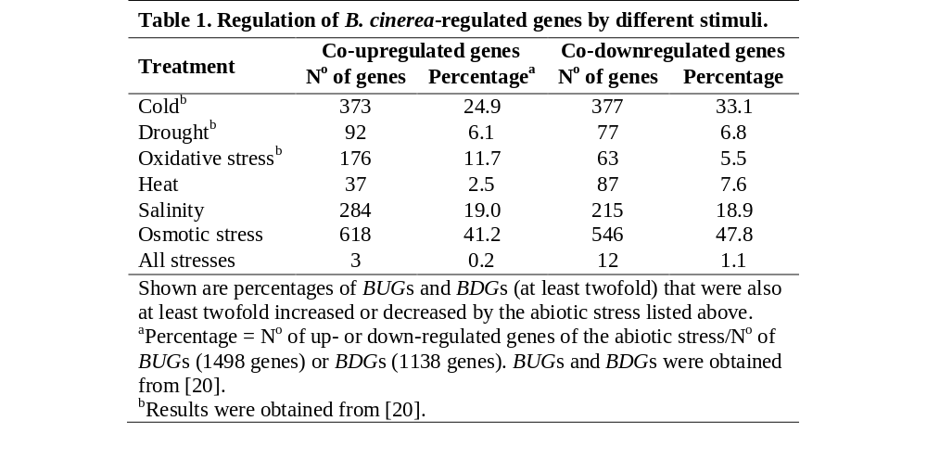
Comparisons of gene expression in Arabidopsis plants under biotic and abiotic stress conditions.
Up-regulated
Down-regulated
06/10/2015
6th BWC
10

Slide 11
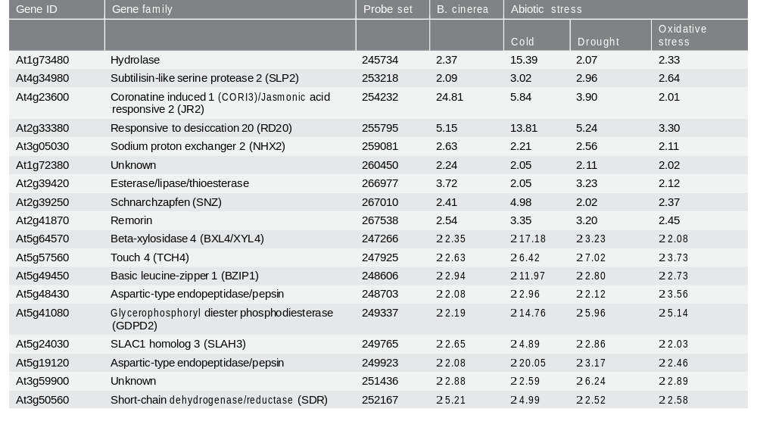
Changes in expression of up- or down-regulated genes during B. cinerea and abiotic stress treatments in Arabidopsis plants
06/10/2015
6th BWC
11

Slide 12
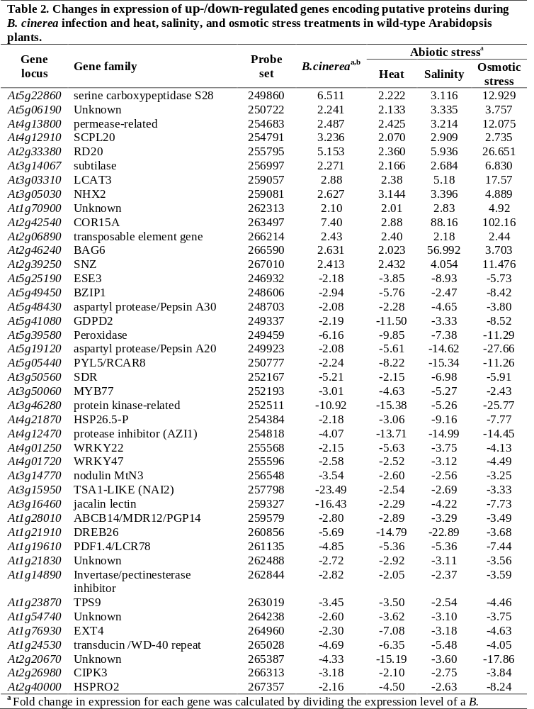
Identification of differentially expressed genes in response to B. cinerea
06/10/2015
6th BWC
12

Slide 13
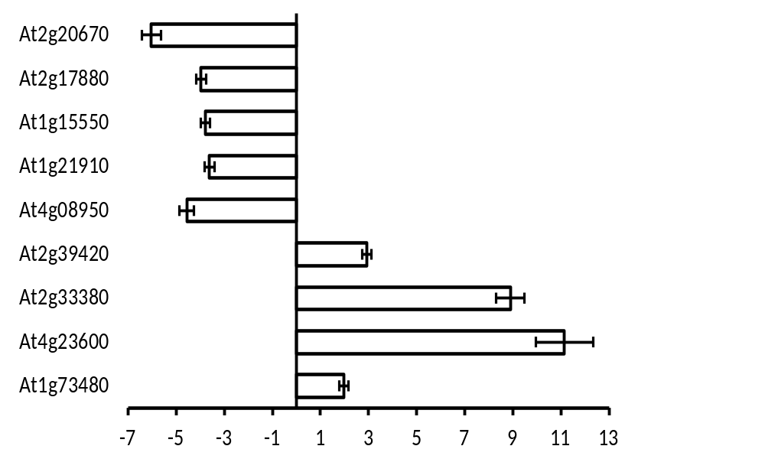
Validation of expression profiles of common genes to B. cinerea infection
At2g20670
DJC24
GA4/GA3ox1
DREB26
EXO
At2g39420
RD20
CORI3
At1g73480
-7
-5
-3
-1
1
3
5
7
9
11
Fold Change
06/10/2015
6th BWC
13

Slide 14
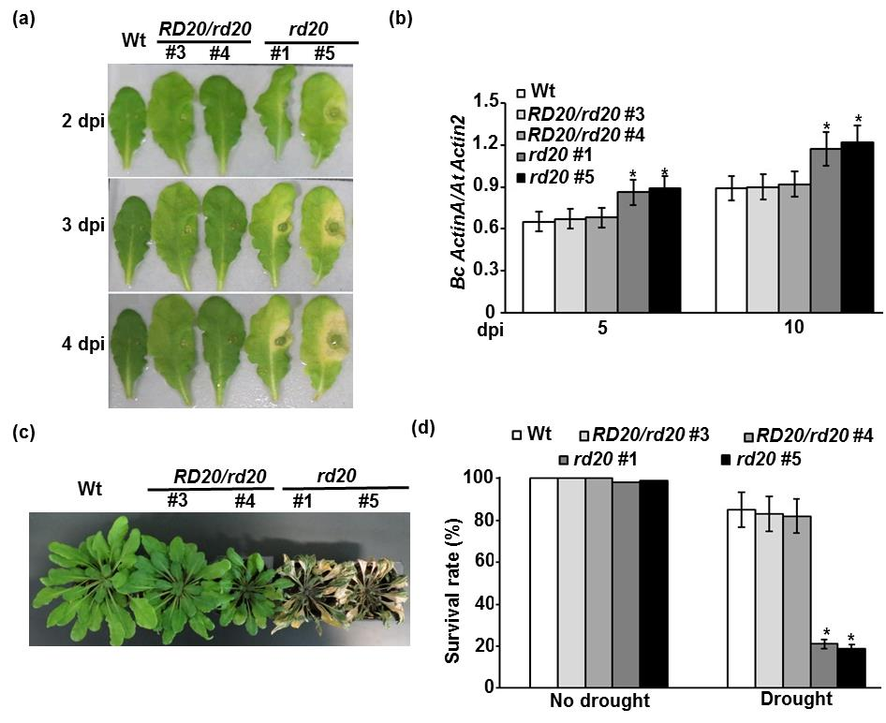
RD20 gene contributes to the plant resistance to biotic and abiotic stresses
06/10/2015
6th BWC
14

Slide 15
Botrytis
α-linolenic acid
LOX
AOS
ROS
AOC
OPR3
PPA₁
OPDA
OPCs
β-oxidation
Enzymatic pathway
Nonenzymatic pathway
JA
JA-Ile
Electrophile Effect
COI1
COI1
COI1
TGA
PHO1;H10
JR3
HPL
VSP2
MRP
Gene expression and Response
06/10/2015
6th BWC
15

Slide 16
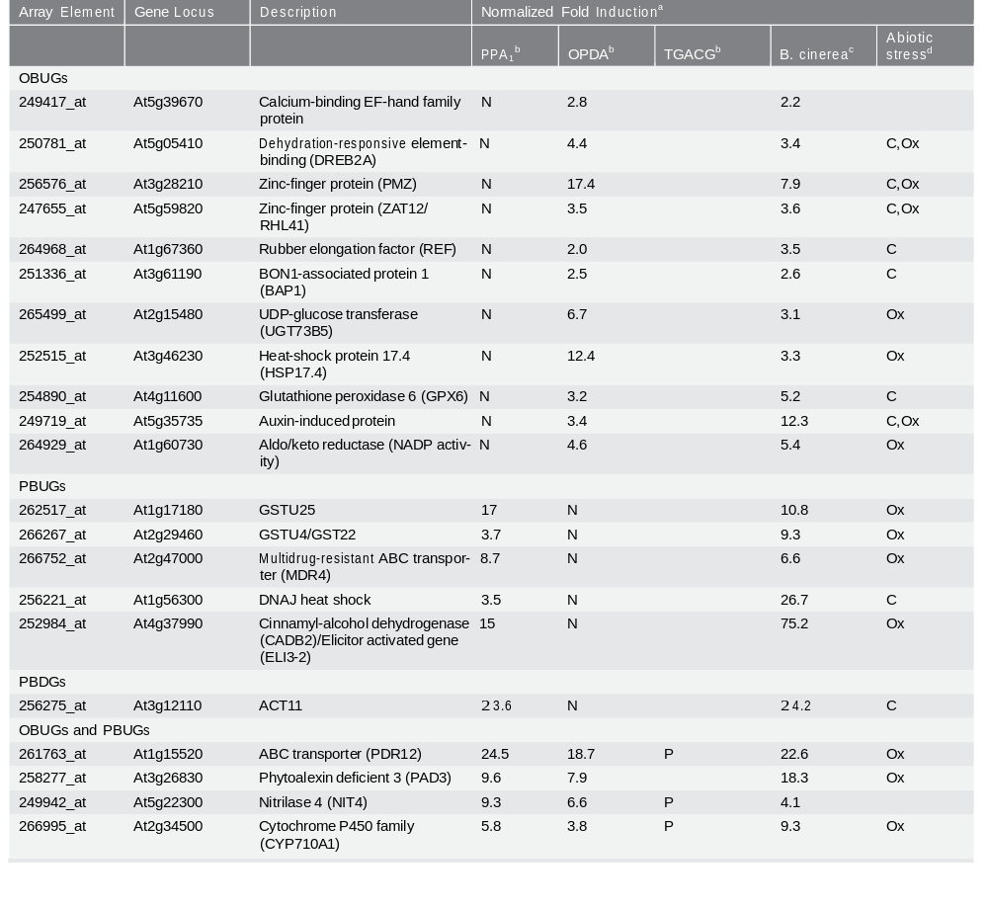
Regulation of cyclopentenone-induced genes during B. cinerea
infection and abiotic stress
06/10/2015
6th BWC
16

Slide 17
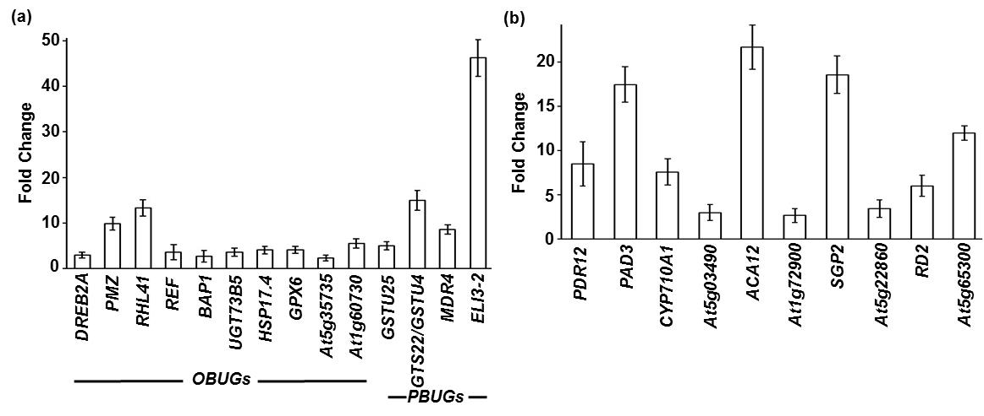
Expression of OBUGs/PBUGs and abiotic stress-regulated genes to B. cinerea infection.
06/10/2015
6th BWC
17

Slide 18
Conclusion
We showed a complex network of biological systems that control plant/environment interactions gene function/dynamic relationships at the molecular levels.
Many genes were identified general markers of common responses to biotic and abiotic stresses (in some cases as responses mediated by oxylipin cyclopentenones),
Identification of common regulators of plant responses to environmental constraints genetic engineering and breeding programs to develop broad-spectrum stress-tolerant crops,
Future research dissect specific functions of stress-involved components; and to map all implicated elements in stress signal transduction pathways.
06/10/2015
6th BWC
18

Slide 19
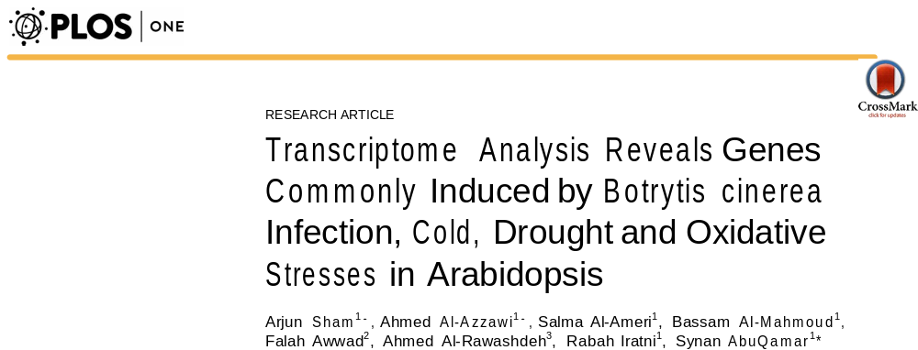

06/10/2015
6th BWC
19

Slide 20

Acknowledgments
Mr. Arjun Sham
Ms. Salma Al-Ameri
Mr. Ahmed Al-Azzawi
Mr. Noushad Karuvantevida
Dr. Rabah Iratni
Dr. Falah Awwad
Dr. Ahmed Al-Rawashdeh
Prof. Elizabeth Blee/Laboratoire des Phytooxylipines - France
Financial Support
Khalifa Center for Genetic Engineering & Biotechnology
06/10/2015
6th BWC
20

Slide 21
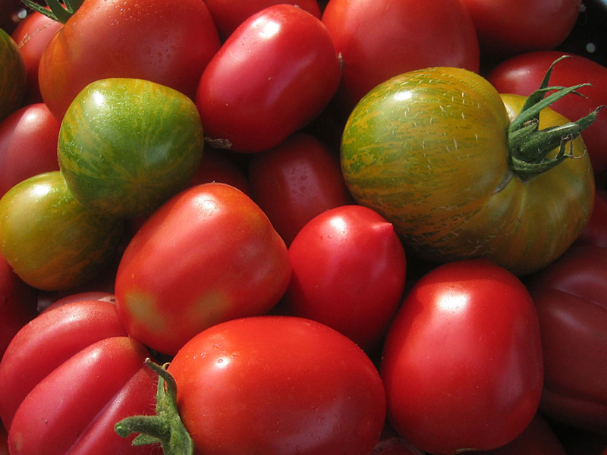
Thank you!!

