Slide 1

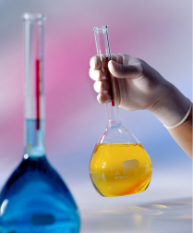
Quality by design approach for establishment of stability indicating method for determination of cefditoren pivoxil
Dr.Sawsan M.Amer
Professor of Analytical Chemistry

Slide 2


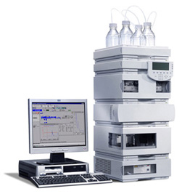
This study was done as part of master degree for one of my students ,Mohamed Gad .
With two other colleges : Assistant Prof.Dr Halla Zazaa from my department & Prof.Dr.Mohamed Korany from Faculty of Pharmacy , Alex,University

Slide 3




Slide 4






Slide 5
Outlines
* Introduction to Cefditoren bivoxil & its degradation
* Introduction to Analytical QbD method .
* Developing & validation of stability indicating HPLC method for determination of CTP in presence of its degradation products .

Slide 6
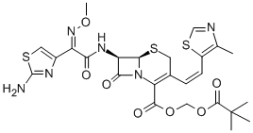
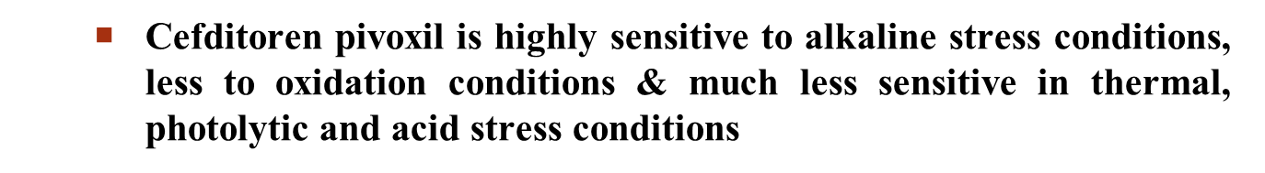
Cefditoren pivoxil (CTP)
It is a semi-synthetic third generation, broad-spectrum cephalosporin orally administered for treatment of respiratory tract infections
Chemical structure

Slide 7
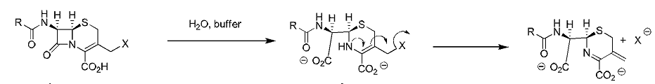
      Chemical stability of CTP
Also, It hydrolysed either spontaneously in aqueous medium or after oral administration, in gastrointestinal tract in the presence of a β- lactamase .
literature review revealed various methods for determination of CTP & different applications of QbD in analytical method development.

Slide 8

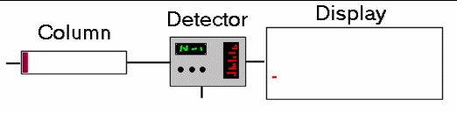
Traditional approach to HPLC, method development depends on trial and error or by changing one factor at time (OFAT) while holding the rest constant . Although it require a very large number of experiments to identify the optimal conditions, they do not account for interaction between factors.
. Computer-assisted QbD approach provides better understanding of method parameters influencing chromatographic process. Design Of Experiment ( DOE) ensures method application with predictable performance during routine work

Slide 9

Aim of work
Development and validation of a robust and ragged stability indicating HPLC method for determination of CTP in the presence of its degradation products.

Slide 10

Degradation solution preparation
Stress degradation studies performed using acid, base, peroxide, thermal and photolytic methods
Highly complicated matrix
0.001M NaOH
0.1M HCl
1% H2O2
H2O (thermal)
H2O (hƲ)
Development solution
CTP Stock standard solution
Reflux for 30 min at 60 °C

Slide 11
Quality by design (QbD)
It is a systematic approach for process development that begins with predefined objectives and emphasizes product, process understanding and process control, based on sound science and quality risk management
Robust method
Analytical method development
QbD principles
Quality by design principles when applied to the development of analytical methods, it termed “Analytical QbD” (AQbD)

Slide 12
Quality by design methodology
Analytical Target Profile (ATP)
Identification of Parameters & Critical quality attributes (CQA)
Risk Assessments
Design of experment
Identification of Design space

Slide 13
        Analytical target profile (ATP)
ATP identification includes selection of method requirements such as target analytes, type of analytical technique, and product specifications.
        2.Critical quality attributes (CQAs)
Critical quality attributes are defined as a property that should be within an appropriate limit or range to ensure the desired product quality.

Slide 14
Critical quality Attributes and Method Parameters
For analytical chromatographic methods, performance criteria as resolution, asymmetry and theoretical plate number can be called critical quality attributes (CQAs).
Critical quality attribute | Predefined Limit
Peak asymmetry | 0.9 to 1.1
Theoretical plate number | > 4000 (maximize)
Pre-resolution | > 4 (maximize)
Post-resolution | > 4 (maximize)
Run time [min] | < 10 min. (minimize)
    Method Parameters
    Flow rate
    Wavelength
    Chromatographic Column type
    Mobile phase Buffer pH
    Temperature
    Methanol%

Slide 15
        3.Risk assessment
Parameters that directly affect the quality of the method are first sorted out, and its possible effects on method development are studied in risk-based approach
Risk assessment aims to find out the risk of method parameters on different aspects of response. Various tools for risk assessment are available as Failure mode effect analysis (FMEA) & Pareto rules .
FMEA is used to rank the factors based on risk (i.e. a product of probability, severity, and detectability) and in combination with Pareto analysis it is possible to select the process parameters

Slide 16
Analytical Method and Risk Management
Risk Factor = Severity x Occurrence x Detectability
• Severity = Effect on efficacy of (CQAs)
• Occurrence = Chance of Failure
Related to process knowledge , changes and controls
• Detectability = Ability to Detect a Failure
 | Low | High
Severity (S) | 1 | 10
Occurrence (O) | 1 | 10
Detectability (D) | 10 | 1
6

Slide 17
Risk assessment
Failure mode and effect analysis(FMEA)
Risk factor (RF) = Severity (S) ×occurrence (O) ×detectability (D)
CTP pre-reslution
CTP post-resolution
CTP asymmetry
Theoretical plate No. (N)
Run time
Pareto rule: 80 % of risk is caused by 20% of causes.

Slide 18
Risk assessment
*The previous figure revealed high risk rank for methanol percentage in mobile phase (MeOH%) and elution temperature (T), relatively lower risk rank for buffer pH on CQAs.
* While factors like detection wavelength and column type show minor risk rank. These factors were easily controlled & Buffer pH was studied in univariate mode.
* MeOH% and T as the major risky factors were subjected to extensive study using multivariate design of experiment (DOE) to model them with CQAs.

Slide 19
Parameters optimization (flow rate & wavelength)
Flow rate:
  Stability indicating method are lengthy methods. So, reduction of run time would be advantageous as long as we maintain acceptable CQAs Flow rate 1.5 mL min⁻¹
  Wavelength:
  For chromatographic detection wavelength , CTP was scanned between 200-400 nm where λ=225 nm was the best in terms of sensitivity and precision that was selected as optimum wavelength

Slide 20
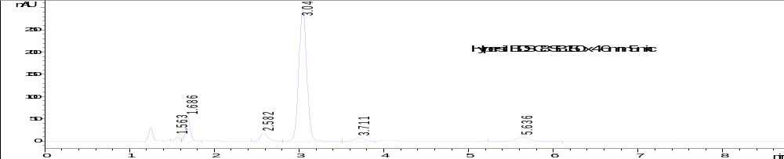
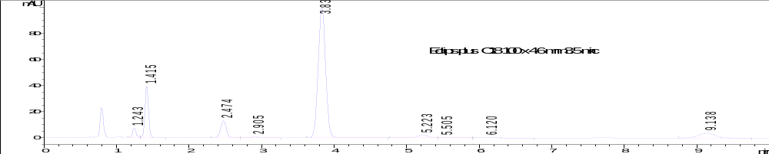
Parameters optimization (Column)
  Reversed phase C18 stationery phase was superior to RP-C8 in terms of number of eluted peaks and resolution.
  Using short RP-C18 column with smaller particle size, superior results were obtained.
Notes:
Small Stationary Phase Particles Reduce possible pore distance for analyte diffusion hence faster diffusion, Differences in diffusion times out of the pore are reduced, Diffusion time decreased

Slide 21
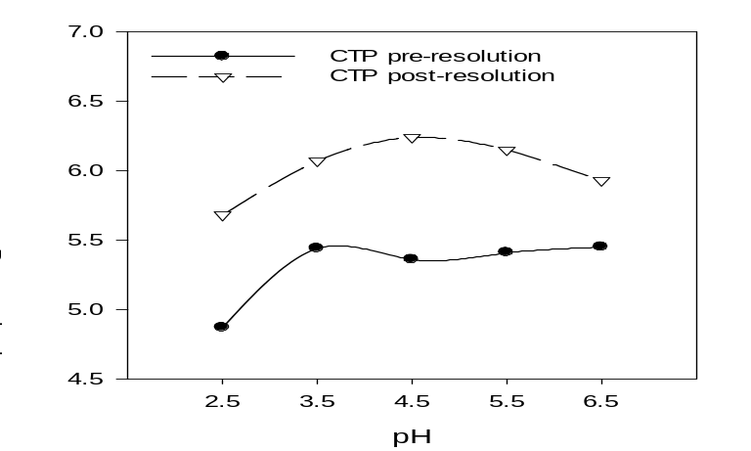
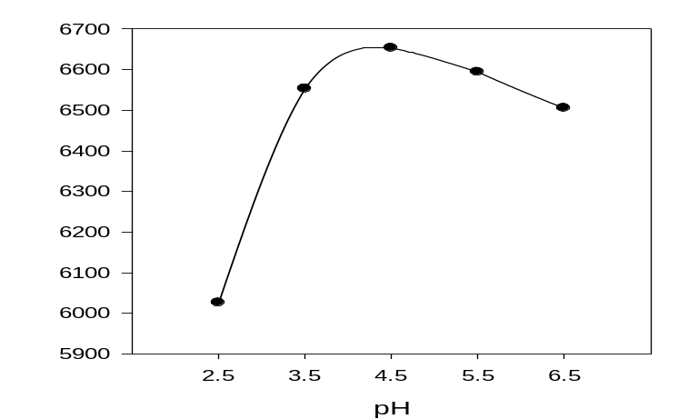
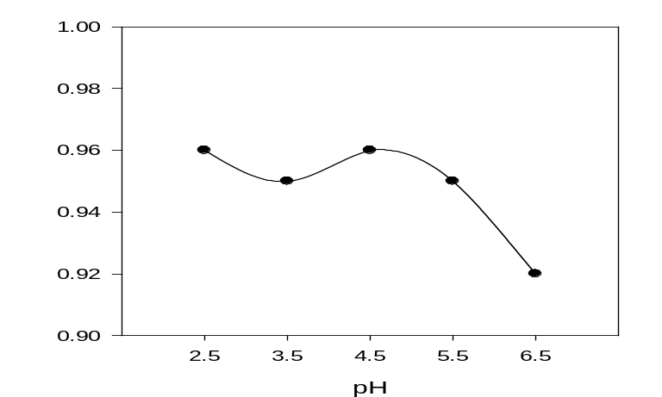
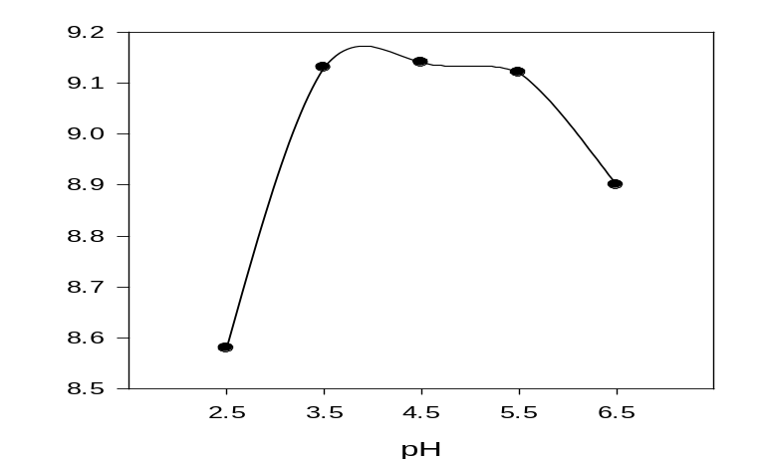
Parameters optimization (pH)
Effect of mobile phase buffer pH on Resolution between CTP and previous or next eluted peaks
Effect of mobile phase buffer pH on CTP peak theoretical plate number.
Effect of mobile phase buffer pH on CTP peak asymmetry.
Effect of mobile phase buffer pH on Retention time of last eluted peak.

Slide 22
        4-Design of experiments (DOE)
It is a useful tool for studying effect of different factors in addition to interaction between factors on given response.
Mathematical and statistical manipulations involved in QbD approach were performed using the Design expert software package Version 7.0.0 (Stat-Ease Inc.).
The Outcomes of DOE are models relate CQAs to input method parameters.

Slide 23
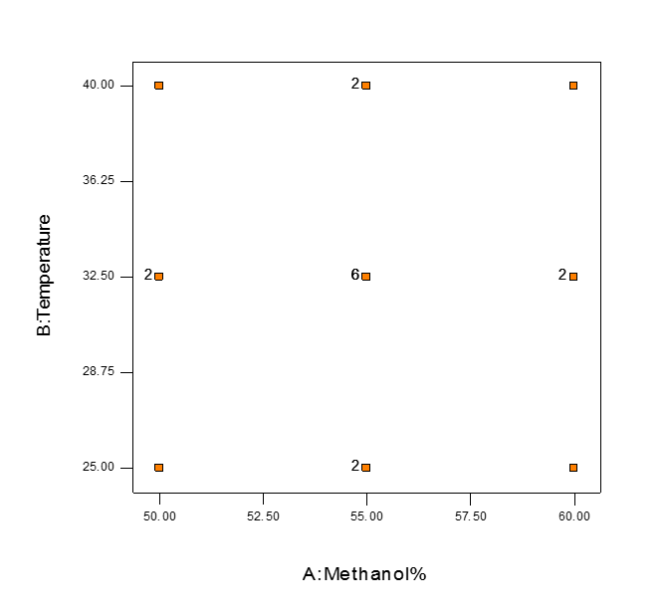
Optimization of chromatographic method was performed using Central composite design ( CCD ) evaluating theoretical plates , peak asymmetry & resolution as the CAAs.
The selected experimental design is face-centered Central composite design .
* It is one of the response surface design.
* It can detect curvature in response surface.

Slide 24
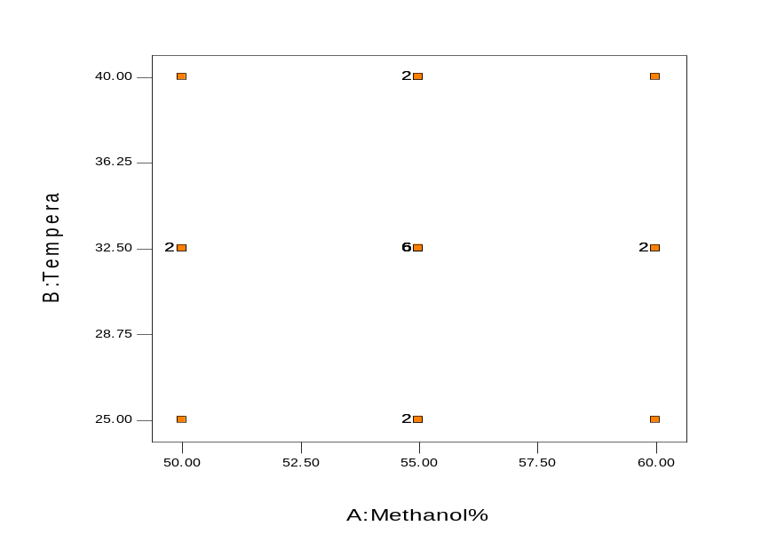
Face-centered Central composite design
It is used to investigate the response surfaces resulted from combined effect of elution temperature and mobile phase methanol percentage namely; asymmetry, theoretical plate, resolutions, retention time of last eluted peak as indication on run time.
  Factorial points= 4
  Center points= 1
  Axial points= 4
  - Replicates= 1
  - Replicates = 6
  - Replicates = 2
Replications of the center point & axial point was done to enhance the performance of the Design .
Notes:
6 or 2 repeating via readjust instrument to parameters combination each
Every measurement is on duplicate bases

Slide 25
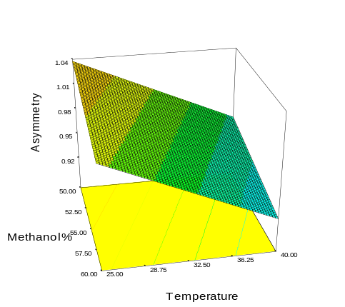
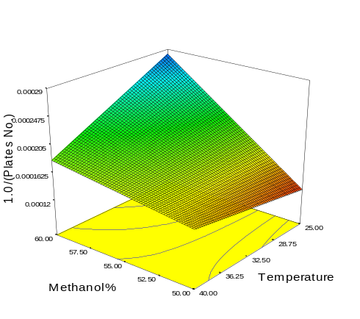
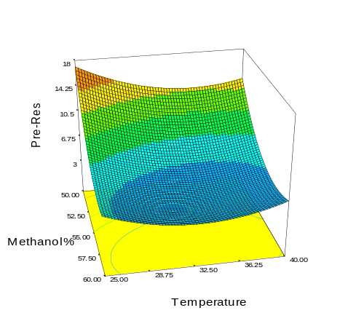
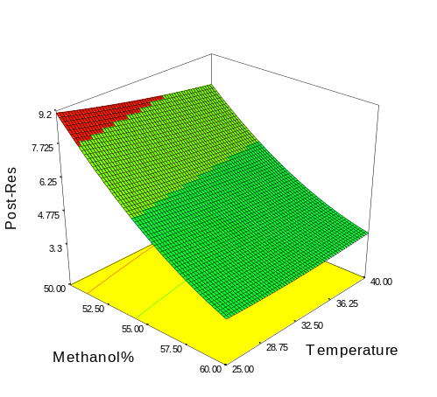
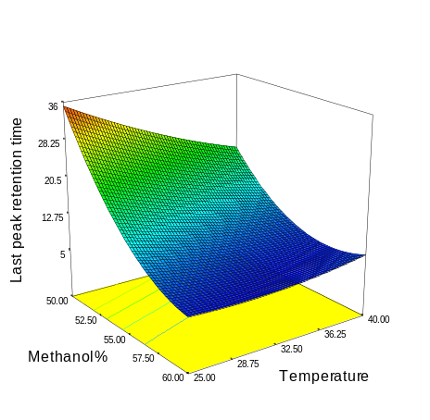
CQAs models of Temperature and Methanol%
3D-Response surface of CTP , (a) asymmetry; (b) Theoretical plate number ; (c) CTP pre- resolution,(d) CTP post-resolution; (e) last peak retention time as function of mobile phase methanol% and elution temperature.

Slide 26
ICH pharmaceutical development guideline, defines DS as the multidimensional combination and interaction of input variables (process parameters) that have been demonstrated to provide assurance of quality.
According to predefined limits of CQAs , each CQA response surface has two distinct spaces: first, failure space where the CQA limits are not satisfied. Second, design space (DS) within which CQA limits are satisfied.
All response surfaces were overlaid in order to define the common design space of MeOH% and T that satisfies all CQAs predefined limits as shown in the next Figure .

Slide 27
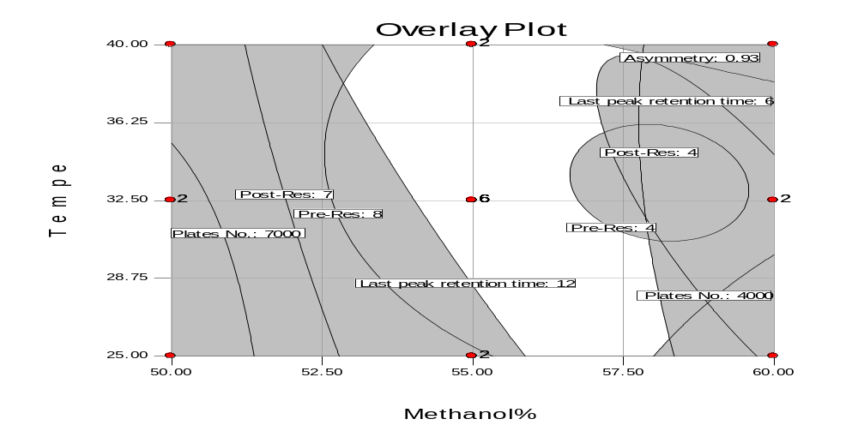
Overlay plot of all response surfaces showing the failure space “gray area”, design space “white area”, control space “green area” and cross point normal operation parameter
Control space
Design space
Control space (CS) is subdivision of DS that is defined according to desirability function.

Slide 28
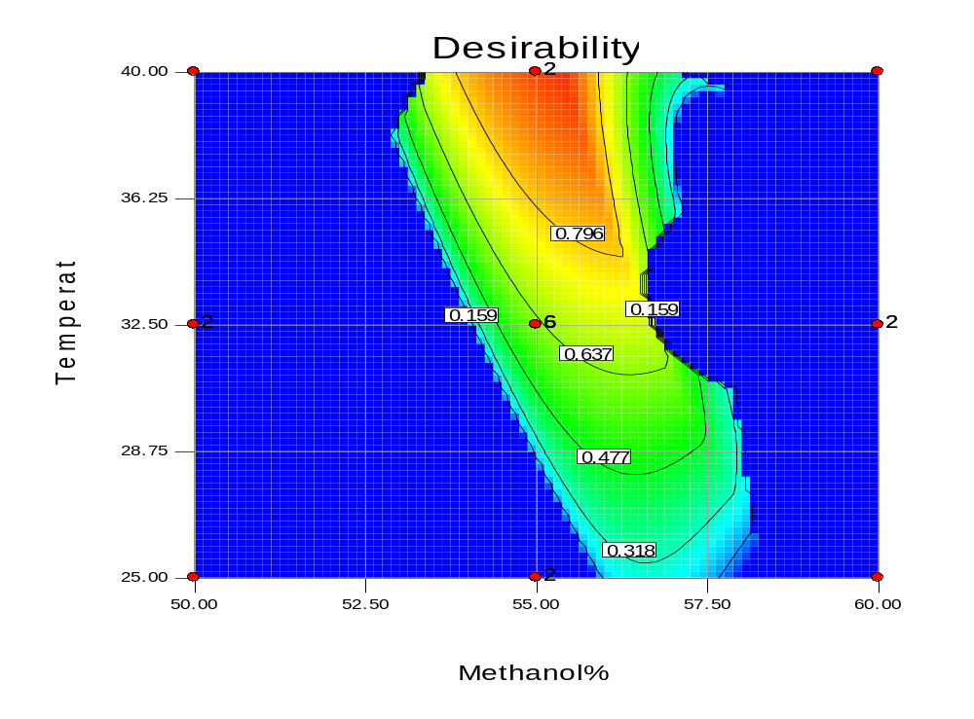
Design space Desirability
Desirability function enabled finding the most desirable space within the DS to be identified as control space (CS) “54-56.5 methanol% and 34-40 °C”; then
Number Theoretical plate (N)
A maximum desirable point was identified as normal operating parameters (NOP) “55 methanol% and 40 °C” within the control space.
Notes:
2D-

Slide 29

Benefits of Application of QbD Approach to Analytical Methods
• Development of a robust method
• Applicable throughout the life cycle of the procedure
• Regulatory flexibility
The Movements within “Design Space” are not a change in method

Slide 30
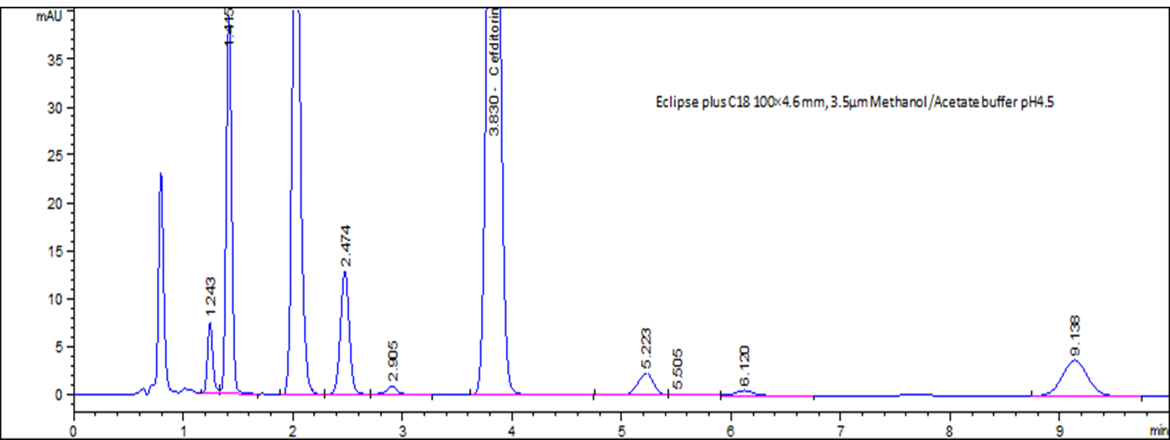
RP-HPLC
Flow rate : 1.5 ml/min
Injection volume: 10 µL
Detection : 225 nm
Temperature: 40 C°
HPLC chromatogram of a CTP & its stress degradation products mixture
methanol: acetate buffer [pH 4.5]:
(55 : 45 , v/v )
C18 column(100×4.6 mm 3.5µm)

Slide 31
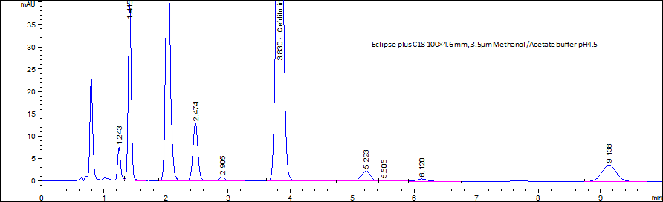
Method parameters
Parameters | Value
Mobile phase | Acetate buffer pH 4.5 : Methanol = 45:55
Flow rate [mL/min] | 1.5
Temperature [°C] | 40
injection volume [µL] | 10
Wavelength [nm] | 225
Oxidation DP
Basic DP
Basic DP
Thermal DP
Acidic DP
Thermal DP
Acidic DP
Photolytic DP
Acidic DP
Typical development solution chromatogram

Slide 32
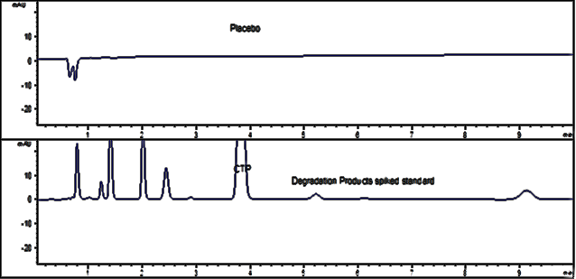
Chromatograms showing CTP spiked with forced degradation products and placebo chromatogram, indicating absence of interference

Slide 33
Method validation
The chromatographic selectivity factor and chromatographic resolution between CTP and degradation products results indicate method specificity.
Parameters | DP 1 | DP2 |  | DP 3 | DP 4 |  | DP 5 |  | CTP |  | DP 6 |  | DP 7 |  | DP 8 |  | DP 9 | Reference value
Resolution (R) | 1.95 |  | 5.3 | 2.7 |  | 3.16 |  | 5.56 |  | 6.21 |  | 1.1 |  | 2.25 |  | 8.44 |  | R >1.5
Selectivity factor (α) | 1.14 |  | 1.07 | 1.01 |  | 1.19 |  | 1.32 |  | 1.36 |  | 1.05 |  | 1.11 |  | 1.49 |  | >1
CTP Asymmetry factor (As) | 0.95 |  |  |  |  |  |  |  |  |  |  |  |  |  |  |  |  | 0.9-1.2
CTP Capacity factor (K΄) | 2.82 |  |  |  |  |  |  |  |  |  |  |  |  |  |  |  |  | 1–10
CTP Column efficiency (N) | 6700 |  |  |  |  |  |  |  |  |  |  |  |  |  |  |  |  | >2000

Slide 34
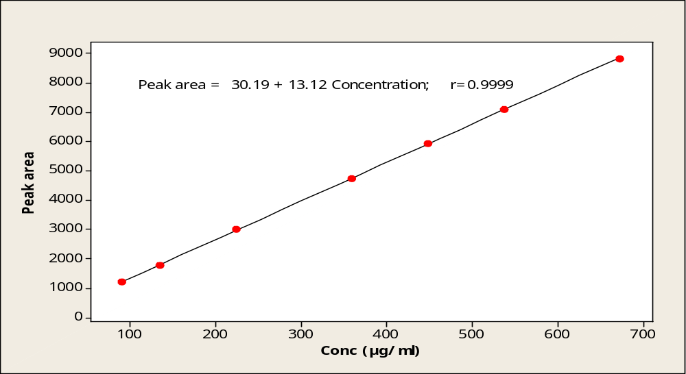
A calibration curve was constructed by plotting the peak area versus concentration of CTP in range of 90-675µg mL-1,

Slide 35
Method validation
Results of assay validation parameters of the proposed HPLC method for determination of CTP
Method parameter | HPLC method
Linearity range | 90-675 µgmL⁻¹
Regression equation (A = bC + a)*
Intercept (a) | 30.2
Slope (b) | 13.1
Correlation coefficient (r) | 0.9999
Accuracy
Mean ± St.dev | 100.4 ± 0.28
50% | 100.50 %
100% | 100.64 %
150% | 100.06 %
Precision
(Intraday %RSD)^{b} | 0.11 %
(Interday %RSD)^{c} | 0.44 %
t-test (2.228)^{d} | 0.62
Robustness | 100.1 – 100.7 %
LOD [µg mL⁻¹] | 5.31
LOQ [µg mL⁻¹] | 16.1
*A is the peak area and C is the concentration.
^{b} Intraday precision (6different determinations at 100% concentrations of / 2 replicate each (n=6))
^{c}Interday precision (6 different determinations at 100% concentrations of / 2 replicate each (n=6)).
^{d}t-tabulated for degree of freedom=10, two sided test at α=0.05.

Slide 36
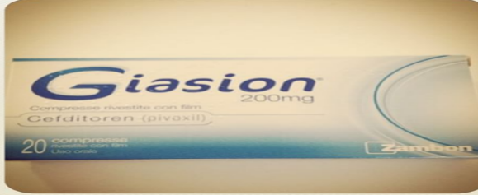
Determination of Cefditoren pivoxil in pharmaceutical formulation (Giasion®400 Tablet ) by the proposed HPLC method
Dosage form | Claimed [mg mL⁻¹] | Found[mg mL⁻¹] | Recovery%
Giasion®400 Tablet Lot No. EE0279 | 0.450 | 0.457 | 101.56
 |  | 0.448 | 99.56
 |  | 0.451 | 100.22
 |  | 0.447 | 99.33
 |  | 0.455 | 101.11
Mean ± SD |  |  | 100.36±0.96
Giasion® film coated tablets by Zambon claimed to contain 490.2 mg of cefditoren pivoxil / tablet = 400 mg of cefditoren.

Slide 37
Statistical comparison between proposed and
reported method for the determination of CTP in
pure powder form.
Item | Cefditoren pivoxil
 | Proposed method | Reported method ª
Mean ± St.dev | 99.89±0.69 | 99.92±0.60
n | 7 | 7
Variance | 0.48 | 0.36
F- value ( 4.28 )^{b} | 0.75
Student's t-test (2.45)^{b} | 0.09
ª Reported method: HPLC method, C18, water- Acetonitrile (50: 50, v/v) as a mobile phase, flow rate of 1.2 ml min⁻¹ and UV detection at 218 nm.
^{b} The figures in parenthesis are the corresponding tabulated values at α= 0.05

Slide 38

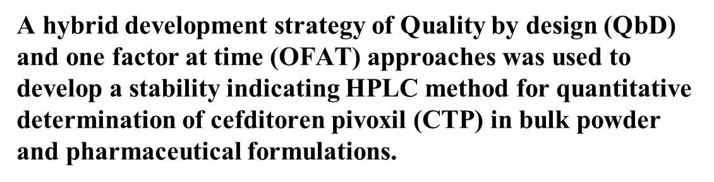

Conclusion

Slide 39
Conclusion
Validation results demonstrated highly specific, accurate, linear, precise and robust method performance.
AQbD development approach introduced good separation, high robustness and confidence in method ability to deliver intended performance.
Design space created during method development, enabled flexibility of method transfer, Provide guidance for troubleshooting method performance.

Slide 40


Slide 41


Any Questions?

