Slide 1
An analysis of Dental Implant Materials with an exclusive focus on Zirconia Vs Titanium
By:
Dr.Saurabh Gupta

Slide 2
Definitions/Terminology
Zircon: Crystal and principal precursor
Zirconium: Metal form of zirconia
Zirconia: White crystalline oxide of zirconium
Zircoium Dioxide: AKA Zirconia

Slide 3
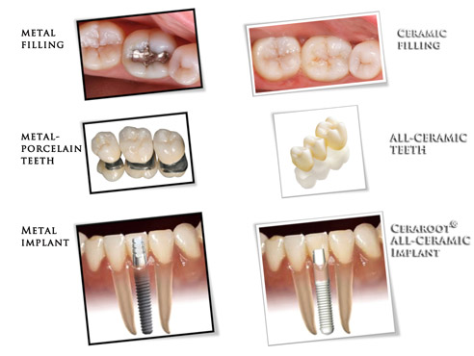
Evolution in Dentistry

Slide 4
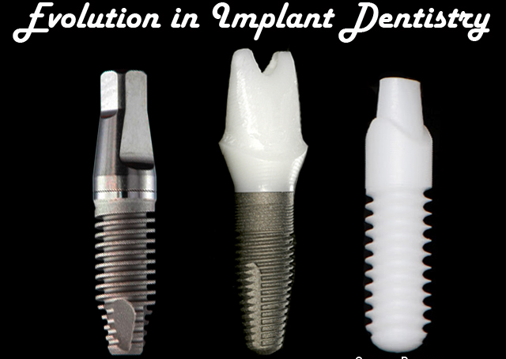

Slide 5
Zirconia implants are an alternative to titanium implants. They were released in 1987 and have recently gained more attention along with holistic dentistry and are being researched.

Slide 6
Zirconia as a Ceramic Dental
Implant Material
Transformation Process

Slide 7
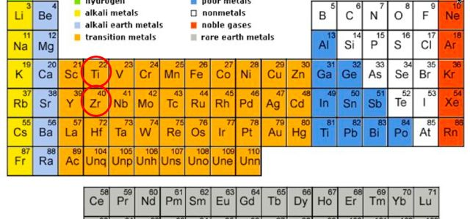
Zirconium
Raw Material
Transitional metal

Slide 8
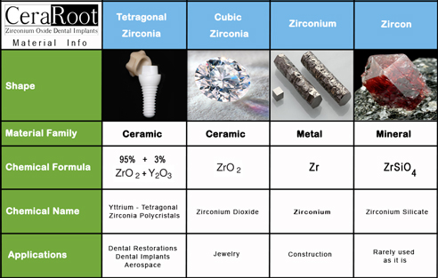
Forms of Zirconia

Slide 9
Chemistry/Process
Obtained by processing/ oxydizing Zirconium (metal)
Initial Chemical Reaction:
Zr + 02 = ZrO2
Zirconium Oxygen Zirconia
(metal) (Ceramic)
Ceramic
ZrO2
Refractory material

Slide 10
Chemistry/Process
ZrO2(Zirconia)
+
AlO2(Alumina): Flexural Strength
+
YO2(Yttria): Aging Resistance
Isostatic Process Compaction + Sintering
Dense Monocline Crystal Structure
Hot Isostatic Pressure(HIP)
Tetragonal crystal structure
HIP-Y-TZP

Slide 11
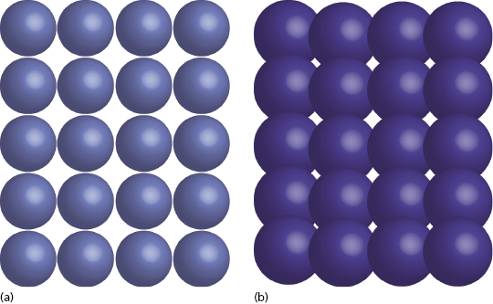
HIP-Y-TZP
Forms of zirconia. (a) Monocline crystalline structure used for crown and bridge fabrication. (b) Tetragonal crystalline structure created after hot isostatic pressing (HIP), used for one-piece implant manufacturing.

Slide 12
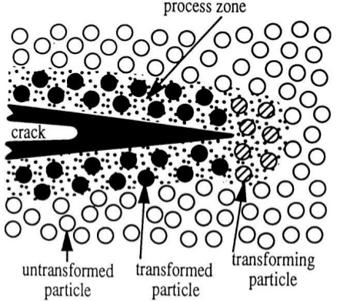
Mechanism of the “crack stop” – Airbag effect
Self- repair capabilities of HIP’d zirconia (HIP-Y-TZP)
AIRBAG EFFECT: Micro crack and the Tetragonal(T) (M) Monocline

Slide 13
Zirconia Ceramic Implant Materials
Dental and Medical Applications
Orthopedics : Hip and Knee replacement(25+years)
Highly Biocompatible
High compressive strength
Inertness in the body fluids
No electrical conductivity (Ions release)

Slide 14
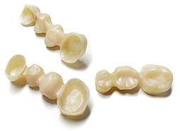
Zirconia Ceramic Implant Materials
Dental Applications(HIP-Y-TZP) 5-10 years
Crowns, copings and frameworks

Slide 15
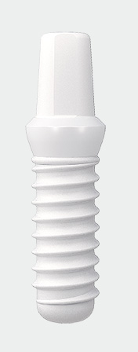

Dental Applications (5-10years)
Types of zirconia implants :
One piece Two piece

Slide 16
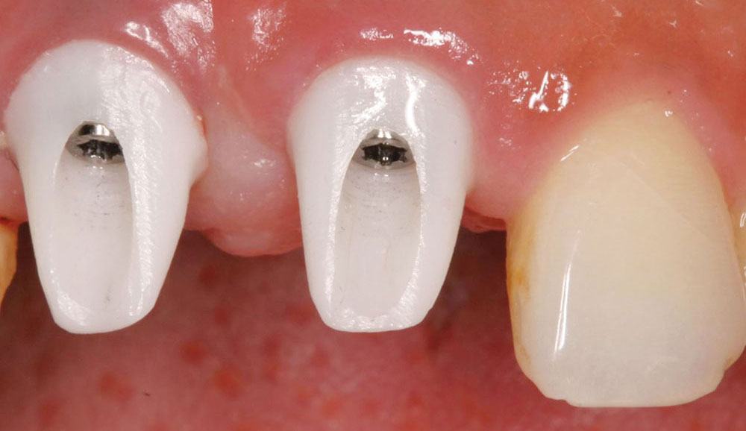
Dental Applications (5-10years)
Abutments on titanium Implants

Slide 17
Does Zirconia Osseointegrate Well as Metal Implants?

Slide 18
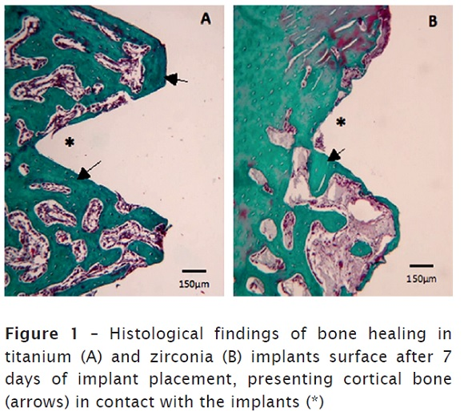
Studies have shown that titanium and zirconia implants have a very similar bone to implant contact(BIC).
BIC = Stability
Notes:
Manzano et al 2014, Monika Strickstrock et al 2017, R Depprich et all 2008

Slide 19
Implant Surface Treatment/Modification
No surface coating(s)
Surface modification and instead sandblasting
Increase in surface contact
Higher Bone-to-implant contact

Slide 20
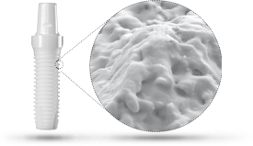
Implant Surface Treatment: Roughness of the surface
Laser Surface Modification
Surface roughness 360%
Bone-to-implant contact > 15%

Slide 21
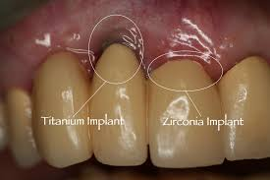
Advantages of a Y-TZP Dental
No grey shadows
Healthy gums
No plaque retention
No soft tissue loss

Slide 22
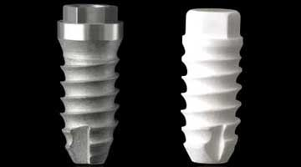
Zirconia Vs Titanium Implants

Slide 23
Peri-implantitis
First, latest studies are showing a significant rate of peri-implantitis with titanium implants.
Titanium seems to attract more bacteria and plaque than ceramic.
Notes:
Peri-implantitis is when the tissue surrounding the implant becomes agitated and inflamed.

Slide 24
Release of titanium particles
Second, there is some evidence that microscopic titanium particles may come off the implant and get trapped in the jaw bone.
Recent studies show that titanium particles are also found throughout the surrounding soft tissue, bone, lymph nodes and even distant organs – Health problems?

Slide 25
Aesthetics
Third, they are grey in color.
Sometimes you can see the greyness through the gum.
Gum around an implant shrink back over a couple of years, exposing the metal surface itself - Not a good look!

Slide 26
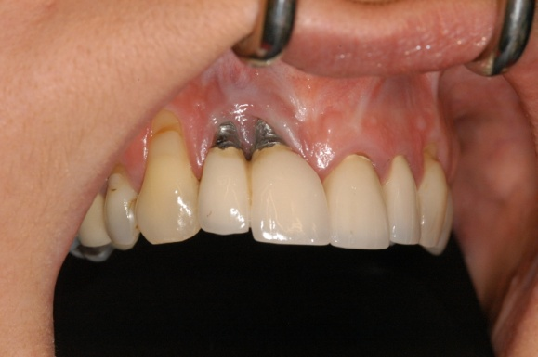
Allergic reaction & Intolerance
Fourth, today’s titanium implants have seen a steady increase in alloy elements added to titanium in order to improve their physical properties and decrease their price.
These new alloy elements are not always as well tolerated by the body, causing some people to have an allergic reaction or intolerance.
Notes:
The Open Chemical and Biomedical Methods Journal, 2009, 2, 26-34
T. Harloff et al. / Health 2 (2010) 306-310

Slide 27
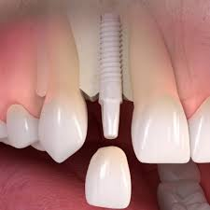
Metal free Implantology
Fifth, a lot of folks nowadays would prefer to get a "metal-free" implant if possible.
They just prefer to minimize the amount of metal in their bodies.

Slide 28

Can ceramic dental implants be a viable alternative to traditional titanium dental implants?
My review of the current "State of the Art"!

Slide 29
Bacteria and especially plaque does not stick to zirconia like it does to titanium less soft tissue inflammation.
Zirconia does not corrode, unlike titanium; does not release any tiny fragments into the surrounding soft tissue, bone or lymph nodes.

Slide 30
3. Tooth-colored doesn’t create a grey shadow under the gums
4. Metal-free implants

Slide 31
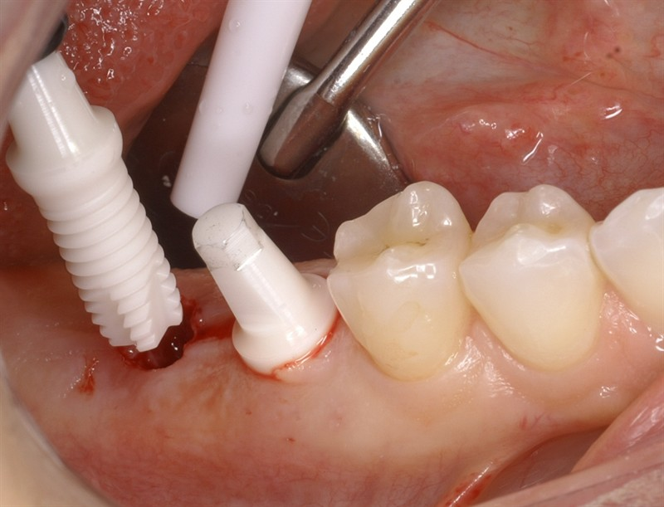
Drawbacks
  Placement:
The implant had to be placed extremely accurately, at the correct angle, and it was very difficult to make adjustments to the angle of the subsequent crown, making ceramic implants more complicated for the surgeon.
Notes:
The major drawback to Zirconia was due to its system design -

Slide 32
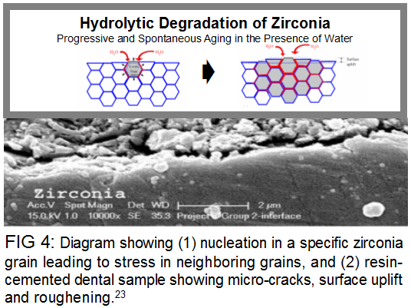
Ageing of Zirconia
LTD (or aging) is defined as the spontaneous t-m transformation occurring over time at low temperatures.

Slide 33

Advancements

Slide 34
New designs of ceramic dental implants are "2-piece”
After the implant has healed up and "integrated" with the jaw bone, the latest designs can correct for angles and different surgical positioning

Slide 35
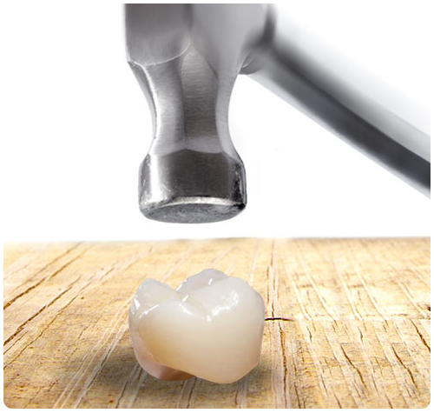
Ceramics are brittle!!
But Zirconia is not a normal ceramic. It is zirconium oxide, and has been nick-named "ceramic steel" due to it's great strength.

Slide 36
Ageing of Zirconia
Zirconia might "age" due to water absorption, and slowly lose strength over a period of years.
But few recent studies shows that aging does not negatively affect the strength of Zirconia.
Simulations show that ceramic dental implants can last many lifetimes without losing their strong structure.

Slide 37
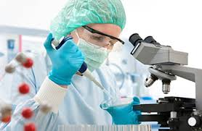
Why zirconia is not the "standard of care" for replacing missing teeth!
A lack of knowledge, and a lack of experience – the research is new.

Slide 38
Future Perspectives
Zirconia implants will gain popularity, due to patient health and aesthetic concerns.

Slide 39

THANK YOU
Dr.Saurabh Gupta
saurabh.ravzz@gmail.com
www.iaoci.com

