Slide 1
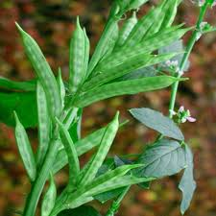
Guar Gum Revisited: Potential Carrier for Targeted Drug Delivery Systems
Dr. Saurabh Dahiya
School of Pharmaceutical Sciences,
Apeejay Stya University, Gurgaon, India.

Slide 2
Guar gum has high drug loading capacity, biocompatibility, and biodegradability which are the key points to design a drug delivery system effectively.
The pursuit of this review presentation is to concisely describe the recent developments of guar gum based drug delivery systems.
Furthermore, biomedical applications and current clinical trial studies of these experimental drug deliveries are summarized briefly. Here, different types of drug deliveries along with the procedure and mechanism of drug release from
carrier are mainly focused.

Slide 3

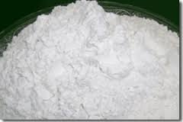
Introduction: Guar Gum
Scientific Name: Cyamopsis tetragonolobus (L.)
Common Name(s): Guar , guar flour , jaguar gum
Family: Fabaceae
Botany: The guar plant is a small nitrogen fixing annual that bears pods, each containing a number of seeds. Native to tropical Asia, the plant grows throughout India and Pakistan and has been grown in the southern US since the beginning of the 20th century.
Agriculture: The world’s production of Guar is concentrated in India, Pakistan and United States with limited amounts grown in South Africa and Brazil. It is suited for sandy, coarse and well drained soils. Most is grown in the areas where rainfall is very less.
Guar gum is a dietary fiber obtained from the endosperm of the Indian cluster bean. The endosperm can account for more than 40% of the seed weight and is separated and ground to form commercial guar gum.
It is white to yellowish white, nearly odourless powder with bland taste.
It is practically insoluble in organic solvents. In cold or hot water, guar gum disperses
and swells almost immediately to form a highly viscous thixotropic sol.
1.Raymond C. RoweSian C. Owen Paul J. Sheskey, Handbook of Pharmaceutical Excipients. , and 6th Edition, 2009, 369
2. Tauseef S., S.Sasi K.,Pharmaceutical and pharmacological profile of guar gum an overview. International Journal of Pharmacy and Pharmaceutical Sciences, ISSN- 0975-1491 Vol 3, Suppl 5, 2011.
3. Guar gum assessed at Drugs.com on February 28, 2015.

Slide 4
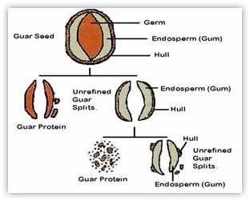
Morphology: Guar Bean
Guar Bean Morphology: Guar beans grow in pods which
are one to two inches long. Typically, there are 6 to 9
Beans per pod.
The seeds are dicotyledons which indicates that there are two endosperm halves per seed.
The endosperm accounts for about one third of the bean weight and contains the majority of the galactomannan. The remaining two thirds are hull and germ which are very high in protein and fiber.
Purity of the polymer depends on effective separation of the hull and germ from the endosperm.
Endosperm halves (splits) may be processed or modified and compounded into guar products with specialized properties. The germ portion of the seed is predominantly protein and the endosperm predominantly guaran.

Slide 5
Industrial Applications
Guar gum has been used for centuries as a thickening agent for foods and pharmaceuticals. It continues to find extensive use for these applications as well as the paper, textile, and oil drilling industries.
The white free flowing powder derived from guar splits, is widely used by the global oil and gas industry for “fracking” a hydraulic fracturing technique.
Due its unique binding properties — the ability to suspend solids, bind water by hydrogen bonding, control the
viscosity of aqueous solutions and form strong tough films — guar gum is mixed with water and sand to “frack” shale gas out of sedimentary shale rock formations.
Owing to unprecedented demand from the United States, China, Germany, Russia and Australia (top five importers), everyone in western Rajasthan with a few bighas to spare decided to jump on the guar bandwagon, forgoing even cash crops like cotton to grow more guar.
India’s production contributes to 80% of the world’s total production figuring up to 6 lakh tons. Synthetic derivatives of guar gum such as guar acetate, guar phthalate, guar acetate phthalate, oxidized guar gum and sodium carboxymethyl guar have also been investigated for their pharmaceutical applications.
The continuous study and research are going on and still more focus is needed to invent its novel application for various sectors.

Slide 6
Guar Gum Business
Exports of guar gum from India: 2,18,479.71 MTs in 2009-10,
7,07,326.43 MTs in 2011-12. (223 % rise)
The rise in the value of exports over these three years period was more outlandish, from $239.08 million to $3446.36 million (over 1,300 % rise).
(Source: Agricultural Products Export Development Authority)
On March 21, 2012 the price of guar gum created history by peaking to Rs.1,00,195/100 kg in the Jodhpur spot market.
(Source: NCDEX and FMC bulletin)
Mar 1, 2015 12:35:17 PM | http://www.thehindu.com/opinion/oped/likevegetableforoil/article4611047.ece

Slide 7
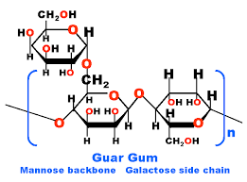
Guar Gum Chemistry
Guar is a galactomannan polysaccharide that forms a viscous gel when placed in contact with water. It forms solutions that range from slightly acidic to neutral pH. Even at low concentrations (1% to 2%) guar gum forms gels in water. The viscosity of these gels is generally unaffected by the pH of the solution.
Food grade guar gum contains ≈ 80% guaran (a galactomannan composed of D mannose and D galactose units) with an average molecular weight of 220 kDa.
However, guar gum is not a uniform product and its viscosity may vary in proportion to the degree of galactomannan crosslinking. Because of this physical composition, guar gum based matrix tablets are currently being evaluated as a method of administering sustained release drugs including Diltiazem, and for colonic drug delivery of corticosteroids to patients with inflammatory bowel disease.
1. Leung AY. Encyclopedia of Common Natural Ingredients Used in Food, Drugs, and Cosmetics . New York, NY: John Wiley and Sons; 1980.
2. Altaf SA, Yu K, Parasrampuria J, Friend DR. Guar gumbased sustainedrelease diltiazem. Pharm Res . 1998;15:11961201.
3. Khullar P, Khar RK, Agarwal SP. Evaluation of guar gum in the preparation of sustained release matrix tablets. Drug Dev Ind Pharm . 1998;24:10951099.
4. Kenyon CJ, Nardi RV, Wong D, Hooper G,. Wilding IR, Friend DR. Colonic delivery of dexamethsone: a pharmacoscintigraphic evaluation. Aliment Pharmacol Ther . 1997;11:205213.
5. Guar gum assessed at Drugs.com on February28, 2015.

Slide 8
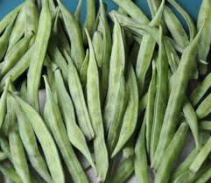
Pharmaceutically important properties of Guar Gum
It consists chiefly of high molecular weight hydrocolloidal polysaccharide, composed of galactan and mannan units combined through glycosidic linkages and shows degradation in the large intestine due the presence of microbial enzymes.
Guar gum is used as a binder, disintegrant in tablet formulations. It also acts as a stabilizer, emulsifier, thickening, and suspending agent in liquid formulations. It has been widely used for colonic drug delivery applications. The swelling ability of guar gum is used in the retardation of drug release from the dosage forms. Its utility as a carrier for colon specific drug delivery is based on its degradation by colonic bacteria.
1. Rama Prasad, Y.V.; Krishnaiah, Y.S.R.; Satyanarayana, S. In vitro Evaluation of Guar Gum as a Carrier for Colon-Specific Drug Delivery. J. Control. Release 1998, 51, 281-287.
2. Krishnaiah, Y.S.R.; Satyanarayana, S.; Rama Prasad, Y.V.; Narasimha Rao, S. Gamma Scintigraphic Studies on Guar Gum Matrix Tablets for Colonic Drug Delivery in Healthy
Subjects. J. Control. Release 1998, 55, 245-252.
3. Krishnaiah, Y.S.R.; Satyanarayana, S.; Rama Prasad, Y.V.; Arasimha Rao, S. Evaluation of Guar Gum as a Compression Coat for Drug Targeting to Colon. Int. J. Pharm. 1998, 171, 137-146.
4. Veeran Gowda K. and Guru V. B., Water Soluble Polymers for Pharmaceutical Applications, Polymers 2011, 3, 1972-2009; doi:10.3390/polym3041972.

Slide 9
In pharmaceuticals, guar gum is used in solid dosage forms as a binder, disintegrant, and as a polymer in the floating drug delivery system.
Guar gum mainly consisting of polysaccharides of high molecular weight (50,000-8,000,000) composed of galactomannans, mannose: galactose ratio is about 2:1.
It consists of linear chains of (1-4)-b-D-mannopyranosyl units with a-D-galactopyranosyl units attached by (1-6) linkages.
It is soluble in hot and cold water but insoluble in most organic solvents. It has excellent thickening, emulsion, stabilizing, and film forming properties. It has an excellent ability to control rheology by water phase management. The viscosity of guar
gum is influenced by temperature, pH, presence of salts, and other solids.
In the subsequent slides, I have concluded findings from various researches involving the usage of guar gum in various scenarios for development of Targeted Drug Delivery Systems.
1. Kaushik A.Y., Tiwari A.K., Gaur A., Role of excipients and polymeric advancements in preparation of floating drug delivery systems. International Journal of Pharmaceutical Investigation | January 2015 | Vol 5 | Issue 1 .
2. Krishnaiah YS, Karthikeyan RS, Gouri Sankar V, Satyanarayana V. Three-layer guar gum matrix tablet formulations for oral controlled delivery of highly soluble trimetazidine dihydrochloride. J Control Release 2002;81:45-56.
3. Al-Saidan SM, Krishnaiah YS, Patro SS, Satyanaryana V. In vitro and in vivo evaluation of guar gum matrix tablets for oral controlled release of water-soluble diltiazem hydrochloride.
AAPS PharmSciTech 2005;6:E14-21.
4. Das S, Deshmukh R, Jha AK. Role of natural polymers in the development of multiparticulate systems for colon targeting. Syst Rev Pharm 2010;1:79.
5. Sinha VR, Kumria R. Polysaccharides in colon-specific drug delivery. Int J Pharm 2001;224:19-38.
6. Evans WC. Pharmacognosy. 16th ed. New York: Saunders Elsevier; 2009. p. 194-218.
7. Wassel GM, Omar SM, Ammar NM. Application of guar flour and prepared guaran in tablet manufacture. J Drug Res 1989;18:1-8.

Slide 10
Guar gum used as an excepient for sustained release :
“Formulation and Evaluation of Fixed-Dose Combination of
Bilayer Gastroretentive Matrix Tablet Containing Atorvastatin as Fast-Release and Atenolol as Sustained-Release”
The objective of the present study was to develop bilayer tablets of Atorvastatin and Atenolol that are characterized by initial fast release of Atorvastatin in the stomach and comply with the release requirements of sustained-release of Atenolol.
Xanthan gum and Guar gum were used as the candidate matrix-forming material to obtain suitable slow release of the drug from the sustained-release layer present in the prepared bilayer tablets due to biocompatibility, inertness, and its wide application as sustained-release excipients.
Xanthan gum and Guar gum were integrated in the sustained-release layer. Bilayer tablets composed of sustained-release layer (10% w/w of Xanthan gum and Guar gum) and fast-release layer [1 : 3 (drug/cyclodextrin)] showed the desired release profile.
These tablets were composed of sustained-release layer and prepared using 10% w/w of Xanthan gum and 10% w/w of Guar gum of total weight of sustained-release layer and fast-release layer, containing Atorvastatin-𝛽-CD solvent evaporation product in 1 : 3 (drug/CD) molar ratio which was proven to be advantageous in the context of enhancing atorvastatin dissolution characteristics in acidic medium.
Sanjay Dey, Sankha Chattopadhyay, and Bhaskar Mazumder. Formulation and Evaluation of Fixed-Dose Combination of Bilayer Gastroretentive Matrix Tablet Containing Atorvastatin as Fast-Release and Atenolol as Sustained-Release. BioMed Research International Volume 2014, Article ID 396106, 12 pages http://dx.doi.org/10.1155/2014/396106

Slide 11
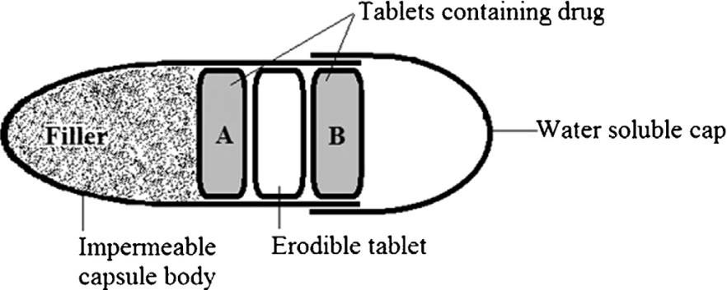
Guar gum used for Chronotherapeutic DDS:
“Utilizing Guar Gum for Development of “Tabs In Cap’ System of Losartan Potassium for Chronotherapeutics”
Schematic diagram of ‘Tablets in capsule’ system designed for bipulse drug release. Tablet A and Tablet B contain drug, separated by an erodible tablet of guargum. (Adapted from reference given below.)
The drug selected was Losartan, an angiotensin receptor blocker reported effective for therapy in patients with hypertension and renal insufficiency. It acts on the renin angiotensin aldosteron system and reduces the intra glomerular pressure that further results in reduction of renal function. Gaur gum erodible tablet was used as time programmer and was sandwiched between two drug loaded tablets (as shown in figure). The assembly was capsulated in an impermeable capsule body and water soluble cap that were sealed.
1. Gangwar G., Kumar A., Pathak K., Utilizing Guar Gum for Development of “Tabs In Cap’ System of Losartan Potassium for Chronotherapeutics. International Journal of Biological Macromolecules 72 (2015) 812–818.
2. T.D. Joseph, L.T. Robert, R.M. Gary, G.W. Barbara, P. Michal, Pharmacotherapy APathophysiologic Approach, 7thed., McGraw-Hill Medical Publishing Division, New York, 2013.
3. H. Kobayashi, Guar gum: A versatile industrial plant polymer, Adv. Mat. Lett. 3(2012) 265.
4. T. Shaikh, S. Sasikumar, Pharmaceutical and Pharmacological Profile of Guar Gum: An Overview, Int. J. Pharmacy Pharm. Sci. 3 (Suppl 5) (2001)38–40.

Slide 12
Selection of guar gum as the significant constituent of the time based system was made on the following pharmaceutical considerations:
A non-ionic carbohydrate polymer is chemically a galactomannan consisting straight chain of mannose units attached by ˇ-D-(1→4) linkages, having ˛-D-galactopyranosyl unit bonded to poly (mannose) chain through (1→6) glycosidic links.
Molecular weight of galactomannan varies ranging from 50 to 8000 kDa depending on the seeds and origin of plants; however polymer usually contains a definite ratio of building blocks, 1: 2 ratio of galactose to mannose.
In water, it forms hydrocolloid reducing the diffusion of water molecules and stablizes its presence. Such water may be held specifically through direct hydrogen bonding or the structuring of water or within extensive but contained inter- and intramolecular voids .
The ability of guar gum to hydrate in water was utilized as time programmer for targeted biphasic delivery of the antihypertensive drug.

Slide 13
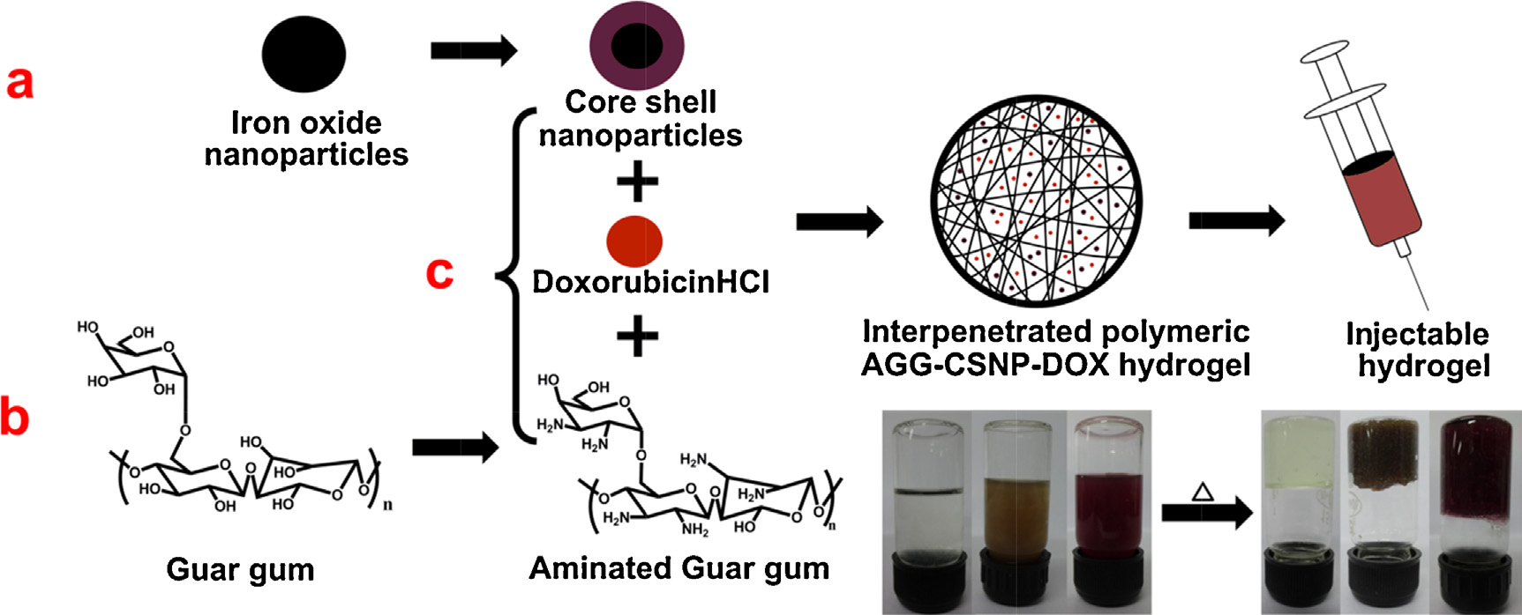
Guar gum used to prepare temperature sensitive magnetic nanoparticles:
“Thermo responsive magnetic nanoparticle – Aminated guar gum hydrogel system for sustained release of doxorubicin hydrochloride”
Schematic showing (a) the synthesis of CSNP from IONP, (b) the synthesis of AGG from GG and (c) the preparation of AGG-CSNP-DOX injectable hydrogel system.
(Figure adapted from reference given below.)
In this study, a stable injectable magnetic nanoparticle incorporated hydro-gel system was prepared as an alternative for the long-term drug release and diagnosis to the cancer patients. The injectable hydrogel system consisted of AGG as the biodegradable polymer and gelling agent, DOX as the anticancer drug and CSNP as the imaging agent without using any toxic crosslinkers. Studies reveal that a strong gel was formed by the reaction between NH3+ groups and water molecules at 37◦C and stable over a wide temperature and pH range. The in vitro drug releasing tendency of DOX is seen up to 21st day of incubation demonstrating the sustained delivery over long period. Hence, the prepared thermo-responsive injectable hydrogel system shows promising applications such as sustained drug release for the solid tumor treatment.
Murali R., Vidhya P., Thanikaivelan P., Thermoresponsive magnetic nanoparticle – Aminated guar gumhydrogel system for sustained release of doxorubicin hydrochloride. Carbohydrate Polymers 110 (2014) 440–445.

Slide 14
Direct administration of chemotherapeutic agents in cancerous solid tumors has shown severe side effects in the system (Kintzel & Dorr, 1995). Injectable hydrogel is an alternative and effective system that can deliver the drug to specific tissues thereby reducing the drug side effects as well as the injection frequency.
The investigators synthesized an injectable hydrogel system comprising biocompatible aminated guar gum, Fe₃O₄–ZnS core–shell nanoparticles and Doxorubicin hydrochloride.
They have further shown that amination of guar gum resulted in attraction of water molecules thereby forming the hydrogel without using toxic crosslinking agents.
Hydrogel formation was observed at 37◦C and was stable up to 95 ◦C.
Thus prepared hydrogel is also stable over a wide pH range.
The in vitro studies show that the maximum de-gelation and drug release up to 90% could be achieved after 20 days of incubation.
Studies reveal that the drug and the core–shell nanoparticles can be released slowly from the hydrogel to provide the healing and diagnosis of the solid tumor thereby avoiding several drug administrations and total excision of organs.

Slide 15
Guar gum used in development of floating DDS:
“Formulation and evaluation of norfloxacin gastro retentive drug delivery systems using natural polymers”.
Dosage forms based on floating systems are basically classified into two types :
1. Effervescent Systems and.
2. Non-effervescent Systems.
In the case of effervescent system, gas-generating agents are used for the effervescence in dosage form and
in case of noneffervescent systems only swellable polymers or hydrocolloids are used e.g., hydroxy propyl methyl cellulose HPMC, Eudragit are used. Guar gum may find an application in development of floating DDS.
Thahera et al. (2012) developed floating system of Norfloxacin with guar gum, sodium CMC, HPMC15 KM with other excipients such as povidone (PVP) K30 (binder), sodium bicarbonate, and microcrystalline cellulose in different concentrations. The formulations were found to extend the drug release over a period of 7-12 h and the drug release decreased with decrease in polymer concentration. A formulation which exhibited 99.87% of drug release in 12 h, and floating lag time of 130 s with a floating time of 24 h was considered as ideal formulation and no drug-excipient interaction in the prepared formulations was confirmed by FTIR studies.
1. Kaushik A.Y., Tiwari A.K., Gaur A., Role of excipients and polymeric advancements in preparation of floating drug delivery systems. International Journal of Pharmaceutical Investigation | January 2015 | Vol 5 | Issue 1 .
2. Thahera PD, Latha AK, Shailaja T, Nyamathulla S, Uhumwangho MU. Formulation and evaluation of norfloxacin gastro retentive drug delivery systems using natural polymers. Int Curr Pharm J. 2012;1:155-64.
3. Sharma N, Agarwal D, Gupta MK, Khinchi MP. A comprehensive review on floating drug delivery system. Int J Res Pharm Biomed Sci 2011;2:428-41.
4. Mayavanshi AV, Gajjar SS. Floating drug delivery systems to increase gastric retention of drugs: A review. Res J Pharm Technol 2008;1:345-8.

Slide 16
Guar gum finds use in designing Metformin floating tablets:
“Formulation and characterization of metformin hydrochloride floating tablets”.
Hajare and Patil (2012) designed floating tablet of Metformin Hcl, an anti-diabetic biguanide with poor bioavailability and absorption window at the upper part of gastrointestinal tract prepared by wet granulation method incorporating natural polymers Guar Gum and k-carrageen and a polymer HPMC either alone or in combination.
Formulation prepared with a combination of 6% w/w k-carrageen, and 11% w/w guar gum showed good gel strength, stable, and persistent buoyancy for 12 h, least floating
lag time of 58 s with good matrix integrity throughout dissolution period.
Comparison study with Glutamet® showed that the optimized formulation has better and complete release than the marketed product.
The presented research studies revealed usefulness of natural polymers over synthetic.
1. Kaushik A.Y., Tiwari A.K., Gaur A., Role of excipients and polymeric advancements in preparation of floating drug delivery systems. International Journal of Pharmaceutical Investigation | January 2015 | Vol 5 | Issue 1 .
2. Hajare AA, Patil VA. Formulation and characterization of metformin hydrochloride floating tablets. Asian J Pharm Res 2012;2:111-7.

Slide 17
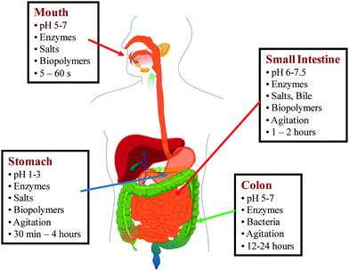
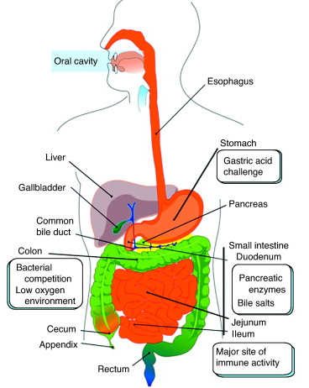
Anatomical spaces important for a formulation scientist
Reference: Pictures adapted from Trends in Biotechnology.

Slide 18
Colonic drug delivery
Site-specific drug delivery to the colon has attracted considerable attention for the past few years in order to develop drug delivery systems that are able to release drugs specifically in the colon in a predictable and reproducible manner.
Colonic drug delivery has gained increased importance not just for the delivery of the drugs for the treatment of local diseases associated with the colon like Crohn’s disease, ulcerative colitis, irritable bowel syndrome and constipation but also for the systemic delivery of proteins, therapeutic peptides, antiasthmatic drugs, antihypertensive drugs and antidiabetic agents.
The site specific drug delivery to colon is important for the treatment of diseases
associated with the colon, reducing the side effects of the drug and reducing the administered dose.
There are various techniques through which colon drug targeting can be achieved, for example, formation of prodrug, coating with pH sensitive polymers, coating with biodegradable polymers, designing formulations using polysaccharides, timed released systems, pressure-controlled drug delivery systems, osmotic pressure controlled systems etc.

Slide 19
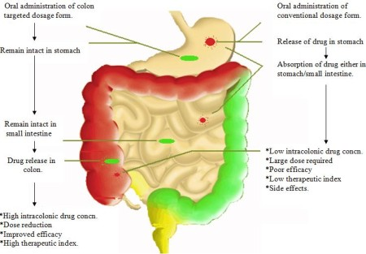
The successful targeted delivery of drugs to the colon via the GIT requires the protection of a drug from degradation and release in the stomach and small intestine and then ensures abrupt or controlled release in the proximal colon. This might be achieved by the use of suitably designed drug delivery systems (DDS) that can protect the drug during its transfer to the colon. Targeting relies on exploiting a unique feature of the intended site and protecting the active agent until it reaches that site.
Fell JT. Targeting of drugs and delivery systems to specific sites in the gastrointestinal tract. J Anat 1996;89:517-9.
Picture adapted from Trends in Biotechnology.

Slide 20
Guar Gum based matrix tablets of Dexamethasone for Colonic delivery:
“In vitro evaluation of dissolution behavior for a colon-specific drug delivery system (CODES™) in multi-pH media using United States Pharmacopeia apparatus II and III”
Guar Gum based matrix tablets of Dexamethasone and other antiinflammatory agents have shown very encouraging results as colon-carriers.
In this study, matrix tablets of Dexamethasone and Budesonide were prepared using 60.5% (w/w) of Guar Gum in the tablets.
The study showed negligibe drug release in simulated gastric and intestinal fluid whereas in simulated colonic fluid significant increase in drug release was observed.
The study demonstrated that the galactomannanase (∼0.1%) accelerated dissolution of Dexamethasone and Budesonide from GG matrix tablet. The extent of drug
dissolution depended on the concentration of galactomannanase.
Guar Gum can potentially be used as a natural polymeric biodegradable material for the preparation of colon specific delivery systems of drugs by either compressing native guar into matrix tablets or chemical modification to reduce its swelling properties.
1.M. Prabaharan , Prospective of guar gum and its derivatives as controlled drug delivery systems. International Journal of Biological Macromolecules 49 (2011) 117–124.
2. D. Wong, S. Larrabeo, K. Clifford, J. Tremblay, D.R. Friend, J. Control. Release 47 (1997) 173–179.

Slide 21
Guar Gum as a Carrier in Colonic Drug Delivery:
Matrix tablet of Indomethacin with GG
Rama Prasad et al. prepared matrix tablets of Indomethacin with GG. These tablets were found to retain their integrity in 0.1M HCl for 2 h and in Sorensen’s phosphate buffer (pH 7.4) for 3 h releasing only 21% of the drug in these 5 h. However, in the presence of 2% rat cecal contents the drug release increased and further increased with 4% concentration of cecal contents. The drug release improved to about
91% in 4% cecal content medium after the enzyme induction of rats.
This study suggests the specificity of these matrices for enzyme trigger in the colon to release the drug. In the absence of enzyme system the GG swells to form a viscous layer that slows down the seeping of the dissolution fluid into the core. The initial 21% release
can be attributed to the dissolution of Indomethacin present on the surface of the tablet.
These investigations re-proved the suitability of GG as a carrier in colonic drug delivery.
1.M. Prabaharan , Prospective of guar gum and its derivatives as controlled drug delivery systems. International Journal of Biological Macromolecules 49 (2011) 117–124.
2. Y.V.RamaPrasad, Y.S. Krishnaiah, S. Satyanarayana, J. Control. Release 51 (1998) 281–287.

Slide 22
Guar Gum as a Compression Coating Agent for Colonic Drug Delivery:
“Compression coated tablets of 5-ASA and matrix tablets of Mebendazole”
In this research work, GG was evaluated as a compression coating agent to protect the drug core of 5-amino salicylic acid (a drug used for the treatment of ulcerative colitis) in upper GIT.
The tablets coated with 300, 200 and 150mg of GG showed cumulative mean drug release percentages of 5.98±0.70, 8.67±0.35 and 12.09±0.29, respectively, after 26 h while tablets coated with 125mg GG disintegrated within 5min in simulated gastric fluid.
Cores with GG coat as high as 300 and 200mg could not successfully release the drug in the presence of rat cecal contents even in 26 h as drug release was 23.85±3.13 and 63.43±6.30%, respectively.
However, the formulation with 150mg of GG as a coating showed 95.51±1.50% of 5-ASA release in the presence of rat cecal contents after 26 h.
Percent drug release from tablet increased considerably from 11th hour and the tablets were completely disintegrated in 26 h.
M. Prabaharan , Prospective of guar gum and its derivatives as controlled drug delivery systems. International Journal of Biological Macromolecules 49 (2011) 117–124
Y.S.R. Krishnaiah, S. Satyanaryana, Y.V. Rama Prasad, Drug Dev. Ind. Pharm. 25 (1999) 651–657.
Y.S.R. Krishnaiah, P.V. Raju, B. Dinesh kumar, P. Bhaskar, V. Satyanarayana, J. Control. Release 77 (2001) 87–95.

Slide 23
The results of drug release studies on compression coated tablets suggested that the thickness of GG coating in the range of 0.61–0.91mm was sufficient to deliver the drugs selectively to the colon.
The results of the studies showed that matrix tablets containing either 20% or 30% of GG is most likely to provide targeting of Mebendazole for local action in the colon.

Slide 24
Why is usage of Guar gum so favored in Colonic Drug Delivery?
Dosage forms enjoy the shielding effect of polysaccharide in upper part of GIT and drug is released in the colon by swelling and biodegradable action of polysaccharidases.
Polysaccharides naturally occurring in plant (e.g. guar gum, pectin, inulin), animal (e.g., chitosan, chondroitin sulfate), algal (e.g. alginates), or microbial (e.g., dextran) origins can be tested for colon targeting. These are broken down by the colonic microflora to simple saccharides by saccharolytic species like bacteroides and bifidobacteria. Hydrolysis of the glycosidic linkages on arrival in the colon triggers the release of the entrapped bioactive.
Although, specifically degraded in the colon, many of these polymers are hydrophilic in nature, and swell under exposure to upper GI conditions, which leads to premature drug release.
To overcome this problem, the natural polysaccharides are chemically modified and mixed with hydrophobic water insoluble polymers, whereas in the case of formulations they are usually coated with pH sensitive polymers.

Slide 25
Guar Gum based tablet formulations of 5-fluorouracil
Intravenous administration of 5-fluorouracil for colon cancer therapy could produce severe systemic side-effects due to its cytotoxic effects on normal cells.
To avoid such problems, recently GG based tablet formulations were developed for site-specific delivery of 5- fluorouracil to the colon without the drug being released in the stomach or small intestine.
In this study, fast disintegrating 5-fluorouracil core tablets were compression coated with 60%, 70% and 80% of GG, and were subjected to in vitro drug release studies.
The amount of 5-fluorouracil released from the compression coated tablets in the dissolution medium at different time intervals was estimated by a HPLC method. GG compression-coated tablets released only 2.5–4% of the 5-fluorouracil in simulated GI fluids.
The results of the study show that compression-coated tablets containing 80% of GG are most likely to provide targeting of 5-fluorouracil for local action in the colon, since they released only 2.38% of the drug in the physiological environment of the stomach and small intestine.
M. Prabaharan , Prospective of guar gum and its derivatives as controlled drug delivery systems. International Journal of Biological Macromolecules 49 (2011) 117–124
Y.S.R. Krishnaiah, V. Satyanarayana, B. Dinesh Kumar, R.S. Karthikeyan, Eur. J. Pharm. Sci. 16 (2002) 185–192.

Slide 26
Methotrexate loaded Guar Gum Microspheres
In this study, Methotrexate loaded GG microspheres were prepared by the emulsification method using glutaraldehyde as a cross-linking agent for colon specific
drug delivery. It was found that particle size, shape, and surface morphology were significantly affected by GG concentration, glutaraldehyde concentration, emulsifier concentration (Span 80), stirring rate, stirring time, and operating temperature.
Methotrexate-loaded microspheres demonstrated high entrapment efficiency (75.7%). The in vitro drug release was investigated using a USP paddle type (type II) dissolution rate test apparatus in different media PBS, gastrointestinal fluid of different pH, and rat cecal content release medium), which was found to be affected by a change to the GG concentration and glutaraldehyde concentration.
The drug release in PBS (pH 7.4) and simulated gastric fluids followed a similar pattern and had a similar release rate, while a significant increase in percent cumulative drug release (91.0%) was observed in the medium containing rat cecal content.
In in vivo studies, GG microspheres delivered most of their drug load (79.0%) to the colon, whereas plain drug suspensions could deliver only 23% of their total dose
to the target site.
M. Prabaharan , Prospective of guar gum and its derivatives as controlled drug delivery systems. International Journal of Biological Macromolecules 49 (2011) 117–124
M. Chaurasia, M.K. Chourasia, N.K. Jain, A. Jain, V. Soni, Y. Gupta, S.K. Jain, AAPS PharmSciTech 7 (2006) E1–E9.

Slide 27
Designing GG based oral delivery of Protein pharmaceuticals
The most challenging task in the development of protein pharmaceuticals is to deal with physical and chemical instabilities of proteins. Protein instability is one of the major reasons due to which protein pharmaceuticals are administered traditionally through injection rather than taken orally like most small chemical drugs.
Peptide and protein drugs are readily degraded by the low pH of the gastric medium in the stomach. In order to achieve the successful oral delivery of protein drugs, they need to be protected from the harsh environment in the stomach. For designing oral dosage forms, the formulator must consider that the natural pH environment of GI tract varies from acidic (pH∼1.2) in the stomach to slightly alkaline in the intestine (pH∼7.4).
In the design of oral delivery of peptide or protein drugs, pH sensitive hydrogels have attracted increasing attention. Swelling of such hydrogels in the stomach is minimal and thus the drug release is also minimal. Due to increase in pH, the extent of swelling
increases as the hydrogels pass down the intestinal tract. A variety of synthetic or natural polymers with acidic or basic pendant groups have been employed to fabricate pH sensitive hydrogels for getting the desired controlled release of protein drugs.
M. Prabaharan , Prospective of guar gum and its derivatives as controlled drug delivery systems. International Journal of Biological Macromolecules 49 (2011) 117–124
W. Wang, Int. J. Pharm. 185 (1999) 129–188.
L. Shargel, A. Yu, Applied Biopharmaceutics and Pharmacokinetics, forth ed., McGraw-Hill, New York, 1999.
Y. Kimura, Biodegradable polymers, in: T. Tsuruta, T. Hayashi, K. Katsoka, K. Ishihara, Y. Kimura (Eds.), Biomedical Applications of Polymeric Materials, CRC Press Inc., Boca Raton, 1993, pp. 164–190.

Slide 28
Guar gum based technique for Protein delivery………
Recently, George and Abraham et.al designed a pH sensitive alginate–GG hydrogel cross-linked with glutaraldehyde for the controlled delivery of protein drugs.
Alginate is a non-toxic polysaccharide with favorable pH sensitive properties for intestinal delivery of protein drugs. Drug leaching during hydrogel preparation and rapid dissolution of alginate at higher pH are major limitations, as it results in very low entrapment efficiency and burst release of entrapped protein drug, once it enters the intestine.
To overcome these limitations, in this study, GG was included in the alginate matrix along with a cross linking agent to ensure maximum encapsulation efficiency and controlled drug release.
The release profiles of a model protein drug (BSA) from alginate–GG hydrogels were studied under simulated gastric and intestinal media. The results of this study showed that the presence of GG and glutaraldehyde cross-linking increases entrapment efficiency and prevents the rapid dissolution of alginate in higher pH of the intestine, which ensures a controlled release of the entrapped drug.
M. Prabaharan , Prospective of guar gum and its derivatives as controlled drug delivery systems. International Journal of Biological Macromolecules 49 (2011) 117–124
M. George, T.E. Abraham, Int. J. Pharm. 335 (2007) 123–129.

Slide 29
Guar Gum based Transdermal drug delivery systems
Transdermal drug delivery device, provides an alternative route for administering medication i.e. across the skin barrier.
In theory, transdermal patches work very simply. A drug is applied in a relatively high dosage to the inside of a patch, which is worn on the skin for an extended period of time. Through a diffusion process, the drug enters the bloodstream directly through the skin. Since there is high concentration on the patch and low concentration in the blood, the drug will keep diffusing into the blood for a long period of time, maintaining the constant concentration of drug in the blood flow.
Recently, Murthy et al. evaluated carboxymethyl GG for its suitability of use in transdermal drug delivery systems. The polymer exhibited good film forming ability and therefore used to prepare films possessing desired properties by varying the composition of the casting solution. In this study, terbutaline sulfate was used as a model drug.
M. Prabaharan , Prospective of guar gum and its derivatives as controlled drug delivery systems. International Journal of Biological Macromolecules 49 (2011) 117–124
H.C. Ansel, A.V. Loyd, N.G. Popovich, Pharmaceutical Dosage Forms and Drug Delivery Systems, seventh ed., Lippincott, Williams & Willkins, Philadelphia, 1999.
S.N. Murthy, S.R.R. Hiremath, K.L.K. Paranjothy, Int. J. Pharm. 272 (2004) 11–18.

Slide 30
Guar gum based Delivery of Phytopharmaceuticals:
“In vitro studies on guar gum based formulation for the colon targeted delivery of sennosides”
The action of sennosides is mainly upon the large intestine and is, therefore, especially suitable in habitual constipation. The present study was carried out to develop colon-targeted delivery system for sennosides using guar gum as a carrier.
Matrix tablets containing various proportions of guar gum were prepared by wet granulation technique using starch paste as a binder.
Guar gum matrix tablets released 4-18% sennosides in the physiological environment of gastrointestinal tract depending on the proportion of the guar gum used in the formulation.
The matrix tablets containing 50% of guar gum were found to be suitable for targeting of sennosides for local action in the colon. The tablets with 50% guar gum released 43% and 96% sennosides with and without rat caecal fluids. This suggests the susceptibility of matrix to the colonic micro flora.
Munira Momin, K. Pundarikakshudu. In vitro studies on guar gum based formulation for the colon targeted delivery of sennosides. J Pharm Pharmaceut Sci (www.ualberta.ca/~csps) 7(3):325-331, 2004.

Slide 31
Challenges in the usage of GG
A major challenge in the design of GG matrices for drug delivery is its high swelling characteristics (a property which requires high compression forces at production to avoid premature burst release), a chemical modification of GG to reduce its
enormous swelling properties is a practical alternative solution, especially for orally administered colon-specific drug delivery systems.
Earlier, it was shown that when GG is cross-linked with borax, a decrease in viscosity is observed in the presence of enzymes, suggesting that GG retains its degradation properties even after cross-linking. However, the borax cross-linked GG was not very successful due to its high swelling in the presence of gastric and intestinal fluids.
M. Prabaharan , Prospective of guar gum and its derivatives as controlled drug delivery systems. International Journal of Biological Macromolecules 49 (2011) 117–124
A. Rubinstein, I. Gliko-Kabir, STP Pharma Sci. 5 (1995) 41–46.

Slide 32
Conclusions
Pharmaceutical formulation developers keep on trying to find ways of achieving better therapeutic efficacy of drugs by modifying the formulation technique, polymeric systems, etc. The formulators try to overcome the drawbacks associated with conventional dosage forms by utilizing tailor-made polymers synthesized specifically to solve the problems.
The use of novel polymers offers benefits but at the same time might prove to be harmful because of the toxicity and other incompatibilities associated with them.
Care should be taken to properly select polymers while designing a delivery system. The ultimate goal is to design and use a cost effective, biocompatible, multifunctional, less toxic polymer so that the delivery systems pass through the various phases of clinical trials and benefit the society.
The polymer of natural origin such as Guar Gum could be one such ideal candidate. However, a lot more scientific studies need to establish its relevance in developing various drug delivery systems.
Let’s! Go Green, adapt more and more natural polymers….

Slide 33
GG and its derivatives are stable, safe and biodegradable.
Due to these favorable properties, they are widely considered as potential target-specific drug delivery carriers.
GG can be used as a colon specific drug carrier in the form of matrix and compression-coated tablets as well as microspheres due to its viscous colloidal dispersions in aqueous solution.
To reduce the enormous swelling properties of GG that limits its application as drug delivery carriers; various approaches of chemical modifications have been taken on GG.
A number of studies have been conducted on plain GG in the form of coatings and matrix tablets for colon-specific drug delivery. However, a substantial amount of research remains to be conducted on GG hydrogels, micro and nanoparticles in order to develop a target-specific drug delivery dosage form which is easier and simpler to formulate and is highly site-specific.

Slide 34

THANK YOU
Dr. Saurabh Dahiya
saurabhdahiya@gmail.com

