Slide 1
About OMICS Group
OMICS Group International is an amalgamation of Open Access publications and worldwide international science conferences and events. Established in the year 2007 with the sole aim of making the information on Sciences and technology ‘Open Access’, OMICS Group publishes 400 online open access scholarly journals in all aspects of Science, Engineering, Management and Technology journals. OMICS Group has been instrumental in taking the knowledge on Science & technology to the doorsteps of ordinary men and women. Research Scholars, Students, Libraries, Educational Institutions, Research centers and the industry are main stakeholders that benefitted greatly from this knowledge dissemination. OMICS Group also organizes 300 International conferences annually across the globe, where knowledge transfer takes place through debates, round table discussions, poster presentations, workshops, symposia and exhibitions.

Slide 2
About OMICS Group Conferences
OMICS Group International is a pioneer and leading science event organizer, which publishes around 400 open access journals and conducts over 300 Medical, Clinical, Engineering, Life Sciences, Phrama scientific conferences all over the globe annually with the support of more than 1000 scientific associations and 30,000 editorial board members and 3.5 million followers to its credit.
OMICS Group has organized 500 conferences, workshops and national symposiums across the major cities including San Francisco, Las Vegas, San Antonio, Omaha, Orlando, Raleigh, Santa Clara, Chicago, Philadelphia, Baltimore, United Kingdom, Valencia, Dubai, Beijing, Hyderabad, Bengaluru and Mumbai.

Slide 3


Photo-excited hot electrons from conductive films forming heterojunctions
Satoshi Ishii,^{1,2,3} Thang Duy Dao^{1,2} Akira Otomo³ and Tadaaki Nagao ^{1,2}
¹ International Center for Materials Nanoarchitectonics (MANA), National Institute for Materials Science (NIMS), Japan
² Core Research for Evolutional Science and Technology (CREST), Japan Science and Technology Agency (JST), Japan
³ Advanced ICT Research Institute, National Institute of Information and Communications Technology (NICT), Japan

Slide 4
Contents
Introduction
  Hot electron excitation from metals
Photodetectors for optical waveguides
Transparent photodetectors with oxides
Summary
References
Japanese patent: Application number (2014) 39325
S. Ishii, et al, under review (2014)

Slide 5


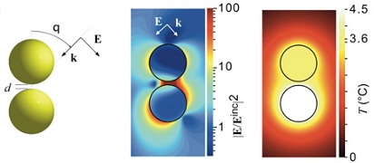
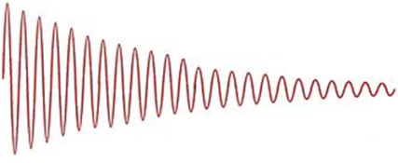
Optical properties of metals
Metals
  Reflect light
    No transmission
Gold
  Complex permittivities
Metallic surface
ε ‘ < 0
losses
Surface plasmon polaritons (SPPs)
Propagation length : ~mm
Hot electrons
Heat
  Thermo-plasmonics
G. Baffou, et al, ACS Nano (2010)

Slide 6
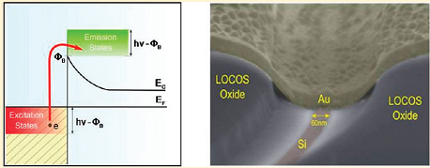
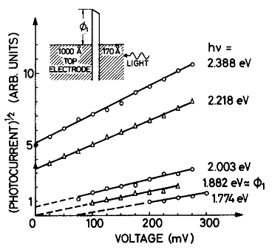
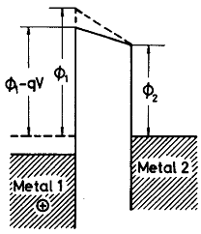
Metallic photodetectors
Absorption in metals = generation of hot electrons
Schottky contacts
  Metal-semiconductor contacts
    e.g. Au-Si
  Internal photoemission from metal
    (photon energy) < (bandgap)
I. Goykhman, Nano Lett. (2011)
MIM structures
  Metal-insulator-metal (MIM) with thin films
  Photocurrent by the hot carriers crossing the insulator barrier
    (photon energy) < (bandgap)
K.H. Gundlach, et al, JAP (1975)

Slide 7
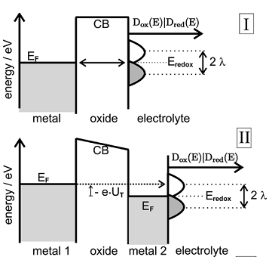
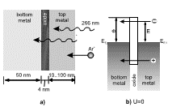
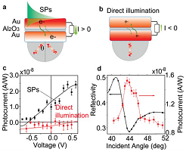
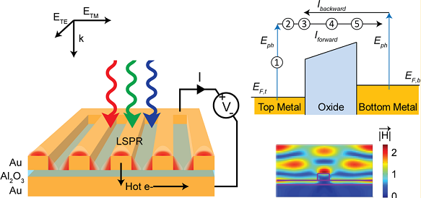
Recent studies using MIM structures
Electrochemical surface science
Excitation by photons & particles
D. Diesing, et al, J Solid State Electrochem. (2003)
Kovacs, et al, PRB (2007)
Excitation by surface plasmons (SPs)
Plasmonic resonances
H.Chalabi, et al, Nano Lett. (2014)
F. Wang and N.A. Melosh, Nano Lett. (2011)

Slide 8
Contents
Introduction
  Hot electron excitation from metals
Photodetectors for optical waveguides
Transparent photodetectors with oxides
Summary
References
Japanese patent: Application number (2014) 39325
S. Ishii, et al, under review (2014)

Slide 9
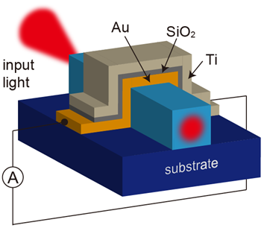
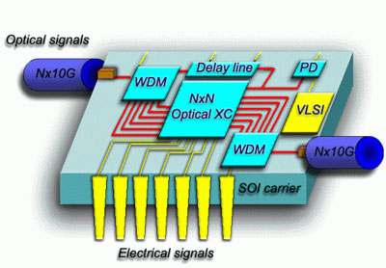
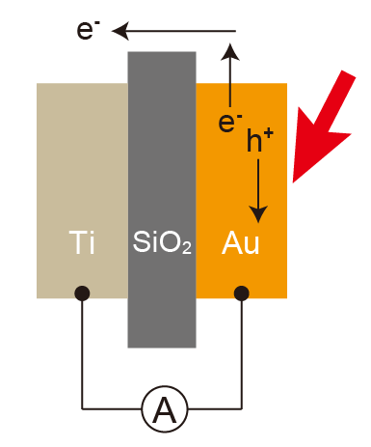
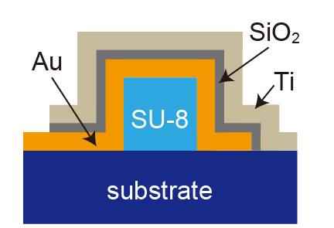
MIM photodetector for optical waveguides
Metals are everywhere on opto-electronic chips
Copyright: IBM
Hot electrons excited in metal films by the evanescent field of guided light
Ishii and Inoue, patent application (2014)

Slide 10
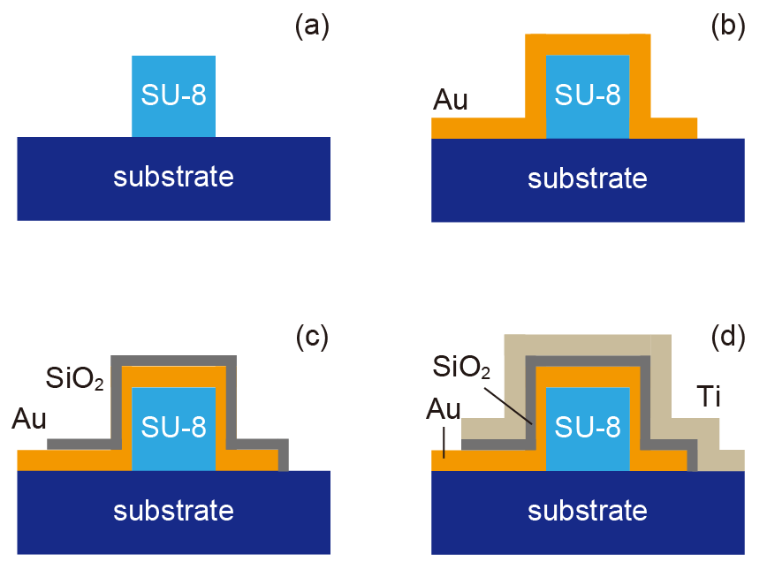
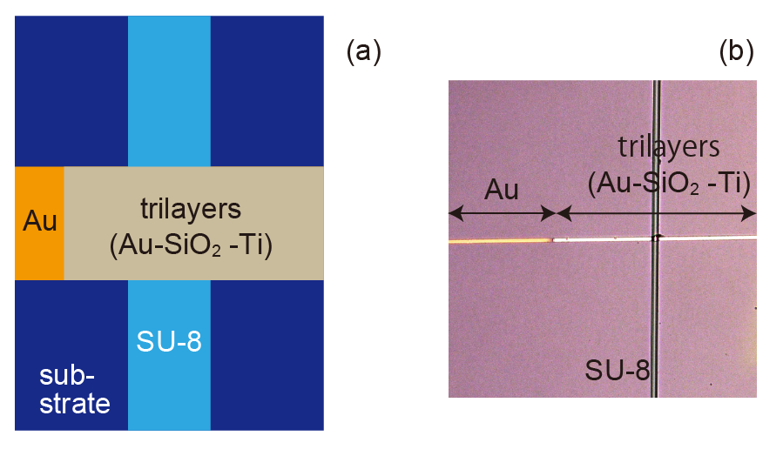
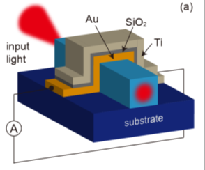
Device fabrication
SU-8 waveguide:
  Height: 1.53 μm
  Ave. width: 6.5 μm
  Film thicknesses:
  Top (Ti): 25 nm
  Middle (SiO₂): 10 nm
  Bottom (Au): 20 nm
  Film widths: 5 μm

Slide 11
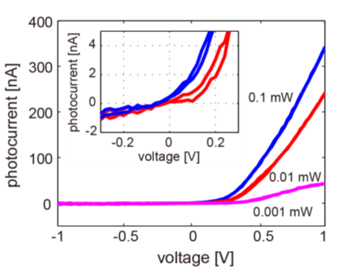
Photodetection
Input wavelength: λ = 680 nm
V_{oc}
Au
Ti
SiO₂
I > 0
A
Photocurrent generation by the guided light
Positive bias↑ => photocurrent ↑
Open circuit voltage (V_{oc}) = -0.05 V
Notes:
MIM121821, 12/25/13, for a single contact 680 nm

Slide 12
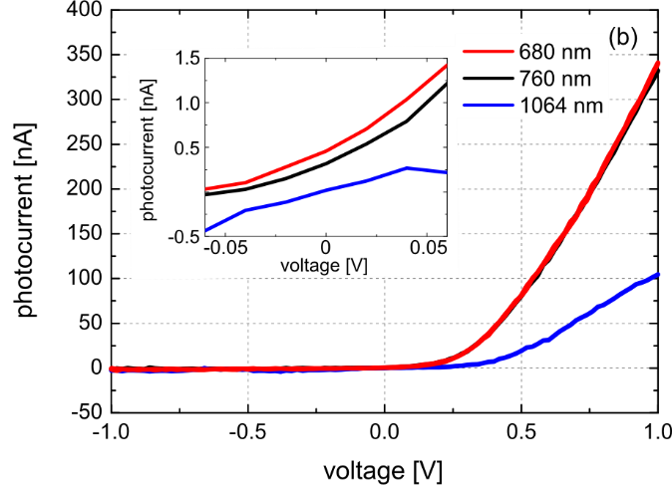
Wavelength dependence
Input power: 0.1 mW
Wavelength: 680, 760 & 1064 nm
Photodetection up to λ = 1064 nm
Higher photocurrent at shorter input wavelength
Open circuit voltage (V_{oc}) ~ 0

Slide 13

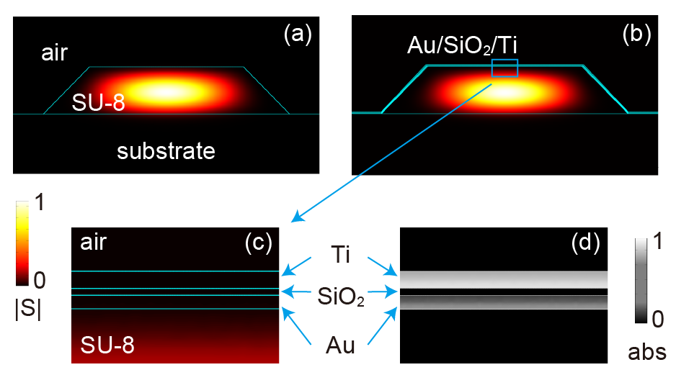
Mode analysis
λ = 680 nm
Mode index:
n = 1.5579
Mode index:
n = 1.5570+i9.3×10⁻⁵
absorption
Small portion of guided light is absorbed by the metals

Slide 14
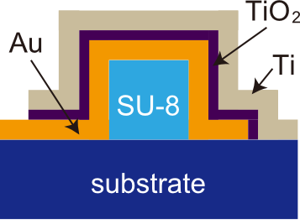
Electronic structures of MIMs
→
E
→
E
4.2 eV
E_{F}
0.9 eV
Au
Ti
Au
Ti
SiO₂
TiO₂
Au-TiO₂-Ti
  Barrier height ~ 0.9 eV
  Open circuit voltage (V_{oc}) for λ < ~1.4 μm
  Tunneling for λ > ~1.4 μm
Au-SiO₂-Ti
  Barrier height ~ 4 eV
  Tunneling for visible and NIR
    Open circuit voltage (V_{oc}) ~ 0

Slide 15
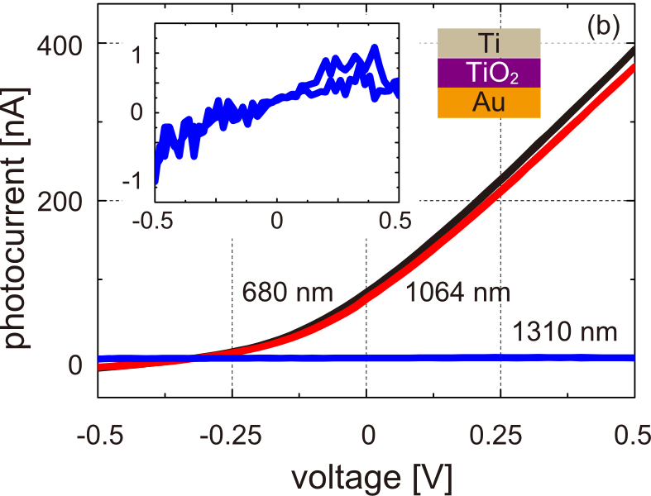
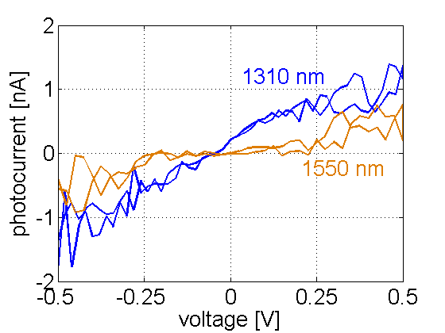
MIM with Au-TiO₂-Ti
Input power: 1.0 mW
1310 nm
Input power: 1.75 mW
Photodetection up to λ = 1550 nm
  λ < ~1400 nm: Open circuit voltage (V_{oc}) < 0
  λ > ~1400 nm: V_{oc} = ~0 (tunneling)
Notes:
(IV_1310nm_fulldark2_1.75mW.csv、041714-MIM021214B)、(IV_1550nmp3_fulldark2_1.75mW.csv、041814-MIM021214B)

Slide 16
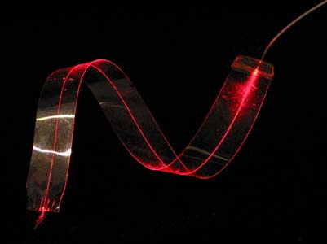
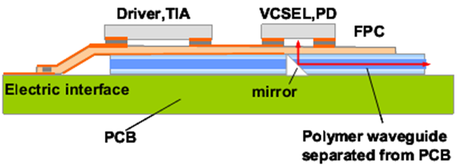
Where can we use MIM?
Silicon photonics
  Si-Ge photodiodes
  Schottky contacts
Ⅲ-Ⅴ photonics (e.g. InP)
  Ⅲ-Ⅴ photodiodes
Polymer/dielectric photonics
  Semiconductor photodiodes
  <= replace with our detectors
© Optical Interlinks
Shiraishi, et al, OFC/NFOEC (2011)

Slide 17
Contents
Introduction
  Hot electron excitation from metals
Photodetectors for optical waveguides
Transparent photodetectors with oxides
Summary

Slide 18
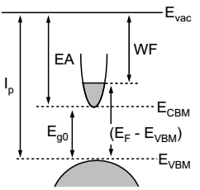
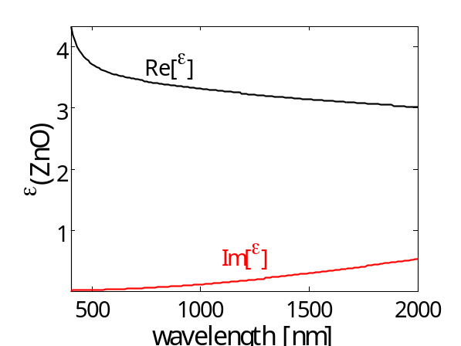

Properties of TCOs
Transparent conductive oxides (TCOs)
  High carrier concentrations ( < ~10⁻²¹ cm⁻³ )
  Transparent (if thin)
  Small light absorption
    Im[ε] > 0
Al:ZnO 50 nm
ε
A. Klein, et al, Materials (2010)
E_{F}
=> Transparent photodetectors with TCO–insulator(I)–TCO structures
I
TCO
TCO
Notes:
ZnO 50 nm, 072514 on glass

Slide 19
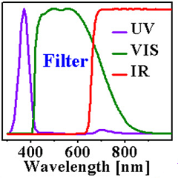
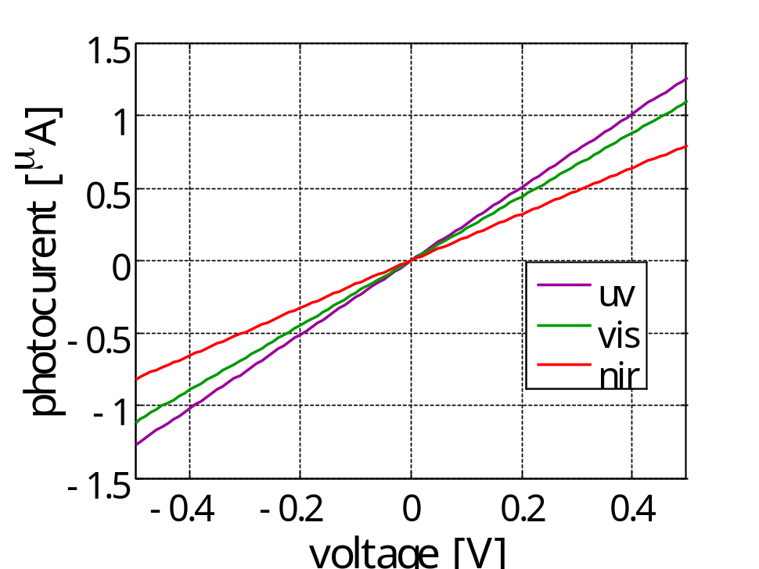
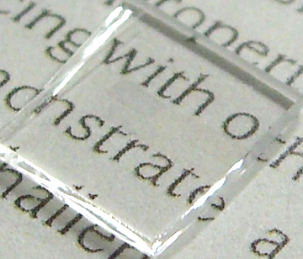
Photodetection with TCOs
AM 1.5
filter
AZO
TiO₂
AZO
fused silica
A
AZO-TiO₂-AZO
Photodetection in VIS & NIR
  E_{g}(TiO₂) = 3.2 eV (λ = 387 nm)
  No pn junctions
AZO
S. Ishii, et al (2014) unpublished
Notes:
Sample info on the photo
Sputtered date: 8/7/14
Films: AZO 30nm/TiO2 20 nm/ AZO 30nm
Tri-layer area: ~1.5 x 2.0 mm (?)
Substrate: fused silica
FIG AZO 30nm/TiO2 20 nm/ AZO 30nm on 8/20/14, on fused silica 2, No anneal, IV on 10/2/14

Slide 20


Summary
MIM photodetectors for optical waveguides
  Photodetection in visible and NIR including telecom wavelengths
  Simple & compact geometry
  Applicable for insulator waveguides (e.g. polymers)
Transparent photodetecors with TCOs
Acknowledgements
Strategic Information and Communications R&D Promotion Programme (SCOPE)
The Japan Prize Foundation

Slide 21

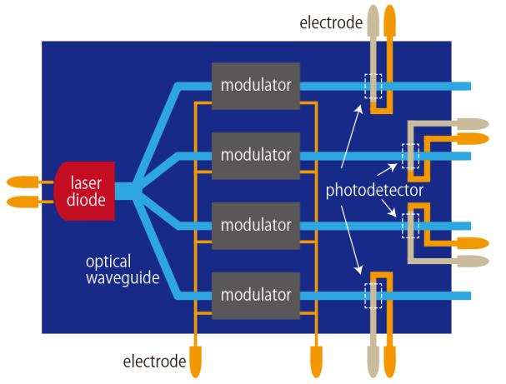
0 1 0 1 0
0 1 0 1 0
light
current

Slide 22
Let Us Meet Again
We welcome you all to our future conferences of OMICS Group International
Please Visit:
http://materialsscience.conferenceseries.com/
Contact us at
materialsscience.conference@omicsgroup.us
materialsscience@omicsgroup.com

