Slide 1
CASE SERIES OF RARE BREAST DISEASES AND THEIR UNUSUAL PRESENTATION
Presenting Author: Dr. Sariya Mohammadi. J
2nd year resident (Gen Surgery)
JSS Medical College, Mysore
Co- Author: Dr. Raxith S.R
Senior Resident
Dept of Gen Surgery
JSS Medical College, Mysore

Slide 2
PRIMARY BREAST LYMPHOMA

Slide 3
INTRODUCTION
primary breast lymphoma is a malignant lymphoma primarily occurring in the breast in the absence of previously detected lymphoma. PBL is a rare disease, accounting for only 0.4-0.5% of all breast malignancies. The median age of patients with diagnosed PBL ranges from 60 to 65 years. This rare condition is especially observed during pregnancy or postpartum, suggesting that tumour growth is influenced by hormonal stimulation.

Slide 4
CASE REPORT
A 38-year-old woman was admitted to our hospital presenting with a lump in the right breast.
Her medical history was unremarkable, and review of symptoms was negative for night sweats, weight loss, or fever.
A physical examination revealed a 10x10x4 cm lump retroareolar in location, irregular, nodular and hard in consistency. Skin over the nipple was normal and there was no discharge from nipple.
Examination of the axilla and neck was negative for enlarged lymph nodes.

Slide 5
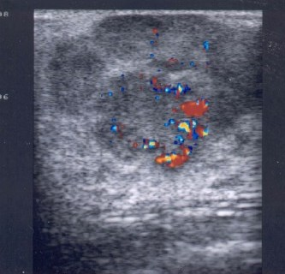
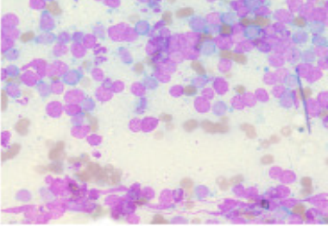
Breast USG: hypervascularized non-homogeneous mass with ill-defined margins.
FNAC: moderate cellularity, comprising of mixed population of malignant lymphoid cells. Cells were monomorphic, with large hyperchomatic eccentrically placed nuclei with multiple nucleoli.
Later on, an incision biopsy was done and showed a high grade malignant Non Hodgkin’s B cell lymphoma.
The tumour cells were positive for CD45, CD20 and CD79a and Negative for CD3.

Slide 6
DISCUSSION
Breast lymphoma is not a common entity
Usually, non-Hodgkin’s type
Most common histologic type is diffuse large B- cell lymphoma. T cell phenotype is extremely rare.
primary breast lymphoma arises from resident stromal lymphocytes. Approximately 1% of patients have breast invlovement. Only 0.1% of breast tumors are lymphomas
Age between 50-60
Can be bilateral with features of Burkitt’s lymphoma
Primary breast lymphoma is diagnosed when the breast is the first major site of involvement with no evidence of concurrent systemic disease.

Slide 7
Painless, mobile enlarging mass.
Right breast is most frequently involved
Can have respiratory symptoms, lymphadenopathy and CNS symptoms.
Well circumscribed mass without calcification on imaging.
FDG-PET has a sensitivity & specificity of 89% & 100% for NHL.
MASTECTOMY is not recommended
systemic chemotherapy is recommended.
Poor prognosis when compared to other extra-nodal lymphomas

Slide 8
IDIOPATHIC GRANULOMATOUS MASTITIS (IGM)- 2 Case Reports

Slide 9
Introduction:
Idiopathic Granulomatous Mastitis (IGM) is an uncommon chronic inflammatory condition of the breast that clinically mimics breast abscess or carcinoma. Etiology is unknown with variable clinical presentation, it is a diagnosis of exclusion. FNAC, core needle biopsy, USG or MRI may help in diagnosis. Histologically it shows non caseating granulomas with chronic inflammatory cells.

Slide 10
In our second case we had a rare association of autoimmune mastitis with granulomatous skin lesions with primary biliary cirrhosis. Autoimmune mastitis is a rare condition where patients with other autoimmune disorders present with breast abscess or features of mastitis. It is due to antigen-antibody reactions. Prolonged corticosteroid use in patients with autoimmune disorders could be a risk factor for developing breast abscess due to immunocompromised state.

Slide 11
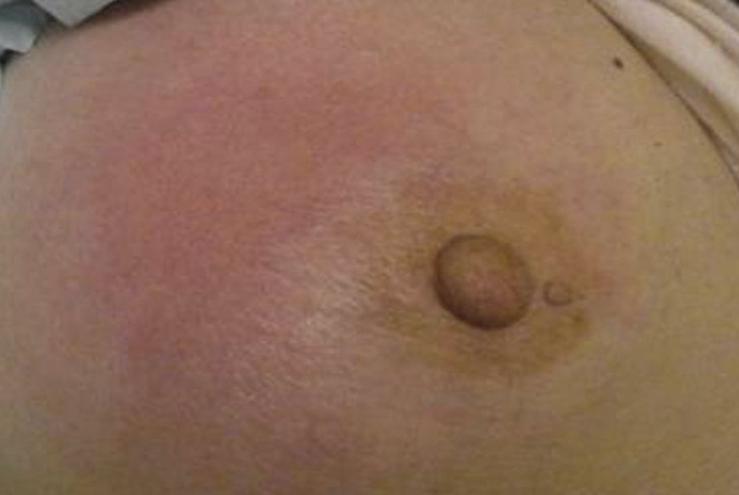
CASE REPORT 2A
A 46-year old woman presented with a painful inflammatory mass in the left breast, measuring 5x5cm mass in upper inner quadrant and no palpable axillary nodes.
She had no particular medical history, never used oral contraceptives and breastfed two children.
Blood tests showed no sign of inflammation.

Slide 12
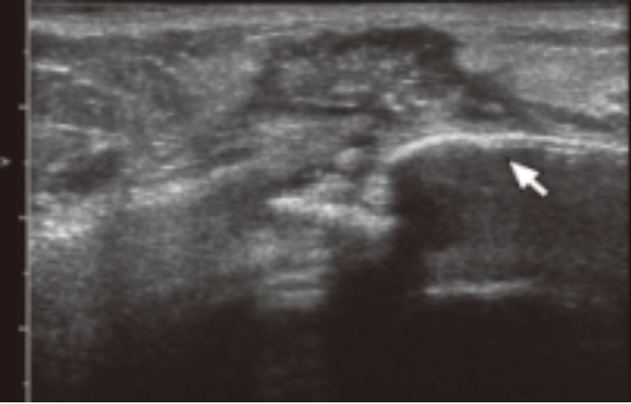
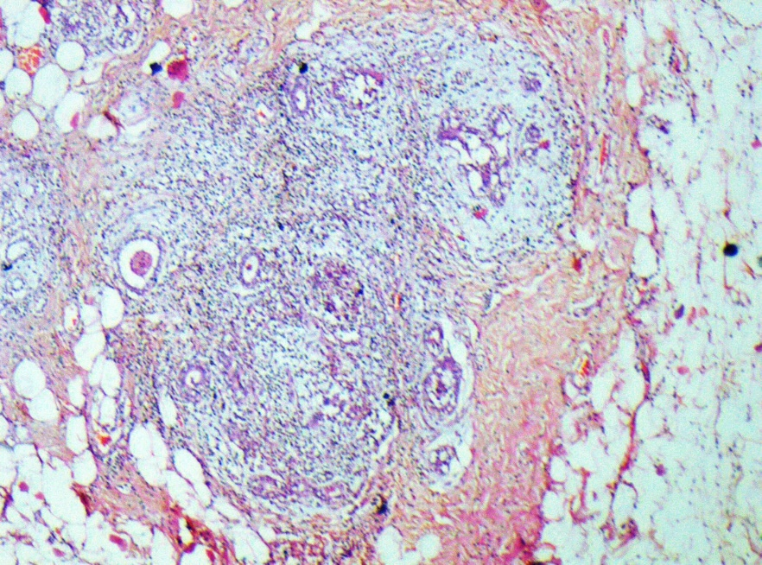
ultrasound of the breast revealed a diffuse lesion, very suggestive for breast cancer.
Fine needle cytology (FNAC) showed clusters of normal ductal cells.
Excision biopsy revealed well-formed noncaseating granulomas with Langhans and foreign body type giant cells within fibrous background tissue. These exhibited a distribution mainly respecting the lobules, but at some sites completely destroying these structures. A few micro-abscesses were found.
H & E 40X clusters of giant cells in breast tissue

Slide 13
No evidence of tuberculosis or sarcoidosis was found. The diagnosis of idiopathic granulomatous mastitis was sustained. Patient was under observation by regular follow-up
After 6months of follow up patient presented with recurrence of lump. Hence, started on steroids.

Slide 14
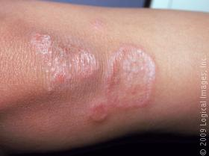
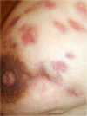
CASE 2B: Autoimmune mastitis with granulomatous skin lesions in Primary biliary cirrhosis- rare association.
18 year-old female patient with complaints of swelling, warmth and erythema in the left breast.
She was diagnosed with mastitis and treated with antibiotics for one month.
later on she had experienced stiffness in the breast and a mass was also palpable.
Previous history of skin rashes which had initially occurred 2 months back. It consisted of painless erythematous patches on her shins, which healed spontaneously over the course of four weeks without bruising.
K/c/o of Primary Biliary Cirrhosis on β- blockers, ursodeoxycholic acid and low dose steroids

Slide 15
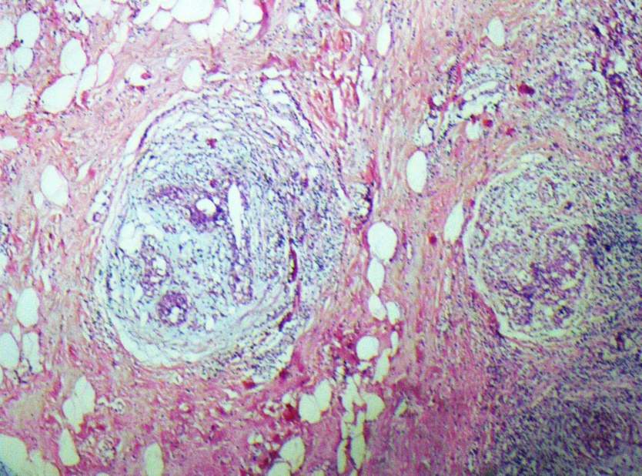
After 15 days, a solid mass was palpable so, mass was surgically resected.
Biopsy reported as granulomatous mastitis
Histological examination of the skin biopsy specimen showed non-caseating granulomas in a periadnexal and perivascular distribution. These were mainly in the dermis extending down into the subcutaneous fat, consistent with a granulomatous dermatitis.
Anti-mitochrondrial antibodies remained positive at a titre of >640. The other auto-antibodies and the angiotensin II converting enzyme assays were normal.
Mantoux skin test was negative.

Slide 16
DISCUSSION
IGM may present with skin induration, erythema, breast edema or mass.
Clinical presentation may mimic malignancy. So, biopsy should be done to exclude malignancy.
Diagnosis of IGM is characterized by non-caseating granulomas, micro abscesses in the absence of other infections like mycobacteria, mycotic and sarcoidosis.
Management of IGM is very challenging from observation, steroid therapy and mastectomy.
Majority of the cases managed by systemic steroids and close follow up. Mastectomy is indicated only who have intractable symptoms.
IGM known for its recurrence. So if there is a recurrence, steroid will be the mainstay of treatment.

Slide 17
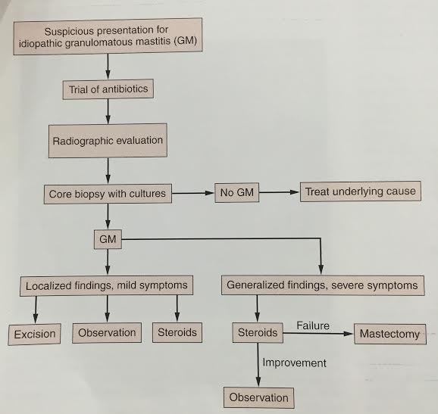
CONTINUED
Although etiology remains undetermined, possibility of systemic auto-immune disease as well as localized immune response to the extravasated secretions from the lobules should be kept in mind.

Slide 18
TUBERCULOUS MASTITIS

Slide 19
introduction
Tuberculous mastitis (TM) is a rare extrapulmonary presentation of tuberculosis accounting for less than 1% of all diseases of the breast. The disease is very rare in males. The most common clinical presentation of tuberculous mastitis is that of a solitary, ill-defined, unilateral hard lump, difficult to differentiate from carcinoma. The lesion may progress into a breast abscess with or without a discharging sinus or TB ulcer.

Slide 20
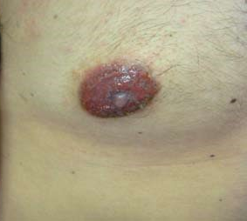
CASE REPORT: 4A
A twenty year old male presented to the surgery department with complaint of painful lump in the left breast of three months duration.
He did not give past history nor family history of TB.
Pain localized to the lump, there were no constitutional symptoms suggestive of tuberculosis.
The lump started as a diffuse swelling in the lower part of the quadrant which gradually increased to the size of about 5-6 cm with which the patient had reported to the hospital.

Slide 21
On examination, a lump of about 8cm×5 cm in the lower outer quadrant was seen. It was irregular, mobile, tender and fluctuant. Nipple and areola appeared erythematous with minimal serous discharge.
A single node was palpable in the left axilla.
On the basis of history and clinical examination, breast abscess or malignancy were made as differential diagnosis.
Hemogram values were within reference range except ESR which was raised to 28 mm/first hour.
X ray chest was normal.
Ultrasonography of the lesion showed an abscess of about 5 cm size following which aspiration of the abscess was undertaken which yielded about 20 ml of pus.

Slide 22
The sample was subjected to Gram stain, Ziehl Neelsen(ZN) stain,and aerobic culture.
No organisms were seen in Gram stain and there was no growth on the plates after 48 hours of incubation.
Acid fast bacilli (AFB) were seen in ZN stain. After the sample was positive for AFB in ZN stain, a part of the sample was cultured on to conventional LJ medium as well as Rapid BACTEC system.
There was growth of M. tuberculosis after a period of about one week in the BACTEC system and in three weeks period on LJ medium.
The patient was started on category 1 schedule of DOTS treatment strategy. The patient responded remarkably well and at follow up after 2 months period his lesion had almost disappeared.

Slide 23
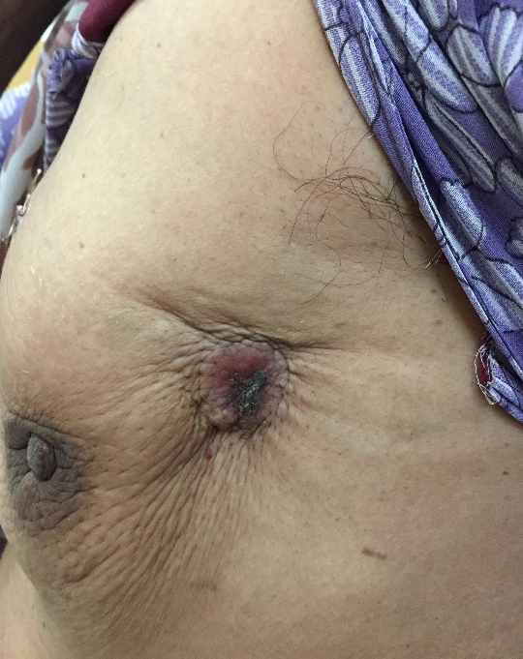
CASE 4B:
A 55-year-old woman admitted to our surgical department complaining of a lump in the upper part of the left breast. The patient noticed the mass 1month ago.
The past and family history were insignificant.
On examination were a non-tender, palpable, mobile mass over left breast upper outer quadrant.
A hyperpigmented scar lesion over the skin in the upper outer quadrant.
no axillary lymphadenopathy.
The examination of the other breast showed no findings.

Slide 24
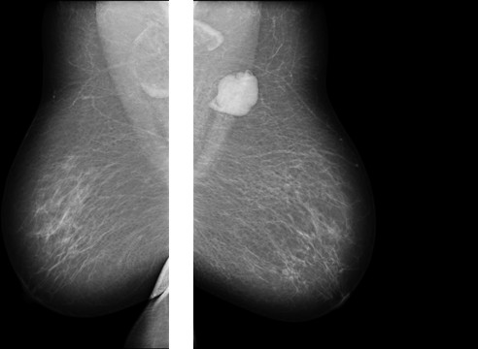
Mammography showed lump in the upper quadrant of the left breast, with doubtful malignant characteristics.
Breast ultrasound showed a nodular lesion with heterogeneous lesion. The lesion considered being malignant.
on fine needle aspiration cytology did not showed malignant cytology but showed few giant cell with lymphocytic infiltrate.
So plan for excision biopsy was considered. The excision of the tumour was performed.
The pathological examination of the specimen showed that the features of tuberculosis.
The full examination (x-ray) showed that tuberculosis was nowhere else; that means that breast tuberculosis was primary. The patient received anti-tuberculosis therapy (3 drugs combined therapy) for 9 months.

Slide 25
DISCUSSION
There has been a significant rise in the prevalence of tuberculosis as well as an increase in its extra-pulmonary manifestations in the past decade.
Migration, drug-resistant strains, HIV infection, chronic diseases, malignancy, transplantation, and other immunosuppressive conditions have contributed to this process. However, breast tuberculosis is a rare form of tuberculosis.
Tuberculous mastitis (TM) is found mostly in young, multiparous women. Male TM is extremely rare, and accounts for only 4% of all cases (7). To our knowledge, only a few cases of tuberculous mastitis in men have been reported . Data are scant on the total number of reported cases in men, its rarity with respect to that of females, presentation and outcomes . This strikingly lower incidence in males points towards a significant role of parity, pregnancy and lactation as likely predisposing factors.

Slide 26
Due to its rarity, no specific guidelines are available for the treatment of tuberculous mastitis. There is little information in the literature regarding optimum length of therapy, but tuberculous mastitis should probably be treated as any other form of extra-pulmonary tuberculosis, which is generally nine months of multi-drug therapy, unless drug resistance is present. Surgical interventions are performed only in severe deformation after adequate anti-tubercular treatment.

Slide 27
METASTATIC MELANOMA OF THE BREAST

Slide 28
INTRODUCTION
Melanoma is the most rapidly increasing cancer in Caucasians, and 20% of patients diagnosed with melanoma will develop metastasis via hematogenic or lymphatic routes.
Melanoma can spread to lymph nodes, secondary sites in the skin, and distant organs such as the breast.
Melanoma in the breast could be primary in the breast skin, primary in the breast tissue, metastasis in the breast, or in-transit metastases to breast tissue and breast skin.
Metastasis is more common in the outer half of the breast because of good vascularity and the presence of more glandular tissue.

Slide 29
CASE REPORT
32year- woman was referred to our hospital for a palpable lump in the right breast since 15 days.
The patient had a history of a primary cutaneous melanoma of the right forearm 1 year back.
The cutaneous lesion was surgically removed with wide local excision and the histopathological examination revealed a Superficial Spreading Malignant Melanoma (SSMM) with thickness of 1.8 mm. The excision margins were free. No regional lymph node involvement. No further treatment was performed for this disease.

Slide 30
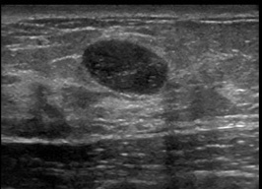
One year later, the patient felt a lump on the right breast. Breast clinical examination confirmed the presence of a hard and mobile lump located in the upper medial quadrant of the right breast.
Ultrasound detected well-defined nodular hypoechoic lesion and diameter of 1.8cm.
On mammography well-defined mass noted without calcifications or architectural distortion.

Slide 31
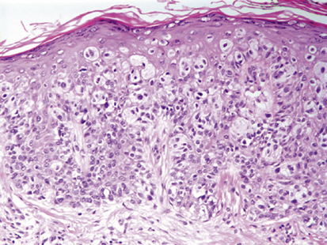
A fine needle aspiration cytology (FNAC) was performed on breast showed possibility of neuroendrocrine lesion.
So further excision biopsy was done showed metastases from malignant melanoma and immunohistochemical reports positive for S100 protein and HMB-45.
A total-body CT examination was performed a week later. No Brain, lung and abdominal lymph node metastases was detected. As there was no evidence of metastatic changes of internal organs the patient was treated with four series of DTIC/CDPP protocol therapy in four weeks intervals. Now on regular follow-up

Slide 32
DISCUSSION
Breast involvement in malignant melanoma is not an isolated finding. It is usually associated with disseminated disease. Subcutaneous tissue, lung, liver, and brain are common secondary involvements in this disease.
Breast metastases are poor prognostic sign.
It is mandatory to differentiate primary from secondary tumor because the
treatment of these two malignancies differs. In patient with solitary breast
metastasis (confirmed by core biopsy) breast conserving therapy can
be performed, opposite to multiple metastases in single or both breasts
where systemic chemotherapy is indicated.

Slide 33
CONCLUSION
We have presented these rare breast diseases and their unusual presentations as there is limited data available and it is important for every clinician to keep these in mind as differential diagnosis for a lump in the breast.
Prompt work-up for every case of lump in the breast should be made and a confirmative histological diagnosis is mandatory in every case.
An attempt should be made for a detailed evaluation to look for other lesions or anything in history which will help us at reaching the correct diagnosis and help us in further planning our management.
All these conditions require adequate surgical procedures combined with systemic therapy.
Close follow-up of every patient is mandatory to look for recurrence.

Slide 34
REFERENCES
Patti L et al. lymphomas of the breast: A clinicopathologic and immunohistochemical study of primary and secondary cases. Cancer 67: 1359-1369
Fatih Altintoprak et al. idiopathic granulomatous mastitis: the scientific world journal Vol 2013,727-5
Richard Tuli et al. Idiopathic granulomatous mastitis masquerading as carcinoma of the breast: a case report and review of literature; intl seminars in surgical oncology2007,4:21
Ahmad Al et al. breast metastasis from a melanoma
Natasa Prvulovic et al. melanoma metastatic to the breast: a report of an unusual case; arch Oncol 2011; 19:79-80

Slide 35
Mallika Tewari et al breast tuberculosis: diagnosis, clinical features and management. Indian J Med Res 122, Aug 2005, 103-110
C. Cantisani et al male tuberculous mastitis: a rare entity. Clin Ter 2013; 164

Slide 36
THANK YOU

