Slide 1
Welcome To All

Slide 2
Introduction About Myself
Saraswathi
Completed M.Sc., M.Phil., M.C.A
Doing PhD[II Year] in Bharathiar University-Part Time
Assistant Professor in Nehru Memorial College

Slide 3
Thanks
My Hearty Thanks To OMICS International to Conduct
the 7th Indo Global Diabetes International Conference
inside India.
My Deepest Thanks to all the Members belonging to the
Organizing Committee.
My Sincere Thanks to all the Members belonging to this
Conference.
My Genuine Thanks to the 7th Indo Global Diabetes for
giving me the opportunity to present the paper here.

Slide 4
Introduction About My Research
Retrieval of Retinas in fast from the database which are
affected by Nonproliferative Diabetic Retinopathy Using
Feature Extraction Methods.
Diagnosis of Different Stages of Diabetic Retinopathy is
one of the parts in my research.
Before Retinas Retrieval , Different Stages are diagnosed
using some Methodologies with MATLAB

Slide 5



Methodologies Available For
Diagnosis Different Stages of Non-Proliferative Diabetic Retinopathy

Slide 6
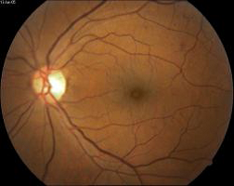
Diabetic Retinopathy
One of the Diabetic eye diseases.
Group of eye conditions that affect people
who have diabetes.
Which causes progressive damage to the
tiny blood vessels in the retina.
Retina- The light sensitive lining at the back
of the eye.
Falls into two different classes:
Nonproliferative and Proliferative.
Diabetic Retinopathy

Slide 7
Nonproliferative Diabetic Retinopathy
NPDR
Also called as “Pre-Proliferative”.
The early state of the disease in which
symptoms will be mild or non-existent.
Progress through three stages.
1. Mild NPDR 2. Moderate NPDR
3. Severe NPDR
Different stages of NPDR are identified through Signs
and Symptoms on the surface of the retina layers.
Diabetic Retinopathy

Slide 8
Signs and Symptoms of NPDR
Microaneurysms- appear as small blood clots on the surface of the retina layers.
Exudates- appear as bright lesions in the retina and have sharp edges and high contrast with the background
Hemorrhages-appear as Bigger blood clots on the surface of the retina.
Diabetic Retinopathy

Slide 9
Diagnosis of Different Stages of NPDR
Mild- Indicated by the presence of at least 1 Microaneurysm on the surface of the retina layers.
Moderate- Indicated by the presence of Hard Exudates on the surface of the retina layers.
Severe-Indicated by the presence of Microaneurysms and Hemorrhages on the surface of the retina layers.
Diabetic Retinopathy

Slide 10
Diagnosis of Mild Stage of NPDR
Steps to Diagnose Mild Stage
Read the Fundus Image.
Convert it into a Green Channel Image.
Adaptive histogram equalization technique is adopted to perform the Contrast enhancement.
Morphological filling is also performed on the green channel image.
The unfilled green channel image is subtracted from the filled one.
Diabetic Retinopathy

Slide 11
Diagnosis of Mild Stage of NPDR
Steps to Diagnose Mild Stage
6. The Previous output image Threshold in intensity to
yield an image (R) with Microaneurysms patches.
7. Converts the true color image RGB to a binary image.
8. Changed the Foreground and Background Pixel Colors.
Diabetic Retinopathy

Slide 12
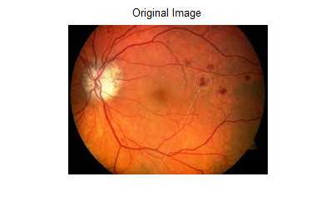
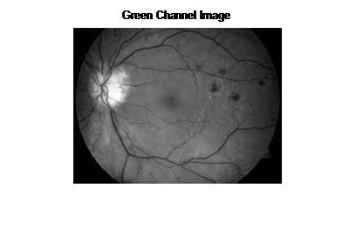
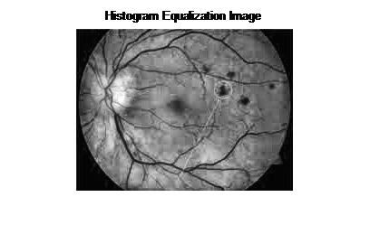
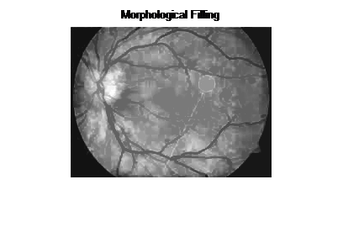
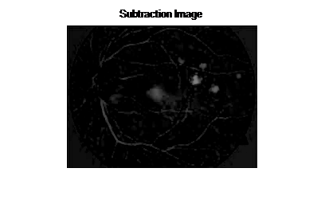
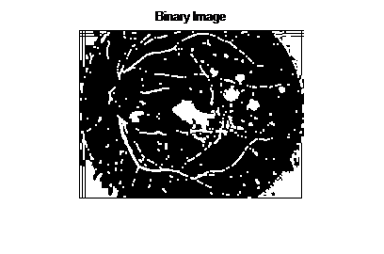
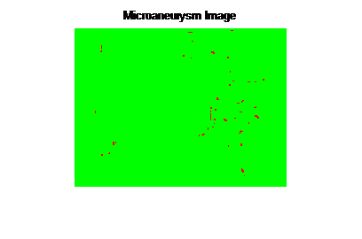
Figures of Mild Stage of NPDR
Diabetic Retinopathy

Slide 13
Diagnosis of Moderate Stage of NPDR
Steps to Diagnose Moderate Stage
Read the Fundus Image.
Convert Image from RGB Color Space to L*a*b* Color
Space.
Use kmeans to cluster the objects into three clusters.
Repeat the clustering three times.
Diabetic Retinopathy

Slide 14
Diagnosis of Moderate Stage of NPDR
Steps to Diagnose Moderate Stage
5. Label every pixel in the image with its cluster_index.
View Different Clusters and Got the correct result from those Clusters.
Diabetic Retinopathy

Slide 15
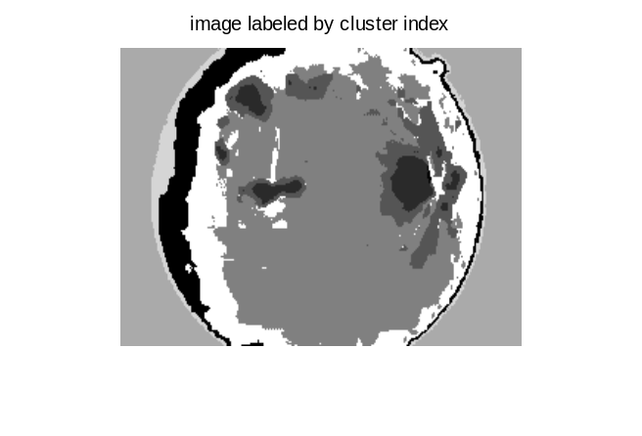
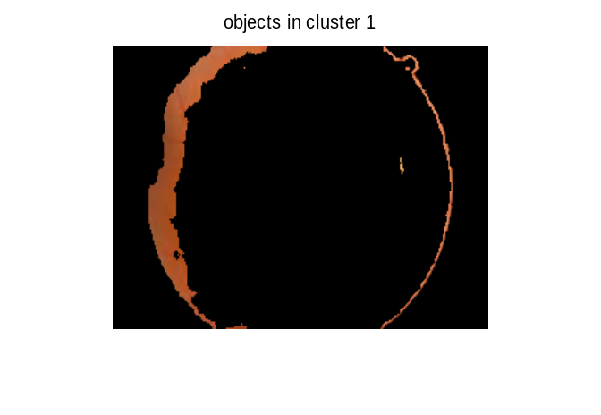
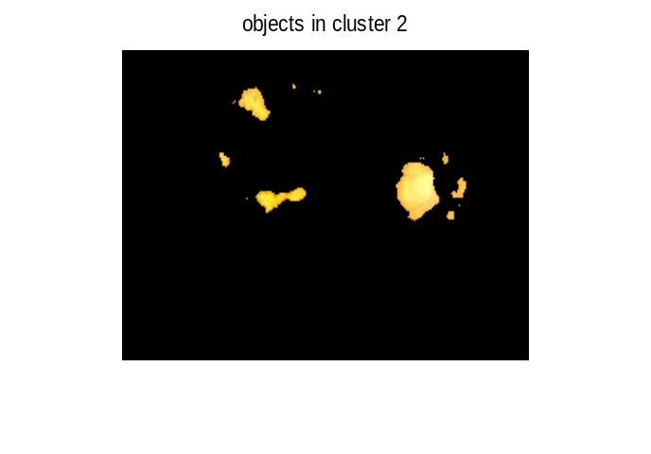
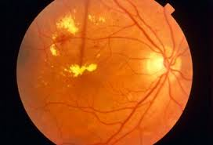
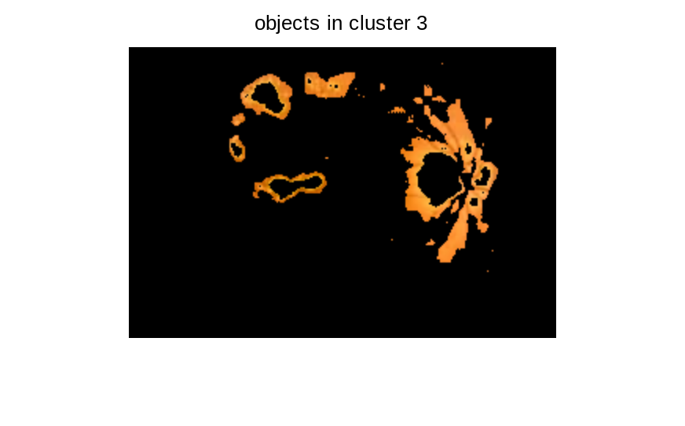

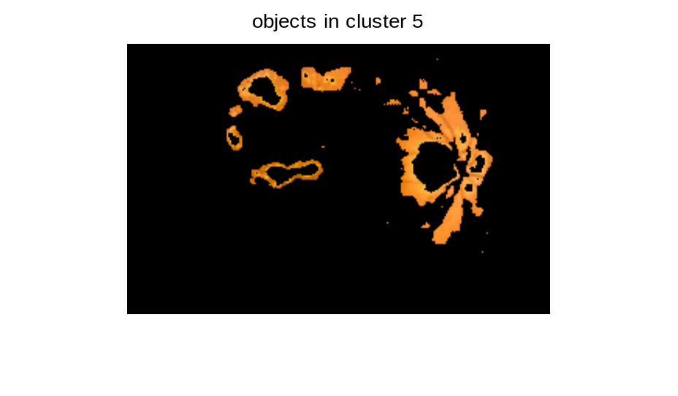
Figures of Moderate Stage of NPDR
Diabetic Retinopathy

Slide 16
Diagnosis of Severe Stage of NPDR
Steps to Diagnose Moderate Stage
Read the Fundus Image.
Convert it into a Green Channel Image.
Morphological filling is performed on the green channel image.
4. The unfilled green channel image is then
subtracted from the filled one.
Diabetic Retinopathy

Slide 17
Diagnosis of Severe Stage of NPDR
Steps to Diagnose Mild Stage
6. The output image Threshold in intensity to yield an
image (R) with Microaneurysms patches.
7. Converts the true color image RGB to a binary image.
8. Changed the Foreground and Background Pixel Colors.
Diabetic Retinopathy

Slide 18
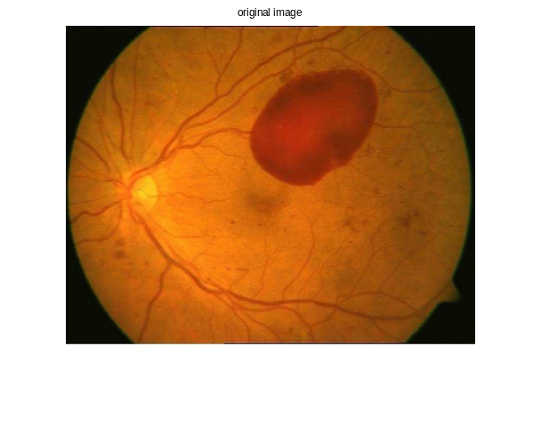
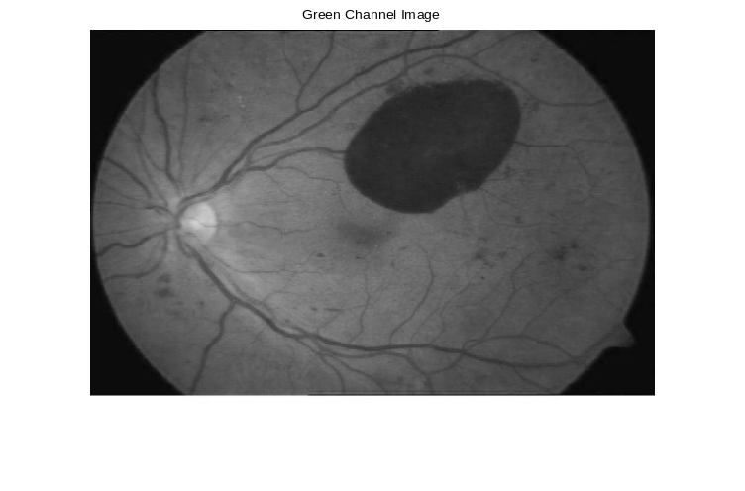
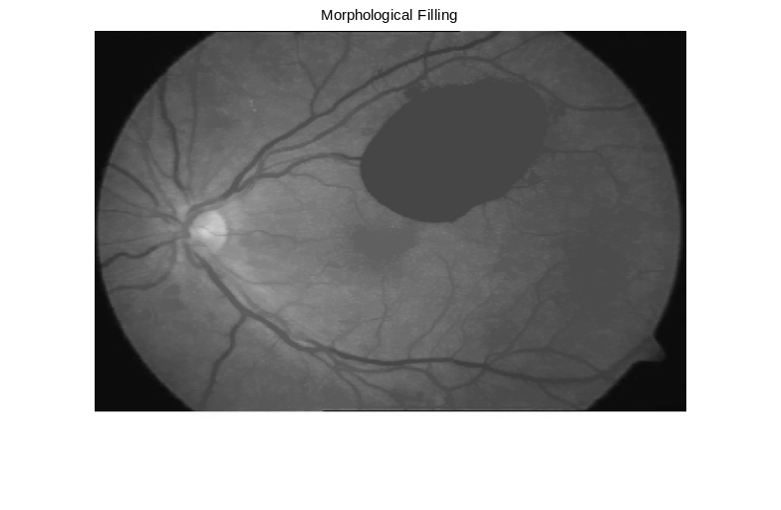
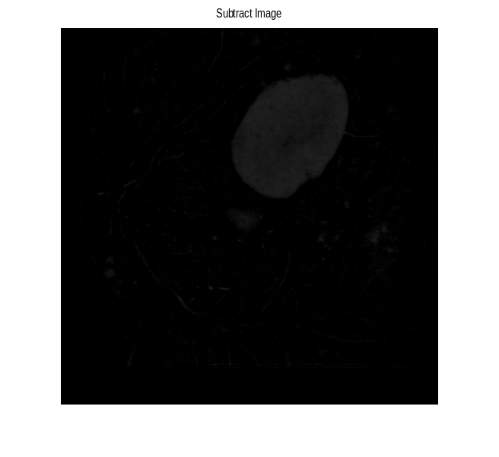
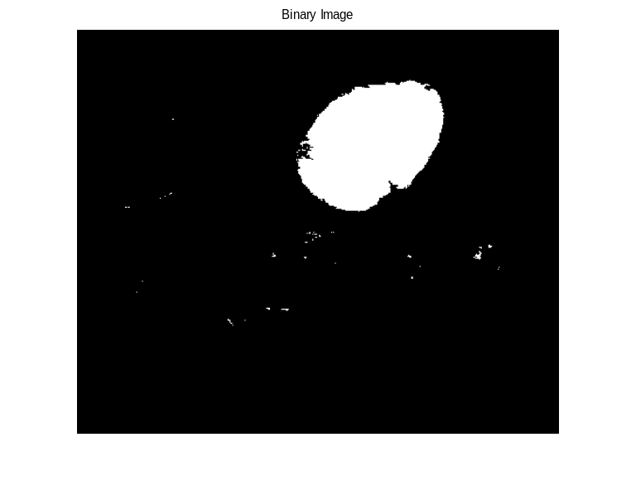
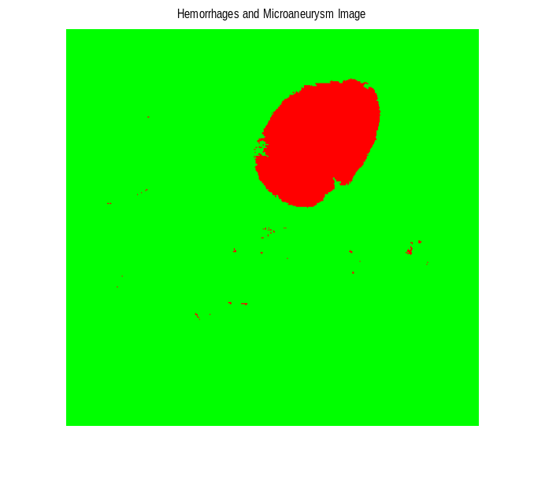
Figures of Severe Stage of NPDR
Diabetic Retinopathy

Slide 19
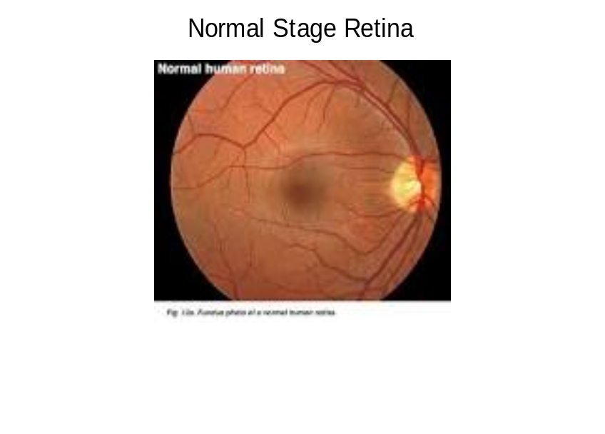

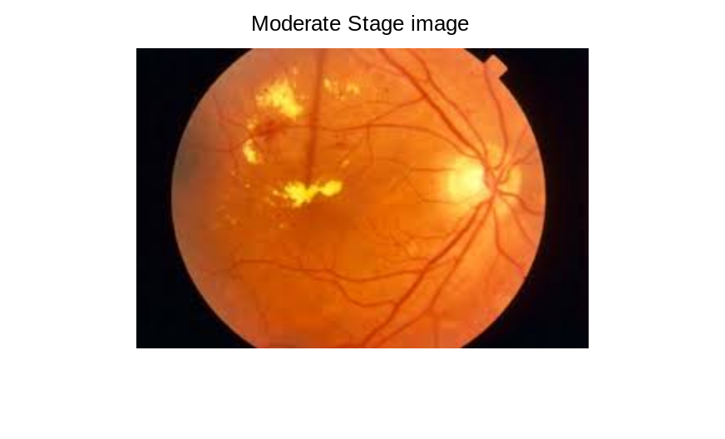
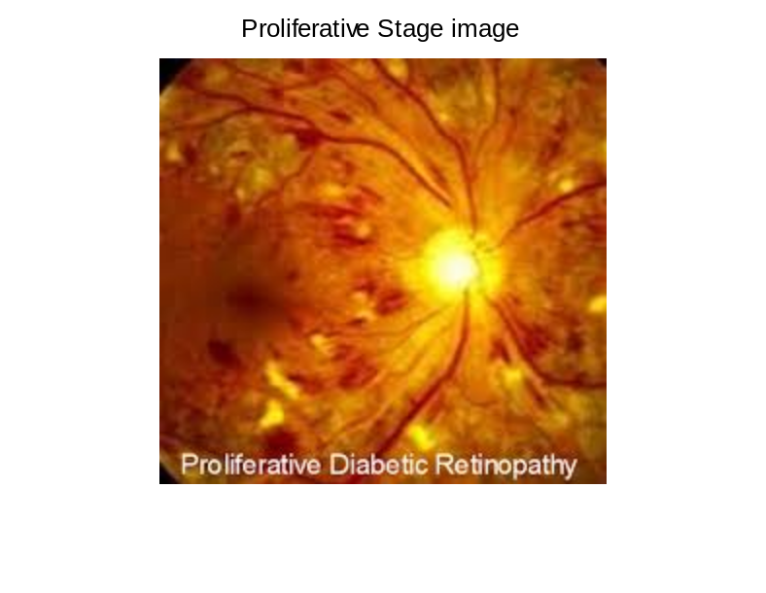

Figures of Different Stages of Retinas
Diabetic Retinopathy

Slide 20
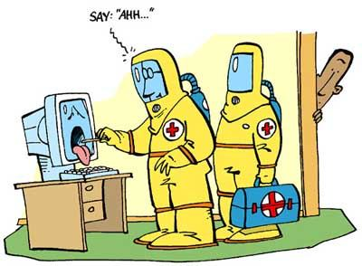
Journal References
“System for Diagnosis of Diabetic Retinopathy using Neural Network”
IJRTE, ISSN: 2277-3878, Volume-3, Issue-2, May 2014.
Dipika Gadriye, Gopichand Khandale, Rahul Nawkhare.
“A Novel Method for Micro Aneurysm Detection and Diabetic Retinopathy
Diagnosis”, International Conference on Innovations In Intelligent
Instrumentation, Optimization And Signal Processing “ICIIIOSP-2013
Adarsh.P, D.Jeyakumari.
“A Segment based Technique for detecting Exudates from Retinal Fundus
image” Atul Kumar et al. International Journal of Computer Science & Engineering Technology (IJCSET).
“Diagnosis Of Diabetic Retinopathy Using Machine Learning
Techniques” R. Priya and P. Aruna, ICTACT Journal On Soft Computing, July 2013,
Volume: 03, Issue: 04.
Diabetic Retinopathy

Slide 21
Journal References
“ An approach to Enhance Automatic Diagnosis of Diabetic Retinopathy and
Classification by Hybrid Multilayer Feed forward Neural Networks by Genetic
Algorithm” Rupa V. Lichode , International Journal of Science, Engineering and
Technology Research (IJSETR), Volume 4, Issue 4, April 2015.
Diabetic Retinopathy

Slide 22
Website References
http://www.ijser.org
http://in.mathworks.com
http://www.ece.ucsb.edu
http://www.emedicinehealth.com
http://drcrnet.jaeb.org
http://www.biomedcentral.com
http://www.bd.com
Diabetic Retinopathy

Slide 23
Conclusion
An early detection and diagnosis of NPDR will aid in prompt treatment and a reduction in the percentage of vision lost for all diabetic patients.
Diabetic Retinopathy

Slide 24
Future Work
To find out the software with some speed to detect the different stages of NPDR to present the safe vision to all diabetic patients.
Diabetic Retinopathy

Slide 25


