Slide 1


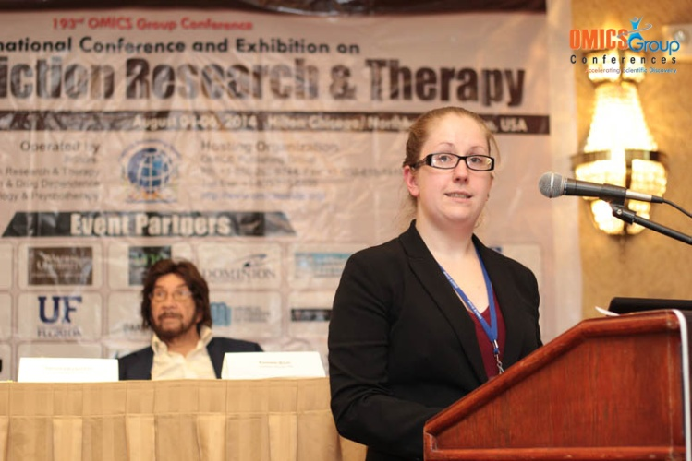
Addiction Therapy-2014
Chicago, USA
August 4 - 6, 2014
Sarah E. Cavanaugh

Slide 2
Alcoholism and mental illness: overlapping diseases requiring a renewed focus
Sarah E. Cavanaugh, PhD
Physicians Committee for Responsible Medicine
Notes:
Good evening. I’d like to begin by thanking the organizing committee for allowing me to present here tonight. Tonight I’ll be speaking about the overlap between alcohol addiction and mental illness, and the need for more specialized research regarding this patient population.
Alcohol use disorders remain a substantial public health concern, due to the many physical, psychological, and social effects of alcohol abuse. Harmful drinking contributes to disorders of all major organ systems, development of several cancers, and leads to over 2.5 millions deaths in the United States every year. Infectious diseases such as HIV and other sexually transmitted infections have been linked to alcohol abuse, likely due to both risky behavior and alcohol-induced suppression of the immune system.

Slide 3
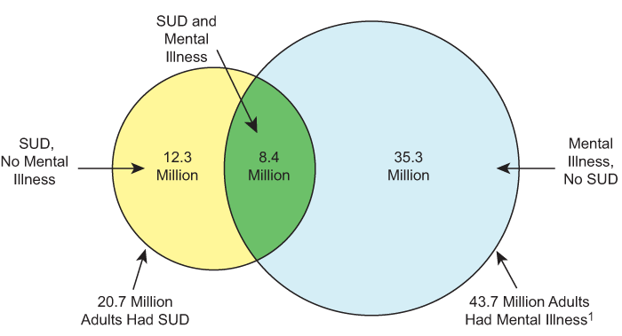
The scope of the problem
Alcohol use disorders do not exist in isolation
>8 million adults with substance abuse and mental health issues
A new research approach is needed
SAMHSA, 2013
Notes:
Alcohol use disorders do not exist in isolation. Among the most common co-occurring health problems are psychiatric illnesses. According to the Substance Abuse and Mental Health Services Administration, 6.4 million adults suffered both substance abuse and mental health disorders in 2011. In 2012, this number jumped to over 8 million. In light of this staggering number, a new research approach is needed to address comorbid alcohol abuse and mental illness.

Slide 4
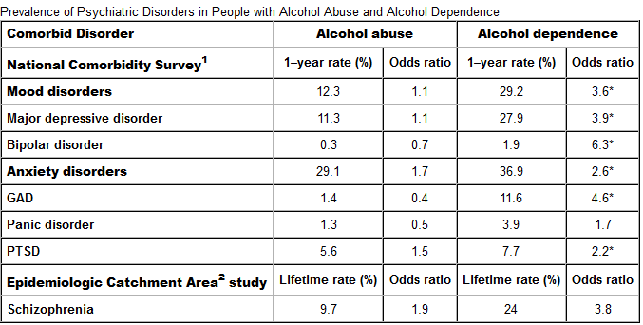
The scope of the problem
Adults with alcohol use disorder are:
3X more likely to suffer anxiety
4X more likely to suffer major depressive episode
Petrakis et. al. 2002
Notes:
Individuals with alcohol use disorders are up to three times more likely to suffer an anxiety disorder, compared to individuals without alcohol use issues. Similarly, patients with an alcohol use disorder are 4 times more likely to suffer a major depressive episode. Schizophrenic individuals are three times as likely as non-schizophrenics to suffer an alcohol use disorder. Post traumatic stress disorder has also been found to frequently co-occur with alcohol and other substance abuse disorders.
In short, there is a great need to understand how to manage the healthcare of patients who exist at the intersection of addiction and mental illness. Unfortunately, despite many years of research, diagnosis and treatment of alcohol abuse disorders and mental illnesses in isolation remains difficult, and we have not yet adequately untangled the two. As a result, for patients with problems in both domains, we do not yet know what treatments are most effective.

Slide 5

The scope of the problem
Less likely to pursue treatment
More likely to drop out or relapse
Shorter overall time to relapse
Notes:
A co-occurring mental illness frequently complicates substance abuse treatment, and vice versa. Individuals with anxiety disorders are less likely to seek treatment for substance abuse issues. Those who do pursue treatment are more likely to drop out or to relapse upon completion. Similarly, the presence and severity of depressive symptoms significantly influences the time to relapse following substance abuse treatment. Patients suffering from post traumatic stress disorder are more likely to relapse following addiction treatment than patients with any other axis I psychiatric illness.

Slide 6

Diagnostic and therapeutic challenges
Three types of healthcare professionals:
  Primary care providers
  Mental health professionals
  Addiction treatment specialists
Notes:
Individuals seeking treatment for alcohol abuse disorders and mental illness are likely to encounter at least one of three different types of healthcare providers.
Primary care physicians are typically the largest point of contact for patients seeking treatment. Primary care providers are qualified to provide treatment for medical problems arising from psychiatric or alcohol use disorders. However, primary care physicians are able to devote very little time to individual patients.
Mental health providers are trained to assess, diagnose, and treat psychiatric diseases and are able to devote larger quantities of time to individual patients. However, there are many different varieties of mental health providers, and many operate using different theories as to how to treat mental illness. Mental health professionals may not be trained to treat addiction.
Similarly, addiction treatment specialists are highly qualified to provide care for individuals with alcohol use disorders, though no one single, effective treatment exists. However, these professionals may not be qualified to address a co-occurring mental illness.

Slide 7
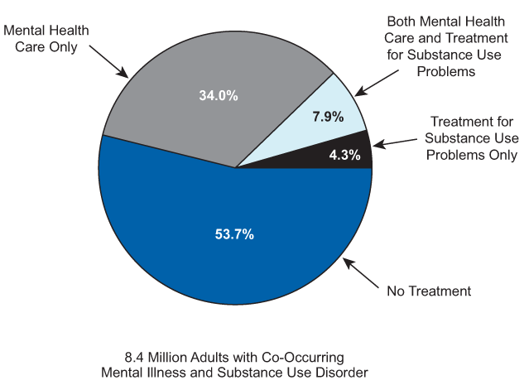
Diagnostic and therapeutic challenges
Treatment permutations:
Sequential treatment
Parallel treatment
Integrated treatment
SAMHSA, 2013
Notes:
A number of different treatment permutations exist for patients with both alcohol use disorders and mental illness.
The most common model of treatment for this patient population is sequential treatment. Commonly, the addiction is treated first. Once abstinence has been attained, the psychiatric symptoms will be addressed.
Alternatively, in parallel treatment both the mental illness and the alcohol use disorder are treated simultaneously.
In both sequential and parallel treatment of these disorders, mental illness and addiction are typically treated by separate providers who may or may not coordinate care.
Finally, integrated care is a model in which both addiction and mental illness are treated simultaneously, and is often provided by healthcare professionals trained to address both psychiatric illness and addiction.

Slide 8
Diagnostic and therapeutic challenges
For comorbid alcohol use and mental health disorders:
No firm diagnostic standards
No standardized treatments
Unique considerations
Notes:
There are a number of diagnostic and therapeutic challenges to treating patients with comorbid alcohol use disorders and mental illness. There are many different types of providers and treatment permutations. However, there are no standard diagnostic guidelines or treatment strategies. Physicians face challenges in determining whether heavy alcohol consumption contributes to or arises from mental illness, or whether there are simply two co-occurring conditions.
Moreover, there are a number of unique considerations to take into account when treating this population. For example, many medications such as those used to treat psychiatric conditions have potentially severe side effects when used in combination with alcohol. Alcohol abuse and mental illness, alone or in combination, may impair a patient’s ability to effectively manage medications on his or her own.

Slide 9
Status of dual diagnosis research
Motivational interviewing and CBT
Inconsistent results
Group counseling
Some improvement in mental health and abstinence
Case management
Inconsistent results
Notes:
A number of comprehensive reviews examining various treatment models for comorbid substance abuse and mental illness have been published in recent years. While the studies compiled in these reviews typically involve patients with alcohol abuse disorders, they are not limited to this one particular addiction. I’ll touch on this point again later.
Individual counseling, typically consisting of cognitive behavioral therapy or motivational interviewing, has produced inconsistent results in mentally ill substance abuse patients. A number of short term studies have failed to show any effect of multiple counseling sessions on abstinence in the long term.
Group therapy is an alternative to individual counseling that may still incorporate cognitive behavioral techniques. While the specifics of group counseling models vary, they typically offer peer support, education, and tools for managing both mental illness and substance abuse issues. One such group, Double Trouble in Recovery, is specifically geared toward patients with dual diagnoses. However, this approach has shown promise in improving abstinence rates, but not in reducing the burden of psychiatric symptoms. Two other groups known as Seeking Safety and Creating Change have been designed for patients specifically with PTSD and substance abuse disorders. Both models have shown promise in treating this particular patient population.
Case management is an intensive, team-based, multidisciplinary approach to treatment, involving clinically coordinated services. A number of studies published over the last two decades have reported inconsistent results in regards to both substance abuse and mental health outcomes. However, there does seem to be a trend toward better global functioning, fewer hospitalizations, and more financial stability among patients receiving this type of care.

Slide 10
Status of dual diagnosis research
Residential treatment
Improved substance abuse outcome, mental health outcome inconsistent
Intensive outpatient treatment
Results inconsistent
Notes:
Residential treatment approaches tend to be fairly successful with regard to substance abuse issues. Patients receiving integrated residential treatment tend to have higher abstinence rates and decreased relapse rates. However, while substance abuse outcomes are promising, mental health outcomes are more inconsistent.
As an alternative to inpatient treatment, intensive outpatient treatment provides care for several hours a day, several days a week. However, relatively few studies have examined this treatment approach thus far, and results have been inconsistent.

Slide 11

Optimizing research and treatment strategies
Large, prospective trials specifically for alcohol abuse patients
  Separating by mental illness
Short v. long-term treatment strategies
Implementation
Funding
Notes:
A new approach is needed to optimize research and treatment strategies for comorbid alcohol abuse and mental illness. There must be a comprehensive approach to treatment based upon data gathered from patients with alcohol use disorders. While a number of treatment approaches have shown promise, more research is required. In many cases, healthcare providers and researchers have grouped all substance abuse disorders into a single category. This may contribute to the slow progress made in the development of effective treatments. Separating trials by addiction category may be more effective—the treatments that work for alcohol abuse disorders may not show then same promise for opiate addictions. Similarly, patients with anxiety disorders and patients with schizophrenia will likely respond to different treatments as well.
Unique therapy delivery services, such as computer-based self-delivered support, should be evaluated as well. However, both alcohol abuse disorders and mental illness are long-term health issues. Determining whether short- or long-term treatment strategies are most effective, and determining how to implement such treatment strategies in a cost-effective manner are other essential areas of research.
These goals are ambitious, and the limiting factor is funding availability. Ultimately, large funding bodies, such as NIAAA and NIMH, must be pushed to favor funding strategies that favor specific and human-based intervention and treatment studies. Only by conducting trials in human patients, and accounting for the enormous complexity of human biology, will we begin to make strides toward developing strategies to diagnose and treat patients with both alcohol abuse disorders and mental illnesses.

Slide 12
Thank you!
Notes:
Thank you for your time and attention.

Slide 13

Meet the eminent gathering once again at
Addiction Therapy-2015
Florida, USA
August 3 - 5, 2015
Addiction Therapy – 2015 Website:
addictiontherapy.conferenceseries.com

