Slide 1
Conference Series LLC Conferences
Conference Series LLC is a pioneer and leading science event organizer, which publishes around 500 open access journals and conducts over 500 Medical, Clinical, Engineering, Life Sciences, Pharma scientific conferences all over the globe annually with the support of more than 1000 scientific associations and 30,000 editorial board members and 3.5 million followers to its credit.
Conference Series LLC has organized 500 conferences, workshops and national symposiums across the major cities including San Francisco, Las Vegas, San Antonio, Omaha, Orlando, Raleigh, Santa Clara, Chicago, Philadelphia, Baltimore, United Kingdom, Valencia, Dubai, Beijing, Hyderabad, Bengaluru and Mumbai.

Slide 2
Supporting Biosimilar Trials in the UK
Sarah Cooper
Business Development Manager
sarah.cooper@nihr.ac.uk
Supporting the life-sciences industry in UK clinical research delivery

Slide 3
Build upon our past to ensure future success
The Clinical Research Network is a flagship achievement for the National Institute for Health Research and the Department of Health England
Recruiting over 3 million patients into clinical research studies in the NHS over the last 5 years

Slide 4








UK landscape
Political commitment to supporting life-sciences industry
Health & Social Care Act 2012 / NHS Constitution 2013
  Embed clinical research in all aspects of care
Clinical Research Network

Slide 5
National Institute for Health Research: integrated health-research system
Invention
Evaluation
Adoption
Early-phase clinical Research
Late-phase clinical Research
NIHR Biomedical Research Centres
> £0.5 billion p.a. investment in relevant infrastructure to support clinical research at all points in development pipeline
NIHR Biomedical Research Units
NIHR Clinical Research Facilities
Experimental Cancer Medicine Centre
Health Technology Cooperatives
Diagnostic Evidence Cooperatives
NIHR Clinical Research Network
Collaboration for Leadership in Applied Health Research and Care
Notes:
Presenter to set context on DH NIHR infrastructure from bench to bedside supporting life sciences industry, whether CRO, pharma, med tech- small or large. The whole infrastructure is there to support the product lifecycle.

Slide 6
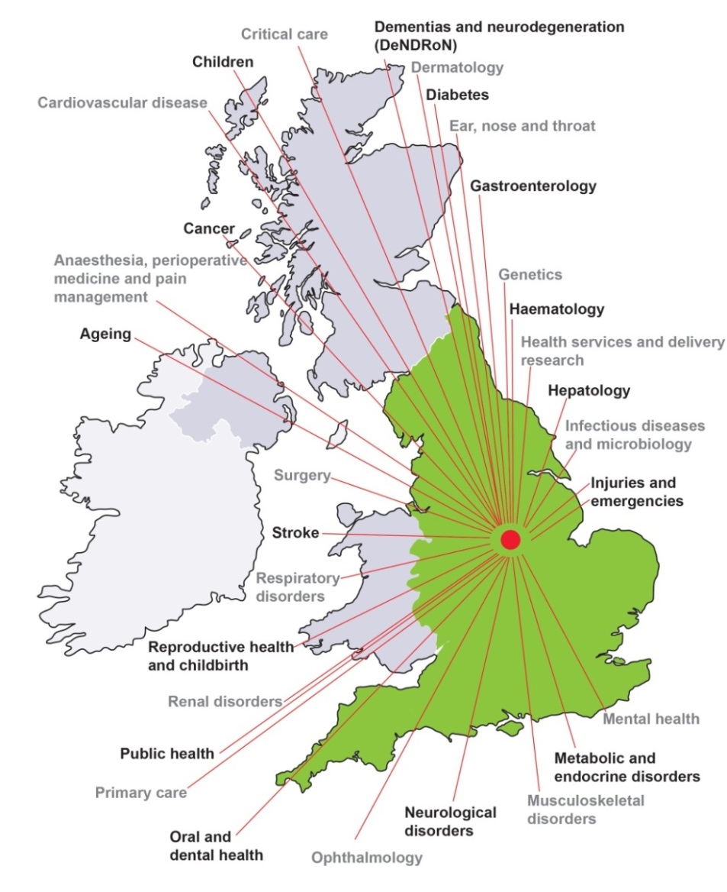
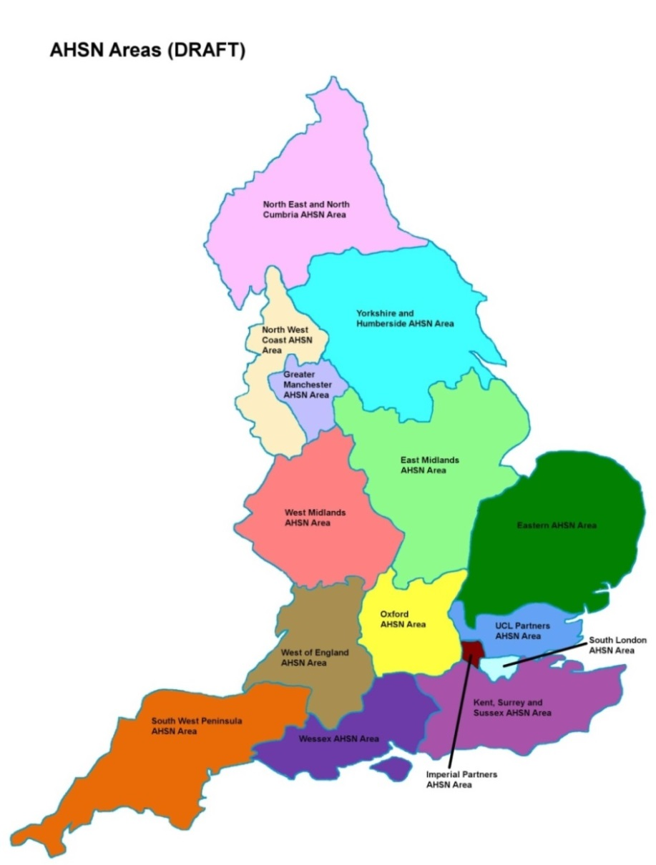
One national network
Research active engaged clinicians across all 30 therapy areas
Detailed understanding of care pathways
15 Local Clinical Research Networks (LCRNs)
Allows flexible deployment of resources
Links with rest of UK
Notes:
Needs to say that the CRN is the research delivery arm of the NHS.
We partner with people to place their study in the UK with confidence.
Expert in all therapeutic areas and work in a national to local/local to national model.
Staff embedded at the NHS trusts to deliver studies.

Slide 7

Global positioning
Clinical Research Network
Notes:
Marks beginning of CRN data

Slide 8
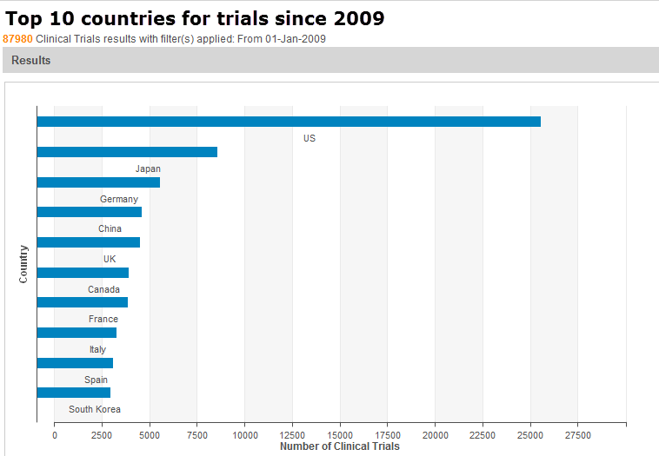
The truth: UK v the world
Source: Thomson Reuters
Notes:
Thomson Reuters = independent consultancy
Gives an idea of UK global positioning

Slide 9
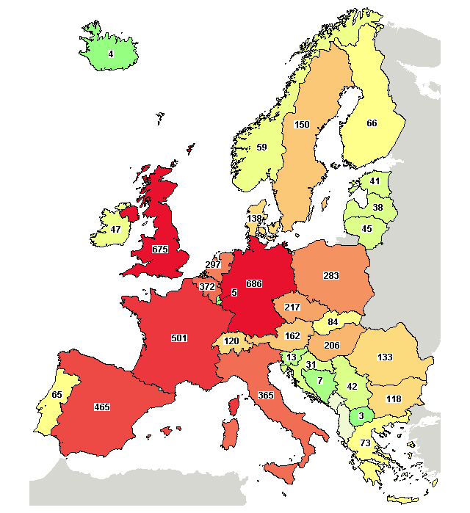
The truth: UK v Europe
Data source: http://clinicaltrials.gov/
1. | Germany | 686
2. | United Kingdom | 675
3. | France | 501
4. | Spain | 465
5. | Belgium | 372
(All Phase II, III, IV studies received from 01/04/2014 to 31/03/2015 funded by Industry)
Retrieved online on 29 April 2015
Clinical Research Network
Notes:
If they are considering where in Europe to place their trial – this information might be useful/surprising
Data source: http://clinicaltrials.gov
“All studies received from 01/04/2014 to 31/03/2015 – last financial year”

Slide 10
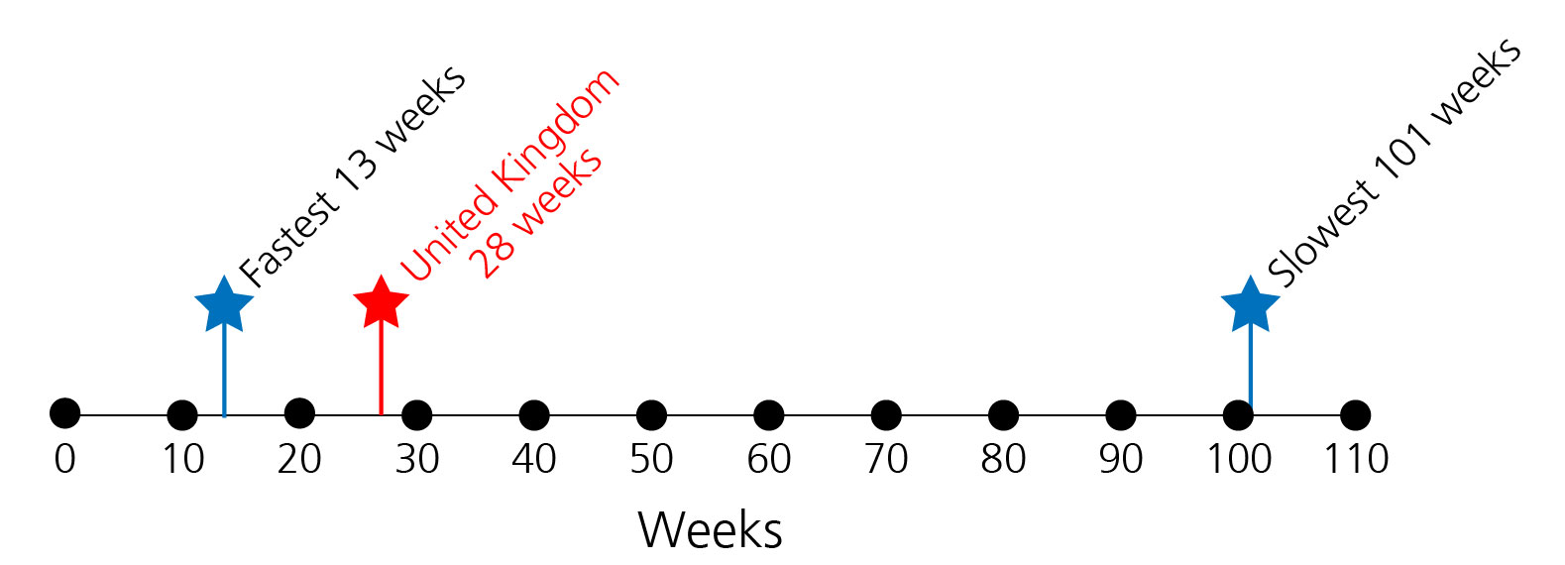
The truth: UK v the world
Data source: Global CRO 1
Median time (weeks) for complex study set up. From final protocol AND global model ICF available, to 1st site initiated in a given country
Notes:
65 countries compared
study set up timeline (in weeks) for complex studies
From final protocol AND global model ICF available, to 1st site initiated in a given country
Fastest 13 weeks (Moldova)
Slowest 101 weeks (China)
Median 28 weeks
UK 28 weeks – bang on the median

Slide 11
The truth: UK v the world
Data source: Global CRO 2
Start-up (SSV-SIV) (Median)
Region/Country | Days | No of studies
Japan | 92 | 568
USA/Canada | 135 | 1893
United Kingdom | 179 | 204
Germany | 245 | 172
Asia Pacific | 250 | 579
Italy | 267 | 199
France | 271 | 170
Poland | 280 | 142
Start point: Site selection visit
End point: Site initiation visit
Notes:
This is evidence for reliability of UK performance. Presenter needs to accept that performance was patchy in the UK but we have turned this around with this change and driving performance management culture locally at the site level.
Presenter needs to explain the 100% time and target being strict (100 patients in 6 month window, so 99 patients in 6 month window frame is a fail).
Highlight 73% last year – phenomenal improvement over last 4 years alongside increased volume of studies

Slide 12
The truth: UK v the Europe
Data source: A leading global pharmaceutical company
Country | No sites | Days between PSV and SIV (average) | Days between PSV and SIV (median)
Germany | 9 | 124 | 112
UK | 18 | 176 | 185
Italy | 8 | 284 | 282
France | 3 | 292 | 285
Spain | 15 | 286 | 305
Global | 317 | 147 | 123
Notes:
2nd behind Germany (again!) and well placed to global mean and median
but double the number of sites compared to Germany
show that Pfizer is doing more in UK compared to rest of Europe

Slide 13
Our vital statistics
Clinical Research Network
Notes:
Marks beginning of CRN data

Slide 14
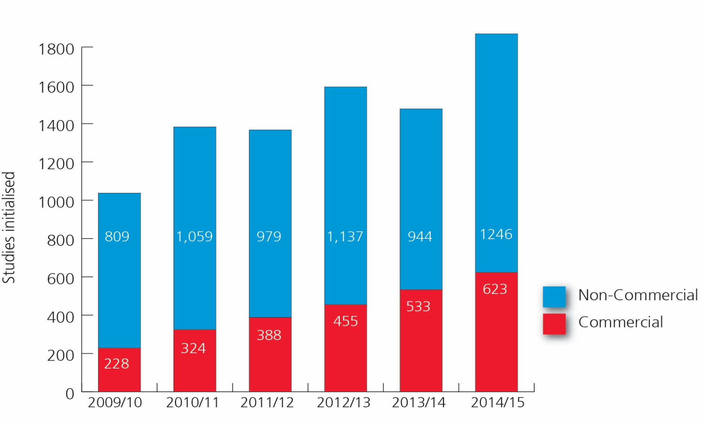
Increased commercial studies
Number of new commercial studies added to the NIHR CRN Portfolio
Predicted 2015/16
Notes:
The number of commercial contract studies entered onto the NIHR CRN Portfolio in 2014/15 is at an all time high, with a 17% increase compared to 2013/14
This percentage annual increase has been consistently delivered for the last five years, with twice as many new studies supported this year compared to 2010/11 (623 compared to 324)
Improvements in delivery of commercial contract research, supported by the NIHR CRN, has led to increased repeat business with customers

Slide 15
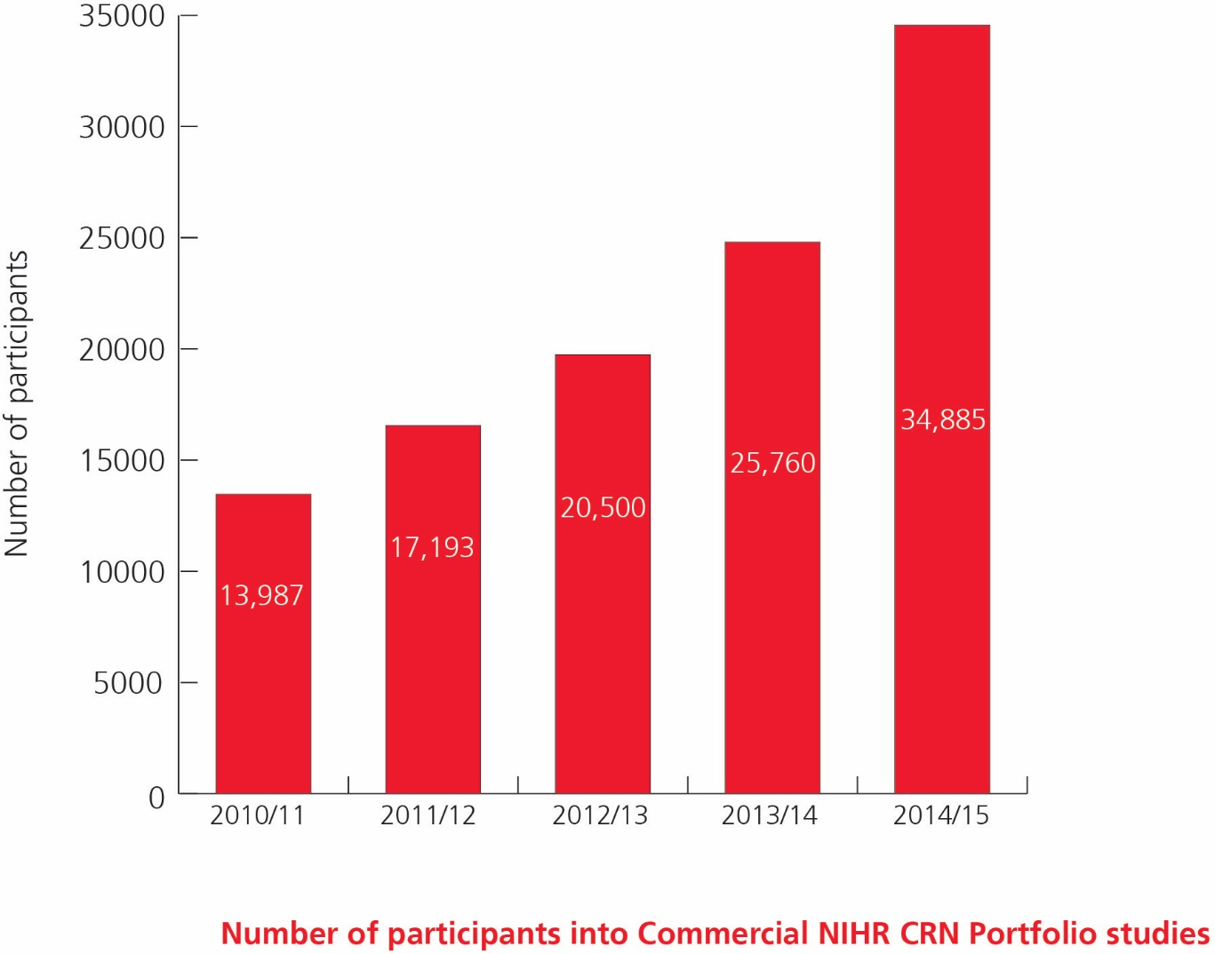
The evidence: recruitment
Number of participants into commercial NIHR CRN Portfolio studies
112,000+ patients recruited to industry studies over the last 7 years
34,500+ patients recruited to commercial contract studies in 14/15
17 first global patients in 2014/15
10 first European patients in 2014/15
Notes:
Presenter needs to highlight that the this is the evidence that debunks the theory that the UK only recruits small numbers of patients. Needs to focus on the fact that even through the studies are getting tougher to recruit and more difficult patient populations, these patient numbers are rising.
Highlight that for all studies (commercial and non commercial) recruitment was over 618,453

Slide 16
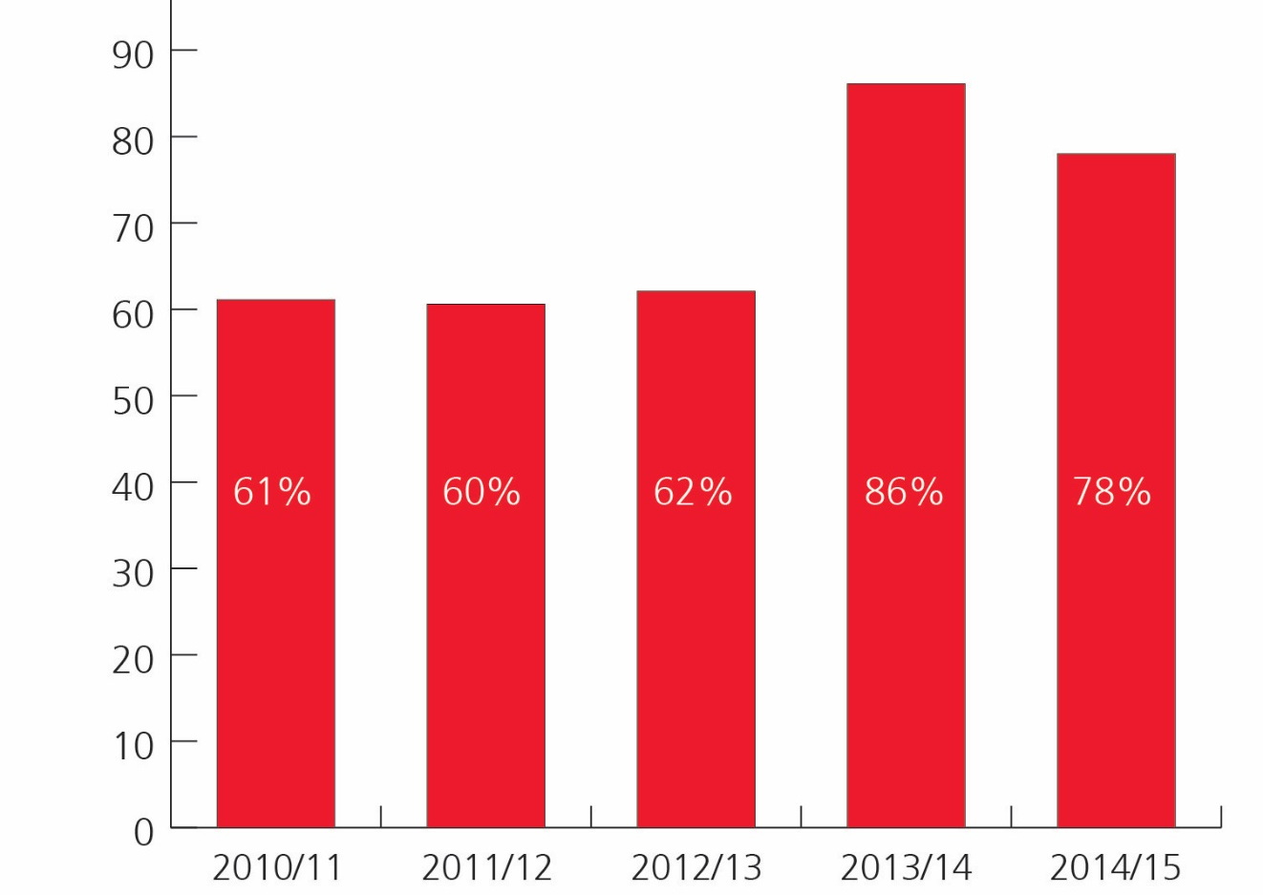
The evidence: NHS engagement
Percentage of NHS Trusts participating in commercial contract studies
99% of National Health Service (NHS) organisations now research-active through the support of the Network
78 % are delivering commercial contract research studies
Notes:
Presenter needs to focus on the fact that more and more NHS organisations are being involved in commercial contract research. As the number of studies are increasing, the number of NHS organisations (and investigators) doing research needs to increase- we are making that happen by introducing the new wave of the key opinion leaders in the UK.
Annual performance commentary
78% of NHS Trusts recruited to commercial contract studies in 2014/15
While the data shows a slight reduction in the number of NHS Trusts involved in commercial research in 2014/15, there has been an increase in the number of new studies supported by the NIHR CRN. Although through the site intelligence service we can see that companies are establishing relationships with NHS Trusts through the NIHR CRN feasibility services and returning to these NHS providers with future studies, based on previous successful delivery and positive working relationships. Commercial sponsors and CROs are continuing to demonstrate an increased willingness to place studies at NHS Trust sites that were previously unknown to them or naïve to commercial contract research, evidenced by increases in site identification requests.
Remains above our 70% target

Slide 17
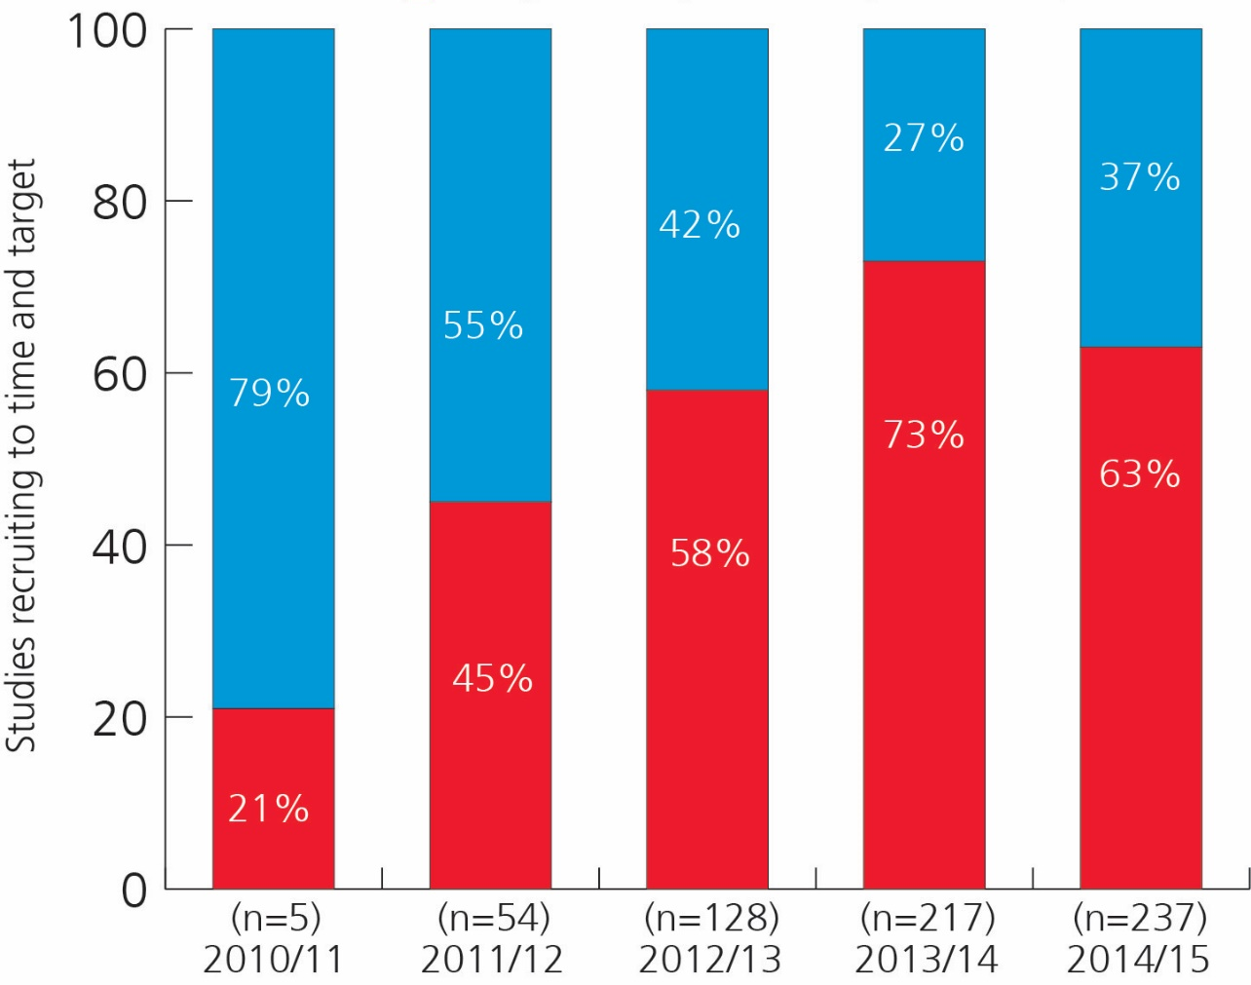
Delivery: time and target
Percentage of NIHR CRN commercial studies recruiting to both 100% time AND 100% target
Predicted 2015/16
Recruiting less than 100% of target or exceeding 100% of planned recruitment period
Recruiting 100% of target AND within 100% of planned recruitment period
Notes:
Annual performance commentary
While the number of participants recruited to commercial contract studies has increased by 35%, the percentage of commercial contract studies recruited to time and target has decreased slightly in 2014/15 but on current data is predicted to rise again in 2015/16.
26% more studies closed in 2014/15 compared to 2013/14

Slide 18
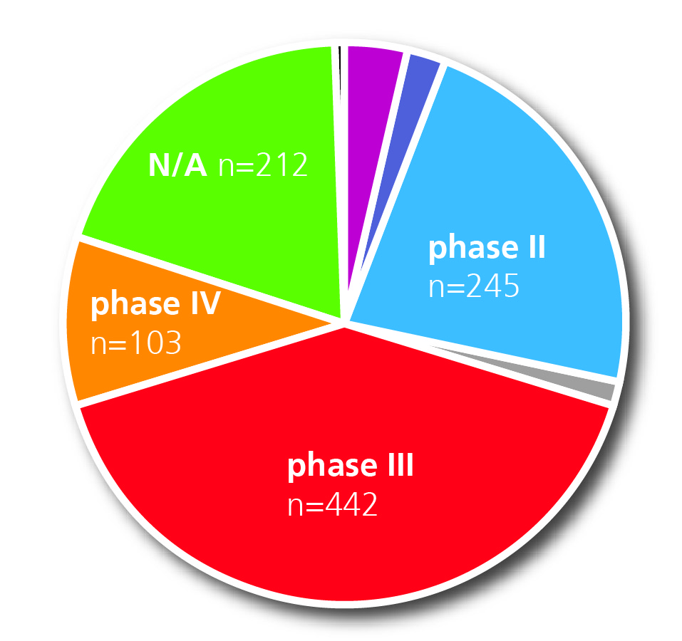
Vital statistics
Commercial contract studies undertaken during 2014 /15 by trial phase
Phase I | 40
Phase I/II | 25
Phase II | 245
Phase II/III | 13
Phase III | 442
Phase IV | 103
Not applicable (N/A) | 212
Notes:
All stats on the slide
May need to explain I/II and II/III classification

Slide 19

CRO partners
changed?
has
what
2010/11 | 30 CROs
2011/12 | 50 CROs
2012/13 | 60 CROs
2013/14 | 83 CROs
2014/15 | 104 CROs
So,
Notes:
Gives an indication of numbers of CROs we have been working with
(all CROs)
Explain we support CROs in same way as companies

Slide 20
Case studies:
Research delivery

Slide 21

LUMINOUS
a Novartis sponsored study
Long-term safety and effectiveness Ranibzumab for all licenced indications
Recruitment target of 30,000 globally
UK was top recruiter globally contributing over 11,000 patients across indications
49 UK sites active with subjects
Top 2 recruiting sites for neovascular AMD globally were from the UK
Notes:
Long term, real-world examination of the safety and effectiveness of Lucentis, used for a variety of retinal problems.
Approximately 30,000 patients were recruited world-wide with over 11,162 coming from the UK from 49 sites demonstrating the Specialty can recruit from a wide range of sites across the UK.
-Top 2 recruiting sites globally were UK sites; Moorfields Eye Hospital (795 nAMD patients) and Frimley Park Hospital (587 nAMD)
-7 out of top 10 recruiting sites were from the UK.
Study success demonstrates collaborative working between network, company and clinical community.

Slide 22

Responding to urgent public
health outbreaks
aims to capture observational data during outbreaks of severe emerging infection 30,000 patients world-wide
Ebola, MERS-CoV, and H7N9
Led by ISARIC (International Severe Acute Respiratory and Emerging Infection Consortium)
Single global protocol
70+ sites in UK with approvals already in place
Clinical Characterisation Protocol for Severe Emerging Infection
Notes:
This slide fades to reveal the text
Urgent public heath outbreaks can cause serious risk to human health.
The Clinical Research Network has an urgent public health plan in place to ensure that urgent public health studies can be set-up and delivered quickly and effectively including:-
Initiation and identification of relevant studies
Expediting study approvals and eligibility for Network support
Local and national plans for delivering urgent public health studies including a pre identified clinical lead for each region
On-going reporting and monitoring arrangements

Slide 23



Real World Studies:
Salford Lung Study
Few exclusions (safety reasons) so more representative of COPD patients
Investigators were patients’ GPs and patients visited usual pharmacies for medication - looked after by their usual care team
Single integrated e-health record across primary and secondary care – patient consent to access records in the system
CRN: North West supported study by recruiting and supporting practices; provided GCP training for staff and advised on delivery

Slide 24
How we support:
Biosimilar trials

Slide 25
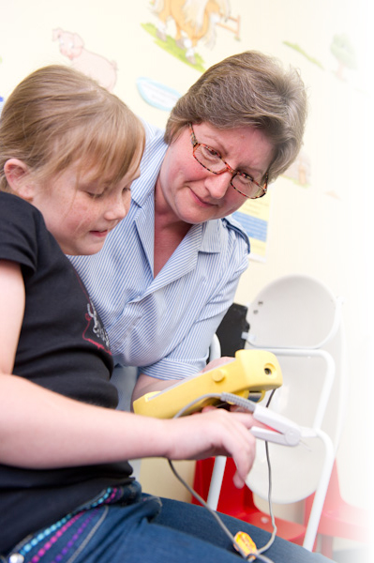
Biosimilar trials- the challenges
Identifying and gaining interest
from Clinicians
Access to suitable sites
Industry using commercially naïve sites
Timely set up and delivery

Slide 26
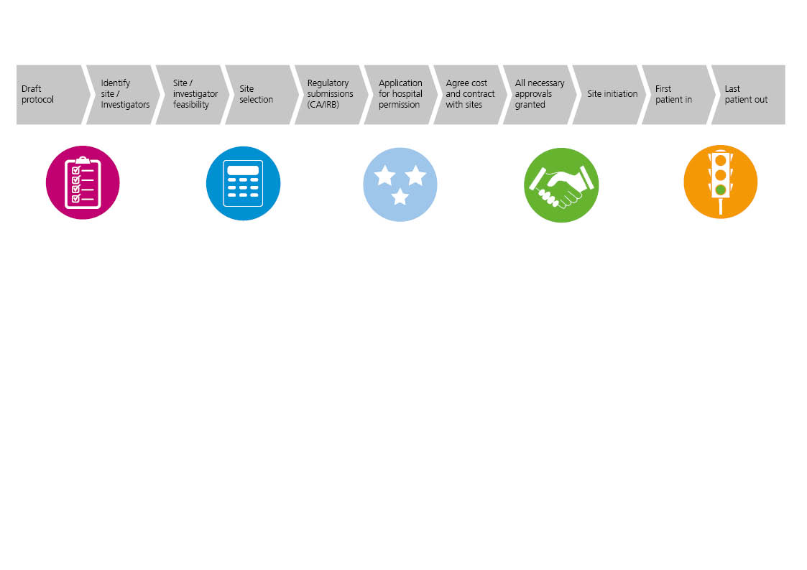
Service summary
FEASIBILITY
Manage and deliver:
Early Feedback
Site Intelligence
Site Identification
Feasibility
Set-up
Delivery
COMMERCIAL COSTING TEMPLATES
Support use
Manage templates
Trust, Primary Care & Device versions
HRA APPROVALS
SYSTEM FOR GAINING NHS PERMISSION
Support use
MODEL AGREEMENTS
Support use
STUDY MANAGEMENT
Collect & collate data
Performance manage study

Slide 27
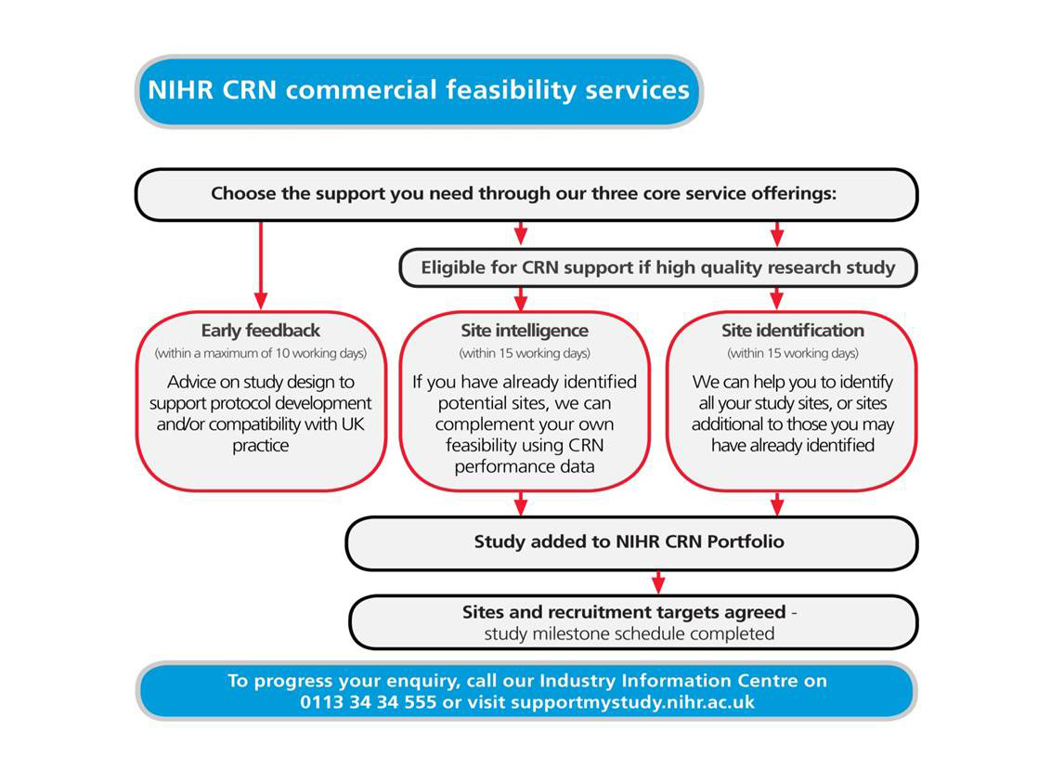
Feasibility services
Notes:
Presenter to link our services to the performance.
Early feedback service
Will your protocol or draft work in the UK National Health Service
Site intelligence
Use of NHS datasets, combined with our own intelligence on individual site performance, to complement your own feasibility
Site selection service
Drawing on 1,000+ primed investigators across all therapy areas, with up-to-the-minute knowledge of patient pathways, study site capacity, availability of local resources etc

Slide 28
Study set-up:
Faster set-up and reduced costs
HRA Approvals System for gaining hospital permission
  Do paperwork once only for multi-centre trials
  Network staff in the National Health Service work on your behalf, using relationships to push study set-up through on the inside
Commercial costing templates
  Transparent prices to assist planning
  Speeds up cost negotiations
Model agreements
  Standard contract accepted across the NHS
  Eliminates the need for lengthy legal review
Notes:
Self explanatory- tools to drive down start up timelines (link to earlier performance slide of start up timelines)

Slide 29

Study delivery and management:
Managing performance with quality
A research-ready workforce
  10,000+ GCP-trained nurses embedded in the National Health Service to support investigators with patient identification, screening, clinical delivery
Proactive study management support
  Study milestone schedule; monthly reviews of recruitment, RAG rating of studies to a site level
Trouble-shooting from the inside
  Our strong relationships with clinicians and detailed knowledge of other potential sites gives you options if a study hits a recruitment problem
Notes:
Self explanatory- focus on performance management.
Highlight RAG reports and active performance management of our studies.

Slide 30

Quality
ICH GCP Training
Almost 23,000 healthcare professionals undertook our GCP training during 2013-14
Free to staff working on NIHR CRN clinical trials
Supported by MHRA
Recently added to the list of GCP programs mutually recognised by TransCelerate member companies
Notes:
Self explanatory
Free of charge training for staff working on clinical trials
TransCelerate BioPharma Inc. is a collaboration of global life-sciences industry companies which aims to find solutions to common issues facing pharmaceutical and biotechnology companies and further improve patient safety, with the goal of delivering more high quality medicines to patients.
TransCelerate members, (which includes companies such as GSK, Pfizer and Roche), have developed guidelines for GCP training standards for research teams - those medical, nursing and clinical support staff delivering the clinical research studies.
Training providers meeting the GCP criteria set out in the guidelines are added to a list of mutually recognised providers. The Clinical Research Network has recently been added to this list.

Slide 31

Challenges and next steps
Diversity of life sciences industry
New technology and methodology changes in life sciences industry
National and international regulatory and political environment
Enhance existing service provision
Extend services and support new customers and new needs
Engage and strengthen relationships with key stakeholders

Slide 32

Summary
The UK environment for clinical research has changed
We are rapidly improving clinical research delivery in the UK
Strategic partners and alliances
Continuous improvement and looking to the future
Help us to help you
Notes:
May want to allude to some of the strategic partners and alliances here – depending on time
Last bullet point to reinforce that not standing still or resting on laurels – constantly moving forward

Slide 33
Network Industry Information Centre
Phone: 00 44 113 34 34 555
Email: supportmystudy@nihr.ac.uk
Web: www.supportmystudy.nihr.ac.uk
Any questions?
Notes:
One way into our system -

Slide 34
Let us meet again..
We welcome you to our future conferences of Conference Series LLC
through
6th International Conference and Exhibition on Biologics and Biosimilars
October 19-21, 2016 Houston, TX, USA
http://biosimilars-biologics.pharmaceuticalconferences.com/europe

