Slide 1

SARA SAFAR ALSHEHRI
6th year Medical student, College of Medicine, King Faisal University, AlAhsa, Saudi Arabia
sarashehri1991@gmail.com
Supervised by:
Professor Kamal-Eldin Abou-Elhamd

Slide 2

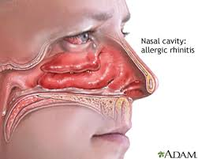

Is Marriage a Risk Factor for Allergic Rhinitis?

Slide 3
INTRODUCTION:
Emotional stress and exercise were reported as stimuli for allergic rhinitis.
It is also reported that sexual intercourse is a stimulus for AR.
Intense emotional stimuli during sexual intercourse can lead to autonomic imbalance with parasympathetic over reactivity, thereby causing release of mast cell mediators that can provoke postcoital rhinitis in these patients.
Postcoital rhinitis can easily be overlooked due to patient embarrassment and unawareness of physicians

Slide 4
INTRODUCTION:
Earlier Studies in psychosomatic medicine have linked type I on immunoglobulin E (IgE) mediated allergic disease as allergic rhinitis with psychological disturbance, particularly negative affecting states including depression and unhappy marriage.
An immune diversity of reactions may be encountered in female patients with hypersensitivity to seminal fluid (Human Seminal Plasma Allergy; HSPA).

Slide 5
INTRODUCTION:
As the consanguinity rate is very high in the Middle East countries, especially on Arab countries, it is highly important to investigate the morbidity patterns of allergic rhinitis in contagious marriages, and the extent, degree and pattern of the consanguinity in Saudi population suffering from atopic diseases like AR.
It is of utmost importance to comprehend the correlation between contagious marriages and AR, for better management of such case, and to know the prevalence among male and female in Kingdom of Saudi Arabia.

Slide 6

#OBJECTIVE OF THE STUDY:
1-To determine the effect of marriage and sexual activity as risk factors on allergic rhinitis
2-To figure out degree of impact of consanguinity in the Saudi population on allergic rhinitis.

Slide 7

# Material & Methods:
The study was conducted at the outpatient ENT clinic of King Faisal University polyclinic center at the period from October 2015 to February 2016.

Slide 8
A random of 60 patients of age group 20-55 years old including both sex.
patients married experienced symptoms related to out- door, indoor allergic rhinitis in the past 12 months.
A cross sectional study.
SPSS version 22.
Descriptive statistical analysis and chi-square test were used,
P<0.05 was applied as a level of significance.

Slide 9
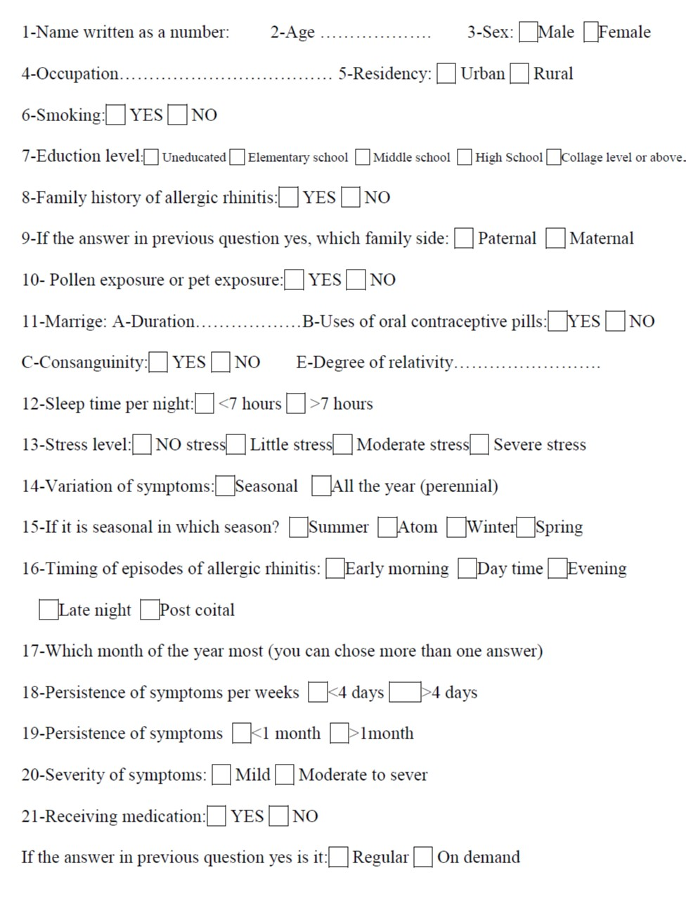

Slide 10
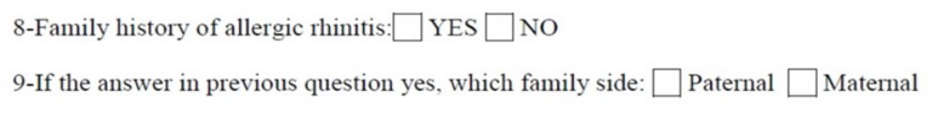
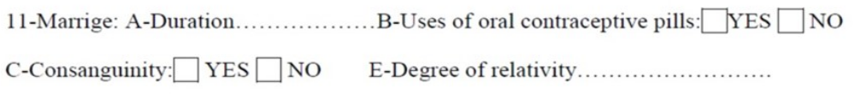
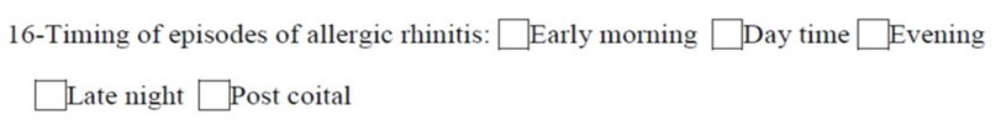

Slide 11
# Results:
Marriage and allergic rhinitis:
The sixty patients were married for a period ranging from (1 month-38 years),
Third of them were relatives (35%)
Only 10 females out of 31 used to take oral contraceptive pills (OCP) as a method of contraception.
Seven female patients and 4 male ones admitted experience of postcoital exacerbation of allergic rhinitis attacks.
There was a significant relationship between the degree of relatively and severity of symptoms with P value of 0.027.

Slide 12
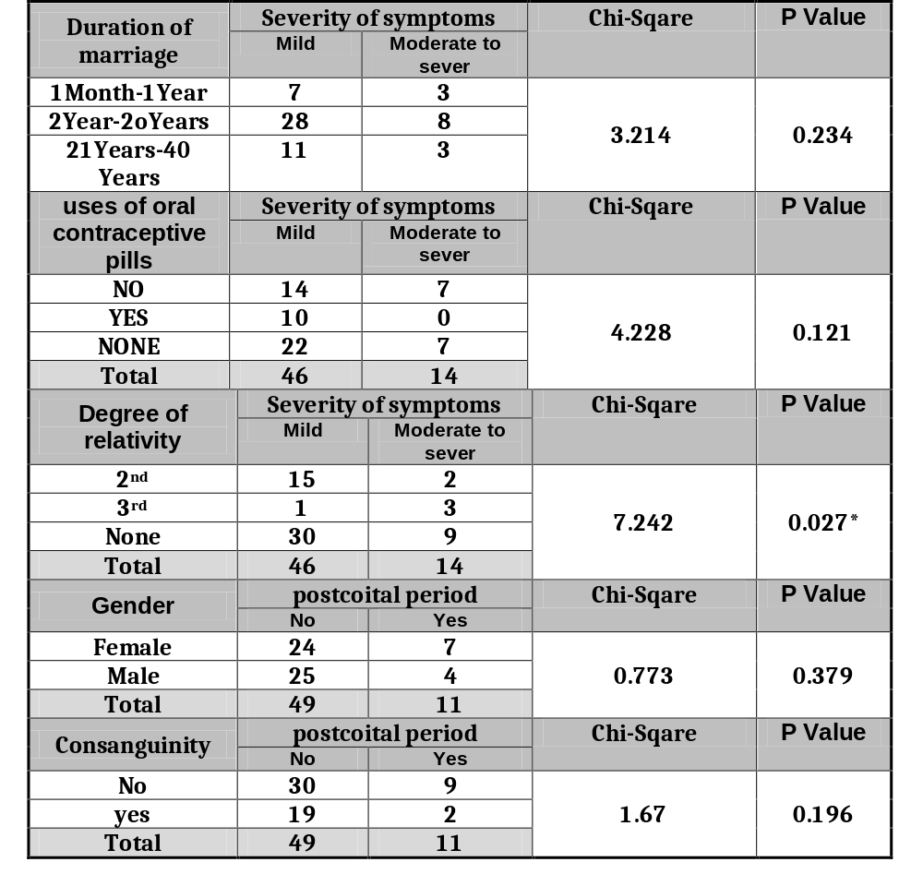

Slide 13
# Discussion:
There is a clear hereditary component in allergic rhinitis that has been well corroborated by segregation studies and investigations in twins.
A family history of AR was strongly associated with AR development in many studies.
In agreement with previous reports, we found that a parental history of AR strongly influenced AR prevalence.
Maternal AR symptom duration of over 1 month increases prevalence of AR in children as what was shown in a Korean study,
in our study we have studied family history as one of the important risk factors for AR, 48% of our cases have positive family history, and 20% of them from the mother’s side.

Slide 14
# Discussion:
Two previous studies could not find any prior description of an association between AR prevalence and marriage.
One substantial study has connected marriage to positive physical and mental health outcomes.
Indeed, marriage exerted a protective effect on AR in the study done by An SY 2015.
In contrast, unhappy marriage or dissatisfied marriage can put people under stress and health problems.
Thirty five percent of our study had positive contagious marriage
so consanguinity was statistically significant.
It is well known that consanguinity marriage in the middle east and Arab countries is far much more than in the developed world

Slide 15
# Discussion:
Steroidal hormones ( oral contraceptive pills ) can influence the development of wheezes in the chest in females, our studied cases didn't show any statistical significance correlation (16% of P value of 0.121).
Human seminal plasma allergy (HSPA), in women, is a rare phenomenon. It is usually caused by sensitization to proteins present in the seminal fluid, leading to immediate hypersensitivity manifestations during or soon after coitus. Symptoms can range from local pruritus to life-threatening anaphylaxis .

Slide 16
# Discussion:
Shad and Sircar, presented in 1991 cases report of four patients had experienced postcoital exacerbation of asthma and allergic rhinitis in India.
Here in our study we have reported 11 cases 7 females and 4 males having postcoital exacerbation of allergic symptoms.
This postcoital rhinitis or honeymoon rhinitis is most probably due to emotional excitement or autonomic parasympathetic over activity with cholinergic release of mast cell mediators.

Slide 17
# CONCLUSION:
Allergic Rhinitis prevalence in Eastern province of Saudi Arabia is significantly higher in the rural areas than urban areas.
Intermittent AR is the predominant type, and of the mild form.
The main trigger factors and risk factors are genetic factors like family history, and environmental factors like pollen and smoking. It is more common in winter, at the early morning time.
18% of cases experienced postcoital exacerbation of AR attacks.

Slide 18
# References:
1. Chen DH, Li CW, Zhong JT, Lin ZB, Peng H, et al. Epidemiological Characterization and Risk Factors of Allergic Rhinitis in the General Population in Guangzhou City in China. PLoS ONE 2014; 9(12): doi:10.1371
2. Wang DY. Risk factors of allergic rhinitis: genetic or environmental? Ther Clin Risk Manag. 2005 ; 1(2): 115-23
3. Shah A., Sircar M. Postcoital asthma and rhinitis Chest 1991; 100(4): 1039 – 41
4. Falliers CJ. Sexercise-induced asthma. Lancet 1976; 2(7994): 1078 – 9
5. Shah A. Asthma and Sex. Indian J chest Dis Allied Sci 2001; 43: 135-137
6. Bell RA, Daly J A , and Gonzalez M C. Affinity-maintenance in marriage and its relationship to women’s marital satisfaction. Journal of Marriage and the Family 1987; 49(2): 445-454
7. Bernstein IL, Englander BE, Gallagher JS, Nathan P, Marcus ZH. Localized and systemic hypersensitivity reactions to human seminal fluid. Ann Intern Med 1981; 94:459–65

Slide 19
# References:
8. Sly RM. Changing prevalence of allergic rhinitis and asthma. Ann Allergy Asthma Immunol 1999; 82(3): 233-248
9. Bauchau V, Durham SR. Prevalence and rate of diagnosis of allergic rhinitis in Europe. Eur Respir J 2004; 24(5): 758–764
10. An SY, Choi HG, Kim SW, Park B, Lee JS, Jang JH, Sung MW. Analysis of various risk factors predisposing subjects to allergic rhinitis Asian Pac J Allergy Immunol. 2015; 33:143-51
11. Hyrkas H, Jaakkola MS, Ikaheimo TM, Hugg TT, Jaakkola JJ. Asthma and allergic rhinitis increase respiratory symptoms in cold weather among young adults. Respiratory Medicine 2014; 108: 63-70
12. Dávila I1, Mullol J, Ferrer M, Bartra J, del Cuvillo A, Montoro J, Jáuregui I, Sastre J, Valero A. Genetic aspects of allergic rhinitis. J Investig Allergol Clin Immunol. 2009;19 Suppl 1:25-31
13. Meyler D, Stimpson J P, and Peek M K. Health concordance within couples: A systematic review. Social Science & Medicine 2007; 64(11): 2297-2310
14. Salam MT, Wenten M, and Gilliland FD. Endogenous and exogenous sex steroid hormones and asthma and wheeze in young women. J Allergy Clin Immunol 2006;117(5):1001-7

Slide 20


