Slide 1


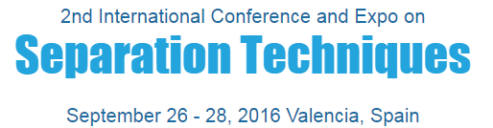
Technical University of Madrid
School of Civil Engineering
ARSENIC SPECIATION
IN EDIBLE MARINE ALGAE:
PRESENCE OF WATER AND LIPID-SOLUBLE
ARSENIC COMPOUNDS
Sara García-Salgado, G. Raber, K.A. Francesconi, M.A. Quijano
sara.garcia@upm.es

Slide 2


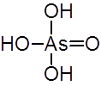
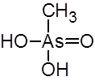

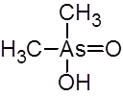
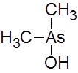
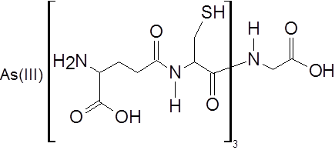
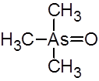
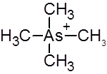
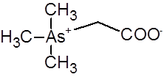
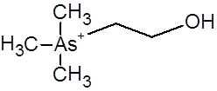
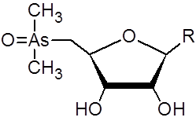
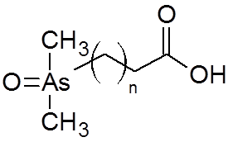
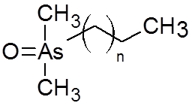
Technical University of Madrid
School of Civil Engineering
Background
Water-soluble
As(III)
As(V)
MMA(V)
MMA(III)
DMA(V)
DMA(III)
TMAO
TETRA
AsB
AsC
AsAz
As(III)-PC₃
Lipid-soluble
As toxicity  strongly dependent on its molecular form
Sampling
Sample preparation
Identification
Quantification
As speciation is the analytical activity that leads to the identification and quantification of a specific chemical form of As in a given environment
AsLip

Slide 3
Technical University of Madrid
School of Civil Engineering
Background
SEAWATER
ALGAE
O
H
O
H
C
H
C
H
1) R
3
1) R
3
Ad (B from SAM)
O
As
O
H
O
As
O
H
O
As
O
H
O
As
O
H
2) M (A from SAM)
2) M (A from SAM)
N
H
O
H
O
H
O
H
C
H
A
B
2
3
N
As (V)
As (V)
MMA (V)
DMA (V)
H
C
N
O
3
+
N
S
O
N
H
O
H
N
2
H
O
O
H
SAM
N
H
C
H
C
H
2
C
H
O
3
3
N
N
3
O
OR
G
O
H
C
H
O
As
O
O
P
O
R
O
As
O
O
As
O
3
O
H
R
O
As
N
N
C
H
O
H
C
H
C
H
O
3
3
3
C
H
H
O
O
H
H
O
O
H
H
O
O
H
3
H
O
O
H
AsLip
AsAz
Adapted from Edmonds et al., 1993
(Nat. Prod. Rep. 10, 421-428)

Slide 4
Technical University of Madrid
School of Civil Engineering
Goals
To evaluate the occurrence of arsenic compounds in edible marine algae for risk assessment
Extraction methods for water and lipid soluble As species
Determination methods of As species
Lipid-soluble:
HPLC-ICP-MS/ES-MS
Water soluble:
HPLC-(UV)-HG-AFS
The development of:

Slide 5
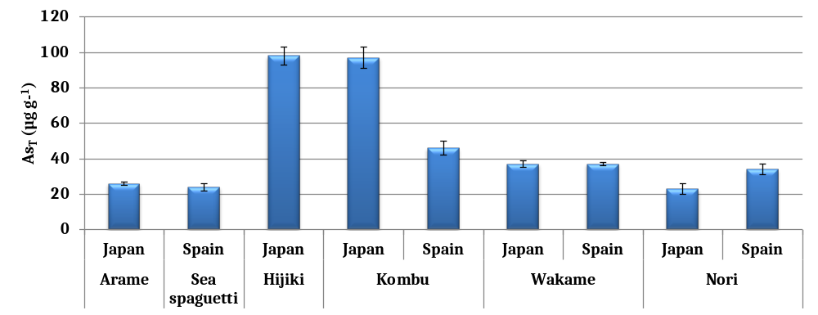
Technical University of Madrid
School of Civil Engineering
Experimental
➔ Determination of total As
  250 mg alga + 10 mL HNO₃/H₂O₂ (1:1; v/v)
MW 200 ºC, 10 min
  Analysis by axial ICP-AES
  Validation: NIES No. 9 Sargasso
98 µg g⁻¹
97 µg g⁻¹
24 µg g⁻¹
23 µg g⁻¹

Slide 6
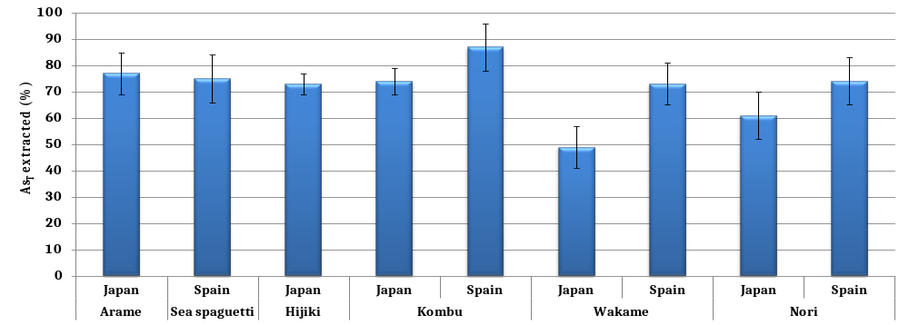
Technical University of Madrid
School of Civil Engineering
Experimental
➔ Water-soluble As species  Extraction
200 mg alga + 8 mL H₂O
MAE 90 ºC, 5 min
3 extraction steps
87%
61%
49%

Slide 7
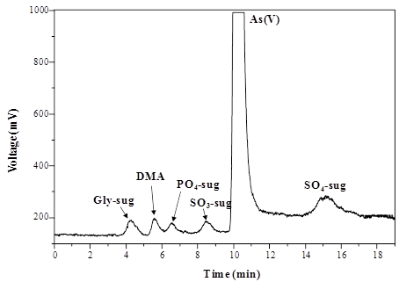
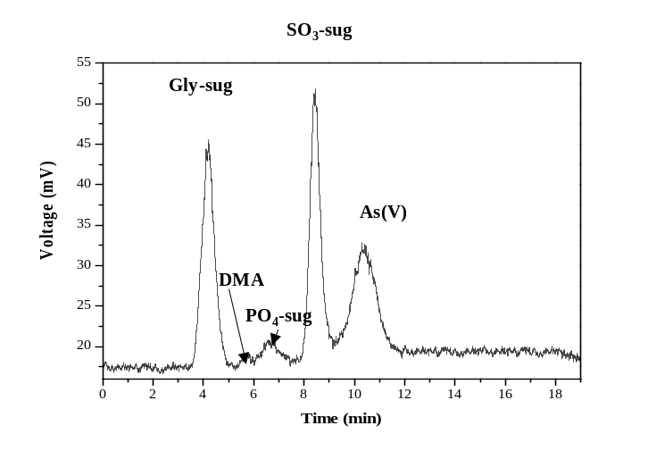
Technical University of Madrid
School of Civil Engineering
Experimental
➔ Water-soluble As species  Determination by HPLC-(UV)-HG-AFS
Anion exchange HPLC conditions |  | HG operation conditions
Analytical column | Hamilton PRP-X100 | HCl | 8.0 mol L⁻¹
Mobile phase | Phosphate 5, 20 and 100 mmol L⁻¹; pH 9.0 | Flow rate | 1.4 mL min⁻¹
Gradiente elution | 0-1 min: 100% 5 mM | NaBH₄ | 1.4% (w/v)
 | 1.1-5 min: 100% 20 mM | Flow rate | 1.4 mL min⁻¹
 | 5.1-15 min: 100% 100 mM | Online UV cracking operation conditions
Flow rate | 1.0 mL min⁻¹ | K₂S₂O₈ | 2% (w/v)
Injection volume | 100 μL | Flow rate | 0.5 mL min⁻¹
Hijiki
Sea spaghetti
G100
G10

Slide 8
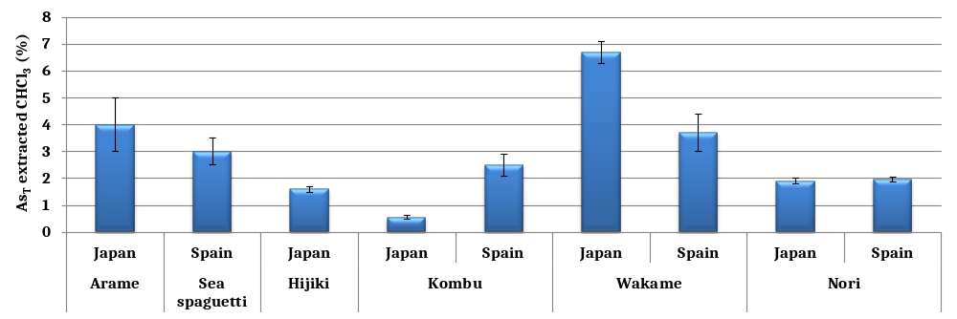
Technical University of Madrid
School of Civil Engineering
Experimental
➔ Lipid-soluble As species  Extraction
1 g alga + 25 g CHCl₃/CH₃OH (2:1; v/v)
Mechanical shaking (overnight)
CHCl₃/CH₃OH extract  Washed with 2 x 20 mL NH₄HCO₃ 1% (m/v)
6.7%
0.55%
CHCl₃ extract  Evaporated to dryness
Re-dissolved in 1 mL CH₃COCH₃-CHCl₃ (1:1; v/v)

Slide 9
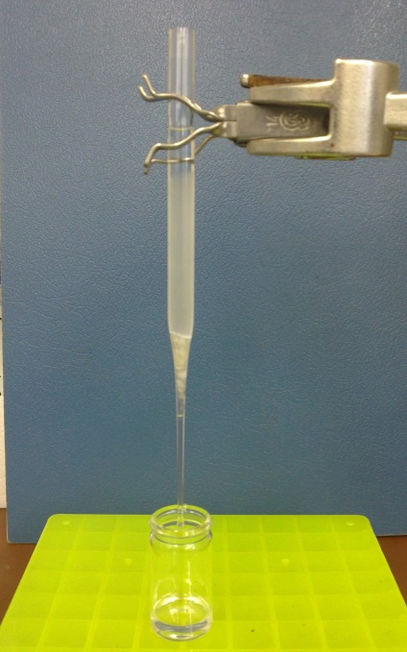
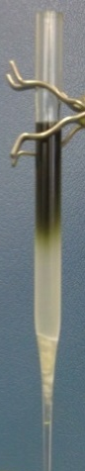
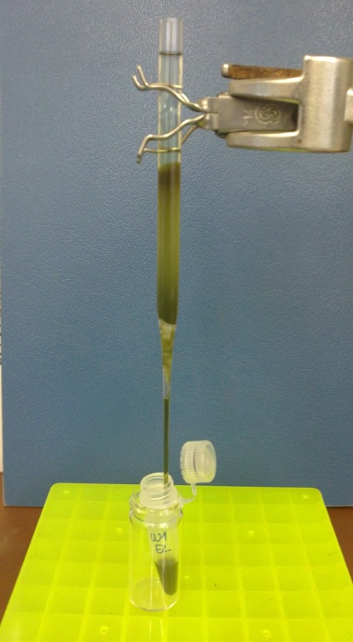
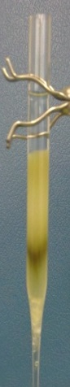
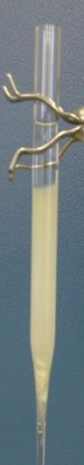
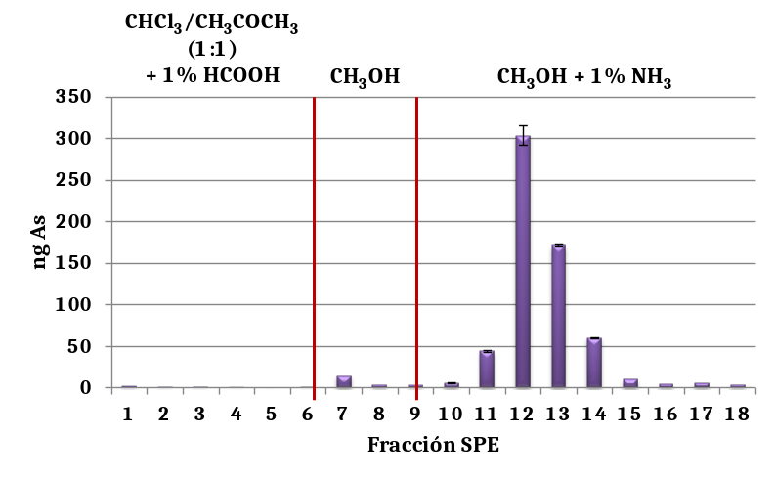
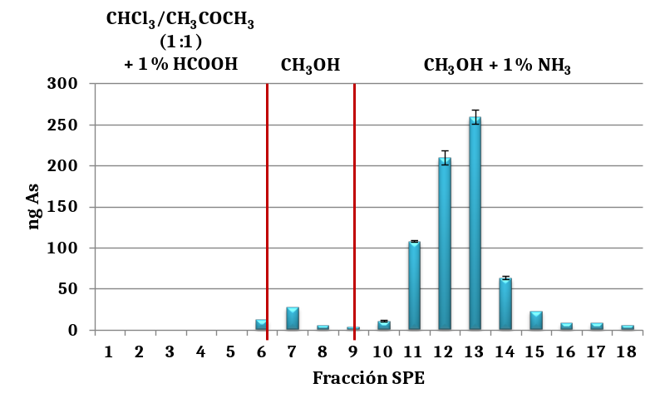
Technical University of Madrid
School of Civil Engineering
Experimental
SPE As recovery
74-118%
SPE matrix removal
90-99%
Clean-up by SPE
CH₃COCH₃/CHCl₃ (1:1)
+ 1% HCOOH
CH₃COCH₃/CHCl₃ (1:1)
+ 1% HCOOH
CH₃OH
+ 1% NH₃
500 µL ext.
CH₃OH
Conditioning
Sample load
Elution
(1st step)
Elution
(2nd step)
Elution
(3rd step)

5 x 1 mL

3 x 1 mL

10 x 1 mL
CH₃COCH₃/CHCl₃
(1:1)
+ 1% HCOOH
Hijiki
CH₃COCH₃/CHCl₃
(1:1)
+ 1% HCOOH
Wakame
CH₃OH
CH₃OH + 1% NH₃
CH₃OH
CH₃OH + 1% NH₃
SPE fraction
SPE fraction
SPE fractions 10-14  Combined, evaporated to dryness and re-dissolved in 200 μL CH₃OH

Slide 10
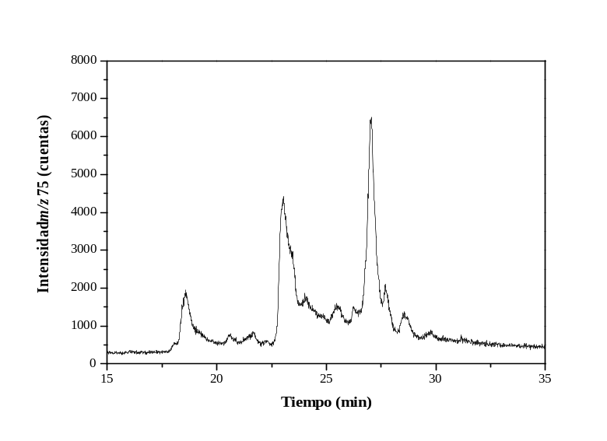
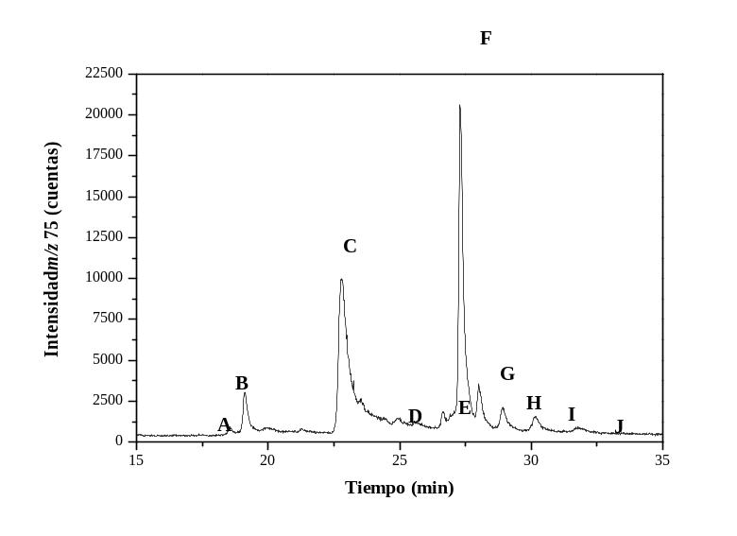
Technical University of Madrid
School of Civil Engineering
Experimental
➔ Lipid-soluble As species  Determination by HPLC-ICP-MS/ES-MS
Reversed-phase HPLC conditions
Analytical column | Zorbax Eclipse XDB-C8
Column temperature | 40 °C
Mobile phase | Acetate 10 mmol L⁻¹; pH 6.0 (NH₃)
 | Methanol
Gradient elution | 0-25 min: 50%-95% CH₃OH
 | 25-40 min: 95% CH₃OH
Flow rate | 1 mL min⁻¹
Injection volume | 40 µL
HPLC
Active splitter
(Agilent G1968D)
ICP-MS
10%
ES-MS
90%
Hijiki
(pre-SPE)
Hijiki
(post-SPE)
Intensity m/z 75 (counts)
Intensity m/z 75 (counts)
Time
Time

Slide 11
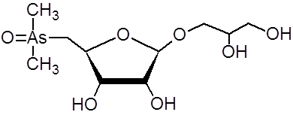
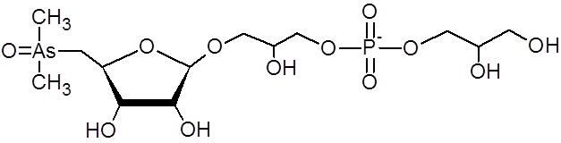
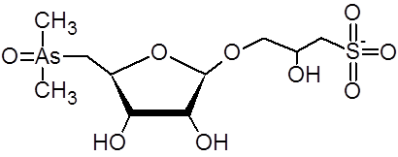
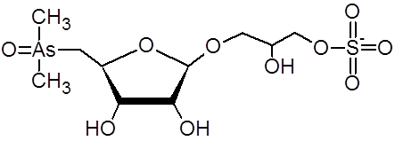
Technical University of Madrid
School of Civil Engineering
Results
➔ Water-soluble As species  Determination by HPLC-(UV)-HG-AFS
Alga | Origin | As species (µg g⁻¹ As)
 |  | DMA | As(V) | Gly-sug | PO₄-sug | SO₃-sug | SO₄-sug
Arame | Japan | 0.48 ± 0.04 | 7.0 ± 0.1 | 1.5 ± 0.1 | 2.04 ± 0.01 | n.d. | n.d.
Sea spaghetti | Spain | n.d. | 2.0 ± 0.1 | 4.5 ± 0.4 | 0.11 ± 0.01 | 4.2 ± 0.9 | n.d.
Hijiki | Japan | 0.44 ± 0.06 | 50.3 ± 0.4 | 1.05 ± 0.03 | 0.4 ± 0.1 | 0.7 ± 0.1 | 2.7 ± 0.4
Kombu | Japan | 0.36 ± 0.03 | 32 ± 3 | 4.7 ± 0.3 | 22 ± 1 | n.d. | n.d.
 | Spain | n.d. | 11 ± 2 | 11 ± 3 | 1.9 ± 0.3 | n.d. | n.d.
Wakame | Japan | 0.025 ± 0.007 | 4.5 ± 0.3 | 2.68 ± 0.03 | 10.10 ± 0.05 | n.d. | n.d.
 | Spain | n.d. | 2.2 ± 0.1 | 14.3 ± 0.2 | 1.5 ± 0.1 | n.d. | n.d.
Nori | Japan | 0.064 ± 0.005 | n.d. | 1.02 ± 0.07 | 13 ± 1 | n.d. | n.d.
 | Spain | n.d. | n.d. | 1.6 ± 0.1 | 20.1 ± 0.3 | n.d. | n.d.
n.d. = not detected
Column recoveries  55-101%
Glycerol arsenosugar (Gly-sug)
Phosphate arsenosugar (PO₄-sug)
Sulfonate arsenosugar (SO₃-sug)
Sulfate arsenosugar (SO₄-sug)

Slide 12
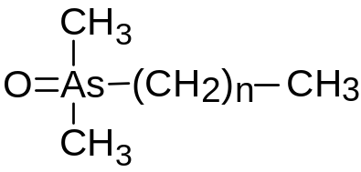
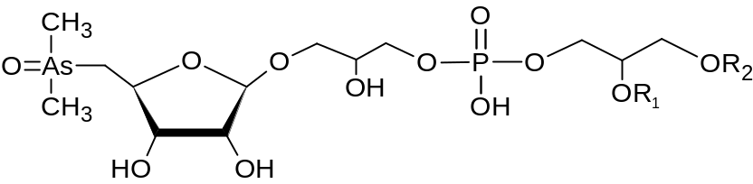
Technical University of Madrid
School of Civil Engineering
Results
➔ Lipid-soluble As species  Determination by HPLC-ICP-MS/ES-MS
Chromatographic peak | Abbreviation | Molecular formula
C | As-HC332 | C₁₇H₃₇OAs
D | As-HC360 | C₁₉H₄₁OAs
E | As-HC388 | C₂₁H₄₅OAs
 | As-PL930 | C₄₃H₈₅O₁₄PAs
 | As-PL944 | C₄₄H₈₇O₁₄PAs
 | As-PL956 | C₄₅H₈₇O₁₄PAs
 | As-PL982 | C₄₇H₈₉O₁₄PAs
F | As-PL958 | C₄₅H₈₉O₁₄PAs
 | As-PL984 | C₄₇H₉₁O₁₄PAs
G | As-PL986 | C₄₇H₉₃O₁₄PAs
 | As-PL1012 | C₄₉H₉₅O₁₄PAs
H | As-PL1014 | C₄₉H₉₇O₁₄PAs
I | As-PL1042 | C₅₁H₁₀₁O₁₄PAs
J | As-PL1070 | C₅₃H₁₀₅O₁₄PAs
As-containing hydrocarbons
(As-HC)
Arsenosugar-phospholipids
(As-PL)
Confirmation of molecular masses
by GC-MS and/or HR-MS
A and B are unknown compounds

Slide 13
Technical University of Madrid
School of Civil Engineering
Results
➔ Lipid-soluble As species  Determination by HPLC-ICP-MS/ES-MS
Chromatographic peak | AsLip | As species (µg kg⁻¹ As)
 |  | Arame | Sea spaghetti | Hijiki | Kombu |  | Wakame |  | Nori
 |  |  |  |  | Japan | Spain | Japan | Spain | Japan | Spain
C | As-HC332 | < 20 | < 20 | (31 ± 2)·10 | < 20 | < 20 | 22 ± 3 | < 20 | < 20 | < 20
D | As-HC360 | < 20 | < 20 | 35 ± 9 | 26 ± 4 | 74 ± 5 | (8 ± 4)·10 | < 20 | < 20 | < 20
E | As-HC388 | 221 ± 3 | < 20 | - | 21 ± 7 | 38 ± 3 | (4 ± 1)·10² | 89 ± 3 | 28 ± 2 | 22 ± 2
 | As-PL930 |  |  | 22 ± 2
F | As-PL958 | 241 ± 3 | 117 ± 2 | (25 ± 4)·10 | 46 ± 2 | 185 ± 7 | (4 ± 1)·10² | 145 ± 6 | 29 ± 4 | 20 ± 1
 | As-PL984 | 56 ± 5 | 30 ± 2 | 85 ± 3 | 20 ± 3 | 51 ± 2 | (14 ± 5)·10 | 56 ± 3 | < 20 | < 20
G | As-PL986 | 52 ± 2 | 29 ± 3 | 58 ± 9 | 27 ± 8 | 50 ± 2 | (20 ± 7)·10 | 81 ± 3 | 22 ± 2 | < 20
 | As-PL1012
H | As-PL1014 | 87 ± 9 | 29 ± 5 | (5 ± 1)·10 | 21 ± 1 | 60 ± 2 | (23 ± 7)·10 | 98 ± 4 | 25 ± 3 | < 20
I | As-PL1042 | < 20 | 21 ± 1 | (3 ± 1)·10 | < 20 | < 20 | (3 ± 1)·10 | < 20 | < 20 | < 20
J | As-PL1070 | < 20 | < 20 | 21 ± 3 | < 20 | < 20 | < 20 | < 20 | < 20 | < 20
Column recoveries  74-100%

Slide 14
Technical University of Madrid
School of Civil Engineering
Results
➔ Water- and lipid-soluble As species abundance
(and the non-extractable As_{T})
Alga | Origin | As(V)+DMA (%) | Σ AsAz (%) | Σ AsLip (%)* | Non-extractable As_{T} (%)
Arame | Japan | 29 ± 1 | 13.5 ± 0.6 | 1.9 ± 0.5 | 19 ± 8
Sea spaghetti | Spain | 8.3 ± 0.8 | 38 ± 5 | 0.98 ± 0.05 | 22 ± 9
Hijiki | Japan | 52 ± 3 | 4.9 ± 0.5 | 0.76 ± 0.06 | 25 ± 4
Kombu | Japan | 33 ± 4 | 28 ± 2 | 0.19 ± 0.02 | 26 ± 5
 | Spain | 24 ± 5 | 28 ± 7 | 1.00 ± 0.05 | 10 ± 9
Wakame | Japan | 12 ± 1 | 34 ± 2 | 3.8 ± 0.5 | 44 ± 8
 | Spain | 6.0 ± 0.3 | 43 ± 1 | 1.4 ± 0.2 | 23 ± 8
Nori | Japan | 0.28 ± 0.04 | 61 ± 9 | 0.35 ± 0.08 | 37 ± 9
 | Spain | - | 64 ± 6 | 0.10 ± 0.01 | 24 ± 9
*Lipid arsenic compounds detected but not identified have not been considered in this sum.

Slide 15
Technical University of Madrid
School of Civil Engineering
Conclusions
Marine algae
High levels of As_{T}  As speciation studies
Water-soluble species
Lipid-soluble compounds
MAE
HPLC-(HG)-UV-AFS
As(V), DMA, 4 AsAz
HPLC-ICP-MS/ES-MS
Shaking; SPE
3 As-HC
11 As-PL
References:
  García-Salgado et al. 2012, Environ. Chem. 9, 63–66.
  García-Salgado and Quijano 2012, Anal. Chim. Acta 714, 38– 46.

Slide 16
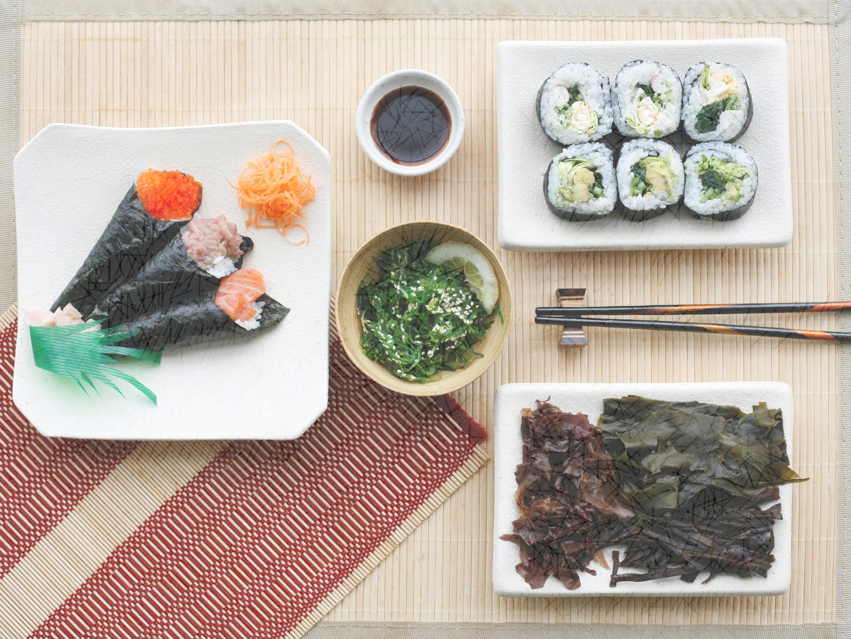
Technical University of Madrid
School of Civil Engineering
Thank you!
Picture by Marta Soul

